Slide 1
ADA MINI PROJECT
Team members:
Bharath kumar N
Chandrashekar V
Chethan BS
Chethan R
Chethan Rao S

Slide 2
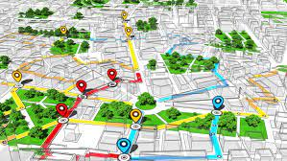
PATH FINDING USING A* ALGORITHM

Slide 3
01
INTRODUCTION

Slide 4
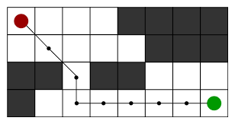
PATH FINDING:
Pathfinding or pathing is the plotting, by a computer application, of the shortest route between two points. It is a more practical variant on solving mazes.
Pathfinding is closely related to the shortest path problem, within graph theory, which examines how to identify the (shortest, cheapest, fastest, etc)path between two points in a large network.

Slide 5

PATH FINDING ALGORITHMS:
Path finding algorithms build on top of graph search algorithms and explore routes between nodes, starting at one node and traversing through relationships until the destination has been reached.
These algorithms find the cheapest path in terms of the number of hops or weight.
Weights can be anything measured, such as time, distance, capacity, or cost.

Slide 6
SHORTEST PATH:
The Shortest Path algorithm calculates the shortest (weighted) path between a pair of nodes. Shortest path is considered to be one of the classical graph problems and has been researched as far back as the 19th century. It has the following use cases:
Finding directions between physical locations. This is the most common usage, and web mapping tools such as Google Maps use the shortest path algorithm, or a variant of it, to provide driving directions.
Social networks can use the algorithm to find the degrees of separation between people.

Slide 7
02
MOTIVATION

Slide 8
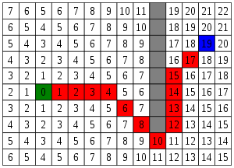
To approximate the shortest path in real-life situations, like- in maps, games where there can be many hindrances.
We can consider a 2D Grid having several obstacles and we start from a source cell (coloured green) to reach towards a goal cell (coloured blue).

Slide 9
03
PROBLEM STATEMENT

Slide 10
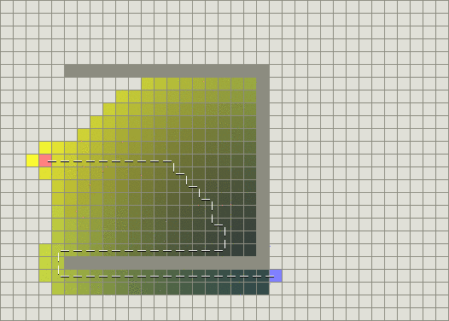
Any path finding will work as long as there are no obstacles on distractions along the way. A genetic A*algorithm has been used for more advanced environments in graph. Implementation of the path finding algorithm for grid based graph with or without obstacles.
a path finding algorithm has been analyzed to find the shortest path between two point's even obstacles. A Path finding algorithm has been proposed for grid based graph, that finds the least cost path from a given initial node to goal node. The solutions for the path finding algorithm has been analyzed to find the shortest path between two points even with obstacles.

Slide 11
04
ALGORITHM USED

Slide 12
A* ALGORITHM
A* is an informed search algorithm, or a best-first search, meaning that it is formulated in terms of weighted graphs: starting from a specific starting node of a graph, it aims to find a path to the given goal node having the smallest cost (least distance travelled, shortest time, etc. At each iteration of its main loop, A* needs to determine which of its paths to extend. It does so based on the cost of the path and an estimate of the cost required to extend the path all the way to the goal. Specifically, A* selects the path that minimizes,f(n)=g(n)+h(n) A* terminates when the path it chooses to extend is a path from start to goal or if there are no paths eligible to be extended.

Slide 13
TIME COMPLEXITY:
Considering a graph, it may take us to travel all the edge to reach the destination cell from the source cell [For example, consider a graph where source and destination nodes are connected by a series of edges, like – 0(source) –>1 –> 2 –> 3 (target)So the worse case time complexity is O(E), where E is the number of edges in the graph

Slide 14
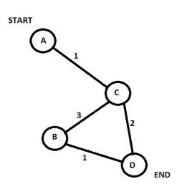
F(n)=G(n)+H(n)
Node | F | G | H | Last
A | 0 | 0 | 0 | -
B | 6 | 4 | 2 | C
C | 2 | 1 | 1 | A
D | 3 | 3 | 0 | C

Slide 15
05
DESIGN

Slide 16
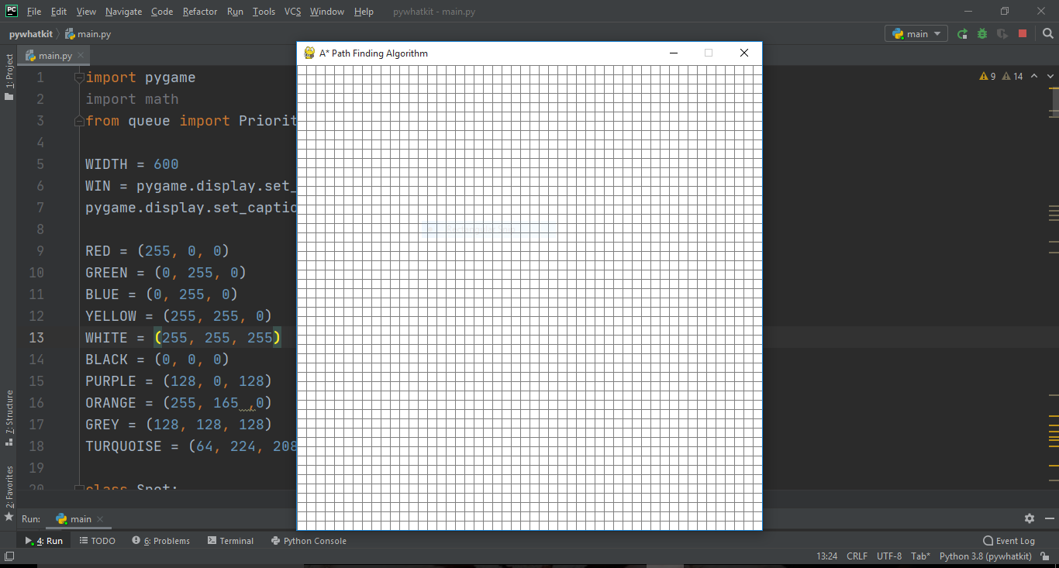
A path finding algorithm has been proposed by using grid based graph.Many problems in graph theory can be represented using a grid method.Grids are a form of implicit graph because we can determine a node’s neighbours based on our location within the grid. Here we have created a 50*50 2D square grid, having many obstacles and we are given a staring cell and a target cell

Slide 17
06
RESULTS

Slide 18
Initially a 50 by 50 grid (white color) appears

Slide 19
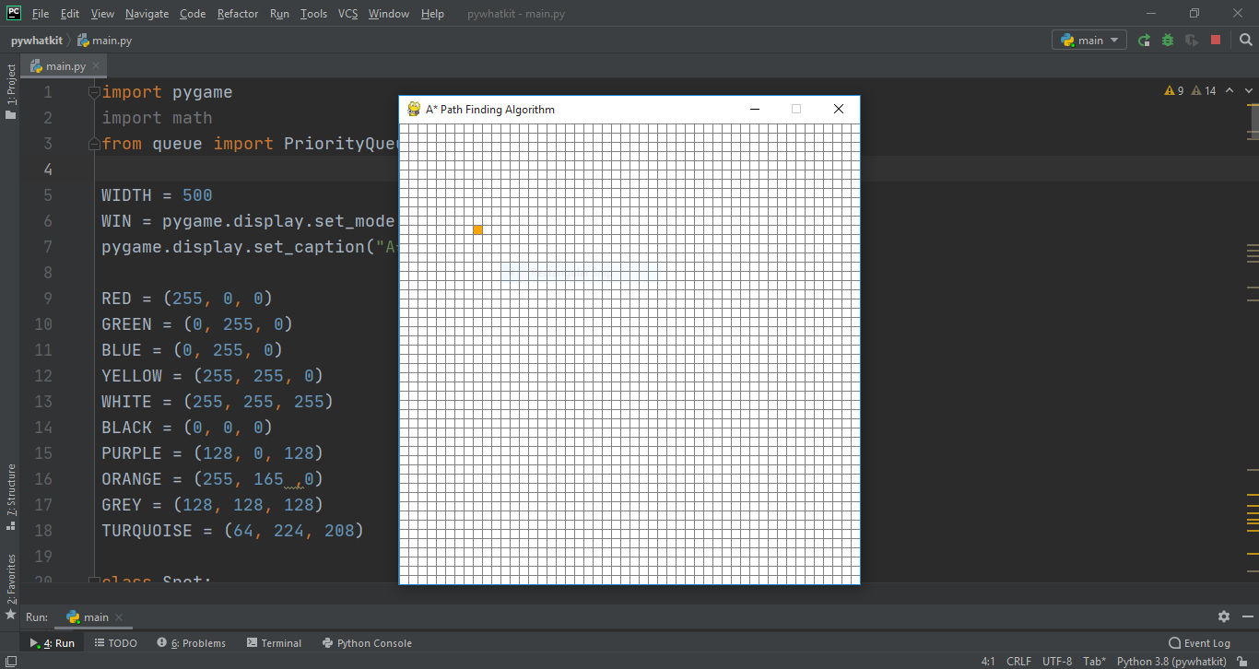
Source node (Orange color) is marked.

Slide 20
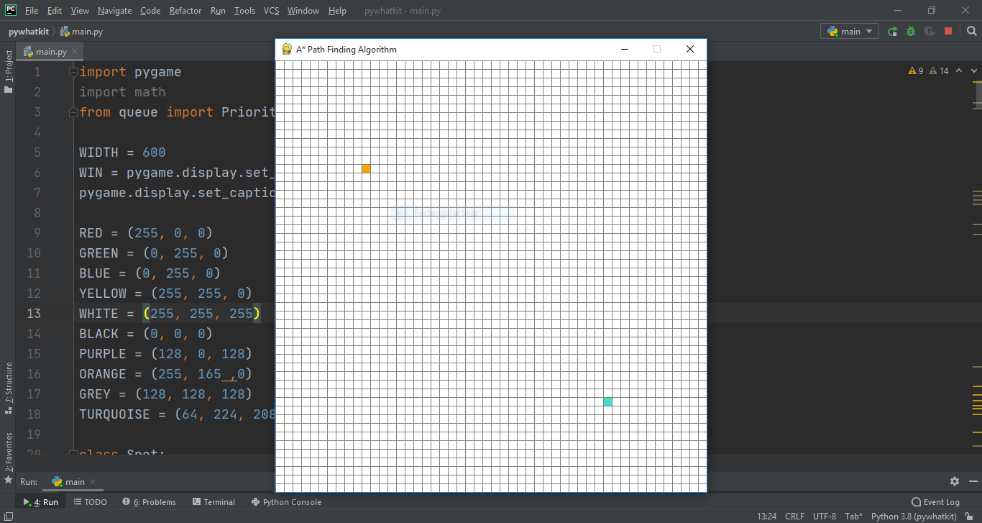
Destination node (Sky blue color) is marked.

Slide 21
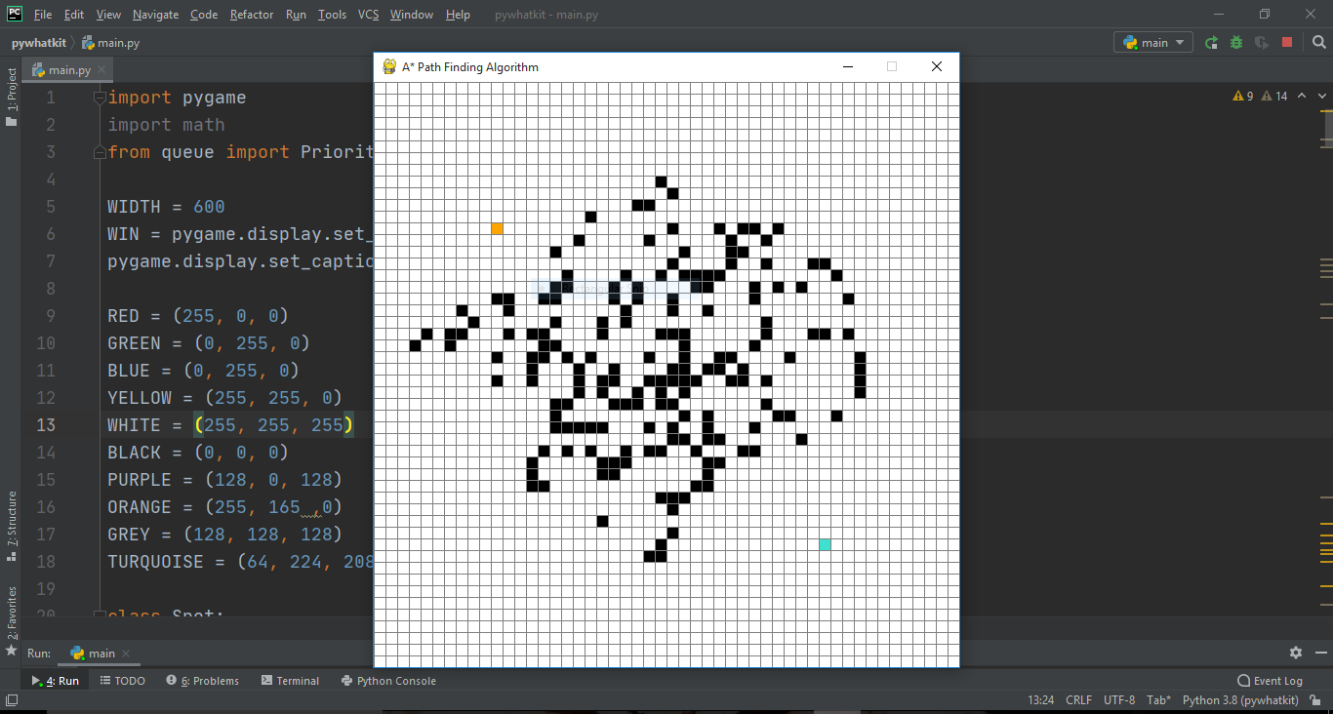
Barriers (Black color) are created.

Slide 22
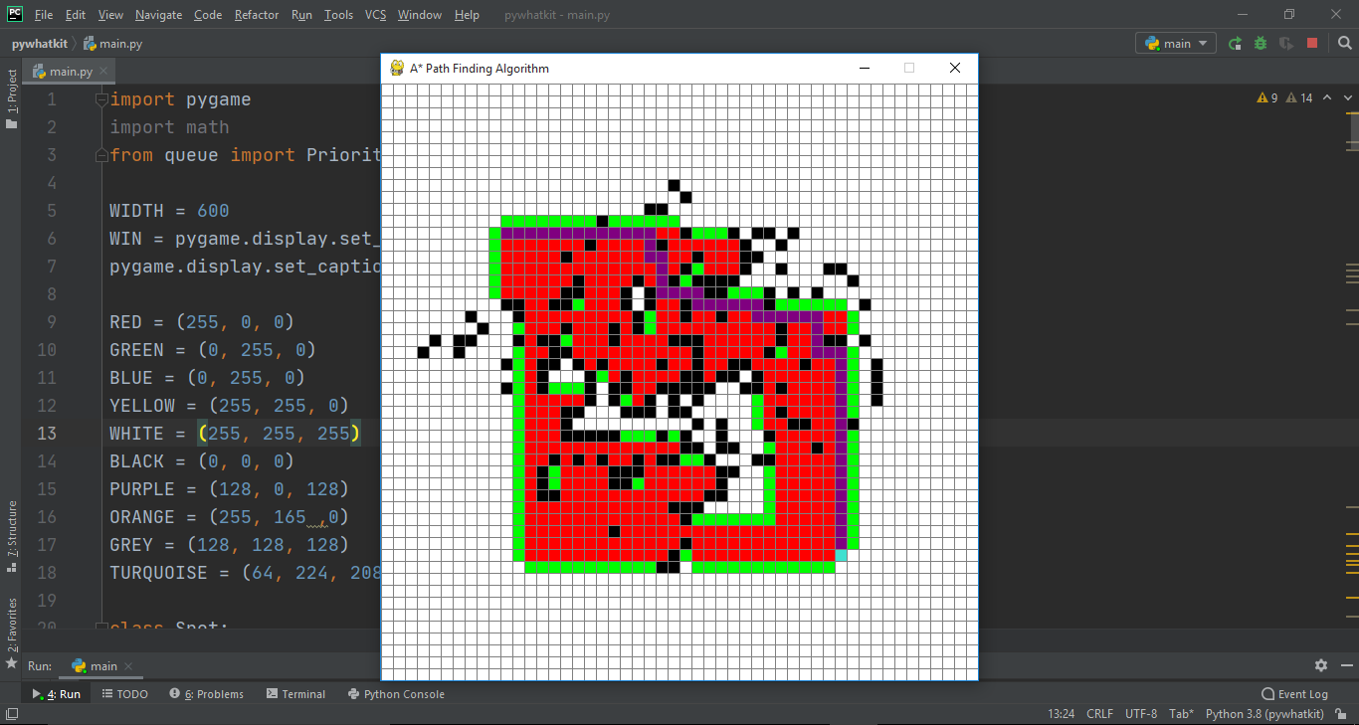
Shortest path(Purple color) from source to destination is found using A* algorithm

Slide 23
07
CONCLUSION AND FUTURE ENHANCEMENT

Slide 24
CONCLUSION:
The basic core of pathfinding algorithm is just a small piece of the puzzle in AI games. The most concern problem is how to use the algorithm to solve difficult problems. A* algorithm is the most popular algorithm in pathfinding.
In this mini Project, A* search algorithm is implemented to find the shortest path between source and destination.Pathfinding is so important in strategy games and other applications.
The map is converted into three main colors; each map has different correspondence to the three colors,After selecting source and destination points, the system will find the shortest path between the selected points.
Other search algorithms can be used and each algorithm has different characteristics.

Slide 25
FUTURE ENHANCEMENT:
Pathfinding is a fundamental component of many important applications in the field of GPS,video games,robotics,logistics and can be implemented in static,dynamic,and real-time environments.
Generally,pathfinding consists of two main steps:graph generation and a pathfinding algorithm.
The graph generation problem is considered as a foundation of robotics and video games applications.In this problem,the pathfinding navigation is conducted in different continuous environments,such as known 2D/3D environments and unknown 2D environments.

Slide 26
THANK YOU...

