Slide 1

DAYANANDA SAGAR UNIVERSITY
SCHOOL OF ENGINEERING
Department of Computer Science and Engineering
2026-2027
Major Project Phase-I
Review 0
TOPOLOGY-AWARE DEEP LEARNING FOR SMALL INTRACRANIAL ANEURYSM DETECTION
Under the Supervision
Prof. Sharath H A
Assistant Prof., Department of CSE
1
Presented By:
Manya B A(ENG23CS0360)
Mohammed Aseel Vanti(ENG23CS0364)
Nisarga Jessy P(ENG23CS0385)
Pavan P Yadav(ENG23CS0396)
Notes:
Title of the project
CSE Dept., SET-Jain University
1

Slide 2
Outline
Problem Definition and Project Relevance
Literature Review and Research Gap
Proposed Methodology
Innovations and Objectives and expected Outcomes
Feasibility evaluation and Project Planning
References
*
Dept of CSE., SOE-Dayananda Sagar University
2 of 18

Slide 3
Problem Definition and Project Relevance
Problem:
Small intracranial aneurysms can be difficult to distinguish from normal vessels using image features alone.
Need:
Existing approaches may not explicitly model the connectivity and structural relationships of cerebral blood vessels.
Our Relevance:
We combine 3D image features with vessel topology using CNN + GAT to investigate improved detection of small aneurysms.
*
Dept of CSE., SOE-Dayananda Sagar University
3 of 18

Slide 4
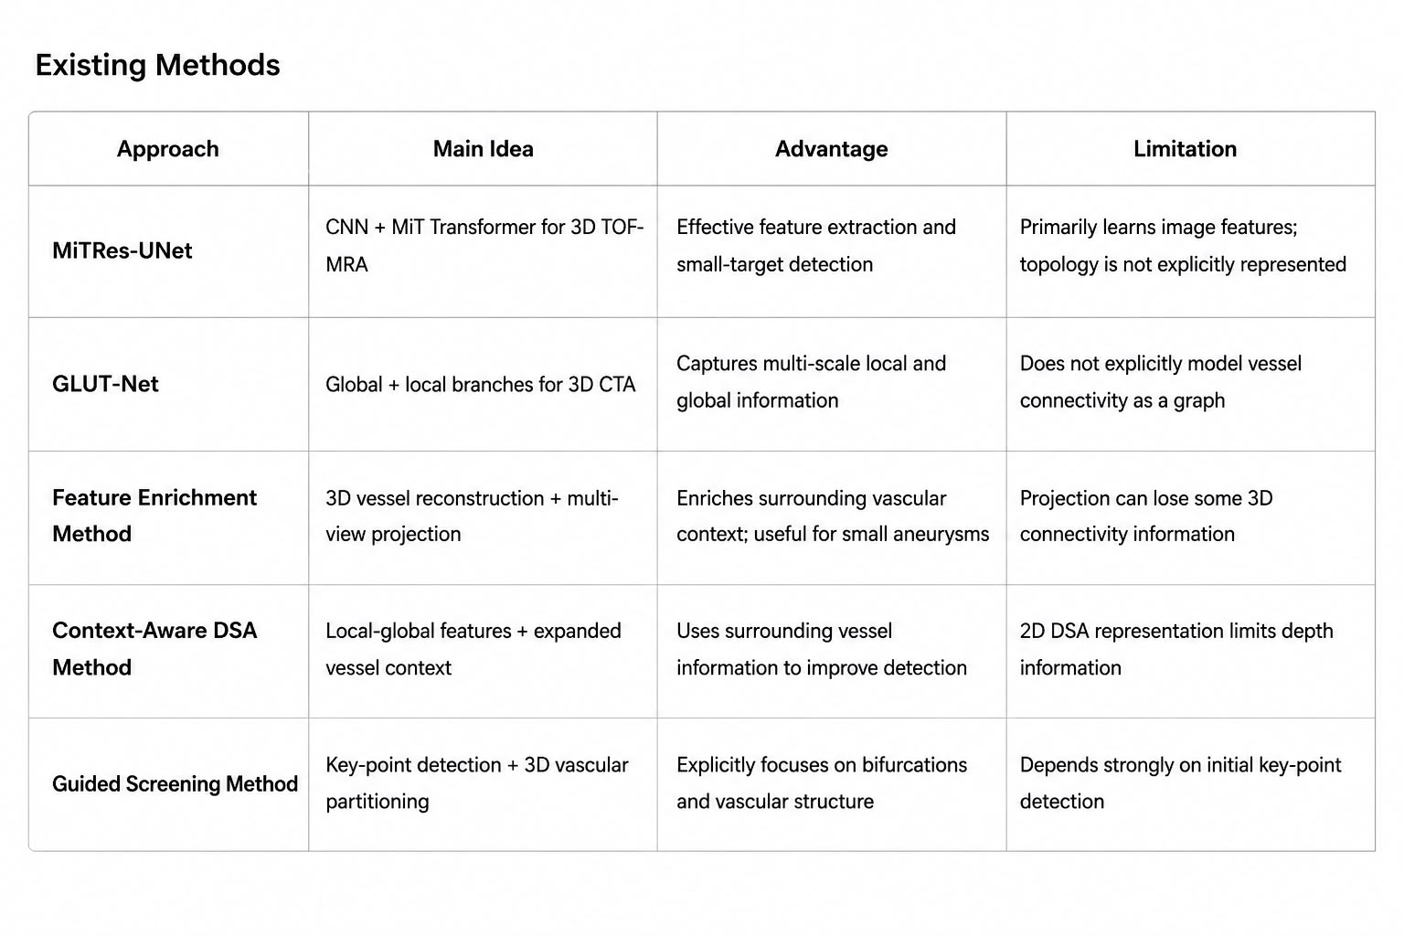
Literature Review and Research Gap
*
Dept of CSE., SOE-Dayananda Sagar University
4 of 18

Slide 5
Literature Review and Research Gap
Research Gap
Existing approaches primarily focus on image, multi-scale, or contextual features.
Explicit representation of vessel connectivity/topology using graph learning is limited.
The contribution of vascular topology to small aneurysm detection requires further investigation.
*
Dept of CSE., SOE-Dayananda Sagar University
5 of 18

Slide 6
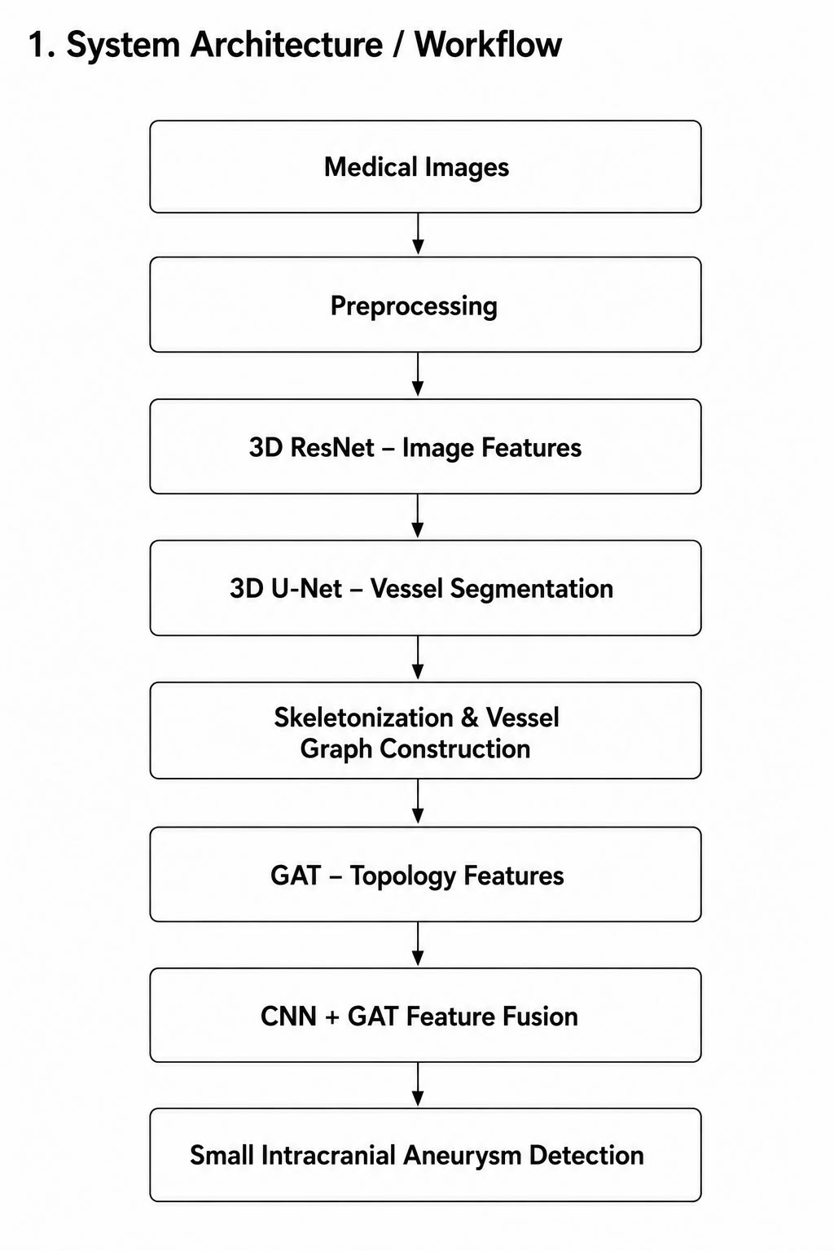
Proposed Methodology
*
Dept of CSE., SOE-Dayananda Sagar University
6 of 18

Slide 7
Proposed Methodology
2.Methods & Technologies
Algorithms
The proposed system will use a 3D image-processing and graph-learning pipeline. First, the angiographic images will undergo preprocessing such as resampling, intensity normalization, and 3D patch extraction.
Vessel masks will then be obtained through 3D vessel segmentation, followed by skeletonization to represent the vascular structure.
The vessel skeleton will be converted into a graph consisting of vessel nodes and connectivity edges.
A Graph Attention Network (GAT) will then learn the importance of neighboring vessel structures. Finally, image and topology features will be fused for aneurysm classification.
*
Dept of CSE., SOE-Dayananda Sagar University
7 of 18

Slide 8
Proposed Methodology
2.Methods & Technologies
Models
The main image model will be a 3D ResNet, which extracts volumetric features from CTA/TOF-MRA scans.
A 3D U-Net will be used for cerebral vessel segmentation so that the vascular structure can be isolated from the surrounding anatomy.
The segmented vessels will be converted into a graph and processed using a Graph Attention Network (GAT) to learn vascular connectivity and structural relationships.
The resulting GAT features will be combined with the 3D ResNet features using a feature-fusion layer, followed by an MLP classification head for aneurysm detection.
We will also develop a 3D CNN-only baseline to determine whether adding topology actually improves detection.
*
Dept of CSE., SOE-Dayananda Sagar University
8 of 18

Slide 9
Proposed Methodology
2.Methods & Technologies
Datasets
We will use the TopAneu 2026 dataset, a multimodal intracranial aneurysm dataset containing 3D MRA and CTA images along with aneurysm and cerebral vessel annotations.
It provides aneurysm location masks, location metadata, vessel segmentation masks, and aneurysm type masks, allowing us to study both aneurysm appearance and the surrounding vascular structure.
We selected TopAneu because its vessel annotations allow us to extract vessel topology and construct graphs for the GAT, while its aneurysm annotations provide the ground truth needed to train and evaluate our small intracranial aneurysm detection model.
*
Dept of CSE., SOE-Dayananda Sagar University
9 of 18

Slide 10
Proposed Methodology
2.Methods & Technologies
Tools
The project will primarily use Python and PyTorch for deep-learning development. MONAI will be used for medical-image preprocessing, 3D transformations, patch extraction, and medical imaging workflows.
PyTorch Geometric will be used to implement the Graph Attention Network and process the vessel graphs. NiBabel/SimpleITK will be used for medical-image loading and manipulation, while scikit-image can be used for skeletonization and morphological operations.
3D Slicer will be used to visually inspect the CTA/MRA scans, vessel segmentation, and extracted vascular structures.
*
Dept of CSE., SOE-Dayananda Sagar University
10 of 18

Slide 11
Proposed Methodology
2.Methods & Technologies
Technologies
The project will use 3D deep learning, graph neural networks, medical image processing, and GPU computing. PyTorch will provide the deep-learning framework, CUDA will provide GPU acceleration, and PyTorch Geometric will provide graph-learning functionality.
The implementation will use CNN-based volumetric feature extraction, U-Net-based segmentation, graph construction, GAT-based topology learning, and multimodal feature fusion.
Git and GitHub will be used for version control, while TensorBoard or Weights & Biases can be used for experiment tracking.
*
Dept of CSE., SOE-Dayananda Sagar University
11 of 18

Slide 12
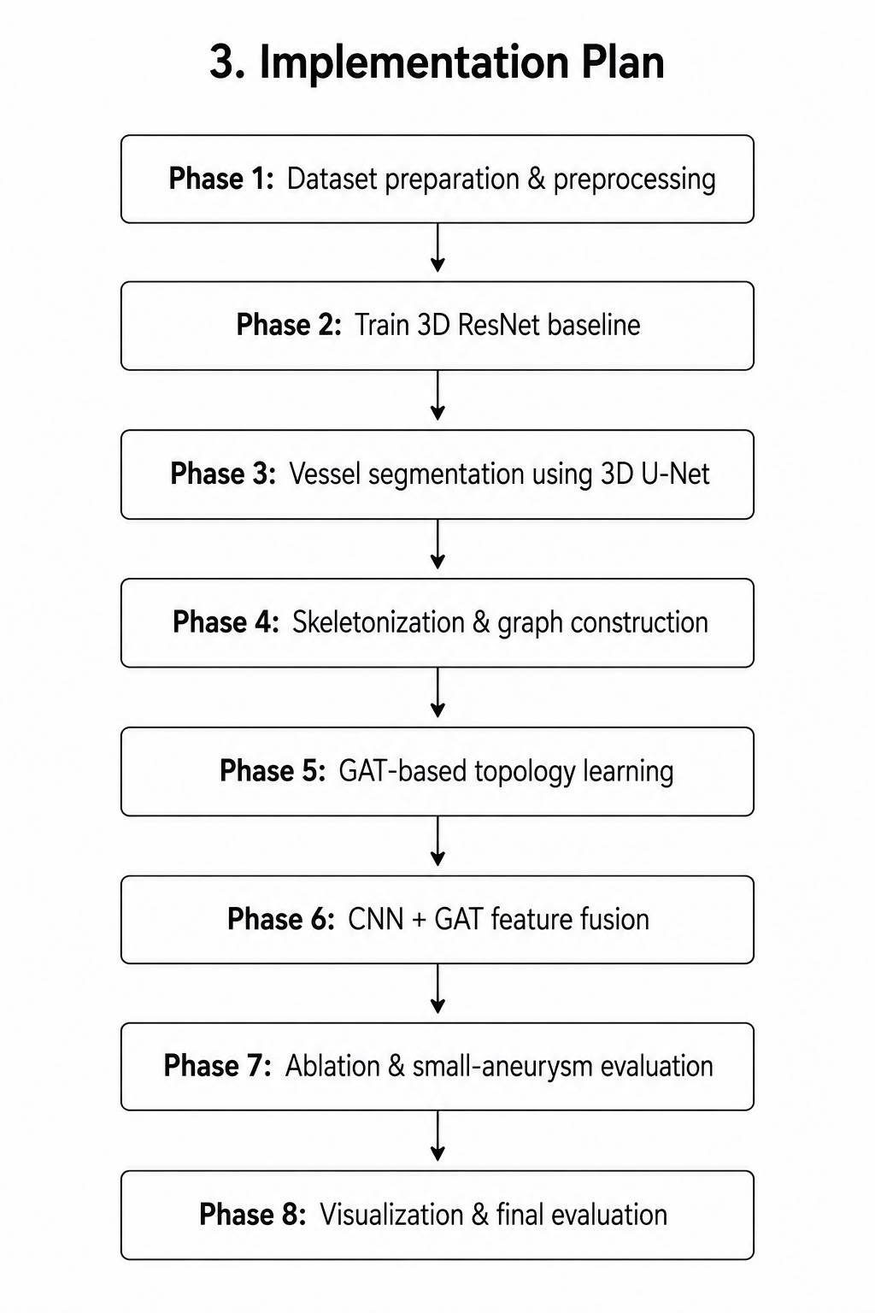
Proposed Methodology
*
Dept of CSE., SOE-Dayananda Sagar University
12 of 18

Slide 13
Innovations and Objectives and expected Outcomes
Objectives
Improve Small Aneurysm Detection: Develop a 3D deep-learning model capable of detecting small intracranial aneurysms from angiographic medical images, where conventional image-based approaches may struggle due to their small size and similarity to normal vessels.
Incorporate Vessel Topology: Represent the cerebral vascular network as a graph and use a Graph Attention Network (GAT) to learn structural relationships such as vessel connectivity, branches, and local vascular context.
Evaluate the Benefit of Topology: Combine 3D image features and vessel-topology features and systematically compare the proposed model with an image-only CNN baseline to determine whether topology improves aneurysm detection, particularly for small lesions.
*
Dept of CSE., SOE-Dayananda Sagar University
13 of 18

Slide 14
Innovations and Objectives and expected Outcomes
INNOVATIONS
Explicit Vessel Topology Representation: Instead of relying only on image intensity and spatial features, we explicitly convert the vessel structure into a graph of nodes and connections and use it as additional information for detection.
CNN + GAT Feature Fusion: The proposed model combines 3D ResNet → image/appearance features GAT → vascular topology features→ Feature Fusion → Aneurysm Detection. This allows the model to consider both what the aneurysm looks like and where/how it is situated within the vessel network.
Focus on Small Aneurysms: Rather than reporting only overall detection performance, we will perform size-wise evaluation to investigate whether topology provides a greater advantage when aneurysms are very small.
*
Dept of CSE., SOE-Dayananda Sagar University
14 of 18

Slide 15
Innovations and Objectives and expected Outcomes
EXPECTED OUTCOMES
1. Improved Detection Performance: The topology-aware CNN + GAT model is expected to improve aneurysm detection compared with the image-only CNN baseline, particularly in challenging small-aneurysm cases.
2. Reduced False Positives: Using the surrounding vascular structure is expected to help distinguish aneurysms from normal vessel branches, junctions, and other visually similar structures, potentially reducing false-positive detections.
3. Interpretable Topology-Aware System: The project will produce a pipeline that can visualize Medical Image → Vessel Segmentation → Skeleton → Vessel Graph → GAT → Aneurysm Prediction providing a more interpretable representation of how vascular structure contributes to the detection decision.
*
Dept of CSE., SOE-Dayananda Sagar University
15 of 18

Slide 16
Feasibility evaluation and Project Planning
Technical & Resource Feasibility
TopAneu 2026| Python + PyTorch/MONAI | 3D ResNet + 3D U-Net + GAT | GPU/Cloud
Timeline & Milestones
Data → Baseline → Segmentation → Graph → GAT → Fusion → Evaluation → Finalization
Risk & Mitigation
Data imbalance → Augmentation
3D computation → Patch-based GPU processing
Segmentation errors → Dice/IoU validation
Graph noise → Skeleton cleanup
No GAT improvement → Ablation study
*
Dept of CSE., SOE-Dayananda Sagar University
16 of 18

Slide 17
References
Y. Zafar, A. Javed, K. M. Malik, J. Santamaria, G. Malik — A Diagnostic System for Intracranial Saccular and Fusiform Aneurysms with Location Detection — 2020
S. C. Pal, D. Toumpanakis, J. Wikström, C. K. Ahuja, R. Strand, A. K. Dhara — Automated Segmentation of Post-Treatment Intracranial Aneurysms from MRA Images: A U-Net based Approach — 2024, INDICON
J. Ahmad, K. Malik, F. Ullah, K. Ahmad, M. Khan, G. Malik — Context-Aware Detection and Grading of Intracranial Aneurysms in DSA Images — 2025, ComComAp
W. Lin, M. Gao, C. Ruan, J. Zhong — Denoising for Intracranial Hemorrhage Images Using Autoencoder Based on CNN — 2021, CEI
R. Ma, S. Tu, P. Li, J. Zhou, B. Zhao, J. Wan, L. Xu — Enriching Computed Tomography Images by Projection for Robust Automated Cerebral Aneurysm Detection and Segmentation — 2021, BIBM
Y. Gao, H. Zheng, Y. Yue, H. Yao — GLUT-Net: Trans-based Segmentation Network for Intracranial Aneurysms in 3D CTA — 2022, CME
*
17 of 18
Dept of CSE., SOE-Dayananda Sagar University

Slide 18
L. Theelke, F. Wilm, C. Marzahl, C. A. Bertram, R. Klopfleisch, A. Maier, M. Aubreville, K. Breininger — Iterative Cross-Scanner Registration for Whole Slide Images — 2021, ICCVW
A. H. Nguyen, F. F. Ting, B. Q. Vuong, C.-M. Ting — MiTRes-UNet: A Hybrid Encoder Framework with Evolutionary Feature Selection for Intracranial Aneurysm Detection — 2026, ISBI
Authors not clearly available in the uploaded paper — Multiple Angle Key Points Detection Guided Screening of Unruptured Intracranial Aneurysms — Year/conference not clearly available
W. Li, Z. Qu, S. Zhang, H. Yuan, Y. Li, H. Ge — Study on the Performance of Microcatheter Commonly Used in Nerve Endovascular Treatment — 2021, ICCEAI
Dataset:- R. Su et al., “TopAneu 2026: Multimodal Vessel-Specific Intracranial Aneurysm Classification and Segmentation Challenge,” Zenodo, 2026.

