Slide 1

Exploring Fictional Masculinity:
Representations of Male Characters in Coming-of-Age Novels
Chase Rogers

Slide 2
THE QUESTION
How do male authors describe and introduce male protagonists in 4 coming-of-age fiction novels?

Slide 3
PROCESS
Hand-transcribe passages as plain-text files.
Passages focus on the introduction of a male protagonist.
Present correlations/findings on webpage using Github.
Focus is on simplicity for general fiction audience.
Use Voyant, primarily the Cirrus and Contexts tools, to analyze adjectives connected to character.
TRANSCRIPTION
ANALYSIS
PRESENTATION

Slide 4
THE NOVELS
Call Me by Your Name by André Acimen
Norwegian Wood by Haruki Murakami
The Sound of Waves by Yukio Mishima
The Sun Also Rises by Ernest Hemingway
Hand-curated corpus
300 word passages focusing on introduction of significant male protagonist
Focus on modern time frame (1925-present)

Slide 5
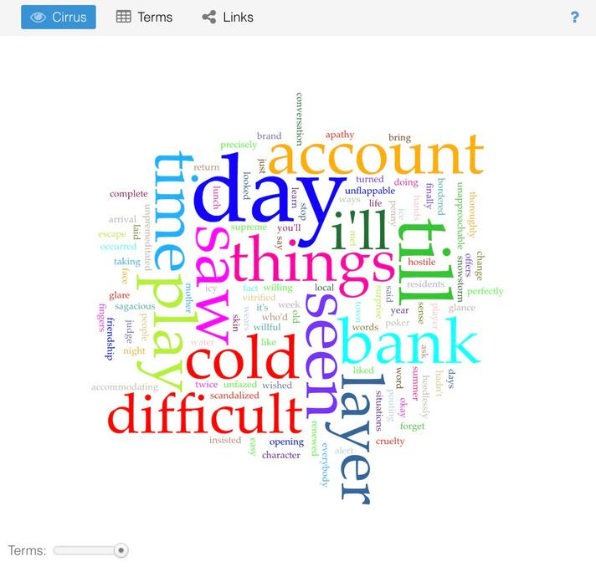
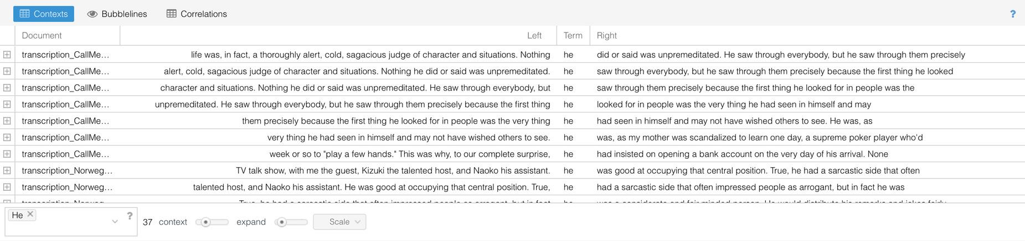
ANALYSIS AND CURRENT FINDINGS
Corpus-wide analysis shows a tendency to attribute a degree of expertise or talent to the male characters in the 4 novels
Description of characters seem to fit the ideals of classically "masculine" traits
No descriptors or adjectives appear twice
Cirrus tool window of Call Me by Your Name
Context tool window of corpus

Slide 6
PRESENTATION
Project will be presented on a static webpage using Github pages
Will use "Minimal" theme through Github themes
Primary section to focus on the analysis of corpus as a whole
Tertiary sections dedicated to the analysis and findings of each book
Visualizations will be through the tools used in Voyant (Cirrus, Context)
Focus will be on visual simplicity and concise, accessible written analysis

Slide 7
WHY DOES IT MATTER?
Exposure to male characters which fit traditional gender stereotypes reinforces those traits (Kneeskern and Reeder, 2022)
There is a lack of research on fictional male characters specifically that needs to be given attention
Critical analysis of these texts can supply well needed awareness of how characters are presented and conscientious consumption
Kneeskern, E. E., & Reeder, P. A. (2022). Examining the impact of fiction literature on children's gender stereotypes. Current Psychology, 41(3), 1472+

Slide 8
WHERE COULD IT GO?
Larger corpus spanning 1925-present containing full texts
analysis on progression of presentation of masculinity
BookNLP to be used for more in-depth and accurate analysis
Presented through interactive timeline with sections displaying common descriptors for each time period
Focus on searching for patterns and connections in adjectives used

Slide 9
Thank you
All questions welcomed

