Slide 1
AE 540 · FINAL PROJECT
Historic URM Building
Flood-Resilience Dashboard
Interactive decision-support powered by a multi-objective genetic algorithm (NSGA-II)
balancing structural safety, heritage preservation, and functional utility
S0 · Sealant / Coating
S1 · Removable Barrier
S2 · Hydrostatic Vents
Ana Ferreira · Penn State University · August 2026
Notes:
Title slide. Introduce the project: an interactive dashboard that couples a live in-browser surrogate engine with the full Python MOGA (NSGA-II) to select flood-adaptation strategies for a historic two-story URM building with basement, in a FEMA AE zone.

Slide 2
The optimization problem
Choose the flood-adaptation strategy and its design genes that best balance three competing objectives for a two-story unreinforced-masonry (URM) building with basement.
Strategies (gene 1)
Objectives (maximize all three)
S0 · Dry — Sealant / Coating
A · Structural
Hydrostatic + earth pressure vs shear and out-of-plane capacity over a triangular hydrograph
Blocks water at the wall face; traps moisture and salts in historic masonry (low reversibility).
B · Preservation
NPS-based sub-scores: reversibility, compatibility, distinguishability, moisture, fenestration
S1 · Dry — Removable Barrier
Deployable perimeter barrier of height PH; reversible, but holds back hydrostatic load.
C · Utility
Immediate usability, recovery time, and lifecycle cost
S2 · Wet — Hydrostatic Vents
Lets water in on purpose to equalize pressure; protects the structure, sacrifices usability.
495
2
min
candidates per live
grid search
design genes:
PH (m) + VIF
composite = worst of
the 3 objectives
Notes:
Decision variables: intervention strategy (0/1/2), protection height PH in [0, 3.5] m, visual impact factor VIF in [0, 1]. The composite score is the minimum of the three objectives — a conservative "weakest link" selection rule.

Slide 3
One dashboard, two engines
JS · LIVE
MOGA · PYTHON
JS · LIVE
MOGA · PYTHON
In-browser surrogate engine
Full MOGA engine (Python)
Exhaustive grid search over 495 candidates (3 strategies × 15 PH × 11 VIF)
Recomputes every chart instantly on each slider change
Deterministic simplification of the Python model
NSGA-II · 20 seeds × 300 generations × population 50
Monte-Carlo scenario sampling + risk-averse aggregation
999 Pareto-front points embedded · live re-runs via local server
How they connect
Sliders
(building profile +
model parameters)
JS engine
grid search
495 candidates
Live charts
KPIs · radar · section
par-coords · 3D
moga_server.py
/api/run → NSGA-II
(uses slider profile)
MOGA 3D front
+ consensus winner
→
→
→
→
Notes:
Every card in the dashboard carries a source badge: JS·LIVE results react to the sliders; MOGA·PYTHON results come from the full optimization run. During the demo, the RUN MOGA ENGINE button calls the local server, which executes the real NSGA-II with the current slider profile and streams fresh Pareto results back into the 3D chart.

Slide 4
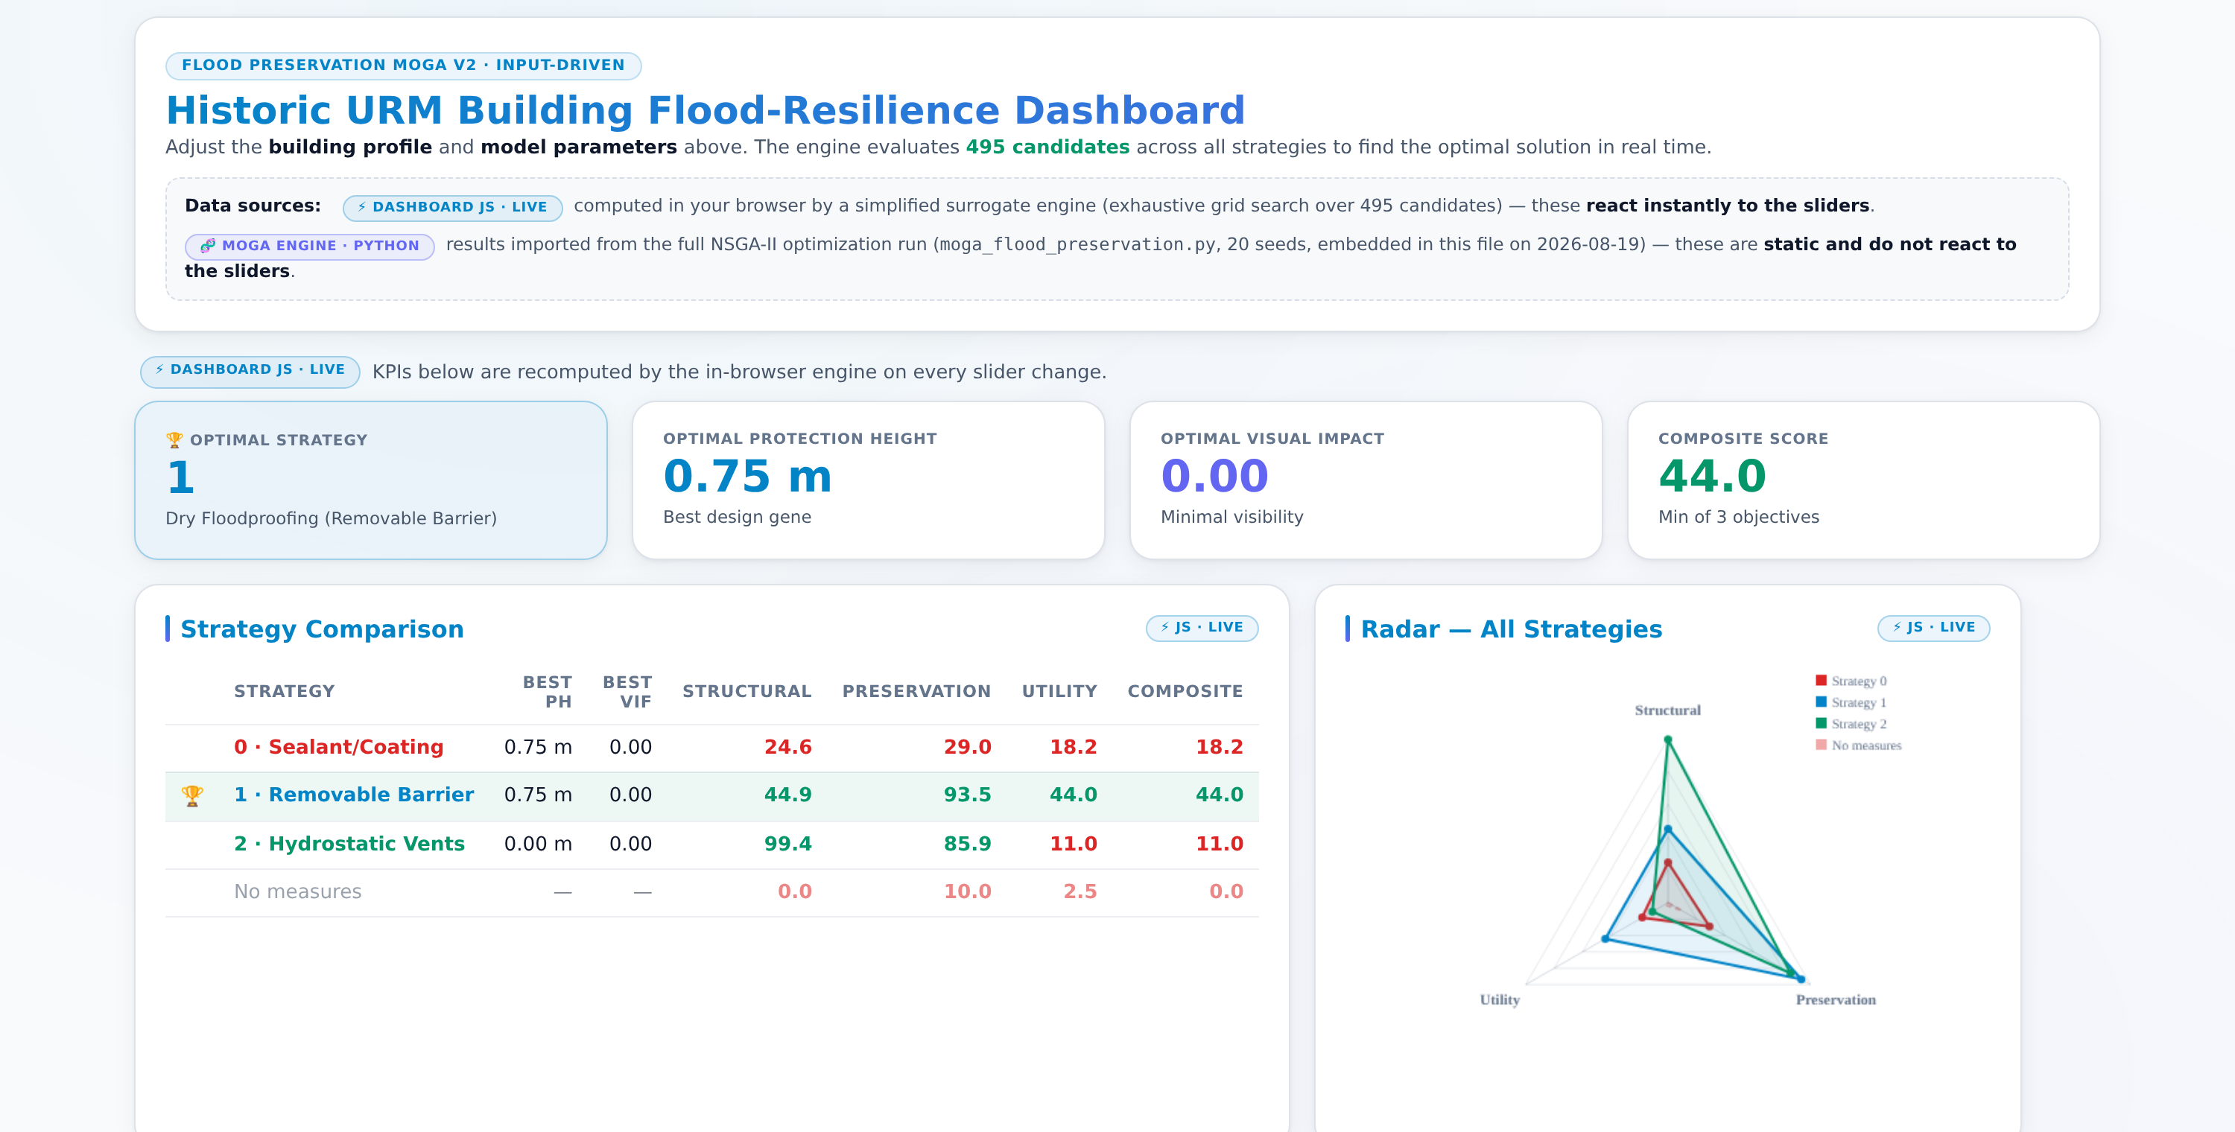
Live results at a glance
JS · LIVE
KPI row = optimal strategy, protection height, visual impact, and composite score · comparison table ranks all strategies against the no-measure baseline · radar shows the three-objective footprint.
Notes:
At the design condition (flood depth 2.5 m, shear 40 kN) the winner is S1 — removable barrier, PH 0.75 m, composite 44. The "No measures" row anchors the value of intervening at all.

Slide 5
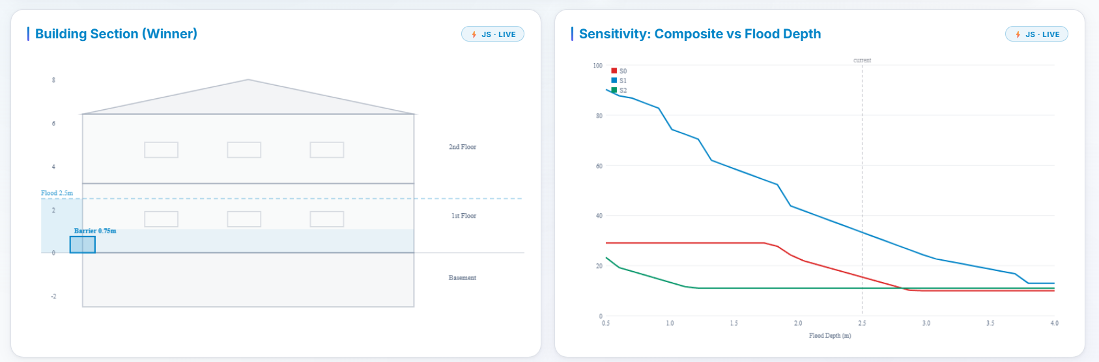
Physical insight: section view & sensitivity
JS · LIVE
Building Section
Sensitivity curves
Draws the winning design on the building: flood line, barrier height, vents, interior leakage — including the full basement depth.
Best composite per strategy as flood depth sweeps 0.5–4.0 m; the dashed line marks the current slider value.
Notes:
The sensitivity chart is the argument for S1 at moderate depths (blue curve dominates until ~2.8 m) and previews the extreme-scenario behavior: all curves collapse as depth grows.

Slide 6
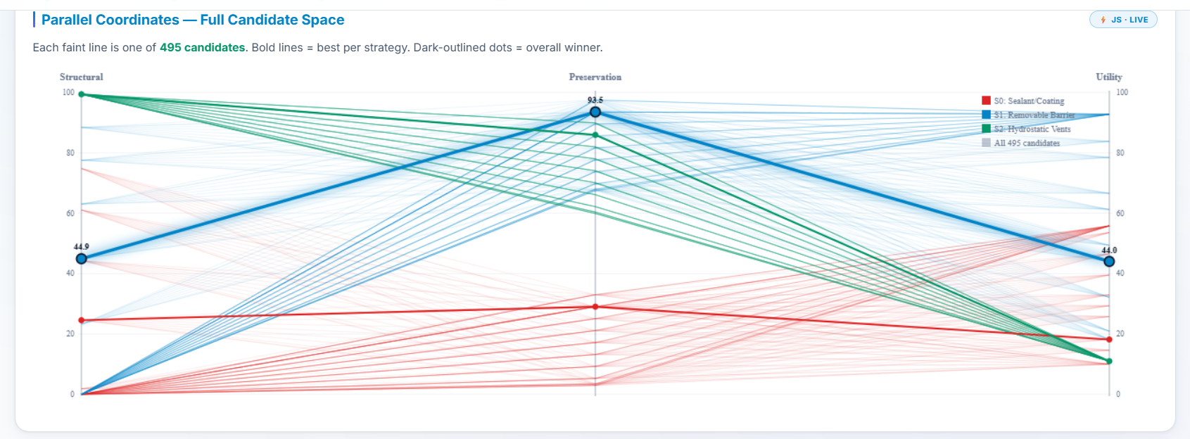
The full candidate space in one picture
JS · LIVE
Each faint line is one of the 495 candidates across Structural, Preservation, and Utility; bold lines are the best design per strategy and the dark-outlined dots mark the overall winner.
The trade-off is legible: S2 (green) tops Structural but collapses on Utility; S0 (red) is dominated almost everywhere — the visual version of the Pareto argument.
Notes:
Good slide to pause on: committee members can trace any single candidate across the three axes and see why the min-composite rule rejects it.

Slide 7
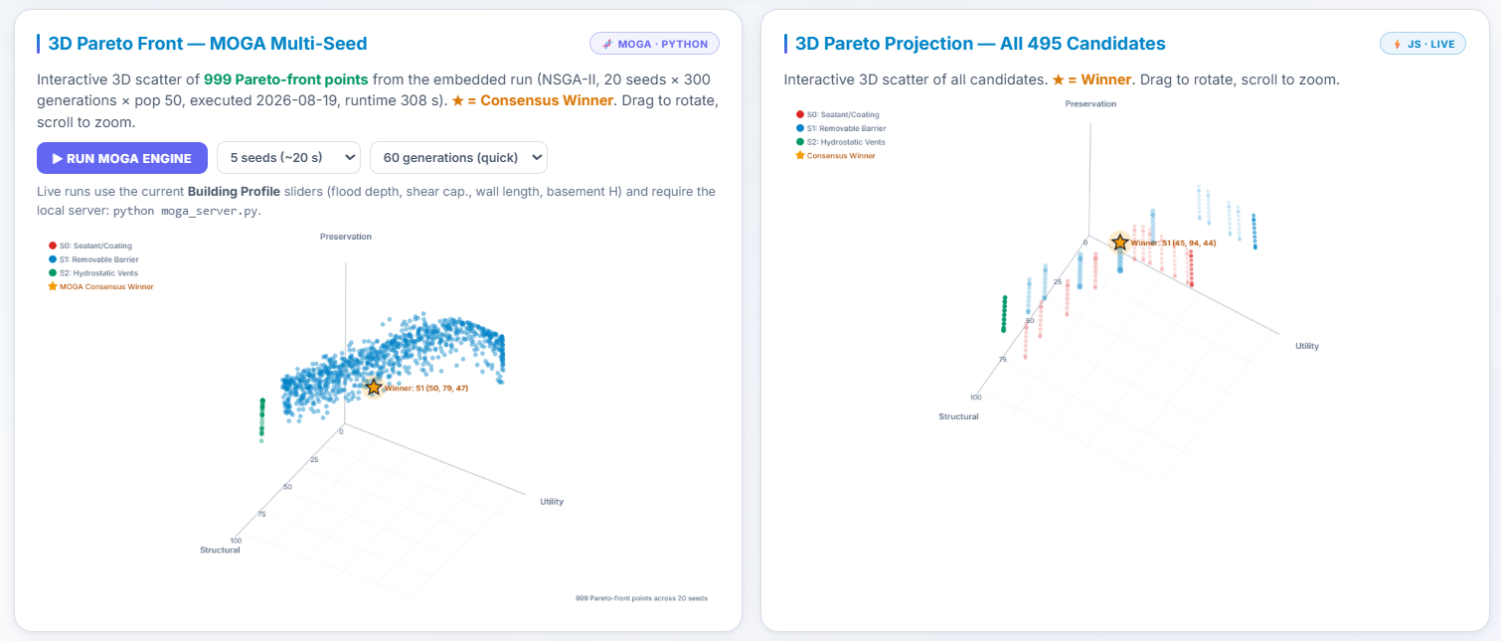
Pareto fronts in 3D: MOGA vs live surrogate
JS · LIVE
MOGA · PYTHON
Left — 999 Pareto-front points from the embedded NSGA-II run (20 seeds × 300 generations); the gold star is the consensus winner: S1, PH 0.73 m, objectives (50, 79, 47).
Right — the live JS projection of all 495 grid candidates under the current sliders. The two engines agree on the winning region — a built-in cross-validation shown side by side.
Notes:
Both charts rotate and zoom live. The RUN MOGA ENGINE button (left card) re-runs the real Python NSGA-II with the current building profile — 5 seeds × 60 generations takes about 20 seconds.

Slide 8
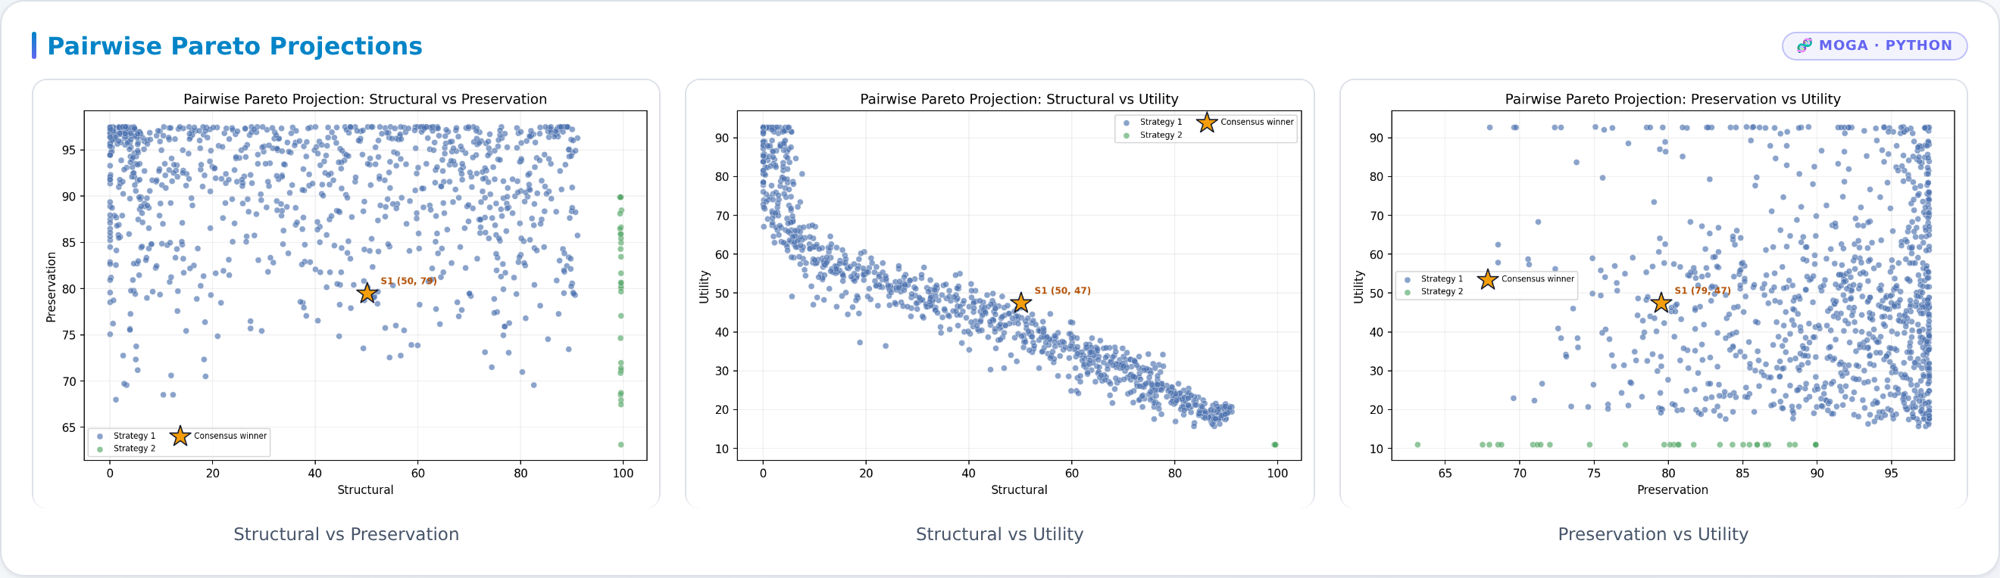
Pairwise Pareto projections
MOGA · PYTHON
Each panel projects the 999-point Pareto cloud onto a pair of objectives; the gold star marks the consensus winner with its coordinates.
Structural vs Utility shows the sharpest trade-off frontier — safety is bought with usability.
S0 (sealant) contributes almost no points to the front: it is dominated, echoing NPS Standard 9 concerns about irreversible moisture damage.
Notes:
The near-absence of red points on the front is a quantitative version of the preservation argument: the optimizer never needs the sealant strategy.

Slide 9
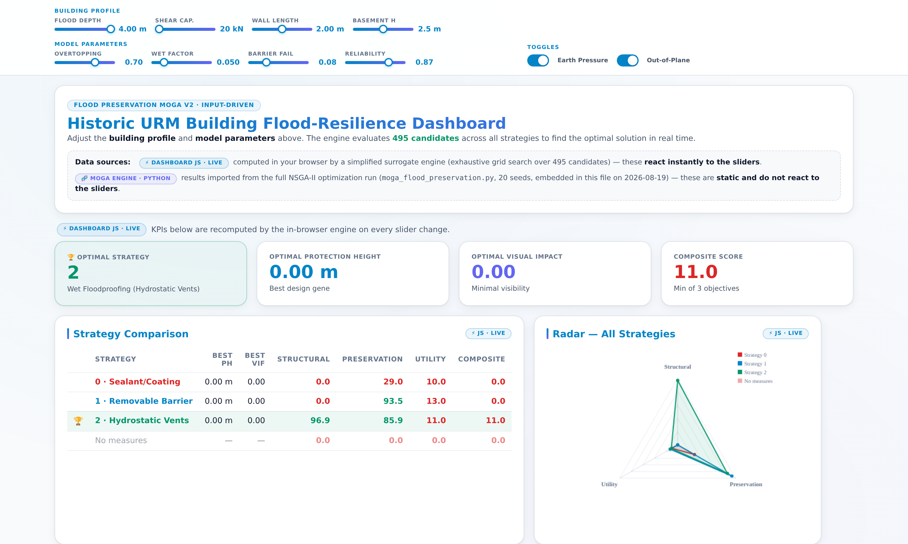
Guardrail behavior under extreme scenarios
JS · LIVE
Flood depth 4.0 m · shear capacity 20 kN · overtopping 0.70
Under this extreme, every dry-floodproofing design fails: at any barrier height, the retained + leaked hydrostatic load exceeds the weak wall’s capacity, so Structural = 0 for S0 and S1 across all 330 dry candidates.
The optimizer therefore recommends S2 — hydrostatic vents: by equalizing pressure instead of resisting it, S2 keeps Structural at 96.9 and wins the composite.
Before abandoning barriers entirely, the engine first shrinks them: at milder extremes the optimal PH collapses toward 0 m — a tall barrier is never chosen when it would break the wall.
Physically consistent: the model refuses designs that would cause structural failure.
Notes:
Live demo moment: drag flood depth to 4.0 m, shear capacity to 20 kN and overtopping to 0.70. The comparison table shows S0 and S1 collapsing to Structural 0.0 while S2 stays at 96.9 — the winner flips to S2 in real time. This demonstrates the optimizer is not just curve-fitting: it respects the structural feasibility boundary.

Slide 10
Takeaways
Design condition → S1
Extremes → S2
Removable barrier, PH 0.73 m, VIF 0.55 — objectives (50, 79, 47); reversible and NPS-compatible.
When barriers would break the wall, the optimizer switches to hydrostatic vents — pressure equalization over resistance.
S0 is dominated
Two engines, one story
Sealant/coating almost never reaches the Pareto front: irreversibility and moisture entrapment cost too much.
The live surrogate and the full NSGA-II agree on the winning region — instant interaction with optimization-grade backing.
Live demo
python moga_server.py → open http://localhost:8000/interactive_dashboard.html → adjust sliders → RUN MOGA ENGINE (5 seeds × 60 generations ≈ 20 s)
Ana Ferreira · AE 540 · Penn State University
Notes:
Close with the live demo: change a slider, click RUN MOGA ENGINE, and show the Python engine updating the 3D Pareto front in ~20 seconds.

