Slide 1

مبادرة وزارة الاتصالات وتكنولوجيا المعلومات لتمكين الشباب للعمل المهني الحر Youth Enablement for Freelancing

Slide 2
Web Development مطور صفحات انترنت

Slide 3

Present : Abdelrahman Mohamed ramy abdelsalam
Mobile store (electronics)
Supervision : Abdulnaser Mohsen

Slide 4
Description
A site for selling mobiles of all kinds and the latest international brands. The site is multilingual and multi-user.

Slide 5
Technology
•Html and html5
•Css3
•Bootstrap
•Javascript , jquary, Ajax
•Mysql
•Php , Laravel

Slide 6
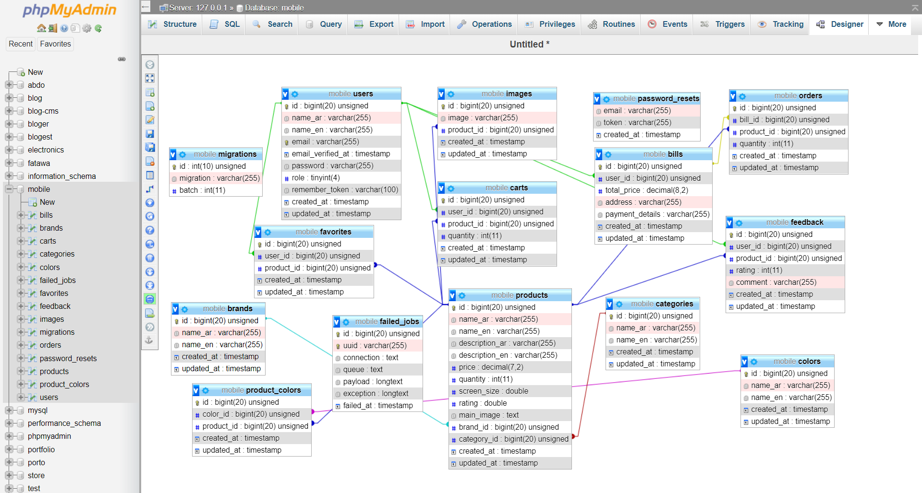
DataBase

Slide 7
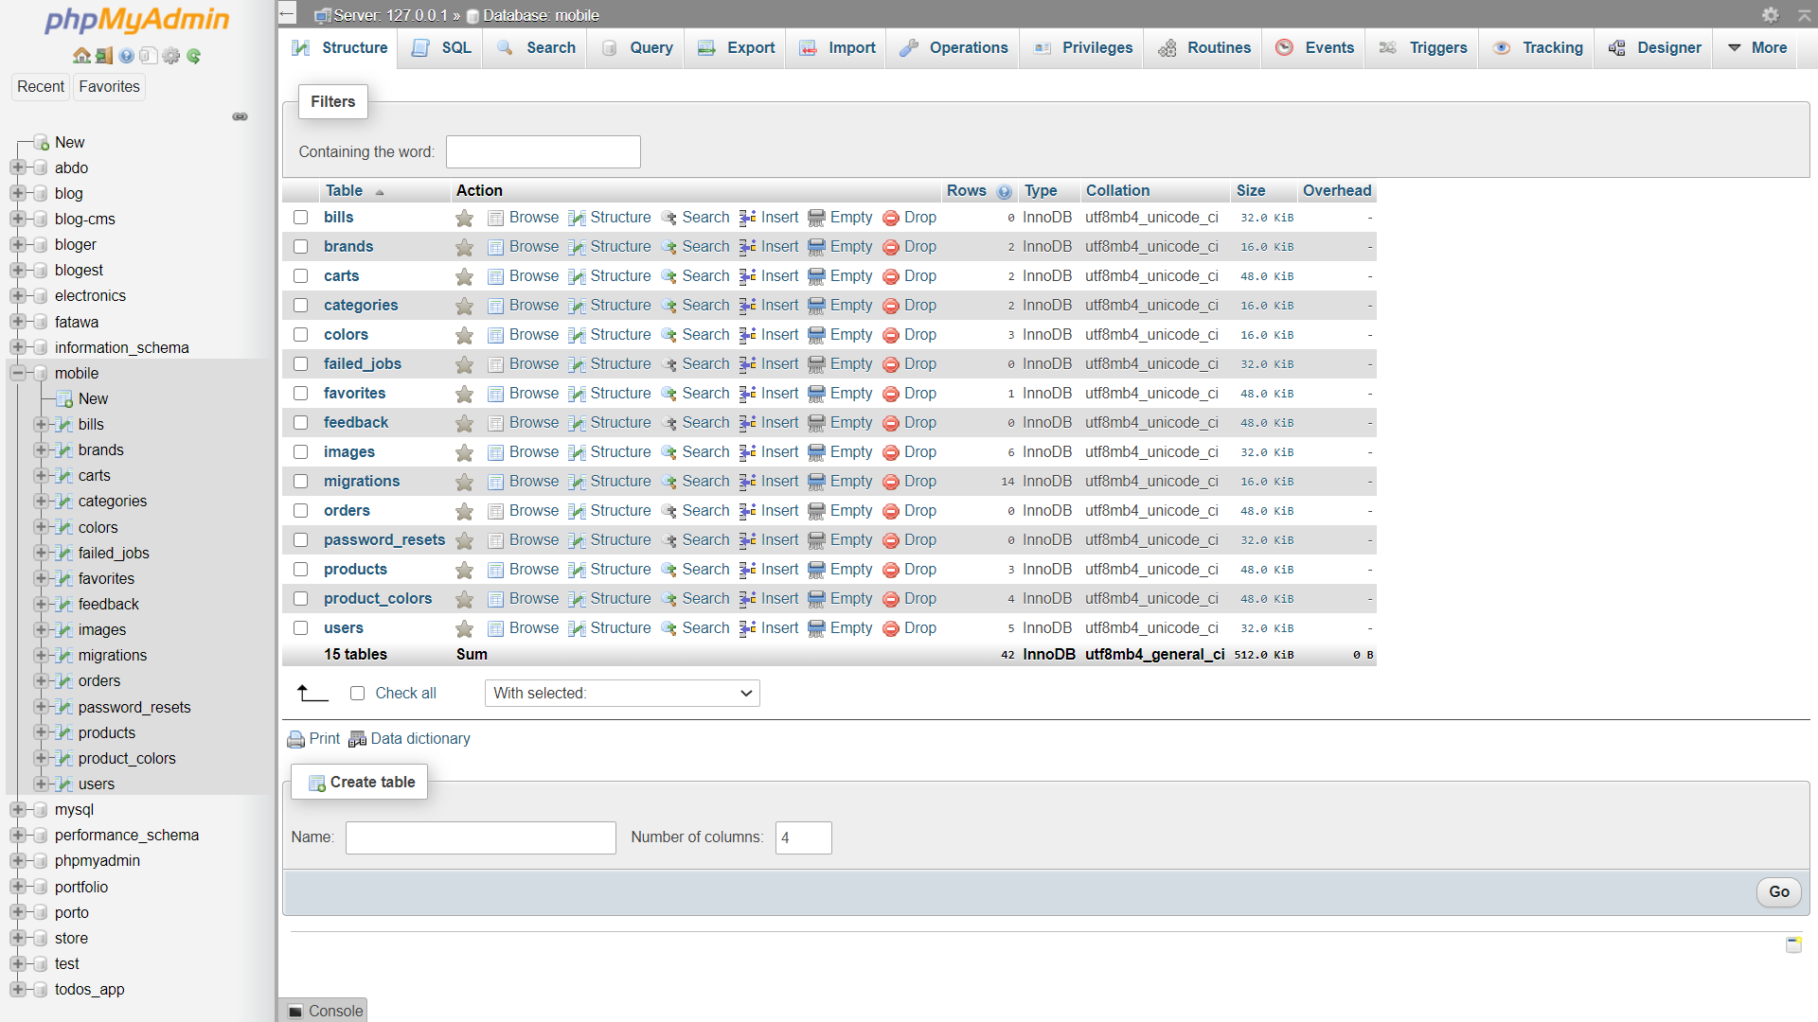
Database (s)

Slide 8
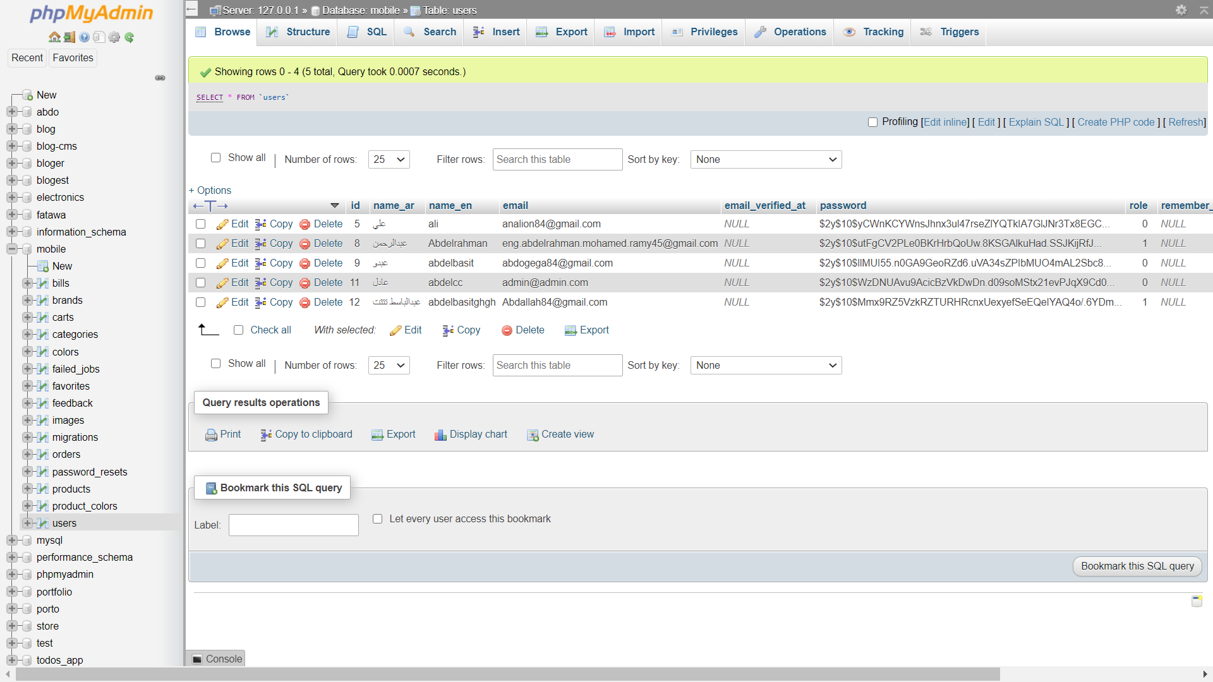
Users

Slide 9
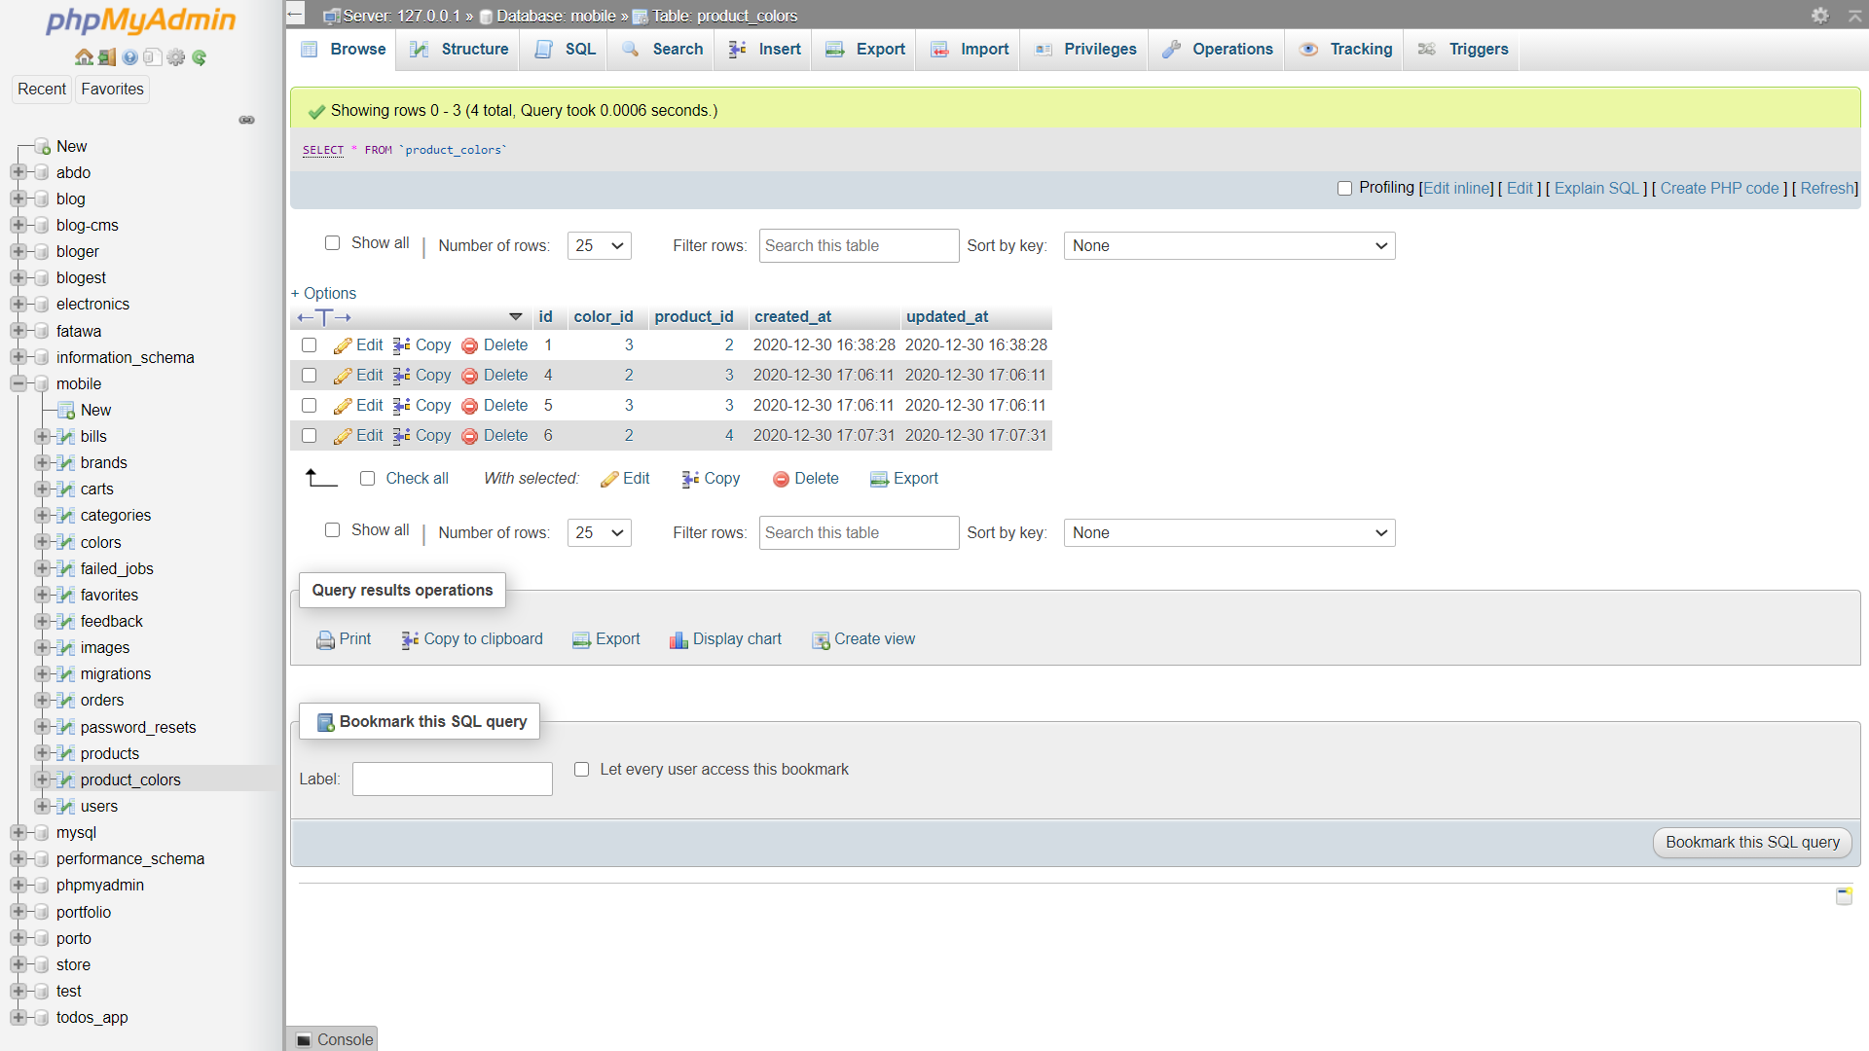
Product color

Slide 10
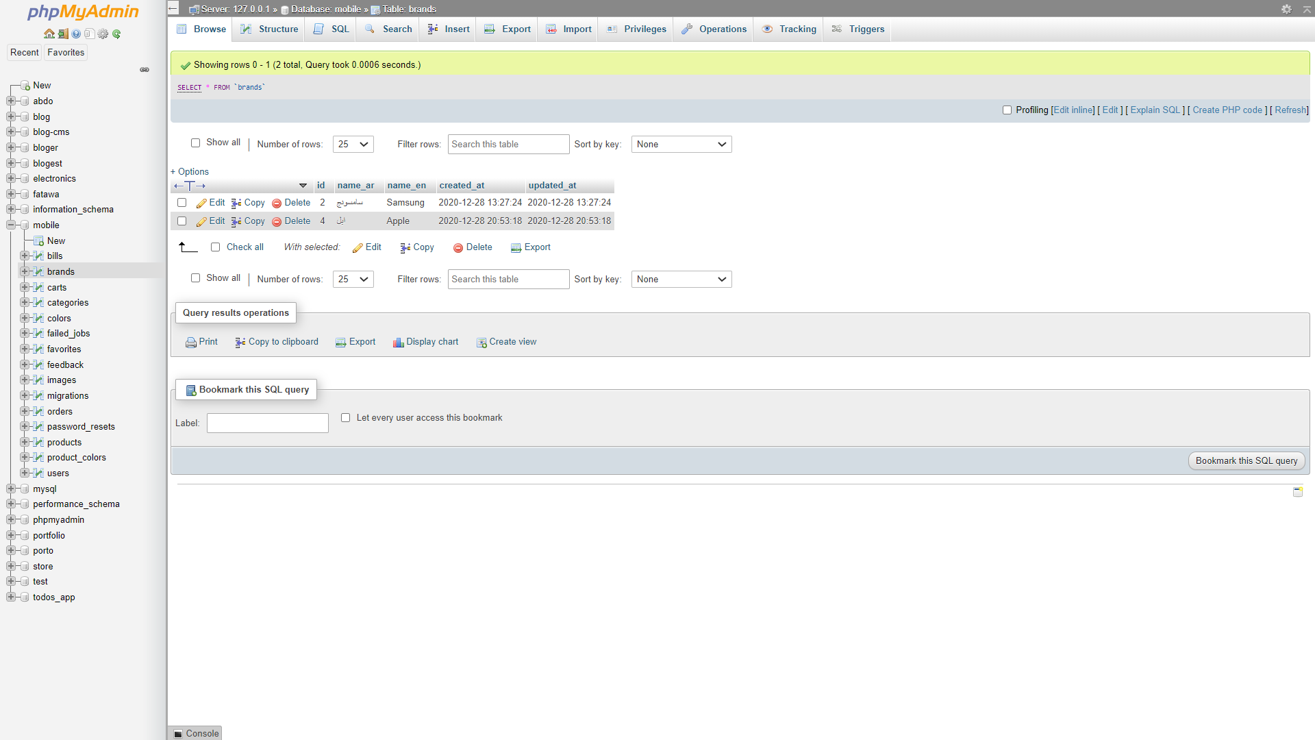

Brand ,category

Slide 11
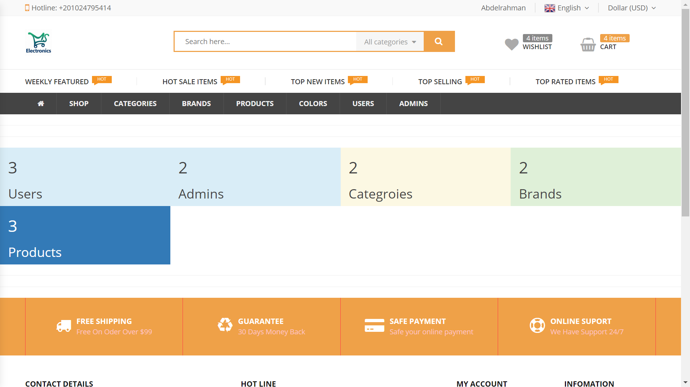
Admin view

Slide 12
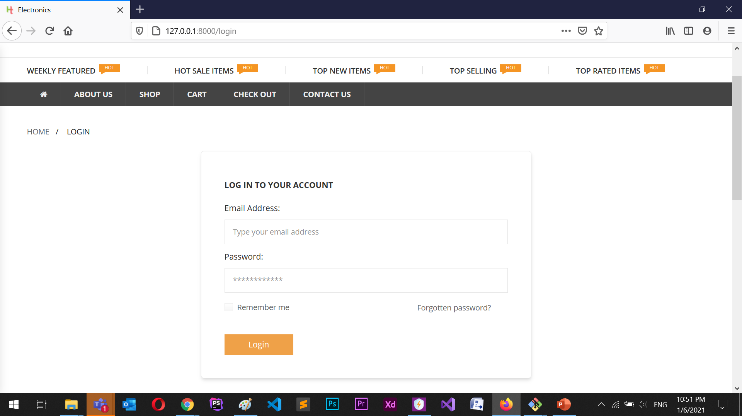
Login

Slide 13
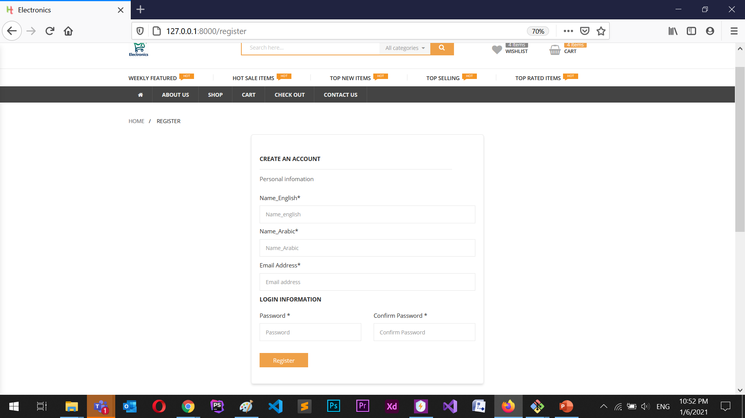
Register

Slide 14
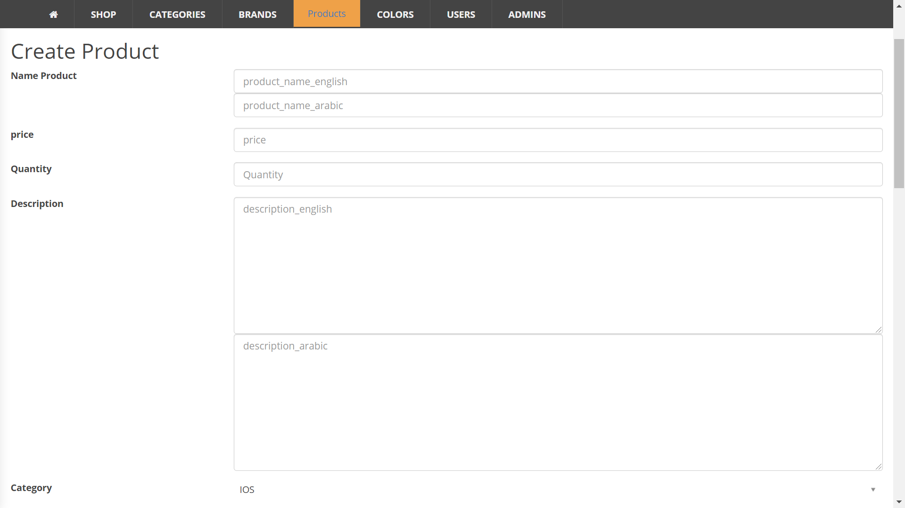
Create product

Slide 15
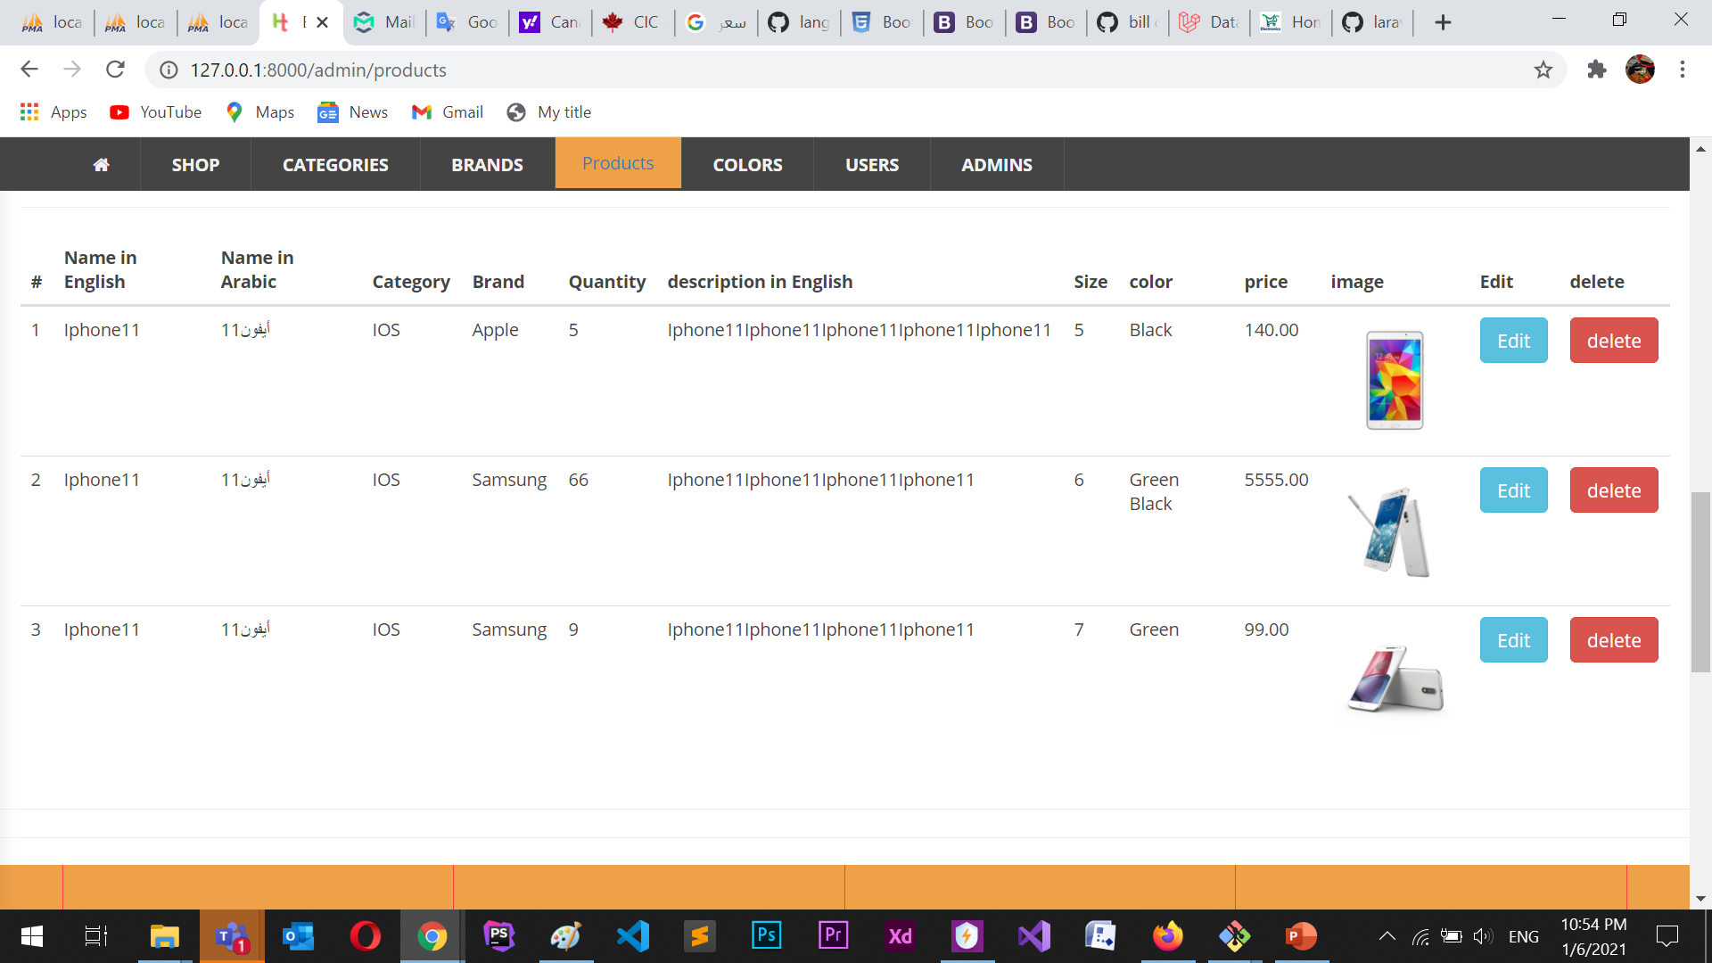
Admin (Delete, Edit)

Slide 16
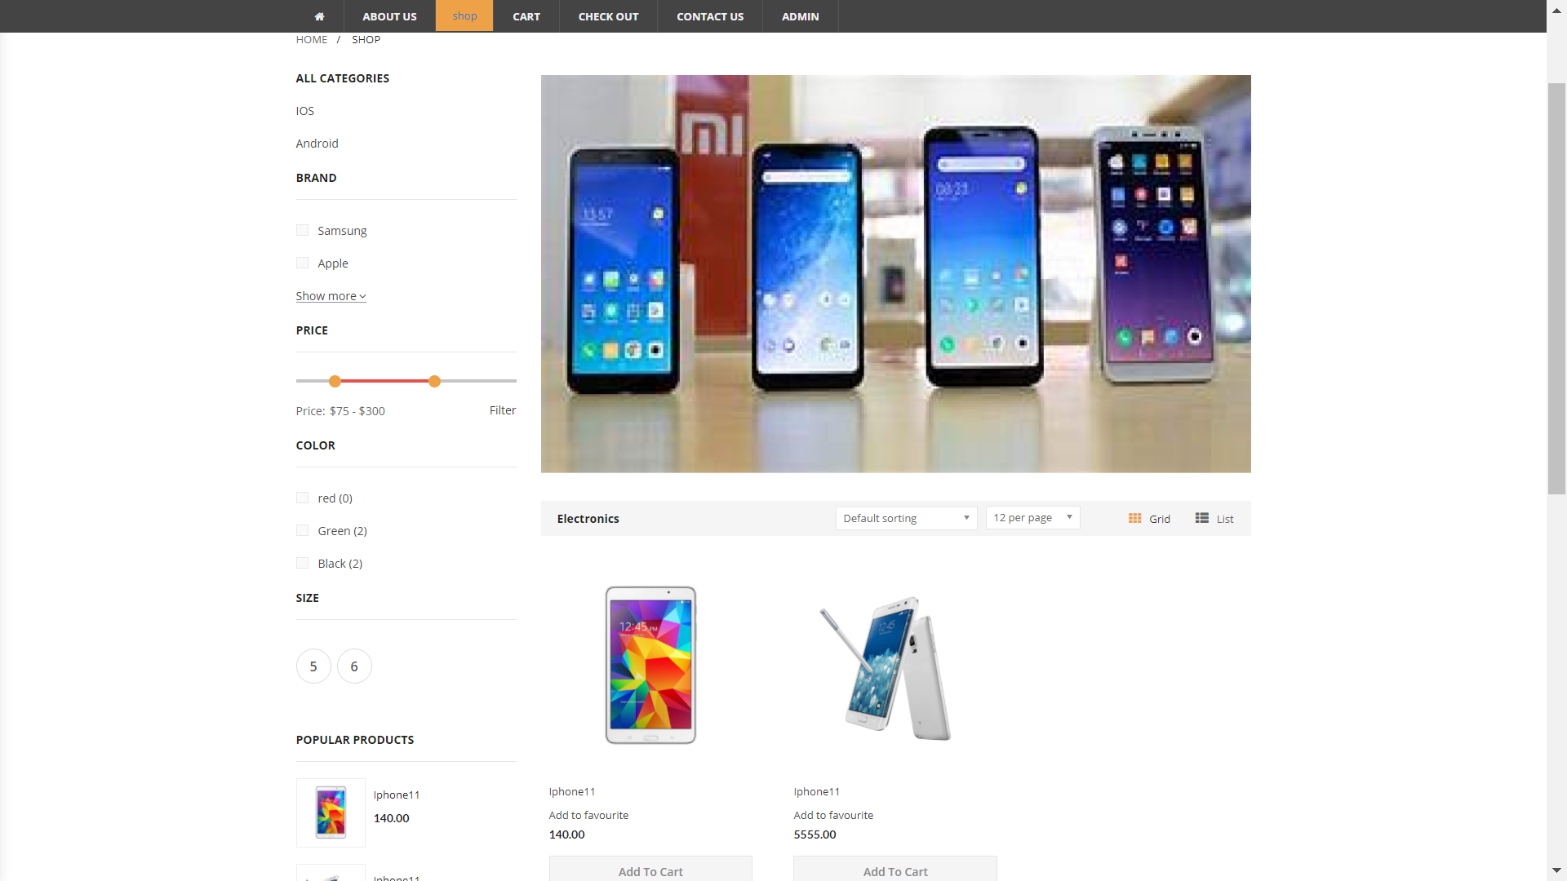
shop (product_view)

Slide 17
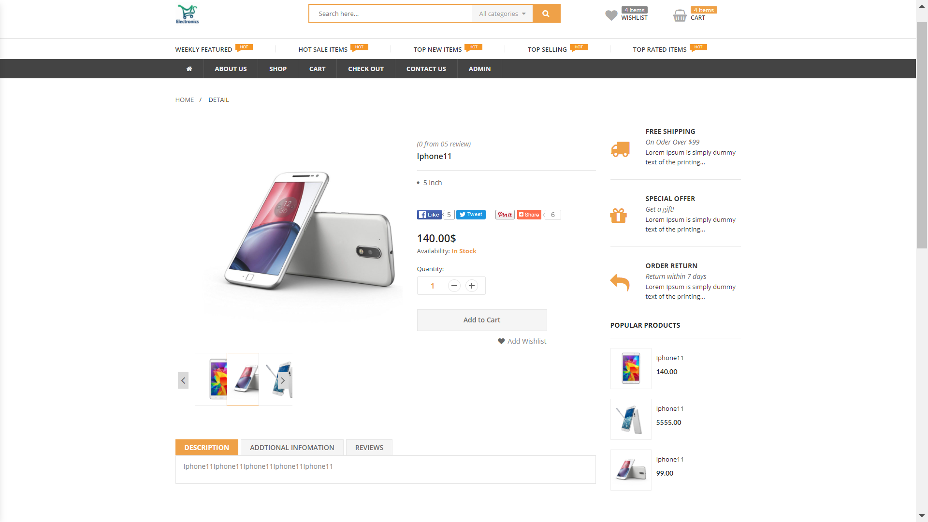
Details product

Slide 18
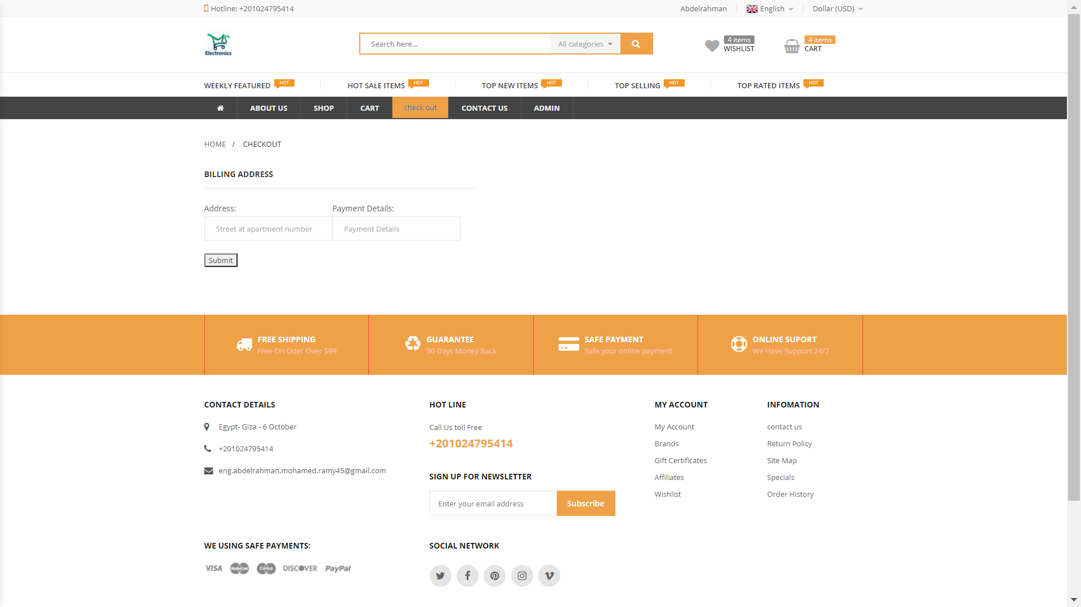
checkout

Slide 19
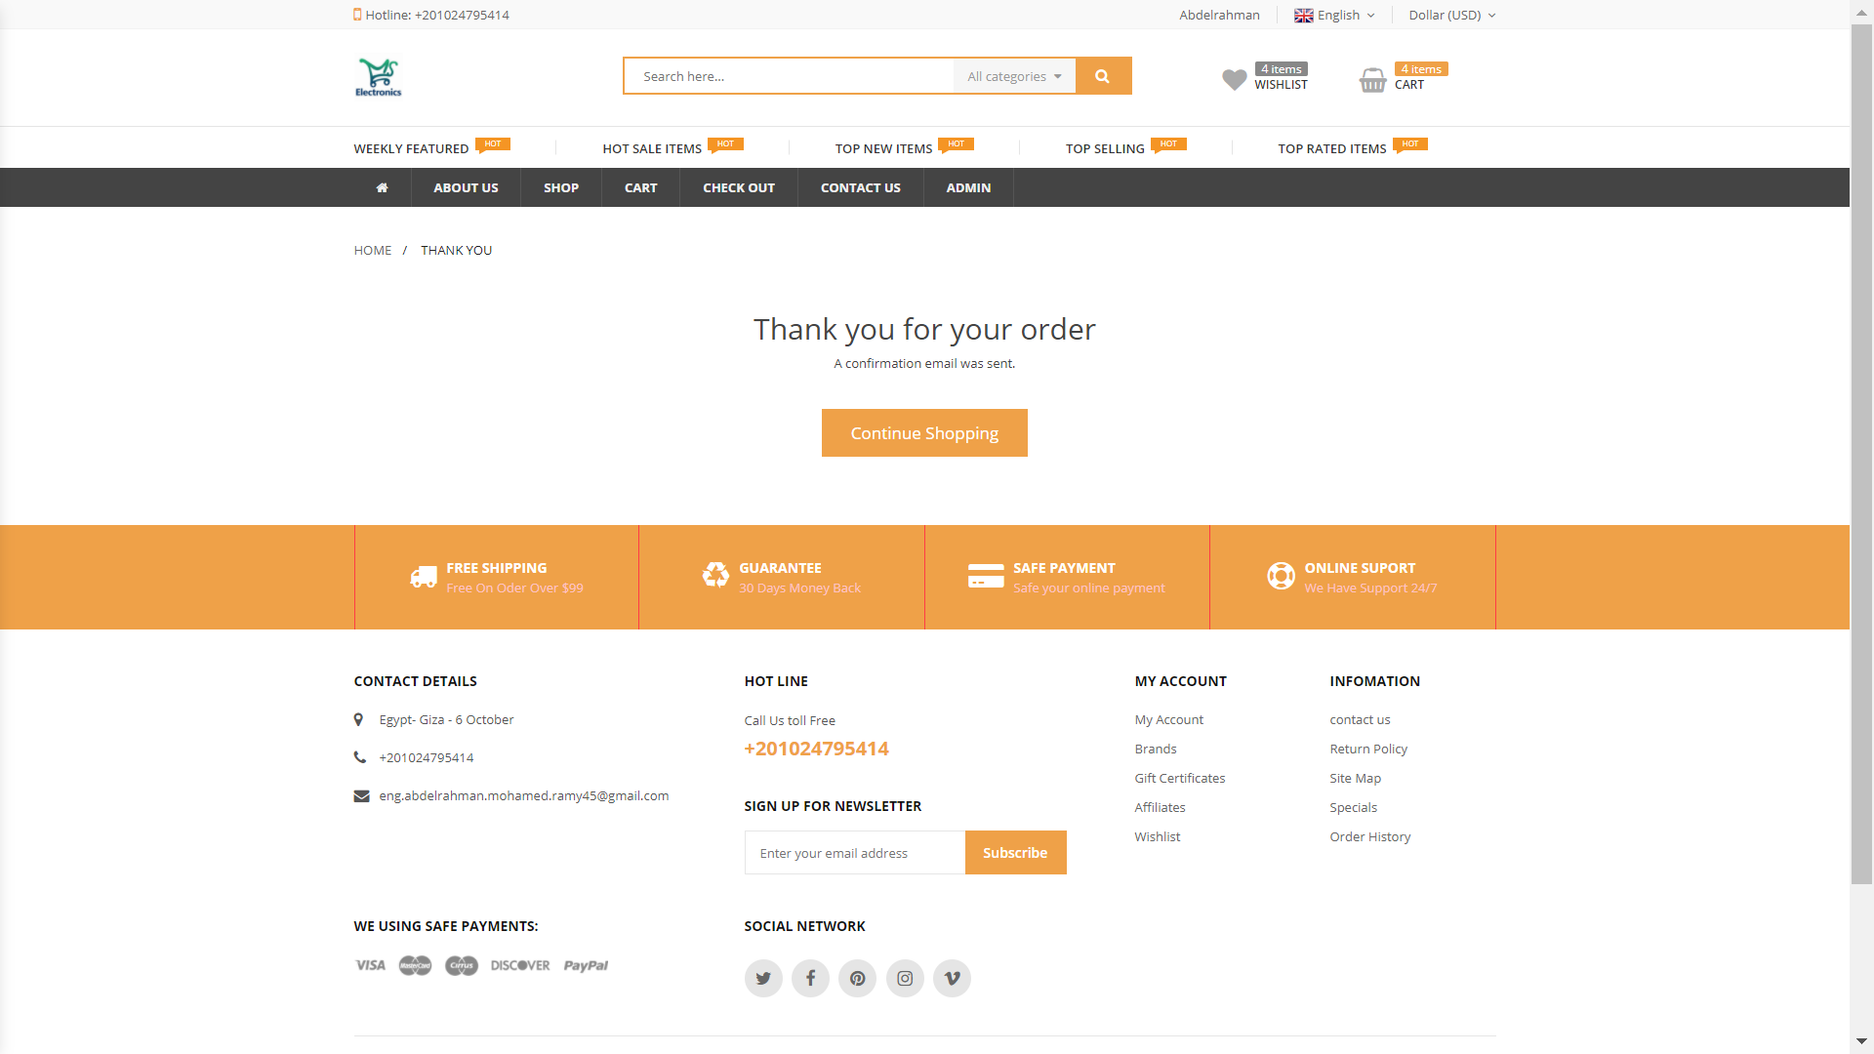
Many Thanks

