Slide 1



Plan my vacation ✈️
Write my code 💻
Clear my inbox 📥
Monitoring and Observability
Error handing, tracing
Scalability, Reliability
Security
Explainability
Governance
Guardrails (policy + safety)
Continuous Evaluation
Compliance and Audits
……
Agentic AI Applications 10% Magic, 90% Engineering
Deepak Agarwal & Niteen Badgujar

Slide 2
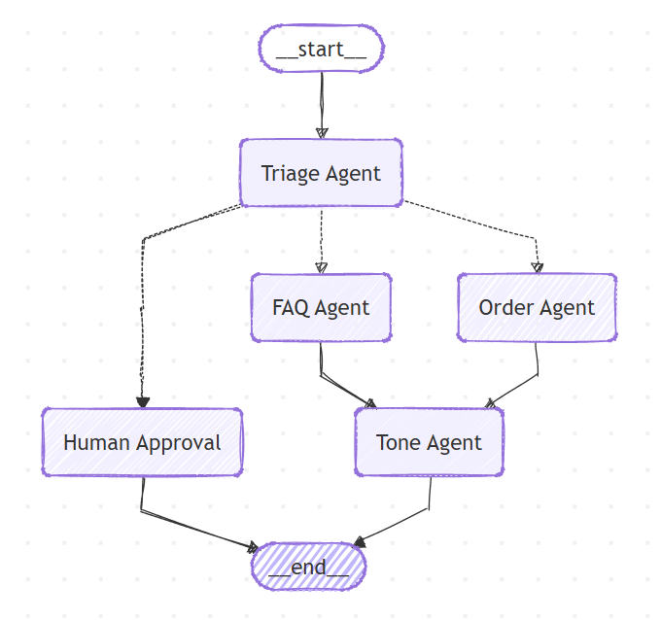
Customer Service Agentic App (“vibe-coded” app)

Slide 3
It has separation of concerns, routing, even human-in-the-loop.… But,
What happens if the backend API is down?
Where to check the logs? How can I co-relate?
Did FAQ or Order Agent handle it?
Was human approval triggered?
What prompt did the model see?
How much does this cost for me?
………
“When it works, nobody asks questions. When it fails, everyone asks different ones.”

Slide 4

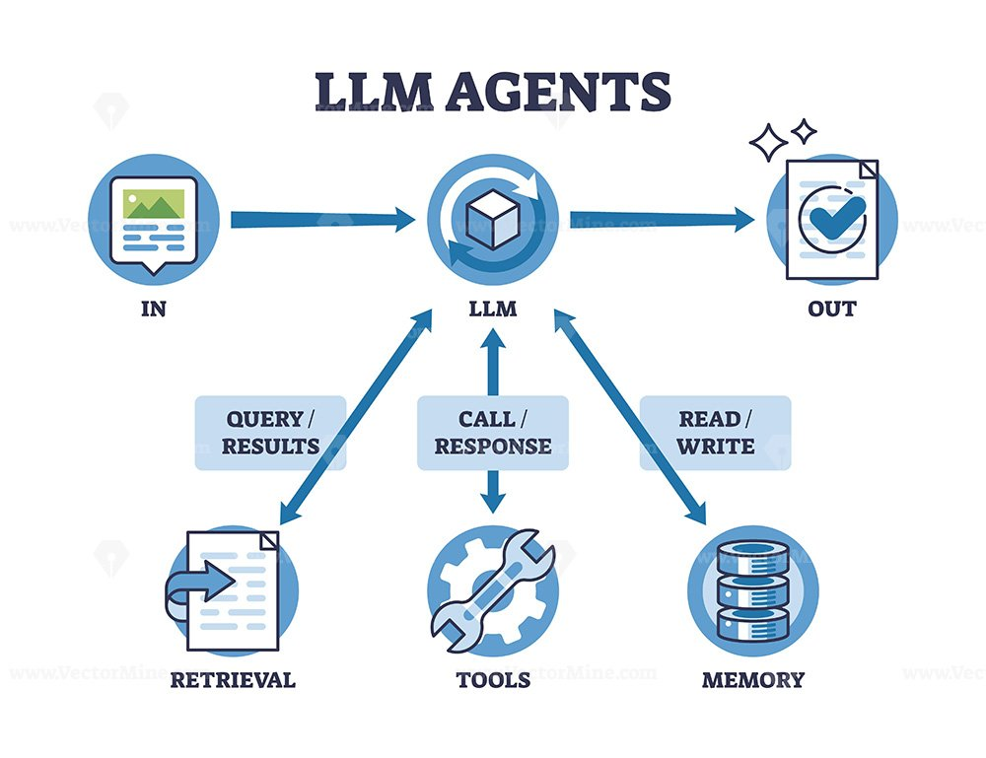

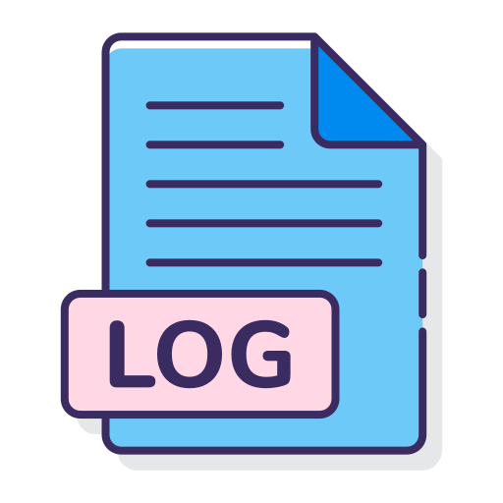

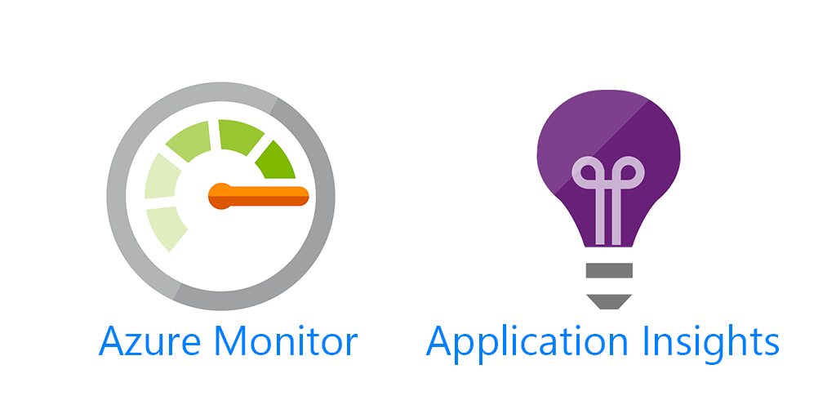



Production Pillar: Observability
Distributed Tracing
Logging
LLM & Agent Tracing
Metrics
Tools and Framework
Langsmith

Slide 5
We can see everything now — traces, logs, prompts, costs… But,
Why did the agent give this answer?
Which document or knowledge did it rely on?
Was this “really” based on company policy or hallucination?
Was the information even correct or up-to-date?
If this is wrong — who do, we blame? The model? The data? Us?
………
“Debugging faults is one skill. Debugging truth is another.”

Slide 6









Production Pillar: RAG (Production-grade)
Groundedness, Hallucination Mitigation
User Trust
Accuracy
Explainability
Evaluations (evals) and continuous improvement (online/offline)
Tools and Framework
Langsmith
Orchestration
Vector Databases
Evals

Slide 7
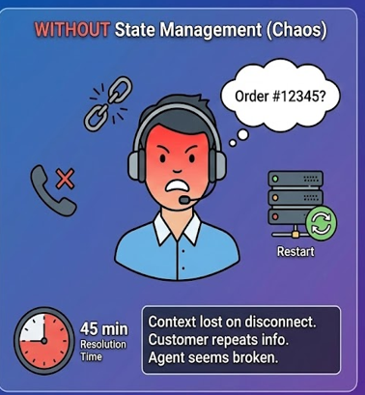
The answers are now grounded in our knowledge… But,
What if the answer is grounded… but still risky?
Who takes responsibility for high-impact decisions?
What context from past interactions should influence this answer?
What happens if the user comes back tomorrow - do we remember?
Are we consistent across conversations, channels, and time?

Slide 8
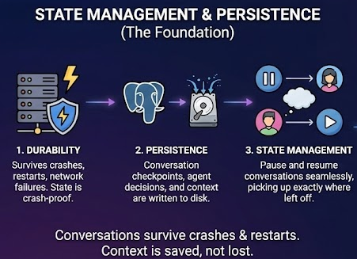
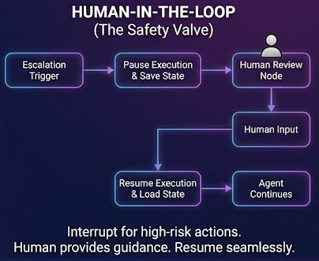
Production Pillar: Durability, Persistency, State & HITL

Slide 9
Production Pillar: Human-in-the-Loop & State Management
State-management
Short-term state (Session memory)
Conversation context
Agent outputs & intermediate decisions
Idempotency & retries
Tools and frameworks -> Redis
Long-term state (User / System memory)
User preferences & history
Past decisions & outcomes
Checkpoints
Business rules & learned constraints
Tools and frameworks ->
(PostgreSQL/Azure Cosmos DB)
Human-in-the-Loop (HITL)
Approval gates for high-risk actions
Policy & compliance checkpoints
Override and correction workflows
Human feedback as a learning signal

Slide 10
Decisions are now accountable and contextual with memory concerns sorted…. But,
What if the answer violates policy?
What if the response leaks PII from retrieved data or memory?
What if the user intentionally provokes toxic or unsafe behavior?
Are guardrails consistent across agents, tools, and channels?
Who enforces “never allowed,” even under pressure?
………
“Production systems fail at the edges - guardrails and policies protects the edges cases.”

Slide 11
Production Pillar: Guardrails & Policies
Safety by design (not by convention)
PII Detection & Redaction - Presidio.
Moderation – All user inputs checked for toxicity & prompt injection shields.
Regulatory compliance.
Consistent behavior across all channels.
Production systems fail at the edge - Guardrails protect the edge.
Tools & Frameworks
Cloud / Managed
Azure AI Content Safety + Prompt Shields
Azure OpenAI content filtering
OpenAI Moderation API
Open-source / Model-based
NVIDIA NeMo Guardrails
Guardrails AI
PII / Data Loss Prevention
Presidio (Analyzer + Anonymizer)
Google Cloud DLP
Policy Engines
Open Policy Agent (OPA)

Slide 12
Congrats - You Built an Agent. Now Build a System.
What we covered (the “production spine”)
Observability (OTel/Jaeger + LangSmith + logs + metrics)
RAG (grounded answers, explainability, eval loop)
HITL + State (accountability + short/long-term memory)
Policy & Guardrails (moderation, PII, toxicity, safety boundaries)
Wait! We still need to sleep well at night...

Slide 13
The “Sleep Well” Checklist
Reliability: timeouts, retries, idempotency, graceful degradation
Scalability & cost: rate limits, caching, queuing, budgets per tenant
Security: least-privilege tools, secret management, sandboxing, allowlists
Incident response: runbooks, kill switches, rollback, feature flags

Slide 14
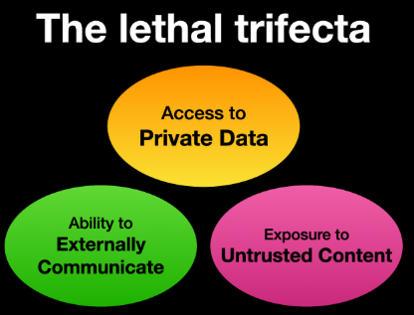
And finally, consider you’ve been warned…!
Source - https://simonwillison.net/2025/Jun/16/the-lethal-trifecta/
Thank you!
Deepak Agarwal & Niteen Badgujar

