Slide 1
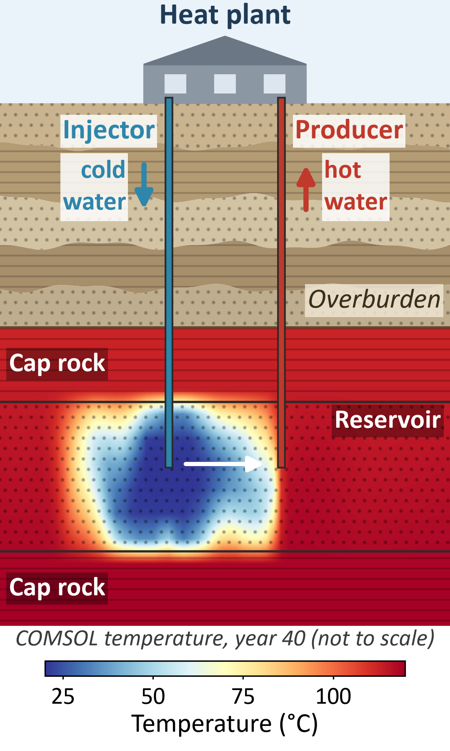
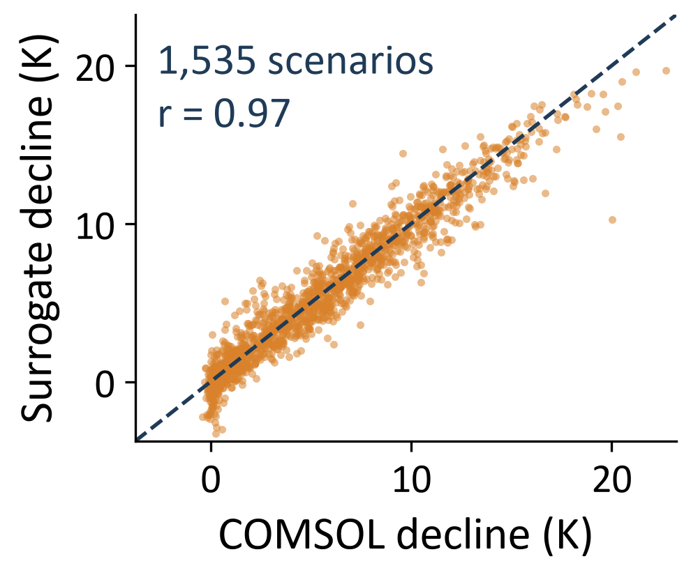
Neural operator surrogate for 3D geothermal doublet simulation
1
Geothermal doublet (COMSOL)
2
Dataset and surrogate
3
Accuracy on 232 test scenarios
4
Screening of 1,535 scenarios
Dataset | COMSOL
Scenarios | 1,535 (LHS design)
Split | 1,074 / 229 / 232
Inputs | 8 maps + 14 params
Outputs | 3D T, p; 3 well curves
Horizon | 40 years
Model A | MAE
Temperature field | 0.92 K
Pressure field | 0.019 MPa
Cooled cells (> 1 K) | 3.0 K
Production temp. | 0.95 K
40-year cooling | 1.26 K
Thermal power | 0.29 MW
Parameters → FiLM
40-year production-temperature decline
Rel. error | A | B
Temperature | 0.24% | 0.24%
Pressure | 0.08% | 0.19%
Wells | 4.90% | 4.74%
3D U-Net
Capacity, yr 40 | MWth
Cluster A / C / B | 24.8 / 22.6 / 20.0
All: surrogate | 22.3
All: COMSOL | 22.4
4D Fourier neural operator
Well-output head
Physics loss: no gain. COMSOL's own fields do not satisfy its residuals.
No scenario exceeds 10% decline (median 5.0 K).
Model A
data loss
Model B
+ mass, energy
✓
A compact neural operator trained on COMSOL data reproduces 3D fields, well outputs and ensemble statistics at ≈ 0.05 s per scenario, supporting preliminary geothermal screening; a physics loss should be validated against the simulator before use.

