Slide 1
502536-3
Human-Computer Interaction
Spring 2016
Raneem Yousif Alyami
rayami@tu.edu.sa

Slide 2
Resources
Previous courses, courses elsewhere, info on the web
HCI Digital Library
Books
Web sites
Standards documents
Go further
  Move beyond lectures & book
  Further courses
  Step into research

Slide 3
HCI
Here we go…

Slide 4
HCI What? HCI Why?
What happens when a human and a computer system interact to perform a task?
  task - write document, calculate budget, solve equation, learn about KSA, drive home, make a reservation, land a plane...
Why is this important?
Computer systems affect every person
Safety, satisfaction, utility is critical
Product success depends on ease of use

Slide 5
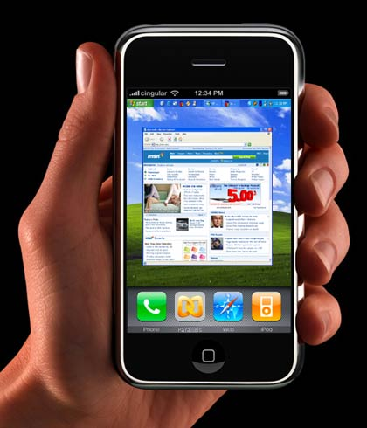


Interfaces in the Real World
Not just computers!
  VCR
  Wristwatch
  Phone
  Copier
  Car
  Plane cockpit
  Airline reservation
  Air traffic control
  Running shoes!

Slide 6
Goals of HCI
Allow users to carry out tasks
  Safely
  Effectively
  Efficiently
  Enjoyably

Slide 7
Usability
Crucial issue in this area!
Combination of
  Ease of learning
  High speed of user task performance
  Low user error rate
  Subjective user satisfaction
  User retention over time

Slide 8
HCI How?
How do we improve interfaces?
Educate software professionals
Draw upon fast accumulating body of knowledge regarding H-C interface design
Integrate UI design methods & techniques into standard software development methodologies now in place

Slide 9
UI Design/Develop Process
User-Centered Design
  Analyze user’s goals & tasks
  Create design alternatives
  Evaluate options
  Implement prototype
  Test
  Refine
IMPLEMENT
DESIGN
USE &
EVALUATE

Slide 10
Above All Else…
Know the User!
  Physical & cognitive abilities (& special needs)
  Personality & culture
  Knowledge & skills
  Motivation
Two Fatal Mistakes:
Assume all users are alike
Assume all users are like the designer

Slide 11
Design Evaluation
“Looks good to me” isn’t good enough!
Both subjective and objective metrics
Some things we can measure
  Time to learn
  Speed of performance
  Rate of errors by user
  Retention over time
  Subjective satisfaction

Slide 12
Course Overview
Human abilities
Evaluate an existing system
  (without involving users)
Design for success
Dialog & interaction styles
Evaluate your design (with users)
Special topics
  CSCW, InfoVis, Ubicomp, Agents, Audio

Slide 13
Overview of the
Design Process
User Centered Design

Slide 14
Good Design (reminder!)
“Every designer wants to build a high-quality interactive system that is admired by colleagues, celebrated by users, circulated widely, and imitated frequently.” (Shneiderman, 1992, p.7)
…and anything goes!…

Slide 15
But What Makes it Good?!
Functionality
Speed & efficiency
Reliability, security, data integrity
Standardization, consistency
USABILITY !

Slide 16
Closer to Fine: A Philosophy
…The human user of any system is the focus of the design process. Planning and implementation is done with the user in mind, and the system is made to fit the user, not the other way around….

Slide 17
“Good Design” Means
Systems are built for humans; must be designed for the user
Recognize individual differences; appreciate design implications of these human factors
Recognize the design of things, procedures, etc., influences human behavior and well-being
Emphasize empirical data & evaluation
Rely on the scientific method
Things, procedures, environments, and people do not exist in isolation

Slide 18
Good Design Is Not…
NOT just applying checklists and guidelines
  These can help, but USD is a whole philosophy
NOT using oneself as the model user
  Know your real users; recognize variation in humans
NOT just common sense
  Knowing how to design a fire alarm so it will be heard over background noise is not something we all know.
  The specialist knows where or how to get the information needed to answer design questions

Slide 19
User Centered Design
A way to force yourself to identify and consider the relevant human factors in your design
Helps reduce the number of decisions made out of the blue, and helps focus design activities
Helps document and defend decisions that may be reviewed later

Slide 20
The Tao of UCD
DESIGN
IMPLEMENT
USE &
EVALUATE

Slide 21
UCD: 9 Step Overview
Define the Context
Describe the User
Task Analysis
Function Allocation
System Layout / Basic Design
Mockups & Prototypes
Usability Testing
Iterative Test & Redesign
Updates & Maintenance

Slide 22
Design Implications
At each stage, consider how the details of your discovery process affect your design
Fact | Implications
Users 16-80 yrs | Range of text sizes Range of grip strength
Some French speakers | Multilingual interface
Astronaut users | Extensive training available
Military context | Aesthetics less of an issue Ruggedness is critical

Slide 23
1. Define the Context
Context: the “type” of uses, applications
  Life critical systems, applications
  Industrial, commercial, military, scientific, consumer
  Office, home, entertainment
  Exploratory, creative, cooperative
Market
Customer (not the same as the User)
…Design Impacts?…

Slide 24
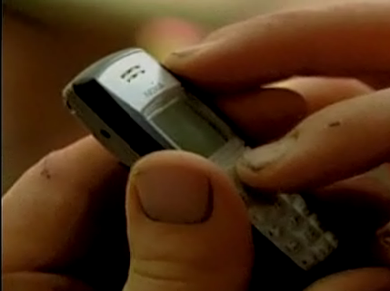
2. Describe the User (!!)
Physical attributes
(age, gender, size, reach, visual angles, etc…)
Perceptual abilities
(hearing, vision, heat sensitivity…)
Cognitive abilities
(memory span, reading level, musical training, math…)
Physical work places
(table height, sound levels, lighting, software version…)
Personality and social traits
(likes, dislikes, preferences, patience…)
Cultural and international diversity
(languages, dialog box flow, symbols…)
Special populations, (dis)abilities

Slide 25
3. Task Analysis
Talk to and observe users (NOT customers) doing what they do
List each and every TASK
Break tasks down into STEPS
ABSTRACT into standard tasks
(monitor, diagnose, predict, control, inspect, transmit, receive, decide, calculate, store, choose, operate, etc.)

Slide 26
4. Function Allocation
Consider the whole system!
Decide who or what is best suited to perform each task (or each step)
  e.g., system remembers login id, and reminds the user, but user remembers the password
Base this on knowledge of system hardware, software, human users’ abilities, culture, communications protocols, privacy, etc.
Allocation constraints: Effectiveness; Cognitive/affective; Cost; Mandatory
…Don’t forget the design implications!…

Slide 27
5. System Layout / Basic Design
Summary of the components and their basic design
Cross-check with any Requirements Documents; Human Factors refs; Hardware specs; Budgets; Laws (ADA); etc.
Ensure that the system will support the design and comply with constraints
(Verification and Validation, in the language of software engineering)

Slide 28
6. Mockups & Prototypes
“Informed Brainstorming”
RAPIDLY mock up the user interfaces for testing with real people
Pen and paper or whiteboard to start
Iterate, iterate, iterate!!
Increasingly functional & veridical
List audio & visual details at same levels of detail in the prototypes
  (i.e. don’t forget either of them)

Slide 29
7. Usability Testing
Get real (or representative) users to do what they do, using the prototypes
Subjective and objective feedback. Sometimes users “want” features that actually yield poor performance
Video tape, lots of notes
Be rigorous wherever possible (stats, etc.)
Feedback into the iterative evaluation & redesign of the system
“Discount” usability testing can be very effective, using fewer subjects, more rapid results

Slide 30
8. Iterative Test & Redesign
Repeat cycles of testing and reworking the system, subject to cost/time constraints
Focus on Functionality First !
Plan for several versions during development

Slide 31
9. Updates & Maintenance
In-the-field feedback, telemetry, user data, logs, surveys, etc.
Analyze and make iterative redesign/test recommendations
Updates and maintenance plan as part of the design!
  (design it so it can be fixed or updated)

Slide 32
UCD: Focusing Your Efforts
There are real-world constraints
Cutting out steps is not the way to economize!
Optimize the efficiency of each step
Here: Focus on the context and the user, to get the most value for the time spent

Slide 33
Concepts, Principles, Guidelines
Remember…
  No “cookbooks” (sorry!)
  No simple, universal checklists
  Think from perspective of user
  There are many concepts, principles, and guidelines to help you
  Focus on higher level principles that apply across situations, display types, etc.
  …and (almost) anything goes…

