Slide 1
Usability Principles
Concepts, Principles, Guidelines

Slide 2
Agenda
Usability Principles
  Why?
  Systems of categorization
  Levels of detail
  Example system of Principles

Slide 3
Why Principles & Guidelines?
…Because, well, not everything goes…
Intended to prevent many bad designs, before they begin, or evaluate existing designs on a scientific basis
Guidelines based on previous designs, experimental findings
Rules can all be “broken” (but usually in order to satisfy another principle)

Slide 4
Concepts, Principles, Guidelines
No “cookbooks”
No simple, universal checklists
There are many concepts, principles, and guidelines
Understand the higher level principles that apply across situations, display types, etc.
Implement the standards and guidelines
…a few details…

Slide 5
Levels of Consideration
Meta-display level
  Apply to the whole system, across media & across displays
  Focus on this in Basic Layout Stage
Display Layout
  Apply to groups of elements in a display
  Focus on this in Prototyping and Redesign
Element level
  Details about specific parts of a display
  Colors, sound attributes, symbols

Slide 6
UI Design Principles (Dix et al.)
Categories
  Learnability
    support for learning for users of all levels
  Flexibility
    support for multiple ways of doing tasks
  Robustness
    support for recovery
Think about these in terms of meta-display, display, and element levels

Slide 7
1. Learnability Principles
Ease with which new users can begin effective interaction and achieve maximal performance
  Predictability
  Synthesizability
  Familiarity
  Generalizability
  Consistency

Slide 8
Predictability
What will this action do?….
Operation visibility - can see avail actions
  grayed menu items
  menus vs. command shell

Slide 9
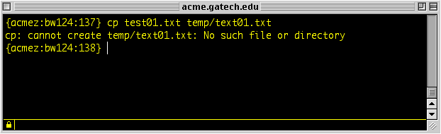
Synthesizability
Support for user in assessing the effect of past operations on current system state
  Moving a file in UNIX shell vs. GUI
  Is same feedback needed for all users, all apps?
Can the user figure out
what caused this error?

Slide 10
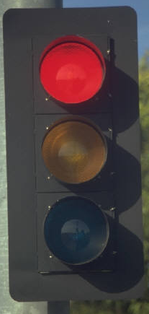
Familiarity
Does UI task leverage existing real-world or domain knowledge?
  Really relevant to first impressions
  Use of metaphors
    Potential pitfalls (see next page)
  Are there limitations on familiarity?
    (e.g. parking lot colors and traffic light)

Slide 11
Generalizability
Can knowledge of one system/UI be extended to other similar ones?
  Example: cut & paste in different applications
  Does knowledge of one aspect of a UI apply to rest of the UI?
    e.g. file browser in OS, file locater in MS-Word
  Aid: UI Developers guidelines

Slide 12
Consistency
Likeness in behavior between similar tasks/operations/situations
  In different things
    interacting
    output
    screen layout
Is this always desirable for all systems, all users?

Slide 13
2. Flexibility Principles
Multiplicity of ways that users and system exchange information
  Dialog Initiative
  Multithreading
  Task migratability
  Substitutivity
  Customizability

Slide 14
Dialog Initiative
Not hampering the user by placing constraints on how dialog is done
  User pre-emptive
    User initiates actions
    More flexible, generally more desirable
  System pre-emptive
    System does all prompts, user responds
    Sometimes necessary

Slide 15
Multithreading
Allowing user to perform more than one task at a time
Two types
  Concurrent
    Input to multiple tasks simultaneously
  Interleaved
    Many tasks, but input to one at a time

Slide 16
Task migratability
Ability to move performance of task to entity (user or system) who can do it better
  Auto-pilot/FMC in planes
  Spell-checking
  Safety controls in plant
For what kinds of tasks should
the user be in control?

Slide 17
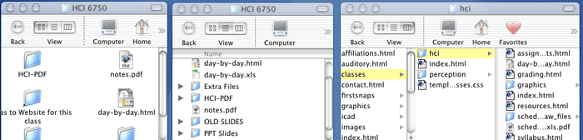
Substitutivity
Flexibility in details of operations
  Allow user to choose interaction methods
  Allow different ways to
    perform actions
    specify data
    configure
  Allow different ways of presenting output
    to suit task, user

Slide 18
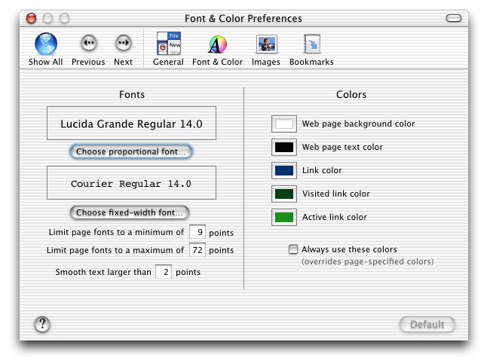
Customizability
Ability of user to modify interface
  By user - adaptability
    Is this a good thing?
  By system - adaptivity
    Is this a good thing?

Slide 19
3. Robustness Principles
Supporting user in determining successful achievement and assessment of goals
  Observability
  Recoverability
  Responsiveness
  Task Conformance

Slide 20
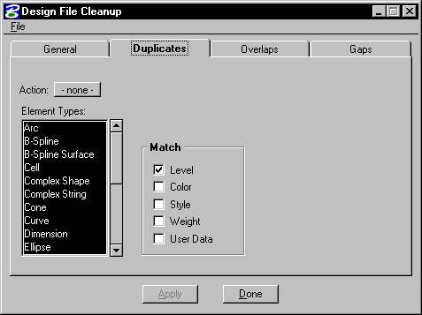
Observability
Can user determine internal state of system from what she perceives?
  Browsability
    Explore current state
    (without changing it)
  Reachability
    Navigate through
    observable states
  Persistence
    How long does observable state persist?

Slide 21
Recoverability
Ability to take corrective action upon recognizing error
  “UNDO”
  Difficulty of recovery procedure should relate to difficulty of original task
  Forward recovery
    Ability to fix when we can’t undo
  Backward recovery
    Undo previous error(s)

Slide 22
Responsiveness
Users perception of rate of communication with system
  Response time
    Time for system to respond in some way to user action(s)
  Users perceptions not always right
  Consistency important
  Response OK if matches user expectations

Slide 23
Task Conformance
Does system support all tasks user wishes to perform in expected ways?
  Task completeness
    Can system do all tasks of interest?
  Task adequacy
    Can user understand how to do tasks?
  Does it allow user to define new tasks?

Slide 24
Application of Principles
In doing design and implementation of your project, revisit this list
Assess your design against these usability principles
REMEMBER: There are other principles!

Slide 25
Upcoming
Human Capabilities
  Physical
  Cognitive

Slide 26
Some Practical Principles
The following pages contain a number of different, practical guidelines at each of the three levels (meta, display, and element levels)
Some are the same or similar to ones we have discussed in class
Some are more specific
They have proven useful to me, but, of course, your mileage may vary

Slide 27
Meta-display Principles, I
Navigation model
  Decide on one navigation metaphor (e.g., menu structure vs. home page), and use it consistently.
Consistent navigation cues
  Families of logos, color schemes, and sounds used to indicate displays are related. Be subtle, consistent, and don’t forget aesthetics!
Fail-safe design principle
  Allow user to go back to previous items, steps, screens, etc. Allow user to undo as many actions as possible. Provide a true “Quit” or “Cancel” option.

Slide 28
Meta-display Principles, II
Open-ended vs. Task completion model
  Distinguish between browsing (open-ended) interaction, and task completion behavior.
Concert vs. Conversation model
  A continuum of interaction types from passive recipient of the information (“concert”) to ask-and-respond dialog between the user and the system (“conversation”).
Computer vs. Appliance model
  May need to avoid “computerese” and jargon.

Slide 29
Meta-display Principles, III
Logo/icon principle
  Top level has a logo (or melody). Lower levels have icon version of logo (or “theme” of melody).
Family of logos principle
  Related applications have icons (and earcons) that form a “family;” in fact, a simple symbolic language to help users navigate.
Process preview and progress indicators
  Provide a preview or summary of what is to come, and provide an indication of how far along the user is at all times.

Slide 30
Display Level Principles, I
Compatibility (cognitive and physical)
  Left is left, up is up. Align display dimensions (in all modalities!) with real-world data dimensions.
Familiarity principle
  Provide users with interface items that relate to their real world.
Appropriate medium/modality
  Choose the best medium to display a given type of information (like function allocation).
Population stereotypes and mappings
  Where possible, build on the expectancies of your user population (red = stop; high pitch = hot).

Slide 31
Display Level Principles, II
Process flow = display flow
  (Western) readers work left-to-right, top-to-bottom. If there is a most frequent order of actions, design display to correspond (left or up = “back;” right or down = “continue”).
Conceptual size = hierarchical position
  Items, objects, groups that are larger (even conceptually) or hierarchy are displayed before smaller items (take note of process flow).
Group like items
  Items similar in content or function should be grouped together n space or time. They should share spatial, physical, or temporal attributes.

Slide 32
Display Level Principles, III
Continuous vs. Discrete data
  Does data “flow” or is it displayed in “chunks”?
Object + action vs. Action + object (action grammar)
  Is an object selected, then an action indicated, or vice versa?
Most important info in “center”
  Center the important info in the display space (both visual and auditory). Controls in the periphery.
Avoid modes
  Each display should have one meaning only, and certainly only one meaning with a screen’s context.

Slide 33
Element Level Guidelines, I
A few “controls” guidelines…
Label-Action match
  Controls say what they do, and do what they say. Consistent both within and across applications. Note: “OK” is not okay!
Button location / icon /action compatibility
  (1) Control icon is compatible with action
  (2) Control location is compatible with the action (and with the icon)
Consistent menus
  Menus should be consistent within and across applications. Most frequently used options located to the top and left.

Slide 34
Element Level Guidelines, II
Several auditory guidelines…
Duration: 100 ms minimum
Loudness: 10-15 dB over ambient; max 90 dB
Onset (“attack”) rate: 1-5 dB per second; 20 ms minimum
Frequency: 300 - 3000 Hz. Varies with age.
Levels of data in a dimension:
  Intensity (pure tones) 4-5
  Frequency 4-7
  Duration 2-3

Slide 35
Element Level Guidelines, III
More auditory guidelines…
Appropriate spectrum
  Complex spectral features for warning or detection; transients for localization; simple spectrum for discrimination
Avoid similar frequencies
  (Leads to “beating”, poor discrimination)
Use population expectancies for mappings
  Louder, brighter, faster, higher pitch = “more” or “up”
  Rising pitch = “moving up” or “getting full”
  Major key, bright spectrum = “happy” or “good”
  Note: Make sure you know which population stereotypes apply
  (e.g., sighted vs. blind listeners)

