Slide 1
Human Abilities 1
Understanding the user

Slide 2
Human Capabilities
Why do we care? (better design!)
Want to improve user performance
Knowing the user informs the design
  Senses
  Information processing systems
  Physical responding
Time and effort expended
to complete tasks

Slide 3
Overview
I. Senses
A. Vision
B. Hearing
C. Touch
D. Smell?
II. Information processing
A. Perceptual
B. Cognitive
1. Memory
a. Short term
b. Medium term
c. Long term
2. Processes
a. Selective attention
b. Learning
c. Problem solving
d. Language
C. Motor system
III. Motor system

Slide 4

I. Senses
Sight, hearing, touch important for current HCI
  smell, taste ???
Abilities and limitations
affect design

Slide 5
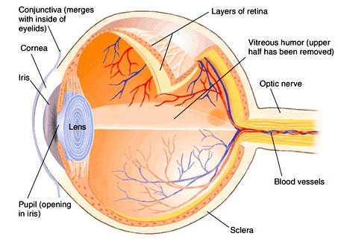
Vision
Visual System
  Eye
  Retina
  Neural pathway
    ~ 80% of brain’s operation

Slide 6
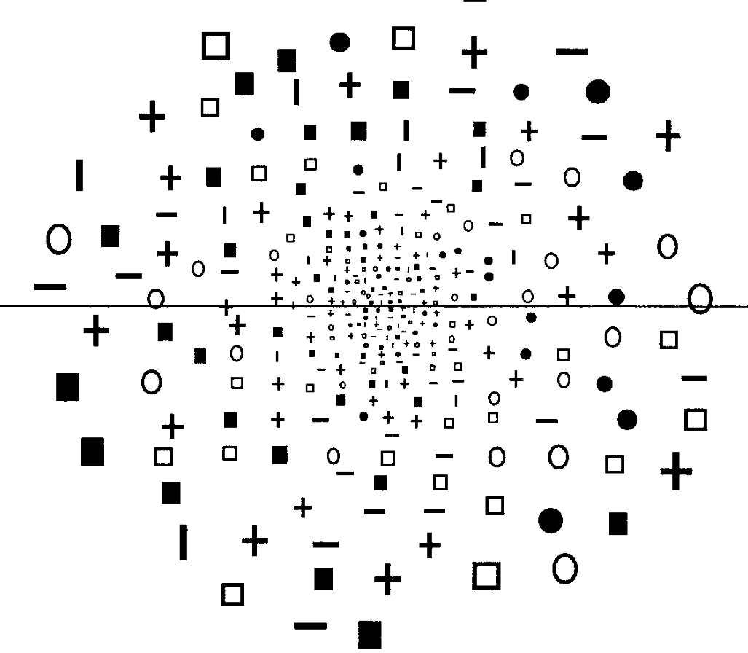
Visual Abilities
Sensitivity
  luminance: 10⁻⁶~10⁷ mL (see notes)
Acuity
  detection, alignment, recognition (visual angle)
  retinal position: fovea has best acuity
Movement
  tracking, reading, vibrations
Note: Vision decreases with age
Implications (??)
  Font size & location depends on task
  Much done by context & grouping
Notes:
Useful Luminance range for vision: 10⁻⁶ ~ 10⁷ milliLamberts
Note:
Absolute threshold 10⁻⁶
comfortable reading: 1~100 mL)
colorless vision 10⁻⁶ ~ 10⁻¹ mL
color vision 1 ~ 10⁷mL
Acuity is better in fovea (center) poorer in periphery

Slide 7
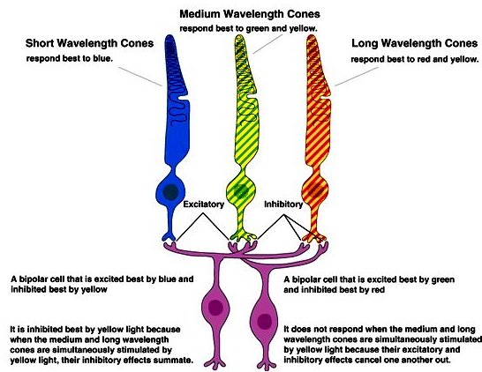
Color Vision
Color & the retina
  380 (blue) ~ 770nm (red)
  Problems with cones or ganglion cells causes problems with color perception
  (not really “color blindness”)
  8% males, 0.5% females
Implications (??)
  avoid saturated colors
  color coding should be redundant when possible

Slide 8
Perception Matters in Usability
Read-flow principle:
  Action items (buttons, links) should support the flow of the user in the same way as reading occurs.
  The last action should be the most-likely action to avoid backtracking.
  Left=back, stop, quit, cancel, previous
  Right=next, continue, submit
<< Previous Slide
Next Slide >>

Slide 9
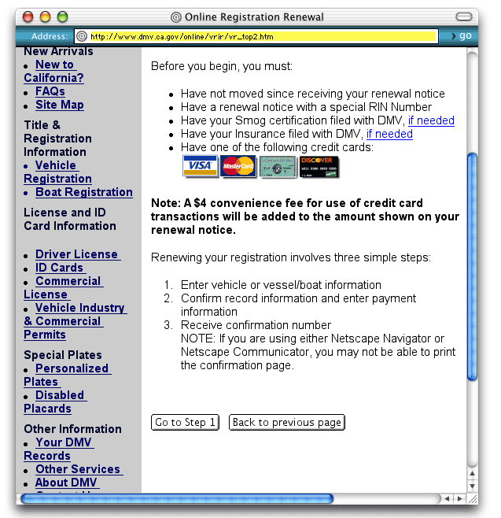
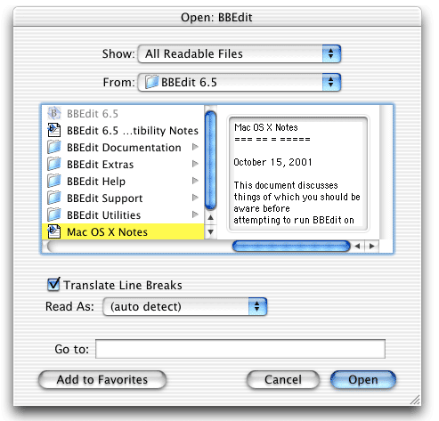
Read flow…
FLOWS
DOES NOT FLOW

Slide 10
Hearing
Capabilities (best-case scenario)
  pitch - frequency (20 - 20,000 Hz)
  loudness - amplitude (30 - 100dB)
  location (5° source & stream separation)
  timbre - type of sound (lots of instruments)
Implications (??)

Slide 11
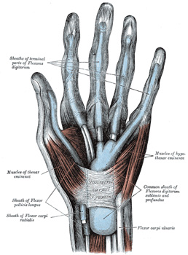
Touch
Three main sensations handled
by different types of receptors:
  Pressure (normal)
  Intense pressure (heat/pain)
  Temperature (hot/cold)
Sensitivity, Dexterity,
Flexibility, Speed
Where important?
  Mouse, Other I/O, VR, surgery

Slide 12
Overview
I. Senses
A. Vision
B. Hearing
C. Touch
D. Smell?
II. Information processing
A. Perceptual
B. Cognitive
1. Memory
a. Short term
b. Medium term
c. Long term
2. Processes
a. Selective attention
b. Learning
c. Problem solving
d. Language
C. Motor system
III. Motor system

Slide 13
III. Motor System
Capabilities
  Range of movement, reach, speed,
  strength, dexterity, accuracy
Often cause of errors
  Wrong button
  Double-click vs. single click
Principles
  Feedback is important
  Minimize eye movement

Slide 14
Human Abilities 2
How do people think?

Slide 15
Agenda
Memory
Cognitive Processes
  Implications
Recap

Slide 16
Overview
I. Senses
A. Vision
B. Hearing
C. Touch
D. Smell?
II. Information processing
A. Perceptual
B. Cognitive
1. Memory
a. Short term
b. Medium term
c. Long term
2. Processes
a. Selective attention
b. Learning
c. Problem solving
d. Language
C. Motor system
III. Motor system

Slide 17
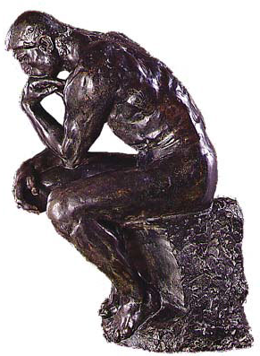
II. Information Processing
Three major systems of
human information processing:
  Perceptual (read-scan)-->memory
  Cognitive (think)
  Motor system (respond)
Perception
Info. Proc.
Respond

Slide 18
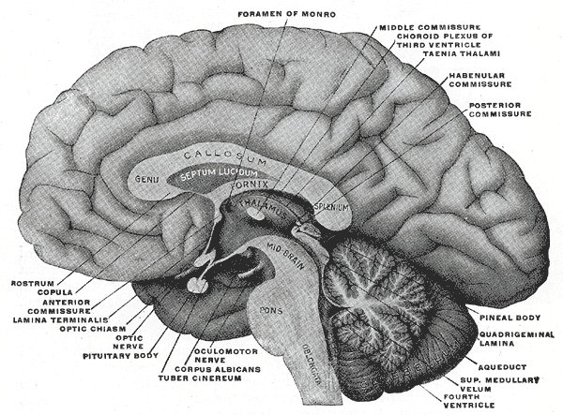
Memory
Four “types”
  Perceptual “buffers” (e.g., chess)
  Short-term memory Conscious
  thought, calculations
  Intermediate Storing intermediate
  results, future plans
  Long-term Permanent, remember everything that ever happened to us

Slide 19
Perceptual Store
Visual and auditory impressions
  visuospatial sketchpad, phonological loop
Very brief, but veridical representation of what was perceived
  Details decay quickly (~.5 sec)
  Rehearsal prevents decay
  Another task prevents rehearsal
Notes:
Veridical - The correct perception of an object, that is, in agreement with the object's real properties.
Next: perceptual store demonstration – have students take out a piece of paper

Slide 20
Notes:
Stare at this for 3 seconds, then answer the following questions:
How many yellow circles? (4)
How many blue rectangles? (6)
How many red squares? (7)

Slide 21
Short-term memory
Use “chunks”: 4-5 units (not 7±2 !)
Display format should match memory subsystem used to perform task
New info can interfere with old info

Slide 22
Memorize these phone numbers
404-894-2000
404-385-7510
Notes:
Chances are the second one will destroy the first… unless you know the GT exchanges and can “chunk”

Slide 23
Long-term Memory
Seemingly permanent & unlimited
  Access is harder, slower (Activity helps)
Episodic memory
  Events & experiences in serial form
    Helps us recall what occurred
Semantic memory
  Structured record of facts, concepts & skills
    One theory says it’s like a network
    Another uses frames & scripts
Notes:
What is your earliest memory?

Slide 24
Memory Characteristics
Things move from STM to LTM by rehearsal & practice and by use in context
We “forget” things due to decay and interference
Unclear if we ever
really forget something
Lack of use
Similar gets in
way of old
Exercises
Notes:
Similarity – learning a new language can interfere with an old language that you haven’t used in awhile.

Slide 25
Cognitive Processing
Cognitive models
  Plenty of them
  How well do they work?
Four main processes of cognitive system:
  Selective Attention
  Learning
  Problem Solving
  Language

Slide 26
Selective Attention
We can focus on one particular thing
Salient visual/auditory cues facilitate s.a.
  Examples?
    Boldface, blinking and beeping
Visual or Auditory Streams form after a few seconds
Notes:
How can we focus on one conversation among a room full of speakers? How can we attend to another conversation while participating in a different one?

Slide 27
Learning
Procedural Learning
  How to do something
Declarative Learning
  Facts about something
Involves
  Memorization
  Understanding concepts & rules
  Acquiring motor skills
  Automatization
Notes:
Procedural – how to make a PBJ sandwich
Declarative – name the 50 state capitals
Automatization – making automatic – assimilating a task or skill

Slide 28
Learning
Facilitated
  By analogy
  By structure & organization
  If presented in incremental units
  Repetition
Use user’s previous knowledge in interface
Notes:
Analogy – “hot is to cold as fire is to ice”
Metaphors capitalize on users’ previous knowledge

Slide 29
Observations
Users focus on getting job done, not learning to effectively use system
Users apply analogy even when it doesn’t apply
Notes:
Users will often labor with a difficult method rather than spending the time to research a more efficient one
Unintended metaphor – throw disk into trash to eject doesn’t erase the disk (early Mac)

Slide 30
Problem Solving
Storage in LTM, then application of knowledge
Reasoning
  Deductive - If A, then B
  Inductive - Generalizing from previous cases to learn about new ones
  Abductive - Reasoning from a fact back to the action or state that caused it
Notes:
Deductive – “if the sun is up, it must be daytime”
Inductive – “when the sun rises, it gets warmer, therefore tomorrow the day will warm up after sunrise”
Abductive – “the sidewalk is wet, it must have rained”

Slide 31
Observations
People are more heuristic than algorithmic
  They try a few quick shots rather than plan
    Resources simply not available
People often choose suboptimal strategies for low priority problems
People learn better strategies with practice

Slide 32
Implications
Allow flexible shortcuts
  Forcing plans will bore user
Have active rather than passive help

Slide 33
Language
Rule-based
  How do you make plurals?
Productive
  We make up sentences
Key-word and positional
  Patterns
Should systems have natural language interfaces?
Notes:
House, houses; mouse, mouses?
Moose -> moose

Slide 34
People
Good
  Infinite capacity LTM
  LTM duration & complexity
  High-learning capability
  Powerful attention mechanism
  Powerful pattern recognition
Bad
  Limited capacity STM
  Limited duration STM
  Unreliable access to LTM
  Error-prone processing
  Slow processing
Computer is opposite!
Allow one who does it
best to do it!
(Function allocation)

Slide 35
Computer Capabilities
Important for HCI too
  Participate in informed brainstorming
Intentional omission (time & scope)
  (Take a CS course ☺)

Slide 36
Recap
I. Senses
A. Vision
B. Hearing
C. Touch
D. Smell?
II. Information processing
A. Perceptual
B. Cognitive
1. Memory
a. Short term
b. Medium term
c. Long term
2. Processes
a. Selective attention
b. Learning
c. Problem solving
d. Language
C. Motor system
III. Motor system

Slide 37
Upcoming
Task Analysis
Requirements Definition
Evaluation without users
  Predictive evaluation
    Heuristic evaluation…
  Interpretive evaluation
    Ethnography…
User modeling

