Slide 1
Requirements Definition
& Task Analysis
What are people trying to accomplish?

Slide 2
Agenda
Task Analysis
  Overview, utility
  Gathering information (input)
  Types of analysis
  Sources and use
  Making sense of it all (output)

Slide 3
Task Analysis
Learning about, analyzing and describing how people do their jobs/work
Examine users’ tasks to better understand what they need from interface and how they will use it
Notes:
Coal shoveling – study by Taylor and the Gilbreths determining what shovel size was optimal for shoveling rice coal vs iron ore… too large, skeletal system is too taxed; too small, and the shoveler has to make too many movements.

Slide 4
Input & Output
Gather data about what users need to do or accomplish
…then…
Represent data for interpretation and use in design decisions

Slide 5
Data to be Gathered
Information about users
Description of environment
  where the tasks will be performed
Major goals of the job
  what will result in a successful end state?
User preferences & needs
  before they even start: coffee, pen, notebook, log sheets…

Slide 6
Data to be Gathered, cont’d…
Tasks & Subtasks:
  Physical
  Cognitive
  Communication
Conditions under which these tasks are done
Results/outcomes of tasks
Requirements to perform task:
  Information
  Communication with others
  Equipment
Must include
Should include
Could include
Exclude

Slide 7
Data Gathering Techniques
Observation
Interviews & Contextual Inquiry
Ethnography
also…
Surveys & Questionnaires
Focus Groups & Expert Debriefing
Competitive Product Review
Documentation mining
Data logging

Slide 8
1. Observation
Watch users do what they do
  Typically from a distance
Record with videotape
  May require coding video later
Take lots of notes, sketches
Focus on specific task-relevant behaviors in notes, but later convert to abstract subtasks

Slide 9
Observation, cont’d
Pros?
Cons?

Slide 10
2. Interviews
Engage the user more than just watching
Structured interviews
  Efficient, but requires training
Unstructured
  Inefficient, but requires no training
Semi-structured
  Good balance
  Often appropriate

Slide 11
Semi-structured Interviews
Predetermine data of interest
Plan for effective question types
  How do you perform task x?
  Why do you perform task x?
  What information do you need to…?
  Who do you need to communicate with to…?
  What do you use to…?
  What happens after you…?
  What is the result or consequence of NOT…?

Slide 12
Interviews, cont’d
Pros?
Cons?

Slide 13
3. Ethnography
Deeply contextual inquiry
  “Wallow in the data”
“Live among” the users
Understanding the full complexity of behavior, in its complete social context
Note: Techniques based in sociology and anthropology--the study of humans

Slide 14
Ethnography, cont’d
Pros?
Cons?

Slide 15
Comment
Techniques 1-3 are similar, but differ in how “plugged in” or engaged the observer gets
There are Pros and Cons of all these techniques

Slide 16
Other Techniques
Often used in addition:
  Surveys & Questionnaires
  Focus Groups & Expert Debriefing
  Competitive Product Review
  Documentation mining
  Data logging

Slide 17
4. Surveys & Questionnaires
Subjective answers in a quantitative format
  What does this mean?
Questions:
  Exploratory vs. confirmatory
  Open-ended vs. categorical (exhaustive)

Slide 18
Questionnaires
Likert Scale is common (odd vs. even ?)

Slide 19
Other Typical Questions
Rank the importance of each of these tasks (give a list of tasks)
List the four most important tasks that you perform (this is an open question)
List the pieces of information you need to have before making a decision about X, in order of importance
Are there any other points you would like to make? (open-ended opinion question; good way to end)

Slide 20
5. Focus Groups
Structured Interview with groups of individuals
  3 to 10 persons
  Use several different groups with different roles or perspectives
  Manage the interaction
    Avoid few people dominating the discussion
Focus on preferences and views, not performance
Relatively low cost, quick way to learn a lot
Audio or video record, with permission

Slide 21
6. Competitive Products
Looking for both good and bad ideas
  Functionality
  UI style
Why are they successful or unsuccessful?
What does successful really mean?
  (Note: Successful does not equal usable)

Slide 22
7. Document Mining
Documentation
  Often contains description of how the tasks should be done
  Standards docs
  Manuals
  Histories
  Best Practices

Slide 23
8. Data Logging
Automatically tracking:
  Keystroke/mouse clicks
  Timers
  Logs of transactions
  Physical location/movement trackers
    Cell phones
    Aware Home

Slide 24
Now What?
You have piles of notes, hours of video, surveys up to here…
How can you digest and represent the data, to turn it into information?

Slide 25
Representing Data (=Output)
Task Outlines
Narratives
Hierarchies & Network Diagrams
  Hierarchical Task Analysis (HTA)
  Entity-Relationship Diagrams
Flow Charts

Slide 26
1. Task Outline
Using a lawnmower to cut grass
  Step 1. Examine lawn
    Make sure grass is dry
    Look for objects laying in the grass
  Step 2. Inspect lawnmower
    Check components for tightness
      Check that grass bag handle is securely fastened to the grass bag support
      Make sure grass bag connector is securely fastened to bag adaptor
      Make sure that deck cover is in place
      Check for any loose parts (such as oil caps)
      Check to make sure blade is attached securely
    Check engine oil level
      Remove oil fill cap and dipstick
      Wipe dipstick
      Replace dipstick completely in lawnmower
      Remove dipstick
      Check that oil is past the level line on dipstick
      …

Slide 27
2. Narratives
Describe tasks in sentences
Often expanded version of task outline
More effective for communicating general idea of task
Not effective for details
Not effective for branching tasks
Not effective for parallel tasks

Slide 28
3. Hierarchies & Networks
Hierarchical Task Analysis (HTA)
  Graphical notation & decomposition of tasks
  Tasks as sets of actions
  Tasks organized into plans (describes sequence)
Network / Entity-Relationship Diagrams
  Objects/people with links to related objects
  Links described functionally and in terms of strength

Slide 29
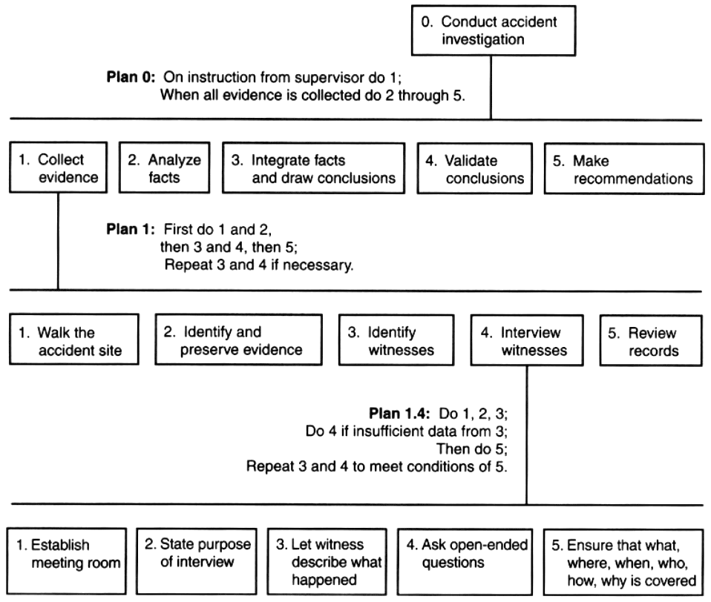
HTA

Slide 30
4. Flow Charts
Flow Chart of Task Steps
  Combines Entity-relationship (network) with sequential flow, branching, parallel tasks.
  Includes actions, decisions, logic, by all elements of the system
  Abstracted
  Mature, well-known, good tools

Slide 31
Flow Chart
Start
Continue?
Document
Manual
Operation
Y
N
Input
Display
End

Slide 32
Summary of Task Analysis
Determine the data you need
Gather it using various appropriate methods and techniques
Represent the tasks and subtasks, plus other related information
Use this data to improve design
Note: Be efficient!

Slide 33
Upcoming
Predictive Evaluation
Interpretive Evaluation
User Modeling
  Physical models
  Cognitive models

