Slide 1
Design of Everyday Things
Don Norman on Design & HCI
Notes:
Key ideas of Norman’s – after lecture re-read the chapters

Slide 2
Execution-Evaluation cycle
Norman (DOET, p. 46)
Gulf
of
Execution
User
Goals
Physical
System
Gulf
of
Evaluation
Notes:
دورة تنفيذ-تقييم
الخليج التنفيذ - كيفية ترجمة الأهداف إلى العمل
الخليج للتقييم - لم تحدث الأمور في نصابها الصحيح؟
Gulf of execution – how to translate the goals to the action
Gulf of evaluation – did the right things happen?

Slide 3
Goals, Execution, Evaluation
Goals
What we
want to happen
Execution
What we
do to the world
Evaluation
Comparing what happened
with what we wanted to happen
(Gulf of Execution)
(Gulf of Evaluation)
Physical System

Slide 4
Execution
Goals
What we
want to happen
An intention to act
so as to achieve the goal
The actual sequence of actions
that we plan to do
The physical execution of that
action sequence
Physical System
Notes:
Break these into further steps
Want to do menu selection – have to find the menu item, - then physically select it

Slide 5
Evaluation
Goals
What we
want to happen
Evaluation of the interpretations
with what we expected to happen
Interpreting the perception according
to our expectations
Perceiving the state
of the world
Physical System
Notes:
Visual system at lowest level
Did it move? Did the setting change? Is this what we wanted?

Slide 6
Seven Stages - All Together
Goals
What we
want to happen
An intention to act
so as to achieve the goal
Evaluation of the interpretations
with what we expected to happen
The actual sequence of actions
that we plan to do
Interpreting the perception according
to our expectations
The physical execution of that
action sequence
Perceiving the state
of the world
Physical System
Notes:
Design – it is useful to consider each of these steps and assess what we are doing to facilitate these steps.

Slide 7
Implications – Which Gulf does Each of These Address?
Make current state and action alternatives visible
Need good conceptual model with consistent system image
Interface should include mappings that reveal relationships between stages
User should receive continuous feedback
Provide affordances
Notes:
Conceptual model helps figure out what to do, and what has happened

Slide 8
Goal: Minimize Gulfs
Gulf of Execution
  Conceptual model
  Affordances
  Natural mappings
Gulf of Interpretation
  Make state visible
  Feedback

Slide 9
Why Design is Hard
Number of things to control has increased dramatically
Displays are more virtual/artificial
Marketplace pressure
  Adding operations cheaper (computers)
  Adding controls expensive (real estate, cost)
Errors are becoming increasingly serious
Notes:
Tremendous complexity, a lot of things to control, much functionality
Displays may be constrained, may not be able to represent things sufficiently
Market – wants things fast
Cost of making mistakes is high – ie, Nuclear power plant, email message sent prematurely

Slide 10
Try and Try Again
Norman thinks that it often takes 5 or 6 tries to get something “right”
Use the framework of gulf of interpretation and gulf of execution to inform your desigs.
Simply may not have that luxury in a competitive business environment
Notes:
Lots of iterations to get things right
Use the framework of gulf of interpretation and gulf of execution to inform your desigs.

Slide 11
Design

Slide 12
Idea Creation
Ideas come from
  Imagination
  Analogy
  Observation of current practice
  Observation of current systems
Borrow from other fields
  Animation
  Theatre
  Information displays
  Architecture
  ...

Slide 13
Idea Creation Methods
1. Consider new use for object
2. Adapt object to be like something else
3. Modify object for a new purpose
4. Magnify - add to object
5. Minimize - subtract from object

Slide 14
Idea Creation Methods
6. Substitute something similar
7. Rearrange aspects of object
8. Change the point of view
9. Combine data into an ensemble

Slide 15
Overall Guidelines for Design
1. Provide a good conceptual model
  User has mental model of how things work
  Build design that allows user to predict effects of actions
2. Make things visible
  Visible affordances, mappings, constraints
  Remind person of what can be done and how to do it

Slide 16
More Specific Design Principles
1. Use simple and natural dialog in user’s language
  Match user’s task in a natural way
  Avoid jargon, techno-speak
  Present exactly info that user needs

Slide 17
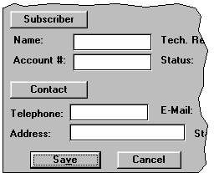
Design Principles
2. Strive for consistency
  Sequences, actions, commands, layout, terminology
  Makes more predictable
OK
Cancel
Help
Done
Cancel
Apply

Slide 18
Design Principles
3. Provide informative feedback
  Continuously inform user about what is occurring
  Most important on frequent, substantive actions
  How to deal with delays?

Slide 19
Design Principles
4. Minimize user’s memory load
  Recognition is better than recall
  Describe required input format, include example and default
    Date: _ _ - _ _ _ - _ _ (DD-Mmm-YY, e.g., 02-Aug-93)
  Use small # of generally applicable commands

Slide 20
Design Principles
5. Permit easy reversal of actions
  Undo!
  Reduces anxiety, encourages experimentation

Slide 21
Design Principles
6. Provide clearly marked exits
  Don’t want the user to feel trapped
  Examples
    Cancel button on dialogs
    Interrupt/resume on lengthy operations (modeless)
    Quit - can exit anytime
    Reset/defaults - restore on a property sheet

Slide 22
Design Principles
7. Provide shortcuts
  Enable frequent users to perform often-used operations quickly
    Keyboard & mouse
      Abbreviations
      Menu shortcuts
      Function keys
      Command completion
      Double click vs. menu selection
    Navigation between windows/forms
    Reuse
      Provide history system

Slide 23
Design Principles
8. Support internal locus of control
  Put user in charge, not computer
  Can be major source of anxiety
System prompt: Enter next command:
vs.
Ready for next command:

Slide 24
Design Principles
9. Handle errors smoothly and positively
That filename already exists, please type
a different one
vs
RENAME FAILED
10. Provide useful help and documentation

Slide 25
Graphic Design

Slide 26
Design Philosophies
Personal preferences:
  Economy of visual elements
  Less is more
  Clean, well organized
Imagery
Color
Sequencing
Layout
Typography
Organization

Slide 27
Graphic Design Principles
Metaphor
Clarity
Consistency
Alignment
Proximity
Contrast

Slide 28

Metaphor
Tying presentation and visual elements to some familiar relevant items
  e.g., Desktop metaphor
  e.g., Elevator metaphor

Slide 29
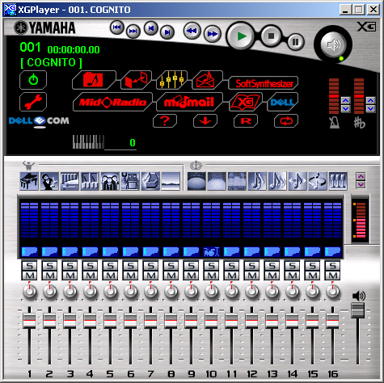
Clarity
Every element in an interface should have a reason for being there
  Make that reason
  clear too!

Slide 30
Clarity
White space
  Leads the eye
  Provides symmetry and balance through its use
  Strengthens impact of message
  Allows eye to rest between elements of activity
  Used to promote simplicity, elegance, class, refinement

Slide 31
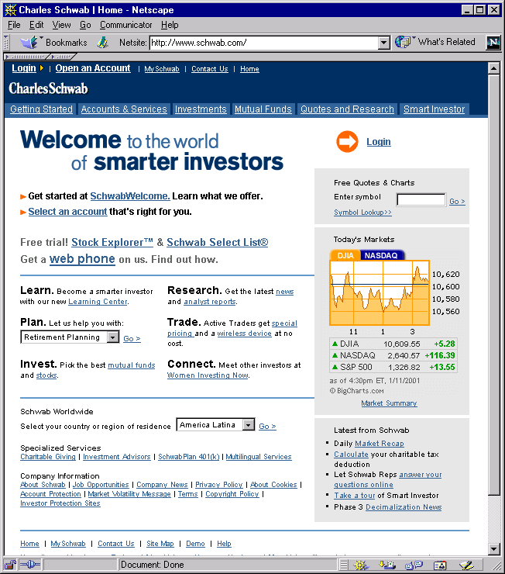
Example
Clear, clean
Appearance
(?)
www.schwab.com

Slide 32
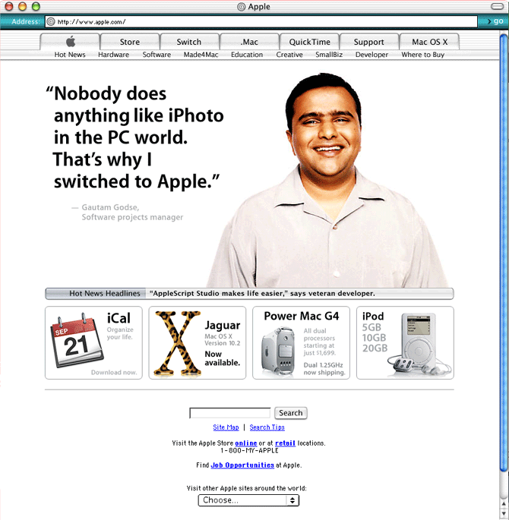
Example
Clear, clean
Appearance
(?)
www.apple.com

Slide 33
Consistency
In layout, color, images, icons, typography, text, …
Within screen, across screens
Stay within metaphor everywhere
Platform may have a style guide
  Follow it!

Slide 34
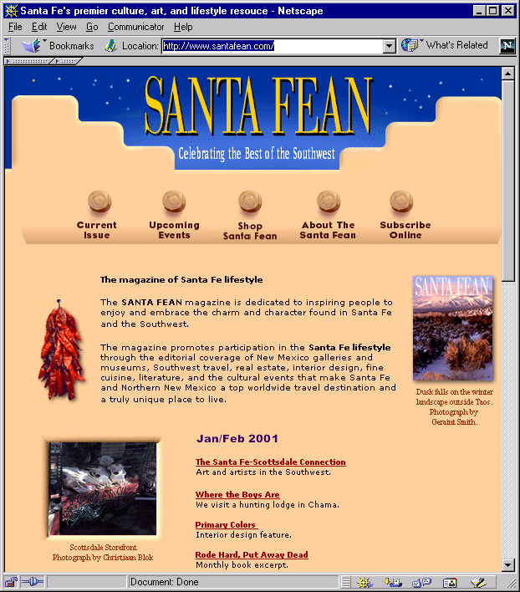
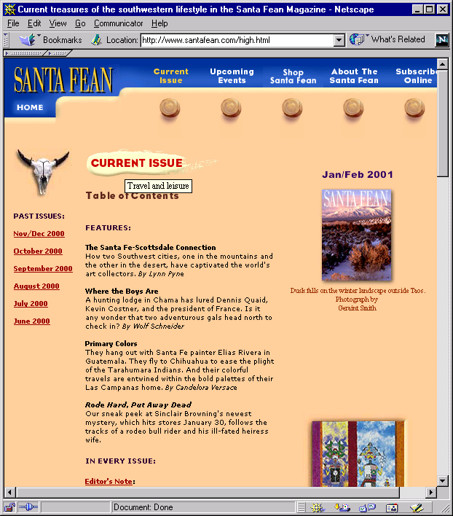
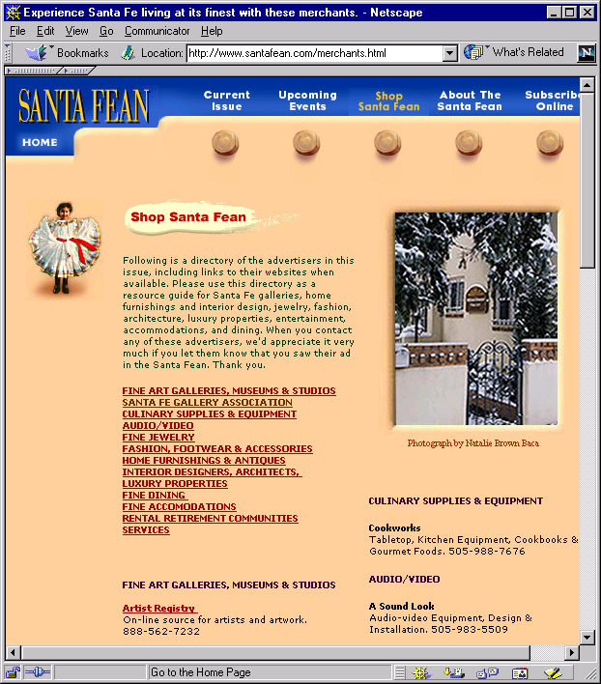
Example
Logo-icon principle
Home page
Content page 1
Content page 2
www.santafean.com

Slide 35
Alignment – “Common Fate”
Western world
  Start from top left
Allows eye to parse display more easily
“Read-flow” principle

Slide 36
Alignment
Grids
  (Hidden) horizontal and vertical lines to help locate window components
  Align related things
  Group items logically
  Minimize number of controls, reduce clutter
Notes:
انحياز
الشبكات
- (مخفي) الخطوط الأفقية والعمودية للمساعدة في تحديد مكونات نافذة
- محاذاة الأمور المتعلقة
- عناصر المجموعة منطقيا
- التقليل من عدد من الضوابط، والحد من فوضى

Slide 37
Alignment
Grids - use them

Slide 38
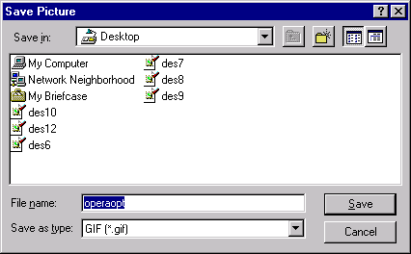
Grid Example

Slide 39
Alignment
Left, center, or right?
Choose one, use it everywhere
Novices often center everything
Here is
some
new text
Here is
some
new text
Here is
some
new text

Slide 40
Proximity
Items close together appear to have a relationship
Distance implies no relationship
Colon ties label and field together
Time
Time
Time:
Notes:
قرب
- عناصر قريبة من بعضها البعض تظهر لديهم علاقة
- المسافة يعني عدم وجود علاقة
- العلاقات القولون التسمية والميدان معا

Slide 41
Example
Name:
Name:
Name
Addr1:
Addr1:
Addr1
Addr2:
Addr2:
Addr2
City:
City:
City
State:
State
State:
Phone:
Phone
Phone:
Fax
Fax:
Fax:
Not
zesty
Enhance grouping
With boxes
Right-align
Field labels

Slide 42
Contrast
Pulls you in
Guides your eyes around the interface
Supports skimming
Take advantage of contrast to add focus or to energize an interface
Can be used to distinguish active control

Slide 43
Contrast
Can be used to set off most important item
  Allow it to dominate
Ask yourself what is the most important item in the interface, highlight it
Use geometry to help sequencing

Slide 44
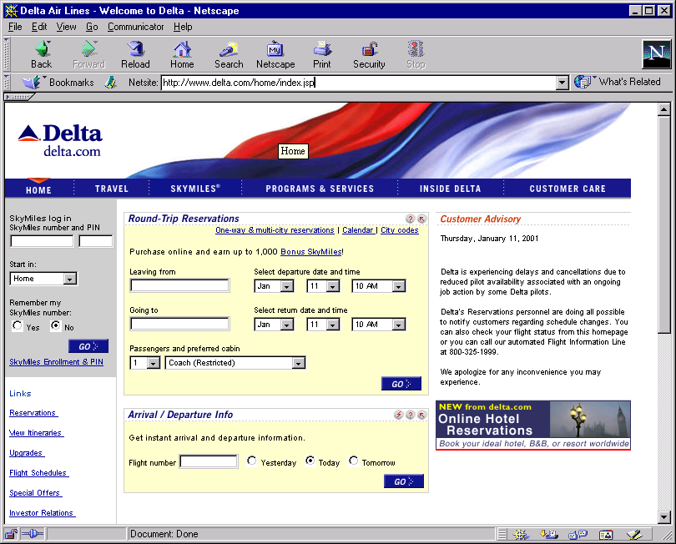
Example
Important
element
www.delta.com

Slide 45
UI Exercise
Look at interface and see where your eye is initially drawn (what dominates?)
Is that the most important thing in the interface?
Sometimes this can (mistakenly) even be white space!

Slide 46
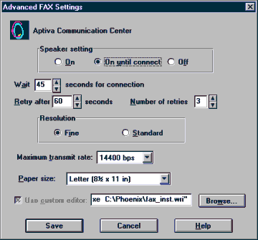
Example
Disorganized
Notes:
مشوش

Slide 47
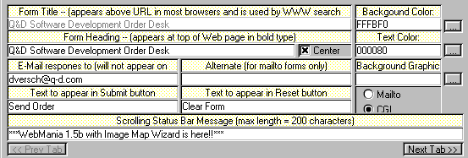
Example
Visual noise

Slide 48
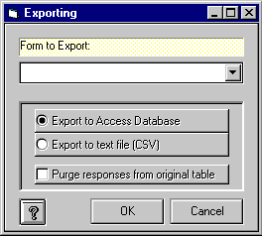
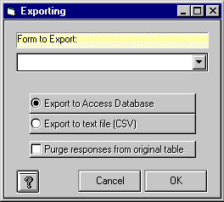
Example
1. Overuse of 3D effects
2. Wrong Button Order

Slide 49
Economy of Visual Elements
Less is more
Minimize borders and heavy outlining, section boundaries (use whitespace)
Reduce clutter
Minimize the number of controls

Slide 50
Typography
Characters and symbols should be easily noticeable and distinguishable
  Avoid heavy use of all upper case
  Mixed case promotes faster reading
HOW MUCH FUN IS IT
TO READ ALL THIS TEXT
WHEN IT’S ALL IN
CAPITALS AND YOU
NEVER GET A REST
How much fun is it
to read all this text
when it’s all in
capitals and you
never get a rest

Slide 51
Typography
Readability
  How easy it is to read a lot of text
Legibility
  How easy it is to recognize a short burst
Typeface = font
(not really, but close enough)

Slide 52
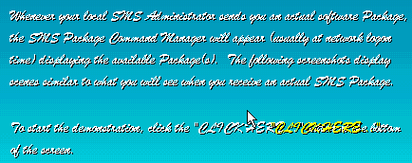
Wow
Yuck

Slide 53
Typography
Serif font - readability
Sans serif font - legibility
  (both are variable spaced)
Monospace font

Slide 54
Fonts
Serif
  Times, Bookman
Sans serif
  Tahoma, Arial
Onscreen fonts
  Georgia
  Geneva
  Verdana
Decorative
  Comic Sans
Script
  Script
Monospaced
  Courier, Lucida

Slide 55
Typography
Guidelines
  Use serif for long, extended text; sans serif for “headlines”
  Use 1-2 fonts/typefaces (3 max)
  Use 1-3 point sizes max
  Never use bold, italics, capitals for large sections of text
  Be careful of text to background color issues

Slide 56
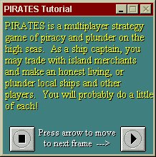

More Wow

Slide 57
Example
Which do you prefer?
CRAFTS AND GAMES
ARTS FESTIVAL
OF ATLANTA AND DECATUR
Crafts and Games:
Arts Festival
Of Atlanta and Decatur
SEPTEMBER 19-24
September 19-24
Come and Enjoy!
COME AND ENJOY
Applies lots of these principles

Slide 58
Color
We see the world via a reflective color model
  Light strikes a surface and is reflected to our eyes--Properties of surface dictate color
  Printers
Colors on display follow the emitted model

Slide 59
Color Attributes
Hue
  native color, pigment
Saturation
  relative purity, brightness, or intensity of a color
Value
  lightness or darkness of a color

Slide 60
Color
On monitors, typically RGB scheme
  0-255 value each red, green, blue
  R: 170 G:43 B: 211
Notes:
اللون
على الشاشات وعادة مخطط RGB
0-255 قيمة كل الأحمر والأخضر والأزرق
R: 170 G: 43 B: 211

Slide 61
Color Guidelines
Design in b/w then add color where appropriate
  Print your design out in b/w to test it
Use color to draw attention, communicate organization, to indicate status, to establish relationships
Avoid using color in non-task related ways
Notes:
إرشادات اللون
- تصميم في ب / ث ثم إضافة اللون عند الاقتضاء
طباعة التصميم الخاص بك في ب / ث لاختباره
- استخدام الألوان لجذب الانتباه، والتواصل المنظمة، للإشارة إلى الوضع، لإقامة علاقات
- تجنب استخدام اللون في طرق غير المهمة ذات الصلة

Slide 62
Color Guidelines
Display color images on black background
Choose bright foreground color (white, bold green,…)
Avoid brown and green as background colors
Be sure foreground colors contrast in both brightness and hue with bg colors

Slide 63
Color Guidelines
Color is good for supporting visual search
Do not use color without some other redundant cue
  Color-blindness
  Monochrome monitors (and printouts)
  Redundant coding enhances performance
Be consistent with color associations from jobs and cultures

Slide 64
Color Guidelines
Limit coding to 8 distinct colors (4 better)
Avoid using saturated blues for text or small, thin lines
Use color on b/w or gray, or b/w on color
To express difference, use high contrast colors (and vice versa)
Notes:
إرشادات اللون
- الحد من الترميز إلى 8 ألوان مختلفة (4 أفضل)
- تجنب استخدام البلوز المشبعة للنص، أو خطوط رقيقة صغيرة
- استخدام اللون على ب / ث أو رمادي، أو ب / ث على اللون
- للتعبير عن الاختلاف، واستخدام ألوان عالية التباين (والعكس بالعكس)

Slide 65
How many...

Slide 66
Find the...
U
B
O
L
C
T
W
M
V
G
R
F
N
I
D
V
Q
P
A
E
K
Y
Z
S
H
X
J

Slide 67
Color Associations
Red
  hot, warning, aggression, love
Pink
  female, cute, cotton candy
Orange
  autumn, warm, Halloween
Yellow
  happy, caution, joy
Brown
  warm, fall, dirt, earth
Green
  lush, pastoral, envy
Purple
  royal, sophisticated, Barney

Slide 68
Color Suites
Designers often pick a palette of 4 or 5 colors
Professional
Monochromatic
Southwestern
Notes:
لون أجنحة
المصممين في كثير من الأحيان اختيار لوحة من 4 أو 5 ألوان
محترف
أحادي اللون
جنوب

Slide 69
Icon Design
Design task
Represent object or action in a familiar and recognizable manner
Limit number of different icons
Make icon stand out from background
Notes:
رمز التصميم
مهمة تصميم
تمثل الكائن أو العمل بطريقة مألوفة ومعروفة
عدد الحد من الرموز المختلفة
جعل أيقونة تبرز من خلفية

Slide 70
Icon Design
Ensure that singly selected icon is clearly visible when surrounded by unselected ones
Make each icon distinctive
Make icons harmonious members of icon family
Avoid excessive detail

Slide 71

Icon Design
What do each of these signify?
Almost always want to accompany your icons
by a text label

Slide 72
Good & Bad Designs
www.baddesigns.com
www.iarchitect.com

