Slide 1
Rapid Prototyping
Sketches, storyboards, mock-ups and scenarios

Slide 2
Agenda
Dimensions and terminology
Non-computer methods
Computer methods

Slide 3
An Essential Concept of UCD
Requirements for an interactive system cannot be fully specified at the beginning of the lifecycle
Iterative design

Slide 4
Design Artifacts
How do we express early design ideas?
  No software coding at this stage
Key notions
  Make it fast!!!
  Allow lots of flexibility for radically different designs
  Make it cheap
  Promote valuable feedback
*** Facilitate iterative design and evaluation ***

Slide 5
Dilemma
You can’t evaluate design until it’s built
  But…
After building, changes to the design are difficult
Simulate the design, in low-cost manner

Slide 6
But…
Be aware of weaknesses of prototypes
Prototypes, obviously, are prototypes: not the “real” system
  Can’t “simulate” non-functional features, such as security or reliability—these are precisely the things sacrificed when developing a prototype
  Response time is key to usability but may be difficult/impossible to convey in a prototype

Slide 7
Prototyping Dimensions
1. Representation
  How is the design depicted or represented?
  Can be just textual description or can be visuals and diagrams
2. Scope
  Is it just the interface (mock-up) or does it include some computational component?

Slide 8
Dimensions (contd)
3. Executability
  Can the prototype be “run”?
  If coding, there will be periods when it can’t
  A goal for later-state prototyping
4. Maturation
  What are the stages of the product as it comes along?
    Revolutionary - Throw out old one
    Evolutionary - Keep changing previous design

Slide 9
Terminology (1)
Early prototyping
Late prototyping

Slide 10
Terminology (2)
Low-fidelity prototype
High-fidelity prototype

Slide 11
Terminology (3)
Horizontal prototype
Vertical prototype
Very broad, does or shows much of the interface,
but does this in a shallow manner
Fewer features or aspects of the interface simulated,
but done in great detail

Slide 12
Prototyping Methods

Slide 13
Design Description
Can simply have a textual description of a system design
  Obvious weakness is that it’s so far from eventual system
  Doesn’t do a good job representing visual aspects of interface

Slide 14

Flow Chart
Functional specification of how the system operates, in a step-by-step flow
IF-THENs, branches, loops
No visual layout/interface specified
More detailed, useful for quick evaluation, but requires more commitment of resources to produce
Also more advanced (sometimes means more rigid) than simpler mockups

Slide 15
Sketches, Mock-ups
Paper-based “drawings” of interfaces
Good for brainstorming
Focuses people on high-level design notions
Not so good for illustrating flow and the details
Quick and cheap -> helpful feedback

Slide 16
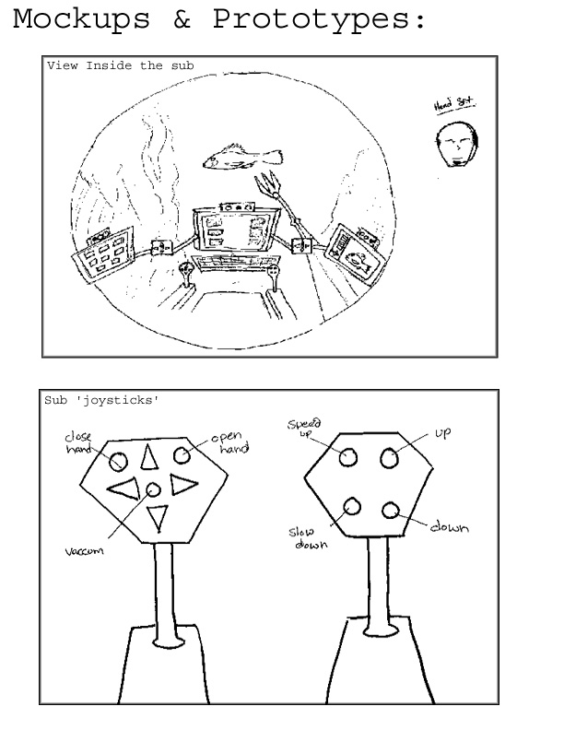
Mockups: Simple sketches…

Slide 17
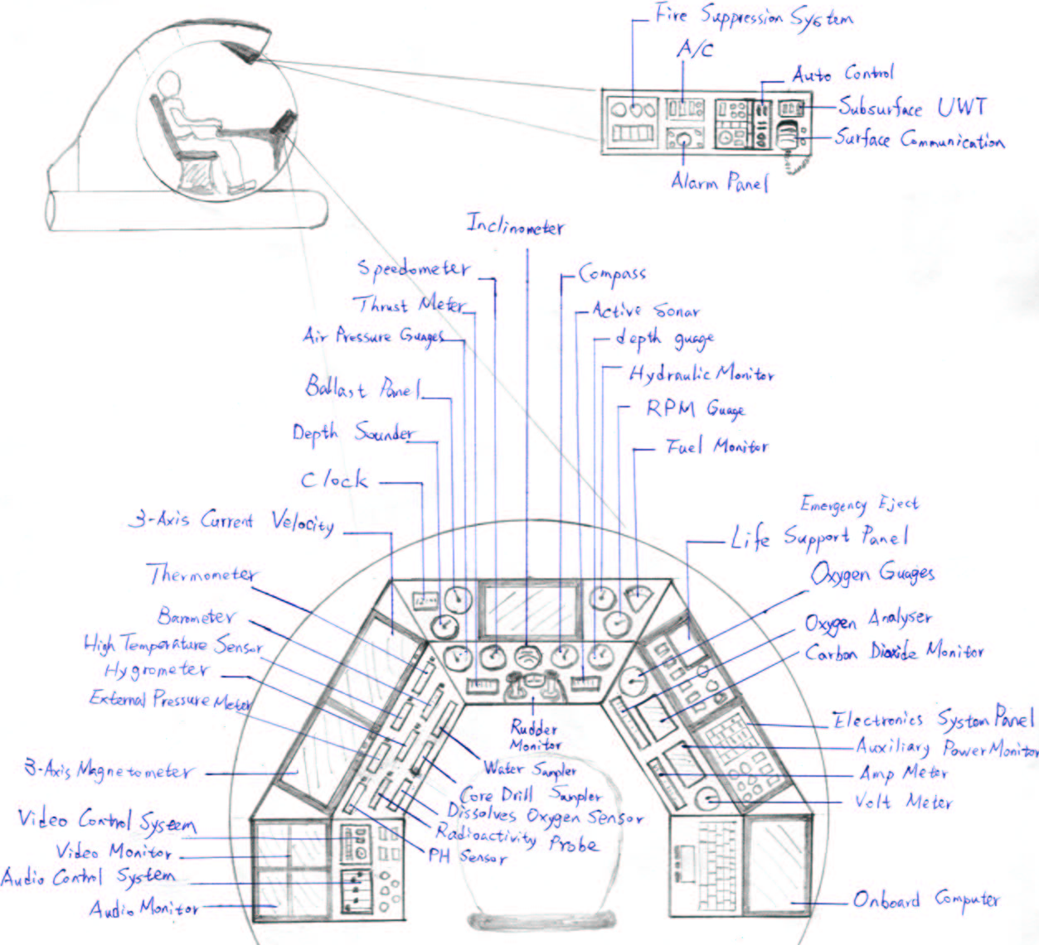
Mockups: Complex details…

Slide 18
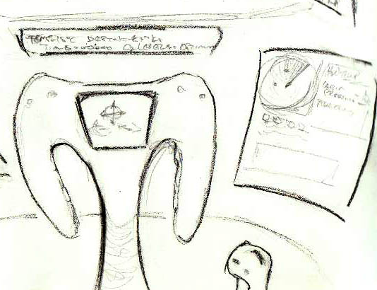
Mockup: Controls…

Slide 19
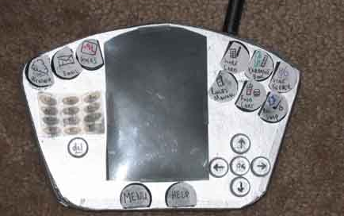
Physical Mock-Up
Styrofoam and Buttons
Spring 2004 CS 4750 project “Golf Caddy” by:
Chris Hamilton
Linda Kang
Luigi Montanez
Ben Tomassetti

Slide 20
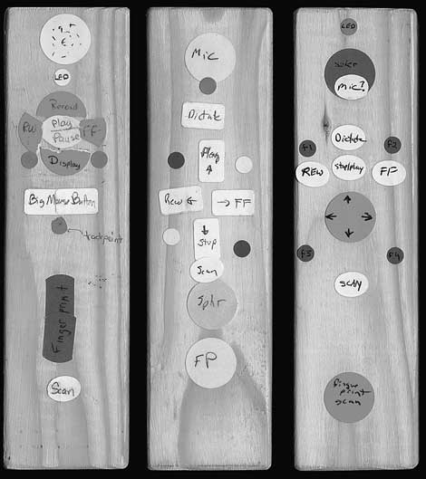
Physical Mock-Ups
Wooden blocks and labels - device control
(Three versions of
a hand-held controller)
Notes:
http://www.user.com/p-files/dictaphone-wood-mic-protos.htm

Slide 21
Storyboarding
Pencil and paper simulation or walkthrough of system look and functionality
  Use sequence of diagrams/drawings
  Show key snap shots
  Quick & easy

Slide 22
Example
Sketches solves two problems with use of more fully-developed prototypes
  User reluctance to suggest changes to what might look like a finished product
  User focus too much on details (graphic design, etc) of UI rather than big picture
  http://swiki.cc.gatech.edu/cs3750/uploads/119/Story_Board.pdf
Notes:
Design for a photo viewing and sharing program
Parking Spot locator project, fall 2006 CS 3750 class project

Slide 23
Scenarios (aka Use Cases)
Hypothetical or fictional situations of use
  Typically involving some person, event, situation and environment
  Provide context of operation
  Often in narrative form, but can also be sketches or even videos
  Also used in cognitive walkthrough
Notes:
Can be a real person or imaginary but should match target user – tell a story

Slide 24
Scenario
Susan walks into the dark house from the garage. She sees the illuminated light switches near the door and chooses the red switch, which is color-coded for “all on” for the current room, which is the laundry room. The lights illuminate the security alarm, which began emitting an auditory warning when the door was opened. Susan walks to the Elan screen and touches it, revealing the top-level menu. She selects the “security” tab, and enters her code at the prompt. The security system is then disarmed and it displays a message saying “security system off”.

Slide 25
Scenario Utility
Engaging and interesting
Allows designer to look at problem from another person’s point of view
Facilitates feedback and opinions
Can be very futuristic and creative
Can involve social and interpersonal aspects of the task

Slide 26
Other Techniques
Tutorials & Manuals
  Maybe write them out ahead of time to flesh out functionality
  Forces designer to be explicit about decisions
  Putting it on paper is valuable

Slide 27
Computer-Supported Methods
Can support more rapid changes to simple mockups
Can support more functionality for prototypes
Can lead to “stale” design, can focus user (or customer) too much on the details of the interface, too early in the design process

Slide 28
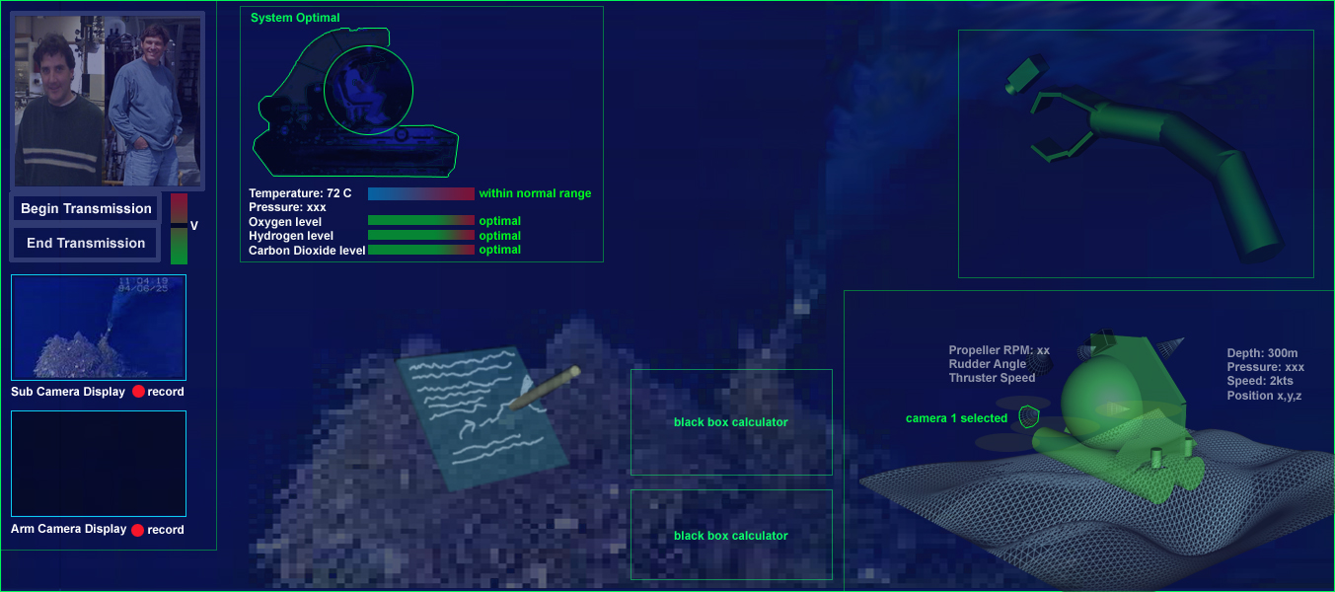
e.g., Computer Mockups

Slide 29
Prototyping Tools
1.Draw/Paint programs
  Draw each screen, good for look
IP Address
OK
Cancel
Thin, horizontal prototype
PhotoShop, Corel Draw,...

Slide 30
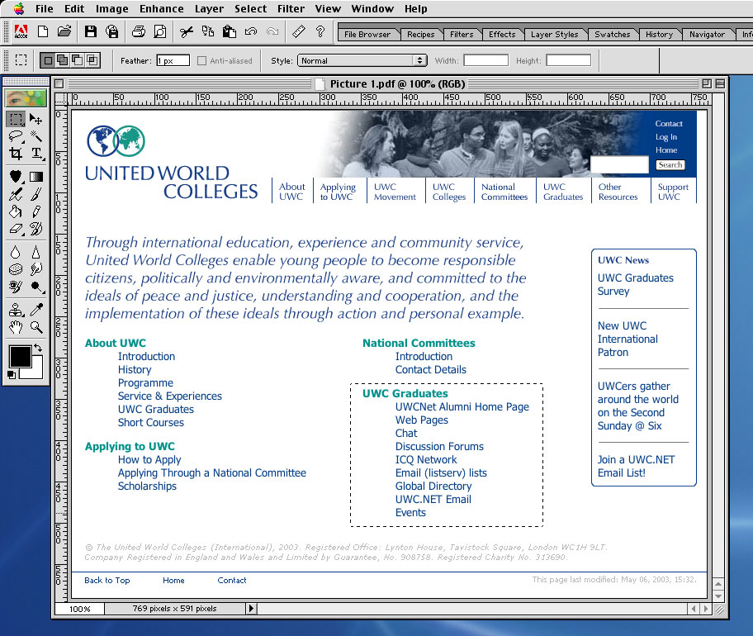
Photoshop

Slide 31
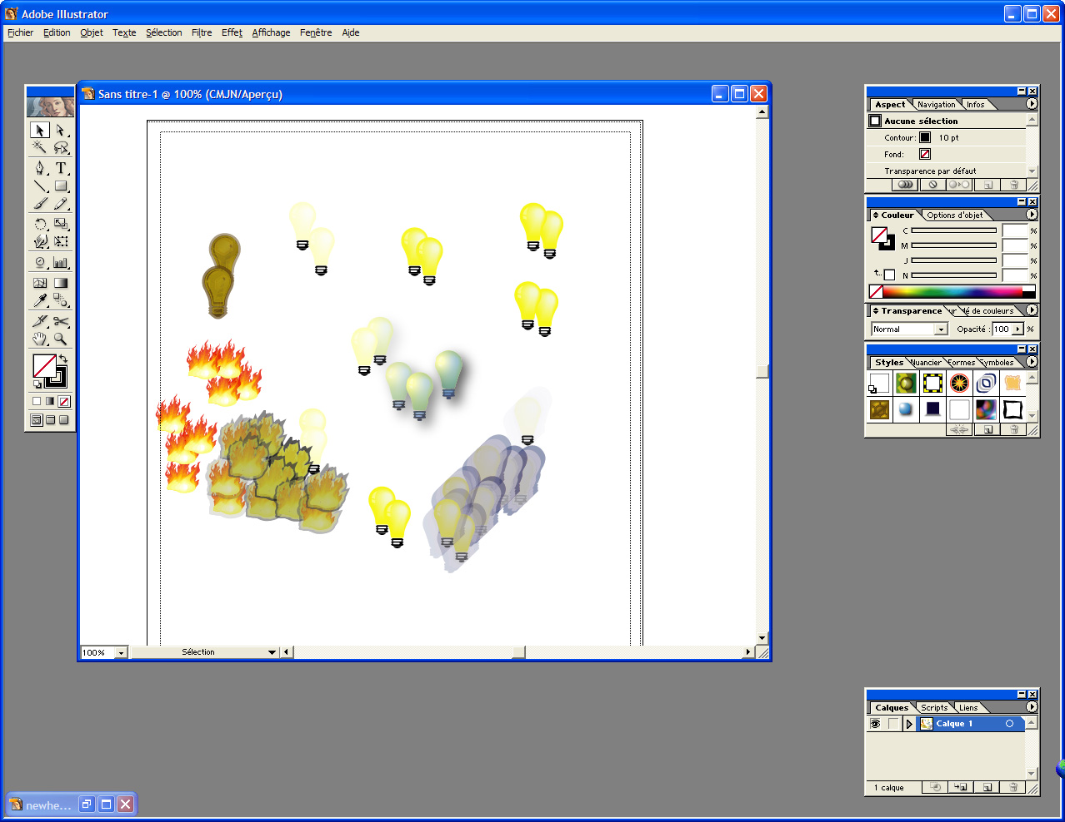
Illustrator

Slide 32
Prototyping Tools
2. Scripted simulations/slide shows
  Put storyboard-like views down with (animated) transitions between them
  Can give user very specific script to follow
  Often called chauffeured prototyping
  Examples: PowerPoint, Hypercard, Macromedia Director, HTML

Slide 33
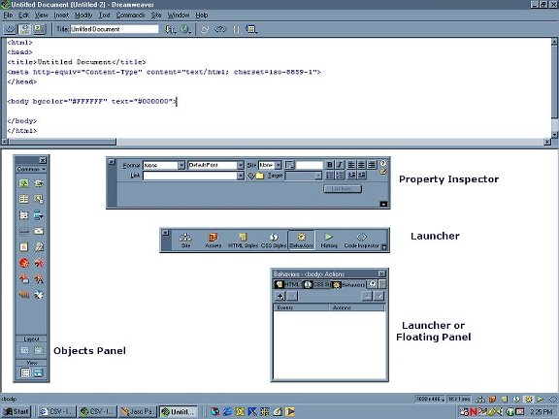
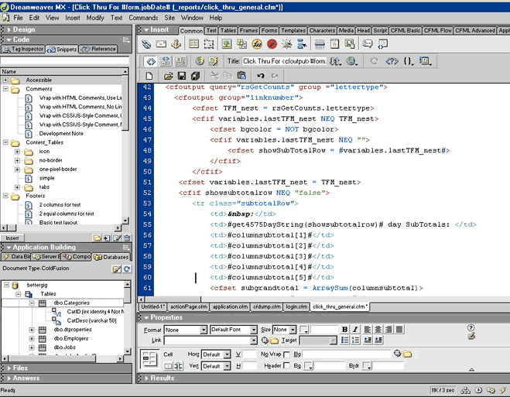
Dreamweaver

Slide 34
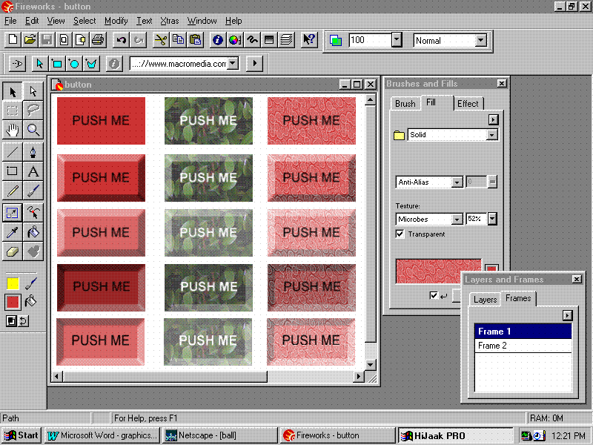
Fireworks

Slide 35
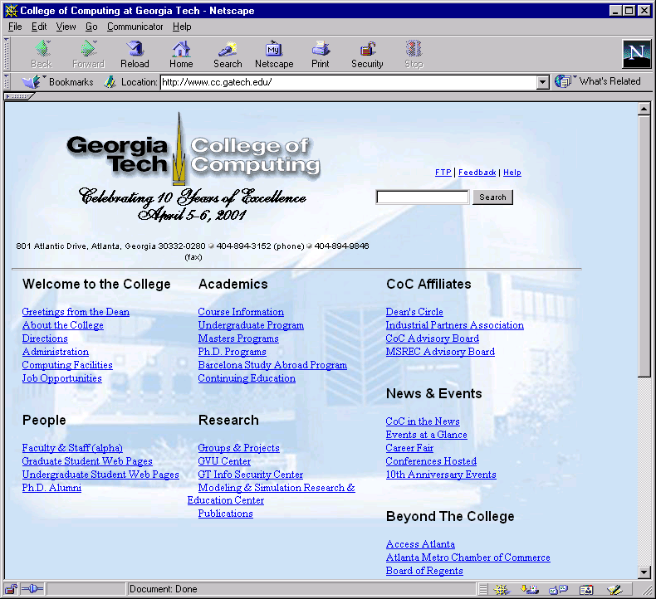
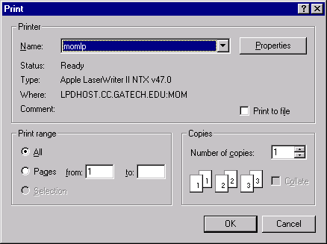
Scripting Example
Ctrl-p
e.g., HTML, Javascript

Slide 36
Macromedia Director
Combines various media with script written in Lingo language
Concerned with place and time
  Objects positioned in space on “stage”
  Objects positioned in time on “score”
Easy to transition between screens
Can export as executable or as Web Shockwave file

Slide 37
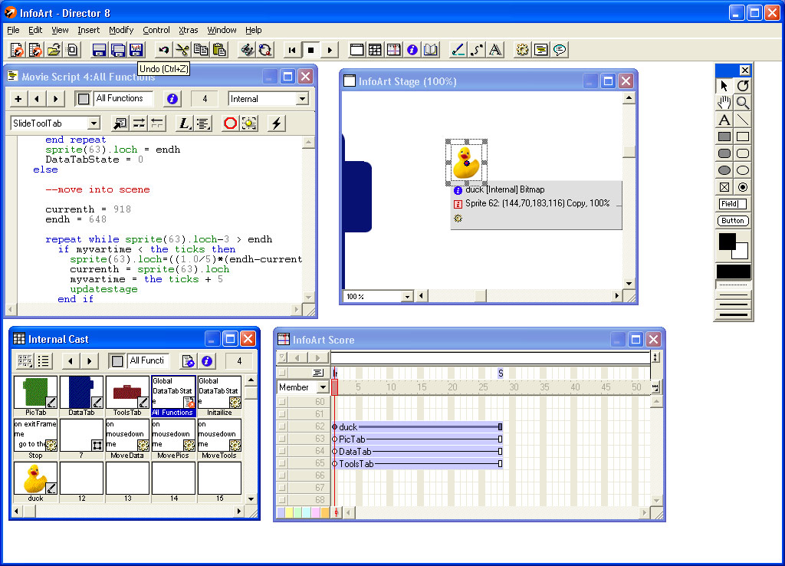

Slide 38
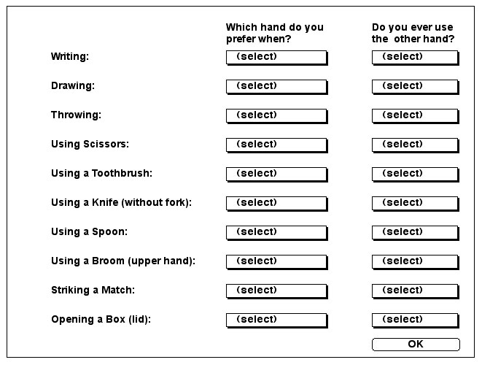
Director Output

Slide 39
Prototyping Tools
3. Interface Builders
  Tools for laying out windows, controls, etc. of interface
    Have build and test modes that are good for exhibiting look and feel
    Generate code to which back-end functionality can be added through programming
  Examples: Visual Basic, Delphi, UIMX, ...

Slide 40
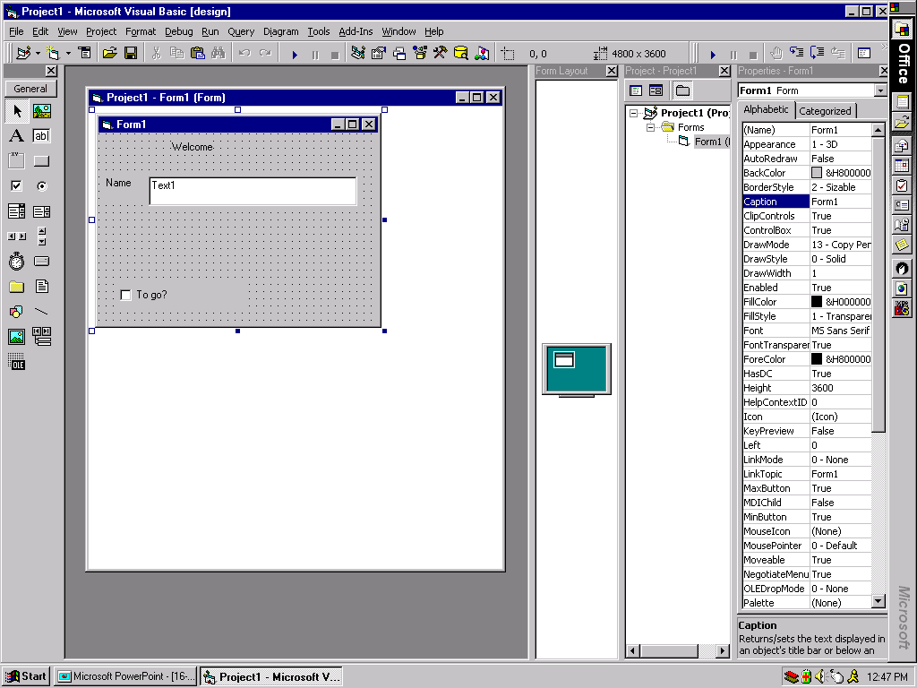
e.g., Visual Basic
Control
properties
UI Controls
Design area

Slide 41
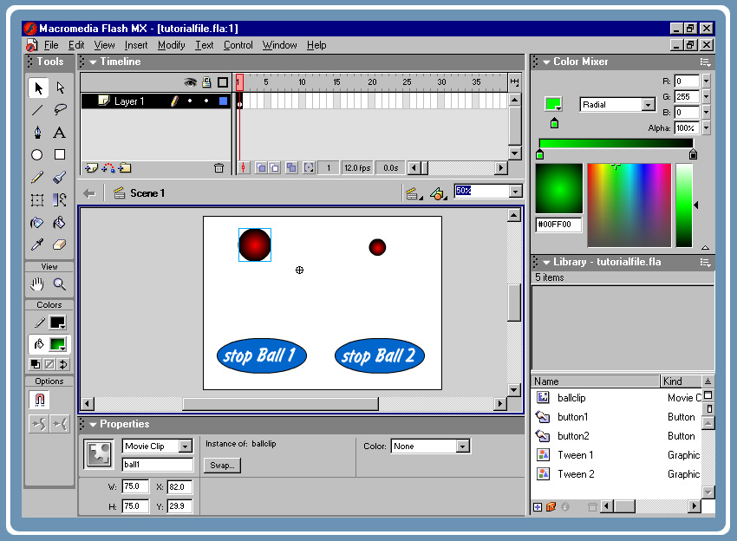
Flash - A category of its own

Slide 42
True Programming
Less useful for rapid prototyping, but can save re-coding time down the road
More constrained in look and feel
Constrained to traditional interaction styles and methods
  Hard to think outside the box…

Slide 43
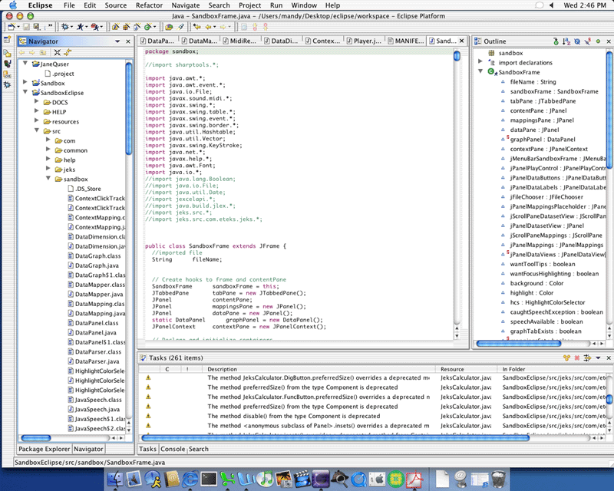
Java

Slide 44
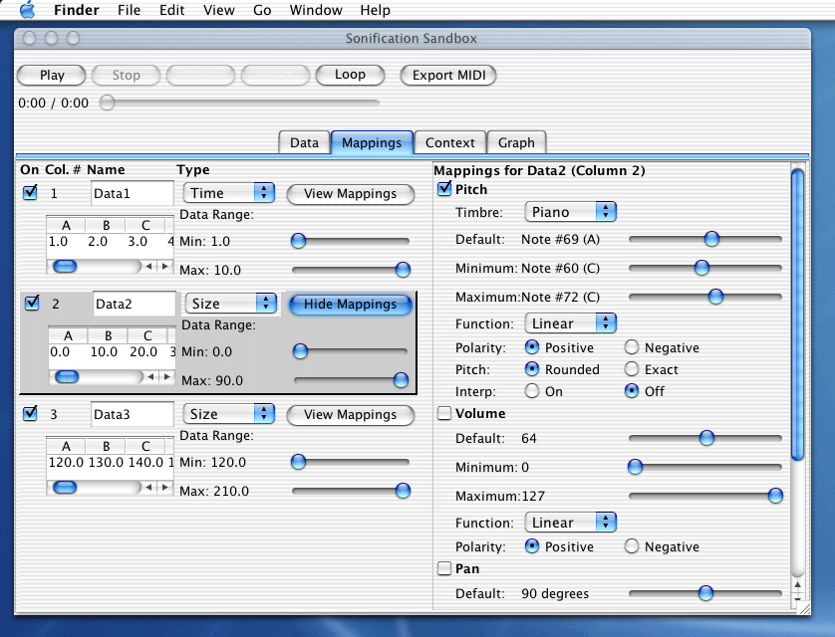
Java Output

Slide 45
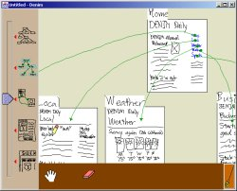
Other Prototyping Tools
Denim
http://guir.berkeley.edu

Slide 46
Prototyping “Enhancements”
Wizard of Oz - Person simulates and controls system from “behind the scenes”
  Use mock interface and
  interact with users
  Good for simulating
  system that would be
  difficult to build
Can be either computer-based or not

Slide 47
Wizard of Oz
Method:
  Behavior should be algorithmic
  Good for voice recognition systems and non-traditional interfaces
Advantages:
  Allows designer to immerse oneself in situation
  See how people respond, how to specify tasks

Slide 48
Prototyping Summary
Tradeoffs of simplicity, manageability
Veracity
Interactiveness
Up-front costs vs. down the road costs
Key: Don’t let the prototyping environment drive or constrain your creativity!!

Slide 49
Tutorials
Photoshop/Illustrator:
http://www.absolutecross.com/tutorials/photoshop/
http://www.planetphotoshop.com/tutorials.html
http://thetechnozone.com/bbyc/Illustrator.htm
http://studio.pinnacle-elite.com/tutorials/aitut01.html
Dreamweaver/HTML:
http://www.cbtcafe.com/dreamweaver/
http://www.sitebuilder.ws/dreamweaver/tutorials/
Fireworks:
http://www.cbtcafe.com/fireworks/index.html
VB:
http://www.vbtutor.net/vbtutor.html
http://juicystudio.com/tutorial/vb/
http://webspace.dialnet.com/paul_pbcoms/vb/tutor.html
Flash:
http://www.uic.edu/depts/accc/seminars/flashintro/index.html
http://www.absolutecross.com/tutorials/flash/
Director:
http://www.herts.ac.uk/lis/mmedia/directortutorial/
http://www.tutorialfind.com/tutorials/macromedia/director/
http://www.fbe.unsw.edu.au/learning/director/

