Slide 1
Introduction to Evaluation
“Informal” approaches

Slide 2
Agenda
What is evaluation?
Goals of evaluation
Styles of evaluation
Predictive Evaluation
Formal Evaluation

Slide 3
Evaluation
Evaluation, in general…
  Gather data about the usability of a design for a particular activity by a specified group of users within a specified environment
Goals
  1. Assess extent of system’s functionality
  2. Assess effect of interface on user
  3. Identify specific problems with system

Slide 4
Forms
Formative (predictive) evaluation
  As project is forming. All through the lifecycle. Early, continuous. Iterative.
  “Evaluating the design”
Summative evaluation
  After a system has been finished. Make judgments about final item.
  “Evaluating the implementation”

Slide 5
Experimental Approach
Lab studies, quantitative results
  Typically in a closed, lab setting
  Manipulate independent variables to see effect on dependent variables
  Replicable
  Expensive, requires real users and lab

Slide 6
Naturalistic Approach
Field studies (qualitative results)
  Observation occurs in “real life” setting
  Watch process over time
  “Ecologically valid”
  Cheap, quick, less training required
  Not reproducible; user-specific results
  Not quantitative (how much better is it…?)

Slide 7
Predictive Evaluation
Expert reviewers often used
  HCI experts (not real users) interact with system, find potential problems, and give prescriptive feedback
  Best if they:
    Haven’t used earlier prototype
    Familiar with domain or task
    Understand user perspectives

Slide 8
Predictive Evaluation Methods
Heuristic Evaluation
Discount Usability Testing
Cognitive Walkthrough
Literature-based Evaluation
Model-based Evaluation

Slide 9
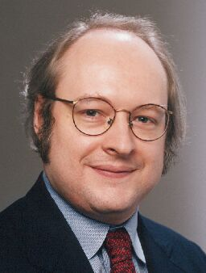
1. Heuristic Evaluation (HE)
Developed by Jakob Nielsen
Several expert usability evaluators assess system based on simple and general heuristics (principles or rules of thumb)
(www.useit.com)

Slide 10
HE: Procedure
Gather inputs
Evaluate system
Debriefing and collection
Severity rating

Slide 11
HE: Gather Inputs
Who are evaluators?
  Need to learn about domain, its practices
Get the prototype to be studied
  May vary from mock-ups and storyboards to a working system

Slide 12
HE: Evaluation Method
Reviewers evaluate system based on high-level heuristics (i.e., usability principles):
• use simple and natural dialog • provide clearly marked exits
• speak user’s language • provide shortcuts
• minimize memory load • provide good error messages
• be consistent • prevent errors
• provide feedback

Slide 13
HE: Updated Heuristics
Another way of stating the principles…
• visibility of system status
• aesthetic and minimalist
design
• user control and freedom
• consistency and standards
• error prevention
• recognition rather than recall
• flexibility and efficiency of use
• recognition, diagnosis and
recovery from errors
• help and documentation
• match between system and real
world

Slide 14
HE: Process
Perform two+ passes through system
Inspect:
  Flow from screen to screen
  Each screen
Evaluate against heuristics
Find “problems”
  Subjective & liberal (if you think it is, it is)
  Don’t dwell on whether it is or isn’t

Slide 15
HE: Debriefing
Organize all problems found by different reviewers
  At this point, decide what are and are not problems
  Group, structure
  Document and record them

Slide 16
HE: Severity Rating
0-4 rating scale
  Note: 4 is typically the most severe
Based on
  frequency
  impact
  persistence
  market impact

Slide 17
HE: Advantage
Cheap, good for small companies who can’t afford more
Getting someone practiced in method is valuable

Slide 18
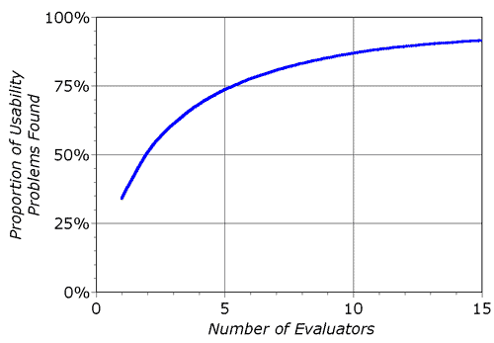
HE: Application
Nielsen found that
about 5 evaluators
found 75% of the
problems
Above that you get more, but at decreasing efficiency

Slide 19
HE: Somewhat Controversial
Very subjective assessment of problems
Why are these the right heuristics?
How to determine what is a true usability problem
  Some recent papers suggest that many identified “problems” really aren’t

Slide 20
2. Discount Usability Testing
Hybrid of empirical usability testing and heuristic evaluation
Have 2 or 3 think-aloud user sessions with paper or prototype mock-ups

Slide 21
Discount Usability in Action
Mockups are not supposed to be perfect!
A variety of approaches for mockups:
  Must be quick to create; economical in use of resources
  Sketches most common
  Paper has its limitations; tends to focus on the visual elements
  Sometimes awkward to use in usability testing

Slide 22
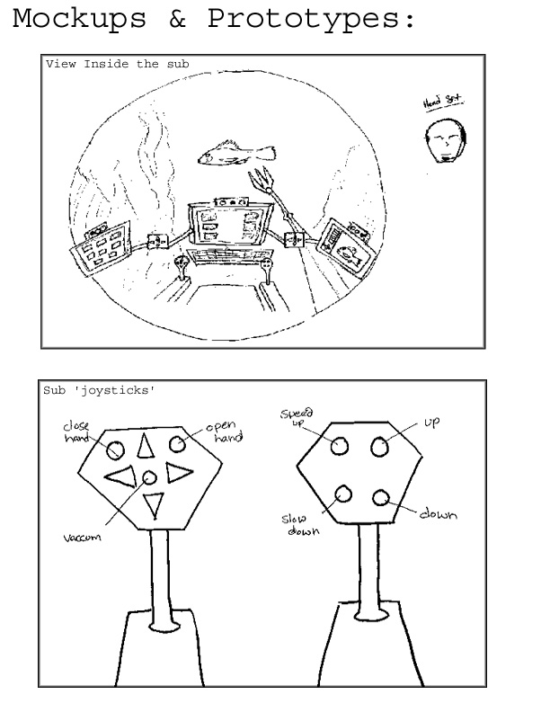
Mockups: Simple sketches…

Slide 23
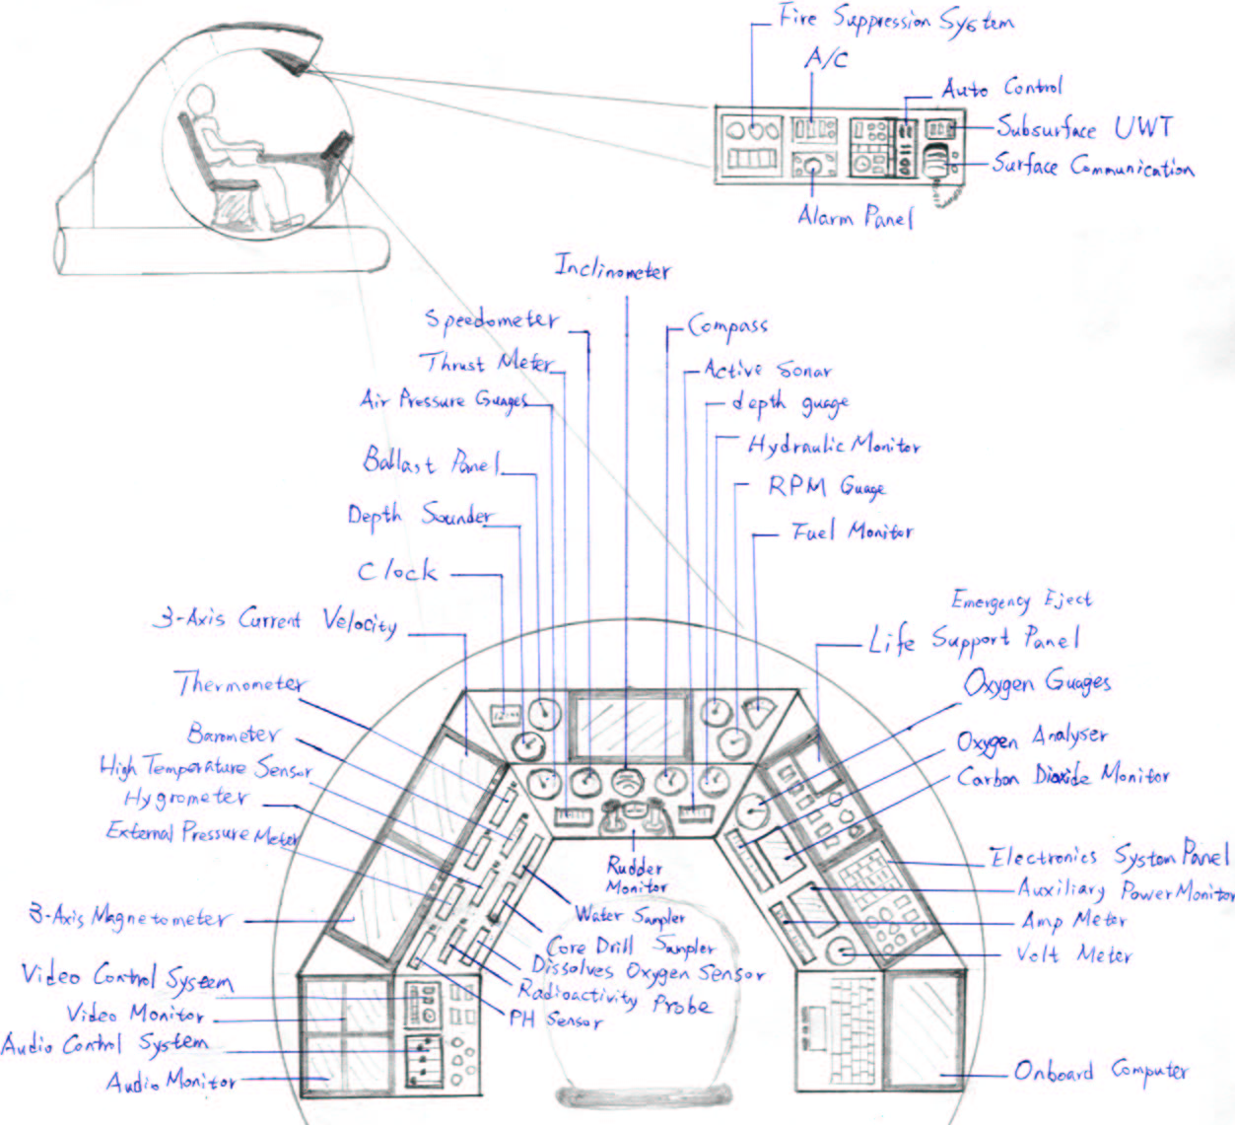
Mockups: Complex details…

Slide 24
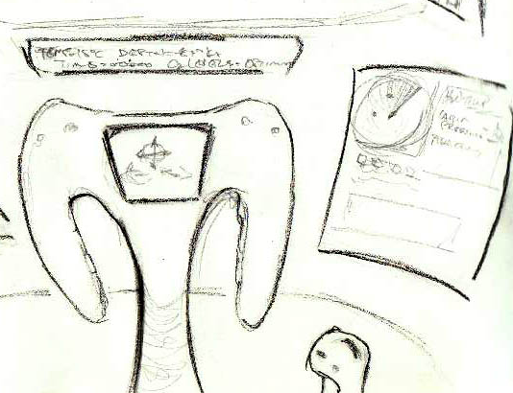
Mockup: Controls…

Slide 25
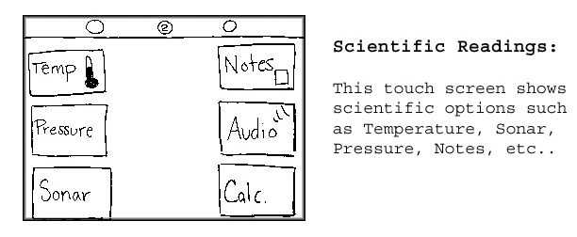
Mockup: Controls + Displays

Slide 26
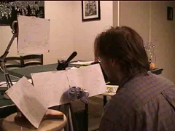
User Testing…(movie)

Slide 27
3. Cognitive Walkthrough
Assess learnability and usability through simulation of the way users explore and become familiar with interactive system
Essentially a usability “thought experiment”
Like code walkthrough in software engineering
From Polson, Lewis, et al. at UC Boulder
Notes:
3

Slide 28
CW: Process
Construct carefully designed tasks from system spec or screen mock-up
Walk through (cognitive & operational) activities required to go from one screen to another
Review actions needed for task, attempt to predict how users would behave and what problems they’ll encounter
Notes:
CW:

Slide 29
CW: Requirements
Description of users and their backgrounds
Description of task user is to perform
Complete list of the actions required to complete task
Prototype or description of system
Notes:
CW:

Slide 30
CW: Assumptions
User has a rough plan (not always true)
User explores system, looking for actions to contribute to performance
User selects action that seems best for reaching desired goal
User interprets response and assesses whether progress has been made toward completing task
Notes:
CW:

Slide 31
CW: Methodology
Step through action sequence
  Action 1
  Response A, B, ..
  Action 2
  Response A
  ...
For each one, ask four questions and try to construct a believability story
Notes:
CW:

Slide 32
CW: Believability Questions
1. Will users be trying to produce whatever effect the given action has?
2. Will users be able to notice that the correct action is available?
3. Once found, will they know it’s the right action for the desired effect?
4. Will users understand feedback after the action?

Slide 33
CW: Answering the Questions
1. Will user be trying to produce effect?
Typical supporting Evidence
  It is part of their original task
  They have experience using the system
  The system tells them to do it
No evidence?
  Construct a failure scenario
  Explain, back up opinion
Notes:
:

Slide 34
CW: Next Question
2.Will user notice the action is available?
Typical supporting evidence
  Experience
  Visible device, such as a button
  Perceivable representation of an action such as a menu item
Notes:
C

Slide 35
CW: Next Question
3.Will user know it’s the right action for the desired effect?
Typical supporting evidence
  Experience
  Interface provides a visual item (such as prompt) to connect action to result effect
  All other actions look wrong
Notes:
CW:

Slide 36
CW: Next Question
4.Will user understand the feedback?
Typical supporting evidence
  Experience
  Recognize a connection between a system response and what user was trying to do
Notes:
CW

Slide 37
CW: Example
Program VCR
  List actions
  Ask questions

Slide 38
4. Literature-based Evaluation
Many systems exist and have been evaluated
Many experiments have shown performance abilities and limits
Apply what is already known, where applicable
  Don’t reinvent the wheel
Examples?
Notes:
4

Slide 39
5. User Modeling
Computer models simulate what users would do, how they would respond
Good models exist for cognitive and motor processes
Not so effective at modeling perception
Fitts’ Law as an example of predicting performance by modeling the human

Slide 40
Empirical Evaluation
Assessing usability
(with users)

Slide 41
Why Evaluate?
Recall:
Users and their tasks were identified
Needs and requirements were specified
Interface was designed, prototype built
But is it any good? Does the system support the users in their tasks? Is it better than what was there before (if anything)?

Slide 42
Why Gather Data?
Design the experiment to collect the data to test the hypotheses to evaluate the interface to refine the design
Information gathered can be:
objective or subjective
Information also can be:
qualitative or quantitative

Slide 43
Conducting an Experiment
Determine the TASK
Determine the performance measures
Develop the experiment
IRB approval
Recruit participants
Collect the data
Inspect & analyze the data
Draw conclusions to resolve design problems
Redesign and implement the revised interface

Slide 44
The Task
Benchmark tasks - gather quantitative data
Representative tasks - add breadth, can help understand process
Tell them what to do, not how to do it
Issues:
  Lab testing vs. field testing
  Validity - typical users; typical tasks; typical setting?
  Run pilot versions to shake out the bugs

Slide 45
Defining Performance
Based on the task
Specific, objective measures/metrics
Examples:
  Speed (reaction time, time to complete)
  Accuracy (errors, hits/misses)
  Production (number of files processed)
  Score (number of points earned)
  …others…?

Slide 46
Types of Variables
Independent
  What you’re studying, what you intentionally vary (e.g., interface feature, interaction device, selection technique)
Dependent
  Performance measures you record or examine (e.g., time, number of errors)

Slide 47
“Controlling” Variables
Prevent a variable from affecting the results in any systematic way
Methods of controlling for a variable:
  Don’t allow it to vary
    e.g., all males
  Allow it to vary randomly
    e.g., randomly assign participants to different groups
  Counterbalance - systematically vary it
    e.g., equal number of males, females in each group
  The appropriate option depends on circumstances

Slide 48
Example
Do people complete operations faster with a black-and-white display or a color one?
  Independent - display type (color or b/w)
  Dependent - time to complete task (minutes)
  Controlled variables - same number of males and females in each group
  Hypothesis: Time to complete the task will be shorter for users with color display
  H_{o}: Time_{color} = Time_{b/w}
  Note: Within/between design issues, next

Slide 49
Experimental Designs
Within Subjects Design
  Every participant provides a score for all levels or conditions
Color B/W
P1 12 secs. 17 secs.
P2 19 secs. 15 secs.
P3 13 secs. 21 secs.
...

Slide 50
Experimental Designs
Between Subjects
  Each participant provides results for only one condition
Color B/W
P1 12 secs. P2 17 secs.
P3 19 secs. P5 15 secs.
P4 13 secs. P6 21 secs.
...

Slide 51
Within vs. Between
What are the advantages and disadvantages of the two techniques?

Slide 52
Within Subjects Designs
More efficient:
  Each subject gives you more data - they complete more “blocks” or “sessions”
More statistical “power”:
  Each person is their own control
Therefore, can require fewer participants
May mean more complicated design to avoid “order effects”
  e.g. seeing color then b/w may be different from seeing b/w then color

Slide 53
Between Subjects Designs
Fewer order effects
  Participant may learn from first condition
  Fatigue may make second performance worse
Simpler design & analysis
Easier to recruit participants (only one session)
Less efficient

Slide 54
Now What…?
You’ve got your task, performance measures, experimental design, etc.
You have hypotheses about what will happen in the experiment
Now you need to gather data
…So you need PARTICIPANTS

Slide 55
IRB, Participants, & Ethics
Institutional Review Board (IRB)
  http://www.osp.gatech.edu/compliance.htm
Reviews all research involving human (or animal) participants
Safeguarding the participants, and thereby the researcher and university
Not a science review (i.e., not to asess your research ideas); only safety & ethics
Complete Web-based forms, submit research summary, sample consent forms, etc.
All experimenters must complete NIH online history/ethics course prior to submitting

Slide 56
Recruiting Participants
Various “subject pools”
  Volunteers
  Paid participants
  Students (e.g., psych undergrads) for course credit
  Friends, acquaintances, family, lab members
  “Public space” participants - e.g., observing people walking through a museum
Must fit user population (validity)
Motivation is a big factor - not only $$ but also explaining the importance of the research
Note: Ethics, IRB, Consent apply to *all* participants, including friends & “pilot subjects”

Slide 57
Ethics
Testing can be arduous
Each participant should consent to be in experiment (informal or formal)
  Know what experiment involves, what to expect, what the potential risks are
Must be able to stop without danger or penalty
All participants to be treated with respect

Slide 58
Before Study
Be well prepared so participant’s time is not wasted
Make sure they know you are testing software, not them
  (Usability testing, not User testing)
Maintain privacy
Explain procedures without compromising results
Can quit anytime
Administer signed consent form

Slide 59
During Study
Make sure participant is comfortable
Session should not be too long
Maintain relaxed atmosphere
Never indicate displeasure or anger

Slide 60
After Study
State how session will help you improve system
Show participant how to perform failed tasks
Don’t compromise privacy (never identify people, only show videos with explicit permission)
Data to be stored anonymously, securely, and/or destroyed

Slide 61
Attribution Theory
Studies why people believe that they succeeded or failed--themselves or outside factors (gender, age differences)
Explain how errors or failures are not participant’s problem---places where interface needs to be improved

