Slide 1
Curve Fitting :Least Squares Method & Our Artistic innovation
Welcome to our presentation on curve fitting and the least squares method. In this project, we developed a GUI-based application that enables users to input data points and fit various types of curves

Slide 2


What is Curve Fitting ?
Curve fitting is the process of constructing a curve that best fits a set of data points.
Imagine we have data of time vs temperature. We want to find a smooth curve that represents the pattern of the temperature over time.

Slide 3
Why Do We Use Curve Fitting?
01
02
03
04
To predict future data points
Scientific data analysis
Use simple animated graphs to show poor fit vs. good fit.
To model real-world systems

Slide 4
01
Introduction to Least Squares Method

Slide 5
The Least Squares Method is a mathematical approach used to find the best-fitting curve or line by minimizing the sum of the squares of the vertical differences (errors) between the observed data points and the values predicted by the model.
Concept

Slide 6
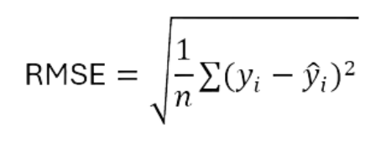
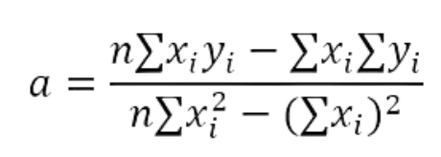
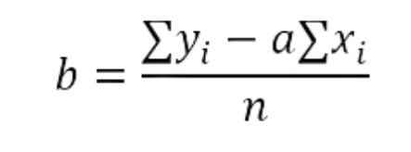
Mathematical Formulas
Slope
RMSE
Intercept:

Slide 7



Features :
Technology Stack :
Add/Delete Data
Tkinter + ttkbootstrap
Quickly input or remove data points.
Instant Calc
NumPy
Calculations update in real time.
Real-time Graph
Matplotlib
Visualizations change instantly

Slide 8
Project Goals
Provide an easy, visual, and accurate way to apply Least Squares
Bridge the gap between theory and application
Help student and professionals explore curve fitting interactively

Slide 9
Challenges faced
1
Designing a user-friendly, responsive UI
2
Preventing invalid user inputs
3
Accurately syncing data, logic, and visualization
4
Graph plotting without lags or crashes

Slide 10






GlitchWave Team
Coding
UI/UX
Math
Each team member played a part in coding, UI/UX, and Math logic.

Slide 11
02
Application Explanation

Slide 12
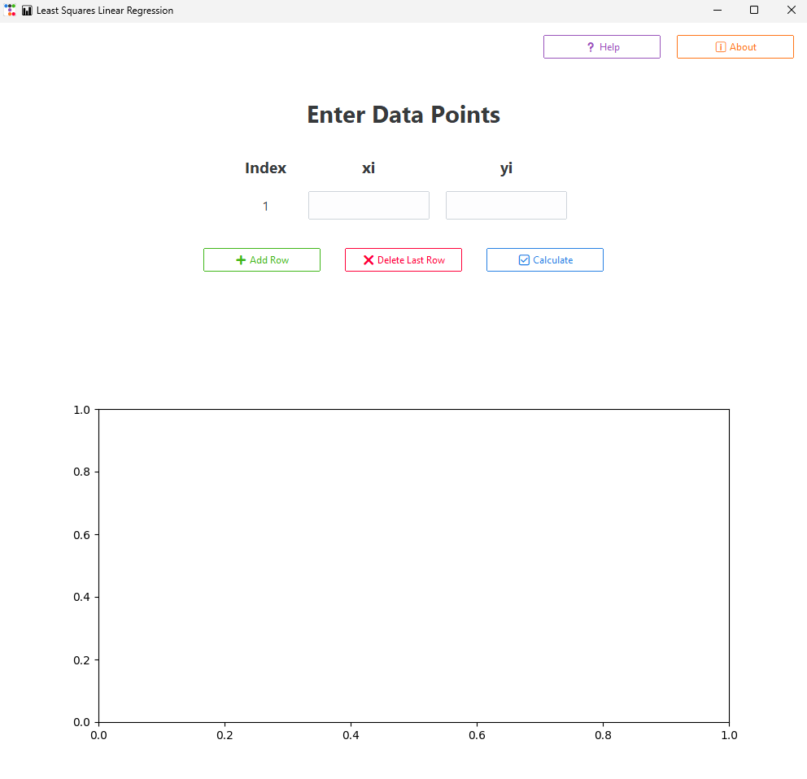
Iuser interface

Slide 13
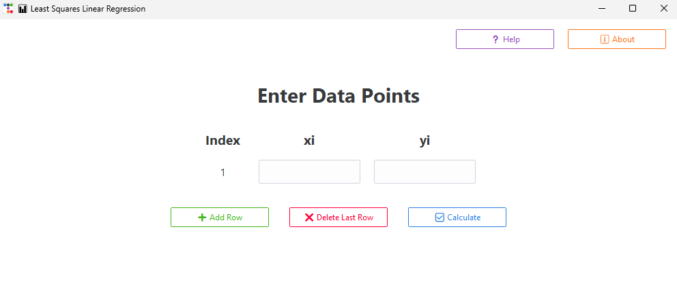

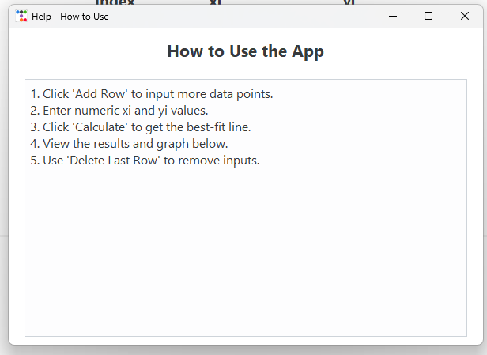
Help button

Slide 14
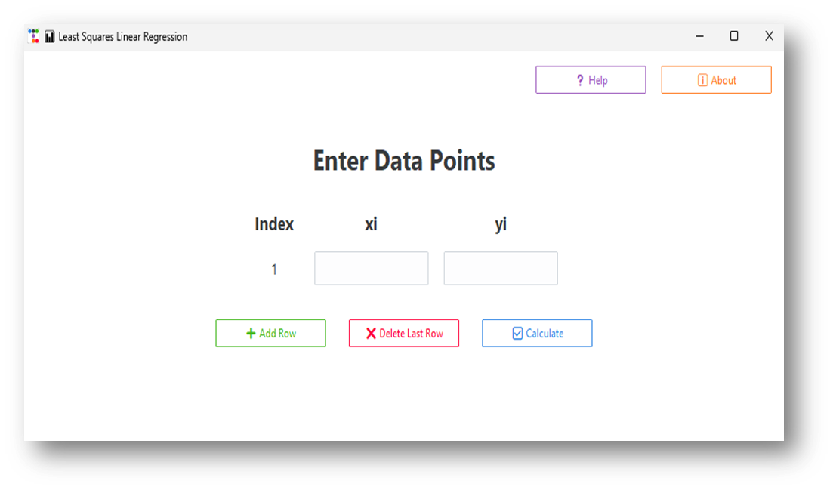

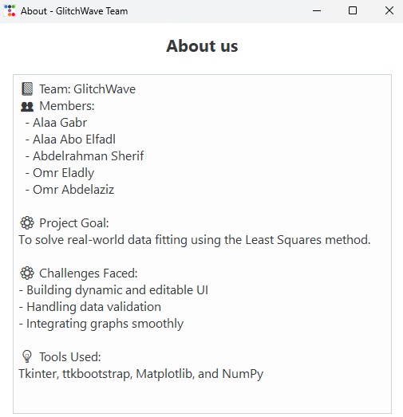
About button

Slide 15
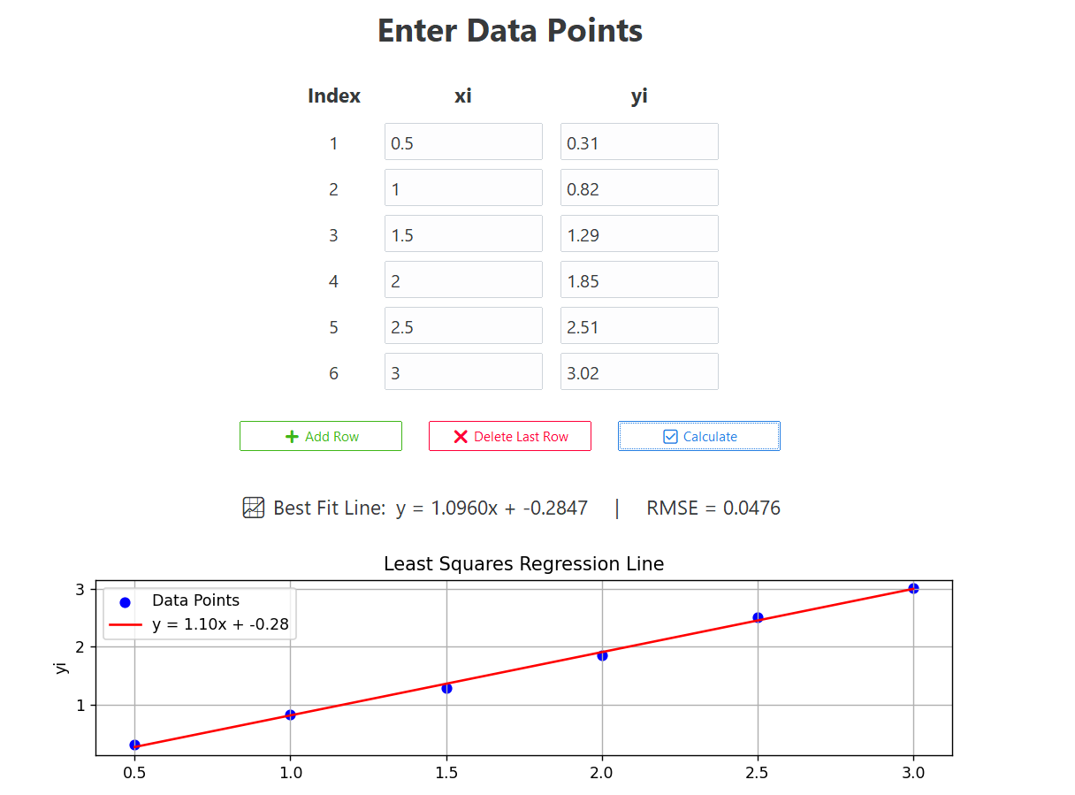
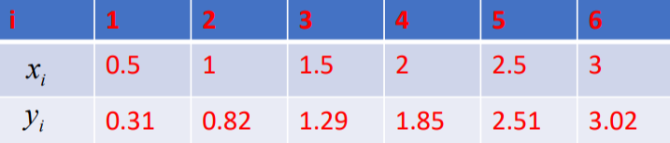
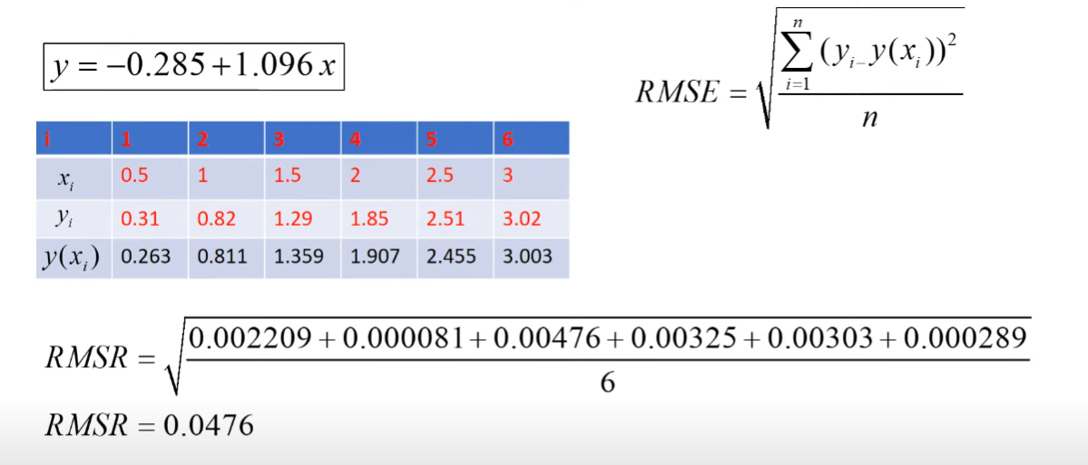
Test case from the lecture

Slide 16
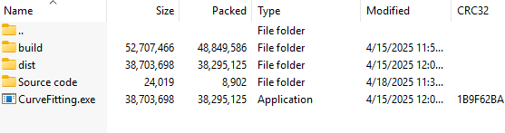
You can find the project in the following link
https://drive.google.com/file/d/1kyAtRMY62ALnpV4s_Q5e6T_DuU2EHChR/view?usp=sharing
After downloading you can run it directly from CurveFitting.exe file f

Slide 17


