Slide 1
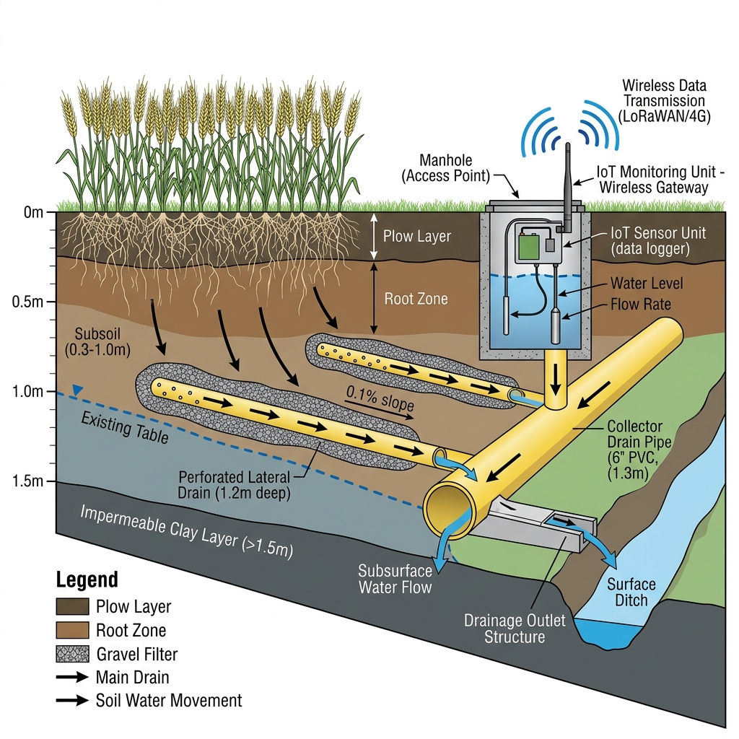
SLIDE 1 OF 3 | 5-MINUTE EXECUTIVE PITCH
Eco-Drain: Invisible, Tamper-Proof Subsurface Drainage
Climate-resilient retrofit of 100,000 feddans in Egypt's Nile Delta
Problem addressed and invisible solution
Ageing networks: Delta drainage is past its 20–25 year design life, causing waterlogging, salinity and 10–30% yield loss.
Hidden failures: buried pipes cannot be inspected, so faults go unseen for years.
Tampering: farmers block surface manholes to pool rice water, causing 25–40% of failures.
Eco-Drain: chambers buried 30–50 cm deep, secured by RFID/GPS, with shock sensors (>2.5g) sending encrypted NB-IoT alerts.
Subsurface drainage retrofit concept
560 m³
water per capita per year, below the 1,000 m³ poverty line
Lead institution, partners and governance
2.3M
feddans of drainage networks past their design life
Lead: Ministry of Water Resources and Irrigation (MWRI) through EPADP, Technical Office for Lower Egypt.
Partners: DRI (verification, MRV), MALR (crop advisory), NREA and EgyptERA (50 MW net metering), Water User Associations.
Governance: inter-ministerial Steering Committee, dedicated PIU in EPADP, local platforms in Kafr El-Sheikh and Dakahlia.
Alignment: Irrigation 2.0, Egypt Vision 2030, National Climate Strategy 2050.
25–40%
of drainage failures caused by tampering
Eco-Drain | Group 10 | EPADP Technical Office, Lower Egypt
1 / 3
Notes:
00:00-01:40 Problem: 560 m3 per capita, 2.3M feddans past design life, 25-40% of failures from tampering. Solution: invisible buried chambers with RFID/GPS and shock alerts. Lead: MWRI/EPADP with DRI, MALR, NREA, EgyptERA and WUAs.

Slide 2
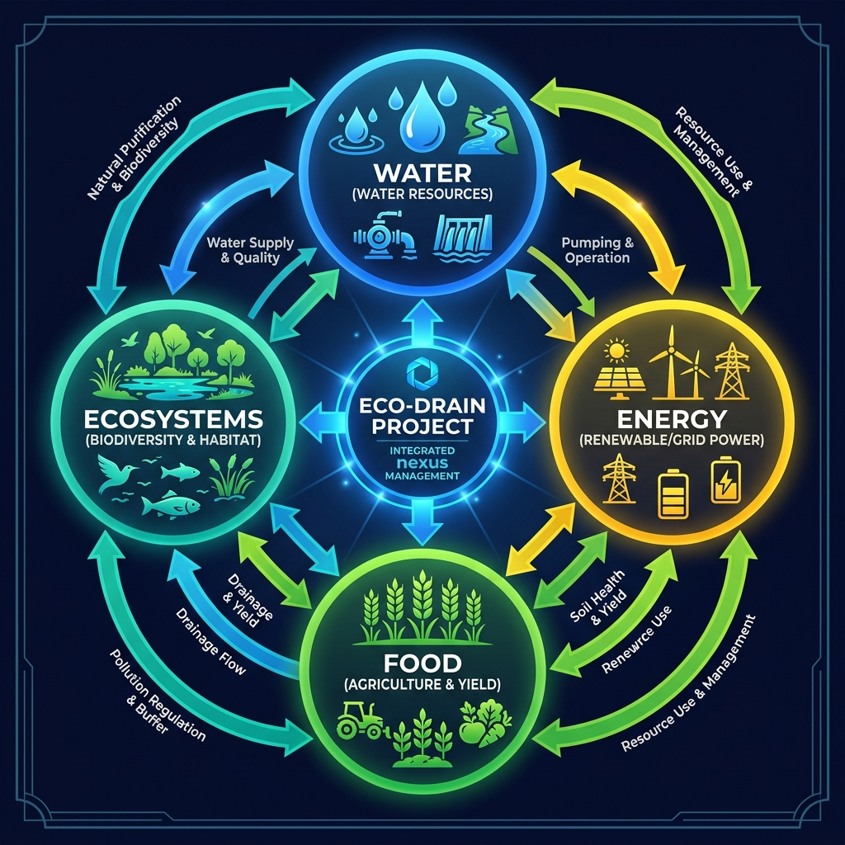
SLIDE 2 OF 3 | 5-MINUTE EXECUTIVE PITCH
Integrated WEFE Interventions and Bankability
Four closed-loop interventions, a formal screening score and a resilience scorecard
WATER
ENERGY
150M m³/yr saved
50 MW solar · 90 GWh/yr
HDPE and geotextile retrofit with smart gate valves using capillary rise: 25–30% less irrigation water.
Distributed PV at 25 pump stations cuts pumping bills by 40%; surplus exported via net metering.
FOOD
ECOSYSTEMS
15–25% higher yields
100k tCO₂/yr · 4,760 feddans
Wheat, rice and maize restored for 200,000 farmers, with automatic flushing when salinity rises.
20 constructed wetlands treat 200M m³/yr and protect Delta lakes (Verra blue carbon).
Water–Energy–Food–Ecosystems nexus
WEFE screening and resilience
How WEFE integration improves bankability
92/100
Resilience: HIGH
Self-funded OPEX: solar net metering pays pump power and protects the DSCR (1.35x).
Avoided cost and revenue: 150M m³/yr is worth about $52.5M; smart-valve payback 0.48 years; $8M energy, $3M export, $5M water, $0.5M carbon per year.
No displacement: in-situ retrofit with zero resettlement or community conflict.
Water 10 · Energy 8 · Food 10 · Ecosystems 8 · Digital 9
Eco-Drain | Group 10 | EPADP Technical Office, Lower Egypt
2 / 3
Notes:
01:40-03:30 Four WEFE interventions: 150M m3 water saved, 50 MW solar, +15-25% yields, 20 wetlands. Composite WEFE score 92/100. Bankability: self-funded OPEX, avoided cost, diversified revenue, no displacement.

Slide 3
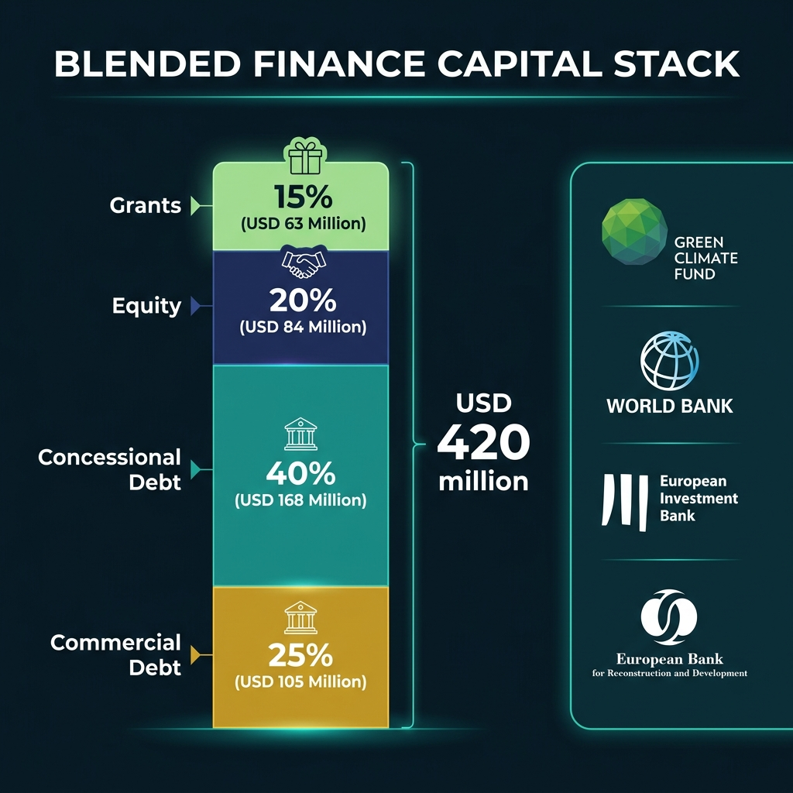
SLIDE 3 OF 3 | 5-MINUTE EXECUTIVE PITCH
Capital Stack, Readiness and Expected Results
USD 420M blended finance, a ready 10-feddan pilot and a three-stage scaling pathway
Budget: USD 420M ($4,200 per feddan)
15% grants ($63M): GCF, AfDB, EU for pilot, digital twin and capacity.
20% government ($84M): in-kind land, pump stations, EPADP staff.
40% concessional debt ($168M): World Bank, AfDB, 20–25 year tenor.
25% PPP / commercial ($105M): solar developers under PPA. EIRR 21.4%.
Current readiness status
Blended-finance capital stack
Track record: EPADP's 50 years, 6M feddans installed, TRL 8–9 technologies.
Pilot ready: 10-feddan unit on an isolated collector to validate before scale-up.
Next step: $1.5M PPF grant request to GCF/AfDB for Kafr El-Sheikh feasibility.
Funding call fit
14/14
Green Climate Fund
Transformational adaptation and digital MRV. Decision: GO
Expected results (KPIs) and scaling pathway
13/14
Adaptation Fund
Ideal for the pilot component. Decision: GO
150M m³
water saved / yr
15–25%
yield increase
90 GWh
clean energy / yr
80%
less tampering
High
PRIMA and EU Global Gateway
Water-agri innovation and Euro-Med cooperation
1 · Pilot 10 feddans (Yr 1)
2 · Core 100k feddans (Yr 2–5)
3 · Scale 4.3M feddans
Eco-Drain | Group 10 | EPADP Technical Office, Lower Egypt
3 / 3
Notes:
03:30-05:00 USD 420M blended finance (15/20/40/25). Funding fit: GCF 14/14, Adaptation Fund 13/14. Ready: 10-feddan pilot, TRL 8-9, PPF request. Scaling: 10 feddans, 100k feddans, 4.3M feddans in the Delta, then Iraq, Jordan and Pakistan.

