Slide 1

DEPI Initiative
Microsoft Machine Learning
Down Syndrome Detection Using CNN
(Image Classification Approach)
Presented By:
Amr Ashraf Ahmed
Abdelrahman Sameh Rashad
Asmaa Elsayed Mohamed
Kerolos Yosry Fared
Mariam Samy Nassif

Slide 2
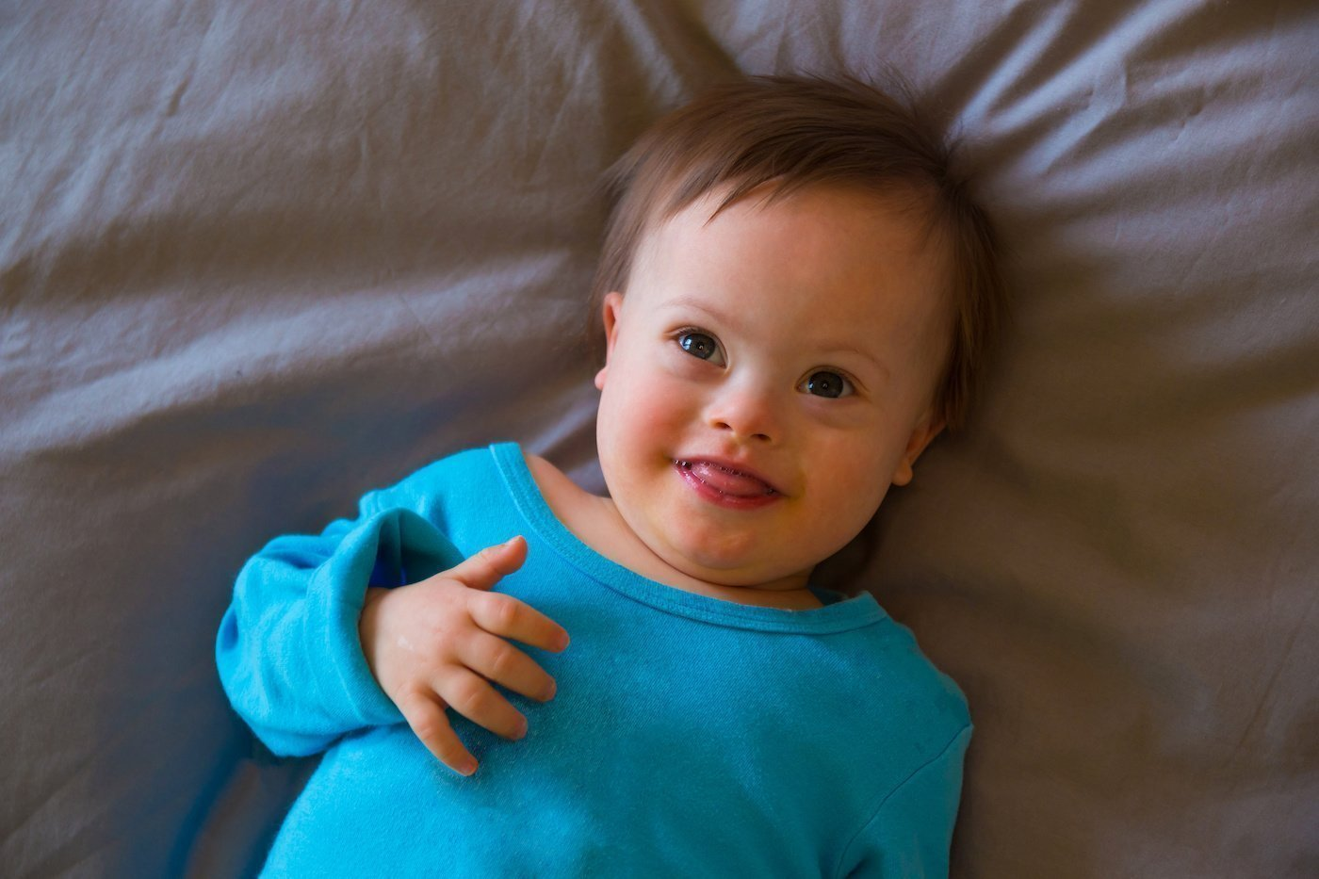
Problem Statement
Genetic Disorder: Down syndrome results from having an extra 21st chromosome, affecting 1 in 800 births globally.
Physical & Developmental Characteristics: Distinct physical traits (e.g., flat facial profile, almond-shaped eyes) and intellectual disabilities.
Health Implications: Associated with health conditions such as heart disease, hearing loss, and vision problems.
Develop a machine learning model to detect Down syndrome using facial features, aiding in early diagnosis.

Slide 3



Project Overview
Dataset
3,000 images of children
(1,500 with Down syndrome, 1,500 healthy).
Labeled images are used to train a convolutional neural network (CNN).
Features
Distance between eyes.
Distance between eyes and mouth.
Model
A CNN-based deep learning model is built to classify images as either Down syndrome or healthy.

Slide 4
Methodology
(Data Preprocessing)
Image Preprocessing:
Resized and normalized images.
Split dataset into training and testing sets.
Feature Extraction:
Features like the distance between eyes and the distance from eyes to mouth are key for classification.
Class Labeling:
Labeled as "Down syndrome" or "Healthy."

Slide 5
Methodology
(Model Architecture)
CNN Structure:
Input Layer: Preprocessed images.
Convolutional Layers: Detect key patterns (e.g., shapes, facial features).
Pooling Layers: Reduce dimensionality while preserving important features.
Dense Layers: Fully connected layers that lead to the final classification.
Activation Function: Relu for hidden layers, Softmax for the output layer.
Training:
Optimizer: Adam optimizer.
Loss Function: Binary cross-entropy.
Early Stopping: To prevent overfitting.

Slide 6
Methodology
(Model Training and Validation)
Metrics:
Accuracy, AUC (Area Under Curve), Precision, and Recall.
AUC: Measures the model's ability to differentiate between Down syndrome and healthy.
Evaluation:
Training on 80% of the dataset, testing on 20%.
Best test AUC score: 0.878.

Slide 7
Challenges
1- Inconsistent Visual Features:
Subtle differences in facial features (e.g., eye shape, facial profile) make it difficult for the model to detect consistent patterns.
2- Feature Variability:
Variations in lighting, quality, and angles in the images affect feature extraction accuracy.
3- Class Imbalance:
Although the dataset is balanced in quantity, the distinctiveness of facial characteristics for Down syndrome is subtle in some images, making it challenging for the model to distinguish between the two classes.

Slide 8
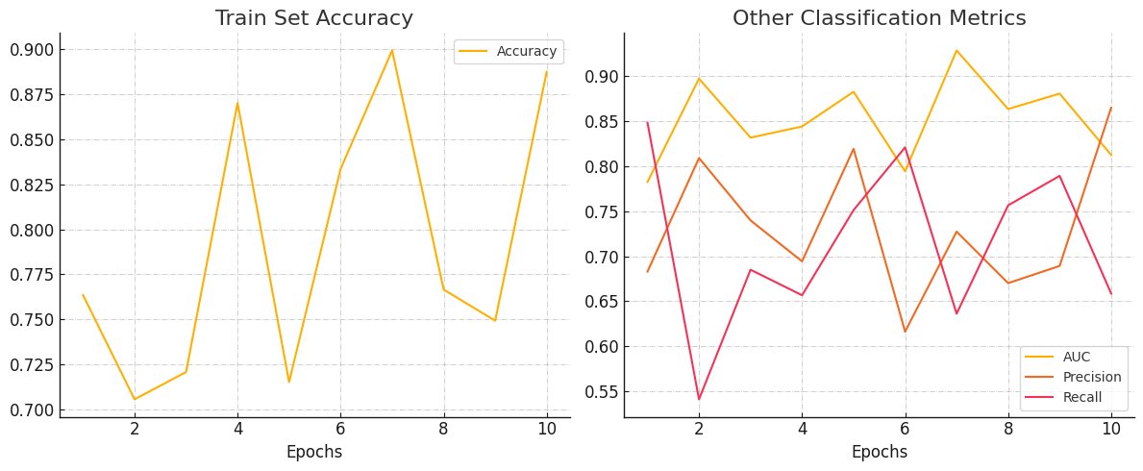
Visualization
And Validation

Slide 9
Future Improvements
Data Augmentation: Introduce image augmentation techniques (e.g., rotation, zoom, flip) to make the model more robust to variations in image quality.
Dataset Expansion: Increase the size and diversity of the dataset by including images from different demographics, lighting conditions, and image angles.
Real-World Deployment: Explore integrating the model into diagnostic tools for use in clinics or healthcare applications.

Slide 10
Thank you

