Slide 1

My 1st Project after I learnt Python Programming & Data Analysis fundamentals
Authored: Abdulaziz Alsulami

Slide 2

Contents
Problem Statement
Procedures Followed
Outcomes

Slide 3
Problem statement
Raising temperature degrees inside medical laboratories
A/C system issues
Health Accreditation from CBAHI
Standard Quality
How we can create a standard to be a showcase and an evidence used as a quality standard?

Slide 4
Procedures followed
Collecting data
Creating efficiency formula
Analyzing Data
Creating user program

Slide 5

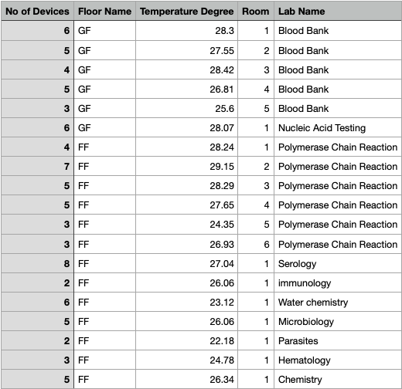
Collecting data

Slide 6
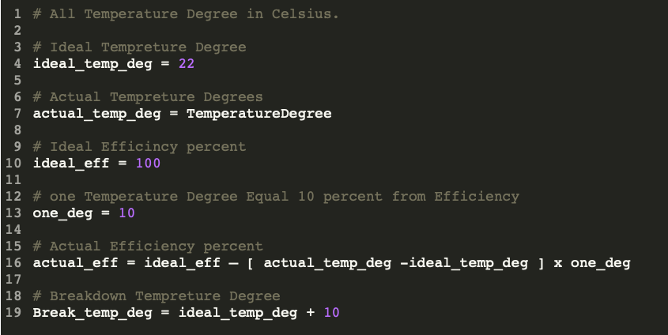
Creating efficiency formula

Slide 7
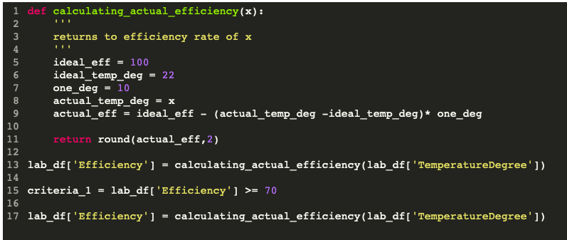
Calculating Efficiency & determining Quality

Slide 8
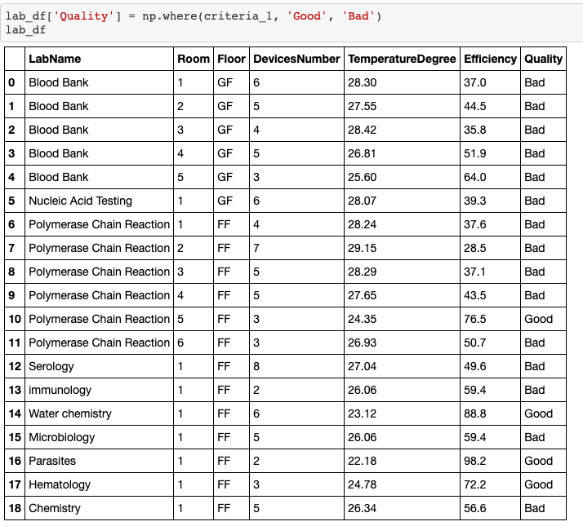
Data frame

Slide 9
Analyzing data
EDA - 1
EDA - 2
EDA - 3

Slide 10
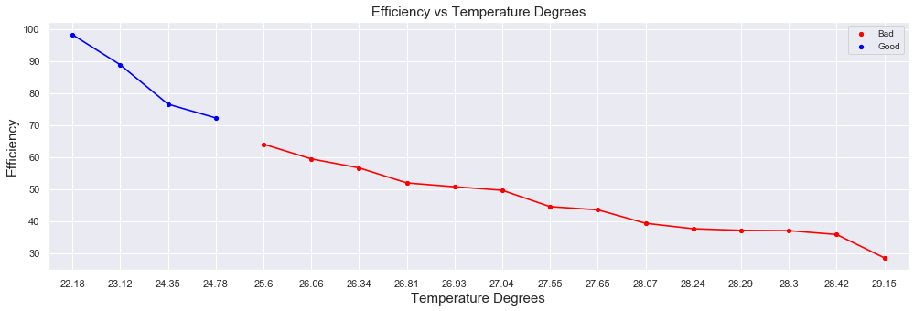
EDA - 1
Inversly Relationship

Slide 11
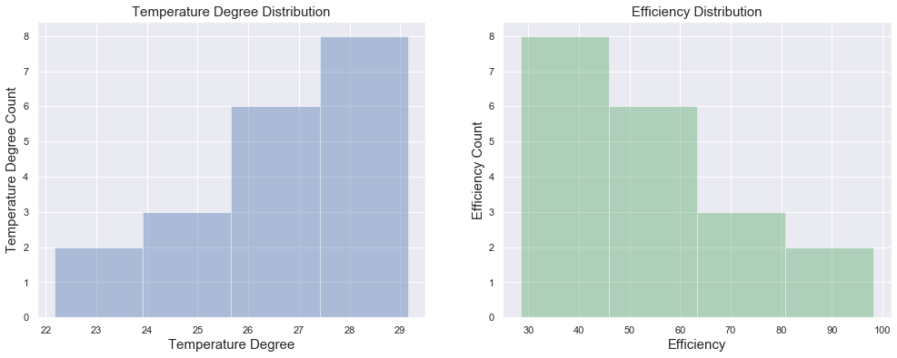
Eda - 2
One degree versus ten percent rate

Slide 12
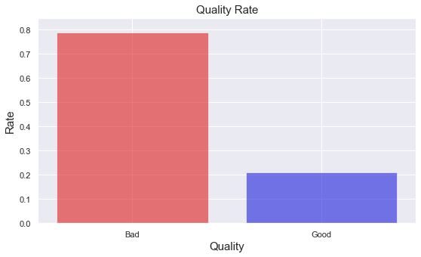

Eda-3
Bad Efficiency Rate $≈79 \%$
Good Efficiency Rate $≈21 \%$

Slide 13
Creating user program
quality type
some statistics
whole data
some graphs
Efficiency rates
reflect your programming skill

Slide 14
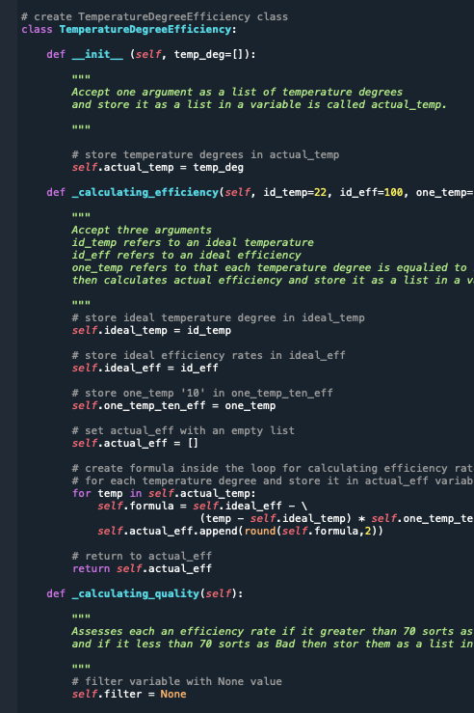
user program
Class
Temperature Degree Efficiency
Function
evaluate input
Function
run program
Function
leave comment

Slide 15
outcomes
Heatlh Accrecditation
New Formula and user program created

Slide 16
Run the program

Slide 17
REFERENCES
https://github.com/engazeez/Personal-Projects

Slide 18

Thank you

