Slide 1
ANN & LR
Artificial Neural Networks and Logistic Regression

Slide 2
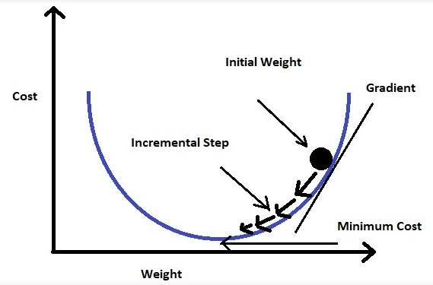
Logistic Regression
Consider a scenario where we need to classify whether an email is spam or not.
Linear regression requires:
a linear relationship between the dependant and independent variable Y = mx+c
Derive the best line of fit from the values by assigning random values to m and c until a Y` value is obtained
Compare obtained Y` against actual Y
Calculate the loss function and minimize it to get best line of fit (a technique called the gradient descent)
Loss Function = L = 1/n ∑((y – ŷ)2)
At minimum loss function we have now the best
Equation and line of best fit

Slide 3
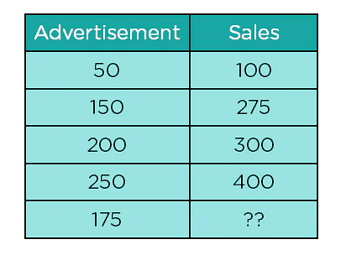
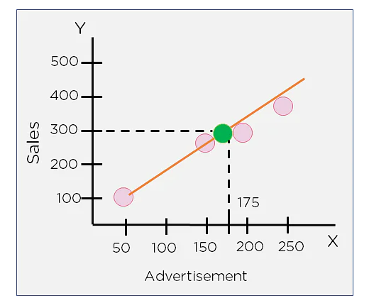
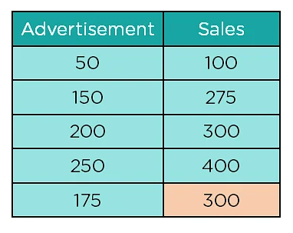
Linear regression example

Slide 4
Logistic Regression: assumptions
The outcome variable is Binary i.e. yes or no, male or female e.t.c
Observations are independent i.e not from same individual
No multicolinearity among the dependent variables i.e. eg height and shoe size these are highly correlated
No extreme outliers
Linear relationship between independent and logit of the response variables. Logit(p) = log(p / (1-p)) where p is the probability of a positive outcome.
Large dataset

Slide 5
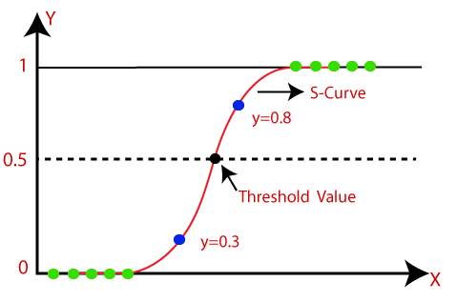
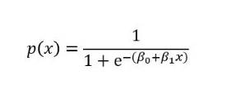
Logistic regression
Needs a probability threshold to classify as belonging in one group or another
It fits values in an s-curve not a line of best fit as linear regression
This is done using the sigmoid function
Use linear regression to determine the line of best fit
The predicted values are then used in the sigmoid function to get the output
The output of the sigmoid function is compared against the threshold which is always 0.5 and classified accordingly

Slide 6


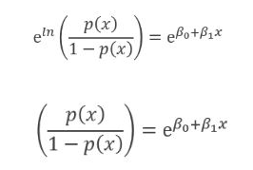
Explanation
Odds (𝜃) = Probability of an event happening / Probability of an event not happening = 𝜃 = p / 1 - p
The line of best fit = 𝑦 = 𝛽0 + 𝛽1* 𝑥
To predict the odds of success we use:
Exponeting both sides gives:
But let Y = e 𝛽0+𝛽1 * 𝑥
Then p(x) / 1 - p(x) = Y
p(x) = Y(1 - p(x))
p(x) = Y - Y(p(x))
p(x) + Y(p(x)) = Y
p(x)(1+Y) = Y
p(x) = Y / 1+Y
This translates into:

Slide 7
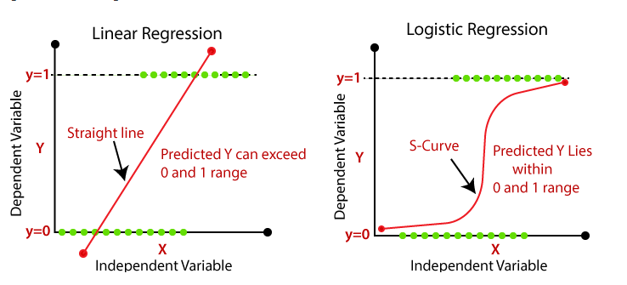
Logistic vs linear regression

Slide 8
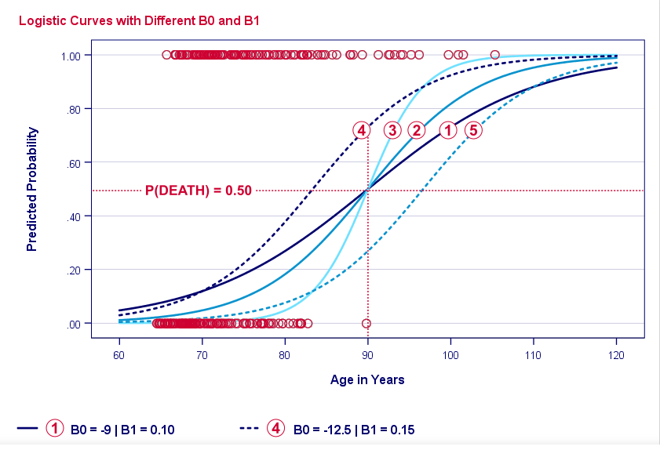
Logistic regression: example

Slide 9
What is an ANN
In the 1940s, Warren S. McCulloch and Walter Pitts published a first mathematical model of the brain that argued that neurons were capable of computing arbitrary functions on Boolean quantities.
Successors to this work slightly refined this logical model by making mathematical “neurons” continuous functions that varied between zero and one. If the inputs of these functions grew large enough, the neuron “fired” (took on the value one), else was quiescent.
Is this how a real neuron behaves? Of course not!

Slide 10
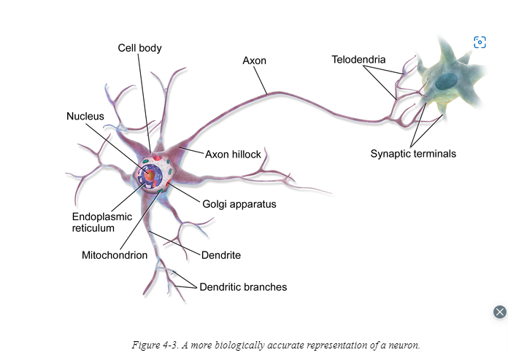
A biological Neuron

Slide 11
Biological Neuron Explained
dendrites: nerve fibres carrying electrical signals to the cell
cell body: computes a non-linear function of its inputs
axon: single long fiber that carries the electrical signal from the cell body to other neurons
synapse: the point of contact between the axon of one cell and the dendrite of another, regulating a chemical connection whose strength affects the input to the cell.

Slide 12
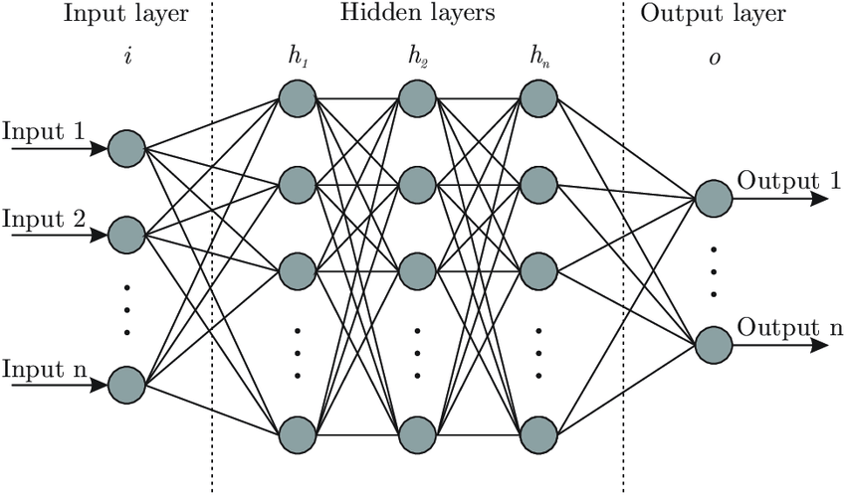
ANN architecture

Slide 13
Architecture explained
A neural network is a massively parallel, distributed processor made up of simple processing units (artificial neurons).
It resembles the brain in two respects:
Knowledge is acquired by the network from its environment through a learning process
Synaptic connection strengths among neurons are used to store the acquired knowledge.

Slide 14
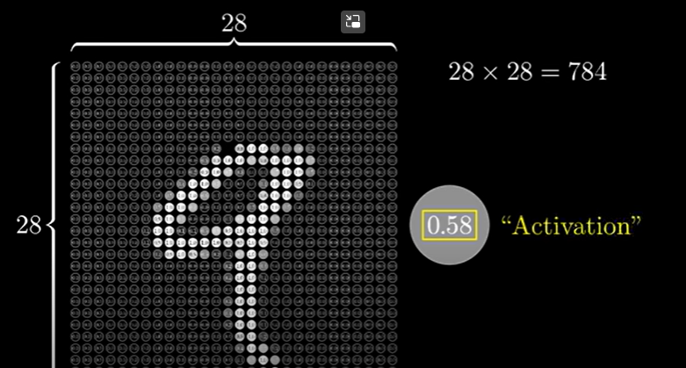
Architecture Explained
Neurons: Thing that holds a number. A number between zero and one. This number is called an activation. We only light up numbers that have a high activation close or equal to one
Notes:
Neuron: This can represent a grayscale value of the corresponding pixel for images ranging from zero for black pixels upto 1 for white pixels
Since each image in minst is made of 28 by 28 pixels, this forms our first layer

Slide 15
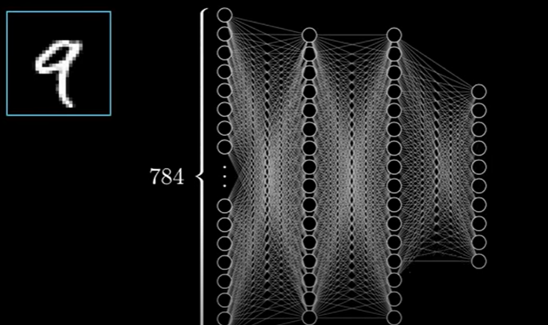
Architecture explained
Input layer: The first 784 neurons make up our first layer

Slide 16
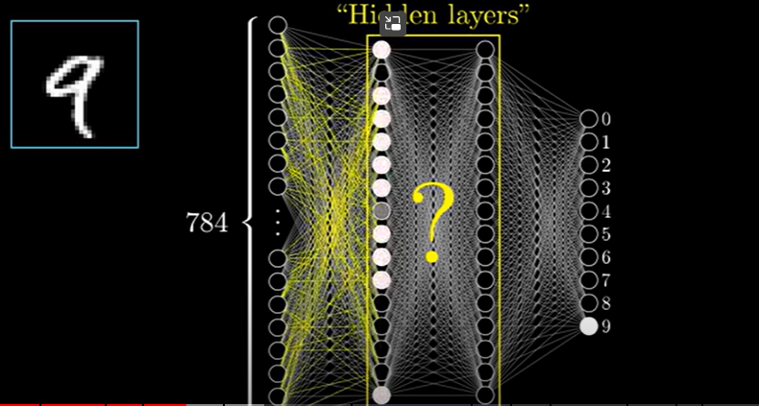
Architecture explained
Hidden layers: contain neurons that are activated based on computations on the links
Notes:
And remember activations in one layer determine the activations in another layer

Slide 17
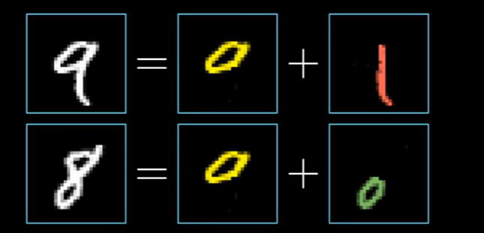
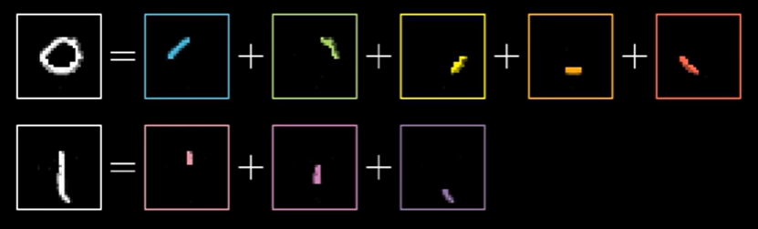
Hidden layers contd
Number representation

Slide 18
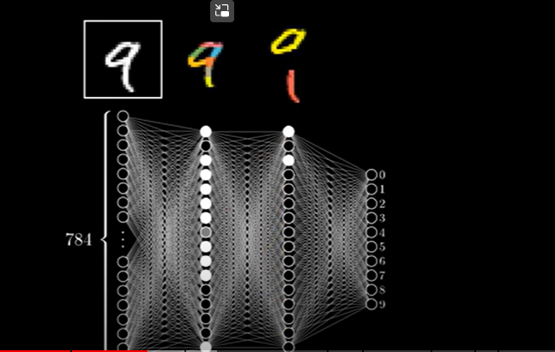
Hidden layers contd

Slide 19
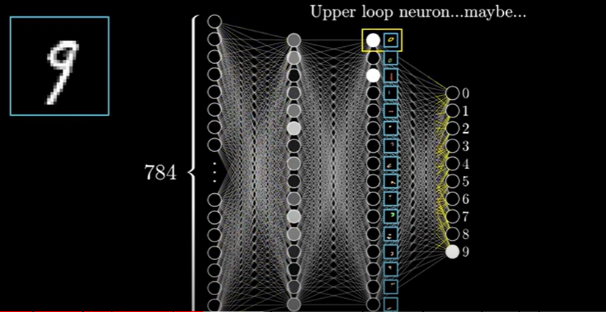
Hidden layers contd

Slide 20
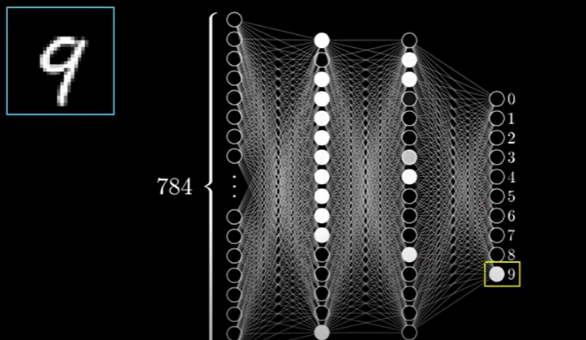
Architecture explained
Output layer: contains 0-9 neurons that have activations based on the processing done in the hidden layers of which the brightest is considered

Slide 21
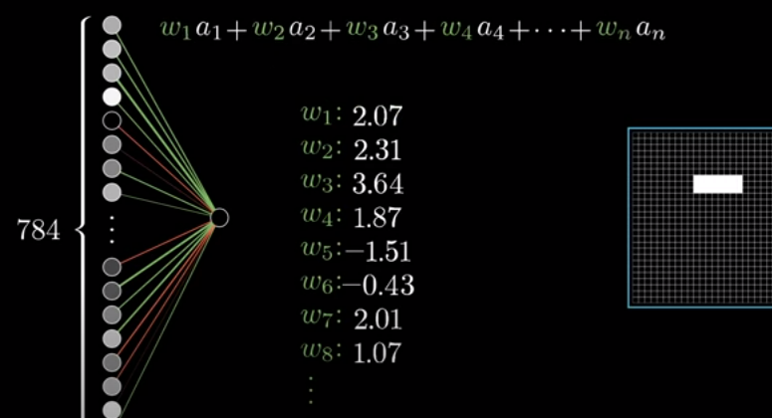
How does this work
A weight is assigned to each link from the neuron. These can be randomly assigned. w1, w2, etc. Take the activations from each of the neurons and compute their weighted sum

Slide 22
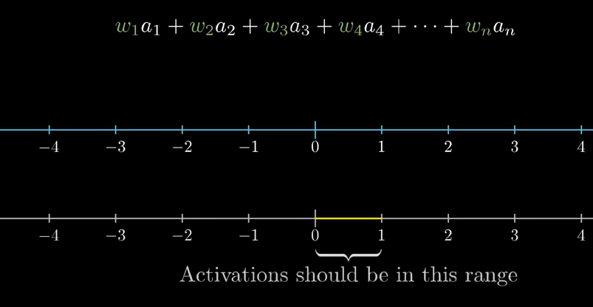
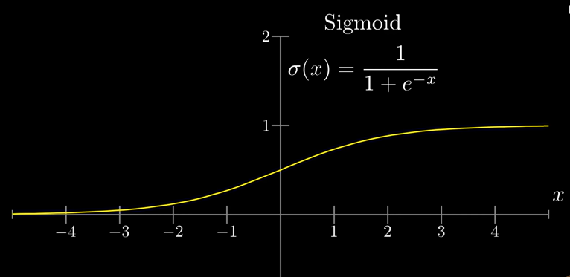
Squashing: the functions
Sigmoid, Relu and others

Slide 23
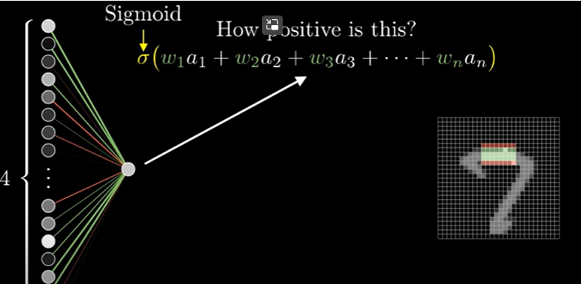
The sum
The resulting sum can be any number but we have to squash it between 0 and 1
This is where functions like sigmoid, RELu come into play

Slide 24
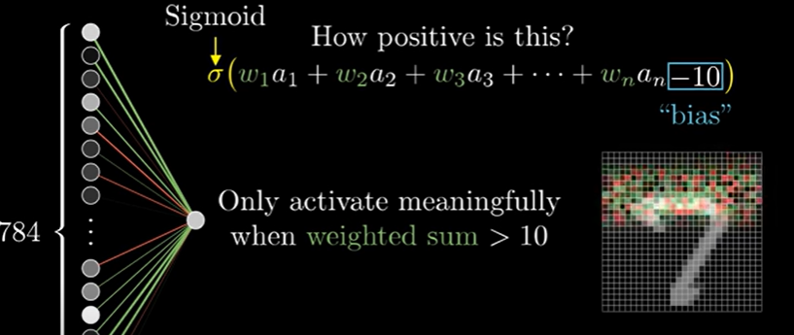
The bias
To cater for activation where sum is > than the number we include bias.
Notes:
Bias is per neuron, backpropagation

Slide 25
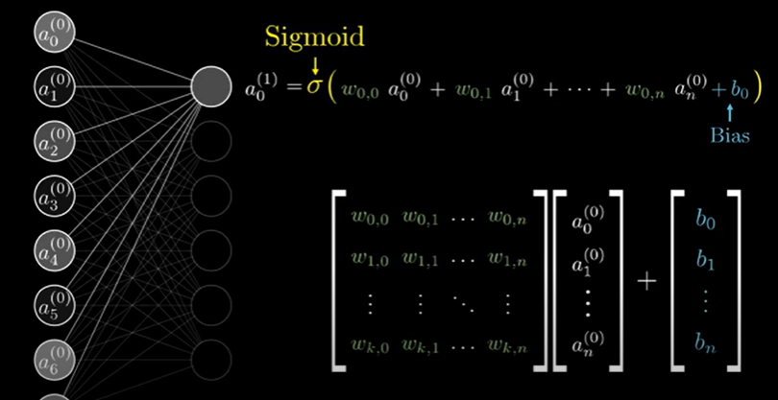

Summary
Learning: is choosing the right weights and bias this can be through backpropagation etc

