Slide 1
Medical Data as the Backbone of AI
Matt Engelhard
Duke Biostatistics & Bioinformatics
June 11, 2026
Notes:
- Quick intro
Today will be a short crash course on

Slide 2
Lecture Outline
What types of data are in electronic health records (EHRs), and why?
The importance of considering multiple data types
Similarities and differences between EHRs and other sources of medical data
Medical data as raw material for AI systems
One prediction task, one type of input data (task-specific, uni-modal)
Any prediction task, one type of input data (task-agnostic, uni-modal)
One prediction task, multiple types of input data (task-specific, multi-modal)
Any prediction task, multiple types of input data (task-agnostic, multi-modal)
Notes:
The first half of this lecture will focus on the data themselves
We’ll be thinking about what kinds of data we might find in the electronic health record, or EHR for a given patient
And why it might be there, recognizing that EHRs are designed for use in routine care
To document what happens, support clinical decision-making, and support billing
Then, the second half will focus on these data as raw material for AI development and how that works
We’ll think about ways to use data to develop systems that range from very specific
-- Focused on one type of data, and one prediction task --
To building systems that understand medical data broadly speaking,
and can support a range of data types and tasks
By the end, you should have a sense of what we might find in the EHR
Why a range of modalities are important and complement one another to enhance prediction and understanding
And an initial, intuitive sense of how they are developed
And trends taking place in model development, including from task specific to task-agnostic and multi-modal

Slide 3
The Electronic Health Record
One stop shop for most varieties of medical data
Notes:
OK – moving into our first part,
let’s think about what we might find in the EHR, and why
Now, not all medical data is found in the EHR, of course
But it does a pretty good job reflecting the range of data we might see
Admittedly limited to a particular clinical setting
Often a large academic medical center

Slide 4
Structured Data
Definition: data organized into specific, queryable fields as part of an overarching model, with each field having a defined purpose.
typically stored in tabular (i.e. table, spreadsheet) format
numeric variables, categorical variables and/or short free text
Examples: demographics, diagnoses, procedures, labs, meds, vitals
Notes:
As we begin our tour of EHR data, let’s start with the structured data
These are [READ DEFINITION]…
They’re data are usually stored in a table, maybe as part of an overarching data model, or in a spreadsheet, say as a csv file
they're comprised of columns of distinct variables, which are usually going to be numeric or categorical, and you might have some text fields here and there
if somebody said they're we're going to hand you a dataset from their clinical study, this is what you'd expect to get
and in the EHR, this is all the stuff you'd pull out of a system like DEDUCE here at duke -- a table of demographics, a table of diagnoses, and so on

Slide 5
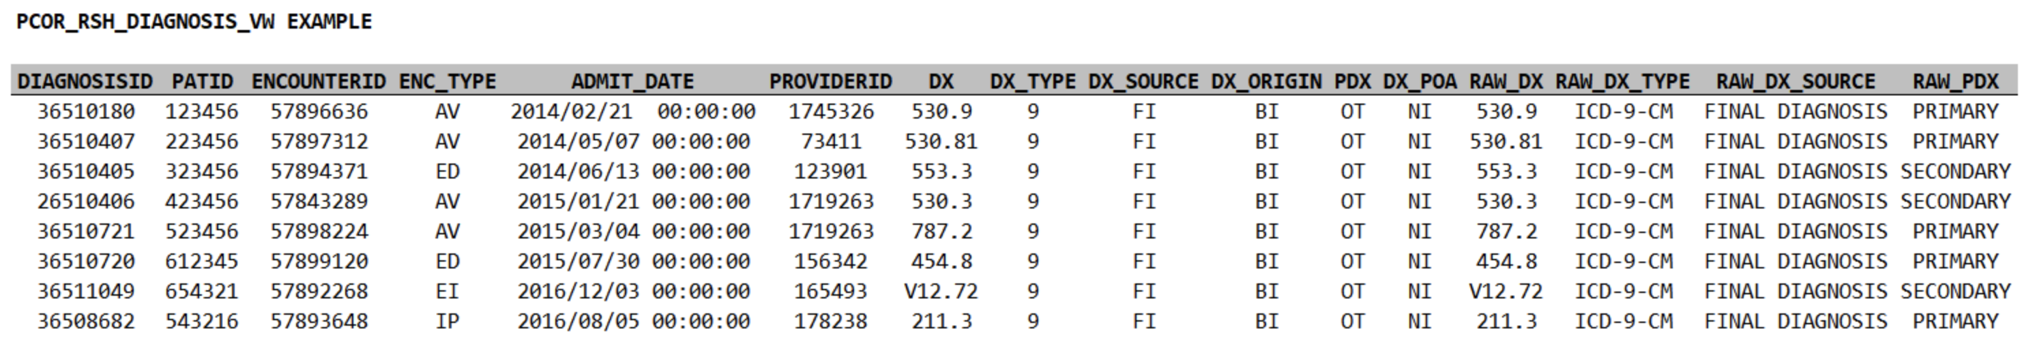
An example of structured EHR data (PCORnet CDM)
COLUMN | DEFINITION
DIAGNOSISID: | An arbitrary identifier for each record. Not currently useful for linkage across tables.
ENCOUNTERID: | The ENCOUNTERID (encounter ID) is an arbitrary identifier for a specific encounter that can be used to link information across tables in the model.
PATID: | The PATID (patient identifier) is an arbitrary, person-level identifier used to link information across tables within the data model. There is a table within the CRDM that allows an investigator with an appropriate IRB protocol to link PATID to MRN.
ENC_TYPE: | Encounter type indicates the setting in which the encounter took place (the same data are provided in the encounter table: AV=Ambulatory Visit, ED=Emergency Department, EI=Emergency Department Admit to Inpatient Hospital Stay, IP=Inpatient Hospital Stay, OS=Observation Stay, NI=No information, UN=Unknown, OT=Other
ADMIT_DATE: | The date on which the encounter began (also included in the encounter table).
PROVIDERID: | Unique identifier for a provider ? can be used to link an encounter to the provider table.
DX: | The diagnosis code; uses either ICD-9 or ICD-10
DX_TYPE: | 09=ICD-9-CM, 10=ICD-10-CM, 11=ICD-11-CM, SM=SNOMED CT, NI=No information, UN=Unknown, OT=Other
DX_SOURCE: | The approximate period within the encounter when the diagnosis was made for the patient; diagnoses are always ?Final Diagnosis (FI)?, from the billing codes.
DX_ORIGIN: | The source of the diagnosis information. ?Billing (BI)? is always the source in this data model. In 2021 OD, other diagnosis types where added that are admission and encounter_diagnosis. Billing diagnosis are still the main diagnosis to use for research projects.
Notes:
Here's an example from Duke's clinical research datamart
we have rows of identifiers, some of which can be used to link this table to other tables, including the patient id
this is a table of diagnoses, so the key column is the column of diagnosis codes
and then we have additional columns of supporting details, including the date and time, and so on
importantly, associated with this table we have a key, or dictionary, which explains what we're seeing in each of the columns

Slide 6
Unstructured Data (i.e., everything else)
Definition: data that is NOT structured data
not natural to organize in tabular format
typically stored in a modality-specific format
Examples:
clinical notes
imaging (e.g. radiology, ophthalmology, ultrasound, pathology)
physiologic time series (e.g. electrophysiologic studies, digital health)
Notes:
Sometimes when thinking about the EHR, we break things down into (1) structured data, and (2) unstructured data
By which we mean everything else:
Unstructured data are defined simply as data that are NOT structured data
i.e. everything that does not fit cleanly into tabular format
these are your clinical notes
your images, (think radiology, pathology, ophthalmology)
your electrophysiologic studies -- electrocardiograms, electroencephalograms, electromyelograms, electrowhateverograms
it includes digital health data -- we're seeing more and more efforts to incorporate this stuff in the EHR
it might even include audio data
the list is always growing
NOT organized into specific, queryable fields as part of an overarching model
and they do NOT fit neatly into a csv file -- instead, they tend to be stored in specific, specialized formats
for images you've got your pngs and jpegs, but you've also got your DICOM files, for example
there's a huge variety here -- far too big to cover in a single lecture
and so we're going to be talking about some general principles and focusing mostly on the most common modalities, which are images and text

Slide 7
Is structured data enough?
What’s contained in structured fields, and what’s missing?
Notes:
The second half will focus on how we use all these different modalities, taken together
But first, let’s think about why
What’s in the structured data, and what’s missing

Slide 8
A patient presents with shortness of breath…
Presents to urgent care and is transferred to the ED
Evaluated in the ED
History of present illness
Review of medical history (including meds and allergies) + social and family hx
Physical exam and review of systems
Lab results: BMP and CBC
Imaging & other studies: CT and EKG
Admitted to the hospital
Notes:
To do that, let’s consider a simplified case to think about what data, both structured and unstructured, will be generated
Suppose we have a patient that goes to urgent care – they’re transferred to the emergency department because the providers at urgent care suspect a PE, or pulmonary embolism
This is a blood that forms usually in the veins in your leg, then dislodges and travels through the right heart and into the lungs, where it can go no further, so it gets stuck, blocking blood flow, damaging tissue, and so on – not good
So they transfer this person to the emergency department, where a bunch of things happen, not necessarily in the particular order I’m showing here
1, a provider is going to document the patient’s story, including all the details believed to be relevant to the current situation
This is going to include the patient’s broader medical history – other medical conditions, their medications, any allergies
As well as their social history and family history – what conditions do family members have
The provider will do a physical examination at some point, again with emphasis on the current situation, and they’ll do a review of systems – this is a head to toe review of patient covering all the different organ systems
They’re also going to get some lab results – in this case, they’ll get a basic metabolic panel, which is a very common, standard set of labs that summarizes your fluid and electrolyte status, kidney function, and blood sugar levels
And they also get a complete blood count, which gives information about the cells in your blood – both white cells and red cells
They’ll also get a CT scan of the lungs, which along with the labs will help them determine whether it’s really a pulmonary embolism versus something else, pinpoint the location, see the extent of the damage, and so on
And this is a pretty serious issue, so this patient needs to be hospitalized – the emergency department is going to go ahead and admit them to the hospital

Slide 9
What will we find in the structured data?
Encounter details (ED admission)
Labs (BMP, CBC)
Vital signs
Procedure codes (CT)
Diagnosis codes (PE)
…what won’t we find?
Notes:
Now, which parts of this story are going to make it into the structured data?
Well, we’ll see who the patient is -- their age, sex, race
We’ll see that they came to the emergency department, and that they were admitted from the ED
We’ll see diagnosis codes, so we SHOULD end up seeing codes related to pulmonary embolism, supposing that ends up being the issue
And we’ll see procedure codes – we’ll see that they got a CT, for example
We’ll even see the details of those labs – the exact electrolyte values, their white cell count, and so on
So, that’s a lot of information. But it is really a comprehensive summary of the encounter?
Let’s thing about what we WON’T see.

Slide 10
The H&P
written by a UNC student and publicly available:
https://www.med.unc.edu/medclerk/education/grading/history-and-physical-examination-h-p-examples/
FHIR systems SHALL support, at minimum, these eight “Common Clinical Notes”:
Consultation Note (11488-4)
Discharge Summary (18842-5)
History & Physical Note (34117-2)
Procedures Note (28570-0)
Progress Note (11506-3)
Imaging Narrative (18748-4)
Laboratory Report Narrative (11502-2)
Pathology Report Narrative (11526-1)
Notes:
To do that, let’s start by looking at patient’s story, as documented by a provider
This example I’m showing you is publicly available on the internet, written by a UNC medical student
as an example of how to write a history and physical, which is a detailed note covering all the elements I mentioned a moment ago
It’s also one of the note types required as part of the FHIR standard.
Now, if you read through this note, what you’ll find is that it’s very information dense.
There’s a ton of detailed information here, and all of it is potentially very important
We get his pain level and a description of the nature of the pain
We get subjective elements of his experience – a ”rattling” in his chest
We see that he had pneumonia about two months ago – this context may be very important to understand
Some of this makes it into structured fields, but more of it doesn’t

Slide 11
The H&P
written by a UNC student and publicly available:
https://www.med.unc.edu/medclerk/education/grading/history-and-physical-examination-h-p-examples/
FHIR systems SHALL support, at minimum, these eight “Common Clinical Notes”:
Consultation Note (11488-4)
Discharge Summary (18842-5)
History & Physical Note (34117-2)
Procedures Note (28570-0)
Progress Note (11506-3)
Imaging Narrative (18748-4)
Laboratory Report Narrative (11502-2)
Pathology Report Narrative (11526-1)
Notes:
Continuing on, we see all those different elements I mentioned
His past medical history, medications, review of systems

Slide 12
The H&P
written by a UNC student and publicly available:
https://www.med.unc.edu/medclerk/education/grading/history-and-physical-examination-h-p-examples/
FHIR systems SHALL support, at minimum, these eight “Common Clinical Notes”:
Consultation Note (11488-4)
Discharge Summary (18842-5)
History & Physical Note (34117-2)
Procedures Note (28570-0)
Progress Note (11506-3)
Imaging Narrative (18748-4)
Laboratory Report Narrative (11502-2)
Pathology Report Narrative (11526-1)
Notes:
And finally, we get to the assessment and plan --
This is the providers putting all the pieces together, summarizing the situation, and plotting next steps
The structured data will tell us a little bit about what they ended up doing, but it won’t really tell us why.
Here we get quite a bit of insight into the details of their thought process at the time.
This is not something you’ll find in a csv file

Slide 13
Notes are a rich source of info
Notes:
Now you might think – well, this is interesting, and maybe it was very important at the time, but is it really important for the kinds of things that I want to do with the data.
And of course it depends on what you’re doing, exactly, but in general the answer it YES – it matters more than you might think
Here’s the key finding of a recent JAMIA paper focused on identifying cardiovascular diseases and procedures from EHR data
Each of these concepts was identified by chart review by clinical expert annotators
And then they train models to identify those concepts based on
(a) structured data – this is “EHR-S”
And (b) clinical notes – this is “EHR-U”
Their findings tell a pretty consistent and compelling story
Both approaches do pretty well in terms of precision – also known as positive predictive value – in other words, both models are usually right when they tell you they’ve identified one of these concepts
However, the recall – aka the sensitivity – is FAR better for the unstructured models
Very often, the structured data models miss it
And if you look through the details, they do a good job building these models
The issue is not the models themselves – it’s that the structured data very often doesn’t contain the relevant information. It’s only found in the notes.

Slide 14
A patient presents with shortness of breath…
Presents to urgent care and is transferred to the ED
Evaluated in the ED
History of present illness
Review of medical history (including meds and allergies) + social and family hx
Physical exam and review of systems
Lab results: BMP and CBC
Imaging & other studies: CT and EKG
Admitted to the hospital
Notes:
OK, so hopefully I’ve convinced you that the notes matter
What about images?
Going back to our case, we know this patient also had a CT scan

Slide 15
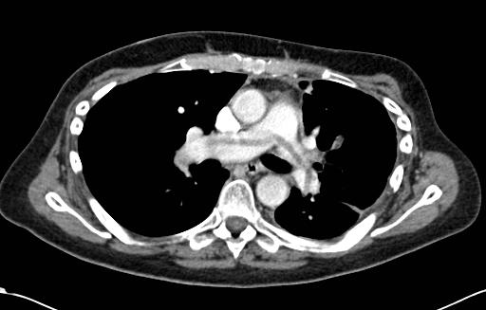
Imaging
A CT is worth a thousand words
Radiologist’s interpretation (e.g. radiology report):
Distills known, salient info
But can miss relevant signal
Large non-occlusive pulmonary embolus draped over the bifurcation of the main pulmonary artery; a saddle pulmonary embolus.
https://radiopaedia.org/cases/pulmonary-embolism-saddle-1?lang=us
Notes:
Here’s a CT slice – this is coming from a really useful site called radiopedia – that shows a large blood clot sitting over the first branching of the main pulmonary artery
Reading a CT is a little beyond the current scope, but here we’re looking at a slice of a patient who’s lying down, with their feet coming out toward you, if you could see them
And the dark areas on either side of the center are lung tissue
So again, think about all the information that’s contained in this image
Which might be a bit difficult if you’re not a radiologist
But it shouldn’t be too hard to convince yourself that there’s a ton information here about the physical characteristics of the blood clot, the surrounding vessels and tissue, and this patient’s anatomy
1000 words wouldn’t be nearly enough to describe it all
And little to none of this information makes it into structured fields
The structured data tells us that the CT scan happened, and what was done as a result – that’s about it.
Now, on top of the scan itself, there will be a note with the radiologist’s description of the image and their interpretation
So, if we use that note, we get part of the way there – we get information about this scan, as interpreted by the radiologist, that is not found in structured fields
Even so, the original scan of course contains more information than the radiologist’s note – at the end of the day, both are very valuable

Slide 16
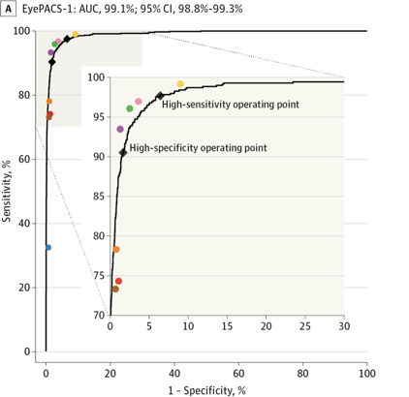
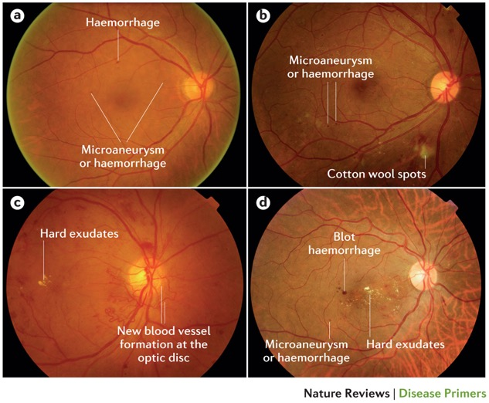
Computer vision vs clinical experts
colored dots are expert performance
Wong, T. Y. et al. (2016) Diabetic retinopathy
Nat. Rev. Dis. Primers doi:10.1038/nrdp.2016.12
Gulshan V, Peng L, Coram M, et al. Development and Validation of a Deep Learning Algorithm for Detection of Diabetic Retinopathy in Retinal Fundus Photographs. JAMA. 2016;316(22):2402–2410. doi:10.1001/jama.2016.17216
Notes:
But as before, we don’t really need to speculate about the value of information in images, or our ability to extract this information
Over the last few years, we’ve seen quite a few results showing that deep neural networks, if given a sufficiently large dataset to learn from -- are capable of analyzing medical images as well as – or in some cases, better than – trained specialists
Here we see the performance of a model that takes a fundoscopic image – that is, an image of the back of the eye – and predicts whether the patient has referrable diabetic retinopathy.
In this case, we see that the sensitivity and specificity of the model are on par with retina specialists
And similar findings have been observed in dermatology – a deep neural network was able to identify malignant skin lesions as well as trained dermatologists – as well as in pathology, radiology, etc
These results hold only for very specific scenarios and again, they also require large amounts of training data
Nevertheless, it’s very clear that there’s information in these images that you wouldn’t get from going over a patient’s previous medical history and other information previously captured in structured fields

Slide 17
A patient presents with shortness of breath…
Presents to urgent care and is transferred to the ED
Evaluated in the ED
History of present illness
Review of medical history (including meds and allergies) + social and family hx
Physical exam and review of systems
Lab results: BMP and CBC
Imaging & other studies: CT and EKG
Admitted to the hospital
Notes:
Now, going back to our snapshot once more, we do see that this patient had an EKG – an electrocardiogram

Slide 18
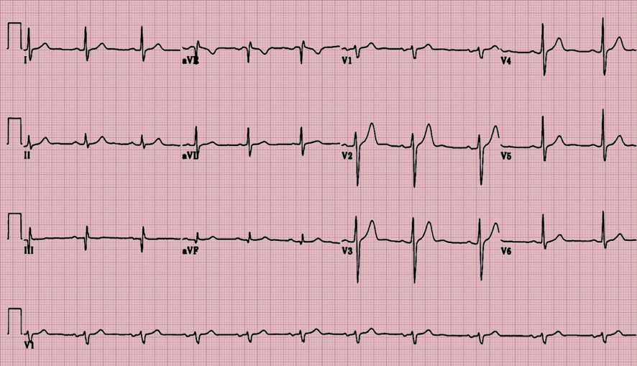
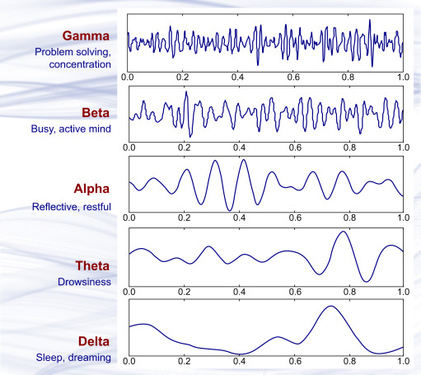
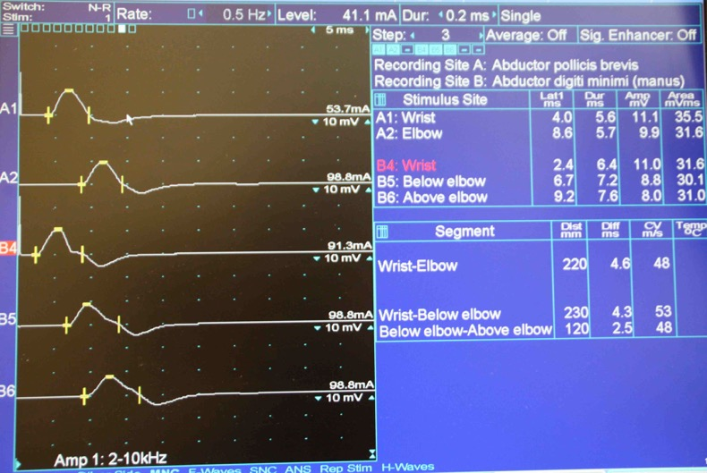
Electrophysiology
EKG
EEG
EMG
Notes:
We’re going to focus less on electrophysiologic studies today, but suffice to say that an analogous argument holds for these data as well
Each of these studies generates a multi-dimensional physiologic time series that contains much more information than the resulting report
And in each case, the value of these data across a range of prediction tasks has been demonstrated in the biomedical literature. In fact, models for these data are fairly similar to the models that are used for image processing
I’m focusing even less on digital heatlh data in this lecture – that is, data captured by wearable devices and pertaining to the wearer’s physiology
But the same arguments hold for digital heatlh data, too, and we anticipate seeing these data integrated in EHR systems in the near future

Slide 19
Why use unstructured data?
Reason 1: it contains information not found in structured fields
clinial/domain knowledge helps gauge whether/when this info will be useful
example: use radiological images when predicting COPD prognosis
Reason 2: it can be more accessible, no expert interpretation needed
example: predict malignancy from smartphone images of skin lesions
Reason 3: it is unaffected (or less affected) by provider decision-making
example: predict need for surgery from imaging of small bowel obstruction
Notes:
Before moving on to HOW we can use unstructured data, let’s take a last, quick, 10000 ft view of why this is a good idea
The first reason, and the one I’ve emphasized most here, is that these data contain information that’s not found in structured fields, yet is useful for a wide variety of analyses and prediction tasks
Now, the importance of that data compared to the structured data depends on the task, and knowing whether and when different data elements are likely to be important really depends on clinical knowledge
As a rule of thumb, it’s good to assume that these data MIGHT be important
So, when both structured and unstructured data are available, it often make sense to first build a simple model that uses structured data only
then see whether you get an improvement from adding an unstructured data modality that you hypothesize may be relevant. We’ll take a look at how to do that in just a moment.
But there are a couple other reasons we might use unstructured data
Reason 2 is that although we might be accessing the data through an EHR system initially, it might be possible to obtain similar data outside of an HER setting as well
If we find we can predict malignancy from images of skin lesions available in the HER, for example, we might ultimately aim to adapt and deploy the resulting model in a smartphone app
Finally, a third reason is that in some cases, we want to use unstructured, raw data exactly BECAUSE it has not been interpreted by a provider
Most structured data elements are affected by provider decision-making – if the provider things the patient has a PE, they’ll order different labs than if they think the patient had a heart attack
In most cases, this is helpful -- we want to take advantage of this information
But in other cases – prediction of referable diabetic retinopathy, going back to our earlier example – our goal is just the opposite – we want to see whether an algorithm can identify the condition WITHOUT the retina specialist’s interpretation
If that’s the case, we need to avoid structured elements that reflect provider decisions – and instead work only from that fundoscopic image

Slide 20
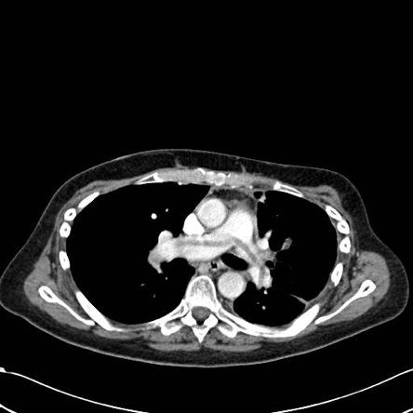
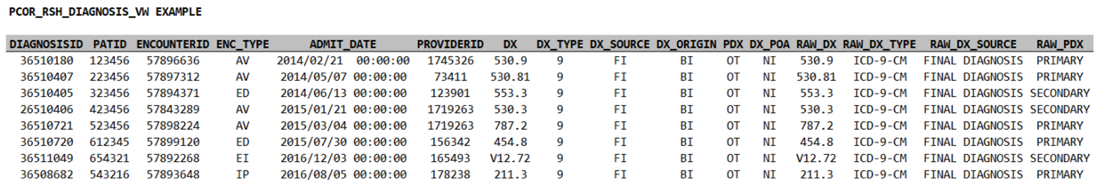
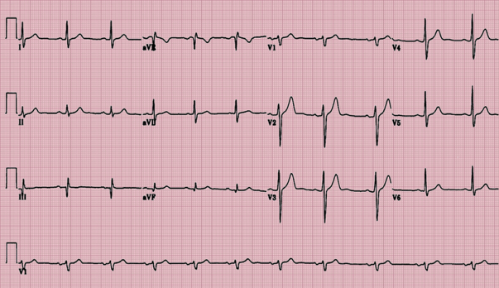
Why might we need many modalities?
Structured EHR data
Imaging
Clinical notes
EKG and other physiologic time-series
Notes:
Why multi-modal data?
In some cases, there’s overlap between them
But in many cases, each modality contains distinct information
That may be important to decision-making
So ideally we’d like to have methods that consider all modalities together
And synthesize it
Including by retaining information about what’s shared between modalities, and what’s distinct

Slide 21



A patient timeline of structured data
Lab test
Diagnosis code
Medication
Notes:
In the EHR, and in real life, data are collected over time, in sequence
We might see a lab test (diagnostic reasoning)
Followed by a dx code (making a dx, or billing)
Followed by a medication indicating a decision about treatment
If we focus on structured data only, this is ALL we’ll see

Slide 22
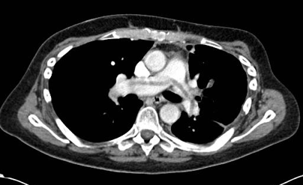
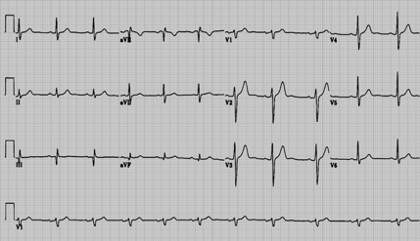
A patient timeline of multi-modal data
Imaging
Note
Electrophysiology
Lab test
Diagnosis code
Medication
Notes:
When adding the unstructured data to this timeline
A much richer picture emerges
We see not just what providers did, but have much more evidence as to why
Both from the raw findings, e.g. images
And in notes, which often describe the rationale
It’s this kind of rich, multi-modal timeline that we want our AI methods
To be able to make sense of

Slide 23
Task-specific, single-modality AI
Image processing
Natural language processing
Structured data processing
Notes:
So now let’s think about how we can do that
And as previously mentioned, we’ll move from systems that are more special purpose
Meaning they solve one prediction task based on one type of data (one modality)
To systems that are increasingly general
Let’s begin with with models that focus on one prediction task from one type of data
“task-specific, single-modality”

Slide 24
A typical prediction model
outcome
logistic
regression
label
vector of clinical variables
(e.g. age, sex, BP, HR)
Notes:
These are your typical prediction models
We might [APACHE EXAMPLE]
This also works for structured data [group codes or events in a given window]

Slide 25
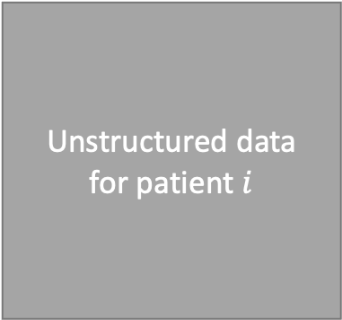
Learning representations of complex medical data
Unstructured data
for patient $i$
Modality-Specific
Encoder
outcome
logistic
regression
logistic
regression
label
input data
vector of features
that concisely represent the input
“learned feature extraction”
Notes:
But once we move outside of tabular data toward complex modalities
We need a way of extracting a limited number of salient features from these modalities
And to do that, we can think about the notion of an encoder
Without worrying at this stage about how we obtain it, suffice to say that our encoder
Is going to take a particular complex input modality as input
And produce a vector representation as output
This representation contains salient features that are useful for a specific prediction task

Slide 26
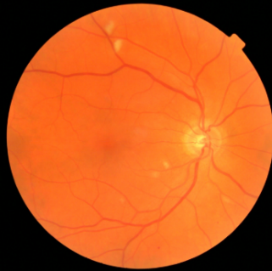
Learning representations of images
CNN
Encoder
outcome
logistic
regression
label
vector of features
(indicating high-level motifs)
image
Notes:
Let’s think about a few specific examples
Now, imagine that instead of clinical variables, we instead had a fundoscopic image for each study participant.
Applying logistic regression directly to the pixels in the image isn’t going to work here.
Instead, we can apply an encoder – in this case, a convolutional neural network – to each image.
This will give us a feature vector that describes the degree to which 1000 or so complex patterns – patterns that are known to be important for other prediction tasks – are present in the image
We can then use logistic regression or a one-hidden-layer neural network to predict the probability of heart attack from these feature vectors
And depending on how big our dataset is, we may or may not have enough data to improve this encoder
Such that the features it extracts are optimal for the prediction task at hand

Slide 27
Learning representations of clinical notes
NLP
Encoder
pulmonary embolism
logistic
regression
label
vector of features
(old: indicating word counts)
(new: indicating semantic features)
document
Notes:
Now for this brief lecture we’re of course not going to think about exactly how each of these encoders works
But what’s important is that we have a process
Optimized for a particular type of data
by which that data type, in this case a text document, can be encoded as a feature vector
In our image processing example, the elements of this feature vector corresponded to high level motifs, or patterns, that might be present in the images
This time, the elements of this feature vector might correspond to counts of words in a document
Or they might correspond to high level semantic motifs
In both cases, at the end of the day we have a feature vector that we can use to predict an outcome of interest via logistic regression

Slide 28
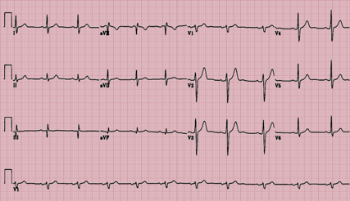
Learning representations of other modalities
Modality-Specific
Encoder
outcome
logistic
regression
label
EKG
vector of features
Notes:
This is the important, general principle to understand
The details of the encoder are going to be modality-specific and potentially complex
But, the general rule when working with unstructured data is that you’ll need to identify and use encoders appropriate for each modality
If you’re working with EEG data, you’ll need an encoder designed for EEG data
If you’re working with digital health data, you’ll need an encoder designed for digital health data
Currently, many of the most effective encoders are neural network based, but this is not necessarily or always the case

Slide 29
Learning representations of complex medical data
Unstructured data
for patient $i$
Modality-Specific
Encoder
outcome
logistic
regression
logistic
regression
label
input data
vector of features
that concisely represent the input
“learned feature extraction”
Notes:
Now, importantly, in the one modality, one prediction task paradigm
These encoders will be developed on a single prediction task
But training them requires quite a bit of data
So it will be a prediction task with often millions of examples…

Slide 30

Transfer learning: Train on one task, fine-tune on another
CNN
Encoder
dog?
logistic
regression
update weights
for new task
CNN
Encoder
retinopathy?
logistic
regression
The model remains task-specific, but can be adapted to new tasks ad hoc
This tends to be helpful, because some features are important to many tasks
Notes:
We often don’t have as much data as we might like – enough to train these encoders
But it turns out that for a given modality, often the important features are largely conserved between different prediction tasks
At the very least, it turns out that it doesn’t hurt to start with [PRETRAINED MODEL]
So again, the more traditional paradigm is that we train for individual tasks – which often requires a lot of labels
And then

Slide 31
Task-agnostic, single-modality AI
Image processing
Natural language processing
Structured data processing
Notes:
Move toward situations where we’re still focused on one type of data
But we try to learn in a way that is more general…

Slide 32


Self-supervision: predict the missing patch
Which is correct?
Filling in the blank – or identifying the correct completion – requires an understanding of fundoscopic images
Notes:
The idea here is called “self-supervision” – the idea that we learn to extract features that predict labels
That are in fact derived from the data themselves
In short, we build a model that’s able to predict what’s missing, or what might come next
And it turns out that being able to do this… [UNDERSTANDING, MANY TASKS]
I think from this example you can convince yourself that to be able to solve the prediction task I’ve given
You might have to have an understanding of what fundoscopic images look like,, and how they fit together

Slide 33
Self-supervision: predict the missing patch
CNN
Encoder
assess
similarity
Filling in the blank – or identifying the correct completion – requires an understanding of fundoscopic images helpful for many prediction tasks
Notes:
The way we would make this kind of prediction…

Slide 34
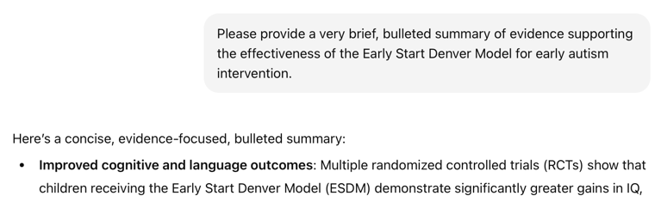


Self-supervision: predict the next word or event
EHR Foundation models
Intuition:
Learn representations sufficient to predict the next (or missing) EHR event; these can then be adapted for specific prediction tasks.
y, next word
x, conversation history
y, next event
x, EHR event history
Notes:
In the NLP case…
And we can do the same thing with structured EHR data…

Slide 35
Task-specific, multi-modality AI
Image processing
Natural language processing
Structured data processing
Notes:
So we’ve thought about how we learn representations that aren’t tied to a particular task
But rather reflect a general understanding of a given modality
That turns out to useful for many tasks
But now, how do we solve the other problem – how do we put information from many modalities together

Slide 36
Separate Prediction Models
P(outcome | data)
logistic
regression
clinical variables
CNN
Encoder
P(outcome | data)
logistic
regression
image
image features
NLP
Encoder
P(outcome | data)
logistic
regression
document
document features
Notes:
Well, the simplest way, which sometimes does work well
Is to simply build models for each of the modalities you care about…

Slide 37
Late fusion
P(outcome | data)
logistic
regression
aggregate predictions
clinical variables
CNN
Encoder
P(outcome | data)
logistic
regression
image
image features
NLP
Encoder
P(outcome | data)
logistic
regression
document
document features
Notes:
And then put their predictions together at the very end
What’s gained here: simplicit
What’s lost? Interactions between modalities

Slide 38
Late fusion
P(outcome | data)
logistic
regression
aggregate predictions
Average
Max (e.g., MIL)
Meta-predictor (this is called stacking)
Bayesian fusion
(a range of strategies, some more complicated than others, can be used to aggregate)
clinical variables
CNN
Encoder
P(outcome | data)
logistic
regression
image
image features
NLP
Encoder
P(outcome | data)
logistic
regression
document
document features
Notes:
But this is commonly done – it’s called late fusion
And the question is how exactly we aggregate

Slide 39
Joint fusion by feature concatenation
CNN
Encoder
P(outcome | data)
prediction
head
(typically a one-layer MLP)
image
NLP
Encoder
concatenated, multi-modal features
document
Notes:
But what if we want to make predictions from all three types of data, together?
As this diagram suggests, we can approach this by simply concatenating – in other words stacking – all of our feature vectors together. We can combine our clinical variables with our extracted image features and extracted NLP features.
Of course, this is the obvious thing to do once you understand the concept of an encoder, but having effective encoders for some of these data types – notably image data – is still a fairly recent development

Slide 40
Joint fusion by feature concatenation
Train independently
Concatenate
Train together
CNN
Encoder
P(outcome | data)
prediction
head
(typically a one-layer MLP)
image
NLP
Encoder
concatenated, multi-modal features
document
Notes:
But what if we want to make predictions from all three types of data, together?
As this diagram suggests, we can approach this by simply concatenating – in other words stacking – all of our feature vectors together. We can combine our clinical variables with our extracted image features and extracted NLP features.
Of course, this is the obvious thing to do once you understand the concept of an encoder, but having effective encoders for some of these data types – notably image data – is still a fairly recent development

Slide 41
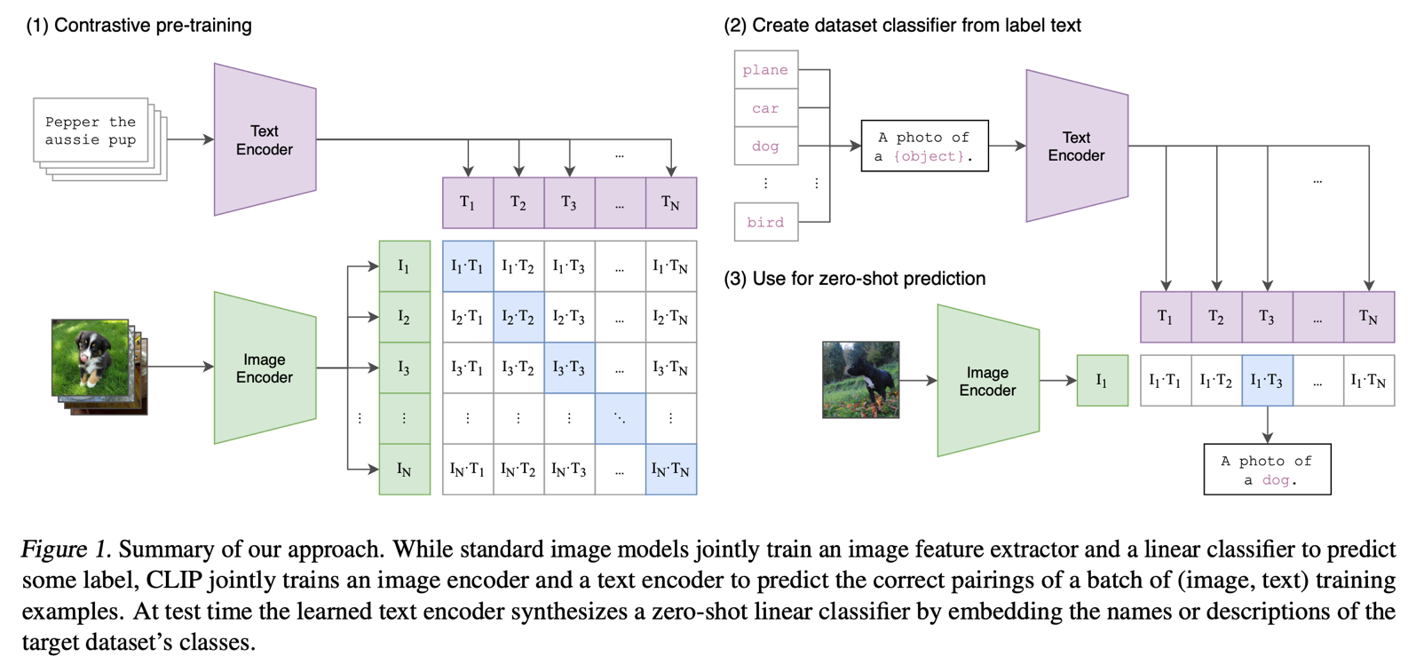
Joint fusion via contrastive learning
Radford A, Kim JW, Hallacy C, Ramesh A, Goh G, Agarwal S, Sastry G, Askell A, Mishkin P, Clark J, Krueger G. Learning transferable visual models from natural language supervision. InInternational conference on machine learning 2021 Jul 1 (pp. 8748-8763). PmLR.
Notes:
We learn representations that are sufficient to allow us to determine
Which picture corresponds with which text description
It’s actually a very simple but powerful idea
And this would work for any pair of modalities
Determine which EEG corresponds to which MRI, for example

Slide 42
Joint fusion in shared representation space
Contrastive (e.g., CLIP) loss applied
CNN
Encoder
+
=
P(outcome | data)
image
MLP
NLP
Encoder
Train independently to predict outcome
Train together to (a) predict outcome, and (b) reduce contrastive loss
multimodal
representation
document
Notes:
But what if we want to make predictions from all three types of data, together?
As this diagram suggests, we can approach this by simply concatenating – in other words stacking – all of our feature vectors together. We can combine our clinical variables with our extracted image features and extracted NLP features.
Of course, this is the obvious thing to do once you understand the concept of an encoder, but having effective encoders for some of these data types – notably image data – is still a fairly recent development

Slide 43
Joint fusion in shared representation space
Q: What happens if we train to minimize the contrastive loss only?
Contrastive (e.g., CLIP) loss applied
CNN
Encoder
+
=
P(outcome | data)
image
MLP
NLP
Encoder
Train independently to predict outcome
Train together to (a) predict outcome, and (b) reduce contrastive loss
multimodal
representation
document
Notes:
But what if we want to make predictions from all three types of data, together?
As this diagram suggests, we can approach this by simply concatenating – in other words stacking – all of our feature vectors together. We can combine our clinical variables with our extracted image features and extracted NLP features.
Of course, this is the obvious thing to do once you understand the concept of an encoder, but having effective encoders for some of these data types – notably image data – is still a fairly recent development

Slide 44
Joint fusion in shared representation space
Q: What happens if we train to minimize the contrastive loss only?
A: we will lose distinct information between modalities that is predictive of the outcome
Contrastive (e.g., CLIP) loss applied
CNN
Encoder
+
=
P(outcome | data)
image
MLP
NLP
Encoder
Train independently to predict outcome
Train together to (a) predict outcome, and (b) reduce contrastive loss
multimodal
representation
document
Notes:
But what if we want to make predictions from all three types of data, together?
As this diagram suggests, we can approach this by simply concatenating – in other words stacking – all of our feature vectors together. We can combine our clinical variables with our extracted image features and extracted NLP features.
Of course, this is the obvious thing to do once you understand the concept of an encoder, but having effective encoders for some of these data types – notably image data – is still a fairly recent development

Slide 45
Joint fusion in shared representation space
Contrastive loss encourages shared info between modalities to concentrate in a subset of channels
Prediction loss prevents distinct info from being lost
Contrastive (e.g., CLIP) loss applied
CNN
Encoder
+
=
P(outcome | data)
image
MLP
NLP
Encoder
multimodal
representation
Shared info
Image-only info
Text-only info
document
Notes:
But what if we want to make predictions from all three types of data, together?
As this diagram suggests, we can approach this by simply concatenating – in other words stacking – all of our feature vectors together. We can combine our clinical variables with our extracted image features and extracted NLP features.
Of course, this is the obvious thing to do once you understand the concept of an encoder, but having effective encoders for some of these data types – notably image data – is still a fairly recent development

Slide 46
Task-agnostic, multi-modality AI
Image processing
Natural language processing
Structured data processing
Notes:
Now, I’m really past my time here
But this last part I think I can keep short and sweet
Right now, there’s quite a bit of work to combine the best aspects of both
In other words, to build models that have a general understanding of medical data, across many different modalities

Slide 47
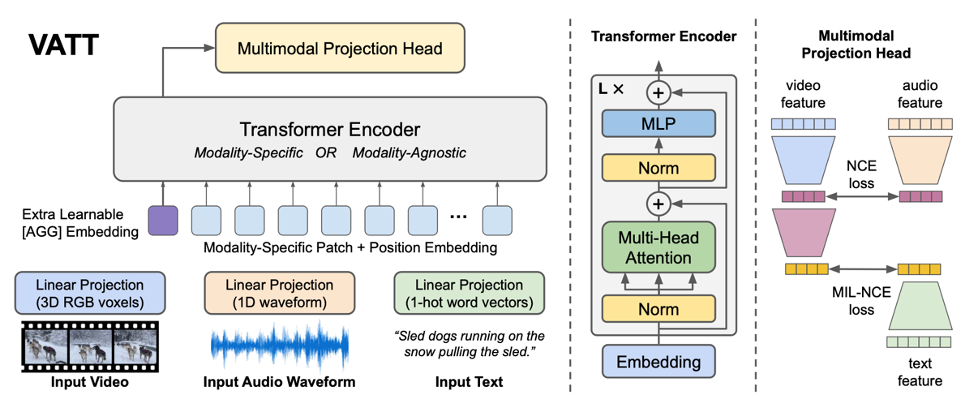
Frontier models have moved to early fusion
Distinct linear projections map raw pixels and waveforms to a shared input embedding space
Contrastive loss is applied to encourage output representations to be similar across modalities
Akbari, H., Yuan, L., Qian, R., Chuang, W.-H., Chang, S.-F., Cui, Y., & Gong, B. (2021). VATT: Transformers for Multimodal Self-Supervised Learning from Raw Video, Audio and Text. Advances in Neural Information Processing Systems (NeurIPS) 34.

Slide 48
Self-supervision: predict the missing multi-modal token
Imaging
Note
Electrophysiology
?
Lab test
Diagnosis code
Medication

Slide 49
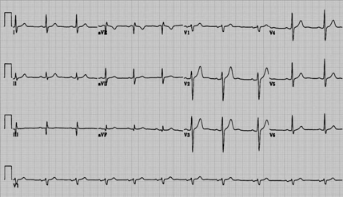


Self-supervision: predict the missing multi-modal token
Imaging
Note
Electrophysiology
?
Lab test
Diagnosis code
Medication

Slide 50
Self-supervision: predict the missing multi-modal token
Imaging
Note
Electrophysiology
?
Lab test
Diagnosis code
Medication

Slide 51
Summary
EHR and other medical data are comprised of multiple data types, or modalities
Distinct modalities complement one another to enhance prediction
We have moved from task-specific, uni-modal models to task-agnostic, multi-modal models that understand health data and support a wide range of analyses
These approaches are highly data intensive up front, but can then be applied in small samples to improve prediction or interpretation

Slide 52
Thank you!
Contact: m.engelhard@duke.edu
Notes:
Thank collaborators
Thanks to the DCABD for the opportunity to present
Thanks very much for listening, and please don’t hesitate to get in touch!

