Slide 1
AI on the horizon
Matthew Engelhard

Slide 2
1. Reinforcement Learning

Slide 3
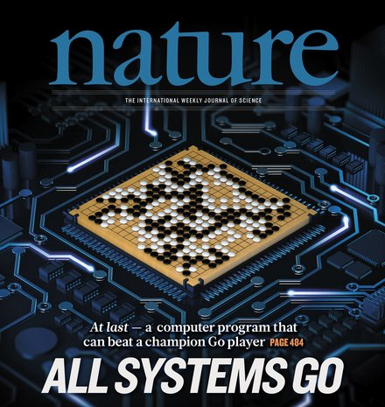
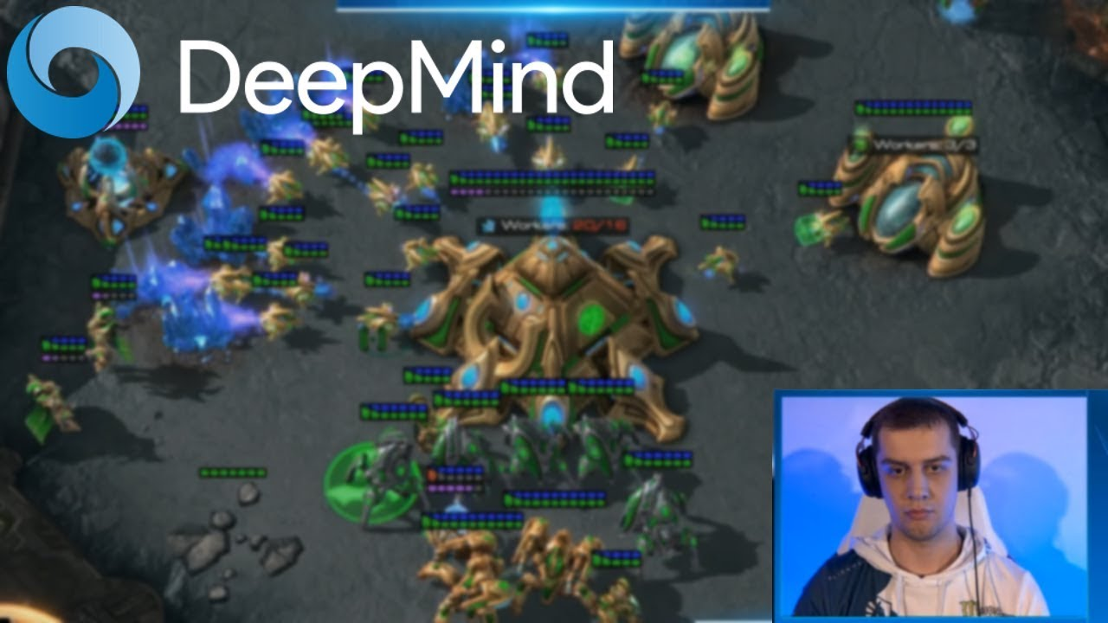
RL for sequential (clinical) decision-making
An agent
takes actions
based on the state of a system
to maximize reward

Slide 4
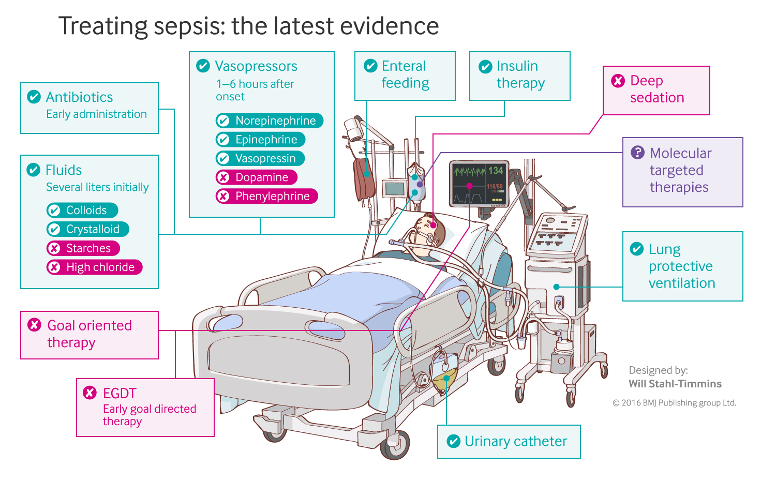
RL for sepsis management
An agent
takes actions
based on the state of a system
to maximize reward
A clinician
gives fluid and/or vasopressor
based on the patient’s physiologic status
to maximize chance of survival

Slide 5
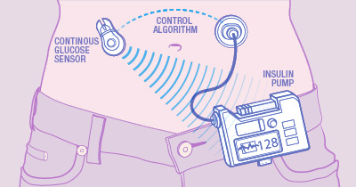
RL for close—loop BG control
An agent
takes actions
based on the state of a system
to maximize reward
A computer program
administers insulin
based on blood glucose and recent patient behaviors
to maintain normoglycemia

Slide 6
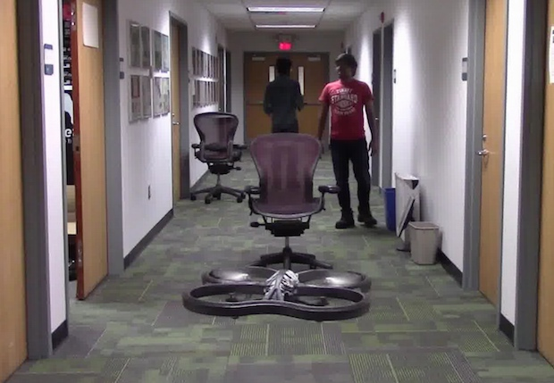
In RL, we typically learn “from scratch”:
Try things and see what works
Initially our actions are random
Drone Uses AI and 11,500 Crashes to Learn How to Fly
Crashing into objects has taught this drone to fly autonomously, by learning what not to do
By Evan Ackerman

Slide 7
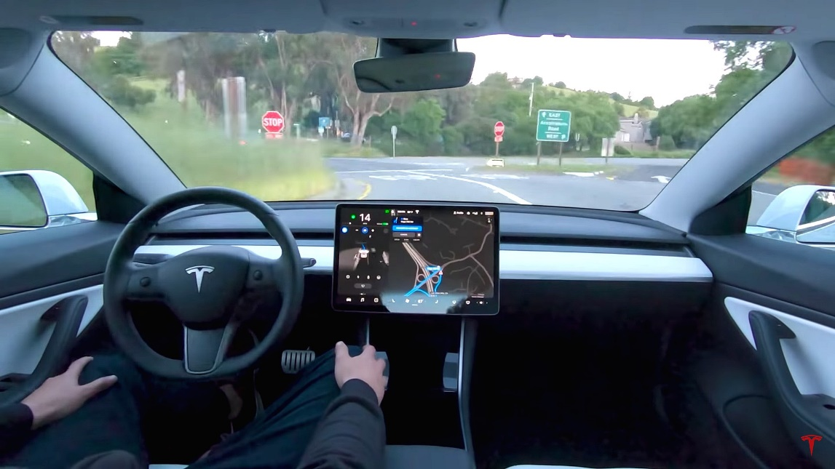
Failing 11,500 times isn’t always an option
-> What are the alternatives?

Slide 8


A1. Learn from Observational Data
The eICU Collaborative Research Database, a freely available multi-center database for critical care research. Pollard TJ, Johnson AEW, Raffa JD, Celi LA, Mark RG and Badawi O. Scientific Data (2018).
provides a large number of (state, action, reward) examples
Notes:
Have a dataset that gives us a large number of {state, action, reward} tuples. Keep updating our Q table or DNN based on these tuples until things converge
It’s as if we’re trying the actions, but the actions we’re able to try are set in advance. So the limitation here is that we can’t explore freely. We may not have any examples of particular actions from a given state, and so their value is unknown to us.
Limitation 1: can’t comprehensively explore
Limitation 2: since the agent is not actually making decisions, there may be confounding variables that are affecting actions that we don’t understand.
Explain how we do this. We simply keep iterating
Cannot control which actions are taken
Tie this back to comments from before

Slide 9
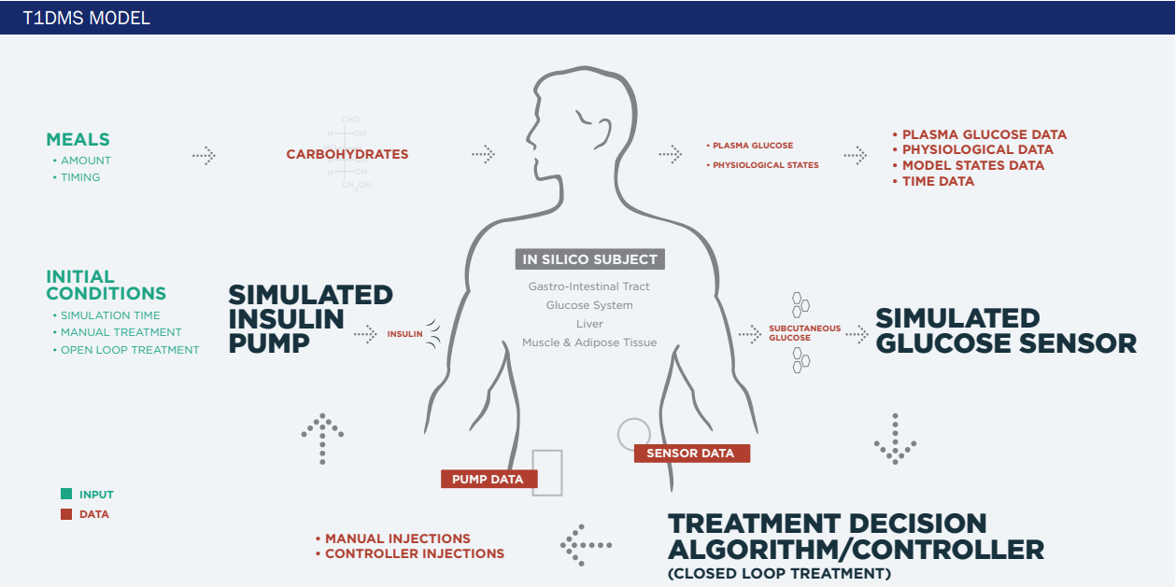
A2. Learn Policy from Simulated Environment
state
Reinforcement Learning Agent
actions
Notes:
State transitions may not match reality
Requires a good existing understanding of how actions influence the state
But, the simulator could be generated using whatever means, and may incorporate physiologic info, for example
So at UVA we have a differential equation based model, includes info about different compartments, long history of development, etc.

Slide 10

A3. Learn with Expert Oversight
physiologic state
algorithm recommendation
physician approval
Notes:
Did this at UVA
Endocrinologist in the loop
- high cost (e.g. clinician time)
- may prevent algorithm from learning a better policy

Slide 11
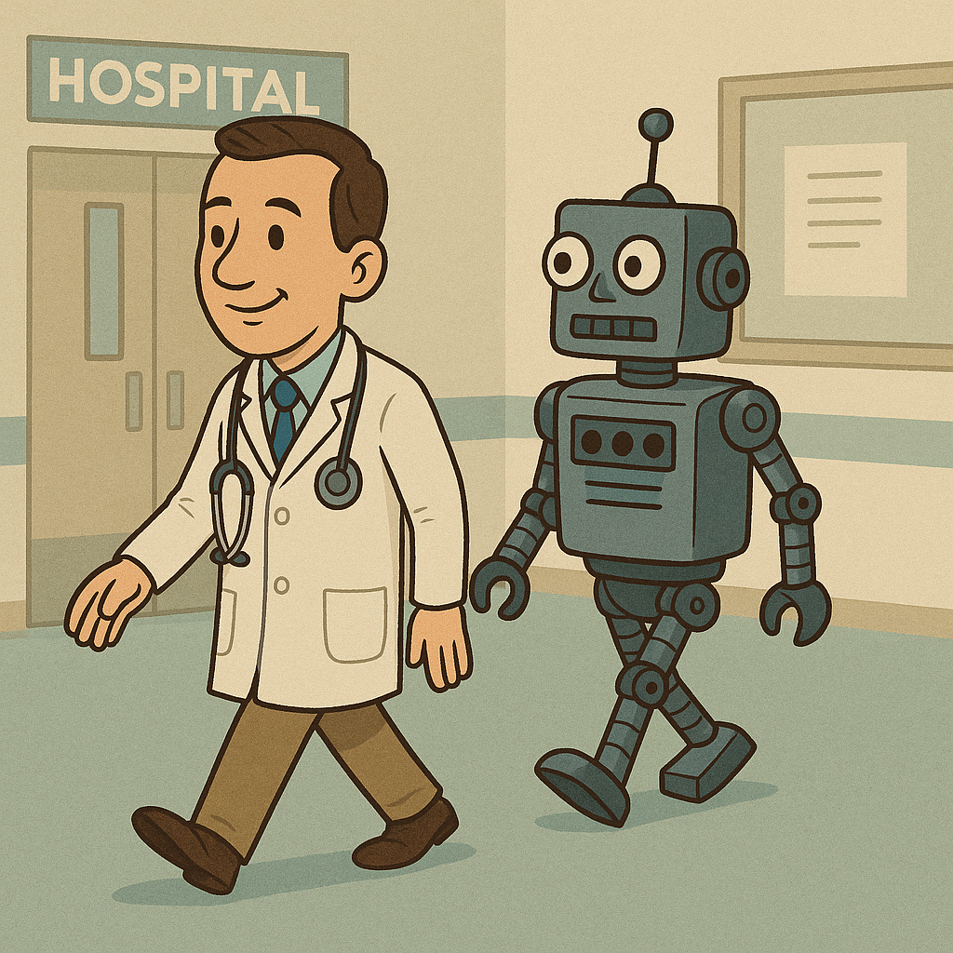
Progress in safe RL and imitation learning
sepsis management
closed-loop BG control
safe learning by imitation

Slide 12
2. Agentic AI

Slide 13
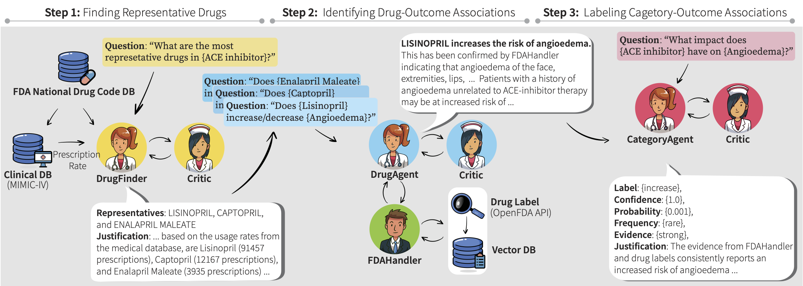
Agents, tools, and orchestration
Jihye Choi, Nils Palumbo, Prasad Chalasani, Matthew Engelhard, Somesh Jha, Anivarya Kumar, & David Page, (2024). MALADE: Orchestration of LLM-powered Agents with Retrieval Augmented Generation for Pharmacovigilance. Machine Learning for Healthcare 2024.

Slide 14
Automated CEU Eligibility Assessment
Figure 1: Rapid Automated Assessment of CEU Eligibility (RAACE) pipeline overview.

Slide 15
A few more discussion questions
How do we ensure clinical AI remains human-centered?
Should we insist that human providers make the decisions?
How do we ensure that care remains aligned with our values?
What influence do AI companies have on healthcare?
Should we be pushing back against this?
If so, how?

