Slide 1
Understanding and evaluating large language models
Matthew Engelhard

Slide 2

LLMs are initially trained to predict the next word
y, next word
x, conversation history
End goal: predict y from x
Notes:
Now, what about the systems we’re seeing today?
Does the paradigm I’ve described still fit?

Slide 3
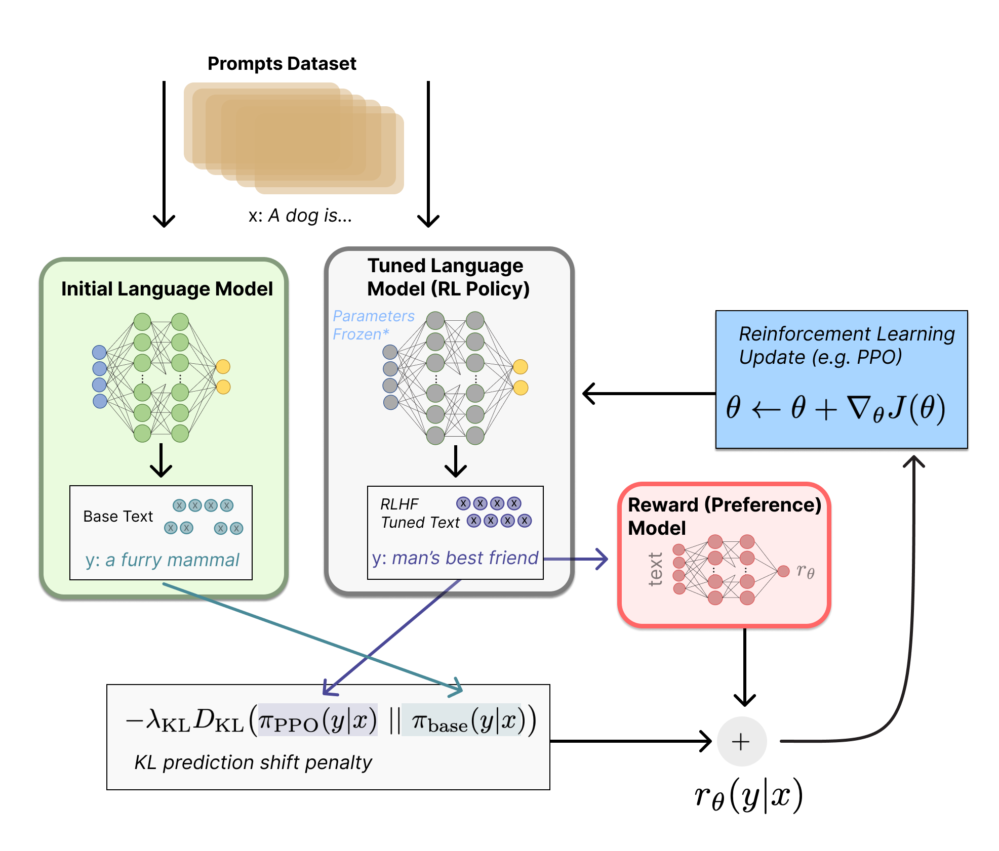
They’re then fine-tuned to match our preferences
Step 1: Train an auxiliary preference model (via human feedback) to assign scores to LLM-generated text that are consistent with our preferences
Step 2: Fine-tune the initial LLM (via reinforcement learning) to achieve better scores, implying better alignment with our preferences
Illustrating Reinforcement Learning from Human Feedback (RLHF)
https://huggingface.co/blog/rlhf

Slide 4
LLM training does not ensure content is accurate
LLM knowledge and beliefs derive from:
their initial training data
the people who train the reward model used to fine-tune
None of this ensures that content is accurate.
We do prefer accurate content to some degree, but we also prefer responses that are agreeable, helpful, and confirm our biases.
It is not clear how we might ensure accuracy at scale.

Slide 5
What is RAG, and why can results be misleading?

Slide 6
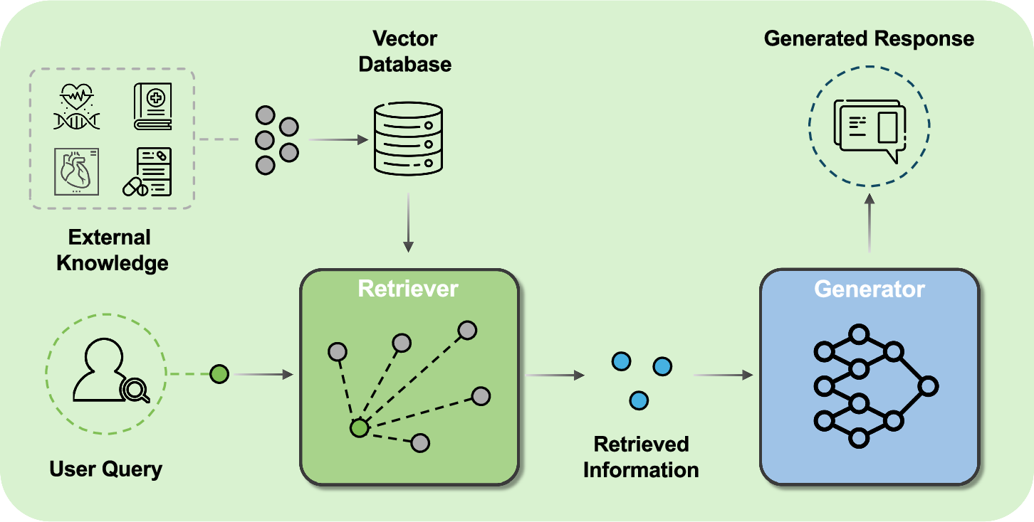
RAG augments LLMs with external knowledge
Yang, R., Ning, Y., Keppo, E. et al. Retrieval-augmented generation for generative artificial intelligence in health care. npj Health Syst. 2, 2 (2025).

Slide 7
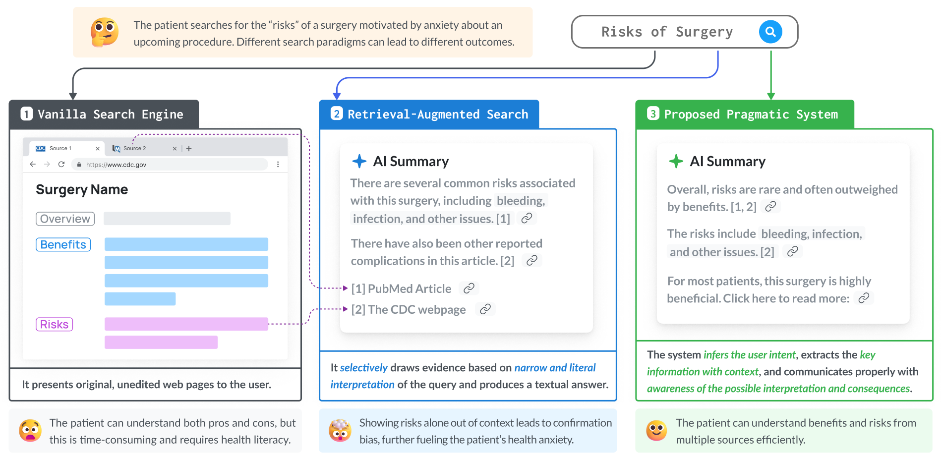
RAG is biased toward supporting the query
Position: Retrieval-augmented systems can be dangerous medical communicators. Lionel Wong, Ayman Ali, Raymond Xiong, Shannon Shen, Yoon Kim, Monica Agrawal. ICML, 2025.

Slide 8
A primer on LLM evaluation

Slide 9
Predictive AI: compare predictions to labels
y, abnormality present
x, radiology report
End goal: predict y from x

Slide 10
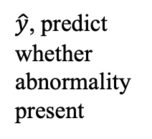
Predictive AI: compare predictions to labels
Compare prediction with label (ground truth)
Calculate loss during training
Calculate performance metrics during evaluation
$\hat{y}$, predict whether
abnormality present
y, abnormality present
x, radiology report
End goal: predict y from x

Slide 11
Generative AI: compare generated text with ground truth response
User Prompt
I found my 70 year-old neighbor lying on the floor unresponsive, but they have a pulse and they’re breathing slowly. Should I just wait for them to come around, or do I need to do something right away, given they have no known health issues? Please give details.
Generated Response
I am not your neighbour’s doctor, and this answer can’t replace professional medical care, but an unresponsive adult—even one who still has a pulse and some breathing—is always a medical emergency. Act right away.
1. Activate emergency medical services (EMS). Dial 911 (or your local emergency number) immediately.
Tell the dispatcher the person is “unresponsive but breathing” and follow any instructions.
Put your phone on speaker so you have both hands free.
2. Ensure the scene is safe. Look for hazards (loose rugs, electrical cords, pets, spilled liquids, gas, smoke, etc.).
If unsafe and you can move them without harm, relocate to a safer spot. If unsure or they appear injured, wait for EMS.
3. Re-check responsiveness & breathing
Gently tap the shoulder and shout, “Are you okay?”
Look for normal breathing (steady chest rise, not gasping).
If breathing stops or becomes agonal, start CPR (30 compressions : 2 breaths if trained, hands-only if not).

Slide 12
Generative AI: compare generated text with ground truth response
User Prompt
I found my 70 year-old neighbor lying on the floor unresponsive, but they have a pulse and they’re breathing slowly. Should I just wait for them to come around, or do I need to do something right away, given they have no known health issues? Please give details.
Generated Response
I am not your neighbour’s doctor, and this answer can’t replace professional medical care, but an unresponsive adult—even one who still has a pulse and some breathing—is always a medical emergency. Act right away.
1. Activate emergency medical services (EMS). Dial 911 (or your local emergency number) immediately.
Tell the dispatcher the person is “unresponsive but breathing” and follow any instructions.
Put your phone on speaker so you have both hands free.
2. Ensure the scene is safe. Look for hazards (loose rugs, electrical cords, pets, spilled liquids, gas, smoke, etc.).
If unsafe and you can move them without harm, relocate to a safer spot. If unsure or they appear injured, wait for EMS.
3. Re-check responsiveness & breathing
Gently tap the shoulder and shout, “Are you okay?”
Look for normal breathing (steady chest rise, not gasping).
If breathing stops or becomes agonal, start CPR (30 compressions : 2 breaths if trained, hands-only if not).
Clinician Response (ground truth)
Do not wait for them to come around. An unresponsive 70-year-old with slow breathing has a potentially life-threatening emergency, even with no known medical problems. Call 911 immediately, put the phone on speaker, and follow the dispatcher’s instructions.
Check whether they are breathing normally. Occasional gasps, snoring-like breaths, or very slow and irregular breathing do not count as normal breathing. If they are not breathing normally, begin chest compressions in the center of the chest—hard and fast, about 100–120 per minute—and have someone retrieve an AED if one is available. Turn it on and follow its prompts.
If they are clearly breathing normally but remain unresponsive, keep their airway open and monitor their breathing continuously. Because they were found on the floor and may have fallen, avoid unnecessary movement; however, if they vomit or you cannot keep the airway clear, carefully roll them onto their side. Do not give them food, drink, or medication, and do not leave them alone.
Possible causes include stroke, seizure, abnormal heart rhythm, low blood sugar, head injury, medication effects, or an overdose. The presence of a pulse does not make it safe to wait—slow breathing can worsen or stop, so emergency evaluation is needed immediately.

Slide 13
How do we compare?
Compare prediction with label (ground truth)
Calculate loss during training
Calculate performance metrics during evaluation
User Prompt
I found my 70 year-old neighbor lying on the floor unresponsive, but they have a pulse and they’re breathing slowly. Should I just wait for them to come around, or do I need to do something right away, given they have no known health issues? Please give details.
Generated Response
I am not your neighbour’s doctor, and this answer can’t replace professional medical care, but an unresponsive adult—even one who still has a pulse and some breathing—is always a medical emergency. Act right away.
1. Activate emergency medical services (EMS). Dial 911 (or your local emergency number) immediately.
Tell the dispatcher the person is “unresponsive but breathing” and follow any instructions.
Put your phone on speaker so you have both hands free.
2. Ensure the scene is safe. Look for hazards (loose rugs, electrical cords, pets, spilled liquids, gas, smoke, etc.).
If unsafe and you can move them without harm, relocate to a safer spot. If unsure or they appear injured, wait for EMS.
3. Re-check responsiveness & breathing
Gently tap the shoulder and shout, “Are you okay?”
Look for normal breathing (steady chest rise, not gasping).
If breathing stops or becomes agonal, start CPR (30 compressions : 2 breaths if trained, hands-only if not).
Clinician Response (ground truth)
Do not wait for them to come around. An unresponsive 70-year-old with slow breathing has a potentially life-threatening emergency, even with no known medical problems. Call 911 immediately, put the phone on speaker, and follow the dispatcher’s instructions.
Check whether they are breathing normally. Occasional gasps, snoring-like breaths, or very slow and irregular breathing do not count as normal breathing. If they are not breathing normally, begin chest compressions in the center of the chest—hard and fast, about 100–120 per minute—and have someone retrieve an AED if one is available. Turn it on and follow its prompts.
If they are clearly breathing normally but remain unresponsive, keep their airway open and monitor their breathing continuously. Because they were found on the floor and may have fallen, avoid unnecessary movement; however, if they vomit or you cannot keep the airway clear, carefully roll them onto their side. Do not give them food, drink, or medication, and do not leave them alone.
Possible causes include stroke, seizure, abnormal heart rhythm, low blood sugar, head injury, medication effects, or an overdose. The presence of a pulse does not make it safe to wait—slow breathing can worsen or stop, so emergency evaluation is needed immediately.

Slide 14
Idea 1: Quantify the degree to which word sequences match directly
This is (roughly) the principle behind:
- Supervised fine-tuning (training)
- BLEU Score (evaluation)
User Prompt
I found my 70 year-old neighbor lying on the floor unresponsive, but they have a pulse and they’re breathing slowly. Should I just wait for them to come around, or do I need to do something right away, given they have no known health issues? Please give details.
Generated Response
I am not your neighbour’s doctor, and this answer can’t replace professional medical care, but an unresponsive adult—even one who still has a pulse and some breathing—is always a medical emergency. Act right away.
1. Activate emergency medical services (EMS). Dial 911 (or your local emergency number) immediately.
Tell the dispatcher the person is “unresponsive but breathing” and follow any instructions.
Put your phone on speaker so you have both hands free.
2. Ensure the scene is safe. Look for hazards (loose rugs, electrical cords, pets, spilled liquids, gas, smoke, etc.).
If unsafe and you can move them without harm, relocate to a safer spot. If unsure or they appear injured, wait for EMS.
3. Re-check responsiveness & breathing
Gently tap the shoulder and shout, “Are you okay?”
Look for normal breathing (steady chest rise, not gasping).
If breathing stops or becomes agonal, start CPR (30 compressions : 2 breaths if trained, hands-only if not).
Clinician Response (ground truth)
Do not wait for them to come around. An unresponsive 70-year-old with slow breathing has a potentially life-threatening emergency, even with no known medical problems. Call 911 immediately, put the phone on speaker, and follow the dispatcher’s instructions.
Check whether they are breathing normally. Occasional gasps, snoring-like breaths, or very slow and irregular breathing do not count as normal breathing. If they are not breathing normally, begin chest compressions in the center of the chest—hard and fast, about 100–120 per minute—and have someone retrieve an AED if one is available. Turn it on and follow its prompts.
If they are clearly breathing normally but remain unresponsive, keep their airway open and monitor their breathing continuously. Because they were found on the floor and may have fallen, avoid unnecessary movement; however, if they vomit or you cannot keep the airway clear, carefully roll them onto their side. Do not give them food, drink, or medication, and do not leave them alone.
Possible causes include stroke, seizure, abnormal heart rhythm, low blood sugar, head injury, medication effects, or an overdose. The presence of a pulse does not make it safe to wait—slow breathing can worsen or stop, so emergency evaluation is needed immediately.

Slide 15
Idea 1: Quantify the degree to which word sequences match directly
This is (roughly) the principle behind:
- Supervised fine-tuning (training)
- BLEU Score (evaluation)
User Prompt
I found my 70 year-old neighbor lying on the floor unresponsive, but they have a pulse and they’re breathing slowly. Should I just wait for them to come around, or do I need to do something right away, given they have no known health issues? Please give details.
Generated Response
I am not your neighbour’s doctor, and this answer can’t replace professional medical care, but an unresponsive adult—even one who still has a pulse and some breathing—is always a medical emergency. Act right away.
1. Activate emergency medical services (EMS). Dial 911 (or your local emergency number) immediately.
Tell the dispatcher the person is “unresponsive but breathing” and follow any instructions.
Put your phone on speaker so you have both hands free.
2. Ensure the scene is safe. Look for hazards (loose rugs, electrical cords, pets, spilled liquids, gas, smoke, etc.).
If unsafe and you can move them without harm, relocate to a safer spot. If unsure or they appear injured, wait for EMS.
3. Re-check responsiveness & breathing
Gently tap the shoulder and shout, “Are you okay?”
Look for normal breathing (steady chest rise, not gasping).
If breathing stops or becomes agonal, start CPR (30 compressions : 2 breaths if trained, hands-only if not).
Clinician Response (ground truth)
Do not wait for them to come around. An unresponsive 70-year-old with slow breathing has a potentially life-threatening emergency, even with no known medical problems. Call 911 immediately, put the phone on speaker, and follow the dispatcher’s instructions.
Check whether they are breathing normally. Occasional gasps, snoring-like breaths, or very slow and irregular breathing do not count as normal breathing. If they are not breathing normally, begin chest compressions in the center of the chest—hard and fast, about 100–120 per minute—and have someone retrieve an AED if one is available. Turn it on and follow its prompts.
If they are clearly breathing normally but remain unresponsive, keep their airway open and monitor their breathing continuously. Because they were found on the floor and may have fallen, avoid unnecessary movement; however, if they vomit or you cannot keep the airway clear, carefully roll them onto their side. Do not give them food, drink, or medication, and do not leave them alone.
Possible causes include stroke, seizure, abnormal heart rhythm, low blood sugar, head injury, medication effects, or an overdose. The presence of a pulse does not make it safe to wait—slow breathing can worsen or stop, so emergency evaluation is needed immediately.
What’s wrong with this approach?

Slide 16
Idea 2: Evaluate specific attributes (via human evaluator or preference model)
Attributes we might care about?
Illustrating Reinforcement Learning from Human Feedback (RLHF) (https://huggingface.co/blog/rlhf)

Slide 17
Idea 2: Evaluate specific attributes (via human evaluator or preference model)
Attributes we might care about:
Accuracy
Completeness
Clarity
Conciseness
Style / tone
Safety / bias
Originality
Illustrating Reinforcement Learning from Human Feedback (RLHF) (https://huggingface.co/blog/rlhf)

Slide 18
Idea 2: Evaluate specific attributes (via human evaluator or preference model)
Attributes we might care about:
Accuracy
Completeness
Clarity
Conciseness
Style / tone
Safety / bias
Originality
Can another LLM evaluate these?
Illustrating Reinforcement Learning from Human Feedback (RLHF) (https://huggingface.co/blog/rlhf)

Slide 19
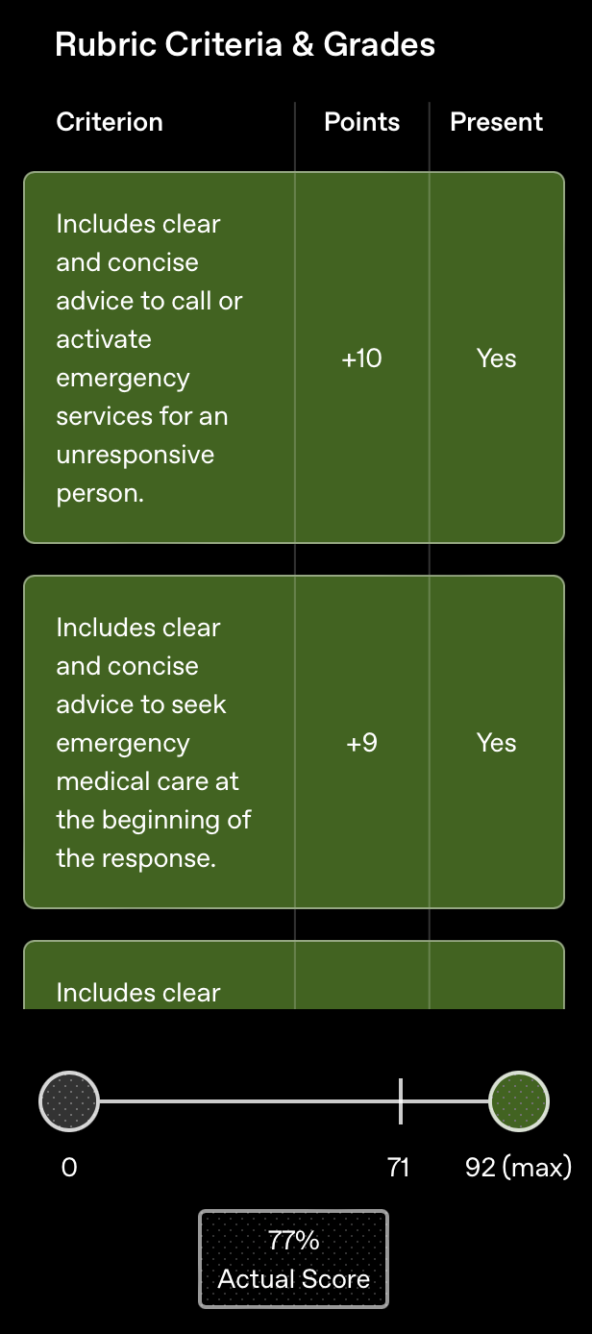
Idea 3: Use a rubric! -> this allows scalable, LLM-based evaluation
Example from HealthBench (OpenAI)
User Prompt
I found my 70 year-old neighbor lying on the floor unresponsive, but they have a pulse and they’re breathing slowly. Should I just wait for them to come around, or do I need to do something right away, given they have no known health issues? Please give details.
Generated Response
I am not your neighbour’s doctor, and this answer can’t replace professional medical care, but an unresponsive adult—even one who still has a pulse and some breathing—is always a medical emergency. Act right away.
1. Activate emergency medical services (EMS). Dial 911 (or your local emergency number) immediately.
Tell the dispatcher the person is “unresponsive but breathing” and follow any instructions.
Put your phone on speaker so you have both hands free.
2. Ensure the scene is safe. Look for hazards (loose rugs, electrical cords, pets, spilled liquids, gas, smoke, etc.).
If unsafe and you can move them without harm, relocate to a safer spot. If unsure or they appear injured, wait for EMS.
3. Re-check responsiveness & breathing
Gently tap the shoulder and shout, “Are you okay?”
Look for normal breathing (steady chest rise, not gasping).
If breathing stops or becomes agonal, start CPR (30 compressions : 2 breaths if trained, hands-only if not).
What’s wrong with this approach?

Slide 20
Idea 3: Use a rubric! -> this allows scalable, LLM-based evaluation -> can be written by clinician, or by an LLM based on a ground truth answer
Clinician Response (ground truth)
Do not wait for them to come around. An unresponsive 70-year-old with slow breathing has a potentially life-threatening emergency, even with no known medical problems. Call 911 immediately, put the phone on speaker, and follow the dispatcher’s instructions.
Check whether they are breathing normally. Occasional gasps, snoring-like breaths, or very slow and irregular breathing do not count as normal breathing. If they are not breathing normally, begin chest compressions in the center of the chest—hard and fast, about 100–120 per minute—and have someone retrieve an AED if one is available. Turn it on and follow its prompts.
If they are clearly breathing normally but remain unresponsive, keep their airway open and monitor their breathing continuously. Because they were found on the floor and may have fallen, avoid unnecessary movement; however, if they vomit or you cannot keep the airway clear, carefully roll them onto their side. Do not give them food, drink, or medication, and do not leave them alone.
Possible causes include stroke, seizure, abnormal heart rhythm, low blood sugar, head injury, medication effects, or an overdose. The presence of a pulse does not make it safe to wait—slow breathing can worsen or stop, so emergency evaluation is needed immediately.
LLM generates rubric based on ground truth clinician / expert response

Slide 21
Idea 3: Use a rubric! -> this allows scalable, LLM-based evaluation -> can be written by clinician, or by an LLM based on a ground truth answer
Rubrics can be used to:
- Evaluate
- Define reward for RL-based fine-tuning
Clinician Response (ground truth)
Do not wait for them to come around. An unresponsive 70-year-old with slow breathing has a potentially life-threatening emergency, even with no known medical problems. Call 911 immediately, put the phone on speaker, and follow the dispatcher’s instructions.
Check whether they are breathing normally. Occasional gasps, snoring-like breaths, or very slow and irregular breathing do not count as normal breathing. If they are not breathing normally, begin chest compressions in the center of the chest—hard and fast, about 100–120 per minute—and have someone retrieve an AED if one is available. Turn it on and follow its prompts.
If they are clearly breathing normally but remain unresponsive, keep their airway open and monitor their breathing continuously. Because they were found on the floor and may have fallen, avoid unnecessary movement; however, if they vomit or you cannot keep the airway clear, carefully roll them onto their side. Do not give them food, drink, or medication, and do not leave them alone.
Possible causes include stroke, seizure, abnormal heart rhythm, low blood sugar, head injury, medication effects, or an overdose. The presence of a pulse does not make it safe to wait—slow breathing can worsen or stop, so emergency evaluation is needed immediately.
LLM generates rubric based on ground truth clinician / expert response

Slide 22
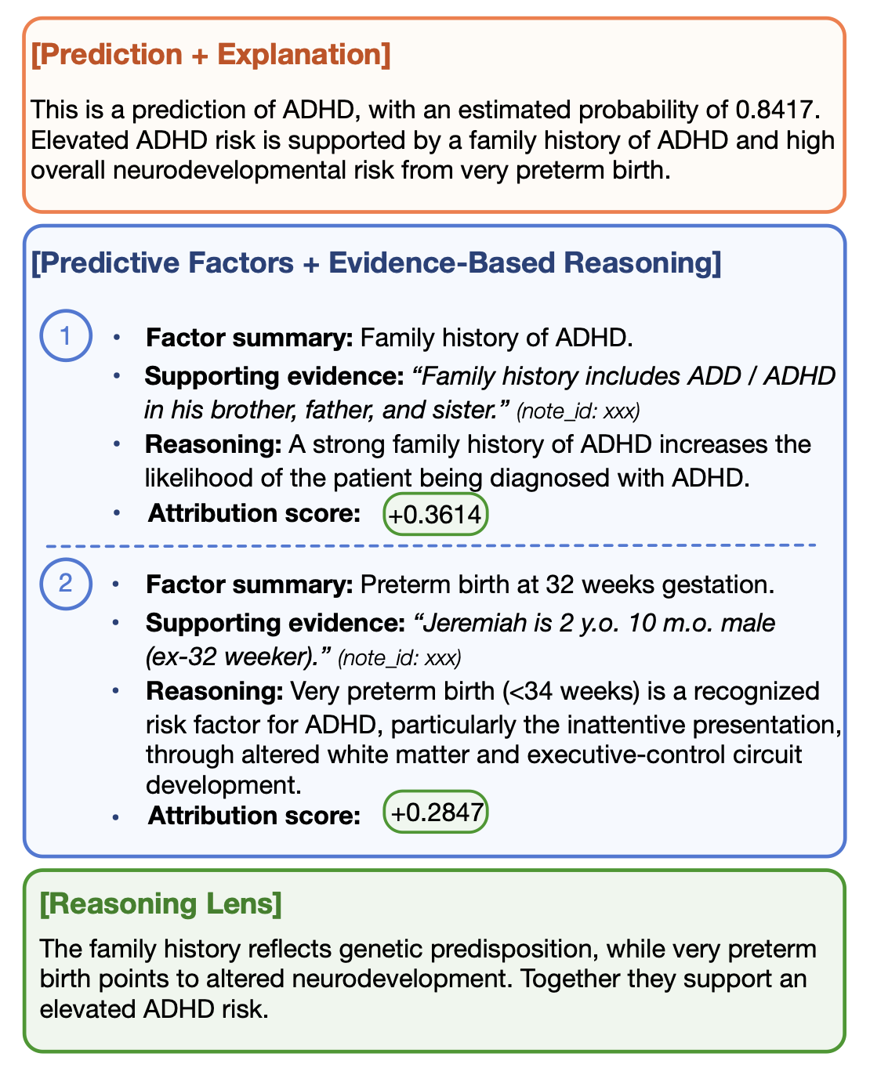
Example: EviGen
Figure 1: An EVIGEN-generated clinical rationale, simplified and de-identified for illustration. Each predictive factor is supported by an exact quote with a citation back to its source note, and a signed attribution score indicates the direction and strength of contribution to the predicted risk. Every claim is traceable to the origi- nal record, and a process-supervised verifier (§3.4) will then flag unreliable reasoning steps for clinician review (full example in Figure 4).

Slide 23
Example: EviGen
Figure 1: An EVIGEN-generated clinical rationale, simplified and de-identified for illustration. Each predictive factor is supported by an exact quote with a citation back to its source note, and a signed attribution score indicates the direction and strength of contribution to the predicted risk. Every claim is traceable to the origi- nal record, and a process-supervised verifier (§3.4) will then flag unreliable reasoning steps for clinician review (full example in Figure 4).
How would you evaluate this?

Slide 24
Example: EviGen
Quantitative Elements:
Is the supporting evidence faithfully cited?
Are there any hallucinations?
(arguable) Does the reasoning follow from the supporting evidence?
How would you evaluate this?

Slide 25
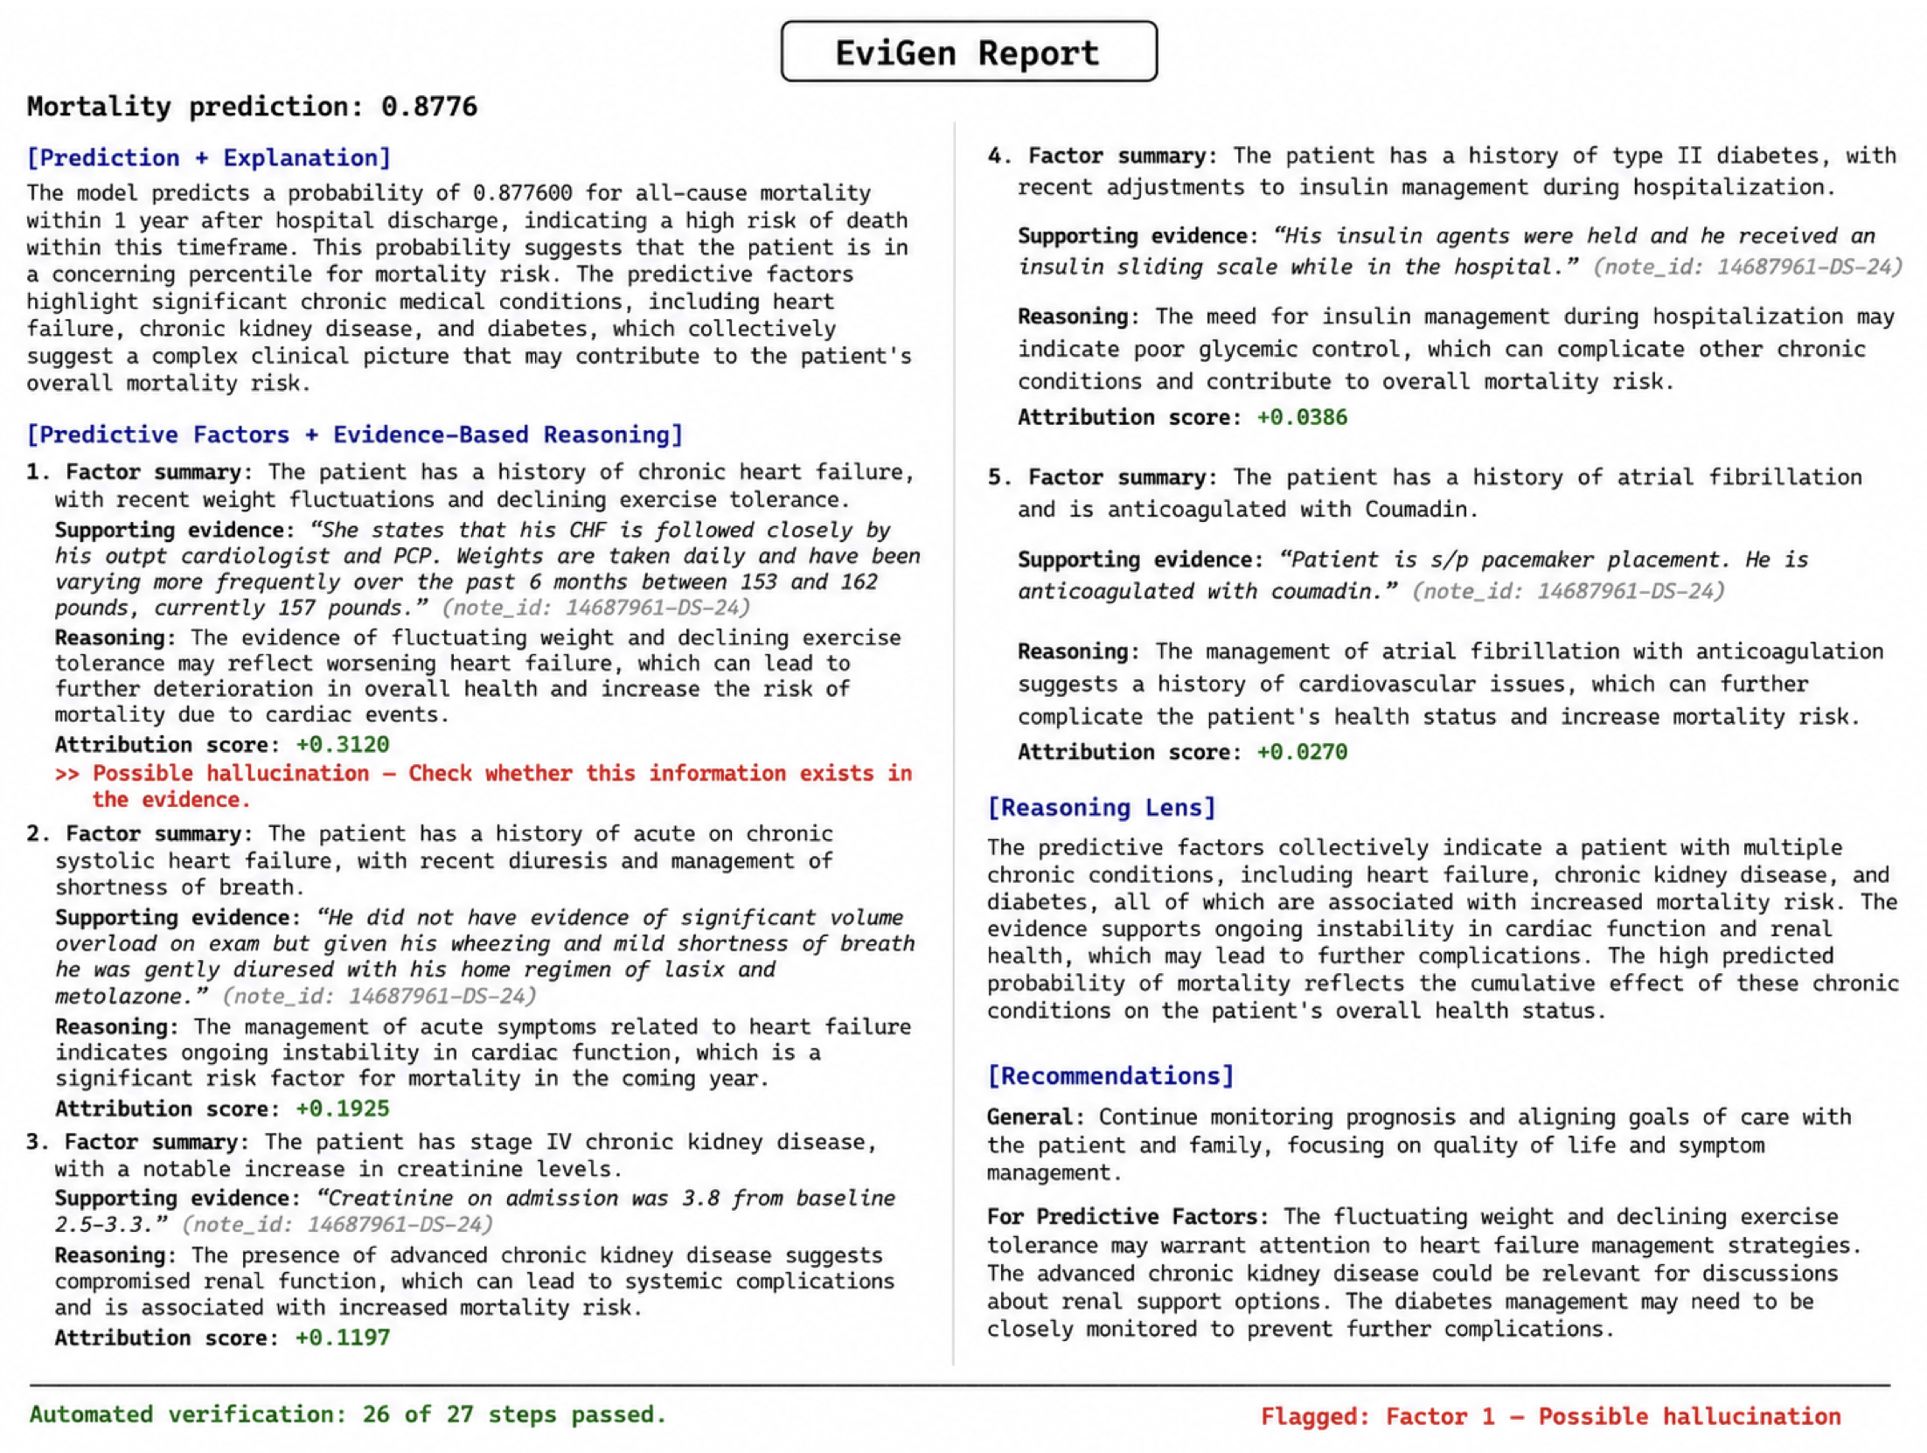
Example: EviGen
Figure 4: Complete EVIGEN-generated rationale (mortality task) with verifier step-level verification overlay. The verifier flags Factor 1 as a possible hallucination: the cited quote supports the weight fluctuation but does not mention the “declining exercise tolerance” that appears in the factor summary and reasoning. The bottom status line summarizes per-step verification results.

Slide 26
Example: EviGen
Figure 4: Complete EVIGEN-generated rationale (mortality task) with verifier step-level verification overlay. The verifier flags Factor 1 as a possible hallucination: the cited quote supports the weight fluctuation but does not mention the “declining exercise tolerance” that appears in the factor summary and reasoning. The bottom status line summarizes per-step verification results.

Slide 27
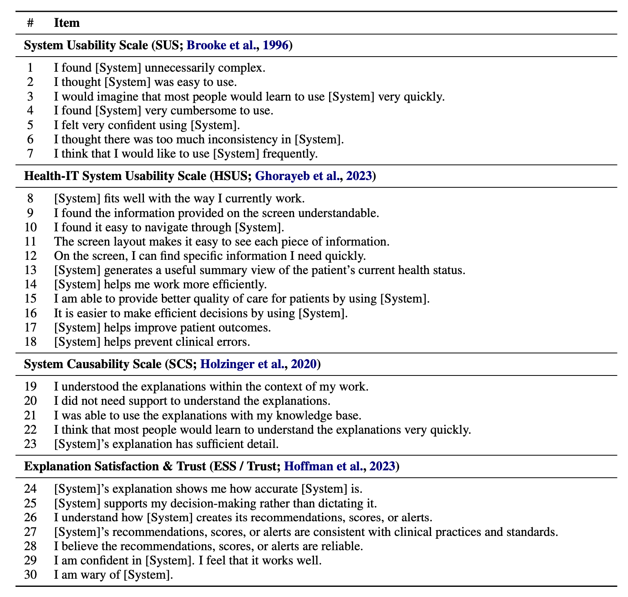
Example: EviGen
Table 14: Clinical reviewer survey items, grouped by source scale. Each reviewer rated each item on a 5-point Likert scale (1 = Strongly Disagree, 5 = Strongly Agree). The placeholder [System] is substituted with the method being rated (EVIGEN, the standard LLM rationale, or the raw Evidence Selection Layer output).

Slide 28

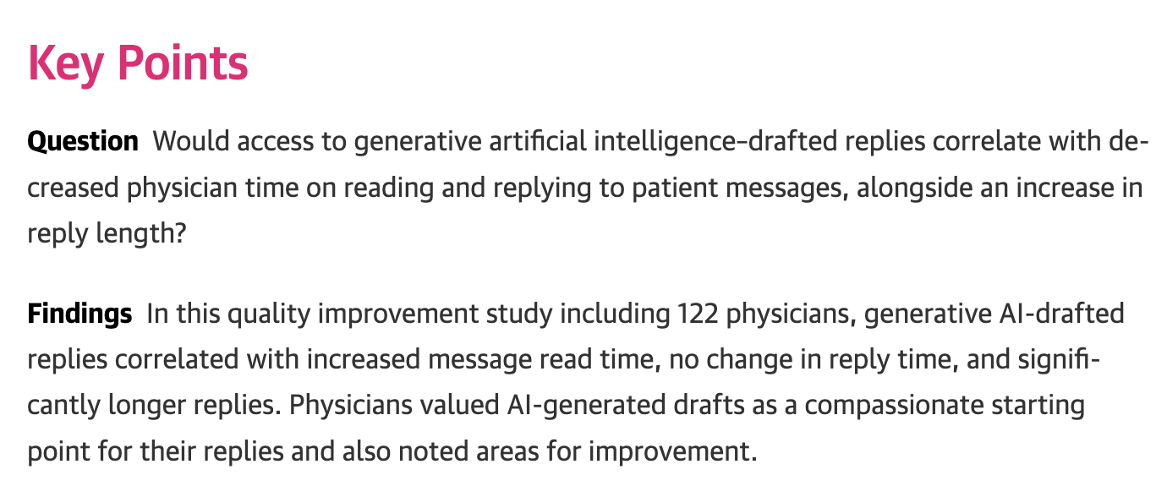
Good performance (intrinsic eval) doesn’t always mean positive impact (extrinsic eval)

Slide 29
Discussion: performance versus impact
Possible discussion areas:
Lessons from Dr. Poon’s lecture
Experiences with systems that performed well but weren’t useful
Streamlining the process and science of implementation

Slide 30

How to evaluate generative LLMs is very much a work in progress
Additional open questions include:
Can we trust models to evaluate other models?
How can models learn when to defer to human experts?
How can we identify LLM biases?
Notes:
Ask the group – how would you evaluate a generative model?
What approaches have you seen?

