Slide 1
Intro to Predictive AI: Logistic Regression
Matt Engelhard
Notes:
Introduce myself
What program are you from?
Today: (1) sense of course overall; (2) logistic regression

Slide 2
Predictive AI with health data
An overview of what we’ll be covering

Slide 3
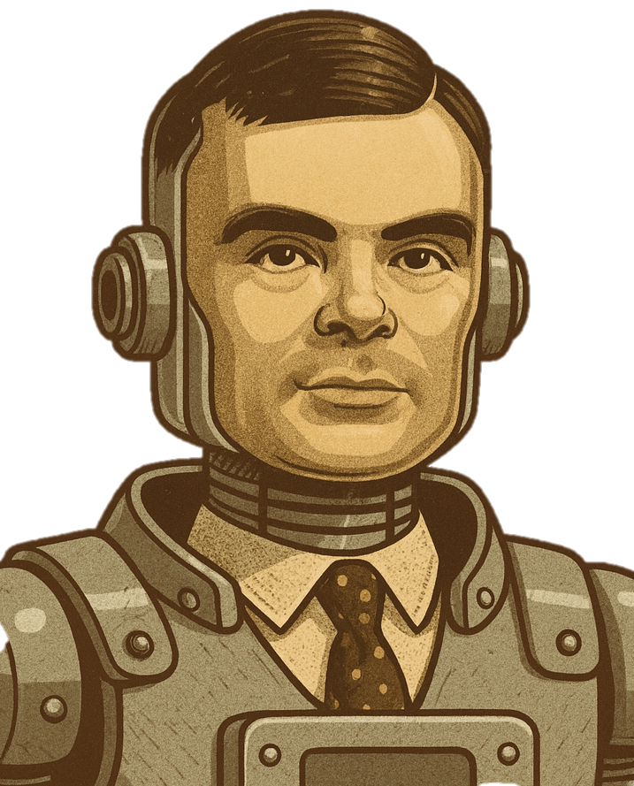
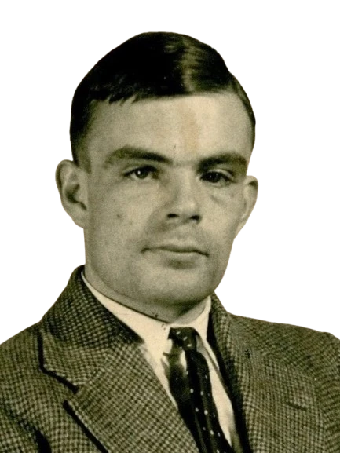
What is AI?
A scientific field concerned with developing intelligent machines.
What is intelligence?
learn from experience
solve problems
make decisions
Turing or TuringBot?
Notes:
AI: building intelligent machines. Not a new field: dates back certainly to the 50s; arguably earlier
So the question of “what is AI” becomes a question of “what is intelligence?, which is hard to define
Systems that reason from experience or data to solve a problem or goal
Turing himself, one of the fathers of AI, gave us the Turing test (has it been passed?
• ⁃ But a system that can reason about images in the same way a radiologist might — certainly this is also “intelligent”

Slide 4
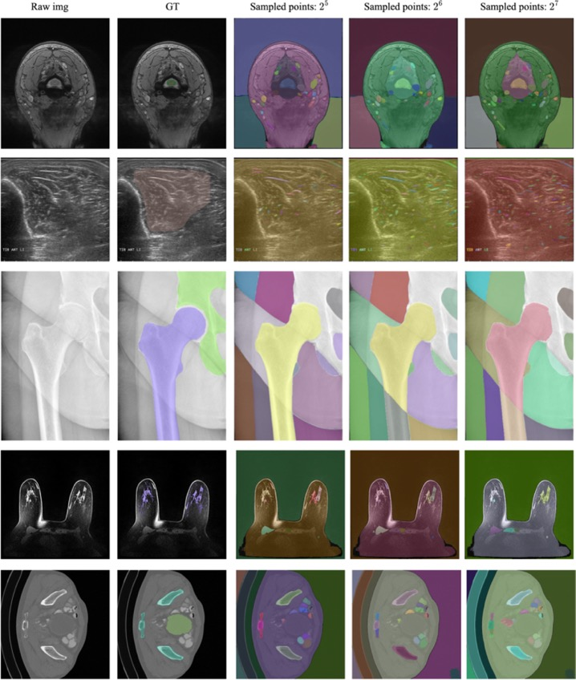
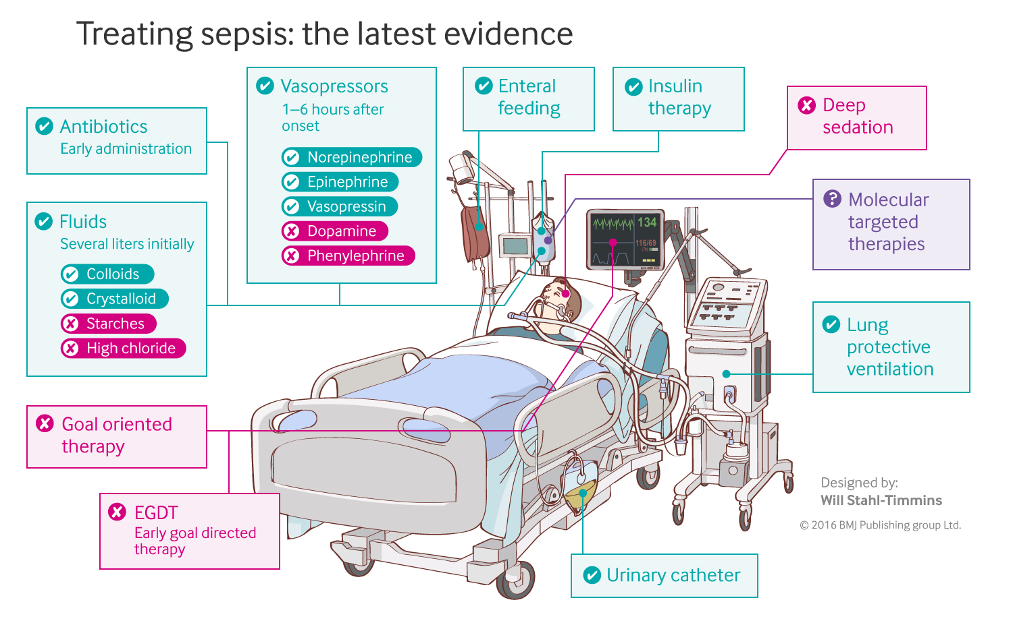
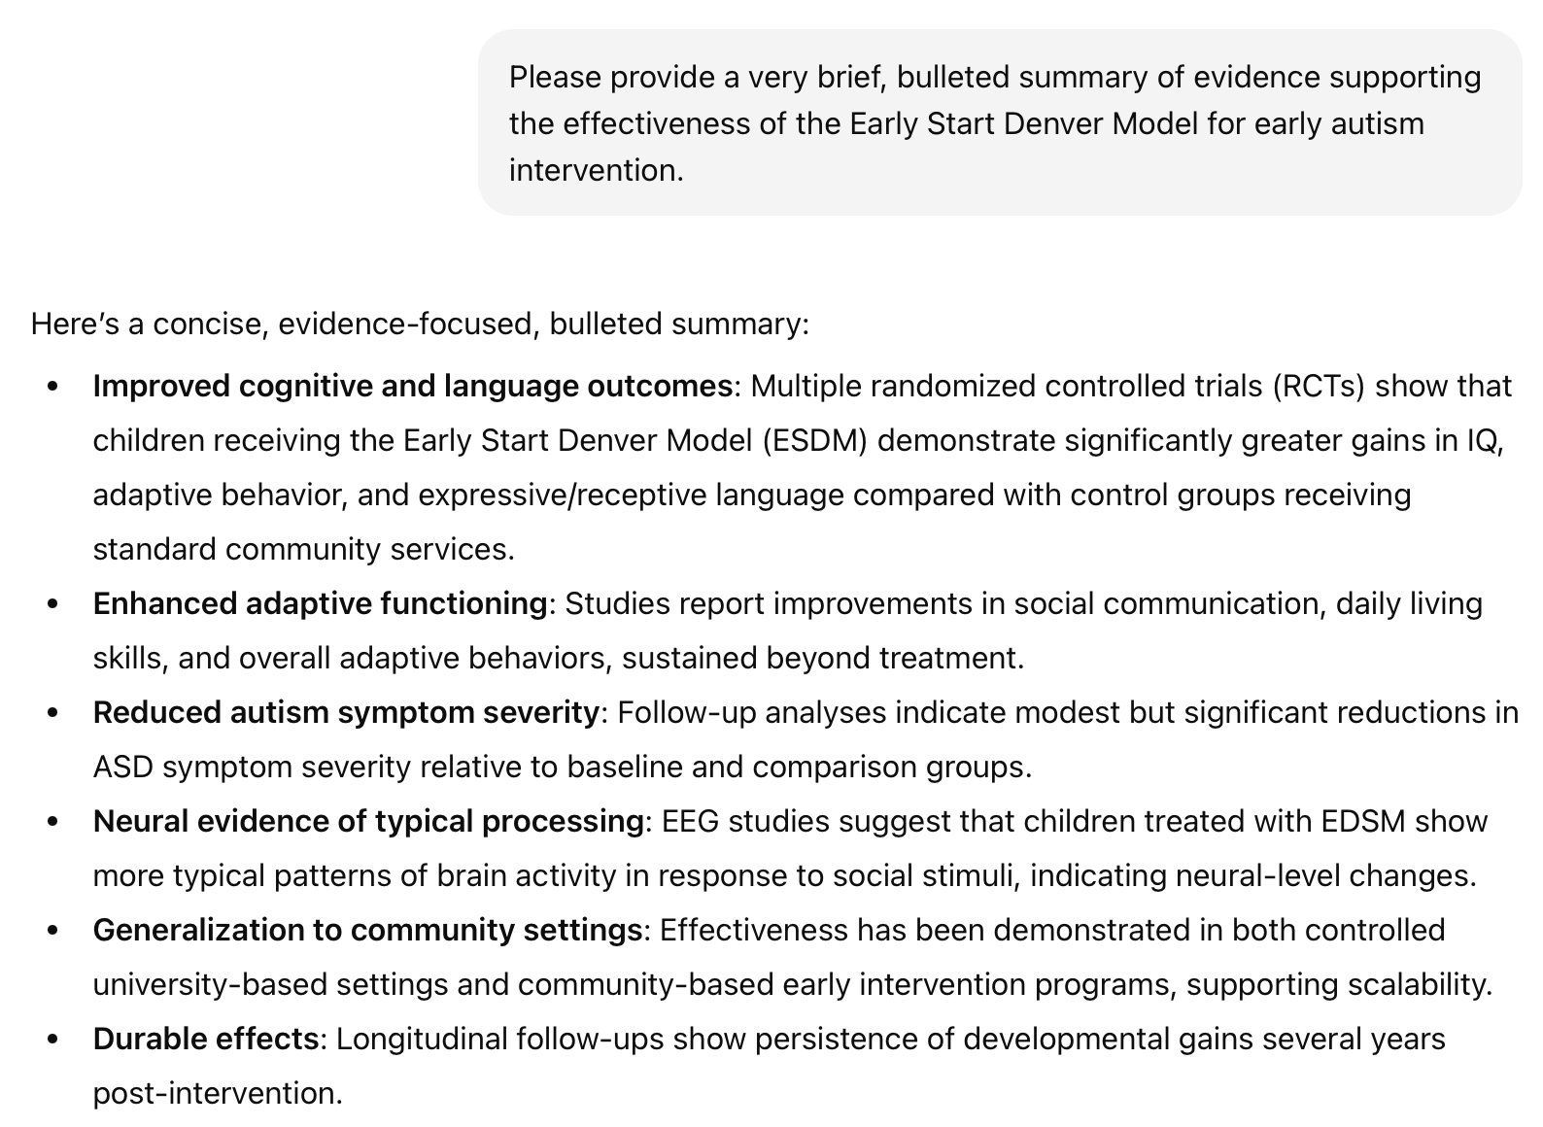

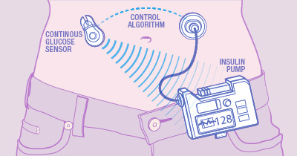
Branches of AI with high clinical impact
Computer vision
Natural language processing
Reinforcement learning
RL-based sepsis management
Mazurowski, Maciej A., et al. "Segment anything model for medical image analysis: an experimental study." Medical Image Analysis 89 (2023): 102918.
closed-loop BG control
Notes:
Three distinct branches with high clinical impact (describe)
Established impact, emerging impact, near future impact
In this course, we will focus on...
We will focus on predictive AI, which (a) is important in and of itself; and (b) will position you to understand genAI

Slide 5
The machine in machine learning
y, associated value or label
x, data/features for a subject or patient
End goal: predict y from x
Notes:
our focus: prediction machines
What are they? functions, algorithms
more specifically: neural network prediction machines
The goal? Predict as well as we can. Approach is secondary.

Slide 6
Simple models often work well for clinical data!
Age
WBC Count
Resp Rate
Creatinine
Mean BP
Hematocrit
Pulse Rate
Temperature
Survival
y, associated value or label
x, data/features for a subject or patient
End goal: predict odds of hospital mortality
(APACHE III)
Notes:
Tabular clinical data
Logistic regression is often enough
Our first module will focus primarily on data like this

Slide 7
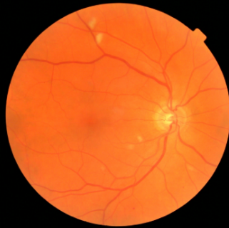
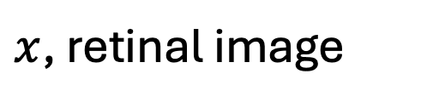
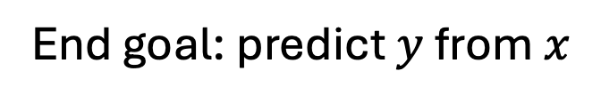
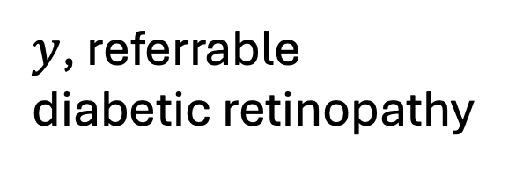
Computer vision: prediction via convolutional neural network
$y$, referrable diabetic retinopathy
$x$, retinal image
End goal: predict $y$ from $x$
Notes:
Image data and other “complex” data
Logistic regression is not enough. Why?
Second module

Slide 8
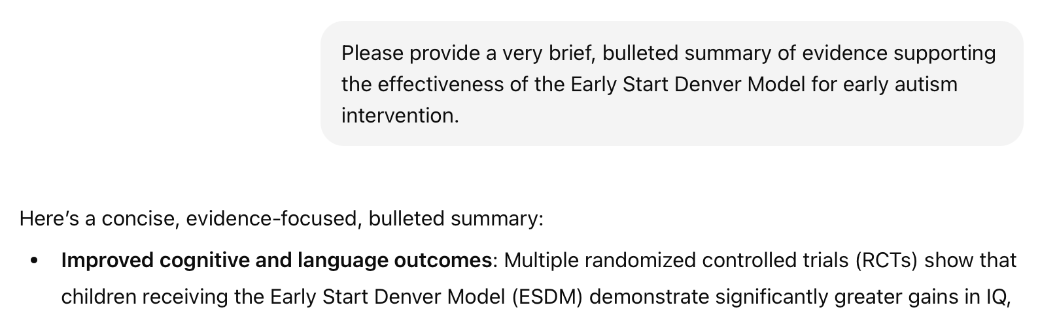

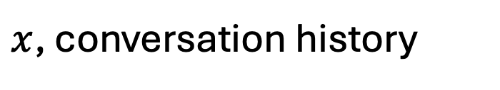
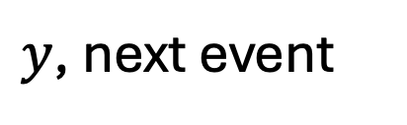
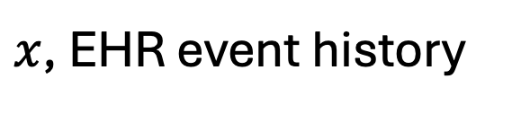
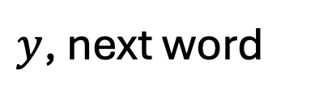
NLP and clinical sequences: prediction via stacked attention networks
$y$, next word
$x$, conversation history
$y$, next event
$x$, EHR event history
Notes:
text data
Challenge: how to convert text to numbers?
Module 3
Similarities between sequences of words vs clinical events

Slide 9
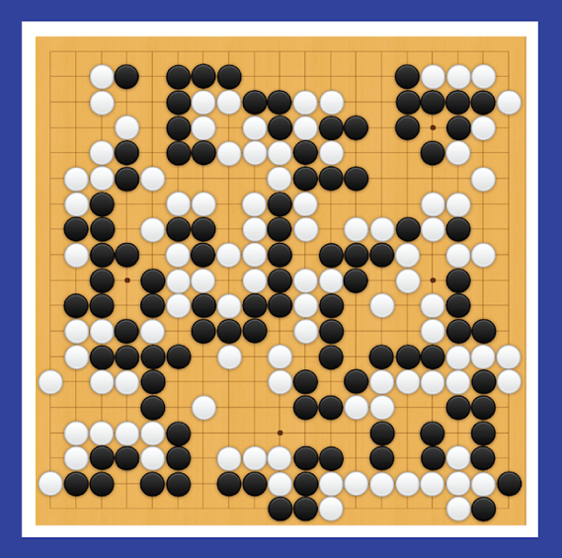
Reinforcement Learning: state to action predictions via dense NN
y, next move
x, Go board state
End goal: predict y from x
Notes:
We will not be covering RL
But importantly, this too is a prediction machine
And what you learn here is foundational for understanding RL for clinical decision-making

Slide 10
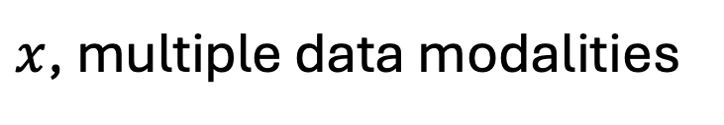
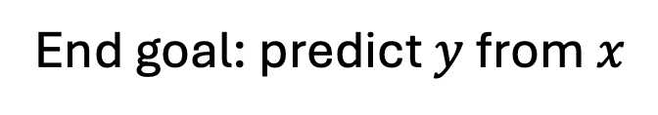
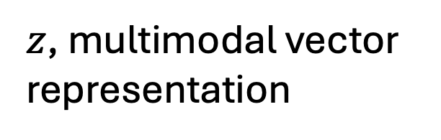
Prediction from multimodal data: modality-specific encoders + multimodal fusion
$y$, referrable diabetic retinopathy
$z$, multimodal vector representation
$x$, multiple data modalities
End goal: predict $y$ from $x$
Notes:
Module 4
Combine information from multiple modalities

Slide 11
As the complexity of the underlying data increases, so too does the probable value added by machine learning
image analysis
(radiology, pathology)
fusion of multiple modalities
Simple models based on clinical variables remain highly relevant
*Use the simplest model that gets the job done*
McKinney et al.
natural language processing (clinical notes)
Craik et al.
clinical and digital health time series
Christodoulou et al.
value added by machine learning
structured EHR or registry data
S. Huang et al.
curated clinical datasets
K. Huang et al.
Khera et al.
Engelhard MM, Navar AM, Pencina MJ. Incremental benefits of machine learning—when do we need a better mousetrap?. JAMA cardiology. 2021 Jun 1;6(6):621-3.
data complexity

Slide 12
Logistic regression
A probabilistic perceptron

Slide 13

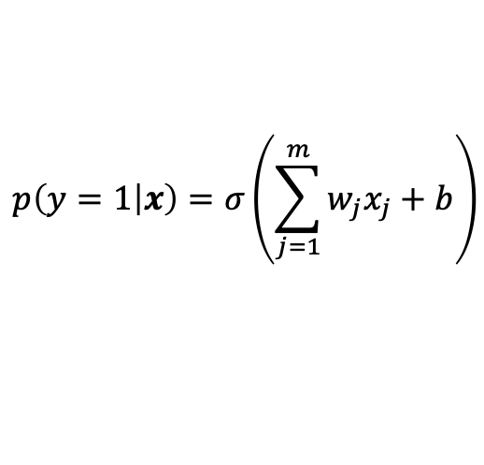

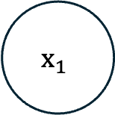




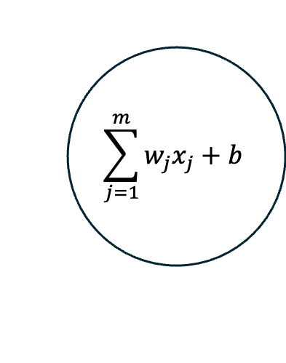
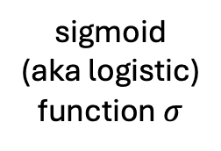

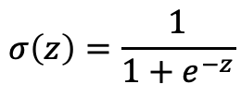
Logistic regression
$$b$$
$$p\left(y=1 | x\right)=σ\left(\sum_{j=1}^{m}{w_{j}x_{j}+b}\right)$$
$$x_{1}$$
$$w_{1}$$
$$\sum_{j=1}^{m}{w_{j}x_{j}}+b$$
…
$$p(y=1|x)$$
$$p\left(y=1 | x\right)=σ\left(w^{T}x+b\right)$$
sigmoid
(aka logistic)
function $σ$
$$x_{m}$$
$$w_{m}$$
$$σ\left(z\right)=\frac{1}{1+e^{−z}}$$
sum
Notes:
Describe the model
Linear model; dot product between features and weights
Followed by logistic link function
Sigmoid -> log-odds to probabilities
On notation:
Column vectors
w^T * x

Slide 14
Logistic regression
$$b$$
$$p\left(y=1 | x\right)=σ\left(\sum_{j=1}^{m}{w_{j}x_{j}+b}\right)$$
$$x_{1}$$
$$w_{1}$$
$$\sum_{j=1}^{m}{w_{j}x_{j}}+b$$
…
$$p(y=1|x)$$
$$p\left(y=1 | x\right)=σ\left(w^{T}x+b\right)$$
sigmoid
(aka logistic)
function $σ$
$$x_{m}$$
$$w_{m}$$
$$σ\left(z\right)=\frac{1}{1+e^{−z}}$$
sum
(view 1) a generalized linear model with a logistic link function
(view 2) a probabilistic perceptron, i.e. a single neuron of a neural network
Notes:
“probabilistic perceptron”
Perceptron: replace sigmoid with a step function
In other words, predict positive if our dot product is positive, else predict negative
“multilayer perceptron”
Here our activation fn is applied to a single value
Later we’ll apply them to vectors: pointwise

Slide 15
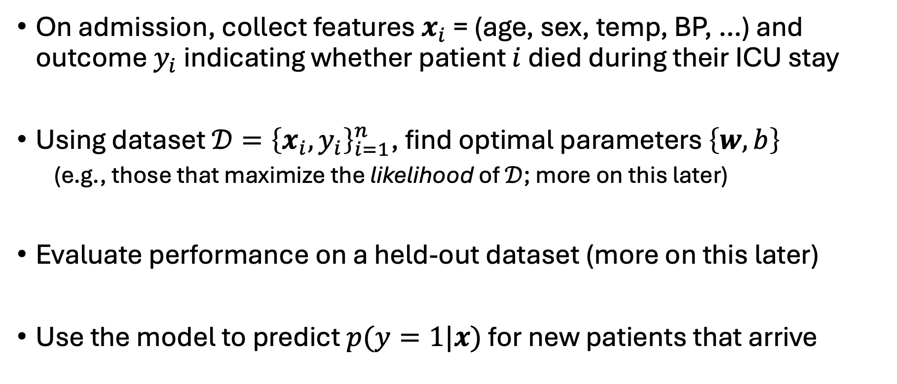
Example: predict ICU mortality
On admission, collect features $x_{i}$ = (age, sex, temp, BP, …) and outcome $y_{i}$ indicating whether patient $i$ died during their ICU stay
Using dataset $𝒟={\left\{x_{i},y_{i}\right\}}_{i=1}^{n}$, find optimal parameters $\left\{w, b\right\}$
(e.g., those that maximize the likelihood of $𝒟$; more on this later)
Evaluate performance on a held-out dataset (more on this later)
Use the model to predict $p(y=1|x)$ for new patients that arrive
Notes:
How might we apply logistic regression to clinical data?
(very similar to your assignment)

Slide 16
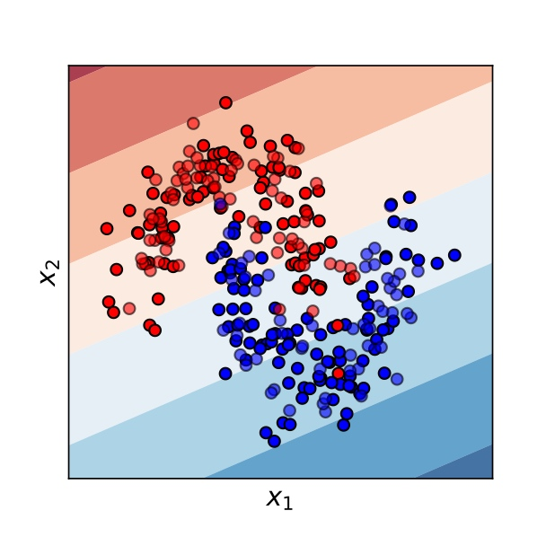
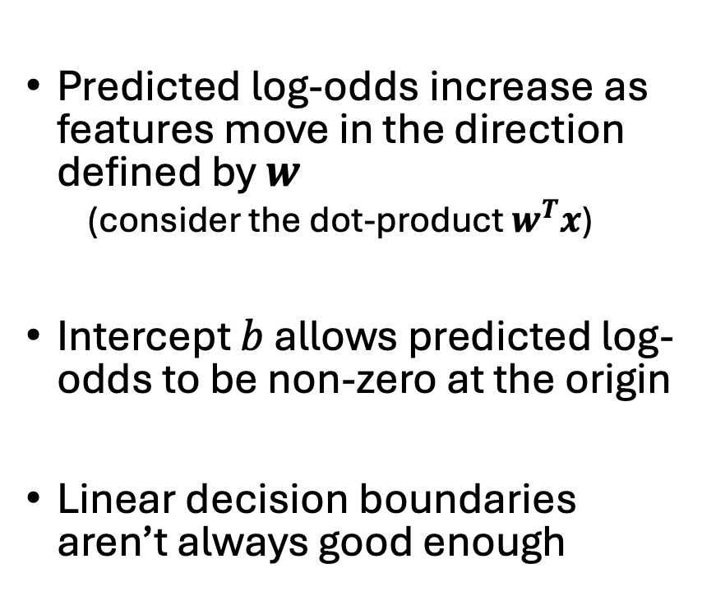

Logistic regression yields linear decision boundaries.
Predicted log-odds increase as features move in the direction defined by $w$
(consider the dot-product $w^{T}x$)
Intercept $b$ allows predicted log-odds to be non-zero at the origin
Linear decision boundaries aren’t always good enough
$$w$$
Notes:
weights w define a direction in feature space
As we move in this direction, predicted log-odds increase
As we move perpendicular to this direction, predicted log-odds are constant
Decision boundary: we say we will predict positive if log-odds greater than some value
This defines a subspace perpendicular to our weight vector

Slide 17
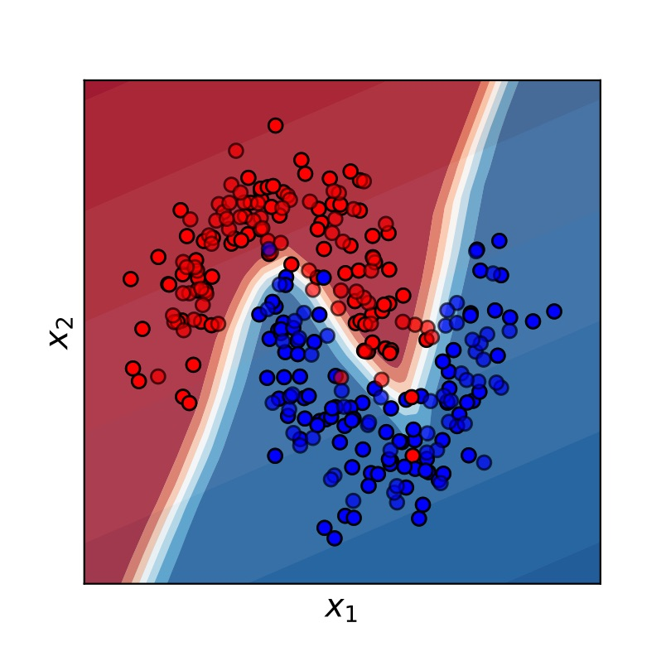
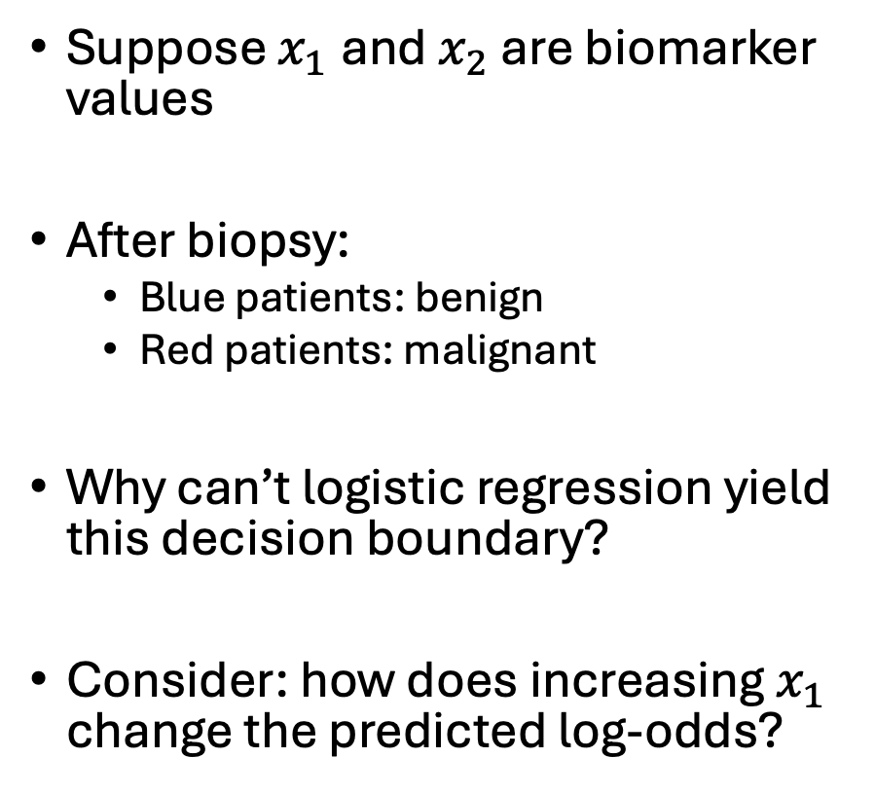
An impossible decision boundary for LR
Neural network
decision boundary
Suppose $x_{1}$and $x_{2}$ are biomarker values
After biopsy:
Blue patients: benign
Red patients: malignant
Why can’t logistic regression yield this decision boundary?
Consider: how does increasing $x_{1}$ change the predicted log-odds?
Notes:
Imagine: red and blue are important!
So… we really need a non-linear decision boundary
Why can’t logistic regression do this?

Slide 18
Recognizing Handwritten Digits
A visual example

Slide 19
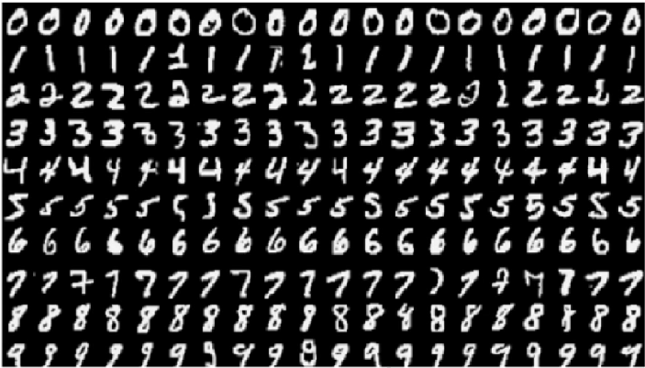
MNIST: Identify handwritten digits

Slide 20
To use logistic regression, we must convert pixels to numbers, then vectorize
convert
to pixels
vectorize
(i.e., flatten)

Slide 21
Start With The Binary Case
Zeros
Ones

Slide 22


We may view the learned $w$ as a filter
$$σ\left( \right)$$
$$⊙$$

Slide 23
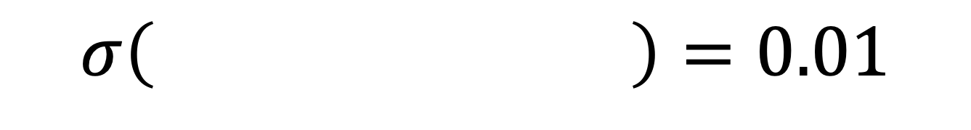
We may view the learned $w$ as a filter
Superimpose and sum to estimate the dot product
When blue regions are revealed, predicted log-odds are negative
$$σ\left( \right)=0.01$$

Slide 24
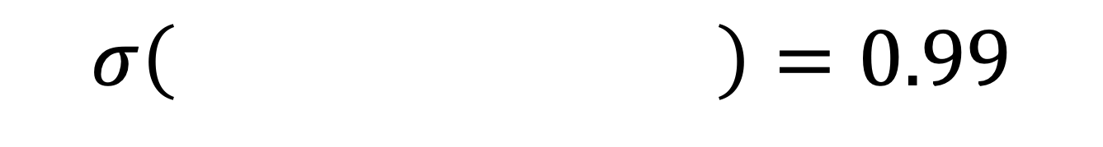
We may view the learned $w$ as a filter
Superimpose and sum to estimate the dot product
When red regions are revealed, predicted log-odds are positive
$$σ\left( \right)=0.99$$

Slide 25
Logistic regression: classification, or risk prediction?
Is logistic regression a classification algorithm?
(discuss and report back in 2 minutes)

Slide 26
Logistic regression: classification, or risk prediction?
Classification
Examples: MNIST, EHR-based phenotyping, pathology detection
Labels are deterministic
Positives and negatives have non-overlapping support (in principle, given the right features)
Risk Prediction
Examples: ICU mortality, heart attack risk, future diagnosis likelihood
Labels are inherently probabilistic
Positives and negatives have overlapping support in any feature space

Slide 27
Summary and what’s next
In this class, we will learn how to build neural network prediction machines from tabular, image, text, and multimodal data.
Logistic regression is an important prediction machine, and it can be viewed as the building block of the neural network. For these reasons, it is important that you understand it well.
Next time, we will focus on building neural networks that overcome the key limitation of logistic regression, namely its linear decision boundary.
Then, we will focus on model learning via stochastic gradient methods.

