Slide 1
Model learning
Matt Engelhard

Slide 2
On homework 1
Goals:
Touch MIMIC-IV data
Begin to learn PyTorch
Explore training dynamics
Conduct careful model evaluation
You may need to bend the instructions a bit in some cases
Hidden layer sizes
Regularization
Low bar to reach out with questions or uncertainties

Slide 3
On ReLU
Networks with sigmoid activations are surprisingly inconsistent
Fixed scale
Vanishing gradient
Piecewise constant approximations
Why ReLU?
Variable scale
Non-trivial gradient over a larger range
Piecewise linear approximations
Much more effective and consistent in practice
Many effective variants on the ReLU
Consider: how many ReLU hidden units needed to get an equally faithful approximation?

Slide 4
Report back: activation functions
Why are non-linear activation functions so important?
Would it ever make sense to build a neural network with linear activation functions (or without activation functions)?
Why or why not?

Slide 5
Overview of learning

Slide 6
How does training, or learning, work?
I want to find the best model parameters.
First, I need to define what best means.
-> for binary classification, we use the cross-entropy loss
-> the best parameters are those that minimize it
Then, I need a strategy for adjusting my parameters to make my model better…
-> our strategy for reducing it is called stochastic gradient descent
-> this is an example of an optimization algorithm
The simplicity of this recipe is a key strength of ML/AI
-> simple learning routines, complex models
-> PyTorch and other ML libraries are designed to make this easy

Slide 7
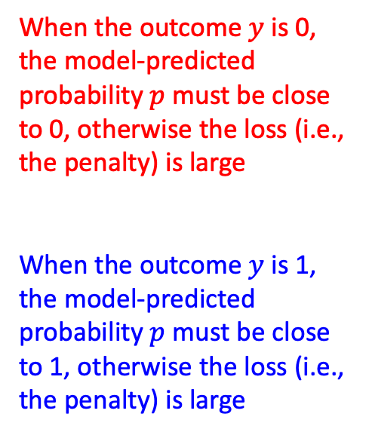
Loss Function for Binary Classification “cross-entropy loss”
When the outcome $y$ is 0, the model-predicted probability $p$ must be close to 0, otherwise the loss (i.e., the penalty) is large
When the outcome $y$ is 1, the model-predicted probability $p$ must be close to 1, otherwise the loss (i.e., the penalty) is large

Slide 8
A Simple Strategy for Optimizing Parameters
Here’s our game.
We want to reduce the loss as much as we can by adjusting our model’s parameters.
We can move any parameter up or down from its current value.
If the loss increases, we’re going the wrong way, and we should try moving that same parameter in the opposite direction.
If the loss decreases, we’re going the right way, and we should keep moving that parameter in that same direction until the loss stops decreasing.
We will keep trying this for all of the parameters until we can no longer decrease the loss; then we’re done.

Slide 9
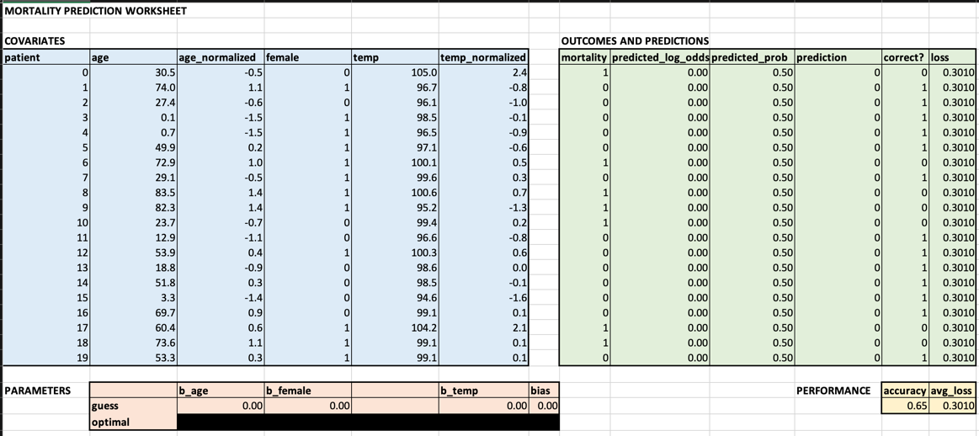
Leter we’ll try this strategy on a small dataset.
Notes:
One thing we could try is to just test out a bunch of different sets of parameter values
Then we can just choose the set associated with the smallest value of the loss
Or we could play around with different parameter values
And see if we can reduce the loss a little by making changes to them
We might try to figure out, through exploration, how changing specific parameters affects the loss
This is what you’ll explore in your exercise

Slide 10


Parameter Optimization by Gradient Descent
We are trying to get to the lowest point (minimum loss).
We do not know where it is (cannot brute force evaluate all parameter combinations).
We cannot see clearly in any direction (loss is a complex, high-dimensional function of parameters).
So, we test the ground around us and walk downhill (calculate gradient, step in opposite direction).

Slide 11
Defining our loss

Slide 12
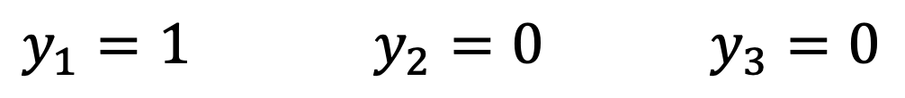
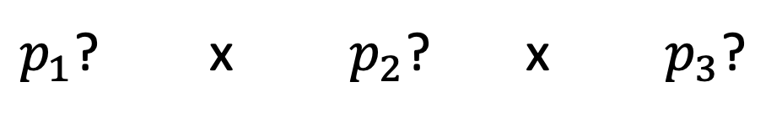
Likelihood from first principles
Our model predicts the probability of death for each patient.
If we change the parameters, we change the predicted probabilities for each patient.
$y_{1}=1$ $y_{2}=0$ $y_{3}=0$
(dies) (survives) (survives)
$p_{1}$? x $p_{2}$? x $p_{3}$?
Notes:
Now there’s actually a lot that could be said about why it’s a good idea to use the mean squared error as our loss for linear regression
But at the same time, it’s pretty straightforward to see that this value being low corresponds pretty well with our idea of the line being a “good fit”
For logistic regression, on the other hand, we’re going to need to think a little bit harder about what value would make sense to use as our loss
To do this, let’s go back to an example we’ve considered before: prediction of mortality in the ICU.
Remember, our model takes some measurements about the patient and predicts their risk of dying during their stay.
To keep things simple, let’s consider three patients – the first one dies, the second one lives, and the third also lives
This is our training set, or at least a portion of it.
For each of these patients, our model takes the initial measurements for those patients as its input, and it spits out a prediction about the probability that they will die
And if we change the parameters of our model – the coefficients associated with each measurement – that’s going to change the predicted probabilities that it spits out for all three of the patients.
Again, we’re making predictions about p1, p2, and p3 – the probability that each of those patients will die during their stay -- and changing any model parameter will change all 3 of those predictions.

Slide 13
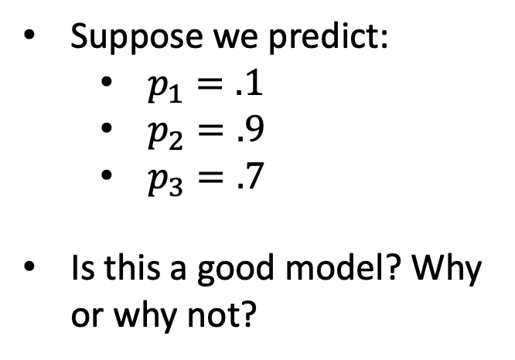
Likelihood from first principles
Suppose we predict:
$p_{1}=.1$
$p_{2}=.9$
$p_{3}=.7$
Is this a good model? Why or why not?
$y_{1}=1$ $y_{2}=0$ $y_{3}=0$
(dies) (survives) (survives)
$p_{1}$? x $p_{2}$? x $p_{3}$?
Notes:
Now just like in linear regression, we’re trying to decide what makes a set of predictions “good” or not good
And that decision has to be based on the outcomes that were actually observed. The predictions have to be consistent with the outcomes in some sense, on average.
Let’s consider a set of specific predictions and consider whether they’re consistent with the outcome
We’ll suppose we predict that p1 is .1
P2 is .9
And p3 is .7
Well, the first patient died and the second two survived
And these predictions – well, we’ve predicted a low probability of death for the patient that actually died, and much higher probability of death for the two patients that actually survived.
It is certainly possible that the first patient could have died despite there only being at 10% risk of death.
But across all three patients, it seems like our predictions aren’t very well aligned with the outcomes that we actually observed.
Specifically, supposing these predictions were correct, we might ask: what was the probability that what actually happened was going to happen?
In other words, what was the probability of those three observed outcomes given the predictions made by our model?
Well, the model predicted that patient 1 had a 10% chance of dying – so the probability of the observed outcome was 10% for that patient
It’s also predicting that Patient 2 had a 90% chance of dying – so, the probability of the observed outcome, not dying , was again 10%
And patient 3 had a 70% chance of dying, so the probability of the observed outcome was 30%
So all in all, if we suppose the model’s predictions accurately reflect the reality of the situation, then the observed outcomes were quite unlikely – 10% * 10% * 30% is pretty small

Slide 14
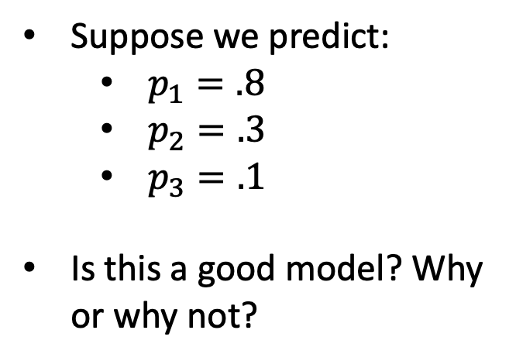
Likelihood from first principles
Suppose we predict:
$p_{1}=.8$
$p_{2}=.3$
$p_{3}=.1$
Is this a good model? Why or why not?
$y_{1}=1$ $y_{2}=0$ $y_{3}=0$
(dies) (survives) (survives)
$p_{1}$? x $p_{2}$? x $p_{3}$?
Notes:
Now let’s consider a different set of parameters
We change the parameters of our model, and now it gives us a new set of predictions for each patient.
Let’s do the same thing again – let’s consider whether these new predictions are aligned with what actually happened
Supposing these predictions were correct, what was the probability of the three observed outcomes?
This time, the model predicts that patient 1 was 80% likely to die, which they did – the probability of that outcome was 80%
It also tells us patient 2 was 30% likely to die, therefore 70% likely to live, which they did – the probability of that outcome was 70%
And along the same lines, the probability of the observed outcome for patient 3 was 90%
So, the chance of the observed outcomes as a whole, given the model, is now 80% for patient 1, times 70% for patient 2, times 90% for patient 3
That’s a lot bigger than the 10% * 10% * 30% we had before
So, it seems like this new set of parameters is better than the ones we had before
The model’s predictions now align much better with what ended up happening
Said more precisely, given this set of parameters, the probability of the observed outcomes was much higher.

Slide 15
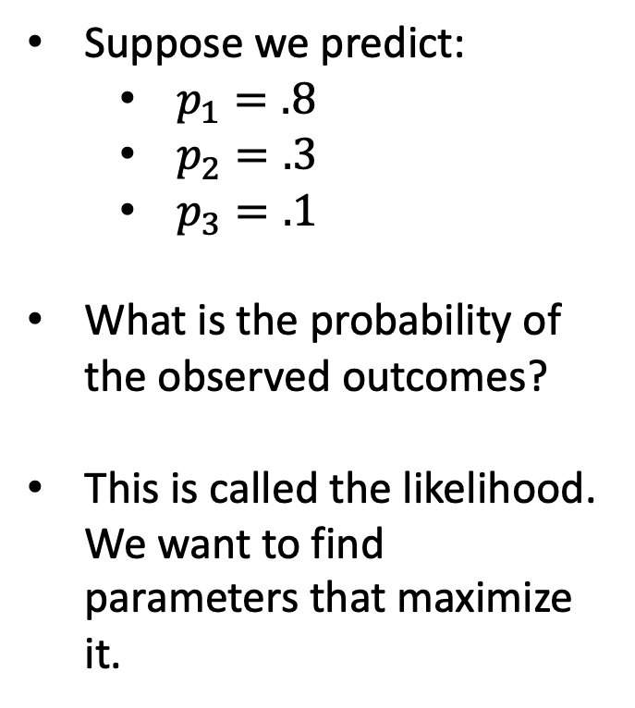
Likelihood from first principles
Suppose we predict:
$p_{1}=.8$
$p_{2}=.3$
$p_{3}=.1$
What is the probability of the observed outcomes?
This is called the likelihood. We want to find parameters that maximize it.
$y_{1}=1$ $y_{2}=0$ $y_{3}=0$
(dies) (survives) (survives)
$p_{1}$? x $p_{2}$? x $p_{3}$?
Notes:
So again, what we’re measuring here is just this:
What’s the probability of the observed outcomes given the current model predictions, which are determined by the parameters
More concisely, what’s the probability of the observed outcomes given the current parameter values
This value is called the likelihood. The better aligned our predictors are with the outcomes, the more it increases.
And in fact, the maximum value it could conceivably be is 1 – if we somehow predicted that patient 1 was 100% likely to die, patient 2 was 100% likely to live, and patient 3 was 100% likely to live, then the probability of the observed outcomes given our model is 100%
But something seems wrong with this… such a model really isn’t acknowledging the fact that there’s randomness in these outcomes.
Such a model seems like it’s TOO tuned to the outcomes – in other words, it’s overfitted. And such a model probably would not be likely to generalize well to new data.

Slide 16
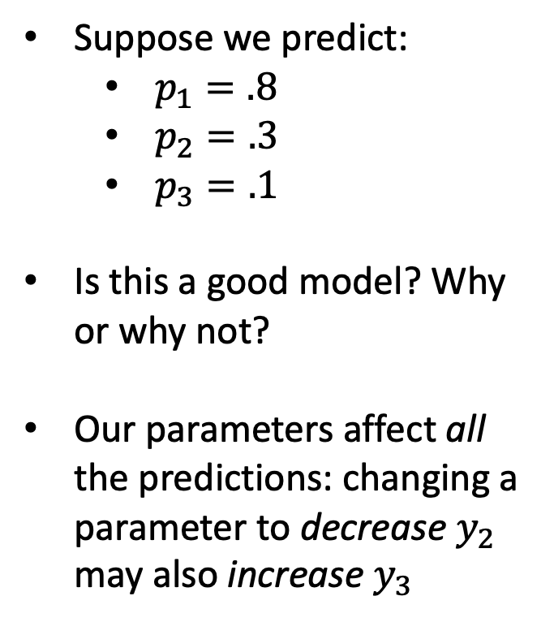
Likelihood from first principles
Suppose we predict:
$p_{1}=.8$
$p_{2}=.3$
$p_{3}=.1$
Is this a good model? Why or why not?
Our parameters affect all the predictions: changing a parameter to decrease $y_{2}$ may also increase $y_{3}$
$y_{1}=1$ $y_{2}=0$ $y_{3}=0$
(dies) (survives) (survives)
$p_{1}$? x $p_{2}$? x $p_{3}$?
Notes:
Fortunately, most models aren’t able to overfit in this way.
When we change a parameter, it’s going to affect predictions for all individuals, not just one of them
So, we might want to make the predicted value of p2 lower to bring it more in line with the observed outcome
But, changing a parameter to decrease the prediction for p2 might also increase the predicted value for p3, for instance
We want values that maximize the likelihood across the whole training set
In other words, the parameters that make the predictions align best with the observed outcomes on average

Slide 17
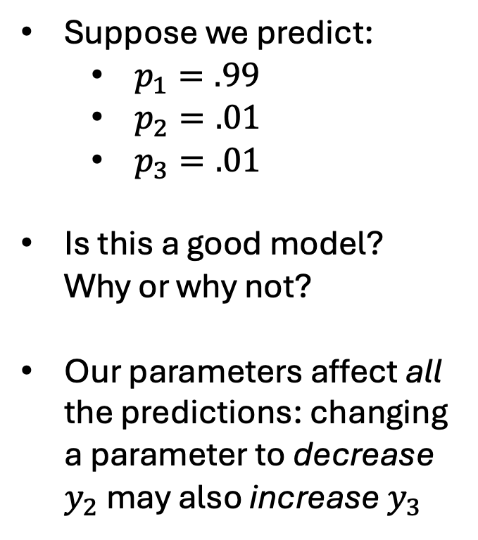
Likelihood from first principles
Suppose we predict:
$p_{1}=.99$
$p_{2}=.01$
$p_{3}=.01$
Is this a good model? Why or why not?
Our parameters affect all the predictions: changing a parameter to decrease $y_{2}$ may also increase $y_{3}$
$y_{1}=1$ $y_{2}=0$ $y_{3}=0$
(dies) (survives) (survives)
$p_{1}$? x $p_{2}$? x $p_{3}$?
Notes:
Fortunately, most models aren’t able to overfit in this way.
When we change a parameter, it’s going to affect predictions for all individuals, not just one of them
So, we might want to make the predicted value of p2 lower to bring it more in line with the observed outcome
But, changing a parameter to decrease the prediction for p2 might also increase the predicted value for p3, for instance
We want values that maximize the likelihood across the whole training set
In other words, the parameters that make the predictions align best with the observed outcomes on average

Slide 18

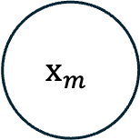

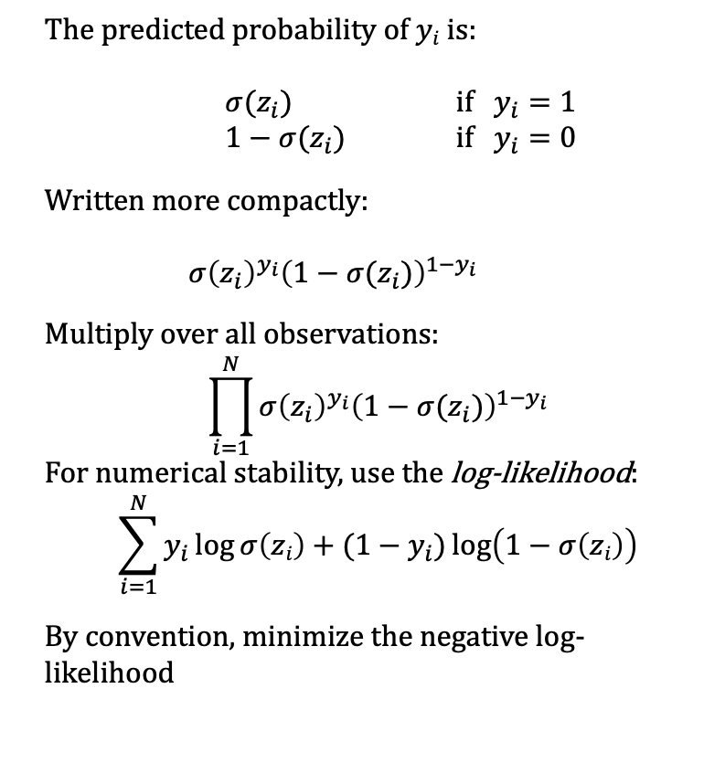
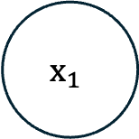

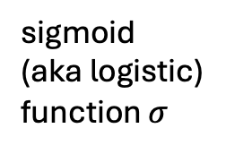


Likelihood from first principles
Probability of all the events $y1,…,yN$given our current model parameters
The predicted probability of $yi$ is:
$σ(z_{i})$ if $y_{i}=1$
$1−σ(z_{i})$ if $y_{i}=0$
Written more compactly:
$σ{\left(z_{i}\right)}^{y_{i}}{\left(1−σ(z_{i})\right)}^{1−y_{i}}$
Multiply over all observations:
$$\prod_{i=1}^{N}{σ{\left(z_{i}\right)}^{y_{i}}{\left(1−σ(z_{i})\right)}^{1−y_{i}}}$$
For numerical stability, use the log-likelihood:
$$\sum_{i=1}^{N}{y_{i}\log{σ\left(zi\right)}+(1−y_{i})\log\left(1−σ\left(zi\right)\right)}$$
By convention, minimize the negative log-likelihood
$$x_{1}$$
$$w_{1}$$
$$Σ$$
…
$$p(y=1|x)$$
$$x_{m}$$
sum
sigmoid
(aka logistic)
function $σ$
$$w_{m}$$
Notes:
Now, let’s go back to our logistic regression model and relate our discussion to the equations we’ve discussed
In logistic regression, we have predictors x
We take the dot product of x and the vector b of parameters
Then we add our bias parameter, which gives us z
So far, we have a linear function of the x-es
Then we squash the value z to a valid probability by passing it through the logistic function, indicated here with sigma
And that gives us our predicted probability – the predicted probability that the outcome y is 1
Now, so far we’ve been thinking in terms of the probability that y is 1
We can do this because y can only be 1 or 0
And if y is 1 with probability p, then y must NOT be 1 – y must be 0 – with probability 1 – p
This can be written as shown on the right hand of the slide
Our model predicts that y is 1 with probability p
And that y is 0 with probability 1 - p

Slide 19

Likelihood from first principles
Probability of all the events $y1,…,yN$given our current model parameters
The predicted probability of $yi$ is:
$σ(z_{i})$ if $y_{i}=1$
$1−σ(z_{i})$ if $y_{i}=0$
Written more compactly:
$σ{\left(z_{i}\right)}^{y_{i}}{\left(1−σ(z_{i})\right)}^{1−y_{i}}$
Multiply over all observations:
$$\prod_{i=1}^{N}{σ{\left(z_{i}\right)}^{y_{i}}{\left(1−σ(z_{i})\right)}^{1−y_{i}}}$$
For numerical stability, use the log-likelihood:
$$\sum_{i=1}^{N}{y_{i}\log{σ\left(zi\right)}+(1−y_{i})\log\left(1−σ\left(zi\right)\right)}$$
By convention, minimize the negative log-likelihood
“cross-entropy loss” or “log loss”
$$y_{i}\log{σ\left(zi\right)}+(1−y_{i})\log\left(1−σ\left(zi\right)\right)$$
Notes:
Now, let’s go back to our logistic regression model and relate our discussion to the equations we’ve discussed
In logistic regression, we have predictors x
We take the dot product of x and the vector b of parameters
Then we add our bias parameter, which gives us z
So far, we have a linear function of the x-es
Then we squash the value z to a valid probability by passing it through the logistic function, indicated here with sigma
And that gives us our predicted probability – the predicted probability that the outcome y is 1
Now, so far we’ve been thinking in terms of the probability that y is 1
We can do this because y can only be 1 or 0
And if y is 1 with probability p, then y must NOT be 1 – y must be 0 – with probability 1 – p
This can be written as shown on the right hand of the slide
Our model predicts that y is 1 with probability p
And that y is 0 with probability 1 - p

Slide 20
Likelihood from first principles
Probability of all the events $y1,…,yN$given our current model parameters
Notes on this loss:
Not just for logistic regression
“cross-entropy loss” or “log loss”
$$y_{i}\log{σ\left(zi\right)}+(1−y_{i})\log\left(1−σ\left(zi\right)\right)$$
Notes:
Now, let’s go back to our logistic regression model and relate our discussion to the equations we’ve discussed
In logistic regression, we have predictors x
We take the dot product of x and the vector b of parameters
Then we add our bias parameter, which gives us z
So far, we have a linear function of the x-es
Then we squash the value z to a valid probability by passing it through the logistic function, indicated here with sigma
And that gives us our predicted probability – the predicted probability that the outcome y is 1
Now, so far we’ve been thinking in terms of the probability that y is 1
We can do this because y can only be 1 or 0
And if y is 1 with probability p, then y must NOT be 1 – y must be 0 – with probability 1 – p
This can be written as shown on the right hand of the slide
Our model predicts that y is 1 with probability p
And that y is 0 with probability 1 - p

Slide 21
Likelihood from first principles
Probability of all the events $y1,…,yN$given our current model parameters
Notes on this loss:
Not just for logistic regression
Consider the loss for confident incorrect predictions
“cross-entropy loss” or “log loss”
$$y_{i}\log{σ\left(zi\right)}+(1−y_{i})\log\left(1−σ\left(zi\right)\right)$$
Notes:
Now, let’s go back to our logistic regression model and relate our discussion to the equations we’ve discussed
In logistic regression, we have predictors x
We take the dot product of x and the vector b of parameters
Then we add our bias parameter, which gives us z
So far, we have a linear function of the x-es
Then we squash the value z to a valid probability by passing it through the logistic function, indicated here with sigma
And that gives us our predicted probability – the predicted probability that the outcome y is 1
Now, so far we’ve been thinking in terms of the probability that y is 1
We can do this because y can only be 1 or 0
And if y is 1 with probability p, then y must NOT be 1 – y must be 0 – with probability 1 – p
This can be written as shown on the right hand of the slide
Our model predicts that y is 1 with probability p
And that y is 0 with probability 1 - p

Slide 22
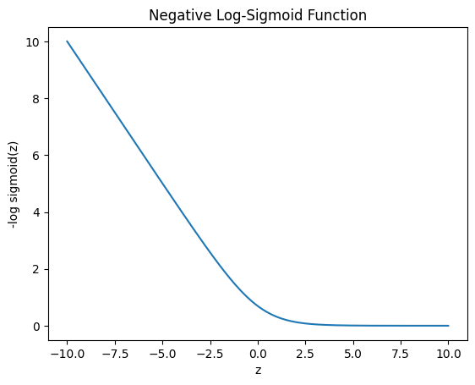
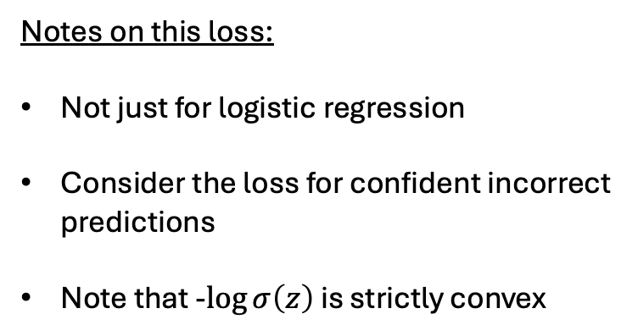
Likelihood from first principles
Probability of all the events $y1,…,yN$given our current model parameters
Notes on this loss:
Not just for logistic regression
Consider the loss for confident incorrect predictions
Note that -$\log{σ\left(z\right)}$ is strictly convex
“cross-entropy loss” or “log loss”
$$y_{i}\log{σ\left(zi\right)}+(1−y_{i})\log\left(1−σ\left(zi\right)\right)$$
Notes:
Could also note that this –log(\sigma(z)) = softplus(-z)

Slide 23
Report back: choice of loss function
Often we evaluate performance using the area under the ROC curve (AUC). Would it make sense to directly optimize this by using –AUC as our loss function? Why or why not?

Slide 24
An initial look at regularization

Slide 25
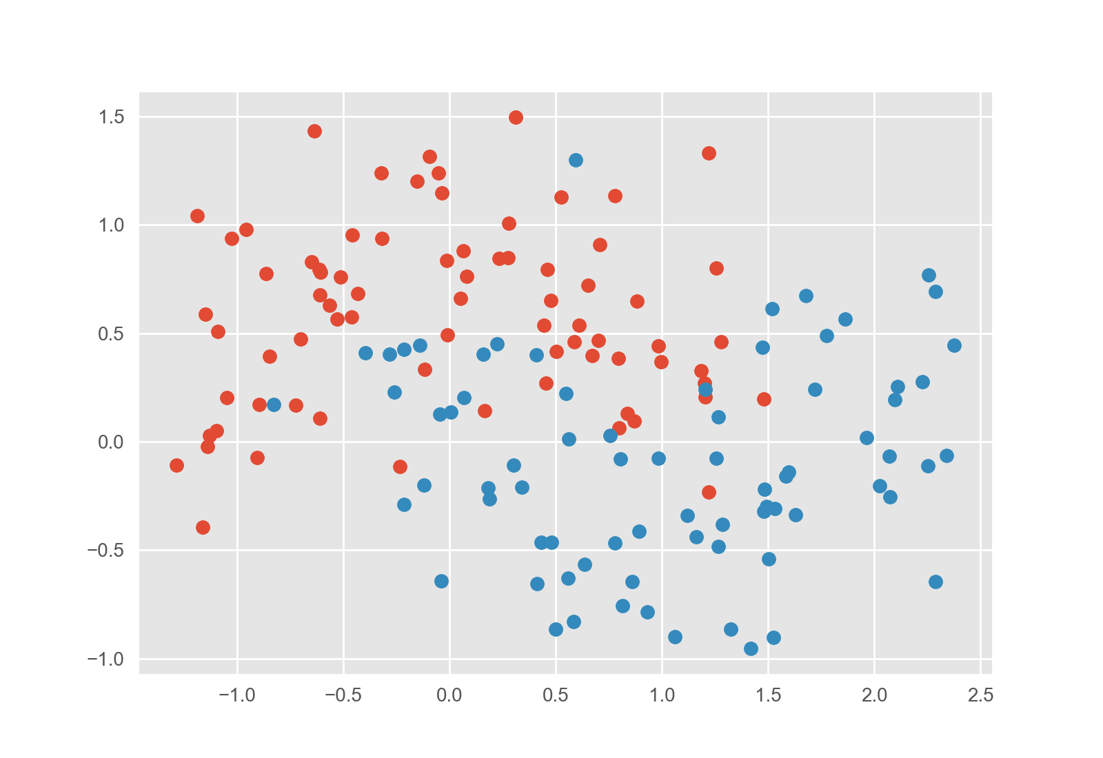
Let’s teach a neural network to identify cancer
Initial decision boundary
(epoch 0)

Slide 26
Let’s teach a neural network to identify cancer
Updated decision boundary
(epoch 1)
Sure.

Slide 27
Let’s teach a neural network to identify cancer
Updated decision boundary
(epoch 4)
Wow!

Slide 28
Let’s teach a neural network to identify cancer
Updated decision boundary
(epoch 23)
Hmm…
It doesn’t know when to stop.

Slide 29
We need a strategy to decide when to stop.
Strategy 1:
Penalize complexity
(regularization)
We could quantify how curvy the line is and add that value to the loss.
Notes:
Note that really strategy 1 is explicit regularization, whereas strategy 2 is implicit regularization

Slide 30
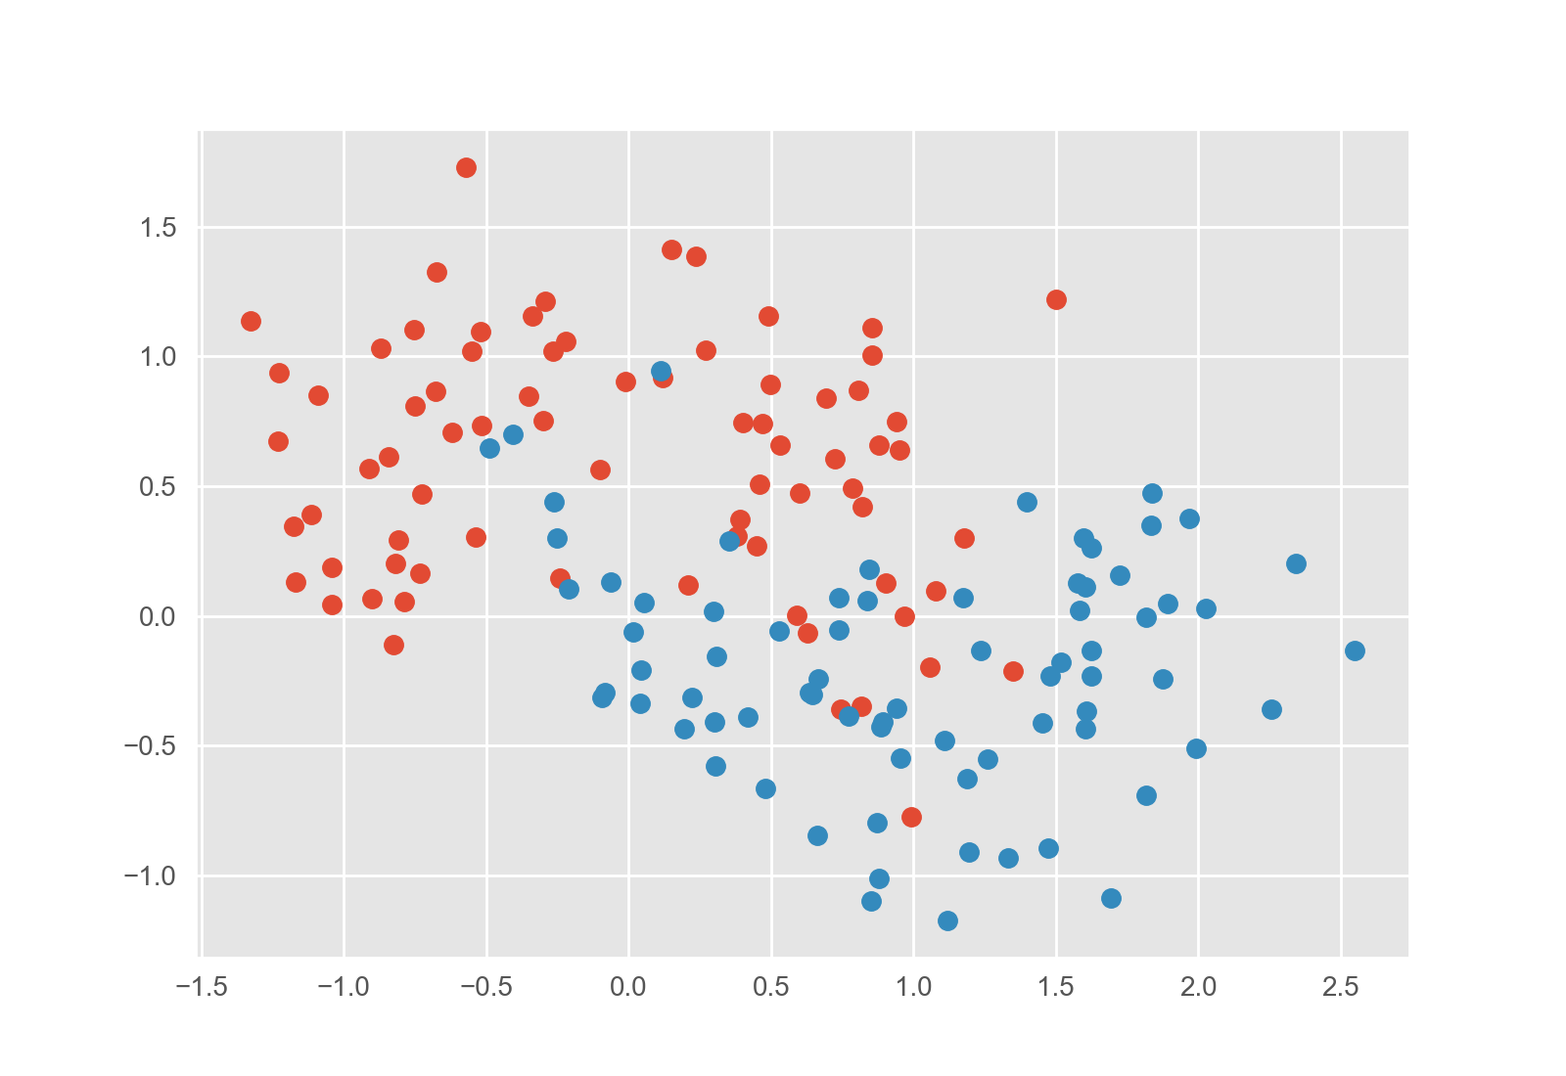
We need a strategy to decide when to stop.
Strategy 2:
Keep checking the validation set
(early stopping)
When our boundary no longer works well on new data, we know we’ve gone too far.
Notes:
Note that really strategy 1 is explicit regularization, whereas strategy 2 is implicit regularization

Slide 31

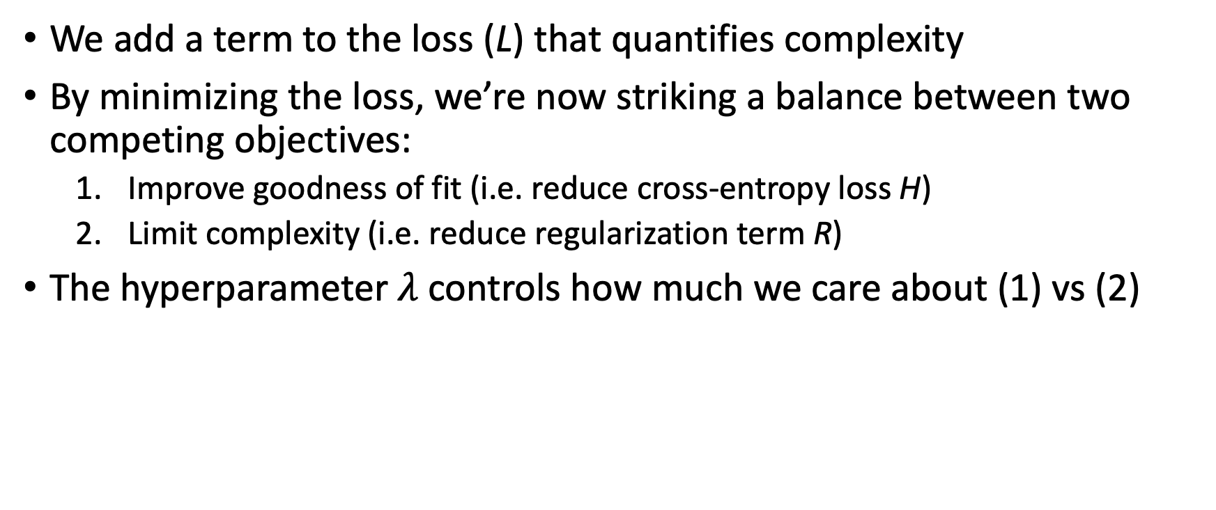
Strategy 1: Explicit Regularization
We add a term to the loss (L) that quantifies complexity
By minimizing the loss, we’re now striking a balance between two competing objectives:
Improve goodness of fit (i.e. reduce cross-entropy loss H)
Limit complexity (i.e. reduce regularization term R)
The hyperparameter $λ$controls how much we care about (1) vs (2)
$$L=H+λR$$

Slide 32

Examples of Explicit Regularization
L₂ (i.e. ridge) regularization: $R={\left\|θ\right\|}_{2}^{2}$
In other words, we penalize the sum of squares of parameters
Common in linear models and in neural networks
$$L=H+λR$$

Slide 33
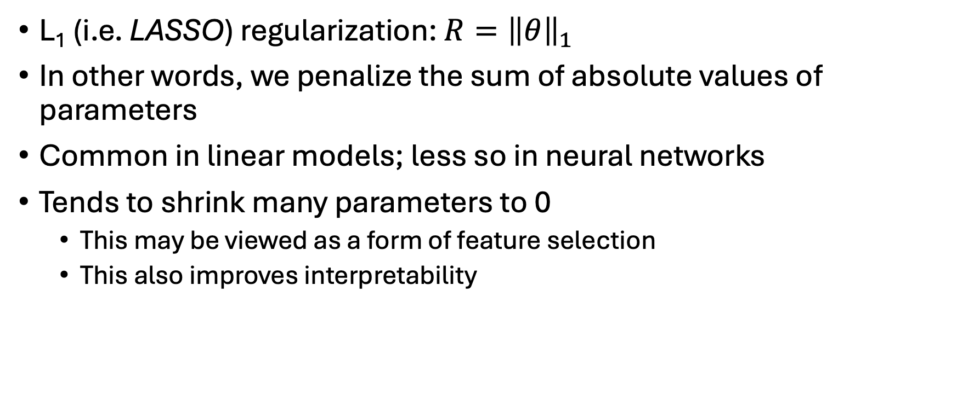
Examples of Explicit Regularization
L₁ (i.e. LASSO) regularization: $R={\left\|θ\right\|}_{1}$
In other words, we penalize the sum of absolute values of parameters
Common in linear models; less so in neural networks
Tends to shrink many parameters to 0
This may be viewed as a form of feature selection
This also improves interpretability
$$L=H+λR$$

Slide 34
Strategy 2: Early Stopping
During optimization, we can check the validation loss as we go.
Instead of optimizing to convergence, we can optimize until the validation loss stops improving
Saves computational cost
Performs better on validation (and test) sets
Widely used technique
Best Validation (and Generalization) Here
Training Loss Keeps Improving
Notes:
One important way to use the validation set, which is very common when training neural networks,
Is to monitor performance on the validation set repeatedly during training
As long as performance on the validation set is improving, we keep fine-tuning our model’s parameters by following the gradient of the loss
But when validation performance starts getting worse, we’re overfitting, so we stop training and lock in our current model parameters
Using the validation set in this way is called “early stopping”, and we’ll use it when training our neural network models both in scikit-learn and in tensorflow

Slide 35
Strategy 3: Dropout
Exclusive to neural networks
During training, we set some hidden features to zero at random (different features for each training step)
This has a dual effect:
Parameter shrinkage (similar to L₂)
Encourages redundancy / redundant features; in other words, the network must model the relationship between x and y in multiple ways

Slide 36
Mitigating Overfitting in Practice
Machine learning almost always uses some form of regularization and/or early stopping
Very common to use multiple forms at once
Dropout + early stopping in neural networks
Combination of L1 and L2 regularization in linear models (i.e. elastic net)
The validation set is the key: used to choose between strategies
A key, often time-consuming step in ML/AI research projects.

Slide 37
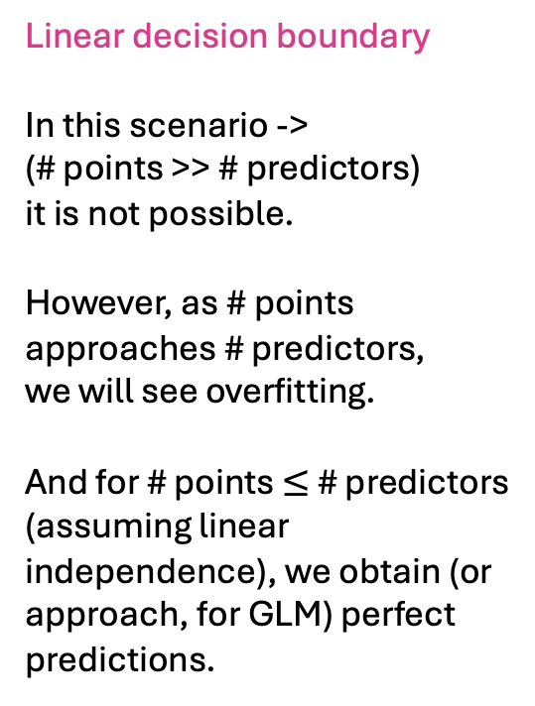
Logistic regression / GLMs can also overfit
Linear decision boundary
In this scenario ->
(# points >> # predictors)
it is not possible.
However, as # points approaches # predictors,
we will see overfitting.
And for # points $≤$ # predictors
(assuming linear independence), we obtain (or approach, for GLM) perfect predictions.

Slide 38
Very brief review of overfitting in linear models

Slide 39
Suppose we have the following data
Patient | Predictor 1 (numeric) | Predictor 2 (numeric) | Outcome (numeric)
A | .5 | .75 | 1.5
B | 1 | .75 | 1.25
> Goal: find the linear equation that best predicts the outcome

Slide 40
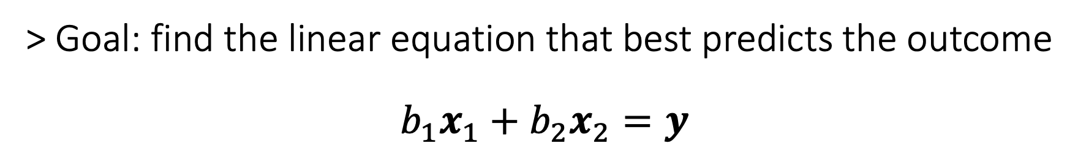
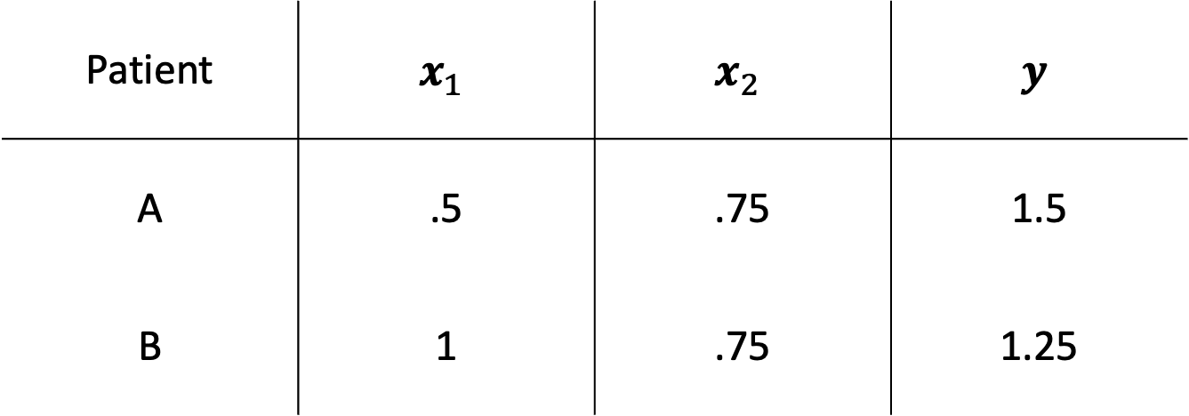
Patient | $$x_{1}$$ | $$x_{2}$$ | $$y$$
A | .5 | .75 | 1.5
B | 1 | .75 | 1.25
> Goal: find the linear equation that best predicts the outcome
$$b_{1}x_{1}+b_{2}x_{2}=y$$

Slide 41

value in patient B
Short version:
Outcomes define a point in N-dimensional space
Each feature/predictor is a basis vector
So, if we have at least N linearly independent features, we get perfect prediction
Consider: are features linearly independent in practice?
$$y$$
1
1
value in patient A

Slide 42

value in patient B
Short version:
Outcomes define a point in N-dimensional space
Each feature/predictor is a basis vector
So, if we have at least N linearly independent features, we get perfect prediction
Consider: are features linearly independent in practice?
$$y$$
1
$$x_{1}$$
1
value in patient A

Slide 43
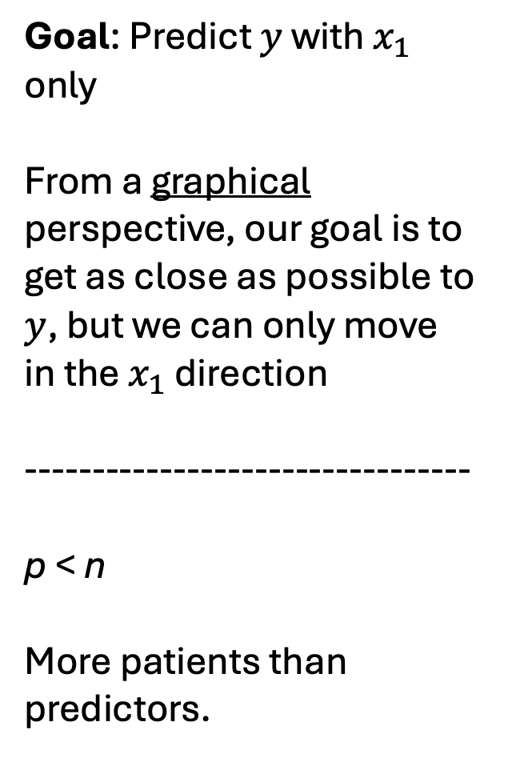
Goal: Predict $y$ with $x_{1}$ only
From a graphical perspective, our goal is to get as close as possible to $y$, but we can only move in the $x_{1}$ direction
---------------------------------
p < n
More patients than predictors.
value in patient B
$$y$$
1
$$x_{1}$$
1
value in patient A

Slide 44

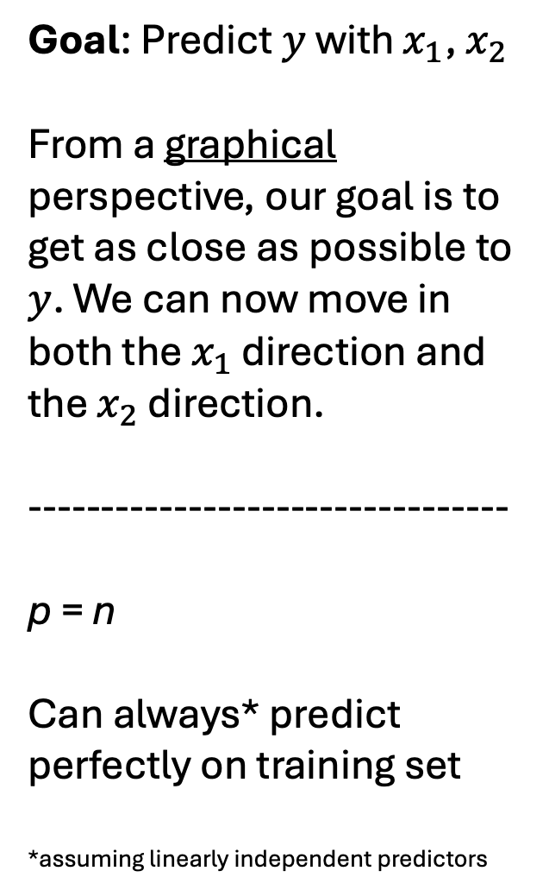
Goal: Predict $y$ with $x_{1}$, $x_{2}$
From a graphical perspective, our goal is to get as close as possible to $y$. We can now move in both the $x_{1}$ direction and the $x_{2}$ direction.
---------------------------------
p = n
Can always* predict perfectly on training set
*assuming linearly independent predictors
value in patient B
$$y$$
1
$$x_{1}$$
$$x_{2}$$
1
value in patient A

Slide 45
Goal: Predict $y$ with $x_{1}$, $x_{2}$
From a graphical perspective, our goal is to get as close as possible to $y$. We can now move in both the $x_{1}$ direction and the $x_{2}$ direction.
---------------------------------
p = n
Can always* predict perfectly on training set
*assuming linearly independent predictors
value in patient B
$$y$$
1
$$x_{1}$$
$$x_{2}$$
1
value in patient A

Slide 46
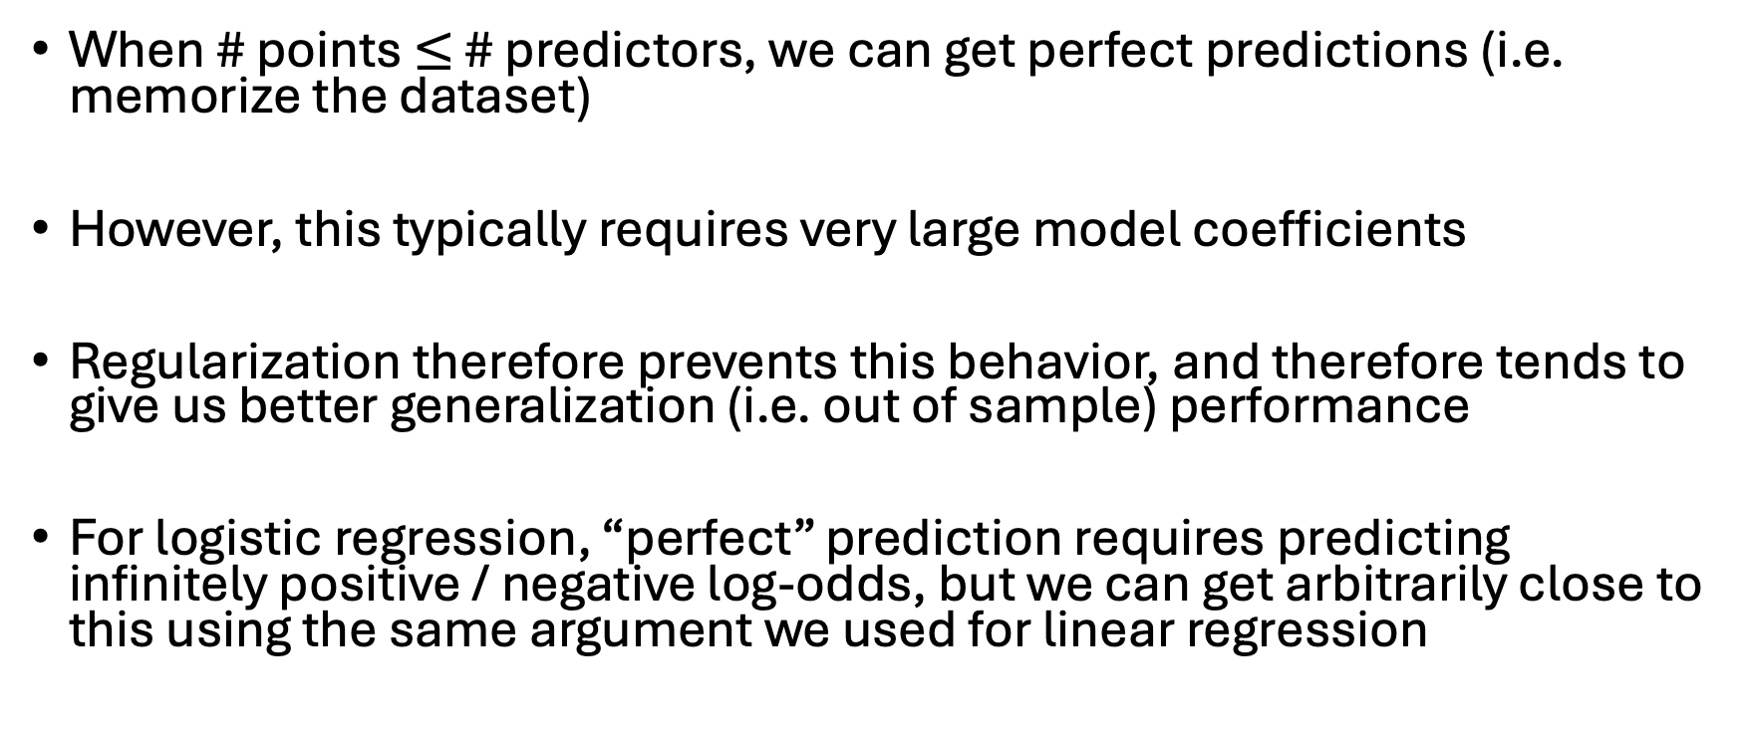
Takeaways
When # points $≤$ # predictors, we can get perfect predictions (i.e. memorize the dataset)
However, this typically requires very large model coefficients
Regularization therefore prevents this behavior, and therefore tends to give us better generalization (i.e. out of sample) performance
For logistic regression, “perfect” prediction requires predicting infinitely positive / negative log-odds, but we can get arbitrarily close to this using the same argument we used for linear regression

Slide 47
Regularization in PyTorch
import torch
import torch.nn as nn
# simple logistic regression
model = nn.Linear(d_in, 1)
criterion = nn.BCEWithLogitsLoss()
lambda_l2 = 1e-3
# forward pass
logits = model(X).squeeze()
data_loss = criterion(logits, y.float())
# manual L2 regularization (weights only, no bias)
l2_penalty = sum((p**2).sum() for name, p in model.named_parameters()
if "weight" in name)
loss = data_loss + lambda_l2 * l2_penalty
loss.backward()
Entirely flexible
In ML we consider a wide variety of “regularizers”
“Weight decay” is similar but not identical to L2 regularization

Slide 48
Calculating the gradient

Slide 49
Why autodifferentiation (i.e. backprop)?
Numeric differentiation
Not exact
One forward pass per parameter
Symbolic differentiation
Expressions become intractable
Numerically unstable
Autodifferentiation
Exact
Requires only one forward pass and one backward pass through the network

Slide 50
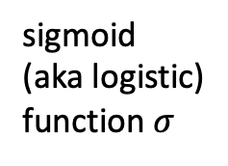
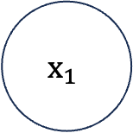
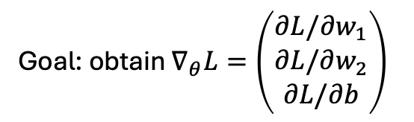

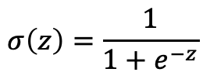

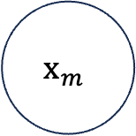

Autodifferentiation for logistic regression
Write our model as $f_{θ}(x)$, where $θ=\{w_{1}, w_{2}, b\}$
$$x_{1}$$
$$b$$
$$w_{1}$$
$$f_{θ}\left(x\right)=p=σ\left(w_{1}x_{1}+w_{2}x_{2}+b\right)$$
$$Σ$$
$$σ\left(z\right)=\frac{1}{1+e^{−z}}$$
$$p(y=1|x)$$
$$x_{m}$$
sum
sigmoid
(aka logistic)
function $σ$
$$w_{m}$$
$$L(f_{θ}\left(x\right),y)=−\left(y log f_{θ}\left(x\right)+\left(1−y\right)log \left(1−f_{θ}\left(x\right)\right)\right)$$
Goal: obtain $∇_{θ}L=\left(\begin{aligned}∂L/∂w_{1} \\ ∂L/∂w_{2} \\ ∂L/∂b\end{aligned}\right)$
Notes:
Goal: obtain gradient of loss with respect to model parameters

Slide 51
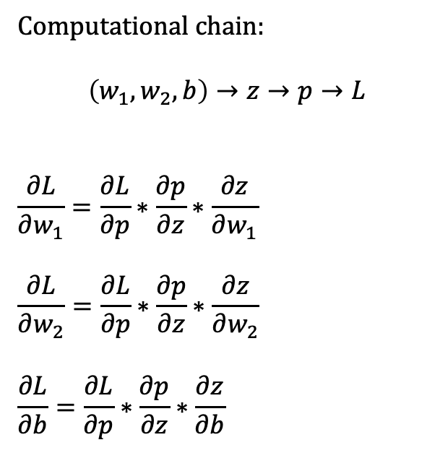
Autodifferentiation for logistic regression
Computational chain:
$$\left(w_{1},w_{2},b\right)→z→p→L$$
$$\frac{∂L}{∂w_{1}}=\frac{∂L}{∂p}∗\frac{∂p}{∂z}∗\frac{∂z}{∂w_{1}}$$
$$\frac{∂L}{∂w_{2}}=\frac{∂L}{∂p}∗\frac{∂p}{∂z}∗\frac{∂z}{∂w_{2}}$$
$$\frac{∂L}{∂b}=\frac{∂L}{∂p}∗\frac{∂p}{∂z}∗\frac{∂z}{∂b}$$
$$x_{1}$$
$$b$$
$$w_{1}$$
$$Σ$$
$$p(y=1|x)$$
$$x_{m}$$
sum
sigmoid
(aka logistic)
function $σ$
$$w_{m}$$
Notes:
Goal: obtain gradient of loss with respect to model parameters

Slide 52
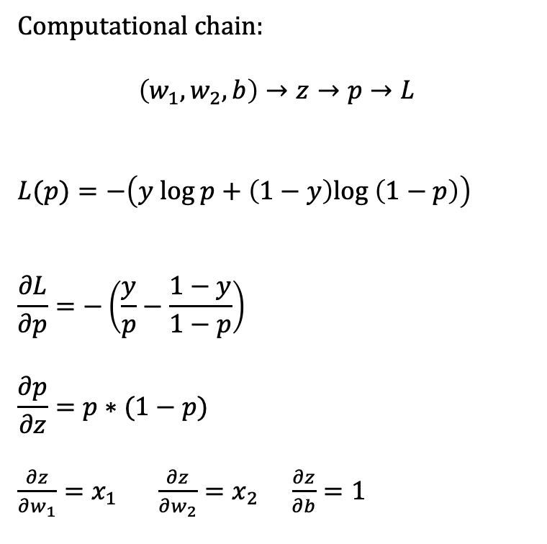
Autodifferentiation for logistic regression
Computational chain:
$$\left(w_{1},w_{2},b\right)→z→p→L$$
$$L(p)=−\left(y log p+\left(1−y\right)log \left(1−p\right)\right)$$
$$\frac{∂L}{∂p}=−\left(\frac{y}{p}−\frac{1−y}{1−p}\right)$$
$$\frac{∂p}{∂z}=p∗(1−p)$$
$\frac{∂z}{∂w_{1}}=x_{1} \frac{∂z}{∂w_{2}}=x_{2}$ $\frac{∂z}{∂b}=1$
$$x_{1}$$
$$b$$
$$w_{1}$$
$$Σ$$
$$p(y=1|x)$$
$$x_{m}$$
sum
sigmoid
(aka logistic)
function $σ$
$$w_{m}$$
Notes:
Goal: obtain gradient of loss with respect to model parameters

Slide 53
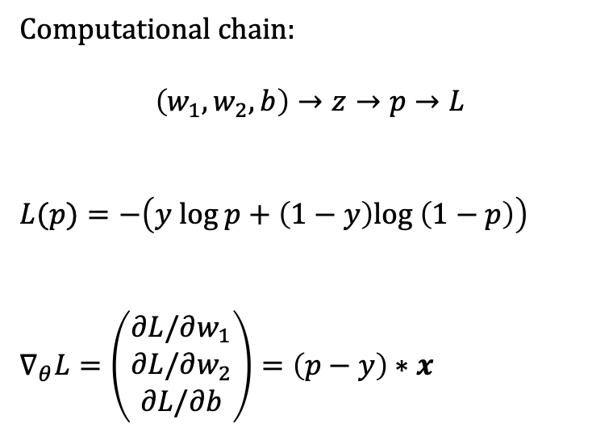

Autodifferentiation for logistic regression
Computational chain:
$$\left(w_{1},w_{2},b\right)→z→p→L$$
$$L(p)=−\left(y log p+\left(1−y\right)log \left(1−p\right)\right)$$
$$∇_{θ}L=\left(\begin{aligned}∂L/∂w_{1} \\ ∂L/∂w_{2} \\ ∂L/∂b\end{aligned}\right)=\left(p−y\right)∗x$$
$$x_{1}$$
$$b$$
$$w_{1}$$
$$Σ$$
$$p(y=1|x)$$
$$x_{m}$$
sum
sigmoid
(aka logistic)
function $σ$
$$w_{m}$$
Notes:
Goal: obtain gradient of loss with respect to model parameters

Slide 54
Autodiff in PyTorch
def bce_from_logits(logits, y):
return torch.mean(
torch.log(1 + torch.exp(logits)) - y * logits
)
Each PyTorch primitive (e.g., torch.log) has a registered derivative
These registered derivatives are composed in the backwards pass

Slide 55
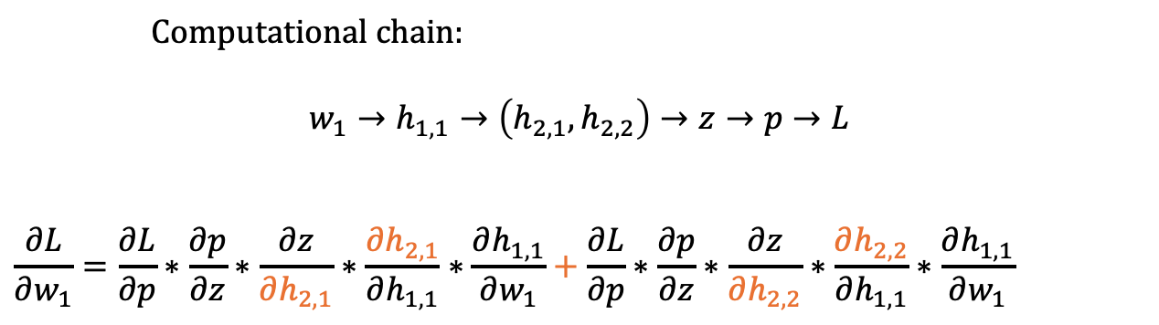



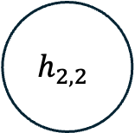
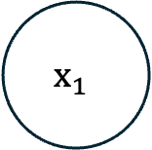

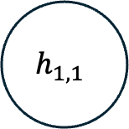
Aggregating across multiple paths
$$h_{2,1}$$
$$x_{1}$$
$$w_{1}$$
$$h_{1,1}$$
$$Σ$$
$$p(y=1|x)$$
$$h_{2,2}$$
Computational chain:
$$w_{1}→h_{1,1}→\left(h_{2,1},h_{2,2}\right)→z→p→L$$
$$\frac{∂L}{∂w_{1}}=\frac{∂L}{∂p}∗\frac{∂p}{∂z}∗\frac{∂z}{∂h_{2,1}}∗\frac{∂h_{2,1}}{∂h_{1,1}}∗\frac{∂h_{1,1}}{∂w_{1}}+\frac{∂L}{∂p}∗\frac{∂p}{∂z}∗\frac{∂z}{∂h_{2,2}}∗\frac{∂h_{2,2}}{∂h_{1,1}}∗\frac{∂h_{1,1}}{∂w_{1}}$$
Notes:
Goal: obtain gradient of loss with respect to model parameters

Slide 56
Autodiff in PyTorch
def bce_from_logits(logits, y):
return torch.mean(
torch.log(1 + torch.exp(logits)) - y * logits
)
Each PyTorch primitive (e.g., torch.log) has a registered derivative
These registered derivatives are composed in the backwards pass
Complex graphs require extensive bookkeeping, but the principles are simple

Slide 57
Parameter Optimization by stochastic gradient descent (SGD)
Implemented by calculating exact gradient for a given minibatch
Each minibatch yields a noisy estimate of the full-sample gradient
Can be viewed as noise injection
Injected noise helps us avoid local minima

Slide 58
Overview of common variations on SGD
Adaptation | Summary | Intuition | Example optimizer(s)
Momentum | Averages gradients over time | Roll a heavy ball downhill and push it based on the gradient | SGD with momentum, Adam
Adaptive learning rates | Different step sizes per parameter | Parameters with noisy gradients take smaller steps | RMSprop, Adam
Second-moment tracking | Tracks gradient variance | Commit to directions that keep changing | RMSprop, Adam
Weight decay correction | Ensures shrinkage is uniform across parameters | Shrinkage should not depend on gradient variance | SGD (no correction needed), AdamW
Bias correction | Fixes early-step underestimation | Warm up statistics before trusting them | Adam, AdamW

Slide 59
Activity: guess and check regression (i.e., you are the optimizer)
https://github.com/engelhard-lab/lectures/blob/main/activities/guess_and_check_regression.xlsx
Notes:
One thing we could try is to just test out a bunch of different sets of parameter values
Then we can just choose the set associated with the smallest value of the loss
Or we could play around with different parameter values
And see if we can reduce the loss a little by making changes to them
We might try to figure out, through exploration, how changing specific parameters affects the loss
This is what you’ll explore in your exercise

