Slide 1
A brief note on model learning
Matthew Engelhard

Slide 2
How does training, or learning, work?
I want to find the best model parameters.
First, I need to define what best means.
-> define the loss
-> the best parameters are those that minimize it
Then, I need a strategy for adjusting my parameters to make my model better…
-> …in other words, a strategy for reducing the loss
-> this is the field of optimization

Slide 3
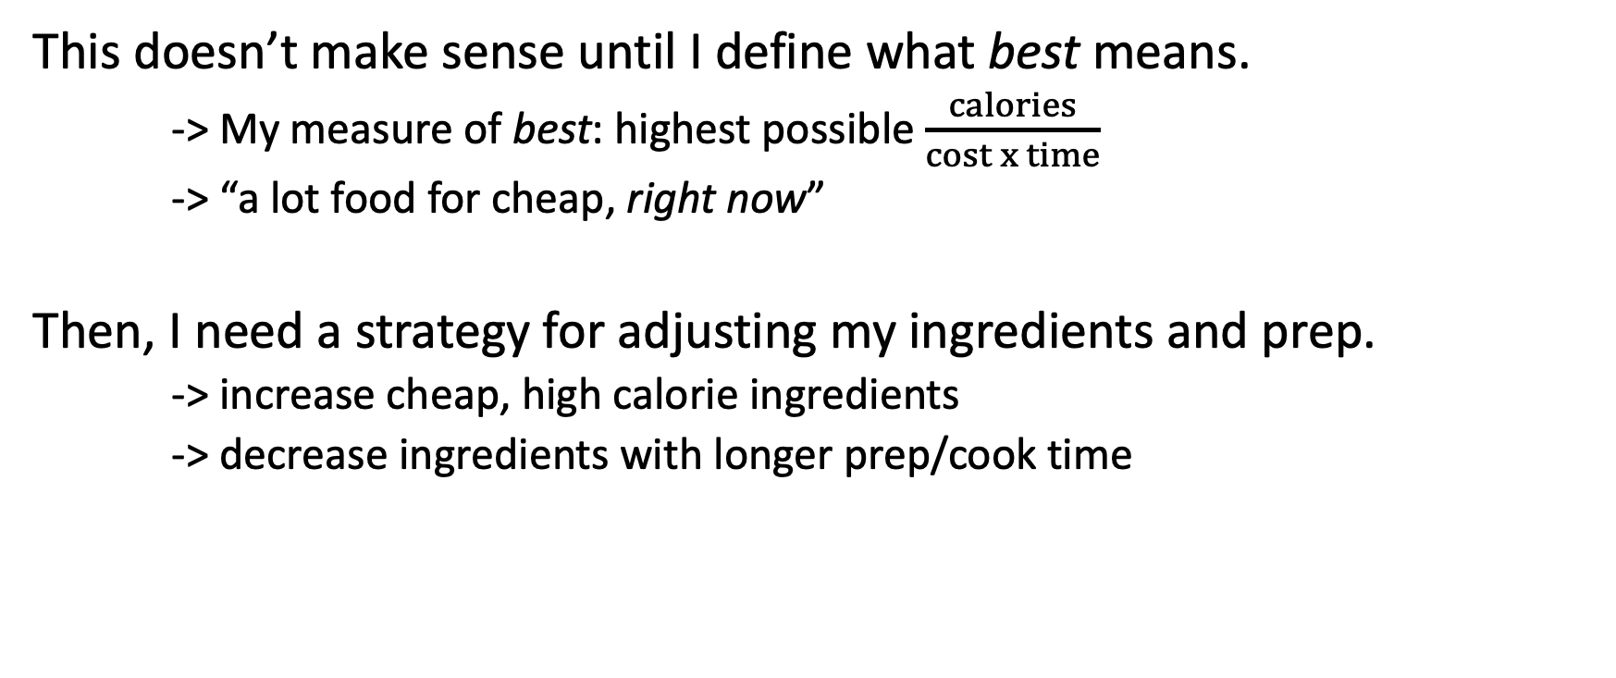
I want to find the best dinner recipe.
This doesn’t make sense until I define what best means.
-> My measure of best: highest possible $\frac{calories}{cost x time}$
-> “a lot food for cheap, right now”
Then, I need a strategy for adjusting my ingredients and prep.
-> increase cheap, high calorie ingredients
-> decrease ingredients with longer prep/cook time

Slide 4

I want to find the best dinner recipe.
This doesn’t make sense until I define what best means.
-> My measure of best: highest possible $\frac{calories}{cost x time}$
-> “a lot food for cheap, right now”
Then, I need a strategy for adjusting my ingredients and prep.
-> increase cheap, high calorie ingredients
-> decrease ingredients with longer prep/cook time

Slide 5
How does training, or learning, work?
I want to find the best model parameters.
First, I need to define what best means.
-> for binary classification, we use the cross-entropy loss
-> the best parameters are those that minimize it
Then, I need a strategy for adjusting my parameters to make my model better…
-> our strategy for reducing it is called stochastic gradient descent
-> this is an example of an optimization algorithm

Slide 6
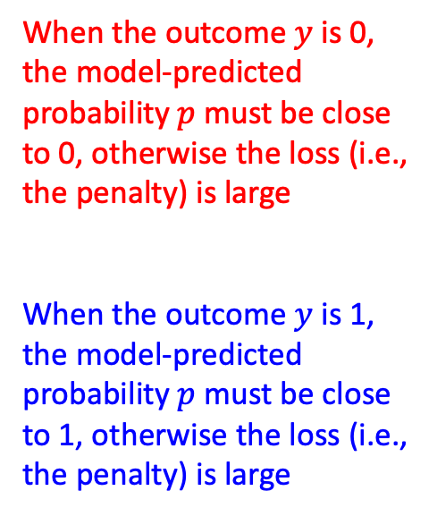
Loss Function for Binary Classification “cross-entropy loss”
When the outcome $y$ is 0, the model-predicted probability $p$ must be close to 0, otherwise the loss (i.e., the penalty) is large
When the outcome $y$ is 1, the model-predicted probability $p$ must be close to 1, otherwise the loss (i.e., the penalty) is large

Slide 7
A Simple Strategy for Optimizing Parameters
Here’s our game.
We want to reduce the loss as much as we can by adjusting our model’s parameters.
We can move any parameter up or down from its current value.
If the loss increases, we’re going the wrong way, and we should try moving that same parameter in the opposite direction.
If the loss decreases, we’re going the right way, and we should keep moving that parameter in that same direction until the loss stops decreasing.
We will keep trying this for all of the parameters until we can no longer decrease the loss; then we’re done.

Slide 8
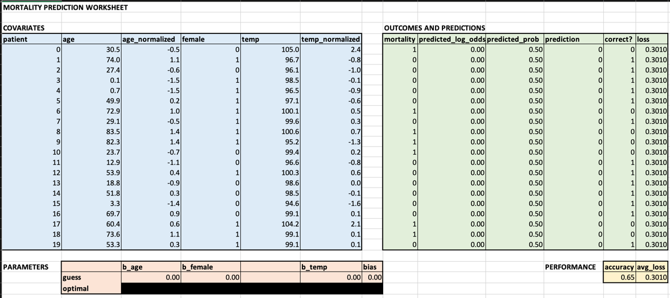
Let’s try this strategy on a small dataset.
Notes:
One thing we could try is to just test out a bunch of different sets of parameter values
Then we can just choose the set associated with the smallest value of the loss
Or we could play around with different parameter values
And see if we can reduce the loss a little by making changes to them
We might try to figure out, through exploration, how changing specific parameters affects the loss
This is what you’ll explore in your exercise

Slide 9


Parameter Optimization by Gradient Descent
We are trying to get to the great valley (minimum loss).
We do not know where it is (cannot test all parameter values).
We cannot see clearly in any direction (complex, high-dimensional function).
So, we test the ground around us, and walk downhill (use calculus / calculate gradient).

Slide 10
Parameter Optimization by Gradient Descent
stochastic
^
We are trying to get to the great valley (minimum loss).
We do not know where it is (cannot test all parameter values).
We cannot see clearly in any direction (complex, high-dimensional function).
So, we test the ground around us, and stumble downhill (use calculus / calculate gradient).

Slide 11
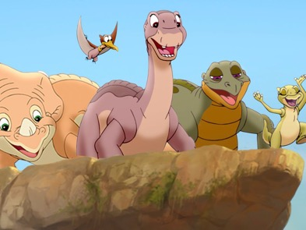
Parameter Optimization by Gradient Descent
We are trying to get to the great valley (minimum loss).
We do not know where it is (cannot test all parameter values).
We cannot see clearly in any direction (complex, high-dimensional function).
So, we test the ground around us, and walk downhill (use calculus / calculate gradient).

