Slide 1
Calibration and Class Balance
Matt Engelhard

Slide 2
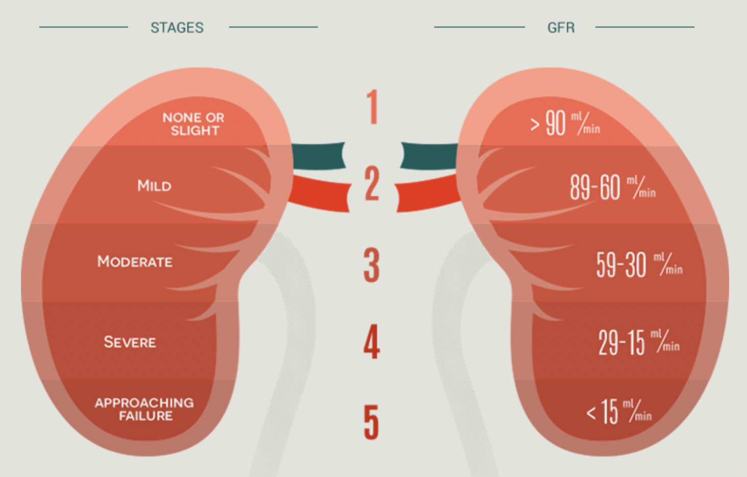
Last Time: Performance metrics are tied to the use case
11%
Probability of Stage IV CKD within two years
Report Back:
How might you use this number in clinical practice (be specific)?
What performance metrics are relevant to this way of using the prediction?

Slide 3
Today
Consider definitions of algorithmic fairness
Assessing model calibration
Class balancing and effects on calibration
Discussion
Small-group activity
Post-hoc calibration techniques
What is fair? Do we emphasize calibration, or discrimination?

Slide 4
Growing concerns about algorithmic bias
You’ve been using the model for a year now, and you’ve noticed something potentially concerning.
The model seems to preferentially refer White patients over Black patients. Specifically, you notice that Black patients are referred only if their clinical presentation is more severe compared to White patients who are referred. You are not sure why this is happening.
Report Back: What are some possible sources of this bias, and what could you do to investigate?

Slide 5
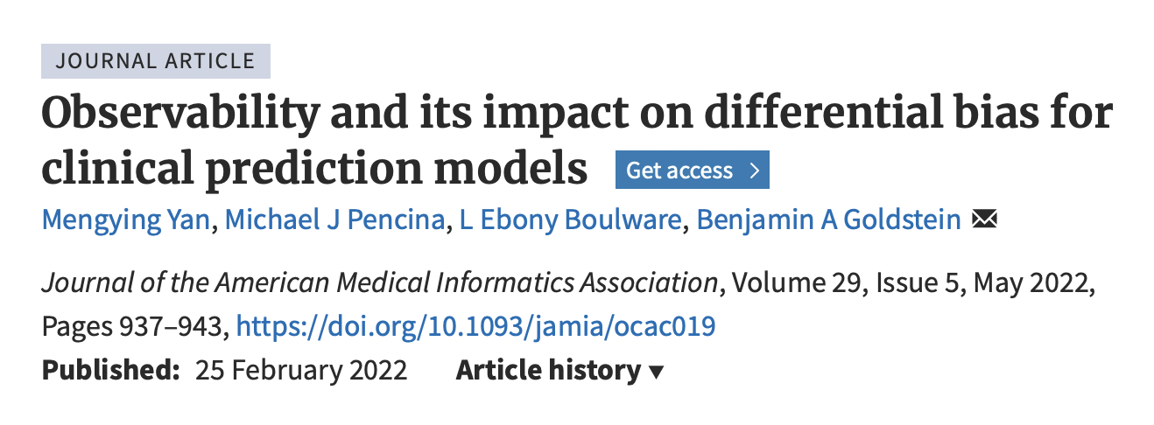
Sources of Algorithmic Bias
Many possible sources, but in most cases, it’s:
Biased outcomes in training data
Poor representation of demographics

Slide 6
What does it mean for a model to be fair?
Consider whether predictions are fair between two groups A and B.
One possible solution is fairness through unawareness, also called blindness, wherein the model is not given information about group status.
Report back:
- What could go wrong if the model is aware of group status?
- What could go wrong if the model is unaware of group status?
Then, propose an alternative approach to achieve or evaluate fairness.

Slide 7
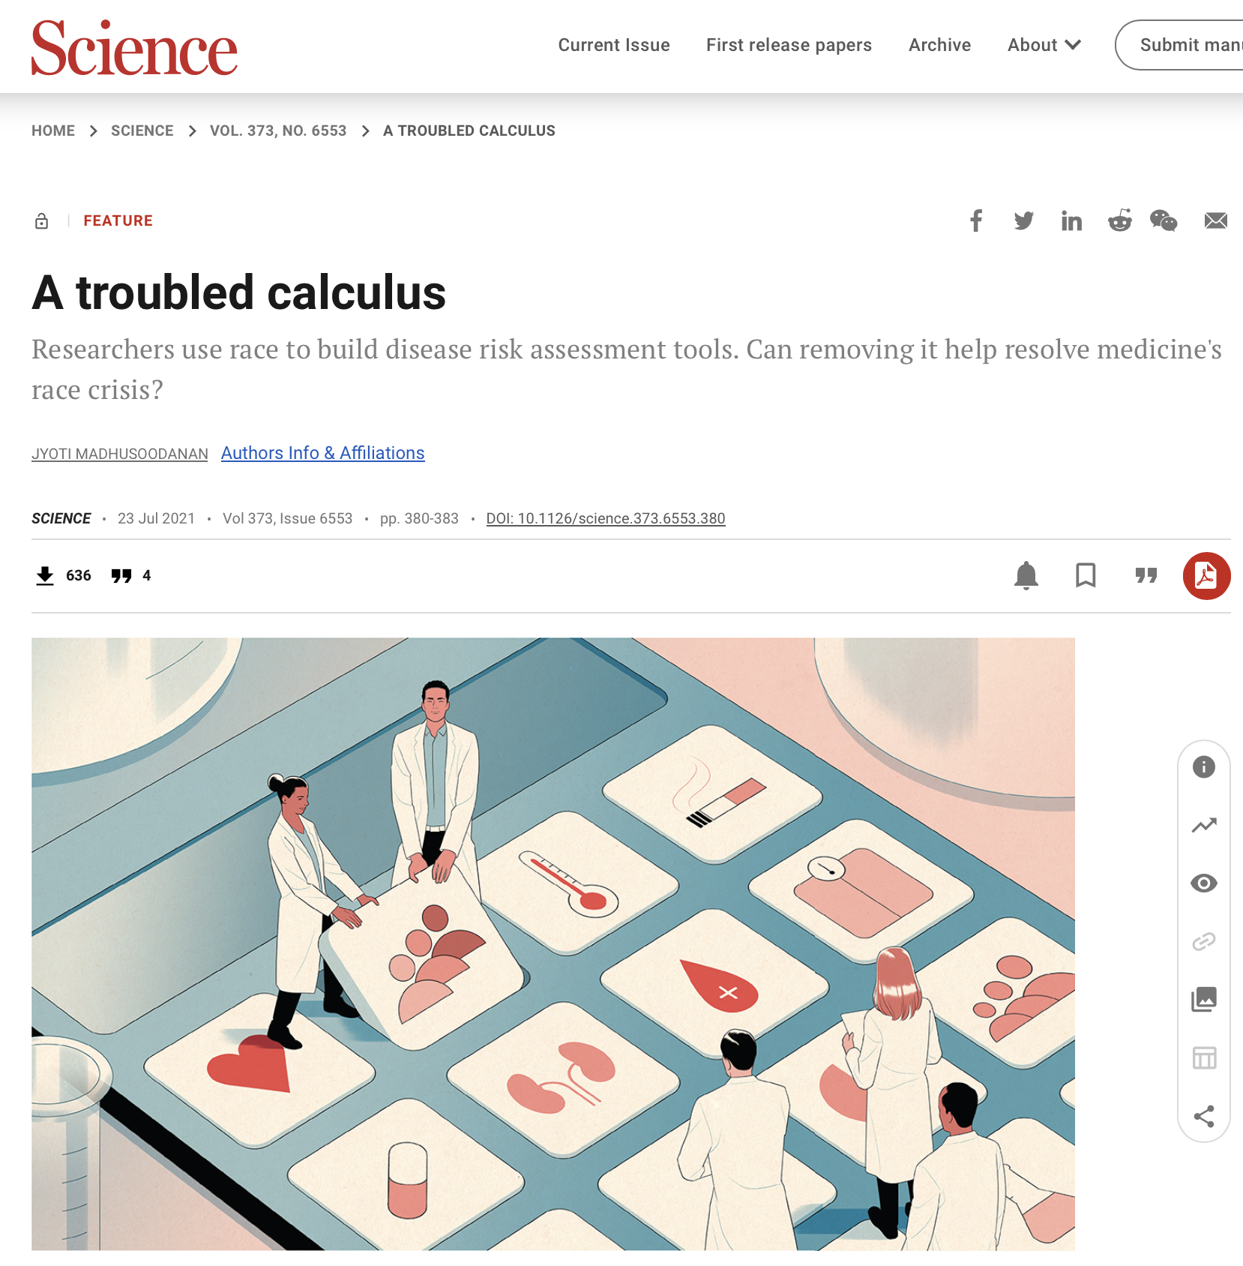
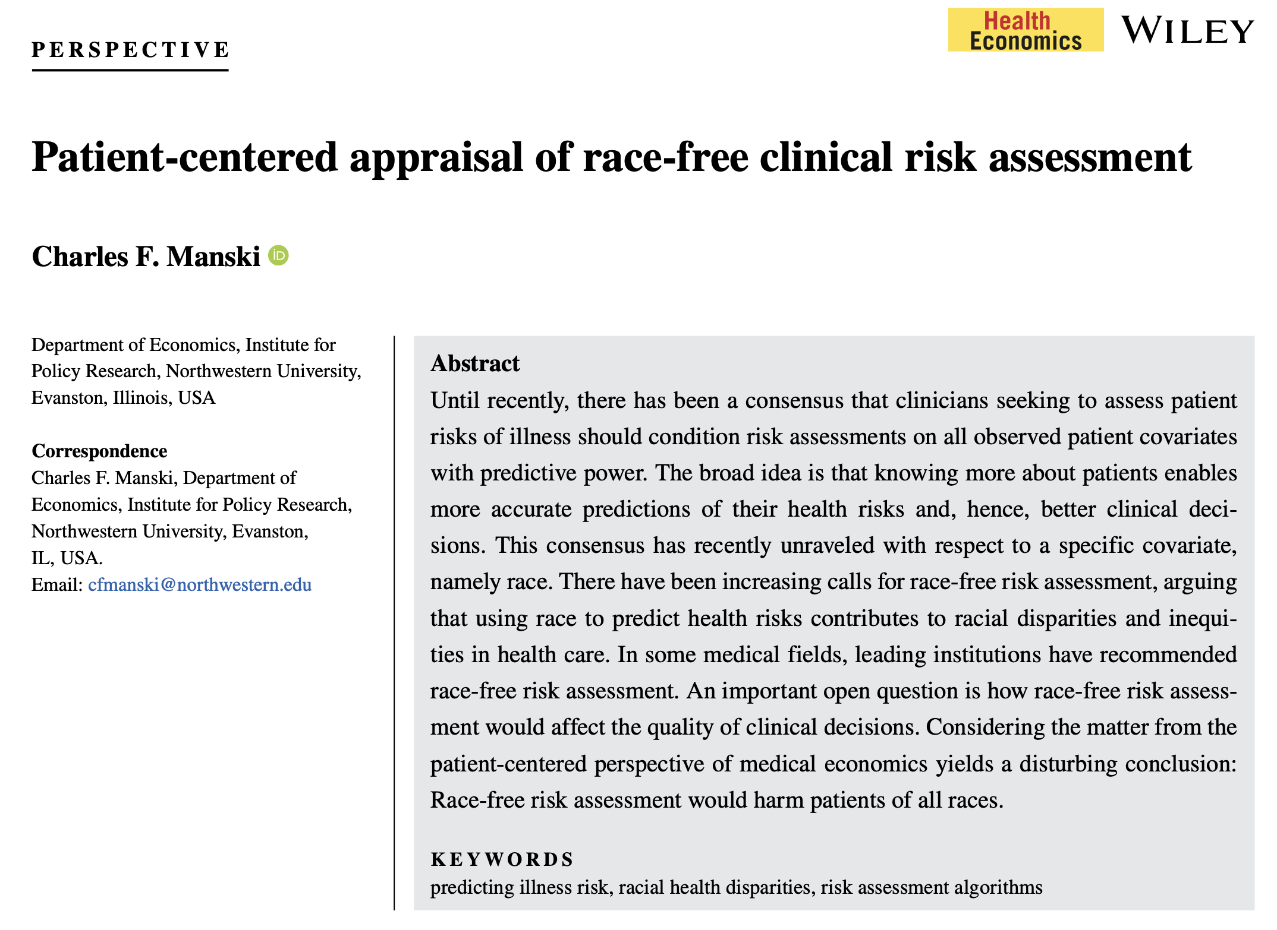

Slide 8
Blindness can be ineffective or even harmful.
In some cases it is effective.
In other cases it isn’t enough to fix the problem.
In still other cases, it can make the problem worse.
Black-Black White-White Black-White White-Black

Slide 9
Possible definitions of algorithmic fairness
Consider whether predictions are fair between two groups A and B.
Blindness: The model cannot see group status
Independence: Model predictions are independent of group status
Separation: Model performance is similar in all groups
Individual fairness: The model makes similar predictions for similar individuals regardless of group status
Except under special (& not realistic) circumstances, (1) – (4) are mutually exclusive.

Slide 10
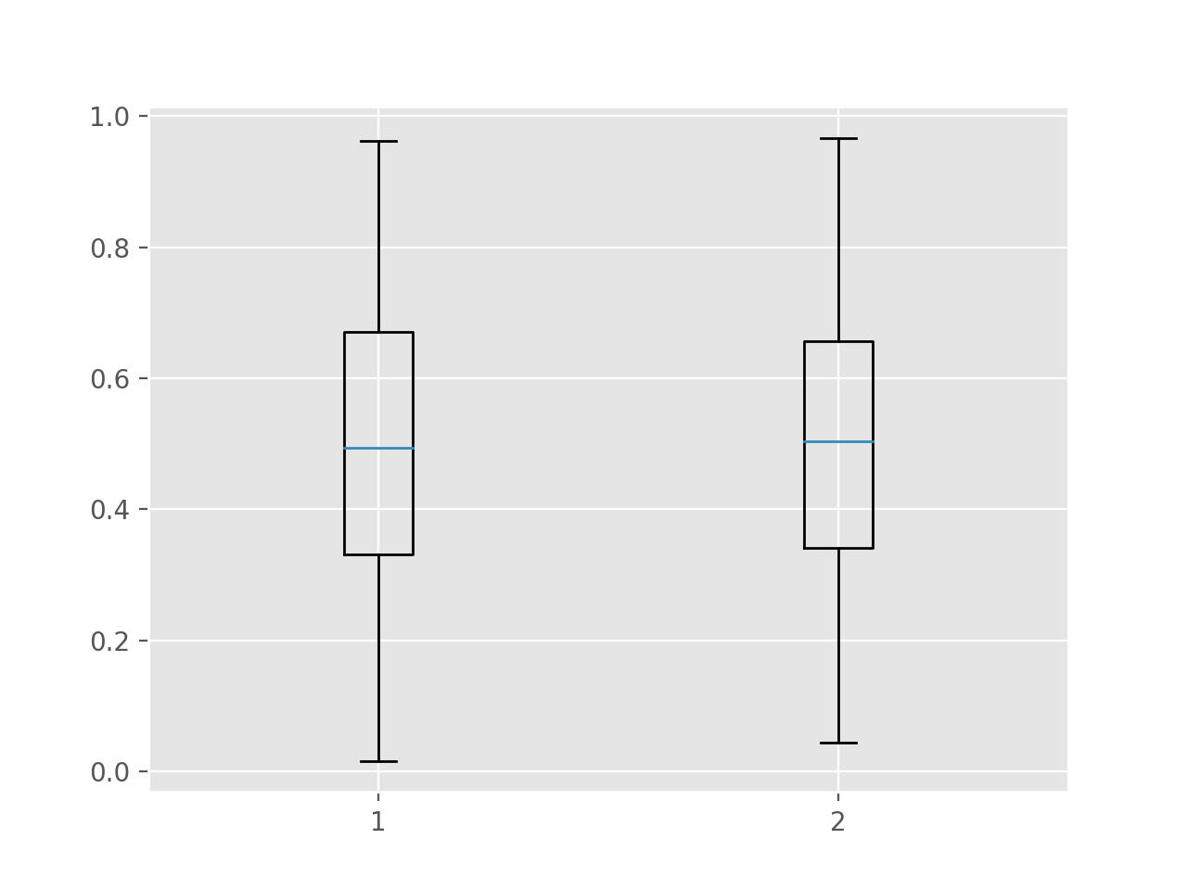
Zooming in on Independence
Model predictions are independent of group status.
This implies that the distribution of model predictions is the same in each group.
Is this fair?
Black White

Slide 11
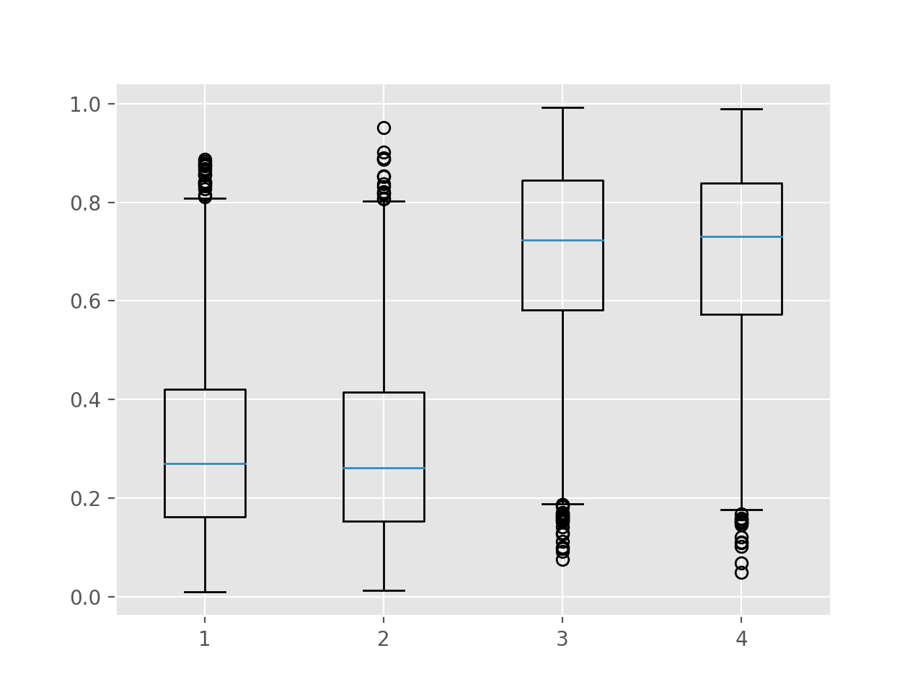
Zooming in on Separation
Model predictions are independent of group status after conditioning on the outcome.
This implies when considering individuals with the same outcome, the distribution of model predictions is the same in each group.
Is this fair?
Black White
Black White
Did not Progress
Progressed to Stage IV

Slide 12
Possible definitions of algorithmic fairness
Consider whether predictions are fair between two groups A and B.
Blindness: The model cannot see group status
Independence: Model predictions are independent of group status
Separation: Model performance is similar in all groups
Individual fairness: The model makes similar predictions for similar individuals regardless of group status
Calibration: model calibration is equally good in both groups (?)
Except under special (& not realistic) circumstances, (1) – (4) are mutually exclusive.

Slide 13
Assessing calibration

Slide 14
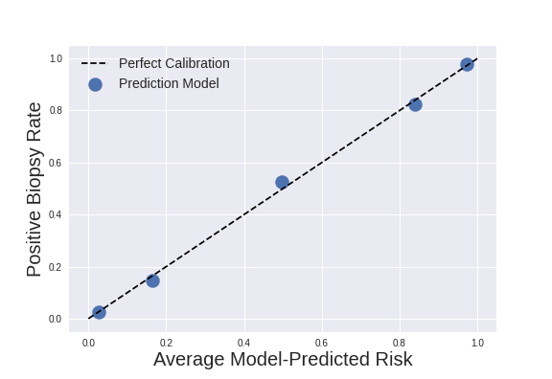
Assess Calibration Graphically

Slide 15
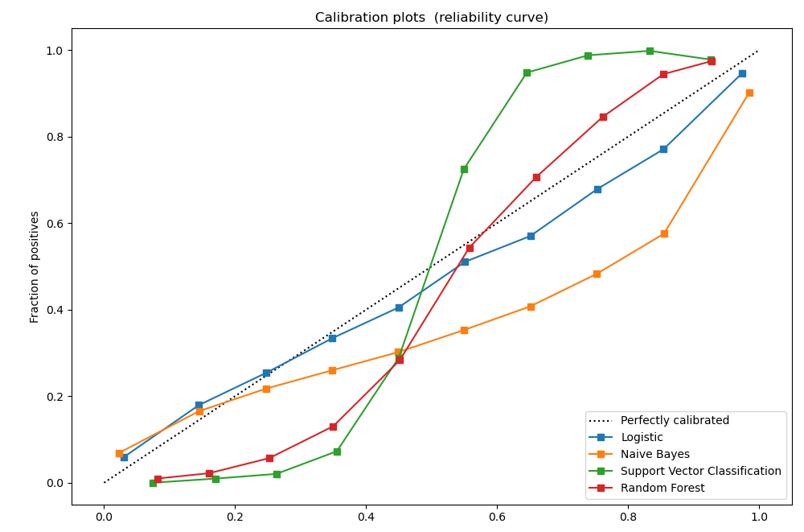
Assess Calibration Graphically
Model-Predicted Risk
From: https://scikit-learn.org/stable/modules/calibration.html
Notes:
Just to give you a sense of what a more typical calibration plot might look like, here’s an example from the scikit-learn documentation
Model whose predicted probabilities are too large (i.e. model-predicted risk > empirical risk): under the line
Model whose predicted probabilities are too small (i.e. model-predicted risk < empirical risk): over the line
Model that is ”overconfident”, meaning its predictions are too extreme (don’t have this)
Model that is “underconfident”, meaning its predictions are not extreme enough (GREEN)

Slide 16
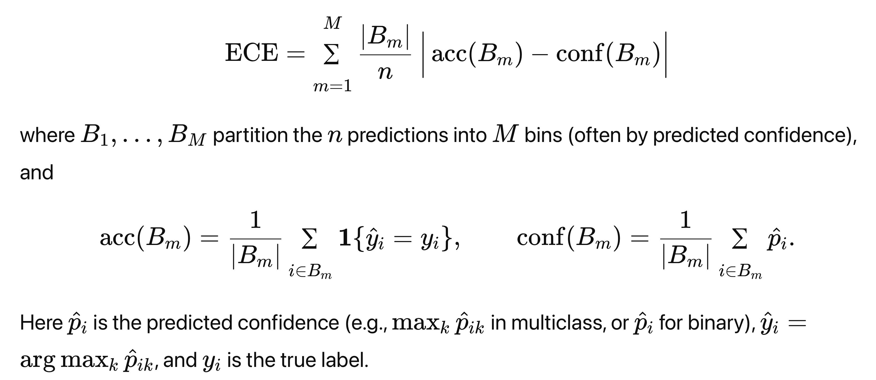
Specific calibration metrics
Quantile-based calibration slope and intercept
Associated Hosmer-Lemeshow test statistic
Limitation: sensitive to bin width
Expected calibration error (ECE)
Also sensitive to bin width
Regression-based calibration slope and intercept
i.e. calibration in the large, calibration slope
Often the favored approach

Slide 17
Class balance

Slide 18
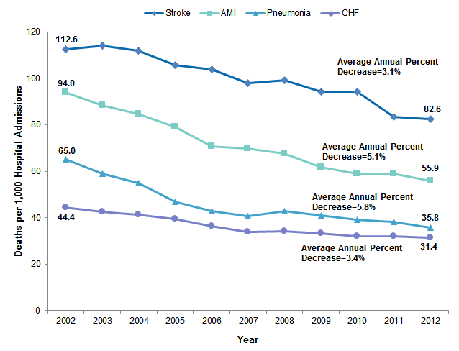
In health AI, we rarely have balanced classes
Diagnosis prediction
ADHD: 1 in 10
Autism: 1 in 31
CF: 1 in 4000
Fibrodysplasia ossificans progressiva (FOP): 1 in 1.5M
Mortality prediction

Slide 19
Assessing calibration for imbalanced problems
Predicted probabilities tend to be close to 0
Must use quantile-based bins
strategy=‘quantile’ when using calibration_curve in sklearn.calibration

Slide 20
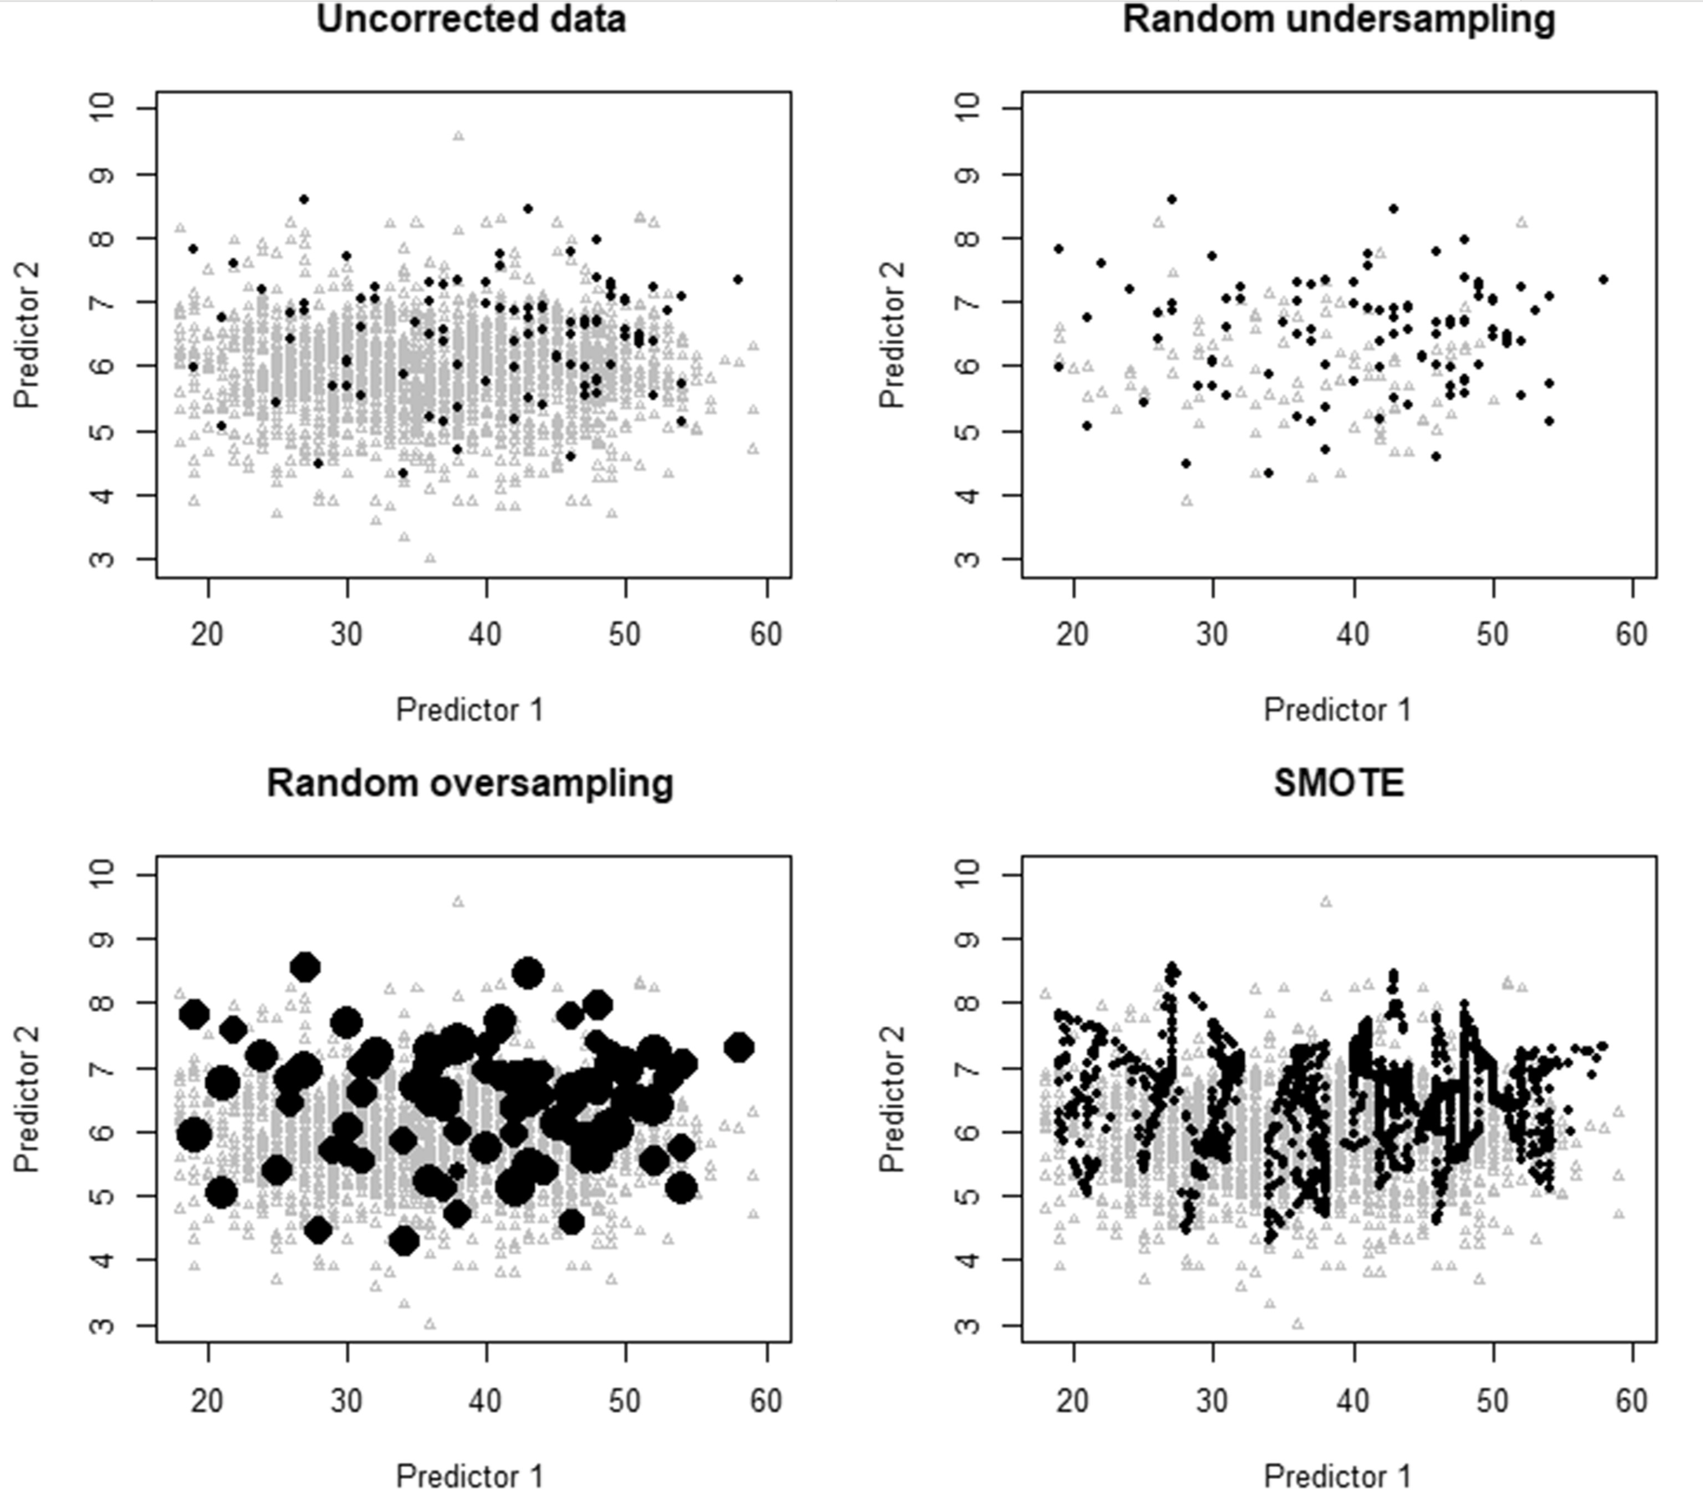
Common techniques for imbalanced problems
Over-/under-sampling
Weighting the loss
Synthetic data approaches, notably SMOTE
What has been your experience with such techniques?
Consider: gradient-based updates in mini-batches
Consider: effects on calibration
Ruben van den Goorbergh, Maarten van Smeden, Dirk Timmerman, Ben Van Calster, The harm of class imbalance corrections for risk prediction models: illustration and simulation using logistic regression, Journal of the American Medical Informatics Association, Volume 29, Issue 9, September 2022, Pages 1525–1534, https://doi.org/10.1093/jamia/ocac093
Notes:
Guidance:
Depends on use case
There are some cases where there is a clear need for balancing
In other cases, it’s because we need to have class representation across mini-batches, otherwise our gradient-based updates become unstable
But in general I would say it is overemphazied, particularly for tabular data
But calibration is important

Slide 21
Activity today: calibration and class balance
Select a prediction task with imbalanced classes
Train a model of your choice without correcting class imbalance
Assess AUROC
Assess calibration
Correct class imbalance, then train again
Assess AUROC
Assess calibration
Two groups will share results
Notes:
You may use e.g. calibration curve

Slide 22
Post-hoc calibration techniques
From simple to not so simple

Slide 23
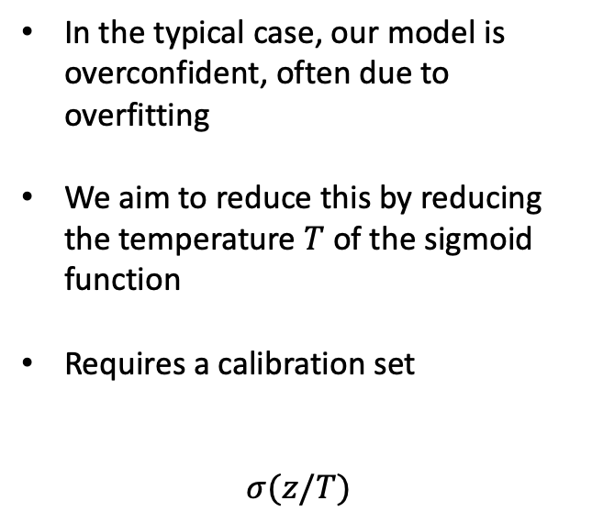
Temperature scaling: binary case
In the typical case, our model is overconfident, often due to overfitting
We aim to reduce this by reducing the temperature $T$ of the sigmoid function
Requires a calibration set
$$σ(z/T)$$

Slide 24
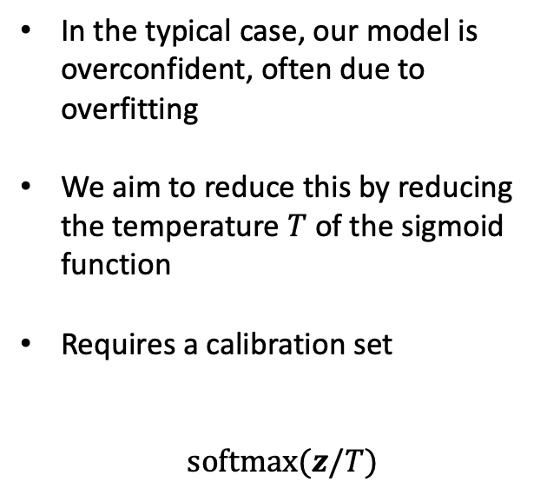
Temperature scaling: multi-class case
In the typical case, our model is overconfident, often due to overfitting
We aim to reduce this by reducing the temperature $T$ of the sigmoid function
Requires a calibration set
$$softmax(z/T)$$

Slide 25
Temperature scaling: binary case
Overconfident (probabilities are too extreme) -> calibrated -> underconfident (probabilities are not extreme enough)
Reflected in the calibration slope

Slide 26
Temperature scaling: binary case
Overconfident (probabilities are too extreme) -> calibrated -> underconfident (probabilities are not extreme enough)
Consider the effects of parameter shrinkage (e.g., L2 or L1 regularization)
Notes:
Regularization tends to move you from overconfident to underconfident

Slide 27
Temperature scaling: binary case
Predicted probabilities too low -> calibrated -> predicted probabilities too high
Reflected in the calibration in the large

Slide 28



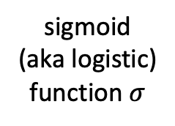

Platt scaling
Fit a logistic regression model on your predicted probabilities
Or, a more flexible alternative: isotonic regression
$$b$$
$$wx+b$$
Old predicted probabilities
$$w$$
New predicted probabilities
sigmoid
(aka logistic)
function $σ$
sum
Notes:
Monotonic stepwise function
Or more empirical approaches

Slide 29

Vector scaling
$softmax(Wz+b)$
Necessary when you need to rebalance for multi-class problems
Requires a substantial calibration set
Notes:
Monotonic stepwise function
Or more empirical approaches

Slide 30
Calibration, discrimination, and fairness

Slide 31
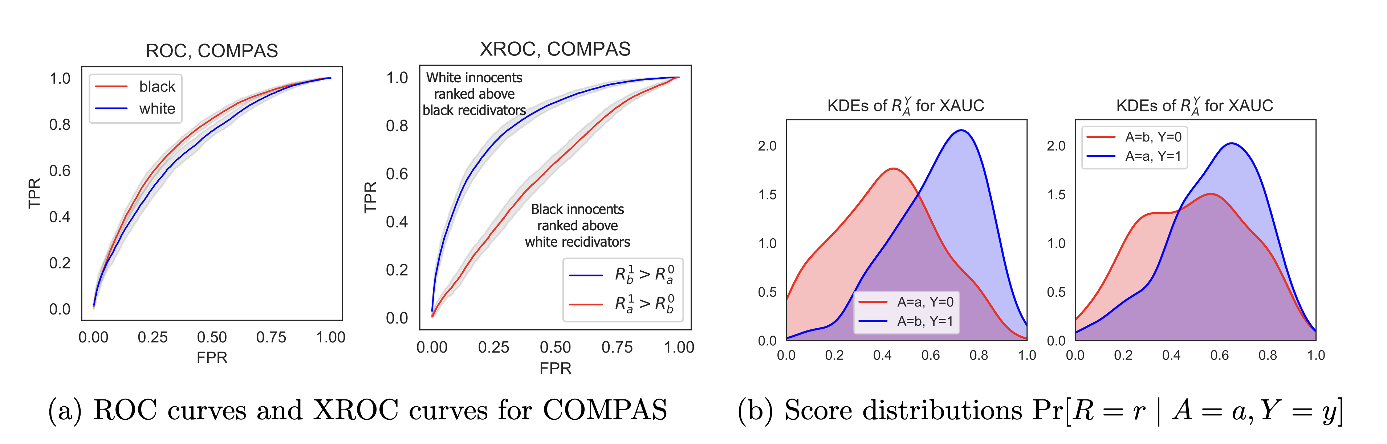

Assessing fairness with group conditional AUC (xAUC)
xAUC_{A,B} = $P(S_{+}^{A}>S_{−}^{B})$
[i.e. we are now conditioning on group status in addition to pos/neg]
Consider $Δ$xAUC = |xAUC_{B,A} – xAUC_{A,B}|
Does lower $Δ$xAUC
imply a fairer model?

Slide 32
Our “fair” model is one that aims to minimize differences in xCI (similar to xAUC)
Depending on the use case, this can be good or bad, fair or unfair.
Black-Black White-White Black-White White-Black

Slide 33
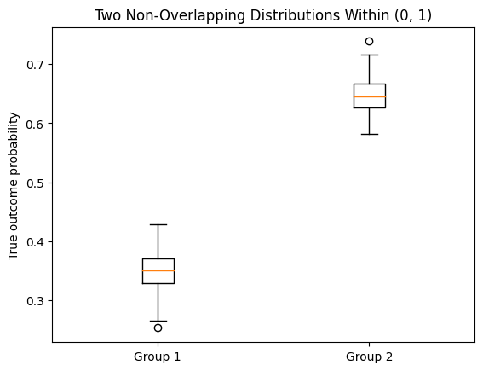

Consider the xAUC for a calibrated model
Suppose there is a true difference between groups 1 and 2
Suppose further that our model is optimal in the sense that its predictions are equal to the true outcome probabilities
What is the xAUC_{1,2}?
What is the xAUC_{2,1}?
xAUC_{1,2} = $P(S_{+}^{1}>S_{−}^{2})$

Slide 34
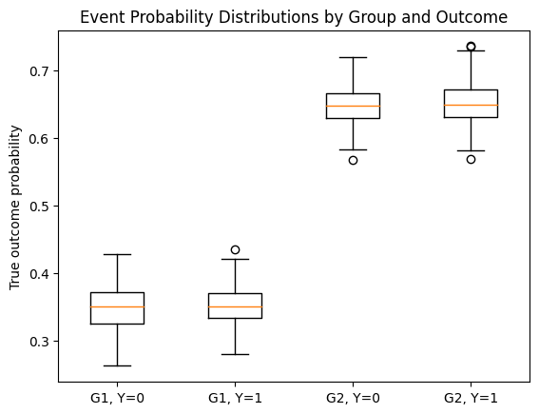
Consider the xAUC for a calibrated model
Suppose there is a true difference between groups 1 and 2
Suppose further that our model is optimal in the sense that its predictions are equal to the true outcome probabilities
What is the xAUC_{1,2}?
What is the xAUC_{2,1}?
xAUC_{1,2} = $P(S_{+}^{1}>S_{−}^{2})$
Notes:
Now we’ve stratified by the outcome
Explain the simulation
Question: have we achieved separation? i.e. are the distributions of our predictions the same after conditioning on group status?

Slide 35
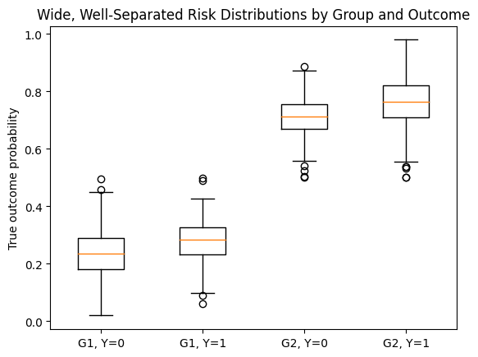
Consider the xAUC for a calibrated model
Suppose there is a true difference between groups 1 and 2
Suppose further that our model is optimal in the sense that its predictions are equal to the true outcome probabilities
Are the distributions the same across groups after conditioning on outcomes? Why or why not?
xAUC_{1,2} = $P(S_{+}^{1}>S_{−}^{2})$
Notes:
Now we’ve stratified by the outcome
Explain the simulation
Question: have we achieved separation? i.e. are the distributions of our predictions the same after conditioning on group status?

Slide 36
Report back
What constitutes a fair model?
A model with equal error rates between groups (and ΔxAUC=0)
A model that is well-calibrated in both groups
Supposing a group difference in risk exists, these two criteria are mutually exclusive.

