Slide 1
Data augmentation and contrastive learning
Matthew Engelhard
Duke Biostatistics & Bioinformatics

Slide 2
Last Time
CNN basics
CNN architectures

Slide 3
Today
Discussion of data augmentation for computer vision
From data augmentation to contrastive learning
A Simple Framework for Contrastive Learning of Visual Representations (SimCLR)
Examples of contrastive learning in healthcare
A look ahead at multi-modal data

Slide 4
Soon
Attribution methods / XAI for computer vision and beyond
(activity) a closer look at contrastive learning
Midterm on March 4

Slide 5
Data Augmentation

Slide 6
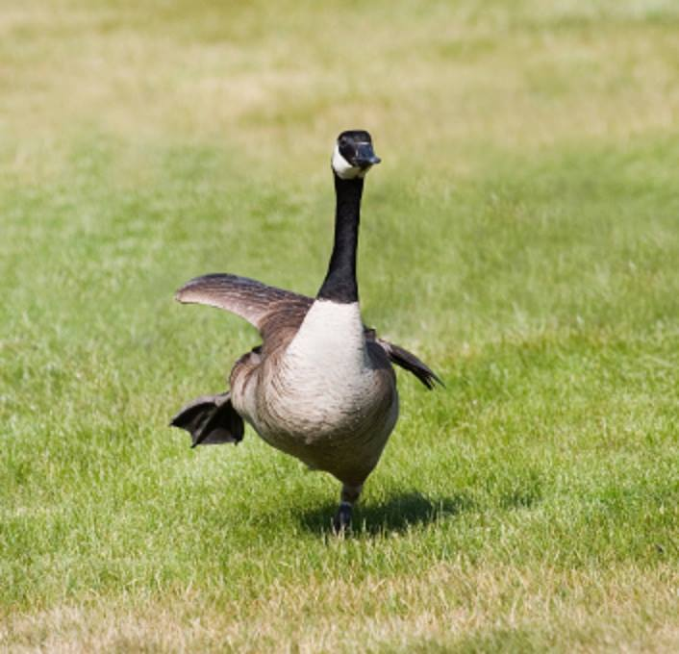
CNN: It’s a goose

Slide 7
CNN: (translation invariance) Still a goose!

Slide 8
CNN: ?
Notes:
Will the CNN identify this?
Not rotation invariant

Slide 9
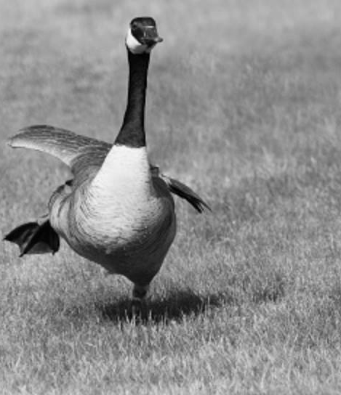
CNN: I don’t see anything.

Slide 10
CNN: This is a bowling pin.

Slide 11
Data augmentation from first principles
What kind of changes do we want to be robust to?
What data augmentation follows from this?

Slide 12
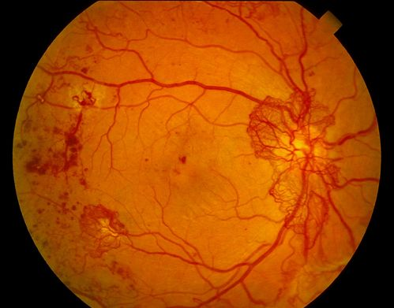

Data augmentation from first principles
What kind of changes do we want to be robust to?
What data augmentation follows from this?
What are key differences between medical images and naturalistic images?
What are the implications for data augmentation?

Slide 13
Consider augmentations for tabular data
y, associated value or label
Age
WBC Count
Mean BP
Hematocrit
Creatinine
Pulse Rate
Temperature
Survival
Respiratory Rate
Are there analogous augmentations?
Why or why not?
x, data/features for a subject or patient
Notes:
Another hospital where all the measurements are a little higher, or a little lower
What would be a rotation in this context?
Consider permutation of two different ECG leads, for example

Slide 14
Augmentation summary
Consider what variations you expect your model to encounter in the real world / when generalizing
Effective augmentation has a big impact on generalization performance

Slide 15
Contrastive Learning

Slide 16
From augmentation to contrastive learning
Consider the following line of reasoning:
Predictions should be robust to superficial augmentations, i.e. the prediction should not change
This should be true for all prediction tasks we might consider
This in turn implies that latent representations should be the same
Contrastive learning is motivated by this observation
This paradigm proves to be surprisingly effective.

Slide 17
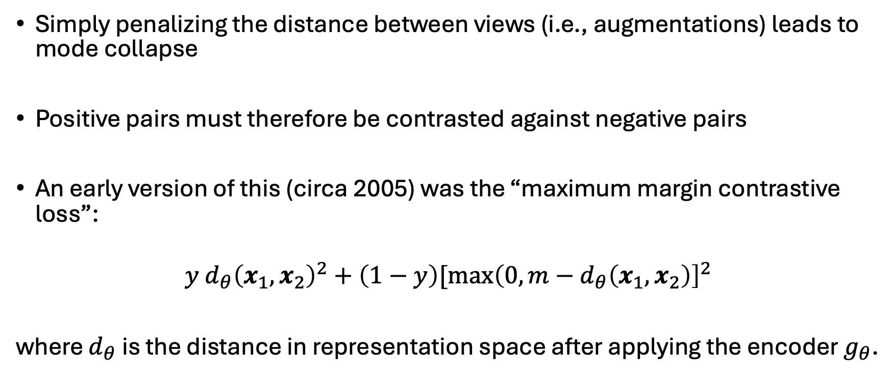
An early contrastive loss
Simply penalizing the distance between views (i.e., augmentations) leads to mode collapse
Positive pairs must therefore be contrasted against negative pairs
An early version of this (circa 2005) was the “maximum margin contrastive loss”:
$$y d_{θ}{\left(x_{1},x_{2}\right)}^{2}+\left(1−y\right)[{\max\left(0,m−d_{θ}\left(x_{1},x_{2}\right)\right]}^{2}$$
where $d_{θ}$ is the distance in representation space after applying the encoder $g_{θ}$.

Slide 18
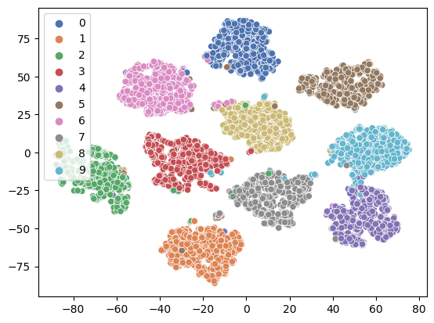
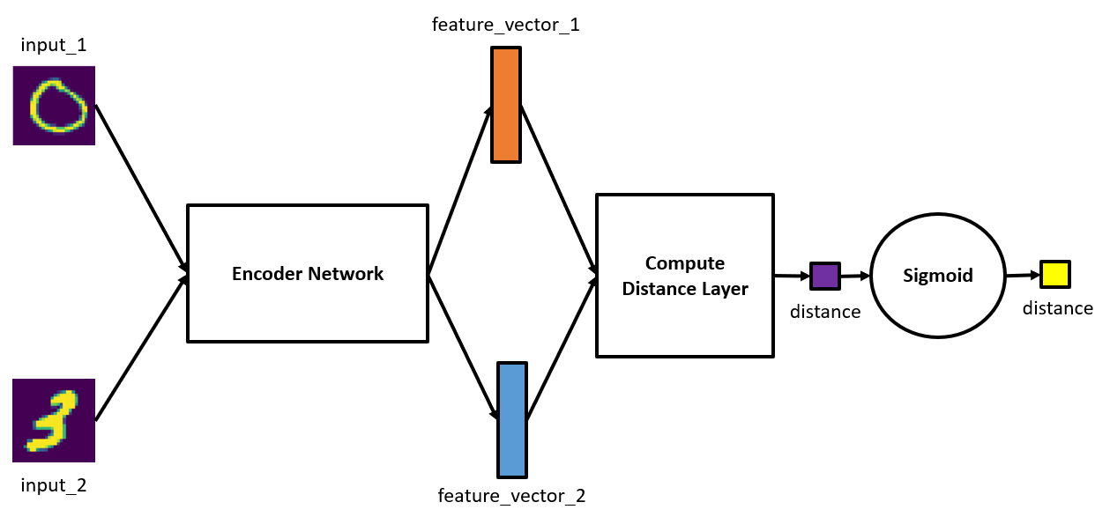
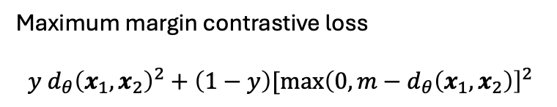
MNIST: digits form well-defined clusters
Maximum margin contrastive loss
$$y d_{θ}{\left(x_{1},x_{2}\right)}^{2}+\left(1−y\right)[{\max\left(0,m−d_{θ}\left(x_{1},x_{2}\right)\right]}^{2}$$

Slide 19
SimCLR: 3 primary improvements
Choice of loss function
Minibatch construction
Use of a projection head

Slide 20
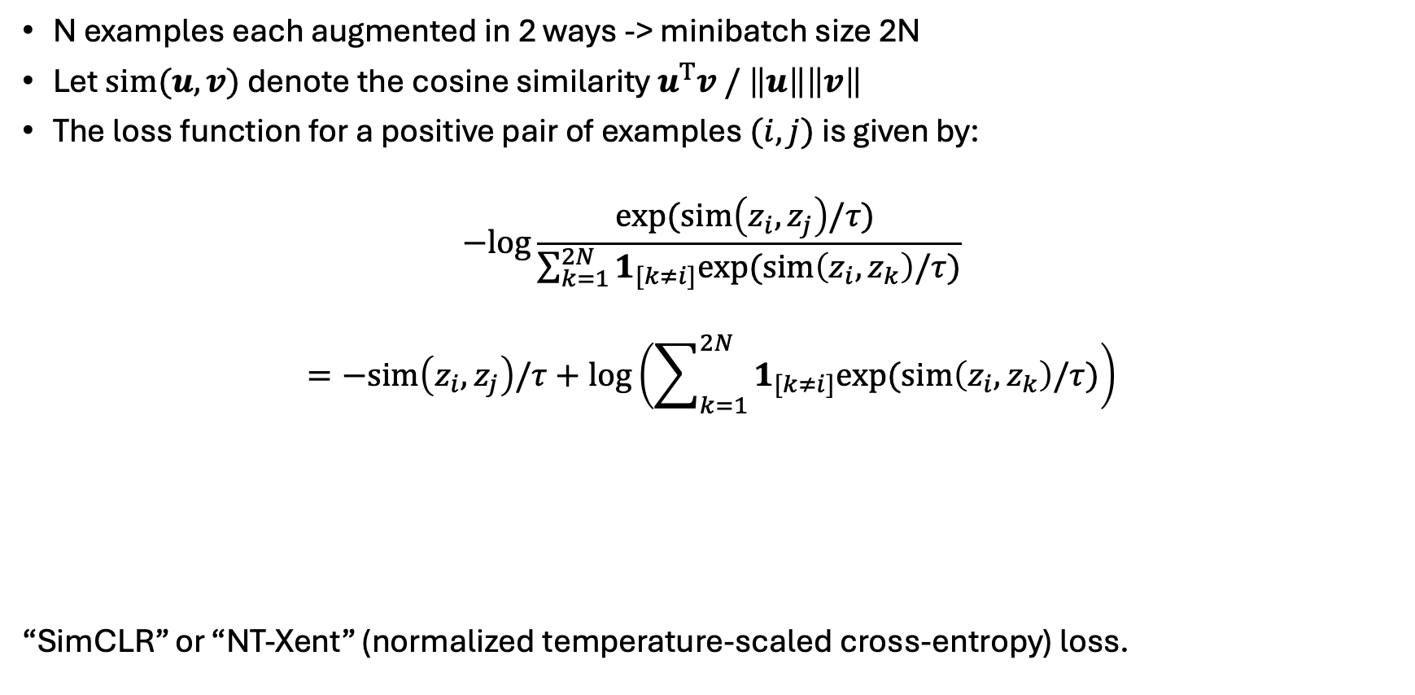
Minibatch construction and loss
N examples each augmented in 2 ways -> minibatch size 2N
Let $sim(u, v)$ denote the cosine similarity $u^{T}v / \left\|u\right\|\left\|v\right\|$
The loss function for a positive pair of examples $(i, j)$ is given by:
$$−log\frac{exp⁡(sim\left(z_{i},z_{j}\right)/τ) }{\sum_{k=1}^{2N}{1_{[k≠i]}exp⁡(sim\left(z_{i},z_{k}\right)/τ)}}$$
$$=−sim\left(z_{i},z_{j}\right)/τ+\log\left(\sum_{k=1}^{2N}{1_{[k≠i]}exp⁡(sim\left(z_{i},z_{k}\right)/τ)}\right)$$
“SimCLR” or “NT-Xent” (normalized temperature-scaled cross-entropy) loss.
attraction between
positive pairs
repulsion between
negative pairs

Slide 21
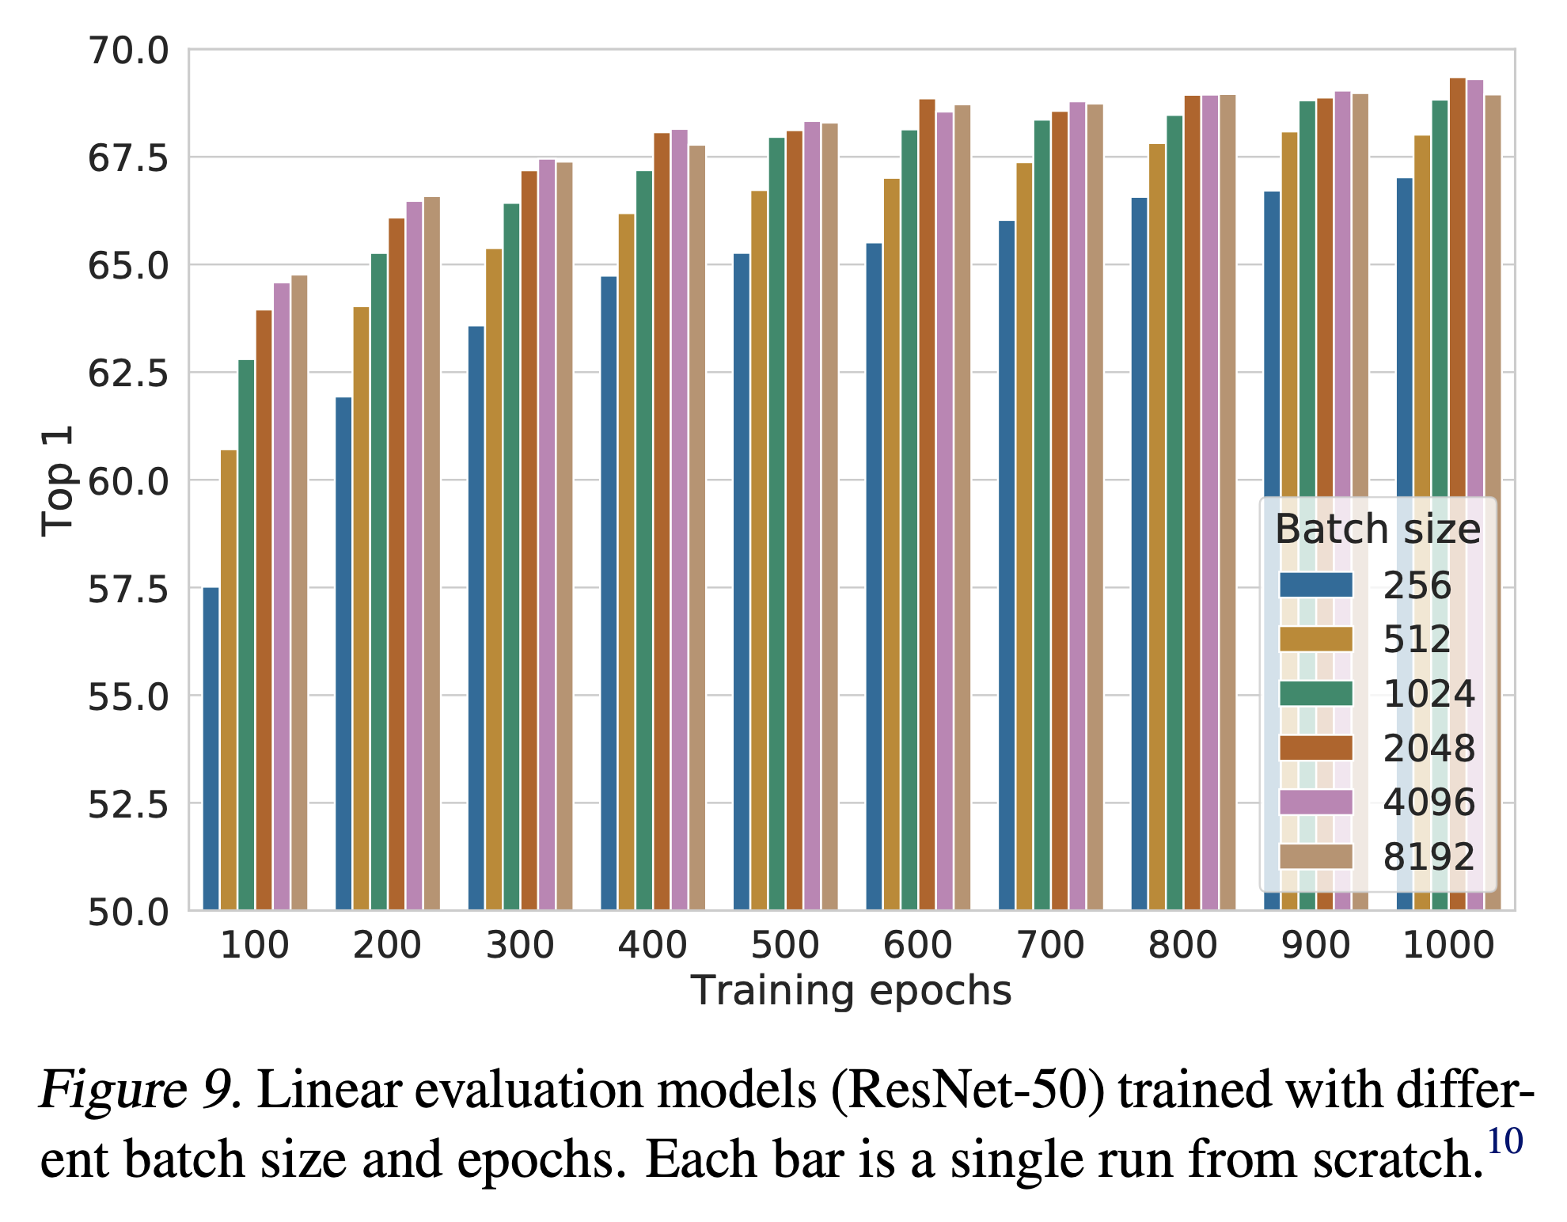
Benefit of larger batch size

Slide 22
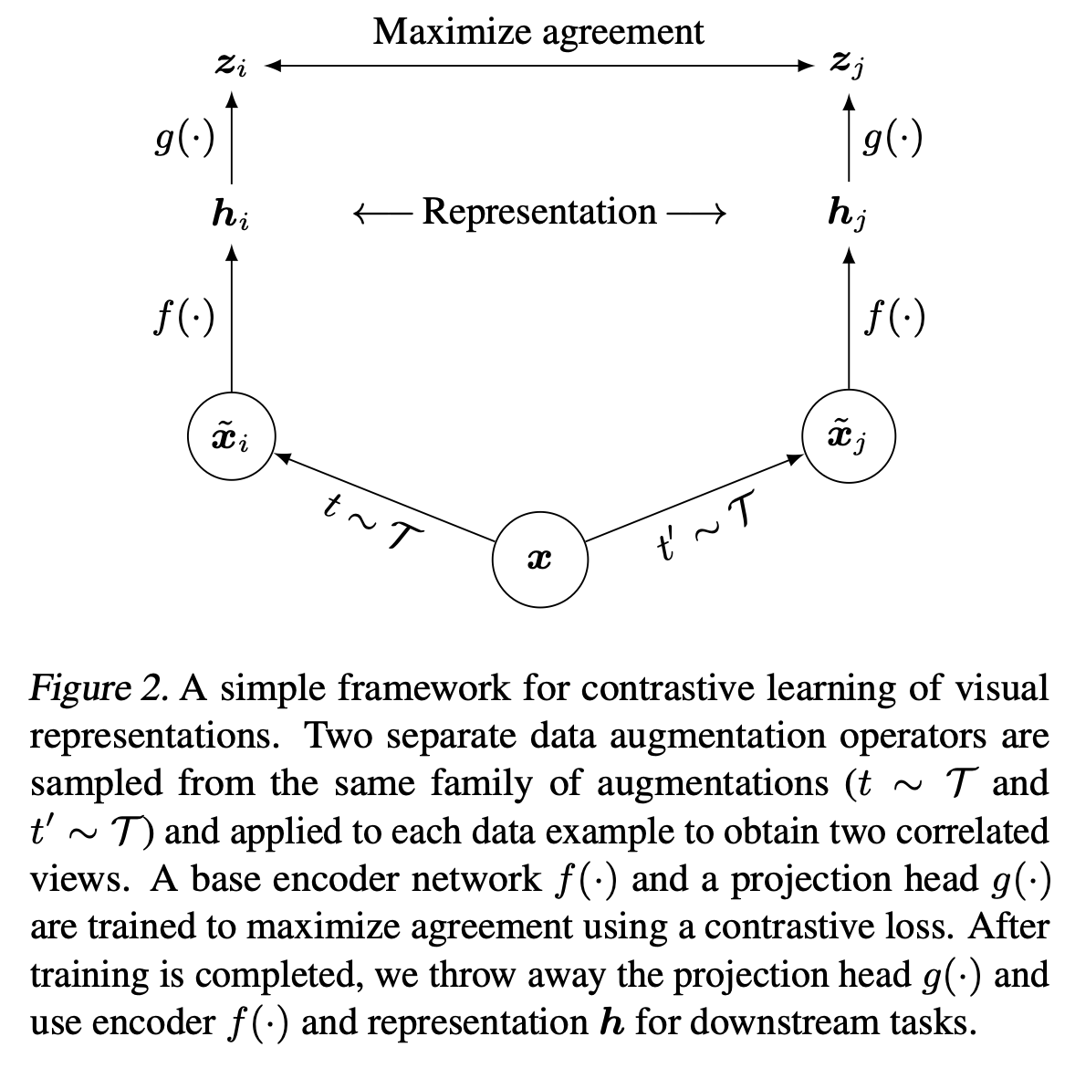
Contrastive loss applied after projection head

Slide 23
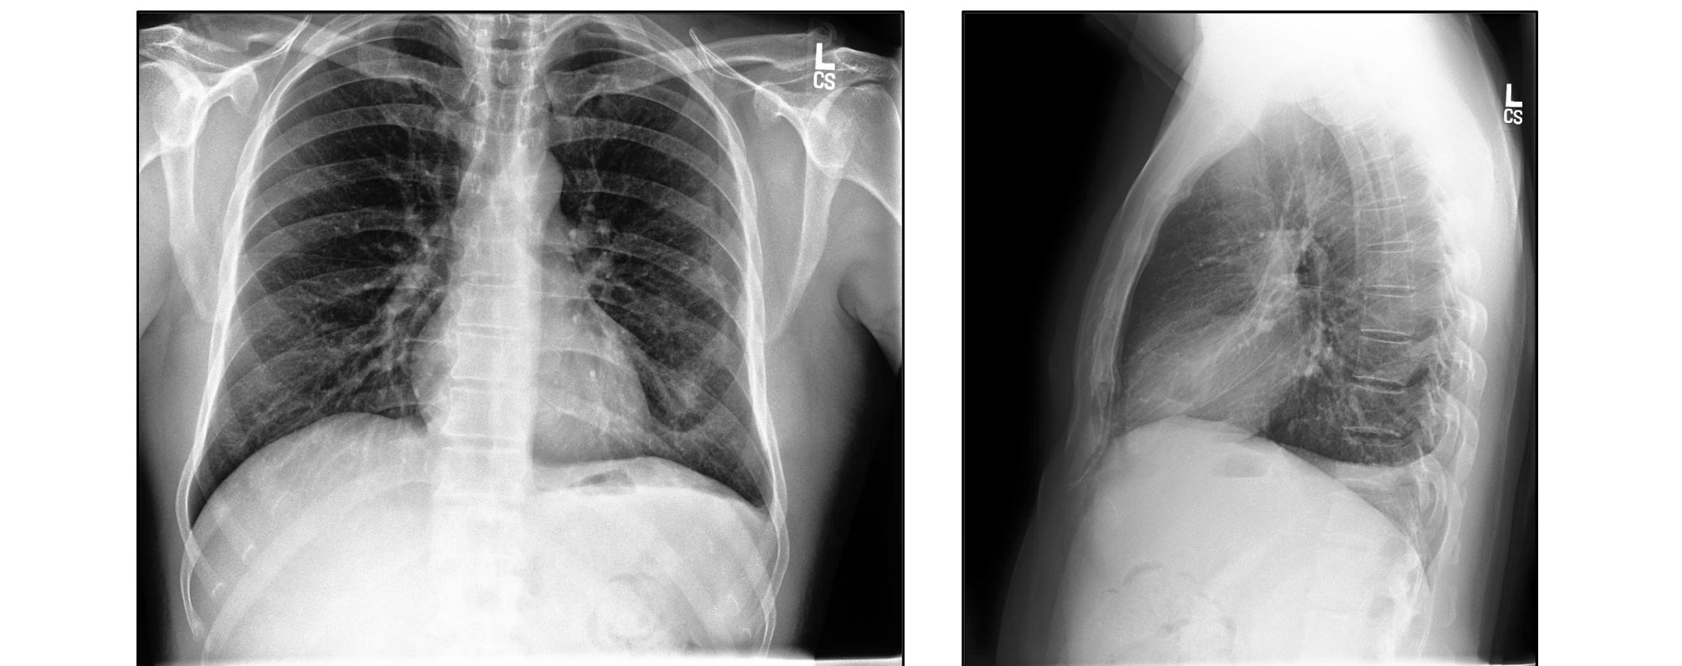
Contrastive learning in coding assignment 2
Evaluate benefits of SimCLR-based pre-training compared to:
Full or partial fine-tuning
Using representations learned from ImageNet

Slide 24
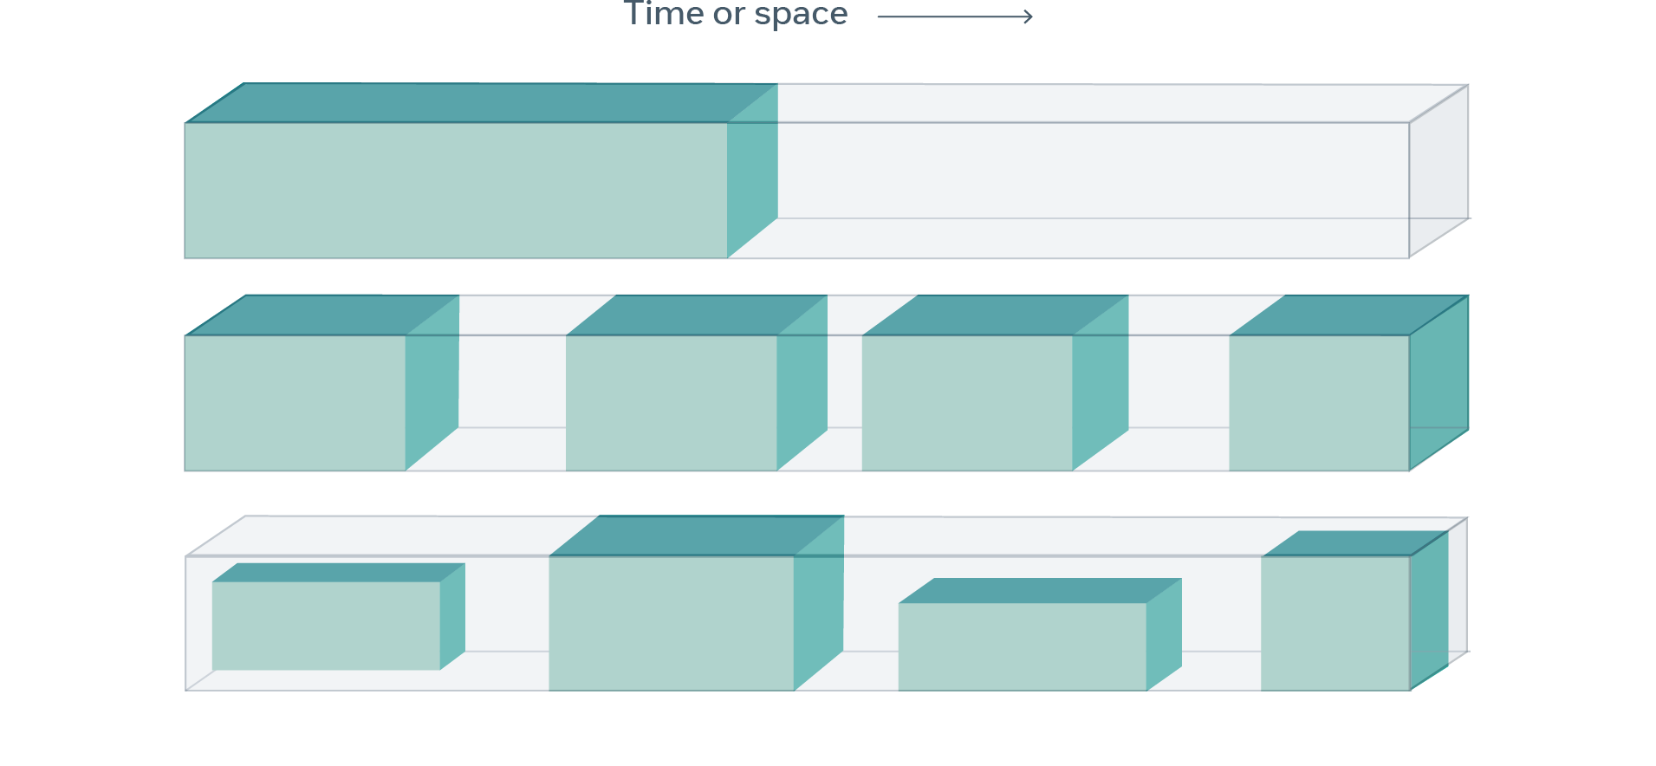
Self-supervised learning: The dark matter of intelligence
“Self-supervised learning obtains supervisory signals from the data itself, often leveraging the underlying structure in the data. The general technique of self-supervised learning is to predict any unobserved or hidden part (or property) of the input from any observed or unhidden part of the input.”
LeCun & Misra. Self-supervised learning: The dark matter of intelligence. Meta research blog, 2021.

Slide 25
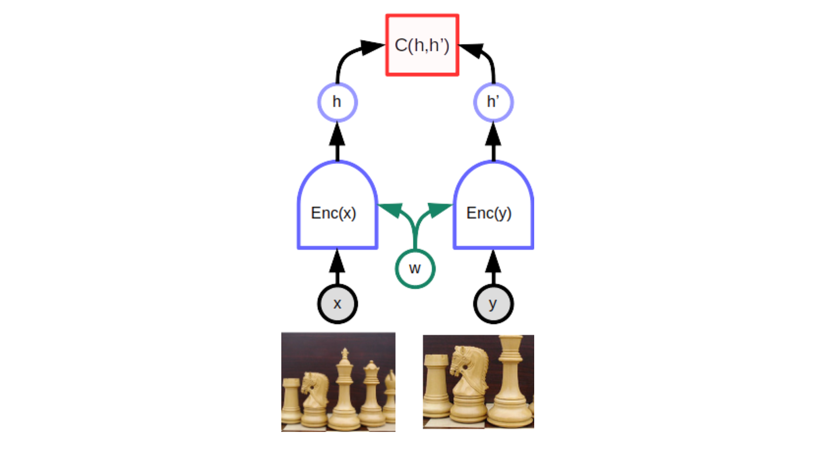
Two key variations on SSL
contrastive / noise contrastive
masked token / patch / sequence prediction

Slide 26
Examples

Slide 27
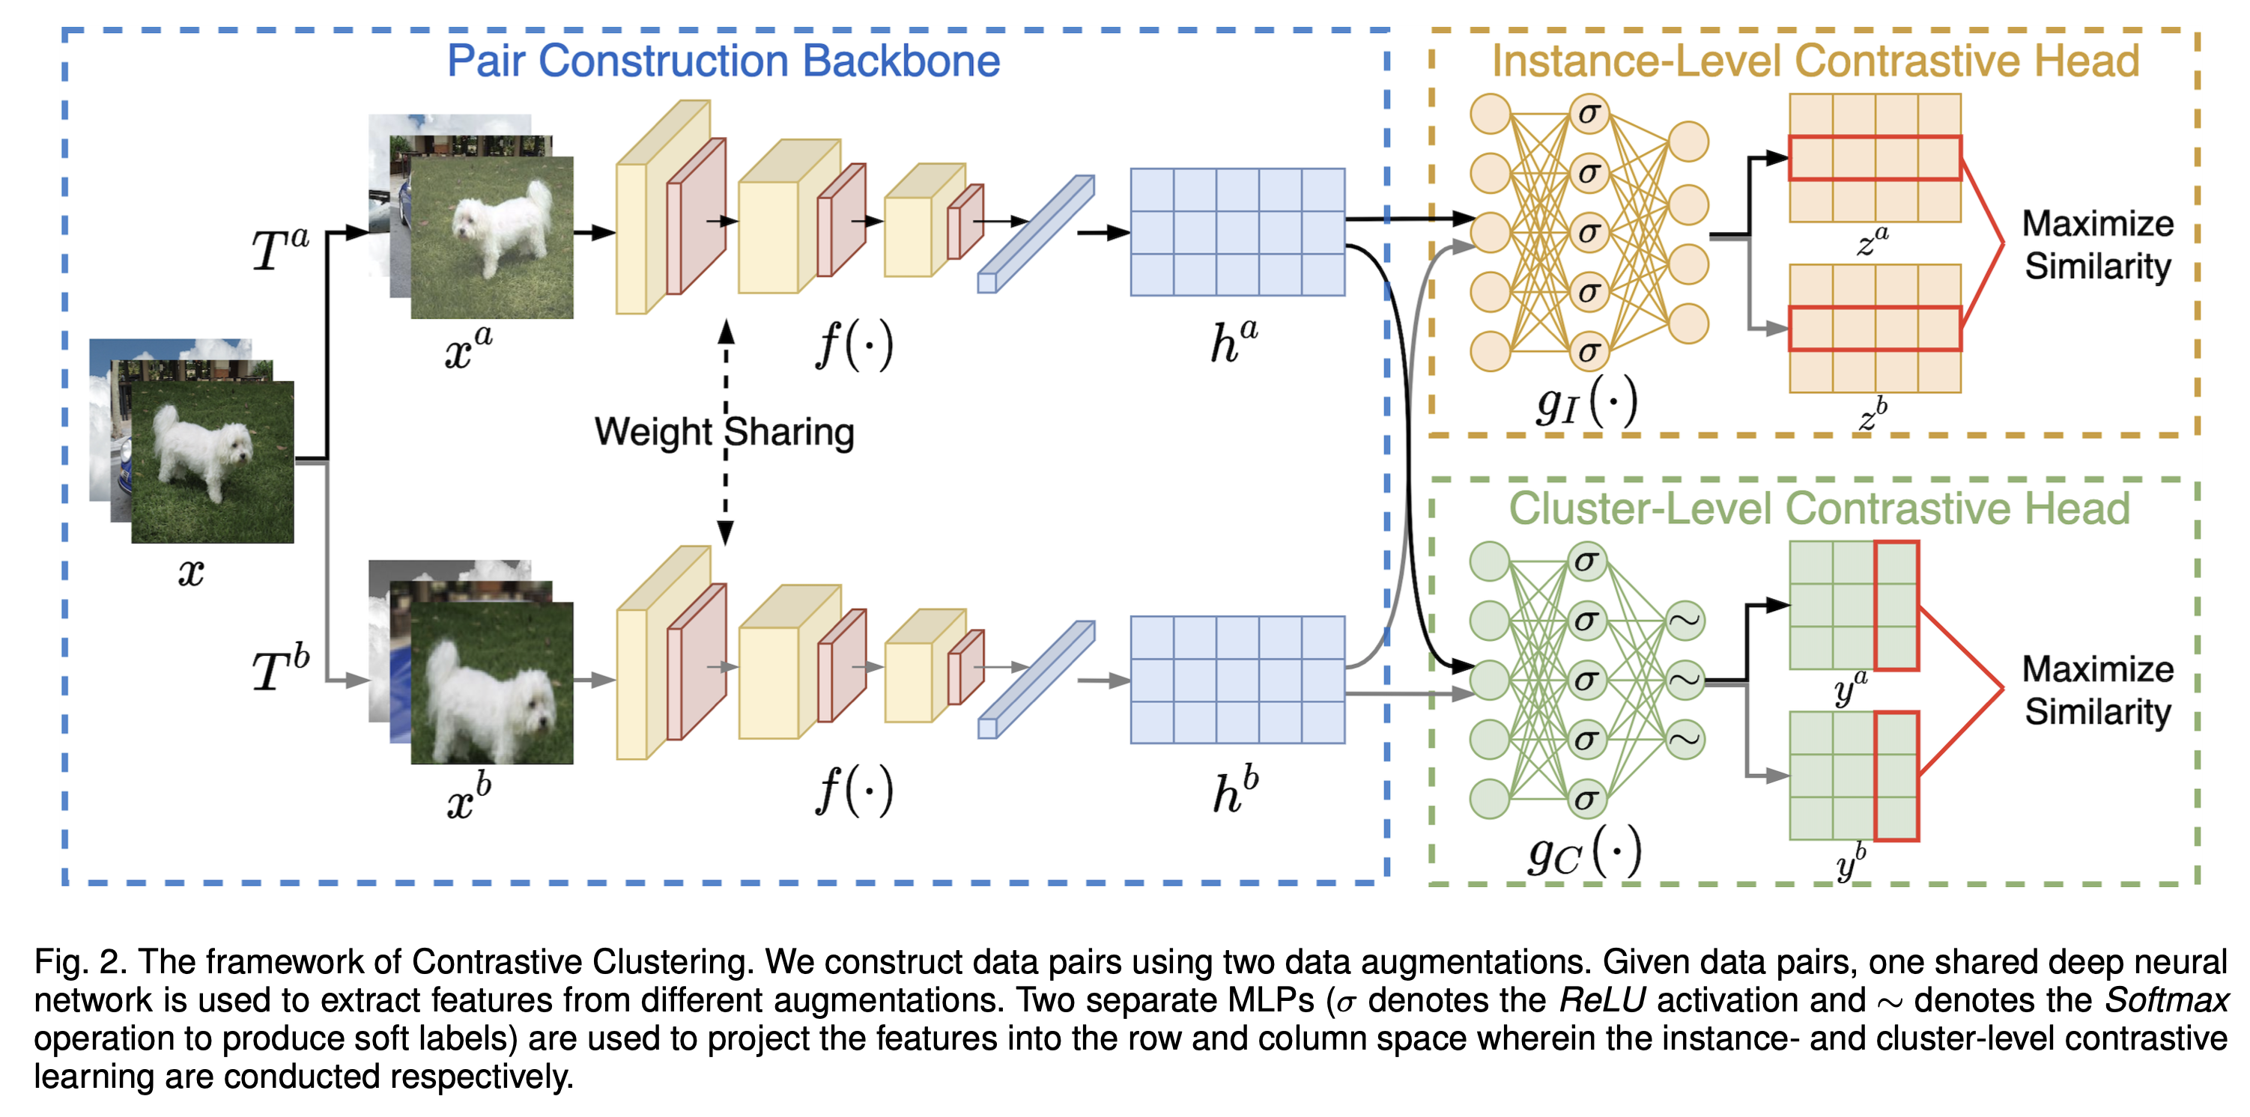
Contrastive clustering
The instance-level contrastive head follows SimCLR
The cluster-level contrastive head ensures cluster assignment is robust to augmentation
This is surprisingly effective in practice, e.g. compared to earlier deep clustering methods
Li, Yunfan, et al. "Contrastive clustering." Proceedings of the AAAI conference on artificial intelligence. 2021.

Slide 28
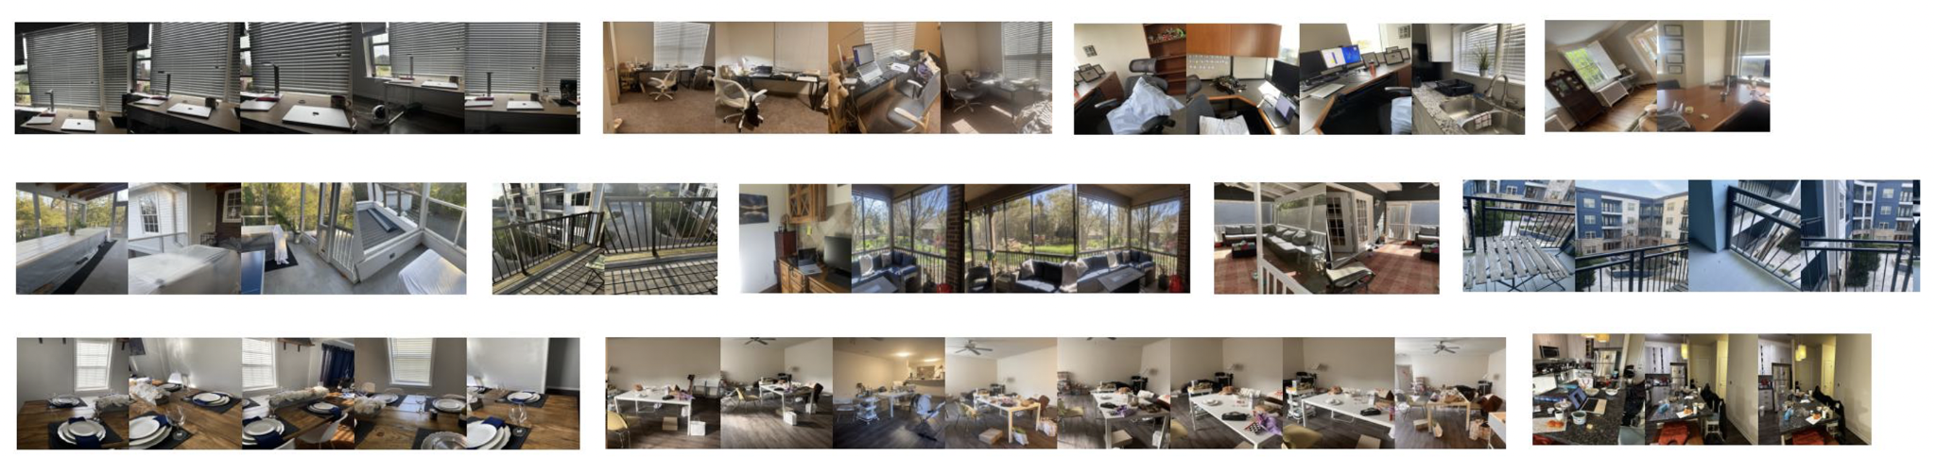
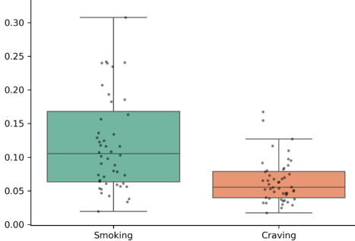
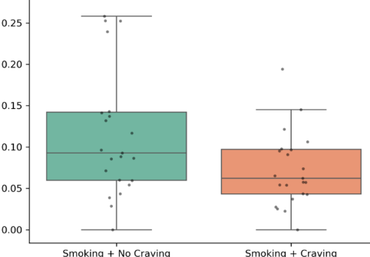
Infinite hierarchical contrastive clustering for personal digital envirotyping
— — — Same location type, different participants — — —
Work area
Porch
Eating area
Normalized mutual information between behavior and environment
Normalized mutual information between behavior and environment
The act of smoking is more environmentally linked than the urge to smoke.
The importance of the environment is reduced when urge is high.
Huang, Oliver, McClernon, and Engelhard. "Infinite hierarchical contrastive clustering for personal digital envirotyping." Findings of ML4H, 2024.
Notes:
Why does CC work? Compare photoEMA to image cropping
Explain NMI in this context
Explain the bar plots

Slide 29
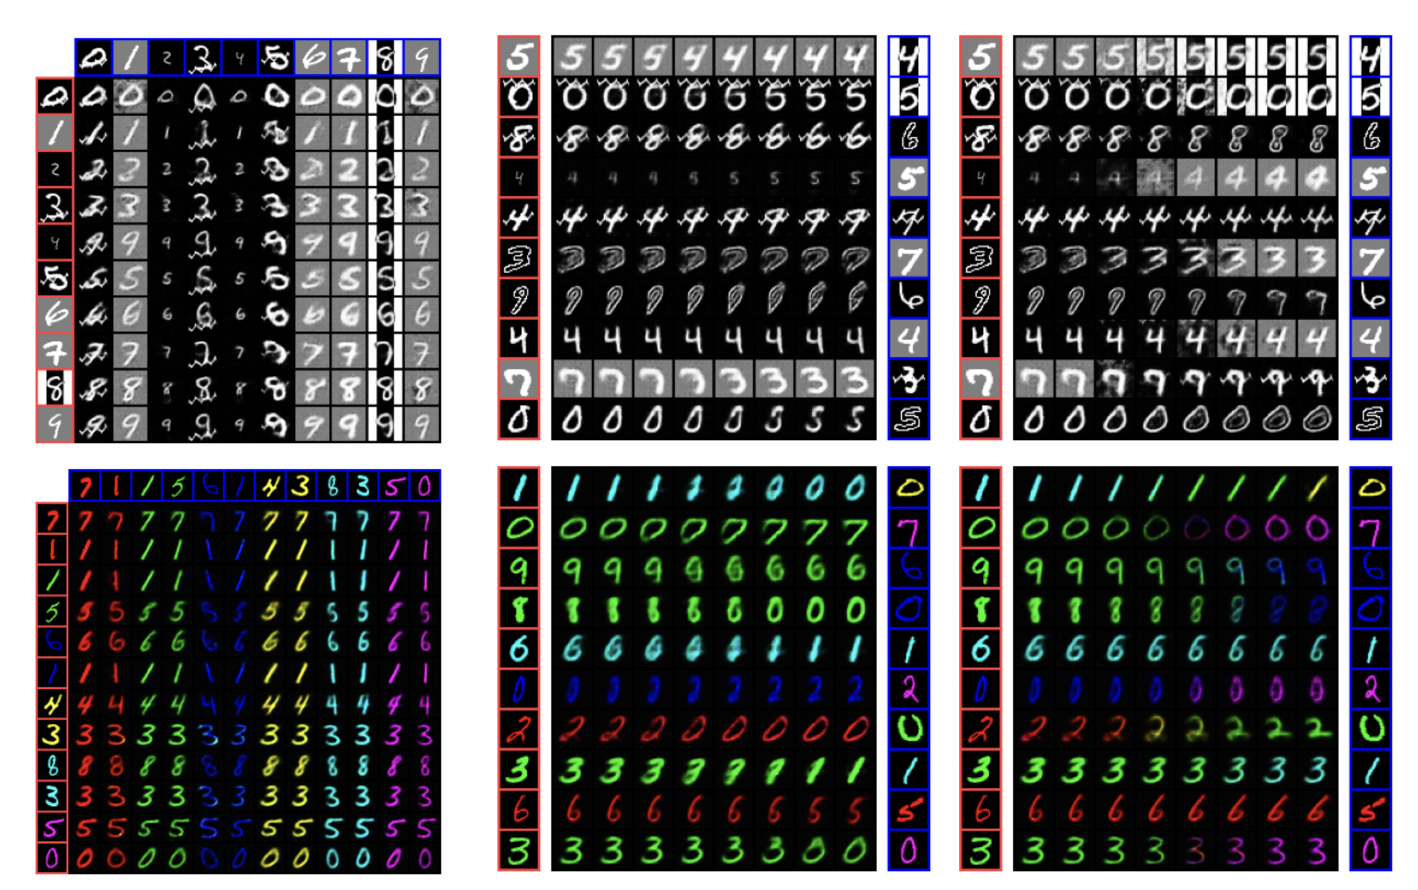
Disentangling style and content
Sun, Minghui, Benjamin A. Goldstein, and Matthew M. Engelhard. "CLEAR: Unlearning Spurious Style-Content Associations with Contrastive LEarning with Anti-contrastive Regularization." arXiv preprint arXiv:2507.18794 (2025).
Figure 4: Swapping and interpolation experiments. In (a), each image is generated using the content semantics from the red axis and style semantics from the blue axis. (b) interpolates content and (c) interpolates style from the source to the target sample, keeping the other factor fixed.
Notes:
Note that in our group activity we will come back to noise contrastive estimation and the relationship to mutual information

Slide 30
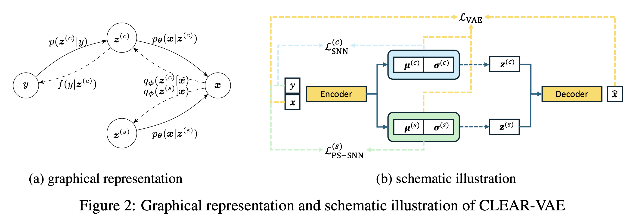
Disentangling style and content
Standard contrastive loss (NT-Xent) maximizes mutual information between label and content features
Anti-contrastive loss minimizes the mutual information between label and style features
Notes:
Note that in our group activity we will come back to noise contrastive estimation and the relationship to mutual information

Slide 31
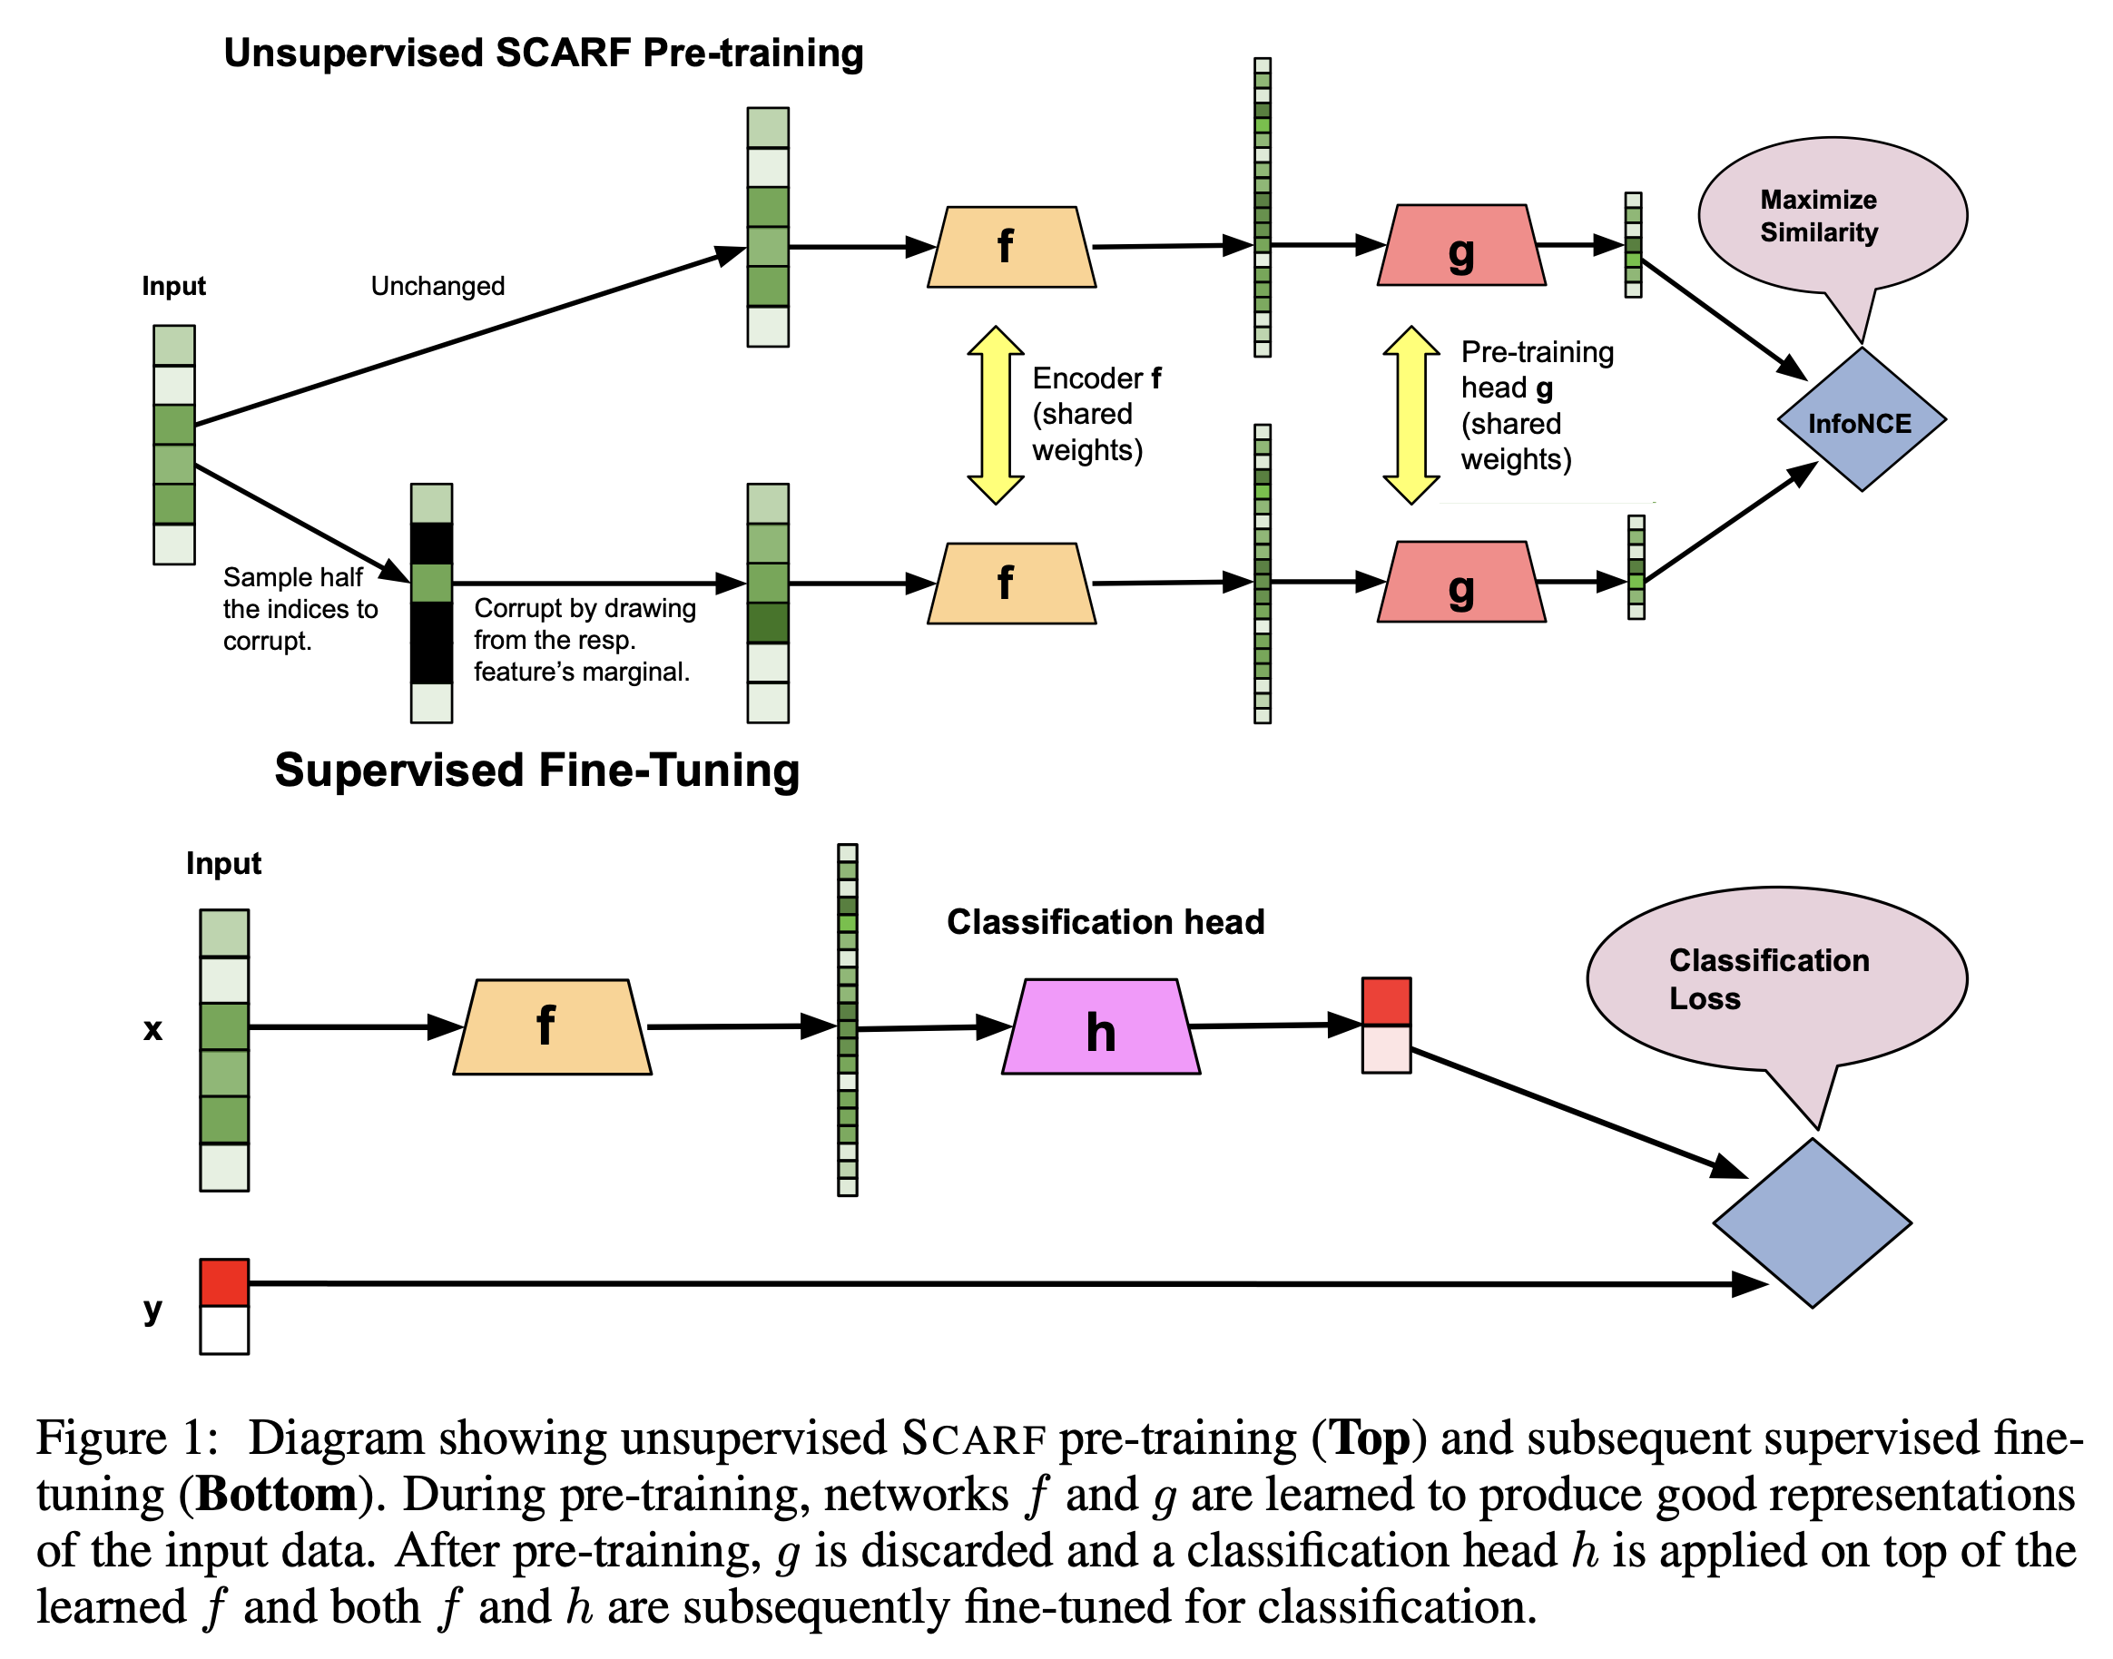
Contrastive learning for tabular data
Self-supervised representation learning for tabular data
Does improve performance in our experiments
Easy to implement
Bahri, Dara, et al. "Scarf: Self-supervised contrastive learning using random feature corruption." ICLR 2022.

Slide 32
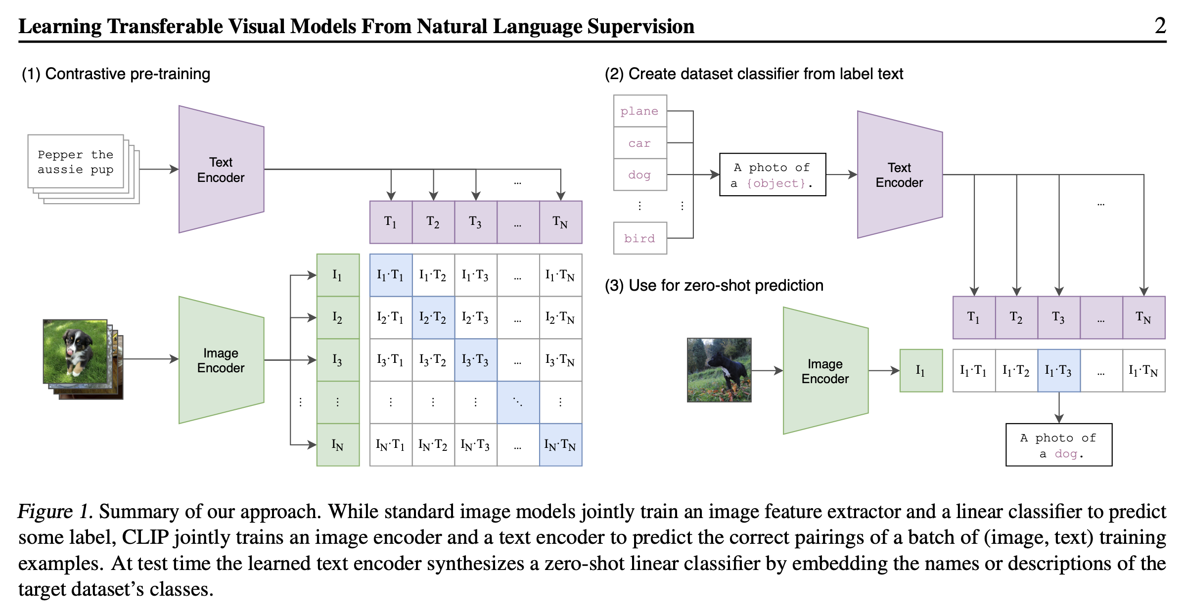
A look ahead at (joint) multi-modal fusion

