Slide 1
Discrimination Metrics
Matt Engelhard
Notes:
Hi everybody
In this lecture, we’ll be learning about measures commonly used to assess classification performance
Having an in-depth understanding of these measures is critical when evaluating a model, whether it’s one you’ve developed or one you’re reading about in a scientific article
Throughout the course, we’ll be thinking about what these measures mean, mathematically, as well as their practical significance in a clinical or healthcare scenario

Slide 2
Preliminaries
Metrics should be informed by the clinical use case

Slide 3
Medical student case study: new kidney risk prediction model
You are a primary care provider seeing diabetic patients. You learn that some colleagues have implemented a new prediction model that aims to prevent or delay kidney failure by predicting 2-year risk of progression to end-stage chronic kidney disease.
This model is based on electronic health record data, including diagnosis and procedure codes, medications, labs, and vitals; as well as social determinants of health.
You think the model sounds promising and start thinking about ways you might use it in practice.
Notes:
You want to understand how well it performs. What do you need to know?

Slide 4
Health AI student case study: new kidney risk prediction model
You are a health AI student developing a new prediction model that aims to prevent or delay kidney failure by predicting 2-year risk of progression to end-stage chronic kidney disease.
This model is based on electronic health record data, including diagnosis and procedure codes, medications, labs, and vitals; as well as social determinants of health.
You want to design a performance evaluation that is aligned with the way providers will use your model in practice.
Notes:
You want to understand how well it performs. What do you need to know?

Slide 5
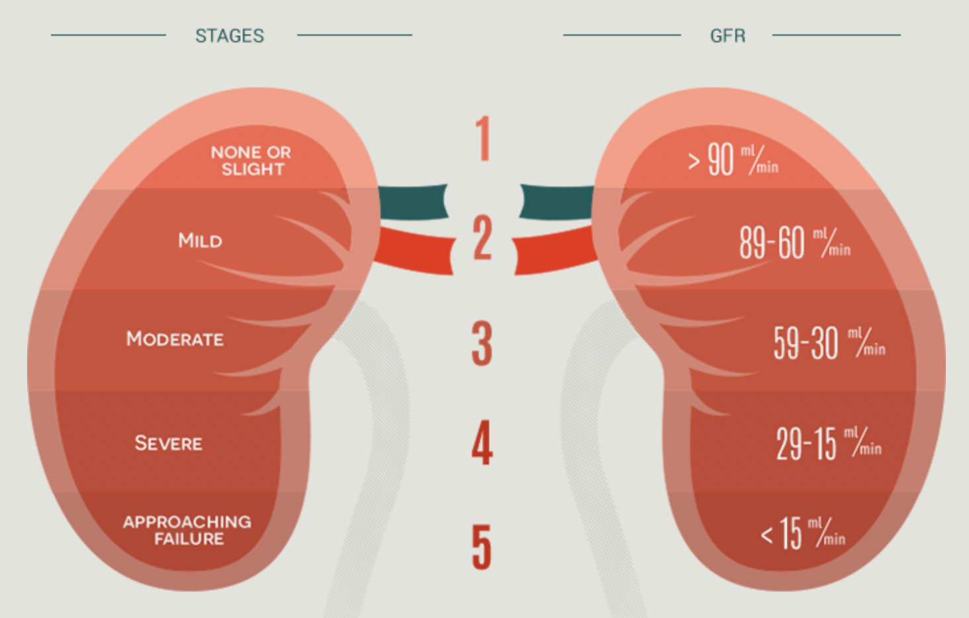
Consider: how might a provider use your model’s predictions?
11%
Probability of Stage IV CKD within two years
Report Back:
How might a clinician use this number (be specific)?
What performance metrics are relevant to this way of using the prediction?
Notes:
What does this number mean?
Is this number high? Is it low?
Helpful to know how this compares to other patients…
- overall
- among patients meeting specific clinical criteria
- among patients in a particular demographic
You might… use the number to decide whether to take a certain action
You might… use the number to provide context around disease, or to set expectations

Slide 6
Discrimination vs Calibration
Did not progress
Progressed to stage IV
True Risk
Perfect calibration
Predicted Risk
Predicted Risk
Can we identify individuals who will progress?
Are our predicted probabilities accurate?
Notes:
Today we’ll focus on discrimination metrics
Next time, we’ll think more about calibration

Slide 7
Today: discrimination metrics
Next time: calibration and class balance

Slide 8
Suppose our features are highly informative. What might our model’s predictions look like?

Slide 9
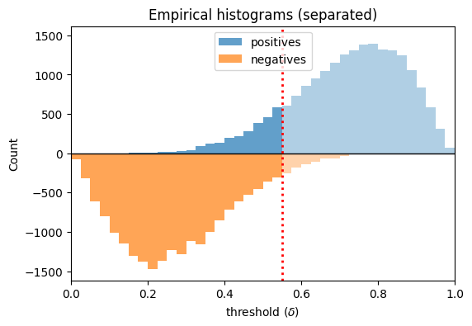
Suppose our features are highly informative. What might our model’s predictions look like?

Slide 10
Suppose our features are highly informative. What might our model’s predictions look like?
Predict
Negative
Predict
positive

Slide 11
Suppose our features are highly informative. What might our model’s predictions look like?
False
negatives
True
positives
True
Negatives
False
positives

Slide 12
Suppose our features are highly informative. What might our model’s predictions look like?
False
negatives
True
positives
Review threshold-specific metrics:
TPR (sensitivity, recall)
FPR (1 – specificity)
Precision (PPV)
NPV
Consider the clinical utility of each!!
True
Negatives
False
positives

Slide 13
Consider: how does each metric change as we vary the threshold?
Review threshold-specific metrics:
TPR (sensitivity, recall)
FPR (1 – specificity)
Precision (PPV)
NPV
Consider the clinical utility of each!!

Slide 14
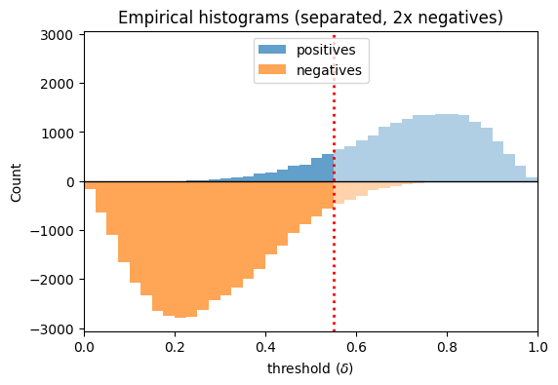
Consider: how does each metric change as we vary class balance?
Review threshold-specific metrics:
TPR (sensitivity, recall)
FPR (1 – specificity)
Precision (PPV)
NPV
Consider the clinical utility of each!!

Slide 15
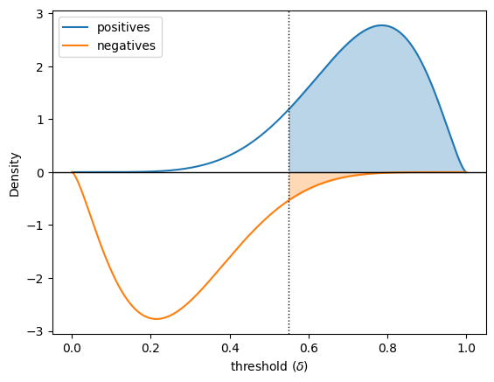
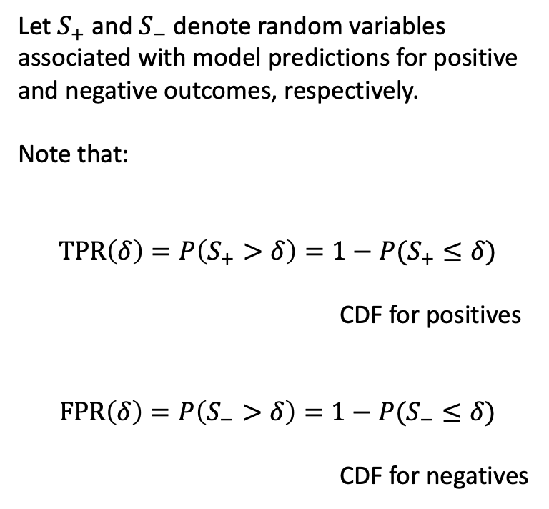
Consider: how does each metric change as we vary the threshold?
Let $S_{+}$ and $S_{−}$ denote random variables associated with model predictions for positive and negative outcomes, respectively.
Note that:
$$TPR\left(δ\right)=P\left(S_{+}>δ\right)=1−P(S_{+}≤δ)$$
CDF for positives
$$FPR\left(δ\right)=P\left(S_{−}>δ\right)=1−P(S_{−}≤δ)$$
CDF for negatives

Slide 16
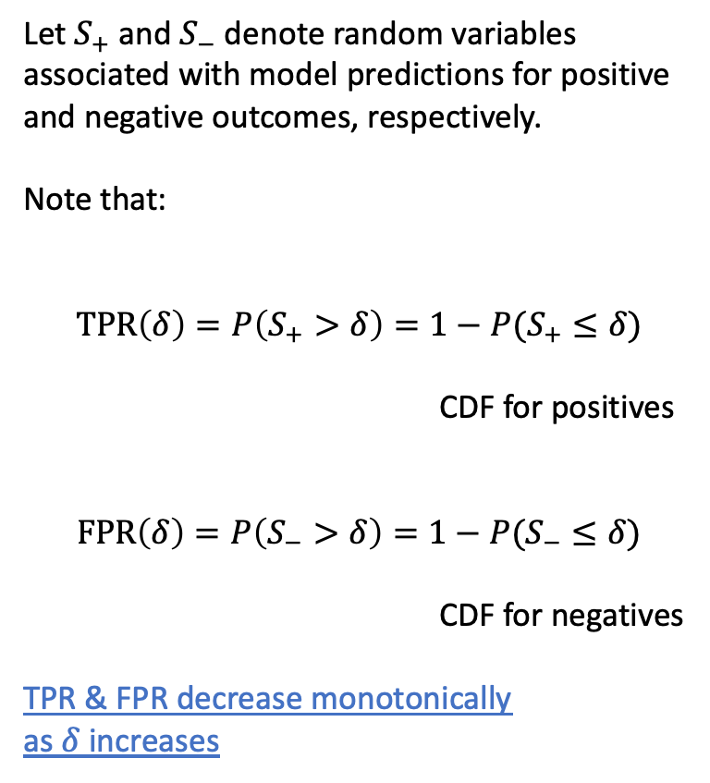
Consider: how does each metric change as we vary the threshold?
Let $S_{+}$ and $S_{−}$ denote random variables associated with model predictions for positive and negative outcomes, respectively.
Note that:
$$TPR\left(δ\right)=P\left(S_{+}>δ\right)=1−P(S_{+}≤δ)$$
CDF for positives
$$FPR\left(δ\right)=P\left(S_{−}>δ\right)=1−P(S_{−}≤δ)$$
CDF for negatives
TPR & FPR decrease monotonically
as $δ$ increases

Slide 17
Consider: how does each metric change as we vary the threshold?

Slide 18
Receiver Operating Characteristic Curve
Illustrates the tradeoff between the TPR (sensitivity) and FPR (1– specificity) as we vary the threshold.
Allows clinicians to consider this tradeoff and select appropriate operating points
The area under this curve (AUC) provides a single number summarizing this tradeoff.
In most cases this is the most important metric (why??)
Notes:
Why don’t people like the AUC?

Slide 19
So, what’s a good AUC value? (i.e., good performance)?
We’ll start to answer this question by taking a look at bad performance.
Notes:
At this point you might be wondering – so, what’s a *good* AUC value?
But we’re going to defer that question for a moment. Let’s start by thinking about what *bad* model performance would look like.

Slide 20
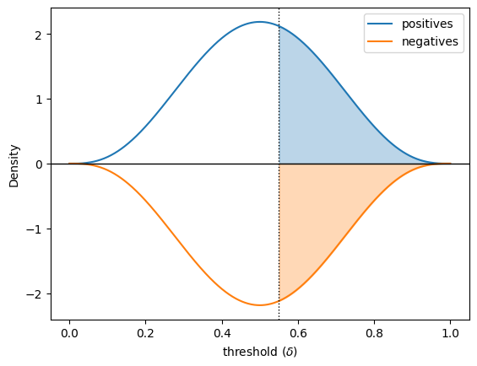
Suppose our features contain no information about the outcome. What might predictions look like?
Similar distributions between positive and negative cases.
The predicted value tells you nothing about which one it’s more likely to be.

Slide 21
Suppose our features contain no information about the outcome. What might predictions look like?
What is the:
TPR (sensitivity)?
FPR (1 – specificity)?
PPV?

Slide 22
Our “no information” predictive model
TPR and FPR always match (why?)
the distributions of positive and negative cases match
the corresponding CDFs match

Slide 23
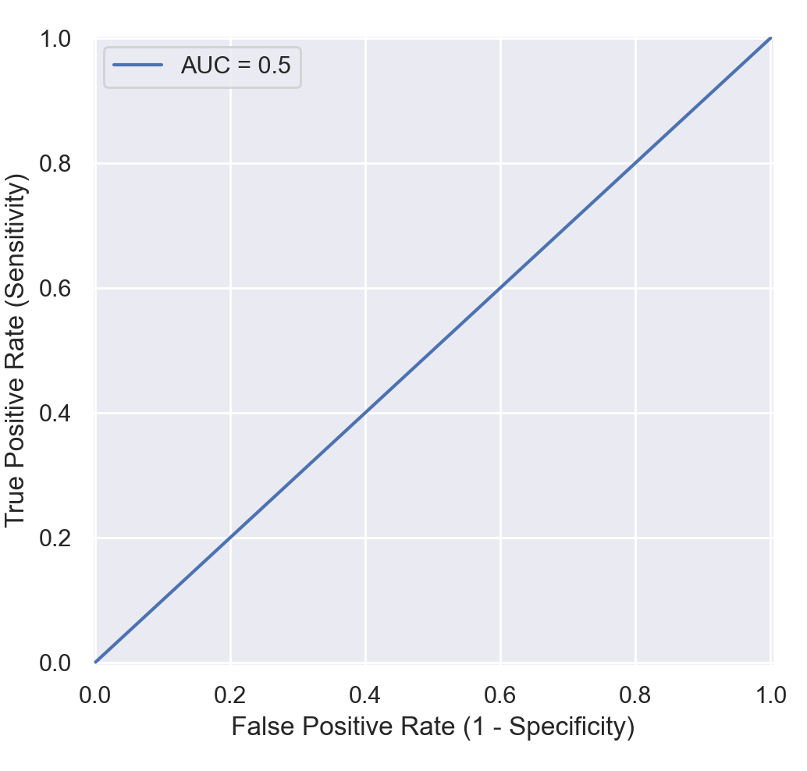
Our “no information” model
AUC is 0.5
Do we ever see AUC < 0.5?
If so, what can we infer about the distributions of our predictions for positive and negative samples?
Notes:
Again, we arrive at our no information curve, where we can vary the threshold from 0 to 1 and always get both sensitivity and false positive rate equal to 1 minus the threshold.
And again, the area under this curve is 0.5.
So, now we’ve seen what BAD performance looks like – namely, a diagonal line running from bottom left to top right on the ROC curve, and a corresponding AUC of 0.5.

Slide 24
So, what’s a good AUC value? (i.e., good performance)?
It depends.
Are predictions better than random?
Are predictions than the previous best performing model?
Are predictions better than expert performance?
Does performance exceed our (informed) expectations?
Is the model clinically useful?
Different expectations for risk prediction vs classification

Slide 25
What can we say about prediction performance when distributions match?
When distributions of predictions match between pos/neg:
predictions provide no information about the outcome
i.e. random guessing
When distributions of features (observed or latent) match between pos/neg:
features contain no information about the outcome
Note that adversarial methods operate on this principle:
Train a discriminator that predicts pos/neg (or real/fake)
Train a generator whose goal is to increase the discriminator’s loss (many variations on this)
Result? Distribution matching
Notes:
Describe variations on this idea
GAN
ADDA

Slide 26
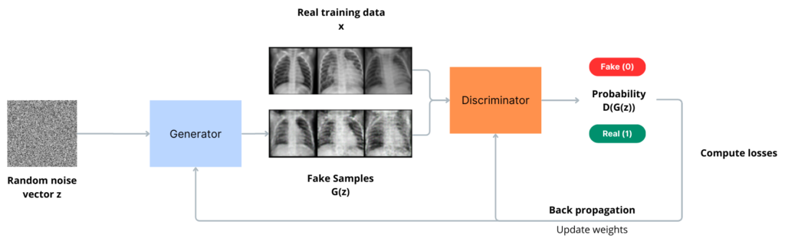
Brief overview of generative adversarial networks (GANs)
Taken from: https://blog.ovhcloud.com/understanding-image-generation-beginner-guide-generative-adversarial-networks-gan/
Notes:
- Generated samples match observed data distribution

Slide 27
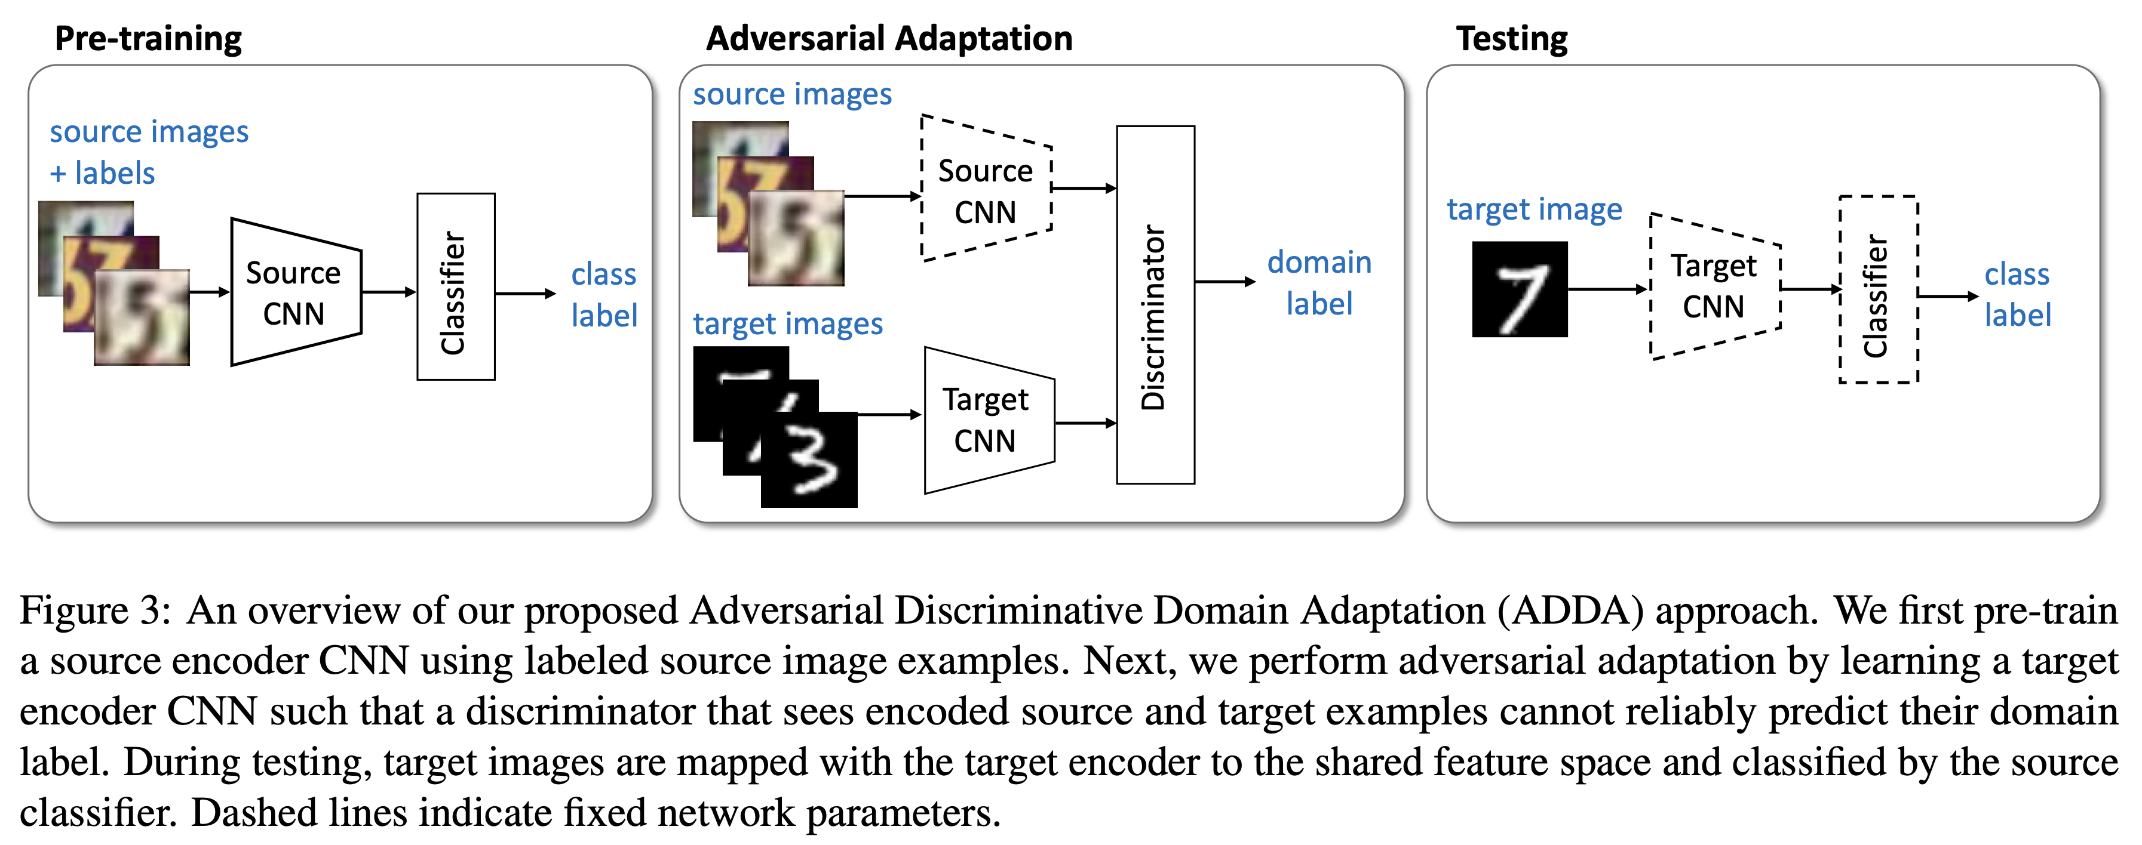
Adversarial discriminative domain adaptation (ADDA)
Tzeng, Eric, et al. "Adversarial discriminative domain adaptation." Proceedings of the IEEE conference on computer vision and pattern recognition. 2017.

Slide 28
We’ve quantified performance across all thresholds, but how do we use the model?
Sometimes the predicted probability really is what we care about.
Example: probability of heart attack
If so, we need to make sure our model is calibrated
More often, we need to pick a threshold so we can decide whether to:
Alert a provider
Get a biopsy
Refer the patient
etc
What threshold should we pick? What’s the right tradeoff?
Notes:
Now as we’ve discussed, we like to be agnostic to the particular decision threshold when quantifying model performance.
However, to actually use predictive models in decision-making, we typically need to pick a specific threshold
Our choice reflects the relative cost we place on false positives versus false negatives – in other words, how much we’re worried about missing cancer versus performing unnecessary testing or interventions.
And of course, this will depend on the scenario. Let’s run through a few hypotheticals.

Slide 29
Healthcare Scenarios Which performance metric is most important?
A computer vision model that detects carcinoma
Notes:
Suppose you were specifying a decision threshold for a computer vision model that detects carcinoma.
Would you be more worried about missing cancer, and therefore pick a high sensitivity threshold, or would you be more worried about unnecessary tests or intervention, and therefore pick a high specificity threshold?
There’s no right answer here – in reality, you’d need to understand the clinical scenario in much more detail to make this call.

Slide 30
Operating Point: high sensitivity
Notes:
Supposing you were more worried about missing cancer, you might pick a high sensitivity operating point like the one shown here.

Slide 31
The Precision-Recall Curve (i.e., PPV-Sensitivity Curve)
Some argue it has greater clinical relevance than the ROC curve
The no information classifier always achieves PPV equal to the base rate, or prevalence (why?)
PPV as well as the area under this curve (average precision) must be interpreted relative to prevalence
Notes:
As an important complement to the ROC curve, therefore, we often also want to plot a precision-recall curve – in other words, a sensitivity versus PPV curve.
The principles are very similar to the ROC curve. If we place our threshold near 1, we catch very few cases, therefore our sensitivity is near 0; however, our PPV is high.
On the other hand, if we place our threshold near 0, we’re predicting that every case is positive, therefore our positive predictive value – in other words, the rate at which we observe positive cases among our predicted positive cases -- is equal to the prevalence.

Slide 32
Operating Point: high sensitivity
Notes:
Here we can see our high sensitivity operating point on the precision-recall curve.

Slide 33
Healthcare Scenarios
A computer vision model that detects carcinoma
An algorithm that detects atrial fibrillation in Apple Watch users
Notes:
Now suppose you were specifying a decision threshold for an algorithm that detects atrial fibrillation in Apple Watch users.
Apple is understandably very concerned about raising too many false alarms given the large number of individuals that wear an Apple watch, therefore they are likely to pick a high specificity threshold…

Slide 34
Operating Point: high specificity
Notes:
Here’s our high specificitiy operating point on the precision-recall curve.

Slide 35
Healthcare Scenarios
A computer vision model that detects carcinoma
An algorithm that detects atrial fibrillation in Apple Watch users
An EHR-based model that monitors autism risk
Notes:
In my research, I consider EHR-based predictive models that monitor autism risk from a young age.
We are trying to identify as many children as possible as early as possible, but at the same time, there’s already a long waiting list to see a specialist, and if we create too many false alarms, we’re going to overburden the system and end up delaying diagnosis for *everyone*.
Therefore we may end up choosing a “balanced” operating point that prioritizes specificity and sensitivity about equally.

Slide 36
Operating Point: balanced
Notes:
And finally, here’s our balanced operating point. Please take a moment to think carefully about these curves and the relationships between them.

Slide 37
Healthcare Scenarios
A computer vision model that detects carcinoma
An algorithm that detects atrial fibrillation in Apple Watch users
An EHR-based model that monitors autism risk
Sometimes specificity and sensitivity are difficult to interpret, particularly for rare conditions or events.
The most clinically relevant measure is often the positive predictive value (or negative predictive value).
Notes:
Now, particularly for rare events, it often makes most sense to focus on positive or negative predictive value rather than sensitivity or specificity.
The PPV and NPV are often more directly relevant to decision-making, because they tell us what we can expect in terms of the true outcome after seeing a positive or negative result, respectively.
And we also know that for rare events, PPV can be low even when specificity is relatively high, because there are many more negative cases than positives.

Slide 38
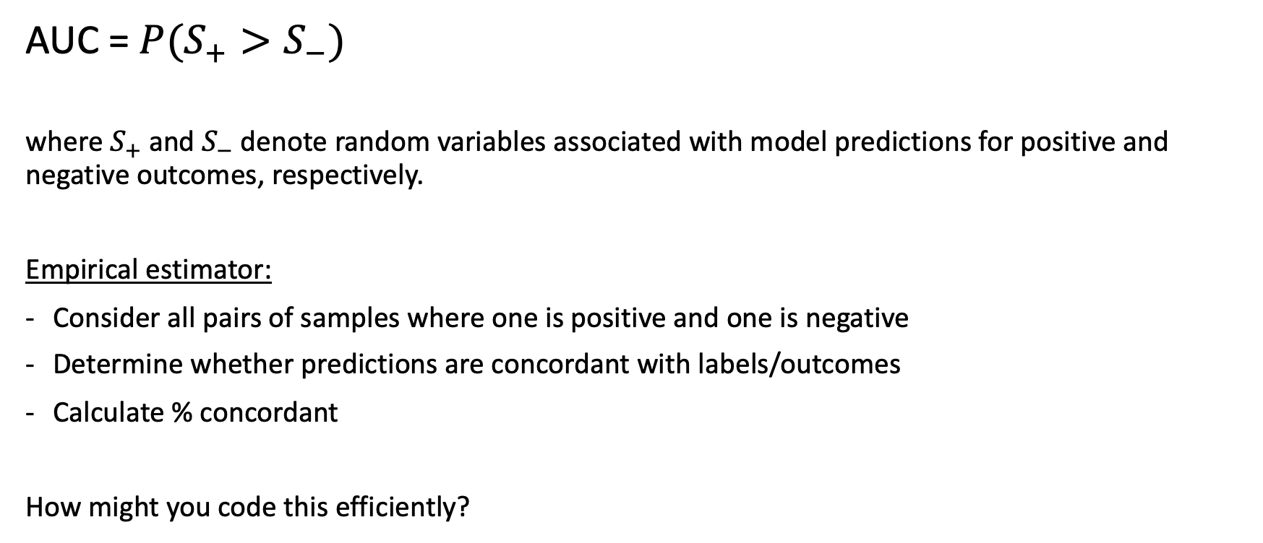
Probabilistic definition of AUC
AUC = $P(S_{+}>S_{−})$
where $S_{+}$ and $S_{−}$ denote random variables associated with model predictions for positive and negative outcomes, respectively.
Empirical estimator:
Consider all pairs of samples where one is positive and one is negative
Determine whether predictions are concordant with labels/outcomes
Calculate % concordant
How might you code this efficiently?

Slide 39
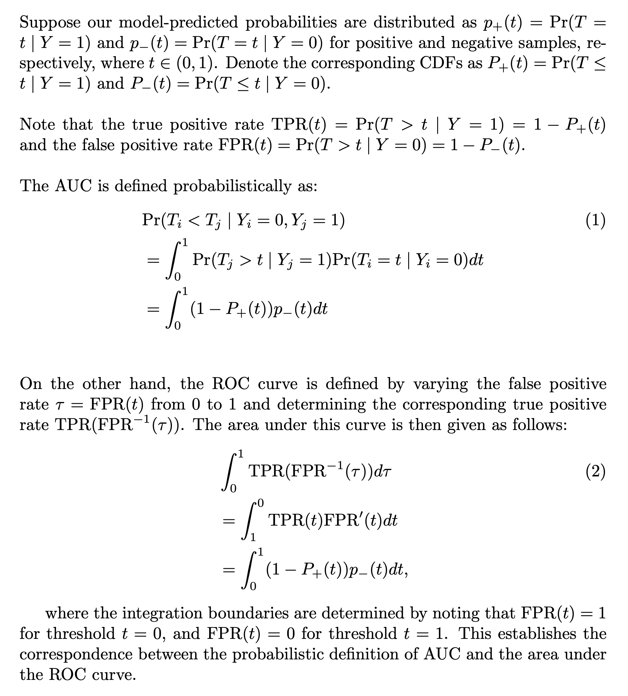
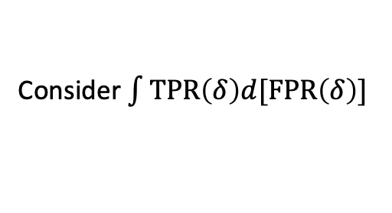
Equivalence of probabilistic and graphical definitions
More detailed, step by step:
Consider $\int{TPR\left(δ\right)d[FPR\left(δ\right)]}$

Slide 40


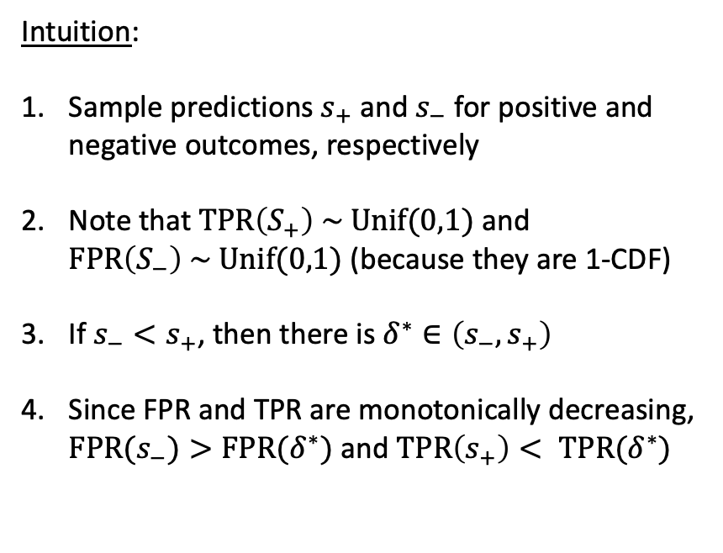
Equivalence of probabilistic and graphical definitions
Intuition:
Sample predictions $s_{+}$ and $s_{−}$ for positive and negative outcomes, respectively
Note that $TPR\left(S_{+}\right) \sim Unif(0,1)$ and $FPR\left(S_{−}\right) \sim Unif(0,1)$ (because they are 1-CDF)
If $s_{−}<s_{+}$, then there is $δ^{∗}∈\left(s_{−}, s_{+}\right)$
Since FPR and TPR are monotonically decreasing, $FPR(s_{−})>FPR(δ^{∗})$ and $TPR\left(s_{+}\right)< TPR(δ^{∗})$
$$(FPR(δ^{∗}), TPR(δ^{∗}))$$
$$(FPR(s_{−}), TPR(s_{+}))$$
Consider $\int{TPR\left(δ\right)d[FPR\left(δ\right)]}$

Slide 41

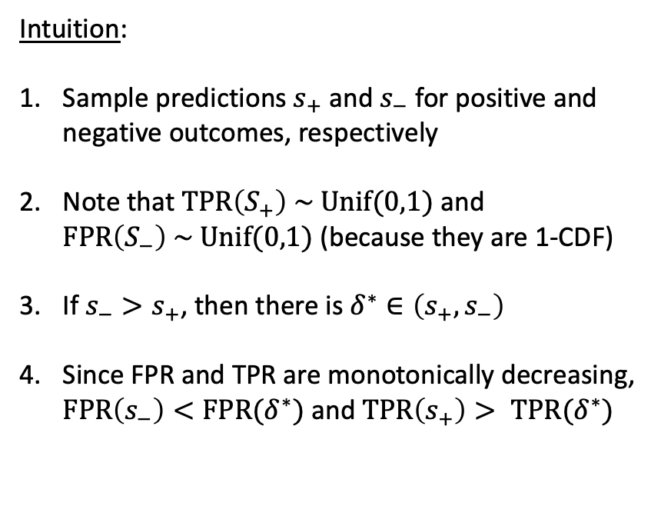
Equivalence of probabilistic and graphical definitions
$$(FPR(s_{−}), TPR(s_{+}))$$
Intuition:
Sample predictions $s_{+}$ and $s_{−}$ for positive and negative outcomes, respectively
Note that $TPR\left(S_{+}\right) \sim Unif(0,1)$ and $FPR\left(S_{−}\right) \sim Unif(0,1)$ (because they are 1-CDF)
If $s_{−}>s_{+}$, then there is $δ^{∗}∈\left(s_{+}, s_{−}\right)$
Since FPR and TPR are monotonically decreasing, $FPR\left(s_{−}\right)<FPR(δ^{∗})$ and $TPR\left(s_{+}\right)> TPR(δ^{∗})$
$$(FPR(δ^{∗}), TPR(δ^{∗}))$$
Consider $\int{TPR\left(δ\right)d[FPR\left(δ\right)]}$

Slide 42
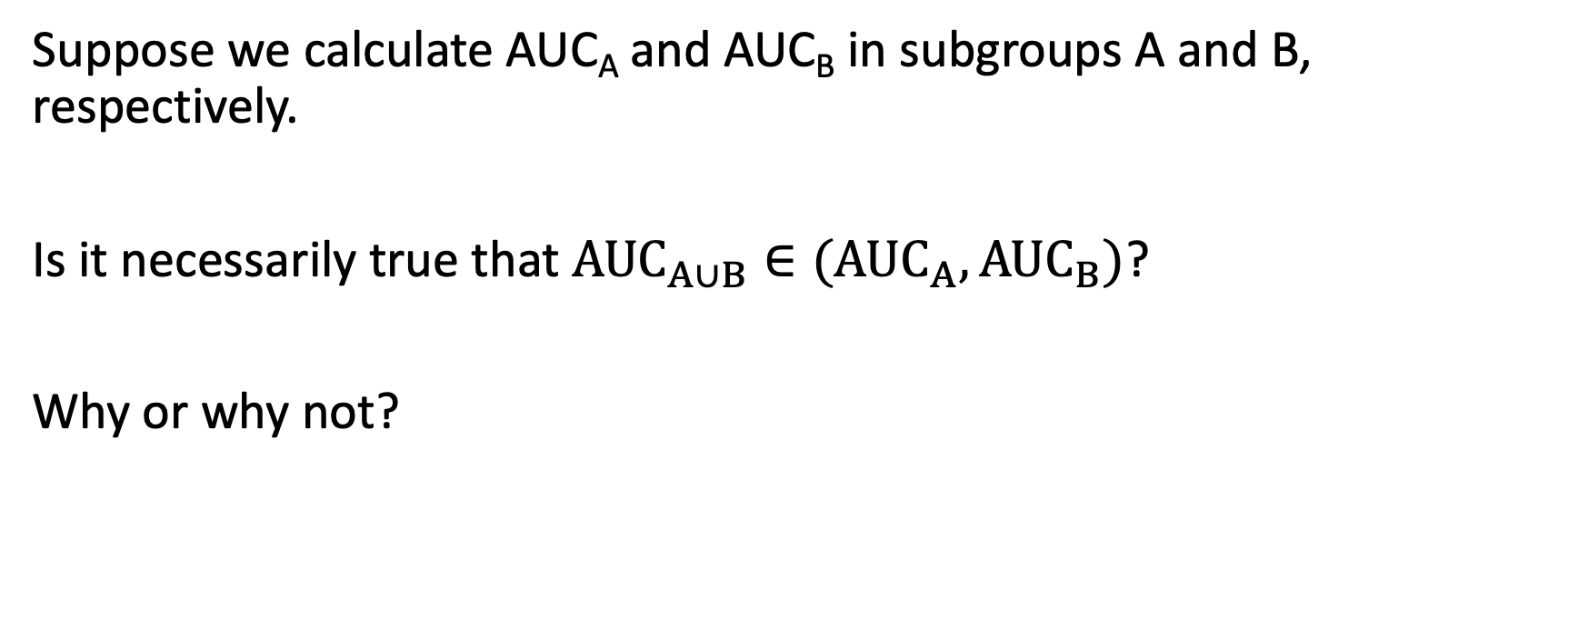
Report back: AUC in subgroups
Suppose we calculate AUC_{A} and AUC_{B} in subgroups A and B, respectively.
Is it necessarily true that $AUC_{A∪B}∈({AUC}_{A}, AUC_{B})$?
Why or why not?

Slide 43
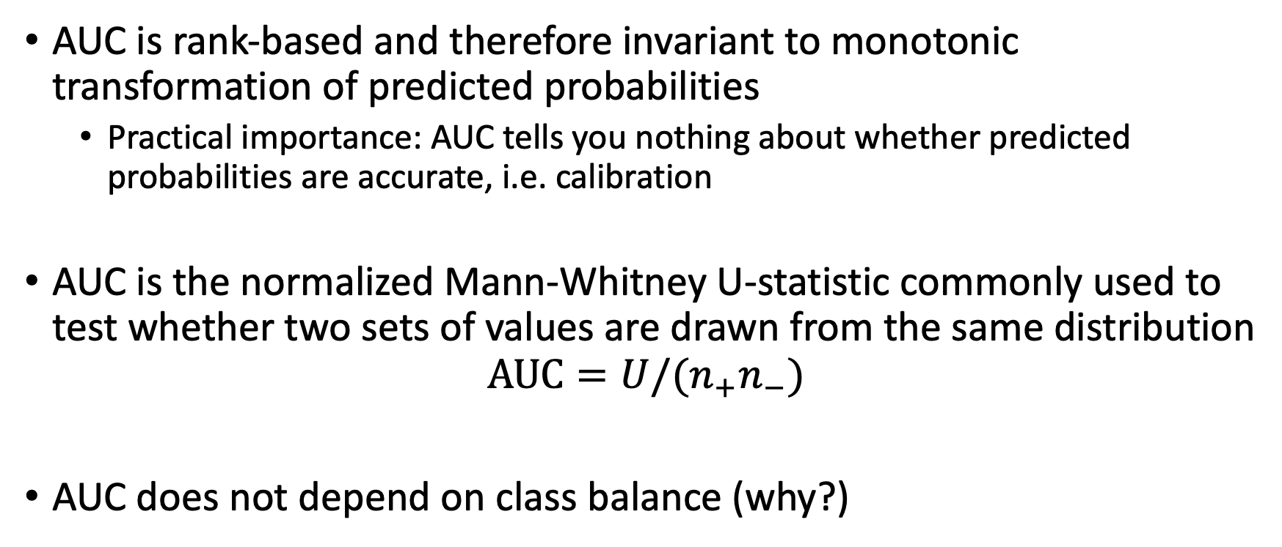
Other notable properties
AUC is rank-based and therefore invariant to monotonic transformation of predicted probabilities
Practical importance: AUC tells you nothing about whether predicted probabilities are accurate, i.e. calibration
AUC is the normalized Mann-Whitney U-statistic commonly used to test whether two sets of values are drawn from the same distribution
$$AUC=U/(n_{+}n_{−})$$
AUC does not depend on class balance (why?)

Slide 44
Multi-class problems

Slide 45
Multi-class problems: “Confusion Matrix”
Predicted Label
Correct Prediction
True Label
Incorrect Prediction
Notes:
Now, in everything we’ve discussed so far, we’re thinking about binary problems – we’re distinguishing positive cases from negative cases
But in this course, we’ll also be considering multi-class problems, in which we’re predicting which of several labels corresponds to our patient, or case
For example, we might predict that a skin lesion is cancerous or benign – this is binary – but alternatively, we might predict what kind of lesion it is – a carcinoma, actinic keratosis, melanoma, and so on
In these problems, instead of a 2 by 2 ”confusion matrix” of TPs, FPs, TNs, and FNs, we instead have an N x N matrix, where N is the number of classes. We can think of this as a cross-tabulation between the true labels and predicted labels. In the top left corner, we have a count of cases for which the true label was the first label –and the predicted label was also the first label. Along the same lines, the box in the 2nd row, 3rd column tells us how many cases there were where the true label was the second label, but our model predicted the third label.
One metric we can calculate directly from this matrix is the accuracy – this is simply the number of correct predictions over the number of total predictions – in other words, the sum of the blue boxes divided by the sum of all boxes
However, it’s not obvious how all the metrics we’ve discussed previously, which are quite useful, can be applied here.

Slide 46
Multi-class problems: Binary for Label 1
Predicted Label
TruePos
<---- False Negatives ---->
False Pos
Correct Prediction
True Label
True Negatives
Incorrect Prediction
<---- False Positives ---->
Notes:
One approach – really the only approach that is common – is to instead go back to binary prediction for each of the labels of interest.
We can consider only the first label, for example. Each patient, or case, is labeled either with that label, or with some other label; and similarly, the model either predicts that label, or it predicts some other label.
If the true label is the first label, and the model also predicts the first label, that’s a true positive; whereas if the model predicts a different label, that’s a false negative.
And if the true label isn’t the first label, and the model predicts the first label, that’s a false positive; whereas if the model predicts a different label, that’s a true negative.
We can then look at all our earlier metrics – sensitivity, specificity, etc – with respect to the binary prediction task defined by the first label.

Slide 47
Multi-class problems: Binary for Label 2
Predicted Label
True Negatives
TruePos
<---- -------- False Negatives ---->
Correct Prediction
True Label
<---- True Negatives --------- ---->
<---- False Positives --------- ---->
Incorrect Prediction
True Negatives
Notes:
And, in exactly the same way, we can define all these metrics with respect to any of the other labels.
Sometimes, we might even consider the average of these metrics across all these binary tasks – a mean precision, for example, not to be confused with the average precision, which is an approximation to the area under the precision-recall curve.

Slide 48
AUC and fairness

Slide 49
What does it mean for a model to be fair?
Consider whether predictions are fair between two groups A and B.
One possible solution is fairness through unawareness, also called blindness, wherein the model is not given information about group status.
Report back:
- What could go wrong if the model is aware of group status?
- What could go wrong if the model is unaware of group status?
Then, propose an alternative approach to achieve or evaluate fairness.
Notes:
You want to correct this problem and make the model fair.
But what does that mean?
Intuitive idea – don’t let the model use sensitive attribute when making predictions
Divide up groups: some argue it’s good to be aware, others that it’s bad

Slide 50
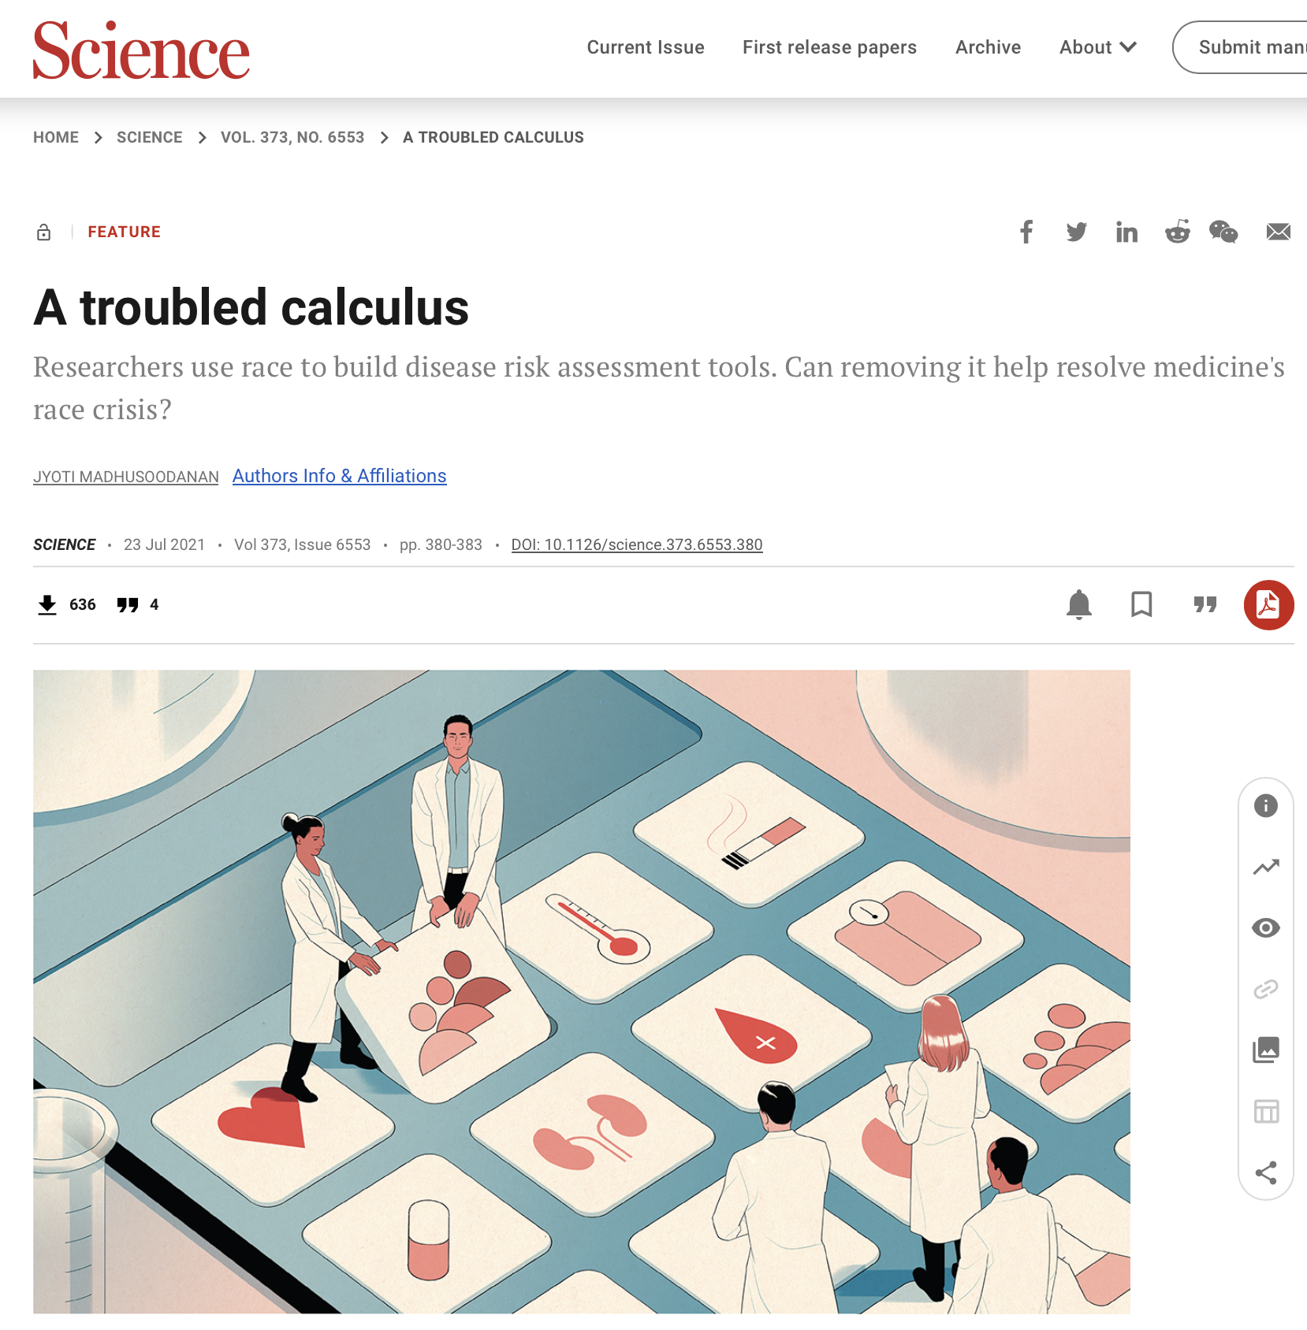
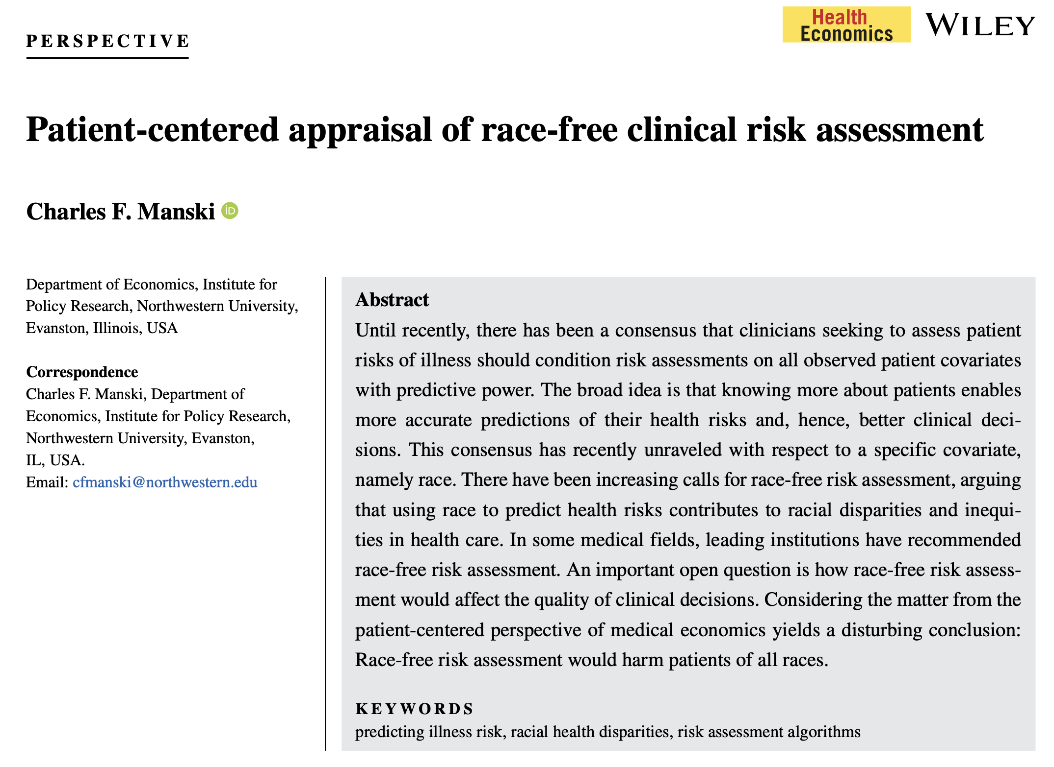
Notes:
Kidney function estimation – clear example where inclusion did harm
Critical to be aware of the potential for harm
But there’s been a trend toward excluding
Almost becoming a precedent within the clinical literature
There’s a danger in this as well
Beware an easy solution to a complex problem

Slide 51
Blindness can be ineffective or even harmful.
In some cases it is effective.
In other cases it isn’t enough to fix the problem.
In still other cases, it can make the problem worse.
Black-Black White-White Black-White White-Black

Slide 52
Possible definitions of algorithmic fairness
Consider whether predictions are fair between two groups A and B.
Blindness: The model cannot see group status
Independence: Model predictions are independent of group status
Separation: Model performance is similar in all groups
Individual fairness: The model makes similar predictions for similar individuals regardless of group status
Except under special (& not realistic) circumstances, (1) – (4) are mutually exclusive.
Notes:
We’ve already considered option 1
What about option 2?
- should predictions be independent of group status
- this would imply, for example, that model predicted risk on average is the same in both groups
- same distributions
- why or why not?
What about option 3?
- what does this mean?
Challenges include differential observability

Slide 53
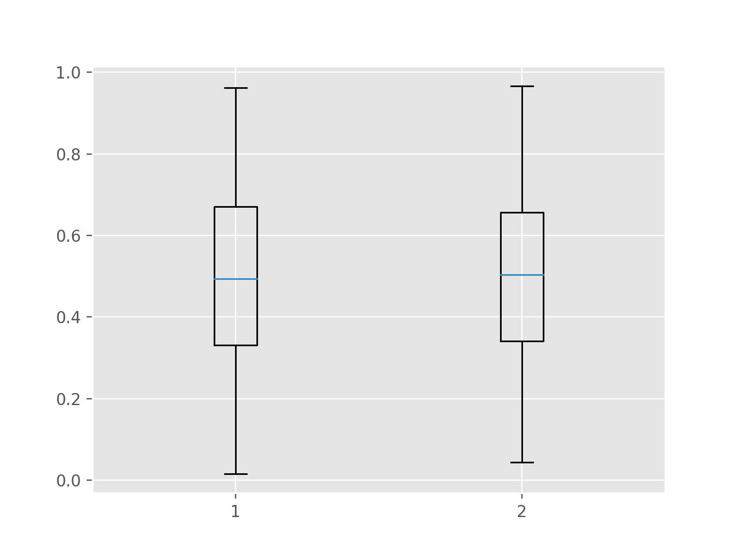
Zooming in on Independence
Model predictions are independent of group status.
This implies that the distribution of model predictions is the same in each group.
Is this fair?
Black White
Notes:
Think about what it would imply.
If we set a threshold, it would imply that White and Black patients would receive intervention at equal rates.
Is this fair?

Slide 54
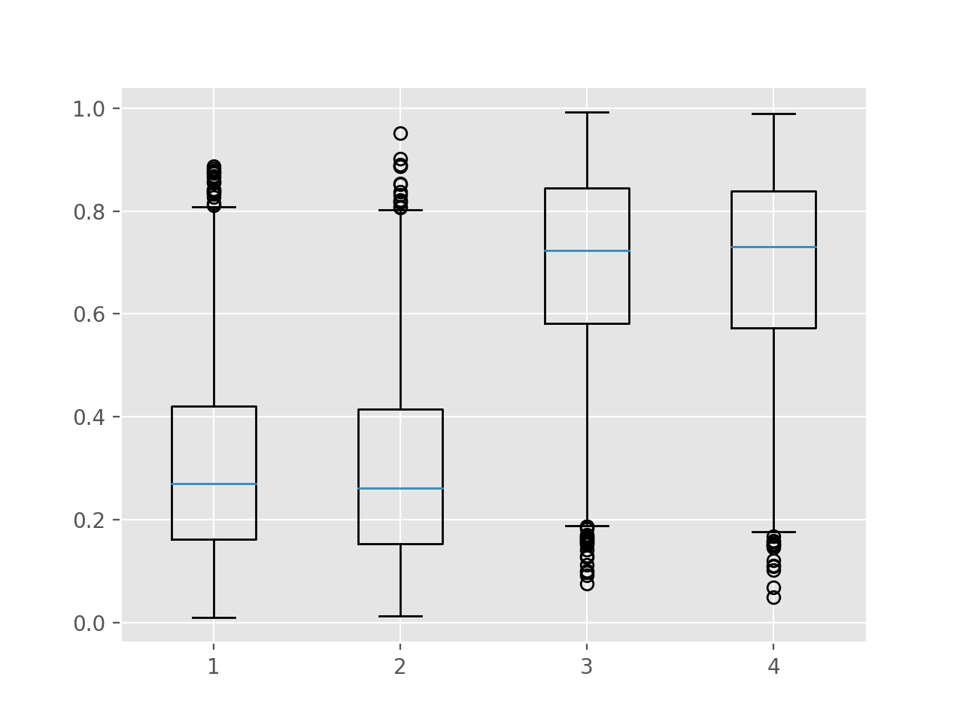
Zooming in on Separation
Model predictions are independent of group status after conditioning on the outcome.
This implies when considering individuals with the same outcome, the distribution of model predictions is the same in each group.
Is this fair?
Black White
Black White
Did not Progress
Progressed to Stage IV
Notes:
Probably the most promising in my view.
Important to note, firstly, that if outcome rates are the same in each group, then this is the same as independence.
But of course, they’re usually not.
And if they’re not, well that means that different groups will receive intervention at different rates.
The biggest problem with this:
- highly dependent on the outcomes being correct!
- difficult standard in most clinical applications
- biased outcomes, differential observability, and so on.

Slide 55
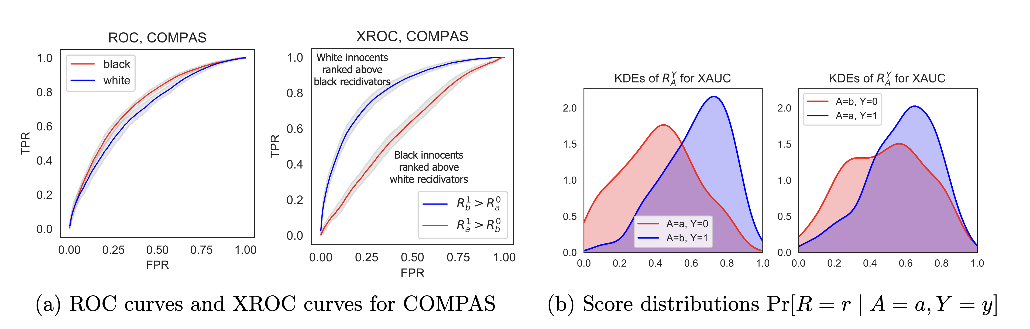

Assessing fairness with group conditional AUC (xAUC)
xAUC_{A,B} = $P(S_{+}^{A}>S_{−}^{B})$
[i.e. we are now conditioning on group status]
Consider $Δ$xAUC = |xAUC_{B,A} – xAUC_{A,B}|
Does lower $Δ$xAUC
imply a fairer model?

