Slide 1
Explainable AI Methods
Matthew Engelhard

Slide 2
Today
Contrastive learning on the board (SimCLR and CLIP batches and losses)
Interpretable versus explainable (definition, example)
Competing perspectives on interpretability
Evolving views of interpretability
Simple explanation methods (saliency maps, Grad-CAM)
More principled explanation methods (integrated & expected gradients, SHAP)

Slide 3
Interpretable vs Explainable

Slide 4
Interpretable versus explainable models
An interpretable model:
It is easy to for us to understand why the model makes the predictions that it makes.
An explainable model:
One or more techniques can be used to provide a human-friendly explanation for each model prediction.
Notes:
Bike versus car?
Bike:
Why did it turn left? I can see the handles
Why did it move forward? I can see the chain
Why did it stall? The chain fell off
Car:
Why did it turn left? It’s because I turned the wheel left… but I can’t really see how turning the wheel left makes the wheel go left
Why did it move forward? It’s because you pushed the pedal.
Why did it stall? You let the clutch out too quickly.

Slide 5
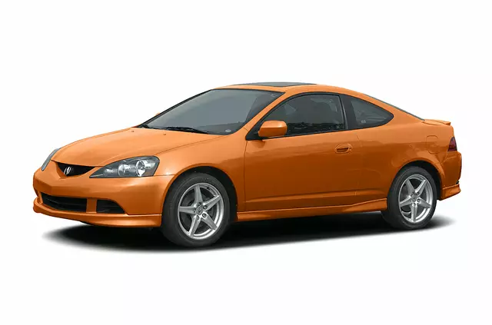
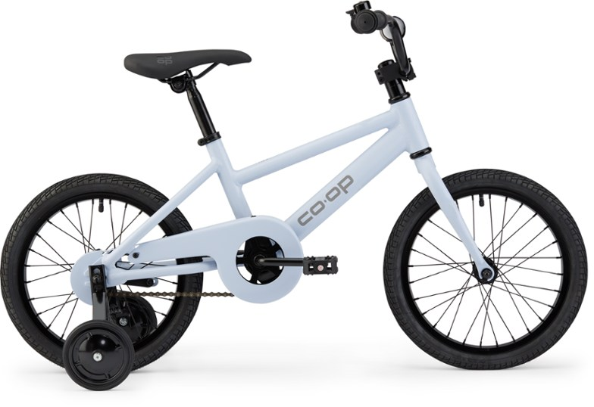
Interpretable Explainable
Notes:
Think about going to the mechanic…
If the brake stops working, will you be able to see why?

Slide 6
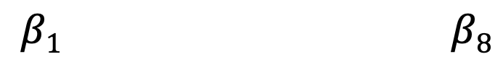
Interpretable: logistic regression
Suppose a new patient is transferred to the ICU, and the (logistic regression) model predicts their mortality risk is high.
Q: Is it hard to figure out why it made that prediction?
A: No. You can look at the coefficients to see which variables increased and decreased the predicted probability.
LOG ODDS
𝜎
y
age
sex
SBP
HR
temp
RR
WBC
HCT
$$β1 β8$$
y, associated label:
(0 = live, 1 = die)
x₁ | x₂ | x₃ | x₄ | x₅ | x₆ | x₇ | x₈
Notes:
Cautions:
not causal
Many predictors can be highly correlated
When we use many predictors, coefficients can be somewhat arbitrary as a result
Don’t assign too much meaning here

Slide 7
Other Interpretable Models?
Decision Tree
HR > 130?
no
yes
live
temp > 40℃?
no
yes
live
die

Slide 8
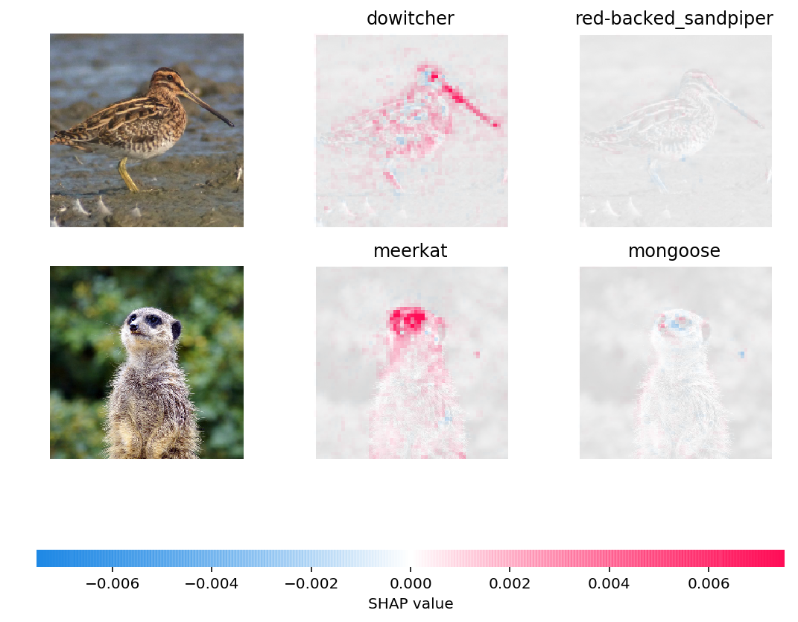
Explainable: CNN
Suppose you apply a CNN to images of animals, and the model predicts that an animal is a meerkat.
Q: Is it hard to figure out why it made that prediction?
A: Yes, an explanation can be provided:
Similarly, we can identify passages within a text document that would change predictions most if they were removed.
Caveats:
This is for a single example; not clear how to summarize across all examples for images and text
Can be very computationally expensive

Slide 9
Explainable: CNN
Saliency maps show gradients for each pixel with respect to the CNN’s loss function. Darker pixels represent those with more influence.
How would this compare to a dermatologist’s explanation?
Notes:
Suppose you were learning to identify lesions from a dermatologist.
You can’t inspect her thought process, but she can give you an explanation…

Slide 10
Interpretable versus explainable models
An interpretable model:
We can understand how the model works in general, for example by inspecting coefficients or tree structure.
An explainable model:
We are presented with case-by-case explanations that decompose predictions into the contributions of different input features.
Notes:
Bike versus car?
Bike:
Why did it turn left? I can see the handles
Why did it move forward? I can see the chain
Why did it stall? The chain fell off
Car:
Why did it turn left? It’s because I turned the wheel left… but I can’t really see how turning the wheel left makes the wheel go left
Why did it move forward? It’s because you pushed the pedal.
Why did it stall? You let the clutch out too quickly.

Slide 11
Competing perspectives on interpretability

Slide 12

Interpretable ? Explainable where does clinician decision-making fall on this spectrum?
Notes:
Think about going to the mechanic…
If the brake stops working, will you be able to see why?

Slide 13
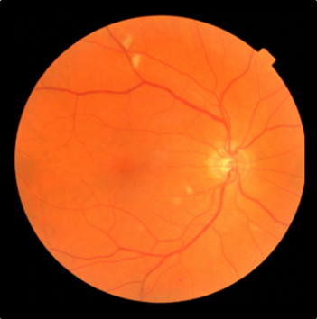
Compared to simpler models, DNNs are a black box. We can explain model predictions, but it’s case by case.
Retinopathy? Yes/No
Notes:
Want to highlight the issue of interpretability
How can we trust a ”black box” diagnostic if we don’t know what’s happening inside?

Slide 14
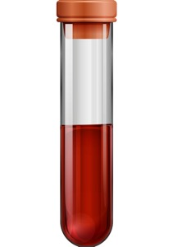
Is PSA measurement a black box?
PSA Level
Notes:
At the same time, I might question whether we fully understand even more traditional diagnostics.
For instance, I might know that PSA is an enzyme found in the prostate, but I have only a very rudimentary understanding of how PSA levels are detected, or how reliable a PSA measurement might be
gamma-seminoprotein or kallikrein-3 (KLK3), is a glycoprotein enzyme encoded in humans by the KLK3 gene

Slide 15
Is clinician decision-making a black box?
Retinopathy? Yes/No
Notes:
Think about going to the mechanic…
If the brake stops working, will you be able to see why?

Slide 16
Two competing perspectives
FDA regulation of clinical decision support considers interpretability.
We can only use tools if we fully understand how they work
We just need to make sure our tools are valid and reliable
Notes:
At the end of the day there are two competing perspectives.
Those that think we must fully understand how these tools work to trust them
And those who think that we just need to know that they DO work.
But that means rigorously and repeatedly validating them, in a variety of settings – health systems, patient populations, other conditions

Slide 17
Evolving views of interpretability

Slide 18
Evolving views of interpretability
Old definition: It is easy to for us to understand why the model makes the predictions that it makes.
New definition: Predictions are explained based on elements or concepts that are understandable to humans.

Slide 19
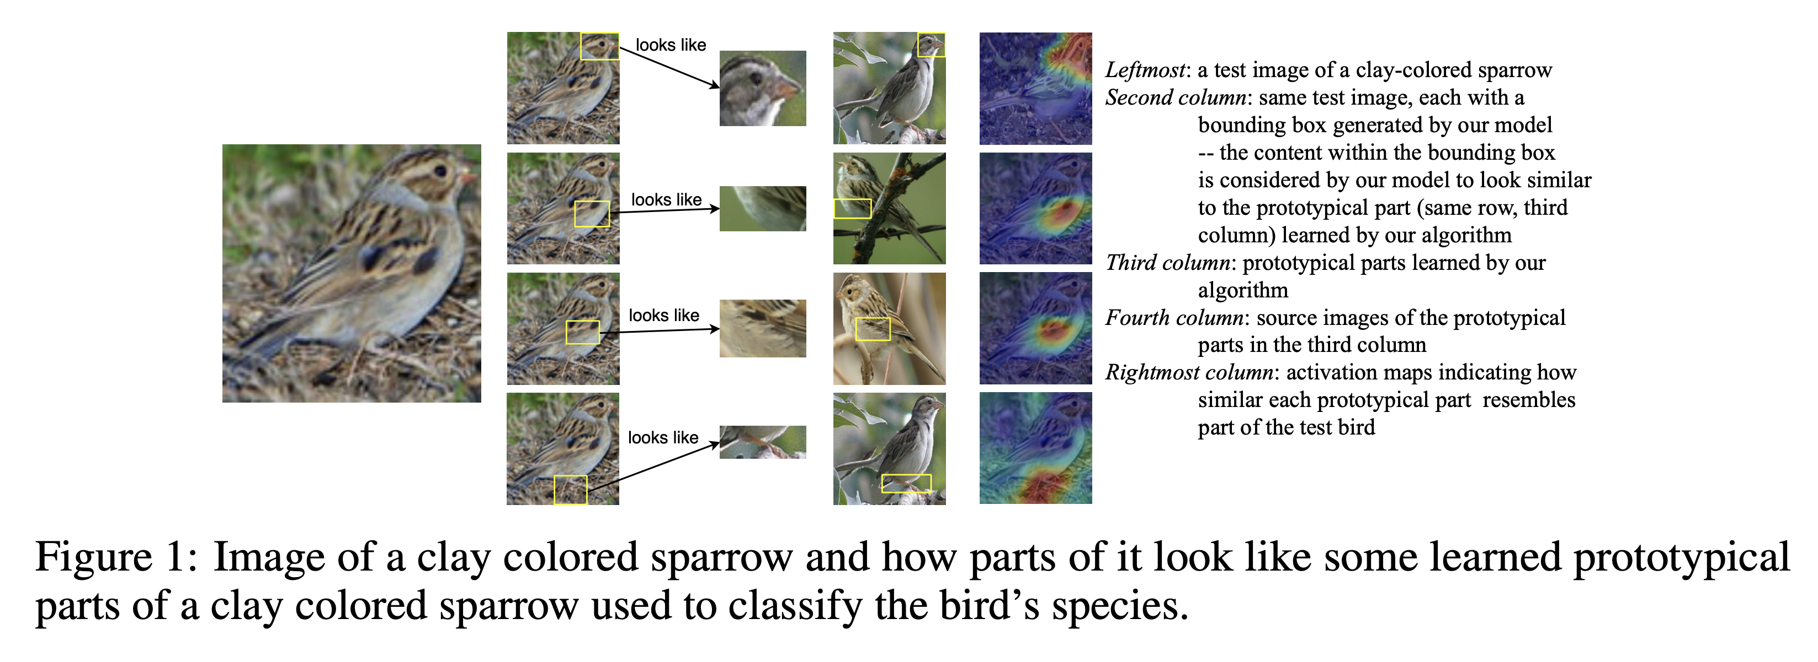
This looks like that
Uses large convolutional filters that can then be used to retrieve best-matching patches from the training set.
Chen C, Li O, Tao D, Barnett A, Rudin C, Su JK. This looks like that: deep learning for interpretable image recognition. Advances in neural information processing systems. 2019;32.

Slide 20
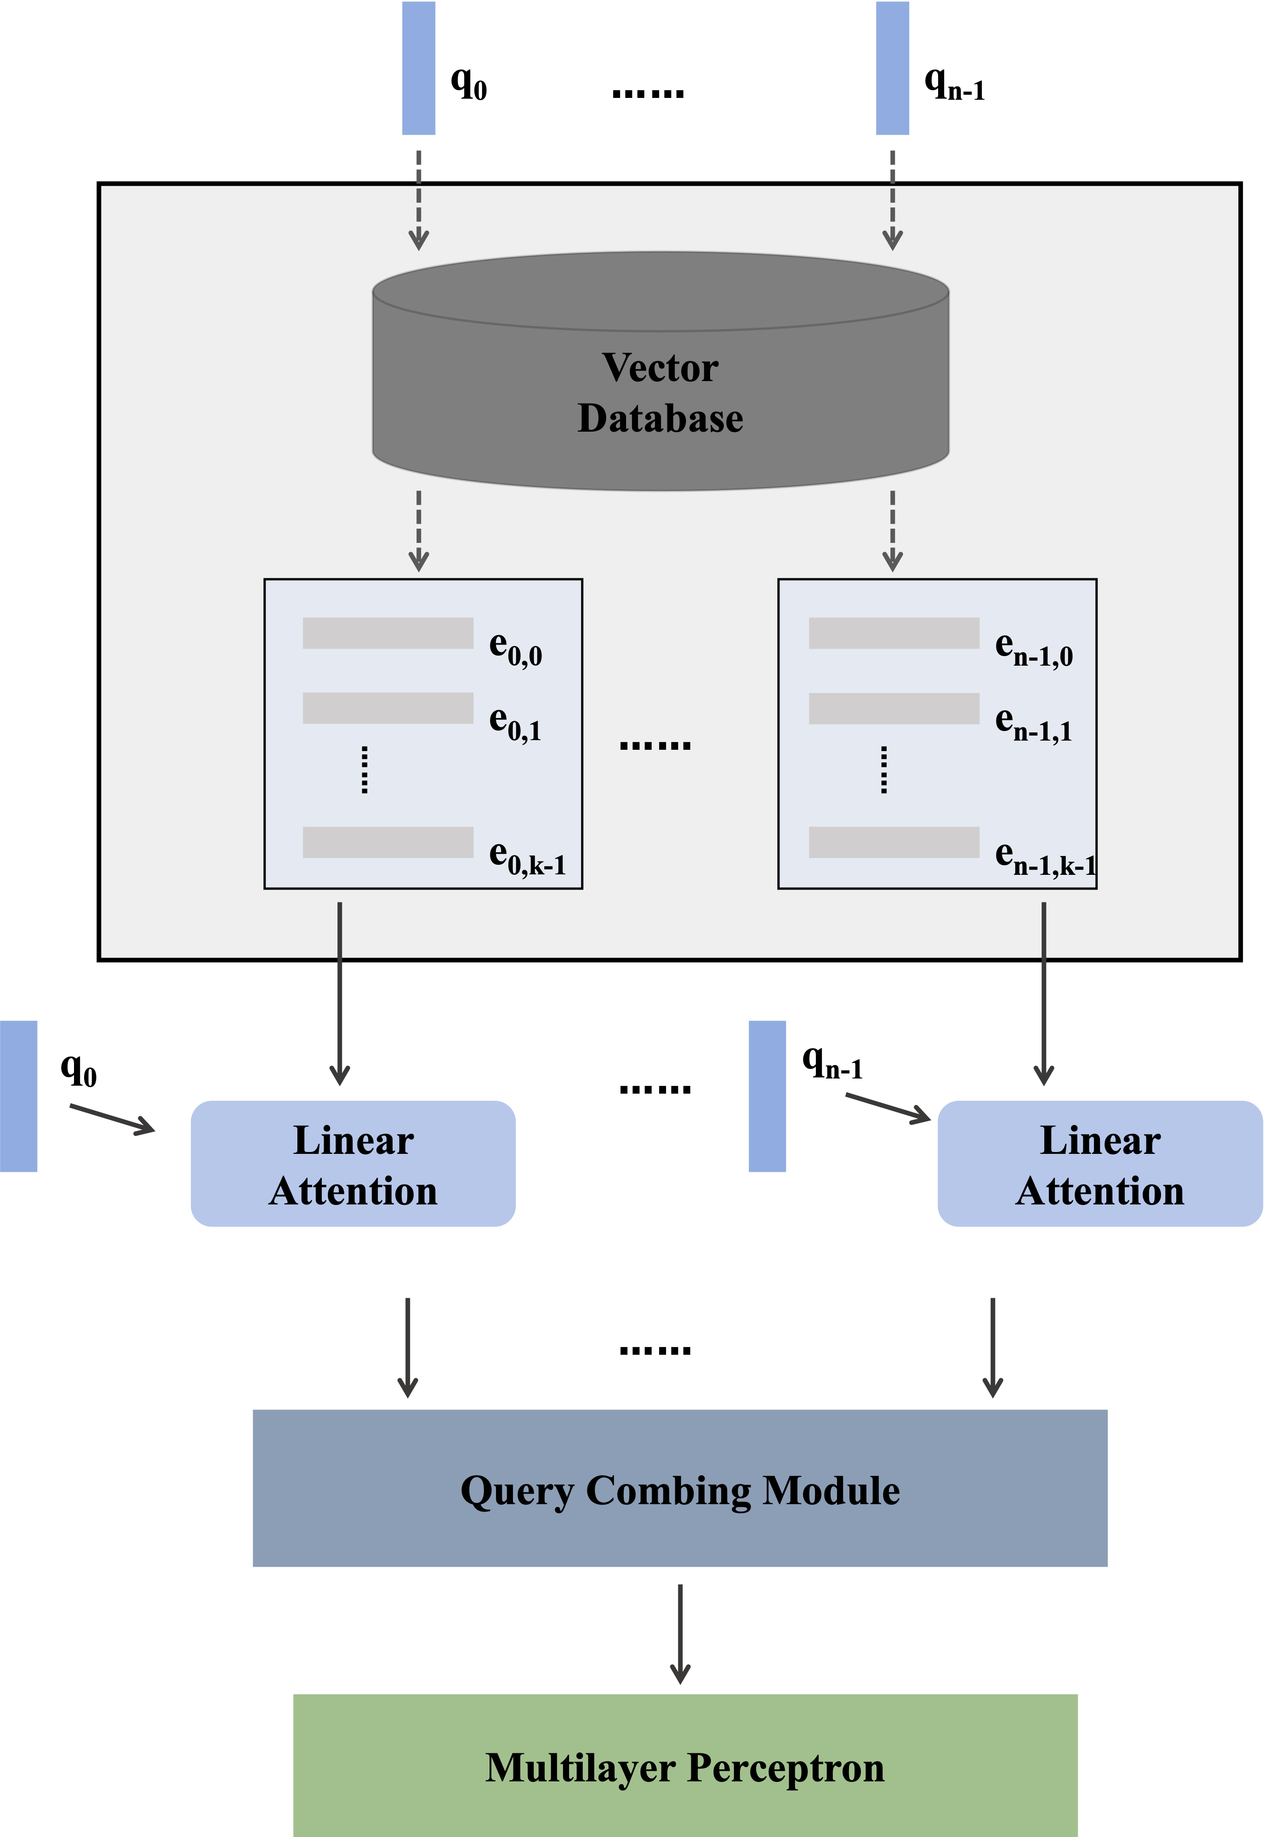
Justify prediction from evidence
Our approach (IRIS):
Rather than manually defining queries using prior knowledge, the model learns query vectors directly from data.
Model Structure
The model has n query vectors, initialized randomly and optimized as learnable parameters
Each query vector retrieves k relevant clinical note embeddings. Only these retrieved embeddings are used for downstream risk prediction
A key mechanism aggregates the retrieved embeddings, enabling the dynamic refinement of the query vectors during training.
Specially designed tricks encourage each query to focus on a distinct, interpretable classification factor
Fengnan Li, Elliot Hill, Jiang Shu, Jiaxin Gao, and Matthew Engelhard. IRIS: Interpretable Retrieval-Augmented Classification for Long Interspersed Document Sequences. In: Proceedings of the 63rd Annual Meeting of the Association for Computational Linguistics (ACL 2025).
Notes:
The question is then – how do we learn to retrieve information relevant to autism
We’ve built a model that initially retrieves at random and tries to predict autism likelihood with whatever information it finds
This is really efficient, because we’re only looking at a small % of the total notes for a given child
But each time, the model sees that some information it’s retrieving is more relevant – more predictive – than other information
So it refines its queries to focus more on the info it retrieved that’s more predictive, and less on the info that’s less predictive
It’s learning how to retrieve information that’s more relevant
And the next time it retrieves, the info will be more relevant

Slide 21
Justify prediction from evidence
Query Interpretation | Typical content of retrieved notes
Skill development | Assessment of developmental milestones including motor skills
Ophthalmological findings* | Findings such as esotropia, exotropia, amblyopia, myopia
Referral to specialty care | Referral to services including ophthalmology and neurology
Late talking | Speech history provided by parent, including current vocabulary
Birth measurements | Percentiles for birth weight, length, and head circumference
To identify which risk factors the model recognizes, We extract query vectors from the trained model and use them to retrieve the most relevant clinical note segments from the vector database. Categories of descriptive findings predictive of autism, as identified by IRIS, are listed in the table.
*consistent with e.g. Perna et al., Association between Autism Spectrum Disorder (ASD) and vision problems. A systematic review and meta-analysis. Mol Psychiatry. 2023 Dec;28(12):5011-5023.
Fengnan Li, Elliot Hill, Jiang Shu, Jiaxin Gao, and Matthew Engelhard. IRIS: Interpretable Retrieval-Augmented Classification for Long Interspersed Document Sequences. In: Proceedings of the 63rd Annual Meeting of the Association for Computational Linguistics (ACL 2025).
Notes:
A first thing I'd like to highlight is that these likelihood factors are broadly consistent with known literature, but one thing that stood out to us was the emphasis on ophthalmological findings
Our model tells us that these findings are *predictive* above and beyond pre-term birth
Which is consistent with existing studies showing that associations with ophthalmological findings are not fully explained by preterm birth
[Association between Autism Spectrum Disorder (ASD) and vision problems. A systematic review and meta-analysis
https://pubmed.ncbi.nlm.nih.gov/37495888/]
Another thing that's important to note is that while we're highlighting the global interpretation of our learned query vectors in this slide, a key advantage is that our model allows us to pinpoint predictive findings for a given patient
So, for example, interpreting the prediction for a particular patient, we can inspect specific note segments retrieved by each of these vectors, then see how each of those is affecting the model's prediction
Which leads me to some of our next steps...

Slide 22
Simple explanation methods

Slide 23
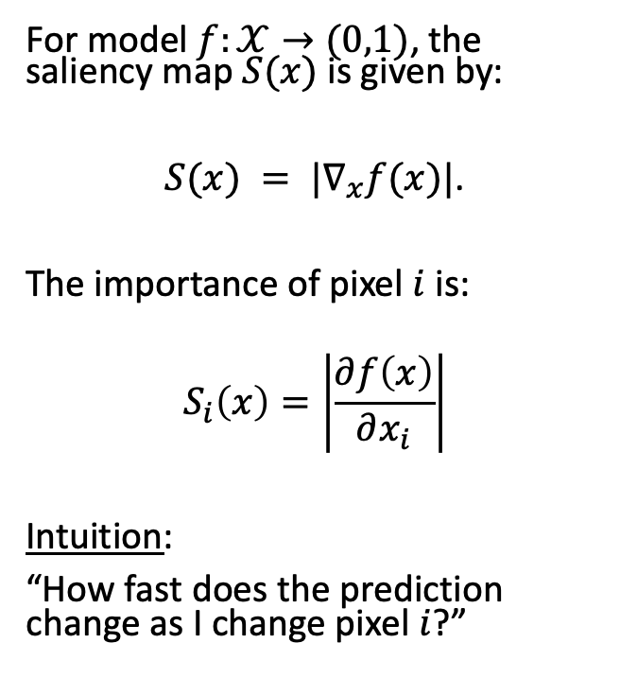
Saliency maps
For model $f:𝒳→(0,1)$, the saliency map $S(x)$ is given by:
$S(x) = |∇_{x}f(x)|$.
The importance of pixel $i$ is:
$$S_{i}\left(x\right)=\left|\frac{∂f\left(x\right)}{∂x_{i}}\right|$$
Intuition:
“How fast does the prediction change as I change pixel $i$?”
Esteva et al., 2017

Slide 24
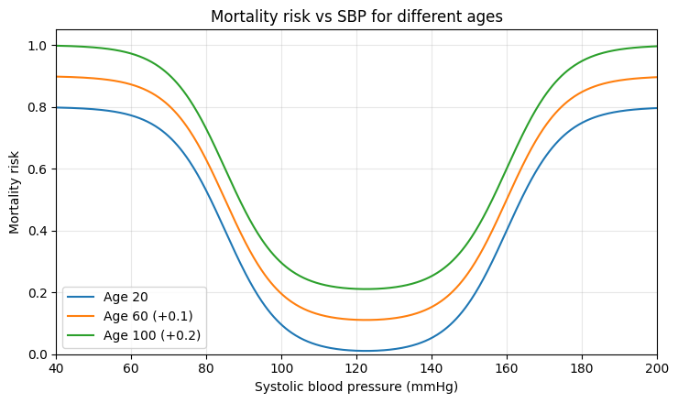
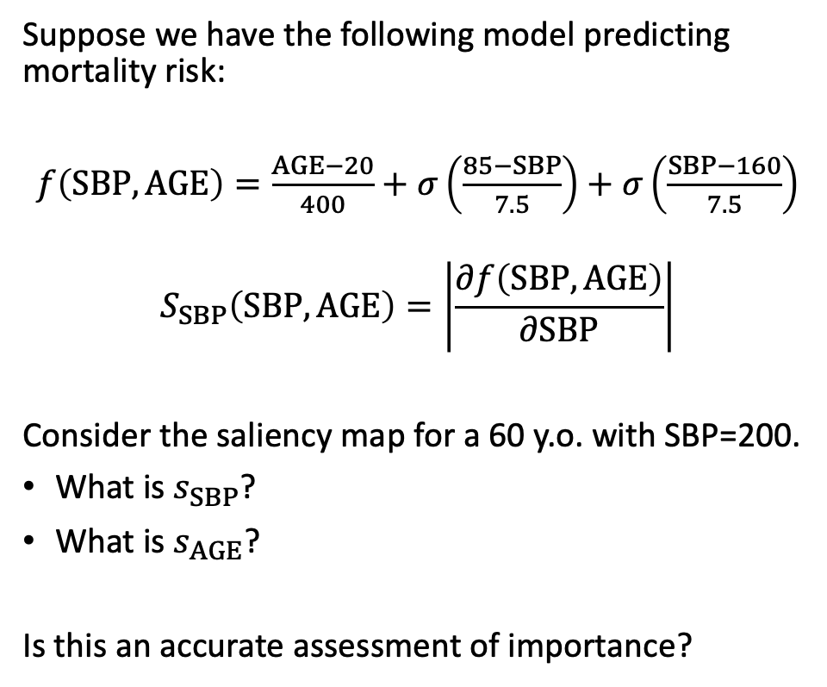
What’s wrong with saliency maps?
Suppose we have the following model predicting mortality risk:
$f\left(SBP,AGE\right)=\frac{AGE−20}{400}+σ\left(\frac{85−SBP}{7.5}\right)+$ $σ\left(\frac{SBP−160}{7.5}\right)$
$$S_{SBP}\left(SBP, AGE\right)=\left|\frac{∂f\left(SBP, AGE\right)}{∂SBP}\right|$$
Consider the saliency map for a 60 y.o. with SBP=200.
What is $s_{SBP}$?
What is $s_{AGE}$?
Is this an accurate assessment of importance?

Slide 25
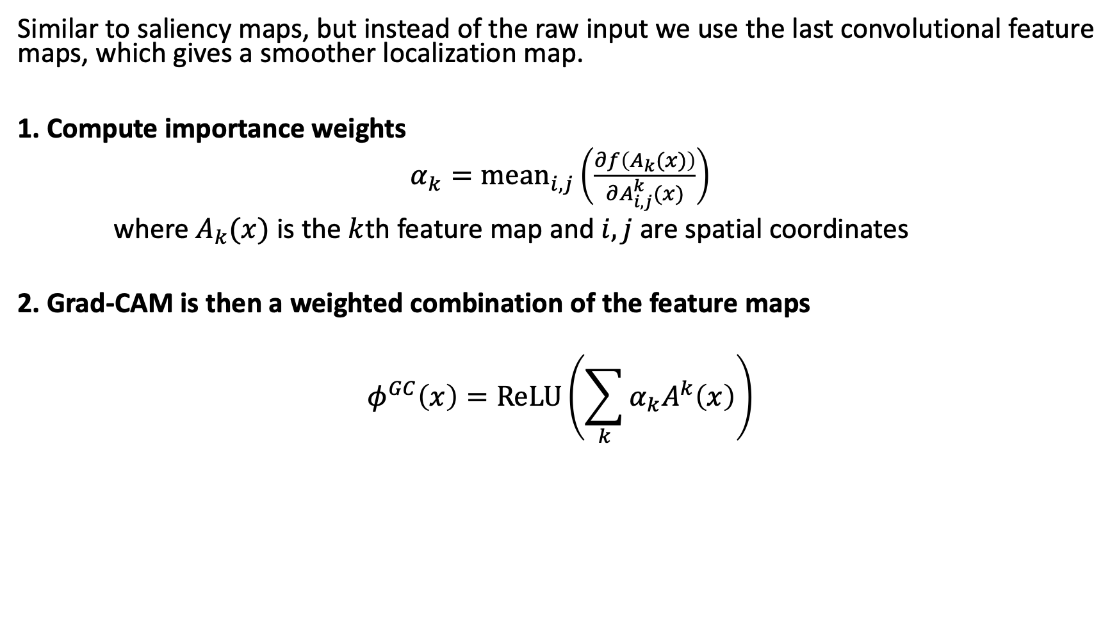
Grad-CAM
Similar to saliency maps, but instead of the raw input we use the last convolutional feature maps, which gives a smoother localization map.
1. Compute importance weights
$α_{k}=mean_{i,j}\left(\frac{∂f\left(A_{k}(x)\right)}{∂A_{i,j}^{k}(x)}\right)$
where $A_{k}(x)$ is the $k$th feature map and $i,j$ are spatial coordinates
2. Grad-CAM is then a weighted combination of the feature maps
$$φ^{GC}\left(x\right)=ReLU\left(\sum_{k}{α_{k}A^{k}\left(x\right)}\right)$$

Slide 26
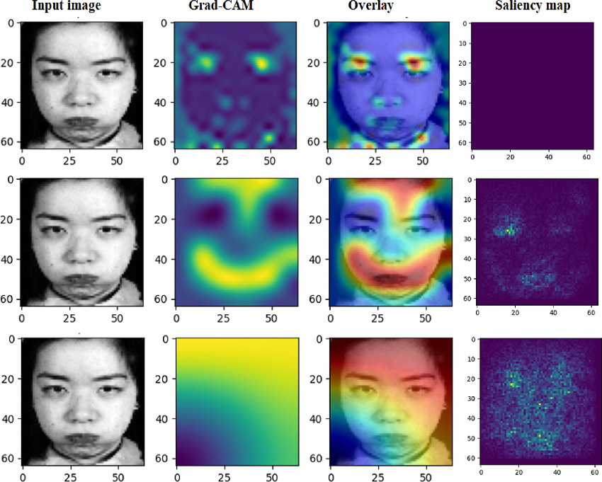
Grad-CAM versus saliency maps for emotion recognition
Grad-CAM and Saliency maps for diﬀerent CNN architectures (16, 32), (32,64, 128), (16, 32, 64, 128) layers for angry emotion

Slide 27
What’s wrong with Grad-CAM?
The limitation is the same as saliency maps
In short, this still focuses on the gradient evaluated at the current input which doesn’t always accurately assess the overall importance of a given feature or region

Slide 28
Better explanation methods

Slide 29
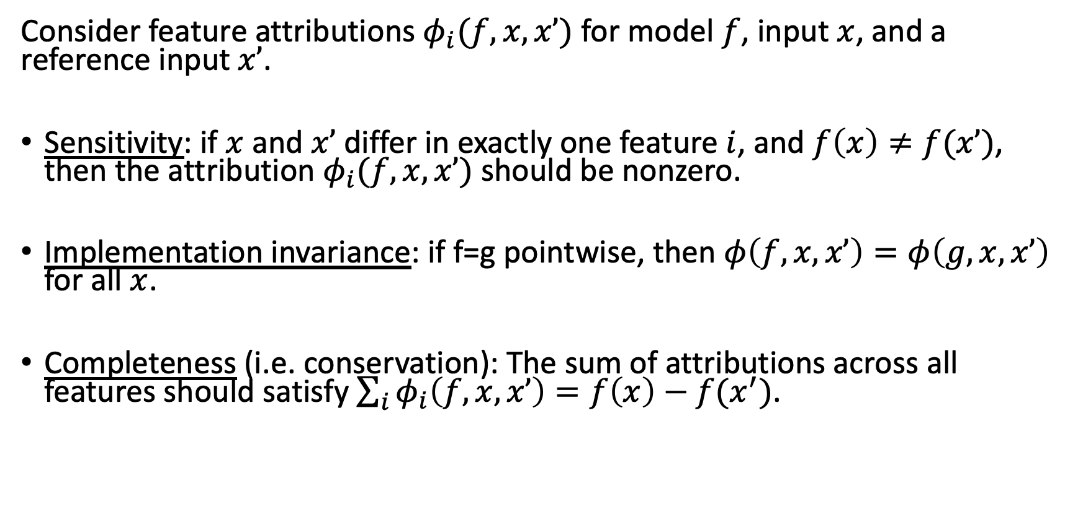
Desirable properties of feature attributions
Consider feature attributions $φ_{i}(f, x, x’)$ for model $f$, input $x$, and a reference input $x’$.
Sensitivity: if $x$ and $x’$ differ in exactly one feature $i$, and $f\left(x\right)≠f(x’)$, then the attribution $φ_{i}(f, x, x’)$ should be nonzero.
Implementation invariance: if f=g pointwise, then $φ\left(f, x, x’\right)=φ\left(g, x, x’\right)$ for all $x$.
Completeness (i.e. conservation): The sum of attributions across all features should satisfy $\sum_{i}{φ_{i}\left(f, x, x’\right)=f\left(x\right)−f(x^{′})}$.
Sundararajan M, Taly A, Yan Q. Axiomatic attribution for deep networks. In: International conference on machine learning 2017 Jul 17 (pp. 3319-3328). PMLR.
Notes:
First, describe the idea of a reference input: why do we need it?

Slide 30
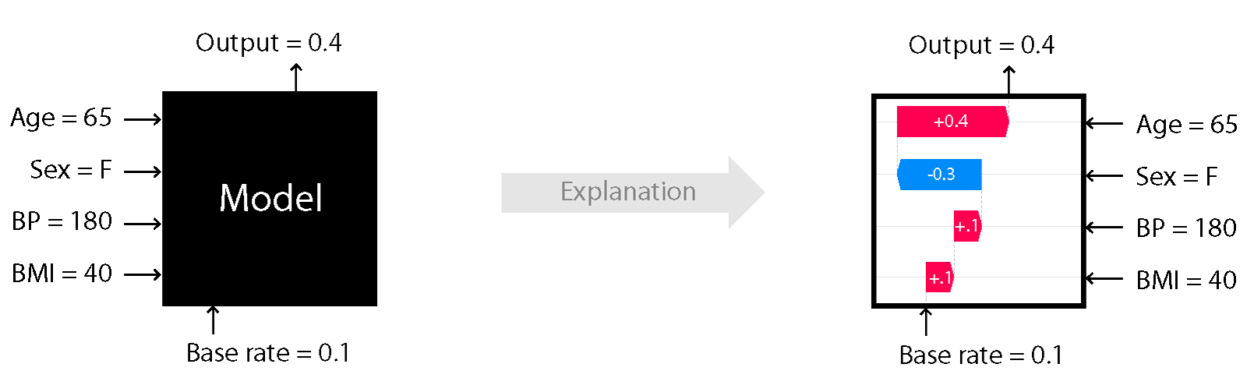
Desirable properties of feature attributions
Goal: decompose $f(x)−f(x’)$into the additive contributions of individual features.
https://shap.readthedocs.io
Notes:
First, describe the idea of a reference input: why do we need it?

Slide 31
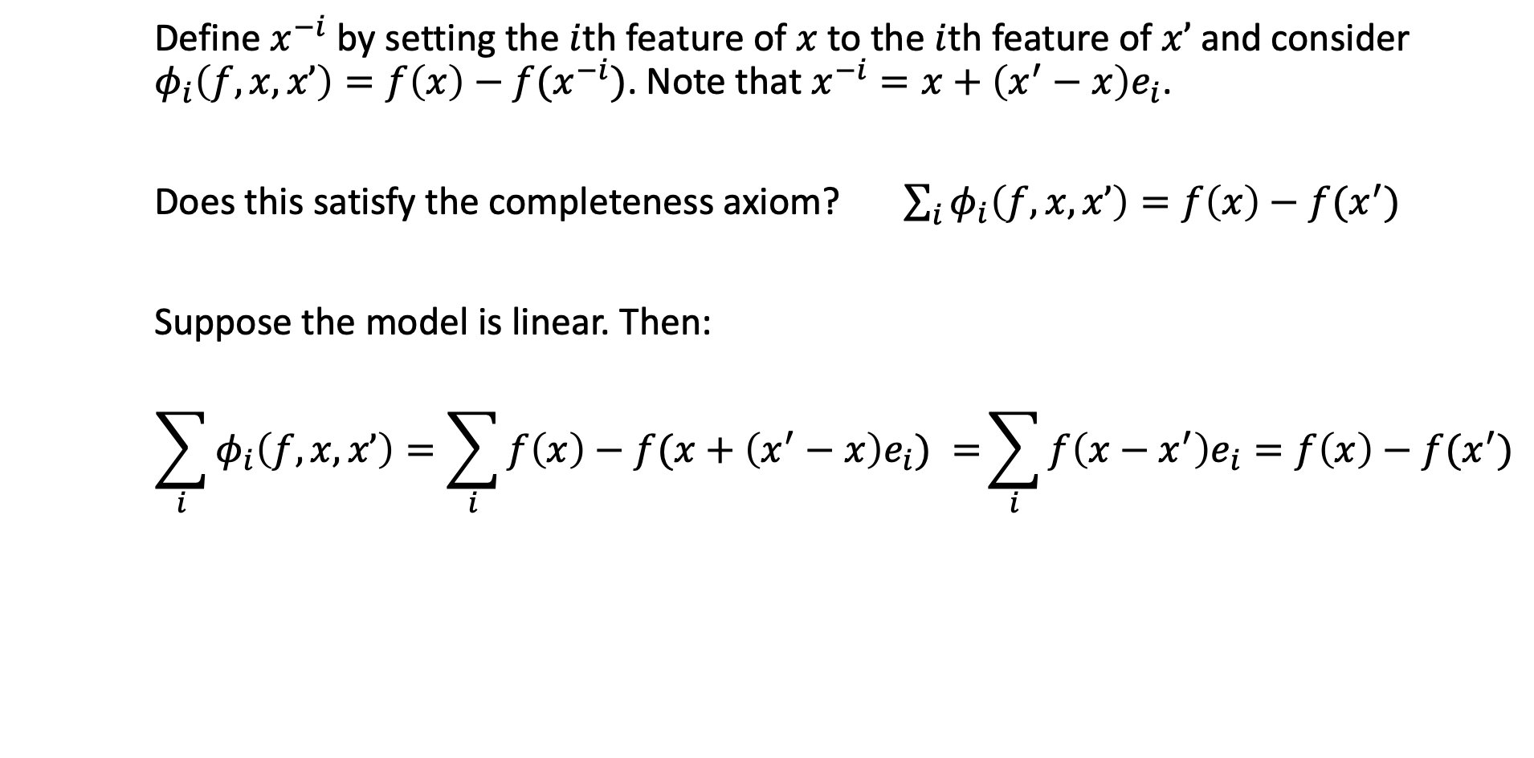
A simple proposal
Define $x^{−i}$ by setting the $i$th feature of $x$ to the $i$th feature of $x’$ and consider $φ_{i}\left(f, x, x’\right)=f\left(x\right)−f(x^{−i})$. Note that $x^{−i}=x+\left(x^{′}−x\right)e_{i}$.
Does this satisfy the completeness axiom? $\sum_{i}{φ_{i}\left(f, x, x’\right)=f\left(x\right)−f(x^{′})}$
Suppose the model is linear. Then:
$$\sum_{i}{φ_{i}\left(f, x, x’\right)=\sum_{i}{f\left(x\right)−f(x+\left(x^{′}−x\right)e_{i}) }=}\sum_{i}{f\left(x−x^{′}\right)e_{i}}=f\left(x\right)−f(x^{′})$$

Slide 32
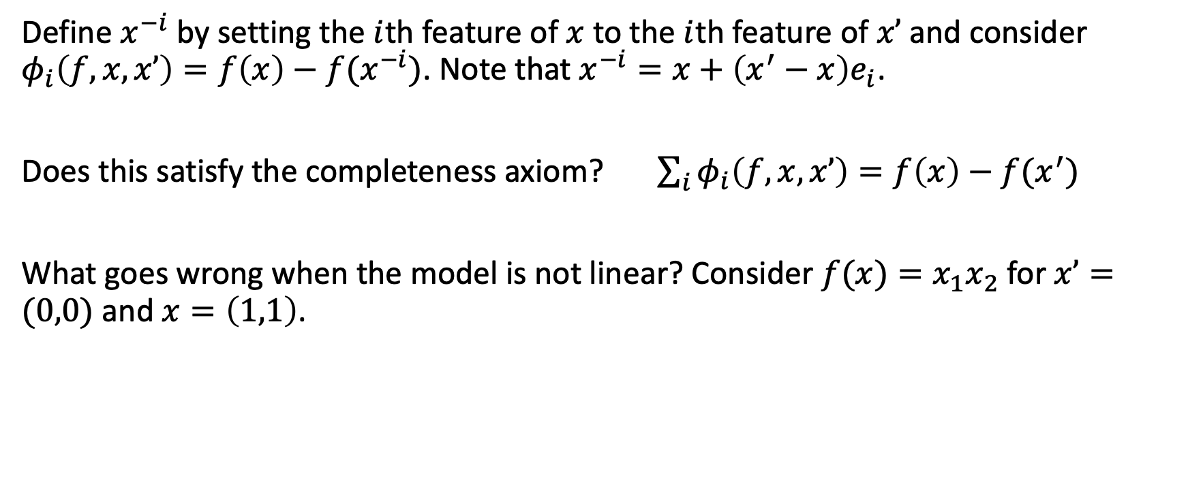
A simple proposal
Define $x^{−i}$ by setting the $i$th feature of $x$ to the $i$th feature of $x’$ and consider $φ_{i}\left(f, x, x’\right)=f\left(x\right)−f(x^{−i})$. Note that $x^{−i}=x+\left(x^{′}−x\right)e_{i}$.
Does this satisfy the completeness axiom? $\sum_{i}{φ_{i}\left(f, x, x’\right)=f\left(x\right)−f(x^{′})}$
What goes wrong when the model is not linear? Consider $f(x)=x_{1}x_{2}$ for $x’=(0,0)$ and $x=\left(1,1\right)$.

Slide 33
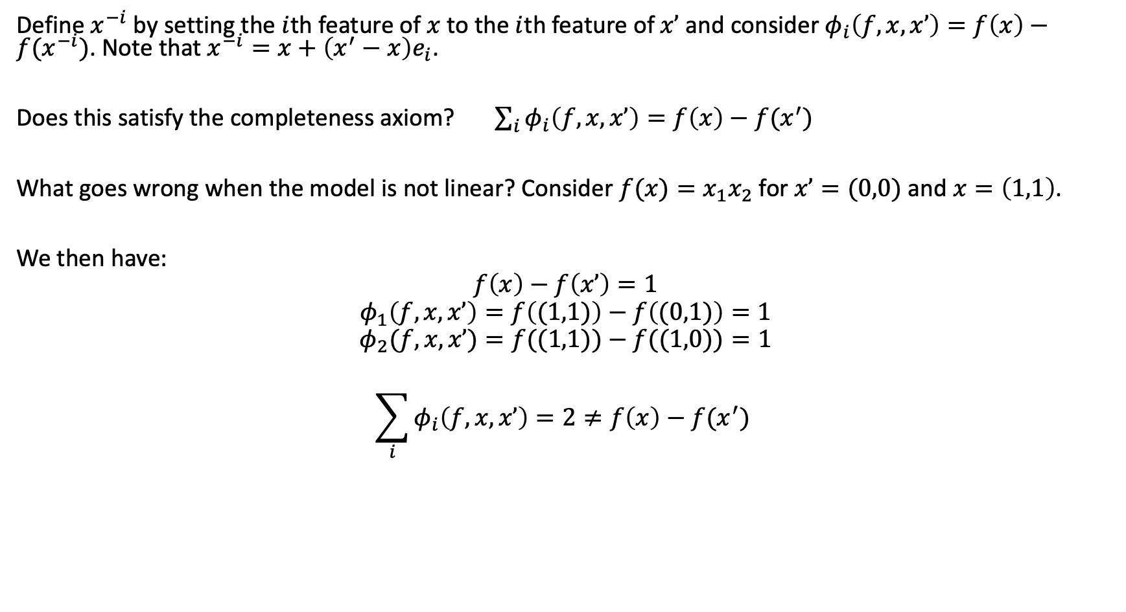
A simple proposal
Define $x^{−i}$ by setting the $i$th feature of $x$ to the $i$th feature of $x’$ and consider $φ_{i}\left(f, x, x’\right)=f\left(x\right)−f(x^{−i})$. Note that $x^{−i}=x+\left(x^{′}−x\right)e_{i}$.
Does this satisfy the completeness axiom? $\sum_{i}{φ_{i}\left(f, x, x’\right)=f\left(x\right)−f(x^{′})}$
What goes wrong when the model is not linear? Consider $f(x)=x_{1}x_{2}$ for $x’=(0,0)$ and $x=\left(1,1\right)$.
We then have:
$$f\left(x\right)−f\left(x’\right)=1$$
$$φ_{1}\left(f,x,x’\right)=f\left((1,1)\right)−f\left((0,1)\right)=1$$
$$φ_{2}(f,x,x’)=f((1,1))−f((1,0))=1$$
$$\sum_{i}{φ_{i}\left(f, x, x’\right)=2≠f\left(x\right)−f(x^{′}) }$$

Slide 34
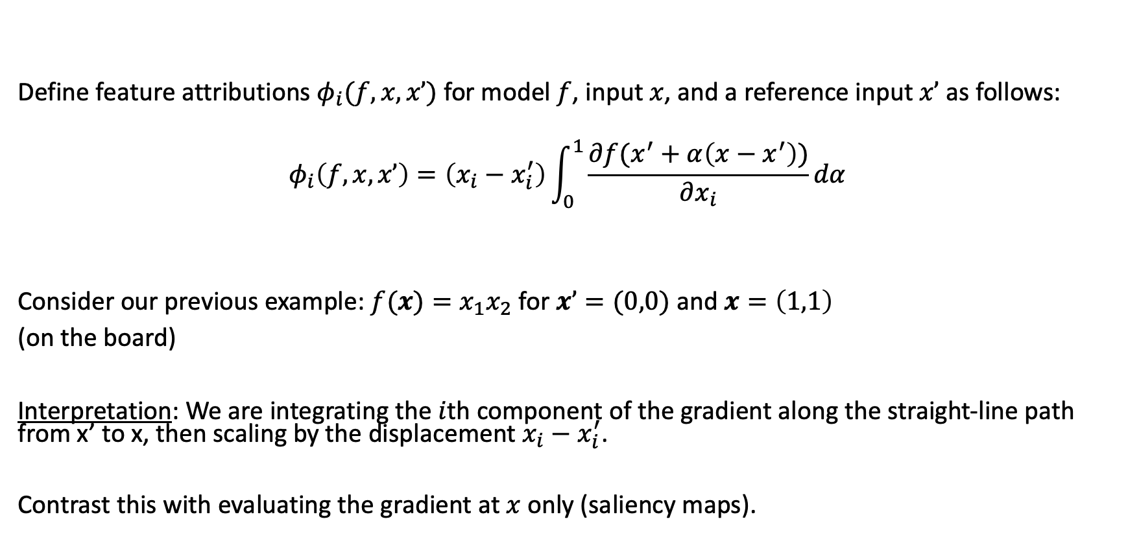
Integrated Gradients
Define feature attributions $φ_{i}(f, x, x’)$ for model $f$, input $x$, and a reference input $x’$ as follows:
$$φ_{i}\left(f, x, x’\right)=\left(x_{i}−x_{i}^{′}\right)\int_{0}^{1}{\frac{∂f(x^{′}+α\left(x−x^{′}\right))}{∂x_{i}}dα}$$
Consider our previous example: $f(x)=x_{1}x_{2}$ for $x’=(0,0)$ and $x=\left(1,1\right)$
(on the board)
Interpretation: We are integrating the $i$th component of the gradient along the straight-line path from x’ to x, then scaling by the displacement $x_{i}−x_{i}^{′}$.
Contrast this with evaluating the gradient at $x$ only (saliency maps).

Slide 35
Integrated Gradients
We must select a baseline. Common choices are:
A black image x’=0
The average image x’=E[X]
A blurred version of x

Slide 36
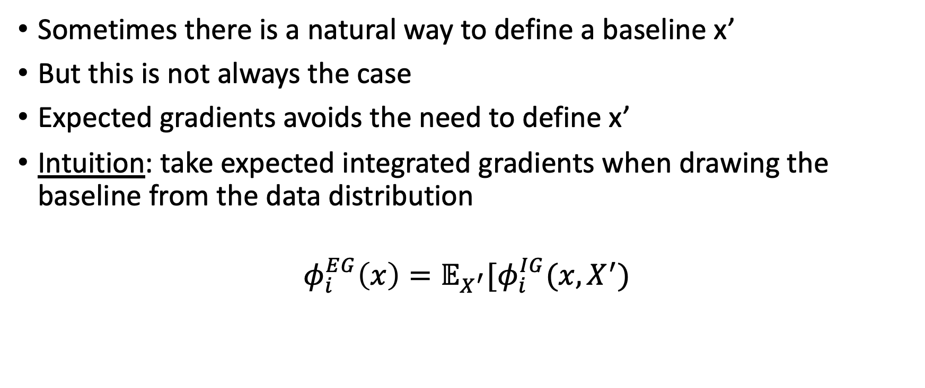
Expected Gradients
Sometimes there is a natural way to define a baseline x’
But this is not always the case
Expected gradients avoids the need to define x’
Intuition: take expected integrated gradients when drawing the baseline from the data distribution
$$φ_{i}^{EG}\left(x\right)=𝔼_{X^{′}}[φ_{i}^{IG}(x,X^{′})$$

Slide 37
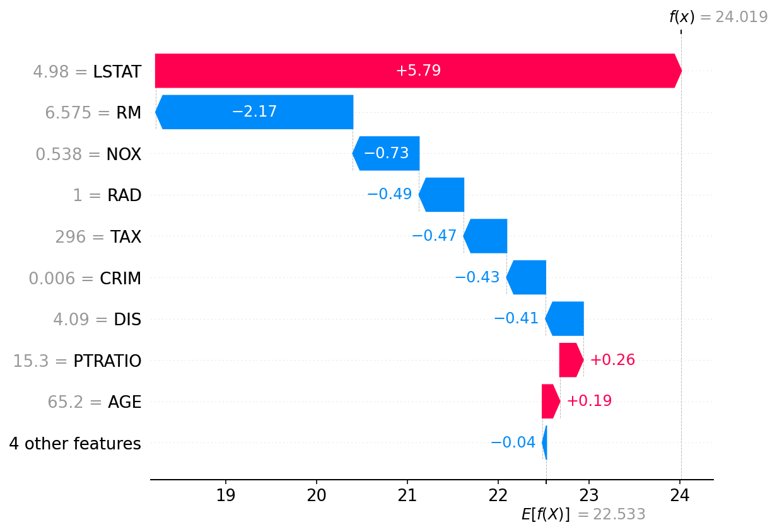
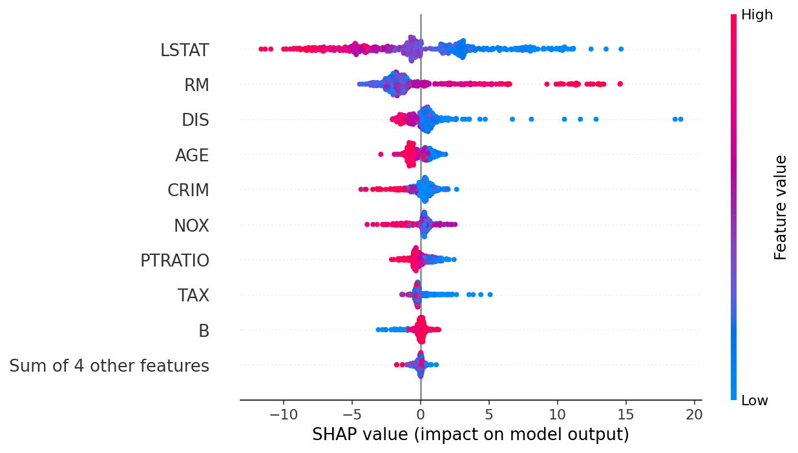
SHAP Values: a game-theoretic approach
For one prediction For all predictions
https://github.com/slundberg/shap

Slide 38
Summary
Interpretable and explainable are related but distinct ideas
The importance of interpretability is argued and views are changing
Neural networks are not interpretable, but we have techniques that can quantify the effect of features on each individual prediction – in other words, explain the prediction
Saliency maps and Grad-CAM are convenient but have limitations
Integrated gradients, expected gradients, and SHAP are more principled but also more computationally intensive

