Slide 1
Multimodal data fusion
Matt Engelhard

Slide 2











Recall: training and use of Transformer architectures for text
Output
representations
$$x_{4}$$
$$x_{5}$$
$$x_{6}$$
$$x_{7}$$
$$x_{8}$$
$$x_{9}$$
$$x_{1}$$
$$x_{2}$$
$$x_{3}$$
$$x_{10}$$
$$x_{11}$$
Transformer Encoder
(token embeddings + positional encodings -> (encoder layer) x N)
Input tokens
Even the smallest person can change the course of the future
Notes:
Show input, block for encoder stack, prediction head
Note weight tying

Slide 3
Today
Transformers for EHR
Multimodal data fusion
Why?
How?
Late fusion
Joint fusion
Early fusion
Examples

Slide 4
Moving to the EHR
A foundation model for EHR data

Slide 5
Models for structured EHR data: the “language” of the EHR
A story about the progression of diabetes…
(“E11.65”, “E11.42”, “I10”, “N18.3”)
E11.65 — Type 2 diabetes mellitus with hyperglycemia
E11.42 — Type 2 diabetes mellitus with diabetic polyneuropathy
I10 — Essential (primary) hypertension
N18.3 — Chronic kidney disease, stage 3

Slide 6









Transformers for Electronic Health Records
Output
representations
$$x_{4}$$
$$x_{5}$$
$$x_{6}$$
$$x_{7}$$
$$x_{8}$$
$$x_{1}$$
$$x_{2}$$
$$x_{3}$$
$$x_{9}$$
Transformer Encoder
(token embeddings + positional encodings -> (encoder layer) x N)
Input tokens
E11.65 E11.42 I10 N18.3
Li, Y., Rao, S., Solares, J.R.A. et al. BEHRT: Transformer for Electronic Health Records. Sci Rep 10, 7155 (2020). https://doi.org/10.1038/s41598-020-62922-y

Slide 7
Transformers for Electronic Health Records
Unique consideration 1: we have position, age, and time
Output
representations
$$x_{4}$$
$$x_{5}$$
$$x_{6}$$
$$x_{7}$$
$$x_{8}$$
$$x_{1}$$
$$x_{2}$$
$$x_{3}$$
$$x_{9}$$
Transformer Encoder
(token embeddings + positional encodings -> (encoder layer) x N)
Input tokens
E11.65 E11.42 I10 N18.3
Li, Y., Rao, S., Solares, J.R.A. et al. BEHRT: Transformer for Electronic Health Records. Sci Rep 10, 7155 (2020). https://doi.org/10.1038/s41598-020-62922-y

Slide 8
Transformers for Electronic Health Records
Unique consideration 2: some tokens have associated values (e.g., labs, vitals)
Output
representations
$$x_{4}$$
$$x_{5}$$
$$x_{6}$$
$$x_{7}$$
$$x_{8}$$
$$x_{1}$$
$$x_{2}$$
$$x_{3}$$
$$x_{9}$$
Transformer Encoder
(token embeddings + positional encodings -> (encoder layer) x N)
Input tokens
E11.65 E11.42 I10 N18.3
Li, Y., Rao, S., Solares, J.R.A. et al. BEHRT: Transformer for Electronic Health Records. Sci Rep 10, 7155 (2020). https://doi.org/10.1038/s41598-020-62922-y

Slide 9
Transformers for Electronic Health Records
Unique consideration 2: some tokens have associated values (e.g., labs, vitals)
One approach to this is shown below
Output
representations
$$x_{4}$$
$$x_{5}$$
$$x_{6}$$
$$x_{7}$$
$$x_{8}$$
$$x_{1}$$
$$x_{2}$$
$$x_{3}$$
$$x_{9}$$
Transformer Encoder
(token embeddings + positional encodings -> (encoder layer) x N)
Input tokens
E11.65 E11.42 I10 N18.3
LAB ID
token
result
quantile
token

Slide 10
Predict diagnosis risk from structured EHRs
Suppose we wish to predict which children are most likely to be diagnosed with asthma based on EHRs from early life
How would we do this without a transformer-based foundation model?
How would we do this with a transformer-based foundation model?
What are the advantages of the latter approach?

Slide 11




Zero-shot prediction via EHR generation
Suppose we wish to predict which children are most likely to be diagnosed with asthma based on EHRs from early life
We don’t have any task-specific data; we only have a decoder-only foundation model trained to predict the next token/event
How might we use this to perform zero-shot asthma prediction?
E11.42 I10 N18.3. [NEXT TOKEN]
TPH
TPH
TPH
TPH
$$x_{1}$$
$$x_{2}$$
$$x_{3}$$
$$x_{4}$$
Output
representations
Transformer Decoder
Important: requires application of a causal mask
[typically by setting inputs to softmax in attention heads to –inf]
E11.65 E11.42 I10 N18.3
Input tokens

Slide 12
Zero-shot prediction via EHR generation
Suppose we wish to predict which children are most likely to be diagnosed with asthma based on EHRs from early life
How might we use this to perform zero-shot asthma prediction?
Generate many sequences conditioned on the observed history
Count how many sequences contain asthma
Predicted prob is the proportion that contain asthma
E11.42 I10 N18.3. [NEXT TOKEN]
TPH
TPH
TPH
TPH
$$x_{1}$$
$$x_{2}$$
$$x_{3}$$
$$x_{4}$$
Output
representations
Transformer Decoder
Important: requires application of a causal mask
[typically by setting inputs to softmax in attention heads to –inf]
E11.65 E11.42 I10 N18.3
Input tokens

Slide 13
What are the benefits of a foundation model?
General-purpose, effective representations that can be used for a wide range of tasks
Improved performance on downstream tasks
Many-shot
Few-shot
Allows zero-shot prediction (similar to text models)
Notes:
For zero-shot, discuss how this can be done

Slide 14
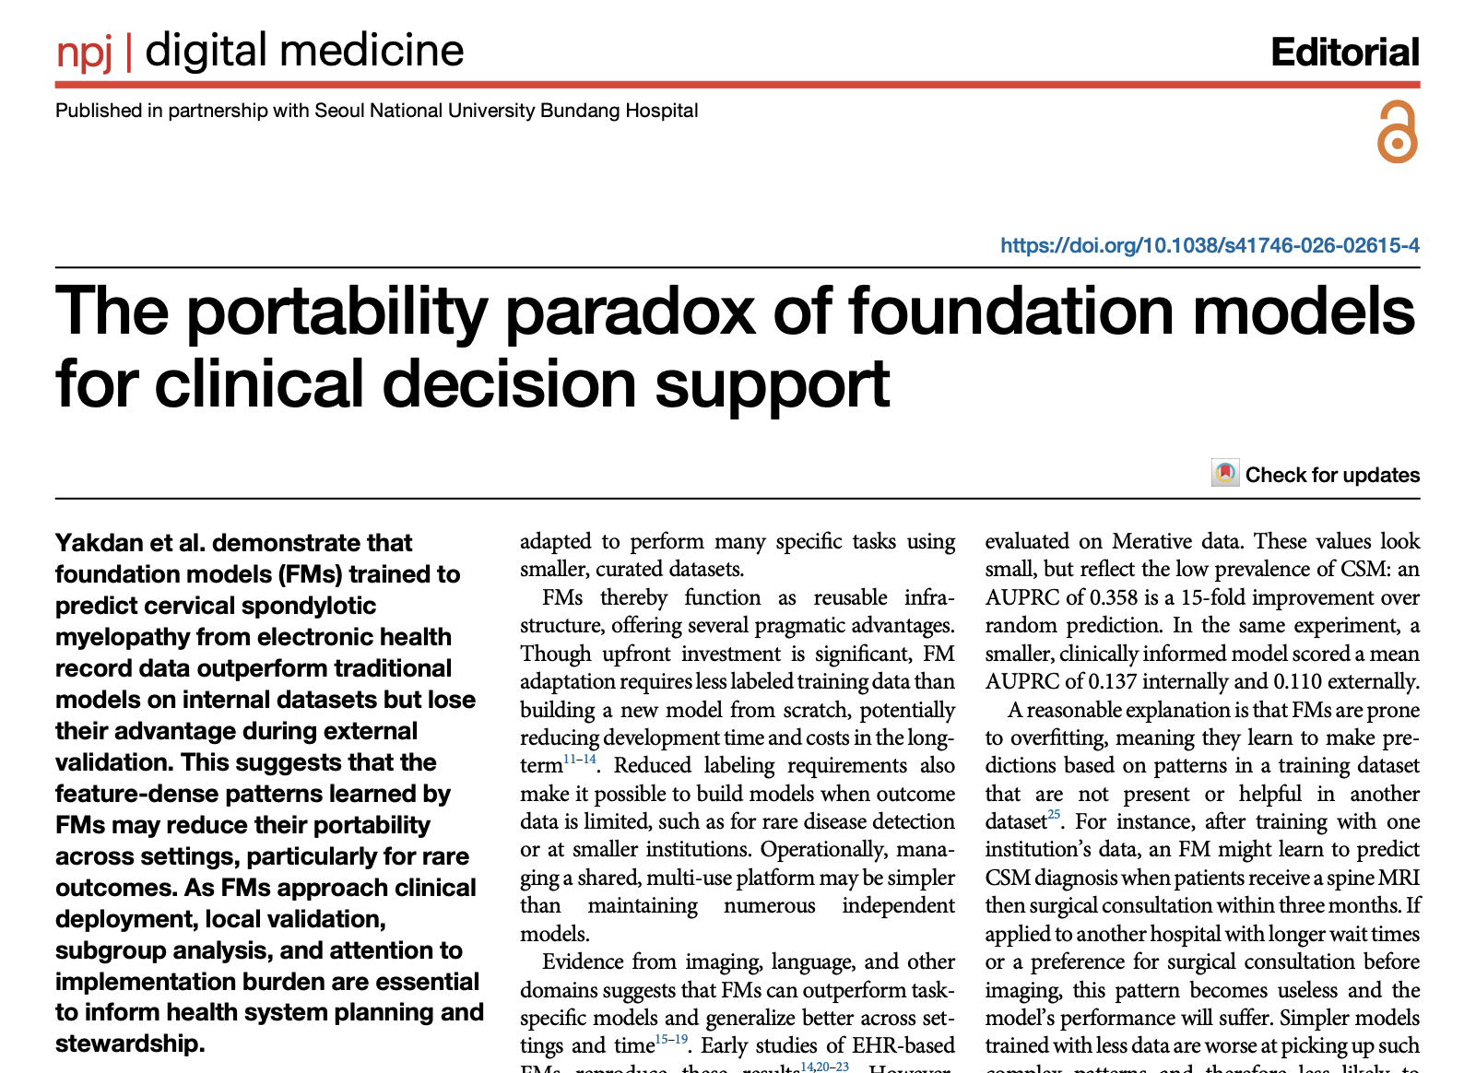
Do foundation models generalize?
Do we need these models to generalize?
View 1: FM should work everywhere
View 2: FM is a recipe that can be used anywhere

Slide 15
Why multimodal fusion?

Slide 16
What will we find in the structured data?
Encounter details (ED admission)
Labs (BMP, CBC)
Vital signs
Procedure codes (CT)
Diagnosis codes (PE)
…what won’t we find?
Notes:
Now, what parts of this fairly complicated story -- and again, this is the super simple, quick and dirty version coming from a non-clinician – which parts are going to make it into the structured data?
Well, we’ll see who the patient is -- their age, sex, race
We’ll see that they came to the emergency department, and that they were admitted from the ED
We’ll see diagnosis codes, so we SHOULD end up seeing codes related to pulmonary embolism, supposing that ends up being the issue
And we’ll see procedure codes – we’ll see that they got a CT, for example
We’ll even see the details of those labs – the exact electrolyte values, their white cell count, and so on
So, that’s a lot of information. But it is really a comprehensive summary of the encounter?
Let’s thing about what we WON’T see.

Slide 17
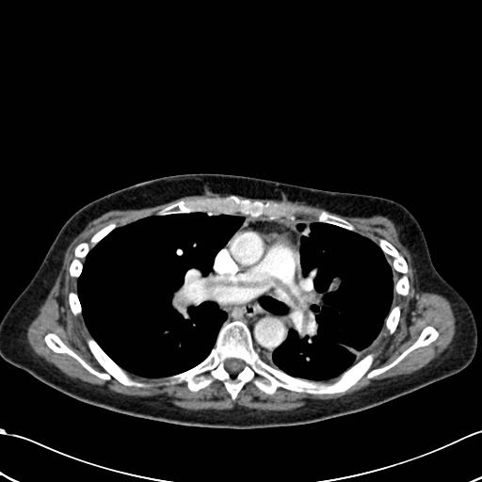
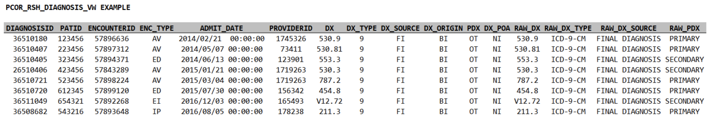
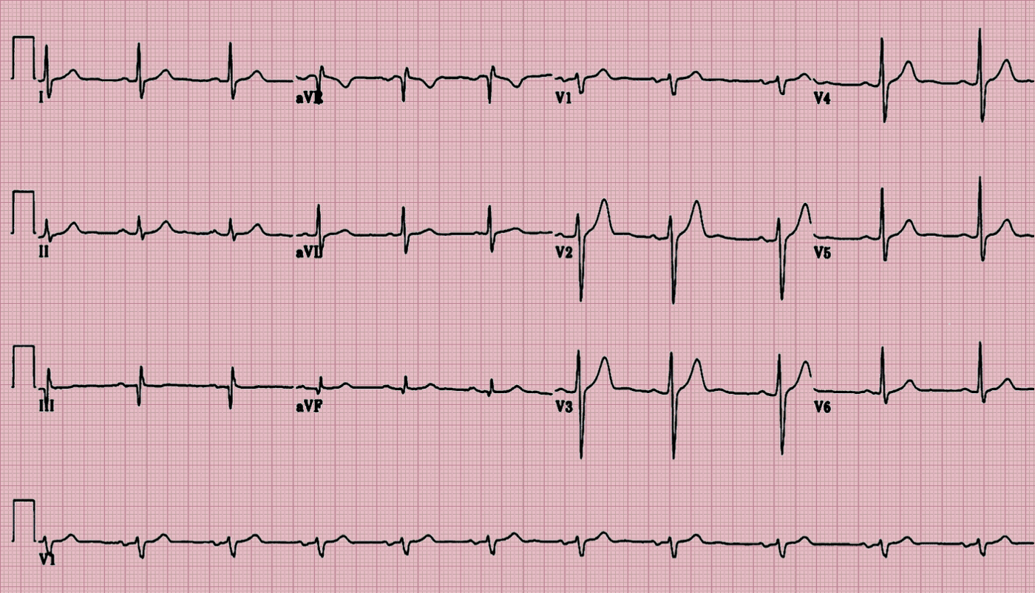
Why do we need many modalities?
Structured EHR data
Imaging
Clinical notes
EKG and other physiologic time-series

Slide 18
How do we do multimodal fusion?

Slide 19
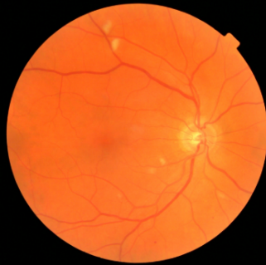
Image Encoder
CNN
Encoder
retinopathy
label
vector of features
(indicating high-level motifs)
image
Notes:
But the important thing to understand is that by applying a deep neural network to medical images
We can extract a set of numeric values that quantify the degree to which specific patterns – patterns that may be clinically relevant – are present in our images
We usually call these values a feature vector
And we can call this neural network an encoder
it takes our images and ENCODES them into a fairly small feature vector of say, 1000 or so values, which is much smaller than the number of pixels in our original image
Then, we can use a very simple model – usually logistic regression – to predict our outcome – in this case, retinopathy – from that feature vector
If we have enough data, we can use it to fine-tune our encoder to make sure it’s extracting the best, most predictive features possible
But, if we have less data, it’s often quite effective to simply apply an encoder that was shown to be effective for a different, ideally related medical image processing task

Slide 20
A typical prediction model
outcome
logistic
regression
label
vector of clinical variables
(e.g. age, sex, BP, HR)
Notes:
Let’s contrast all this with a simpler prediction task
Let’s say we have a vector of clinical variables for each patient in a study of long-term cardiovascular health, and from those variables we want to predict the probability of heart attack within the next 10 years
Here we can simply train a logistic regression model to predict the outcome directly from our variables, and then we might want to evaluate out-of-sample prediction performance

Slide 21
A prediction model for images
CNN
Encoder
outcome
logistic
regression
label
vector of features
(indicating high-level motifs)
image
Notes:
Now, imagine that instead of clinical variables, we instead had a fundoscopic image for each study participant.
Applying logistic regression directly to the pixels in the image isn’t going to work here.
Instead, we can apply an encoder – in this case, a convolutional neural network – to each image.
This will give us a feature vector that describes the degree to which 1000 or so complex patterns – patterns that are known to be important for other prediction tasks – are present in the image
We can then use logistic regression to predict the probability of heart attack from these feature vectors
As before, after training our logistic regression model, we’ll usually want to evaluate out-of-sample prediction performance
If we happen to have thousands of images, we can consider a more involved training process to fine-tune our CNN encoder to make sure the features we’re extracting are the best possible features for our prediction task
More often, we don’t have enough data to do this, so we just use the same encoder that was used in a different – hopefully somewhat related -- task

Slide 22
A prediction model for documents
NLP
Encoder
pulmonary embolism
logistic
regression
label
vector of features
(indicating word counts)
document
Notes:
To really understand all the nuances of how this is done, again I’d recommend an additional course in machine learning or natural language processing
But what’s important is that we have a process by which documents can be encoded as a feature vector
In our image processing example, the elements of this feature vector corresponded to high level motifs, or patterns, that might be present in the images
This time, the elements of this feature vector correspond to counts of words in a document
In both cases, at the end of the day we have a feature vector that we can use to predict an outcome of interest via logistic regression

Slide 23
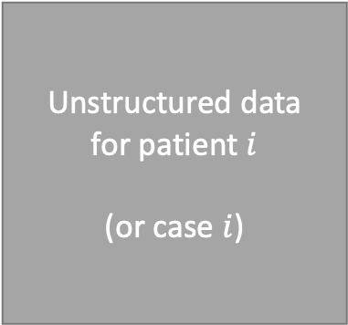
A prediction model for unstructured data
Unstructured data
for patient $i$
(or case $i$)
Modality-Specific
Encoder
outcome
logistic
regression
label
data
vector of features
Notes:
This is the important, general principle to understand
The details of the encoder are going to be modality-specific and potentially complex
But, the general rule when working with unstructured data is that you’ll need to identify and use encoders appropriate for each modality
If you’re working with EEG data, you’ll need an encoder designed for EEG data
If you’re working with digital health data, you’ll need an encoder designed for digital health data
Currently, many of the most effective encoders are neural network based, but this is not necessarily or always the case

Slide 24
A prediction model for unstructured data
Modality-Specific
Encoder
outcome
logistic
regression
label
EKG
vector of features
Notes:
This is the important, general principle to understand
The details of the encoder are going to be modality-specific and potentially complex
But, the general rule when working with unstructured data is that you’ll need to identify and use encoders appropriate for each modality
If you’re working with EEG data, you’ll need an encoder designed for EEG data
If you’re working with digital health data, you’ll need an encoder designed for digital health data
Currently, many of the most effective encoders are neural network based, but this is not necessarily or always the case

Slide 25
1. Late fusion

Slide 26
Separate Prediction Models
P(outcome | data)
logistic
regression
clinical variables
CNN
Encoder
P(outcome | data)
logistic
regression
image
image features
NLP
Encoder
P(outcome | data)
logistic
regression
document
document features
Notes:
Consider predicting the same outcome with (a) clinical variables, (b) a relevant image, or (c) a text document
With the clinical variables, we can use logistic regression – or whatever generalized linear model is appropriate for our outcome – to predict the outcome directly
With the image, we can use a convolutional neural network to encode the image as a feature vector, then use a generalized linear model to predict the outcome from that feature vector
Wtih the document, we can use an NLP encoder, which might be counts-based, or it might be word vector based, to encode the image into document features, then use a generalized linear model to predict the outcome from that feature vector

Slide 27
Late fusion
P(outcome | data)
logistic
regression
aggregate predictions
clinical variables
CNN
Encoder
P(outcome | data)
logistic
regression
image
image features
NLP
Encoder
P(outcome | data)
logistic
regression
document
document features
Notes:
Consider predicting the same outcome with (a) clinical variables, (b) a relevant image, or (c) a text document
With the clinical variables, we can use logistic regression – or whatever generalized linear model is appropriate for our outcome – to predict the outcome directly
With the image, we can use a convolutional neural network to encode the image as a feature vector, then use a generalized linear model to predict the outcome from that feature vector
Wtih the document, we can use an NLP encoder, which might be counts-based, or it might be word vector based, to encode the image into document features, then use a generalized linear model to predict the outcome from that feature vector

Slide 28
Late fusion
P(outcome | data)
logistic
regression
aggregate predictions
Average
(good default strategy; assumes all modalities are equally informative)
clinical variables
CNN
Encoder
P(outcome | data)
logistic
regression
image
image features
NLP
Encoder
P(outcome | data)
logistic
regression
document
document features
Notes:
Consider predicting the same outcome with (a) clinical variables, (b) a relevant image, or (c) a text document
With the clinical variables, we can use logistic regression – or whatever generalized linear model is appropriate for our outcome – to predict the outcome directly
With the image, we can use a convolutional neural network to encode the image as a feature vector, then use a generalized linear model to predict the outcome from that feature vector
Wtih the document, we can use an NLP encoder, which might be counts-based, or it might be word vector based, to encode the image into document features, then use a generalized linear model to predict the outcome from that feature vector

Slide 29
Late fusion
P(outcome | data)
logistic
regression
aggregate predictions
Average
Max
(used in multiple-instance learning; makes sense when the relevant signal might be present only in a single modality)
clinical variables
CNN
Encoder
P(outcome | data)
logistic
regression
image
image features
NLP
Encoder
P(outcome | data)
logistic
regression
document
document features
Notes:
Consider predicting the same outcome with (a) clinical variables, (b) a relevant image, or (c) a text document
With the clinical variables, we can use logistic regression – or whatever generalized linear model is appropriate for our outcome – to predict the outcome directly
With the image, we can use a convolutional neural network to encode the image as a feature vector, then use a generalized linear model to predict the outcome from that feature vector
Wtih the document, we can use an NLP encoder, which might be counts-based, or it might be word vector based, to encode the image into document features, then use a generalized linear model to predict the outcome from that feature vector

Slide 30
Late fusion
P(outcome | data)
logistic
regression
aggregate predictions
Average
Max (e.g., MIL)
Meta-predictor (this is called stacking)
(flexible approach but does require additional training, at which point joint fusion might be better)
clinical variables
CNN
Encoder
P(outcome | data)
logistic
regression
image
image features
NLP
Encoder
P(outcome | data)
logistic
regression
document
document features
Notes:
Consider predicting the same outcome with (a) clinical variables, (b) a relevant image, or (c) a text document
With the clinical variables, we can use logistic regression – or whatever generalized linear model is appropriate for our outcome – to predict the outcome directly
With the image, we can use a convolutional neural network to encode the image as a feature vector, then use a generalized linear model to predict the outcome from that feature vector
Wtih the document, we can use an NLP encoder, which might be counts-based, or it might be word vector based, to encode the image into document features, then use a generalized linear model to predict the outcome from that feature vector

Slide 31
Late fusion
P(outcome | data)
logistic
regression
aggregate predictions
Average
Max (e.g., MIL)
Meta-predictor (this is called stacking)
Bayesian fusion
(incorporates uncertainty about outcome from each modality when aggregating; this is beyond our scope)
clinical variables
CNN
Encoder
P(outcome | data)
logistic
regression
image
image features
NLP
Encoder
P(outcome | data)
logistic
regression
document
document features
Notes:
Consider predicting the same outcome with (a) clinical variables, (b) a relevant image, or (c) a text document
With the clinical variables, we can use logistic regression – or whatever generalized linear model is appropriate for our outcome – to predict the outcome directly
With the image, we can use a convolutional neural network to encode the image as a feature vector, then use a generalized linear model to predict the outcome from that feature vector
Wtih the document, we can use an NLP encoder, which might be counts-based, or it might be word vector based, to encode the image into document features, then use a generalized linear model to predict the outcome from that feature vector

Slide 32
2. Joint fusion

Slide 33
Separate models -> Joint fusion
P(outcome | data)
logistic
regression
clinical variables
CNN
Encoder
P(outcome | data)
logistic
regression
image
image features
NLP
Encoder
P(outcome | data)
logistic
regression
document
document features
Notes:
Consider predicting the same outcome with (a) clinical variables, (b) a relevant image, or (c) a text document
With the clinical variables, we can use logistic regression – or whatever generalized linear model is appropriate for our outcome – to predict the outcome directly
With the image, we can use a convolutional neural network to encode the image as a feature vector, then use a generalized linear model to predict the outcome from that feature vector
Wtih the document, we can use an NLP encoder, which might be counts-based, or it might be word vector based, to encode the image into document features, then use a generalized linear model to predict the outcome from that feature vector

Slide 34
Joint fusion by feature concatenation
CNN
Encoder
P(outcome | data)
logistic
regression
image
NLP
Encoder
concatenated, multi-modal features
document
Notes:
But what if we want to make predictions from all three types of data, together?
As this diagram suggests, we can approach this by simply concatenating – in other words stacking – all of our feature vectors together. We can combine our clinical variables with our extracted image features and extracted NLP features.
Of course, this is the obvious thing to do once you understand the concept of an encoder, but having effective encoders for some of these data types – notably image data – is still a fairly recent development

Slide 35
Joint fusion by feature concatenation
Train independently
Concatenate
Train together
CNN
Encoder
P(outcome | data)
logistic
regression
image
NLP
Encoder
concatenated, multi-modal features
document
Notes:
But what if we want to make predictions from all three types of data, together?
As this diagram suggests, we can approach this by simply concatenating – in other words stacking – all of our feature vectors together. We can combine our clinical variables with our extracted image features and extracted NLP features.
Of course, this is the obvious thing to do once you understand the concept of an encoder, but having effective encoders for some of these data types – notably image data – is still a fairly recent development

Slide 36
Joint fusion by feature concatenation
Train independently
Concatenate
Add a fully-connected layer
Train together
Fine-tune the whole model
CNN
Encoder
P(outcome | data)
MLP
image
NLP
Encoder
concatenated, multi-modal features
document
Notes:
But what if we want to make predictions from all three types of data, together?
As this diagram suggests, we can approach this by simply concatenating – in other words stacking – all of our feature vectors together. We can combine our clinical variables with our extracted image features and extracted NLP features.
Of course, this is the obvious thing to do once you understand the concept of an encoder, but having effective encoders for some of these data types – notably image data – is still a fairly recent development

Slide 37
Joint fusion by feature concatenation
Train independently
Concatenate
Add a fully-connected layer
Train together
Fine-tune the whole model
CNN
Encoder
P(outcome | data)
MLP
image
Why is it important that this be an MLP?
NLP
Encoder
concatenated, multi-modal features
document
Notes:
But what if we want to make predictions from all three types of data, together?
As this diagram suggests, we can approach this by simply concatenating – in other words stacking – all of our feature vectors together. We can combine our clinical variables with our extracted image features and extracted NLP features.
Of course, this is the obvious thing to do once you understand the concept of an encoder, but having effective encoders for some of these data types – notably image data – is still a fairly recent development

Slide 38
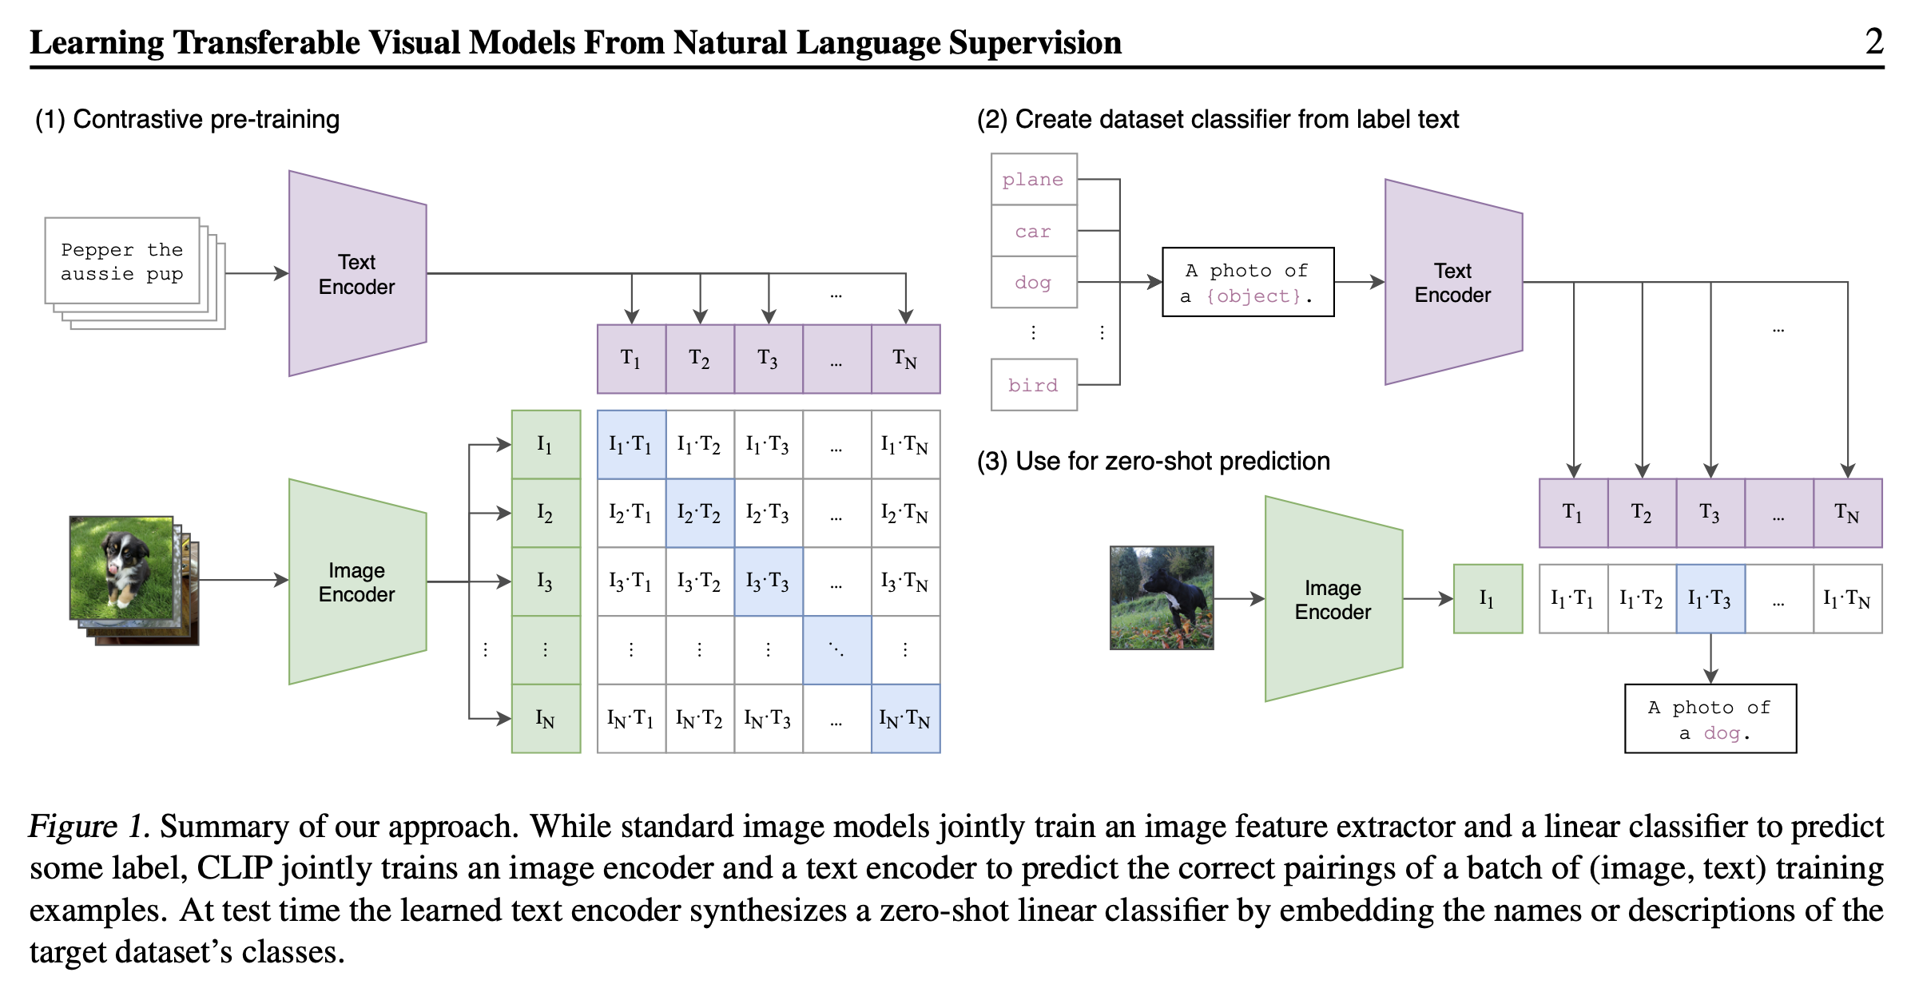
Joint fusion via contrastive learning

Slide 39
Separate Prediction Models
CNN
Encoder
P(outcome | data)
logistic
regression
image
image features
NLP
Encoder
P(outcome | data)
logistic
regression
document
document features
Notes:
Consider predicting the same outcome with (a) clinical variables, (b) a relevant image, or (c) a text document
With the clinical variables, we can use logistic regression – or whatever generalized linear model is appropriate for our outcome – to predict the outcome directly
With the image, we can use a convolutional neural network to encode the image as a feature vector, then use a generalized linear model to predict the outcome from that feature vector
Wtih the document, we can use an NLP encoder, which might be counts-based, or it might be word vector based, to encode the image into document features, then use a generalized linear model to predict the outcome from that feature vector

Slide 40
Joint fusion in shared representation space
Contrastive (e.g., CLIP) loss applied
CNN
Encoder
+
=
P(outcome | data)
image
MLP
NLP
Encoder
Train independently to predict outcome
Train together to (a) predict outcome, and (b) reduce contrastive loss
multimodal
representation
document
Notes:
But what if we want to make predictions from all three types of data, together?
As this diagram suggests, we can approach this by simply concatenating – in other words stacking – all of our feature vectors together. We can combine our clinical variables with our extracted image features and extracted NLP features.
Of course, this is the obvious thing to do once you understand the concept of an encoder, but having effective encoders for some of these data types – notably image data – is still a fairly recent development

Slide 41
Joint fusion in shared representation space
Q: What happens if we train to minimize the contrastive loss only?
Contrastive (e.g., CLIP) loss applied
CNN
Encoder
+
=
P(outcome | data)
image
MLP
NLP
Encoder
Train independently to predict outcome
Train together to (a) predict outcome, and (b) reduce contrastive loss
multimodal
representation
document
Notes:
But what if we want to make predictions from all three types of data, together?
As this diagram suggests, we can approach this by simply concatenating – in other words stacking – all of our feature vectors together. We can combine our clinical variables with our extracted image features and extracted NLP features.
Of course, this is the obvious thing to do once you understand the concept of an encoder, but having effective encoders for some of these data types – notably image data – is still a fairly recent development

Slide 42
Joint fusion in shared representation space
Q: What happens if we train to minimize the contrastive loss only?
A: we will lose distinct information between modalities that is predictive of the outcome
Contrastive (e.g., CLIP) loss applied
CNN
Encoder
+
=
P(outcome | data)
image
MLP
NLP
Encoder
Train independently to predict outcome
Train together to (a) predict outcome, and (b) reduce contrastive loss
multimodal
representation
document
Notes:
But what if we want to make predictions from all three types of data, together?
As this diagram suggests, we can approach this by simply concatenating – in other words stacking – all of our feature vectors together. We can combine our clinical variables with our extracted image features and extracted NLP features.
Of course, this is the obvious thing to do once you understand the concept of an encoder, but having effective encoders for some of these data types – notably image data – is still a fairly recent development

Slide 43
Joint fusion in shared representation space
Q: Does this allow interactions between modalities?
Contrastive (e.g., CLIP) loss applied
CNN
Encoder
+
=
P(outcome | data)
image
MLP
NLP
Encoder
Train independently to predict outcome
Train together to (a) predict outcome, and (b) reduce contrastive loss
multimodal
representation
document
Notes:
But what if we want to make predictions from all three types of data, together?
As this diagram suggests, we can approach this by simply concatenating – in other words stacking – all of our feature vectors together. We can combine our clinical variables with our extracted image features and extracted NLP features.
Of course, this is the obvious thing to do once you understand the concept of an encoder, but having effective encoders for some of these data types – notably image data – is still a fairly recent development

Slide 44
Joint fusion in shared representation space
Q: Does this allow interactions between modalities?
A: Yes, because distinct information between modalities can go in separate channels
Contrastive (e.g., CLIP) loss applied
CNN
Encoder
+
=
P(outcome | data)
image
MLP
NLP
Encoder
Train independently to predict outcome
Train together to (a) predict outcome, and (b) reduce contrastive loss
multimodal
representation
document
Notes:
But what if we want to make predictions from all three types of data, together?
As this diagram suggests, we can approach this by simply concatenating – in other words stacking – all of our feature vectors together. We can combine our clinical variables with our extracted image features and extracted NLP features.
Of course, this is the obvious thing to do once you understand the concept of an encoder, but having effective encoders for some of these data types – notably image data – is still a fairly recent development

Slide 45
Joint fusion in shared representation space
Q: Does adding result in loss of information?
Contrastive (e.g., CLIP) loss applied
CNN
Encoder
+
=
P(outcome | data)
image
MLP
NLP
Encoder
Train independently to predict outcome
Train together to (a) predict outcome, and (b) reduce contrastive loss
multimodal
representation
document
Notes:
But what if we want to make predictions from all three types of data, together?
As this diagram suggests, we can approach this by simply concatenating – in other words stacking – all of our feature vectors together. We can combine our clinical variables with our extracted image features and extracted NLP features.
Of course, this is the obvious thing to do once you understand the concept of an encoder, but having effective encoders for some of these data types – notably image data – is still a fairly recent development

Slide 46
Joint fusion in shared representation space
Q: Does adding result in loss of information?
A: Not necessarily, because distinct information can go in separate channels. Prediction loss helps ensure info is retained.
Contrastive (e.g., CLIP) loss applied
CNN
Encoder
+
=
P(outcome | data)
image
MLP
NLP
Encoder
Train independently to predict outcome
Train together to (a) predict outcome, and (b) reduce contrastive loss
multimodal
representation
document
Notes:
But what if we want to make predictions from all three types of data, together?
As this diagram suggests, we can approach this by simply concatenating – in other words stacking – all of our feature vectors together. We can combine our clinical variables with our extracted image features and extracted NLP features.
Of course, this is the obvious thing to do once you understand the concept of an encoder, but having effective encoders for some of these data types – notably image data – is still a fairly recent development

Slide 47
Joint fusion in shared representation space
Contrastive (e.g., CLIP) loss applied
CNN
Encoder
+
=
P(outcome | data)
image
MLP
NLP
Encoder
multimodal
representation
Shared info
Image-only info
Text-only info
document
Notes:
But what if we want to make predictions from all three types of data, together?
As this diagram suggests, we can approach this by simply concatenating – in other words stacking – all of our feature vectors together. We can combine our clinical variables with our extracted image features and extracted NLP features.
Of course, this is the obvious thing to do once you understand the concept of an encoder, but having effective encoders for some of these data types – notably image data – is still a fairly recent development

Slide 48
Joint fusion in shared representation space
Contrastive loss encourages shared info between modalities to concentrate in a subset of channels
Prediction loss prevents distinct info from being lost
Contrastive (e.g., CLIP) loss applied
CNN
Encoder
+
=
P(outcome | data)
image
MLP
NLP
Encoder
multimodal
representation
Shared info
Image-only info
Text-only info
document
Notes:
But what if we want to make predictions from all three types of data, together?
As this diagram suggests, we can approach this by simply concatenating – in other words stacking – all of our feature vectors together. We can combine our clinical variables with our extracted image features and extracted NLP features.
Of course, this is the obvious thing to do once you understand the concept of an encoder, but having effective encoders for some of these data types – notably image data – is still a fairly recent development

Slide 49
What happens with >2 modalities?
Define CLIP loss for each pair of modalities (usually fine)
Define a *primary* modality
Depends on the nature of the problem
Works best if one modality is particularly information rich; often text
Consider alternative loss structures
For example, Symile-MIMIC considers pairwise and higher-order information
Training objective maximizes a lower bound on the total correlation
Number of loss terms scales linearly rather than quadratically in the number of modalities

Slide 50
On interactions between modalities
Late fusion does not allow interactions!
Joint fusion does allow interactions, but flexibility is limited, as this happens only at the end of feature extraction
Recall: this is similar to the concern that motivated the Transformer, namely that some interactions* were only possible in later layers of the model
*namely, long-distance interactions

Slide 51
3. Early fusion

Slide 52
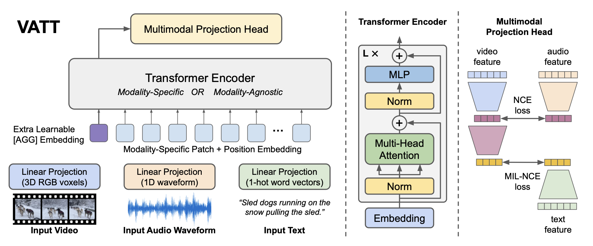
Frontier models have moved to early fusion
Distinct linear projections map raw pixels and waveforms to a shared input embedding space
Contrastive loss is applied to encourage output representations to be similar across modalities
Akbari, H., Yuan, L., Qian, R., Chuang, W.-H., Chang, S.-F., Cui, Y., & Gong, B. (2021). VATT: Transformers for Multimodal Self-Supervised Learning from Raw Video, Audio and Text. Advances in Neural Information Processing Systems (NeurIPS) 34.

Slide 53
Comparing fusion methods
easiest
Late fusion
Joint fusion
Early fusion
ease of
implementation
hardest

Slide 54
Comparing fusion methods
least
Late fusion
Joint fusion
Early fusion
training difficulty and
amount of data required
most

Slide 55
Comparing fusion methods
least flexible (no interactions)
Late fusion
Joint fusion
Early fusion
flexibility of
cross-modal interactions
most flexible

Slide 56
Choosing between fusion strategies
In most cases, your choice will be between:
Late fusion
Joint fusion
Joint fusion requires more data but is usually feasible with health datasets
Early fusion is likely needed to maximize performance, but it is only realistic with large data and self-supervision

Slide 57
Which fusion method to choose?
Prediction of retinopathy with side information (e.g., demographics)
Prediction of lupus from information about multiple organ systems (e.g., kidneys, skin, joints)
Early diagnosis prediction from EHRs
Cardiovascular event prediction from multiple wearables
Share examples you have seen in your work!
Notes:
Lupus is one where late fusion might be good!

Slide 58
Discuss Coding Assignment 3
If needed

Slide 59
Some current directions
(optional content)

Slide 60
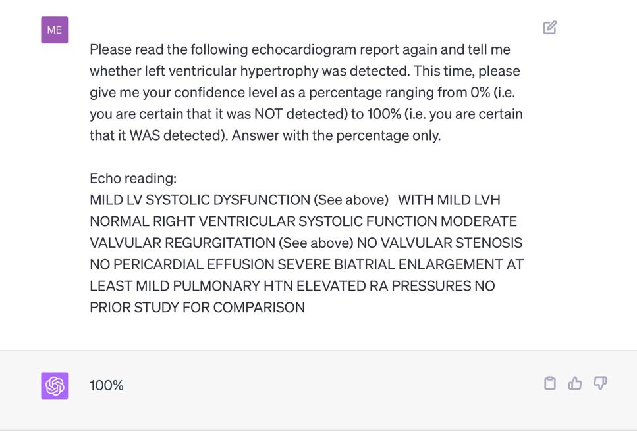
Recall: are all tasks special cases of text generation?
Notes:
Question: *should we* be using generative models for all NLP tasks?
Advantages?
zero-shot
convenient
Disadvantages?
- expensive

Slide 61
Generative LLMs enable “zero-shot” prediction: i.e. prediction without task-specific training
Notes:
Question: *should we* be using generative models for all NLP tasks?
Advantages?
zero-shot
convenient
Disadvantages?
- expensive

Slide 62
Do we still need predictive AI?
and task-specific models?

Slide 63
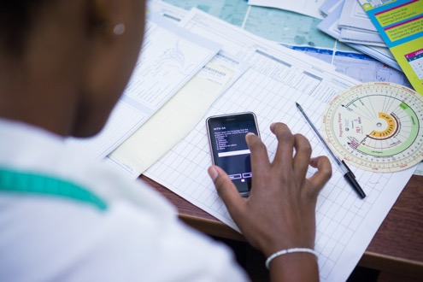
Often predictive and generative models are complementary.
Maternal health response system:
Speech to text (predictive)
Translation (predictive)
Identification of key concepts and topics (predictive)
Triage (predictive)
Generation of template and/or complete responses in specific cases (generative)
It is much easier to evaluate the performance of predictive models, and in turn to know when and how much to trust them.

Slide 64
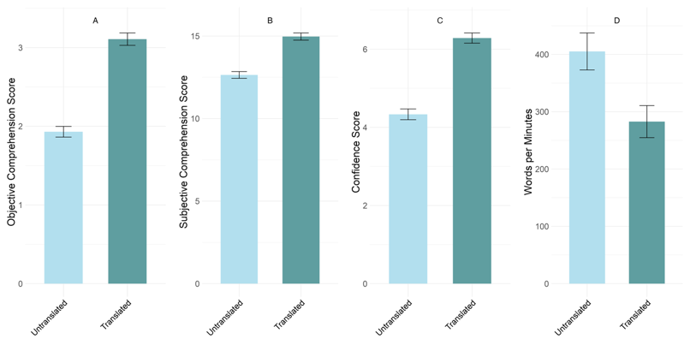


In some cases, however, generative models have superseded predictive models.
“Translation” of discharge notes into plain language using GPT4 substantially improves patients’ ability to comprehend them.
Anivarya Kumar
Isabella Wang
Notes:
Do we treat this as a translation (i.e., sequence to sequence) problem? Or a text generation problem?

Slide 65
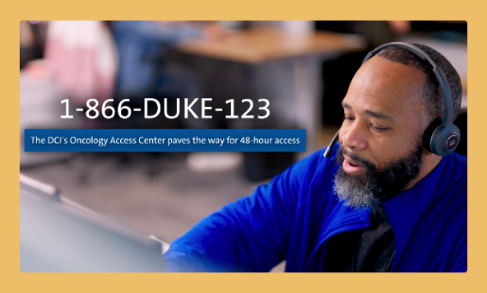

Extracting specific info from documents: predictive or generative?
Data needed to determine scheduling needs
ICD-10
Stage
Age
Date of Dx
Hormone Receptors and molecular biomarkers
History of Treatment (med, surg, rad)
Undiagnosed patients only: Review of symptoms
While a predictive approach might be more trustworthy in principle, generative models can perform many tasks “zero-shot”, i.e. without task-specific training.
DIHI ‘24, led by Emily Norboge

Slide 66
Current directions: RAG vs long context
Suppose we wish to answer questions or extract information from a large collection of documents (e.g., all clinical notes for a given patient)
How do we use an LLM to do this?
Option 1: very long context window
Option 2: retrieval augmented generation (RAG)
Currently, RAG is commonly used because it is effective and scalable, and it (partly) addresses LLM pitfalls, including hallucinations.

Slide 67
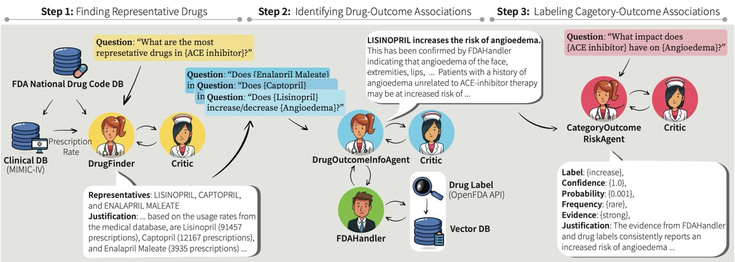
Current directions: agentic AI
Multi-LLM-agent systems including:
An orchestrator agent
Task-specific agents (e.g. DocChat, SQLchat
Critic agents
Choi, Palumbo, et al.; submitted to Machine Learning for Healthcare

Slide 68

Current directions: evaluation of generative models
Open questions include:
Can we trust models to evaluate other models?
How can models learn when to defer to human experts?
How can we identify LLM biases? (more on this in PIONEER sessions)
Notes:
Ask the group – how would you evaluate a generative model?
What approaches have you seen?

