Slide 1
Transformer architectures for text and medical records
Matt Engelhard

Slide 2
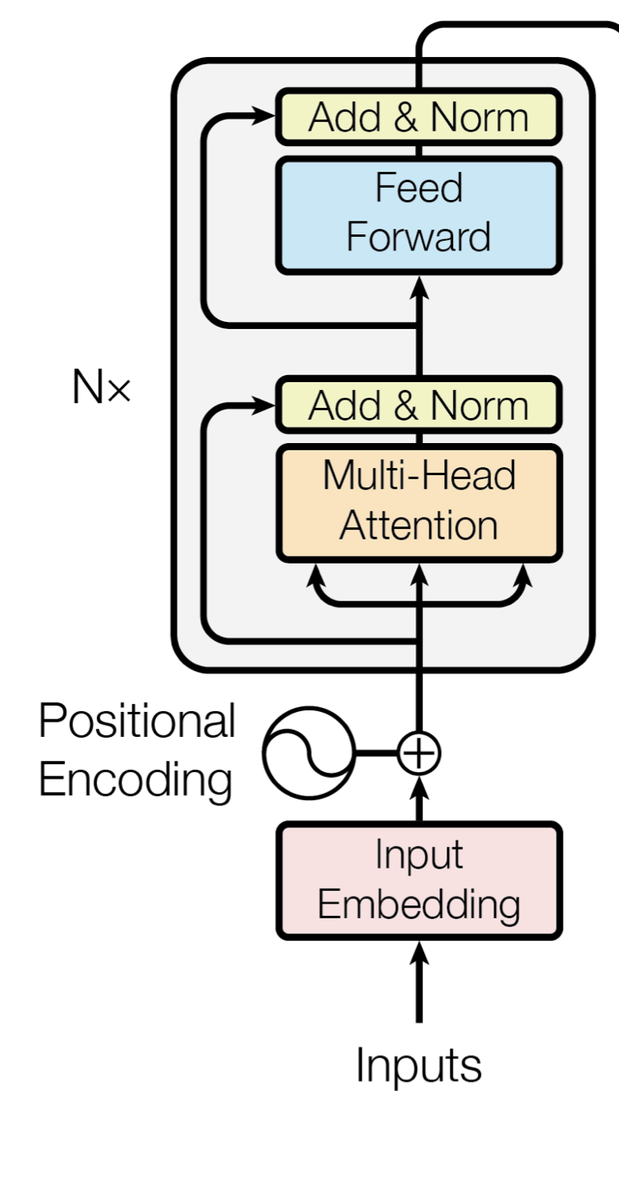
Recall: Transformer Encoder
Input embeddings and positional encodings
Input embeddings: map text to a sequence of dense vector representations
Positional encodings: add information about relative position within the sequence (we will return to this)
Transformer encoder stack (N=6 in Vaswani; N=24 in BERT-large; N=96 in GPT-3)
Multi-head attention: refine representations of words (i.e. the meaning of each token) based on other words
[information exchange across words]
Add & norm: residual connections (add) avoid vanishing gradients in earlier layers; normalizing improves numeric stability
Feed forward: nonlinear refinement of representations
[information exchange across embedding/representation dimensions]
Notes:
What haven’t we covered? Positional encodings.
Again emphasize that we are progressively refining our representations

Slide 3
Recall: Transformer Encoder
Input embeddings and positional encodings
Input embeddings: map text to a sequence of dense vector representations
Positional encodings: add information about relative position within the sequence (we will return to this)
Transformer encoder stack (N=6 in Vaswani; N=24 in BERT-large; N=96 in GPT-3)
Multi-head attention: refine representations of words (i.e. the meaning of each token) based on other words
[information exchange across words]
Add & norm: residual connections (add) avoid vanishing gradients in earlier layers; normalizing improves numeric stability
Feed forward: nonlinear refinement of representations
[information exchange across embedding/representation dimensions]
EMBEDDING LAYER
Notes:
What haven’t we covered? Positional encodings.
Again emphasize that we are progressively refining our representations

Slide 4
Recall: Transformer Encoder
Input embeddings and positional encodings
Input embeddings: map text to a sequence of dense vector representations
Positional encodings: add information about relative position within the sequence (we will return to this)
Transformer encoder stack (N=6 in Vaswani; N=24 in BERT-large; N=96 in GPT-3)
Multi-head attention: refine representations of words (i.e. the meaning of each token) based on other words
[information exchange across words]
Add & norm: residual connections (add) avoid vanishing gradients in earlier layers; normalizing improves numeric stability
Feed forward: nonlinear refinement of representations
[information exchange across embedding/representation dimensions]
STABLE TRAINING
NO VANISHING GRADIENTS
Notes:
What haven’t we covered? Positional encodings.
Again emphasize that we are progressively refining our representations

Slide 5
Recall: Transformer Encoder
Input embeddings and positional encodings
Input embeddings: map text to a sequence of dense vector representations
Positional encodings: add information about relative position within the sequence (we will return to this)
Transformer encoder stack (N=6 in Vaswani; N=24 in BERT-large; N=96 in GPT-3)
Multi-head attention: refine representations of words (i.e. the meaning of each token) based on other words
[information exchange across words]
Add & norm: residual connections (add) avoid vanishing gradients in earlier layers; normalizing improves numeric stability
Feed forward: nonlinear refinement of representations
[information exchange across embedding/representation dimensions]
MLP APPLIED IN PARALLEL
Notes:
What haven’t we covered? Positional encodings.
Again emphasize that we are progressively refining our representations

Slide 6
Recall: Transformer Encoder
Input embeddings and positional encodings
Input embeddings: map text to a sequence of dense vector representations
Positional encodings: add information about relative position within the sequence (we will return to this)
Transformer encoder stack (N=6 in Vaswani; N=24 in BERT-large; N=96 in GPT-3)
Multi-head attention: refine representations of words (i.e. the meaning of each token) based on other words
[information exchange across words]
Add & norm: residual connections (add) avoid vanishing gradients in earlier layers; normalizing improves numeric stability
Feed forward: nonlinear refinement of representations
[information exchange across embedding/representation dimensions]
ON THE WHITEBOARD
Notes:
What haven’t we covered? Positional encodings.
Again emphasize that we are progressively refining our representations

Slide 7
Recall: Transformer Encoder
Input embeddings and positional encodings
Input embeddings: map text to a sequence of dense vector representations
Positional encodings: add information about relative position within the sequence (we will return to this)
Transformer encoder stack (N=6 in Vaswani; N=24 in BERT-large; N=96 in GPT-3)
Multi-head attention: refine representations of words (i.e. the meaning of each token) based on other words
[information exchange across words]
Add & norm: residual connections (add) avoid vanishing gradients in earlier layers; normalizing improves numeric stability
Feed forward: nonlinear refinement of representations
[information exchange across embedding/representation dimensions]
ON THE WHITEBOARD
Notes:
What haven’t we covered? Positional encodings.
Again emphasize that we are progressively refining our representations

Slide 8
Training process
Encoder-only models

Slide 9











Training encoder-only architectures: Masked language modeling (MLM)
Output
representations
$$x_{4}$$
$$x_{5}$$
$$x_{6}$$
$$x_{7}$$
$$x_{8}$$
$$x_{9}$$
$$x_{1}$$
$$x_{2}$$
$$x_{3}$$
$$x_{10}$$
$$x_{11}$$
Transformer Encoder
(token embeddings + positional encodings -> (encoder layer) x N)
Input tokens
Even the smallest person can change the course of the future
Notes:
Show input, block for encoder stack, prediction head
Note weight tying

Slide 10
Training encoder-only architectures: Masked language modeling (MLM)
Token prediction head
CrossEntropy(probs, target_token)
Output
representations
$$x_{4}$$
$$x_{5}$$
$$x_{6}$$
$$x_{7}$$
$$x_{8}$$
$$x_{9}$$
$$x_{1}$$
$$x_{2}$$
$$x_{3}$$
$$x_{10}$$
$$x_{11}$$
Transformer Encoder
(token embeddings + positional encodings -> (encoder layer) x N)
Input tokens
Even the smallest person can [MASK] the course of the future
Notes:
Show input, block for encoder stack, prediction head
Note weight tying

Slide 11
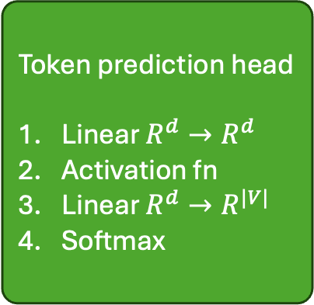
Training encoder-only architectures: Masked language modeling (MLM)
Token prediction head
Linear $R^{d}→R^{d}$
Activation fn
Linear $R^{d}→R^{|V|}$
Softmax
CrossEntropy(probs, target_token)
Output
representations
$$x_{4}$$
$$x_{5}$$
$$x_{6}$$
$$x_{7}$$
$$x_{8}$$
$$x_{9}$$
$$x_{1}$$
$$x_{2}$$
$$x_{3}$$
$$x_{10}$$
$$x_{11}$$
Transformer Encoder
(token embeddings + positional encodings -> (encoder layer) x N)
Input tokens
Even the smallest person can [MASK] the course of the future
Notes:
Show input, block for encoder stack, prediction head
Note weight tying

Slide 12
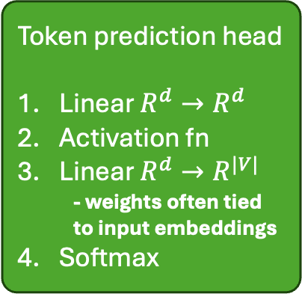
Training encoder-only architectures: Masked language modeling (MLM)
Token prediction head
Linear $R^{d}→R^{d}$
Activation fn
Linear $R^{d}→R^{|V|}$
- weights often tied to input embeddings
Softmax
CrossEntropy(probs, target_token)
Output
representations
$$x_{4}$$
$$x_{5}$$
$$x_{6}$$
$$x_{7}$$
$$x_{8}$$
$$x_{9}$$
$$x_{1}$$
$$x_{2}$$
$$x_{3}$$
$$x_{10}$$
$$x_{11}$$
Transformer Encoder
(token embeddings + positional encodings -> (encoder layer) x N)
Input tokens
Even the smallest person can [MASK] the course of the future
Notes:
Show input, block for encoder stack, prediction head
Note weight tying

Slide 13
Special tokens
[CLS] is a “classification” token prepended to the input sequence
final hidden state at the [CLS] position can attend to all other tokens
for sentence-level classification tasks, a classification head is added on top of the [CLS] hidden state during fine-tuning
[MASK] is used for masked language modeling
[SEP] can be used to separate distinct pieces of the input (e.g. sentences)
[PAD] is used to pad shorter sequences up to a common length
[UNK] is used for tokens not in the vocabulary

Slide 14
How do we use the output?
Encoder-only models

Slide 15








Encoder gives a sequence of representations
Consider: How are these different / better than Word2Vec embeddings?
Output
representations
$$x_{4}$$
$$x_{5}$$
$$x_{6}$$
$$x_{7}$$
$$x_{8}$$
$$x_{9}$$
$$x_{1}$$
$$x_{2}$$
$$x_{3}$$
$$x_{10}$$
$$x_{11}$$
$$x_{12}$$
Transformer Encoder
(token embeddings + positional encodings -> (encoder layer) x N)
Input tokens
[CLS] Even the smallest person can change the course of the future
Notes:
Show input, block for encoder stack, prediction head
Note weight tying

Slide 16
Encoder gives a sequence of representations
Using this for token-level prediction is straightforward: apply prediction head to each output representation.
Per-token
prediction head
CrossEntropy(probs, target)
Output
representations
$$x_{4}$$
$$x_{5}$$
$$x_{6}$$
$$x_{7}$$
$$x_{8}$$
$$x_{9}$$
$$x_{1}$$
$$x_{2}$$
$$x_{3}$$
$$x_{10}$$
$$x_{11}$$
$$x_{12}$$
Transformer Encoder
(token embeddings + positional encodings -> (encoder layer) x N)
Input tokens
[CLS] Even the smallest person can change the course of the future
Notes:
Show input, block for encoder stack, prediction head
Note weight tying

Slide 17
Options for document-level prediction
Consider: How do we make document-level predictions?
Output
representations
$$x_{4}$$
$$x_{5}$$
$$x_{6}$$
$$x_{7}$$
$$x_{8}$$
$$x_{9}$$
$$x_{1}$$
$$x_{2}$$
$$x_{3}$$
$$x_{10}$$
$$x_{11}$$
$$x_{12}$$
Transformer Encoder
(token embeddings + positional encodings -> (encoder layer) x N)
Input tokens
[CLS] Even the smallest person can change the course of the future
Notes:
Show input, block for encoder stack, prediction head
Note weight tying

Slide 18
Options for sentence-level prediction
Most common approach: predict from [CLS] token representation
Classification head
CrossEntropy(probs, target_token)
Output
representations
$$x_{4}$$
$$x_{5}$$
$$x_{6}$$
$$x_{7}$$
$$x_{8}$$
$$x_{9}$$
$$x_{1}$$
$$x_{2}$$
$$x_{3}$$
$$x_{10}$$
$$x_{11}$$
$$x_{12}$$
Transformer Encoder
(token embeddings + positional encodings -> (encoder layer) x N)
Input tokens
[CLS] Even the smallest person can change the course of the future
Notes:
Show input, block for encoder stack, prediction head
Note weight tying

Slide 19

Options for sentence-level prediction
Most common approach: predict from [CLS] token representation
Caveat: requires a tuning strategy to ensure it represents the full document
task specific fine-tuning
General “classification” fine-tuning
Classification head
CrossEntropy(probs, target_token)
Output
representations
$$x_{4}$$
$$x_{5}$$
$$x_{6}$$
$$x_{7}$$
$$x_{8}$$
$$x_{9}$$
$$x_{1}$$
$$x_{2}$$
$$x_{3}$$
$$x_{10}$$
$$x_{11}$$
$$x_{11}$$
Transformer Encoder
(token embeddings + positional encodings -> (encoder layer) x N)
Input tokens
[CLS] Even the smallest person can change the course of the future
Notes:
Show input, block for encoder stack, prediction head
Note weight tying

Slide 20













Options for sentence-level prediction
Classification head
$$\overline{x}$$
CrossEntropy(probs, target_token)
Mean Pooling
Output
representations
$$x_{1}$$
$$x_{2}$$
$$x_{3}$$
$$x_{4}$$
$$x_{5}$$
$$x_{6}$$
$$x_{7}$$
$$x_{8}$$
$$x_{9}$$
$$x_{10}$$
$$x_{11}$$
$$x_{12}$$
Transformer Encoder
(token embeddings + positional encodings -> (encoder layer) x N)
Input tokens
[CLS] Even the smallest person can change the course of the future
Notes:
Show input, block for encoder stack, prediction head
Note weight tying

Slide 21
Options for sentence-level prediction
Classification head
$$\overline{x}$$
CrossEntropy(probs, target_token)
Other pooling method (max pooling, learned pooling)
Output
representations
$$x_{1}$$
$$x_{2}$$
$$x_{3}$$
$$x_{4}$$
$$x_{5}$$
$$x_{6}$$
$$x_{7}$$
$$x_{8}$$
$$x_{9}$$
$$x_{10}$$
$$x_{11}$$
$$x_{12}$$
Transformer Encoder
(token embeddings + positional encodings -> (encoder layer) x N)
Input tokens
[CLS] Even the smallest person can change the course of the future
Notes:
Show input, block for encoder stack, prediction head
Note weight tying

Slide 22
Options for sentence-level prediction
Classification head
$$\overline{x}$$
CrossEntropy(probs, target_token)
Other aggregation method (e.g., RNN)
Output
representations
$$x_{1}$$
$$x_{2}$$
$$x_{3}$$
$$x_{4}$$
$$x_{5}$$
$$x_{6}$$
$$x_{7}$$
$$x_{8}$$
$$x_{9}$$
$$x_{10}$$
$$x_{11}$$
$$x_{12}$$
Transformer Encoder
(token embeddings + positional encodings -> (encoder layer) x N)
Input tokens
[CLS] Even the smallest person can change the course of the future
Notes:
Show input, block for encoder stack, prediction head
Note weight tying

Slide 23
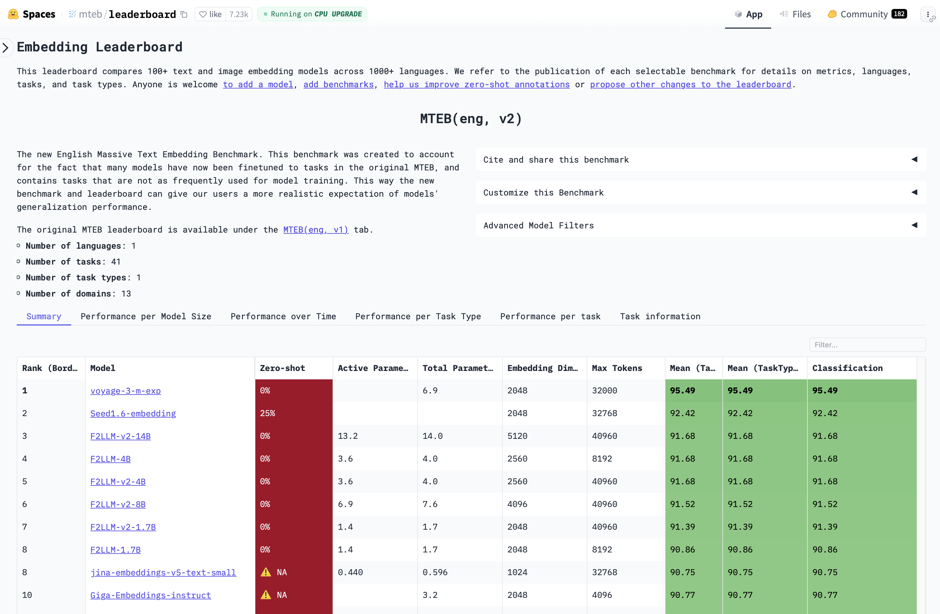
Massive Text Embedding Benchmark (MTEB) leaderboard
Download models tuned for specific types of tasks:
Classification
Retrieval
more
The *zero-shot* column is an indicator of leakage of evaluation tasks into training data
Part of Coding Assignment 3

Slide 24
Training process
Decoder-only models

Slide 25
Training decoder-only architectures: Next token prediction (NTP)
Output
representations
$$x_{4}$$
$$x_{5}$$
$$x_{6}$$
$$x_{7}$$
$$x_{8}$$
$$x_{9}$$
$$x_{1}$$
$$x_{2}$$
$$x_{3}$$
$$x_{10}$$
$$x_{11}$$
Transformer Decoder
(token embeddings + positional encodings -> (decoder layer) x N)
Input tokens
Even the smallest person can change the course of the future
Notes:
Show input, block for encoder stack, prediction head
Note weight tying

Slide 26
Training decoder-only architectures: Next token prediction (NTP)
Token prediction head
CrossEntropy(probs, next_token)
Output
representations
$$x_{4}$$
$$x_{5}$$
$$x_{6}$$
$$x_{7}$$
$$x_{8}$$
$$x_{9}$$
$$x_{1}$$
$$x_{2}$$
$$x_{3}$$
$$x_{10}$$
$$x_{11}$$
Transformer Decoder
(token embeddings + positional encodings -> (decoder layer) x N)
Input tokens
Even the smallest person can change the course of the future
Notes:
Show input, block for encoder stack, prediction head
Note weight tying

Slide 27
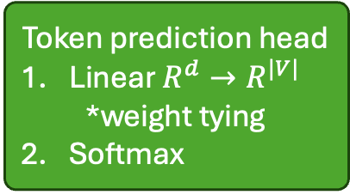
Training decoder-only architectures: Next token prediction (NTP)
Token prediction head
Linear $R^{d}→R^{|V|}$
*weight tying
Softmax
CrossEntropy(probs, next_token)
Output
representations
$$x_{4}$$
$$x_{5}$$
$$x_{6}$$
$$x_{7}$$
$$x_{8}$$
$$x_{9}$$
$$x_{1}$$
$$x_{2}$$
$$x_{3}$$
$$x_{10}$$
$$x_{11}$$
Transformer Decoder
(token embeddings + positional encodings -> (decoder layer) x N)
Input tokens
Even the smallest person can change the course of the future
Notes:
Show input, block for encoder stack, prediction head
Note weight tying

Slide 28
Training decoder-only architectures: Next token prediction (NTP)
the smallest person can change the course of the future [END]
TPH
TPH
TPH
TPH
TPH
TPH
TPH
TPH
TPH
TPH
TPH
Output
representations
$$x_{4}$$
$$x_{5}$$
$$x_{6}$$
$$x_{7}$$
$$x_{8}$$
$$x_{9}$$
$$x_{1}$$
$$x_{2}$$
$$x_{3}$$
$$x_{10}$$
$$x_{11}$$
Transformer Decoder
(token embeddings + positional encodings -> (decoder layer) x N)
Input tokens
Even the smallest person can change the course of the future
Notes:
Show input, block for encoder stack, prediction head
Note weight tying

Slide 29
Training decoder-only architectures: Next token prediction (NTP)
the smallest person can change the course of the future [END]
TPH
TPH
TPH
TPH
TPH
TPH
TPH
TPH
TPH
TPH
TPH
Output
representations
$$x_{4}$$
$$x_{5}$$
$$x_{6}$$
$$x_{7}$$
$$x_{8}$$
$$x_{9}$$
$$x_{1}$$
$$x_{2}$$
$$x_{3}$$
$$x_{10}$$
$$x_{11}$$
Transformer Decoder
Important: requires application of a causal mask
[typically by setting inputs to softmax in attention heads to –inf]
Input tokens
Even the smallest person can change the course of the future
Notes:
Show input, block for encoder stack, prediction head
Note weight tying

Slide 30
How do we use the output?
Decoder-only models

Slide 31
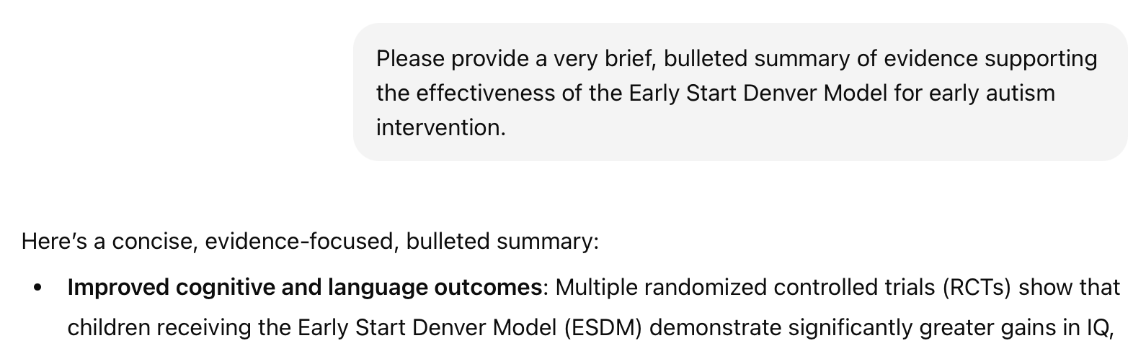

Now we can generate text!
y, next word
x, conversation history
“next-token prediction”
Notes:
Now, what about the systems we’re seeing today?
Does the paradigm I’ve described still fit?
“next-token predictor”
“stochastic parrot”
Generation via repeated prediction
Make the point about truth

Slide 32
Given a pre-trained model, we can…
Perform supervised fine-tuning (SFT) on a particular corpus
Uses the usual next-token prediction objective
Align the model with preferences (RLHF) [next slide]
Additional emerging fine-tuning paradigms
e.g. fine-tune to optimize performance on a given rubric
This is just a preview and mostly beyond our scope

Slide 33
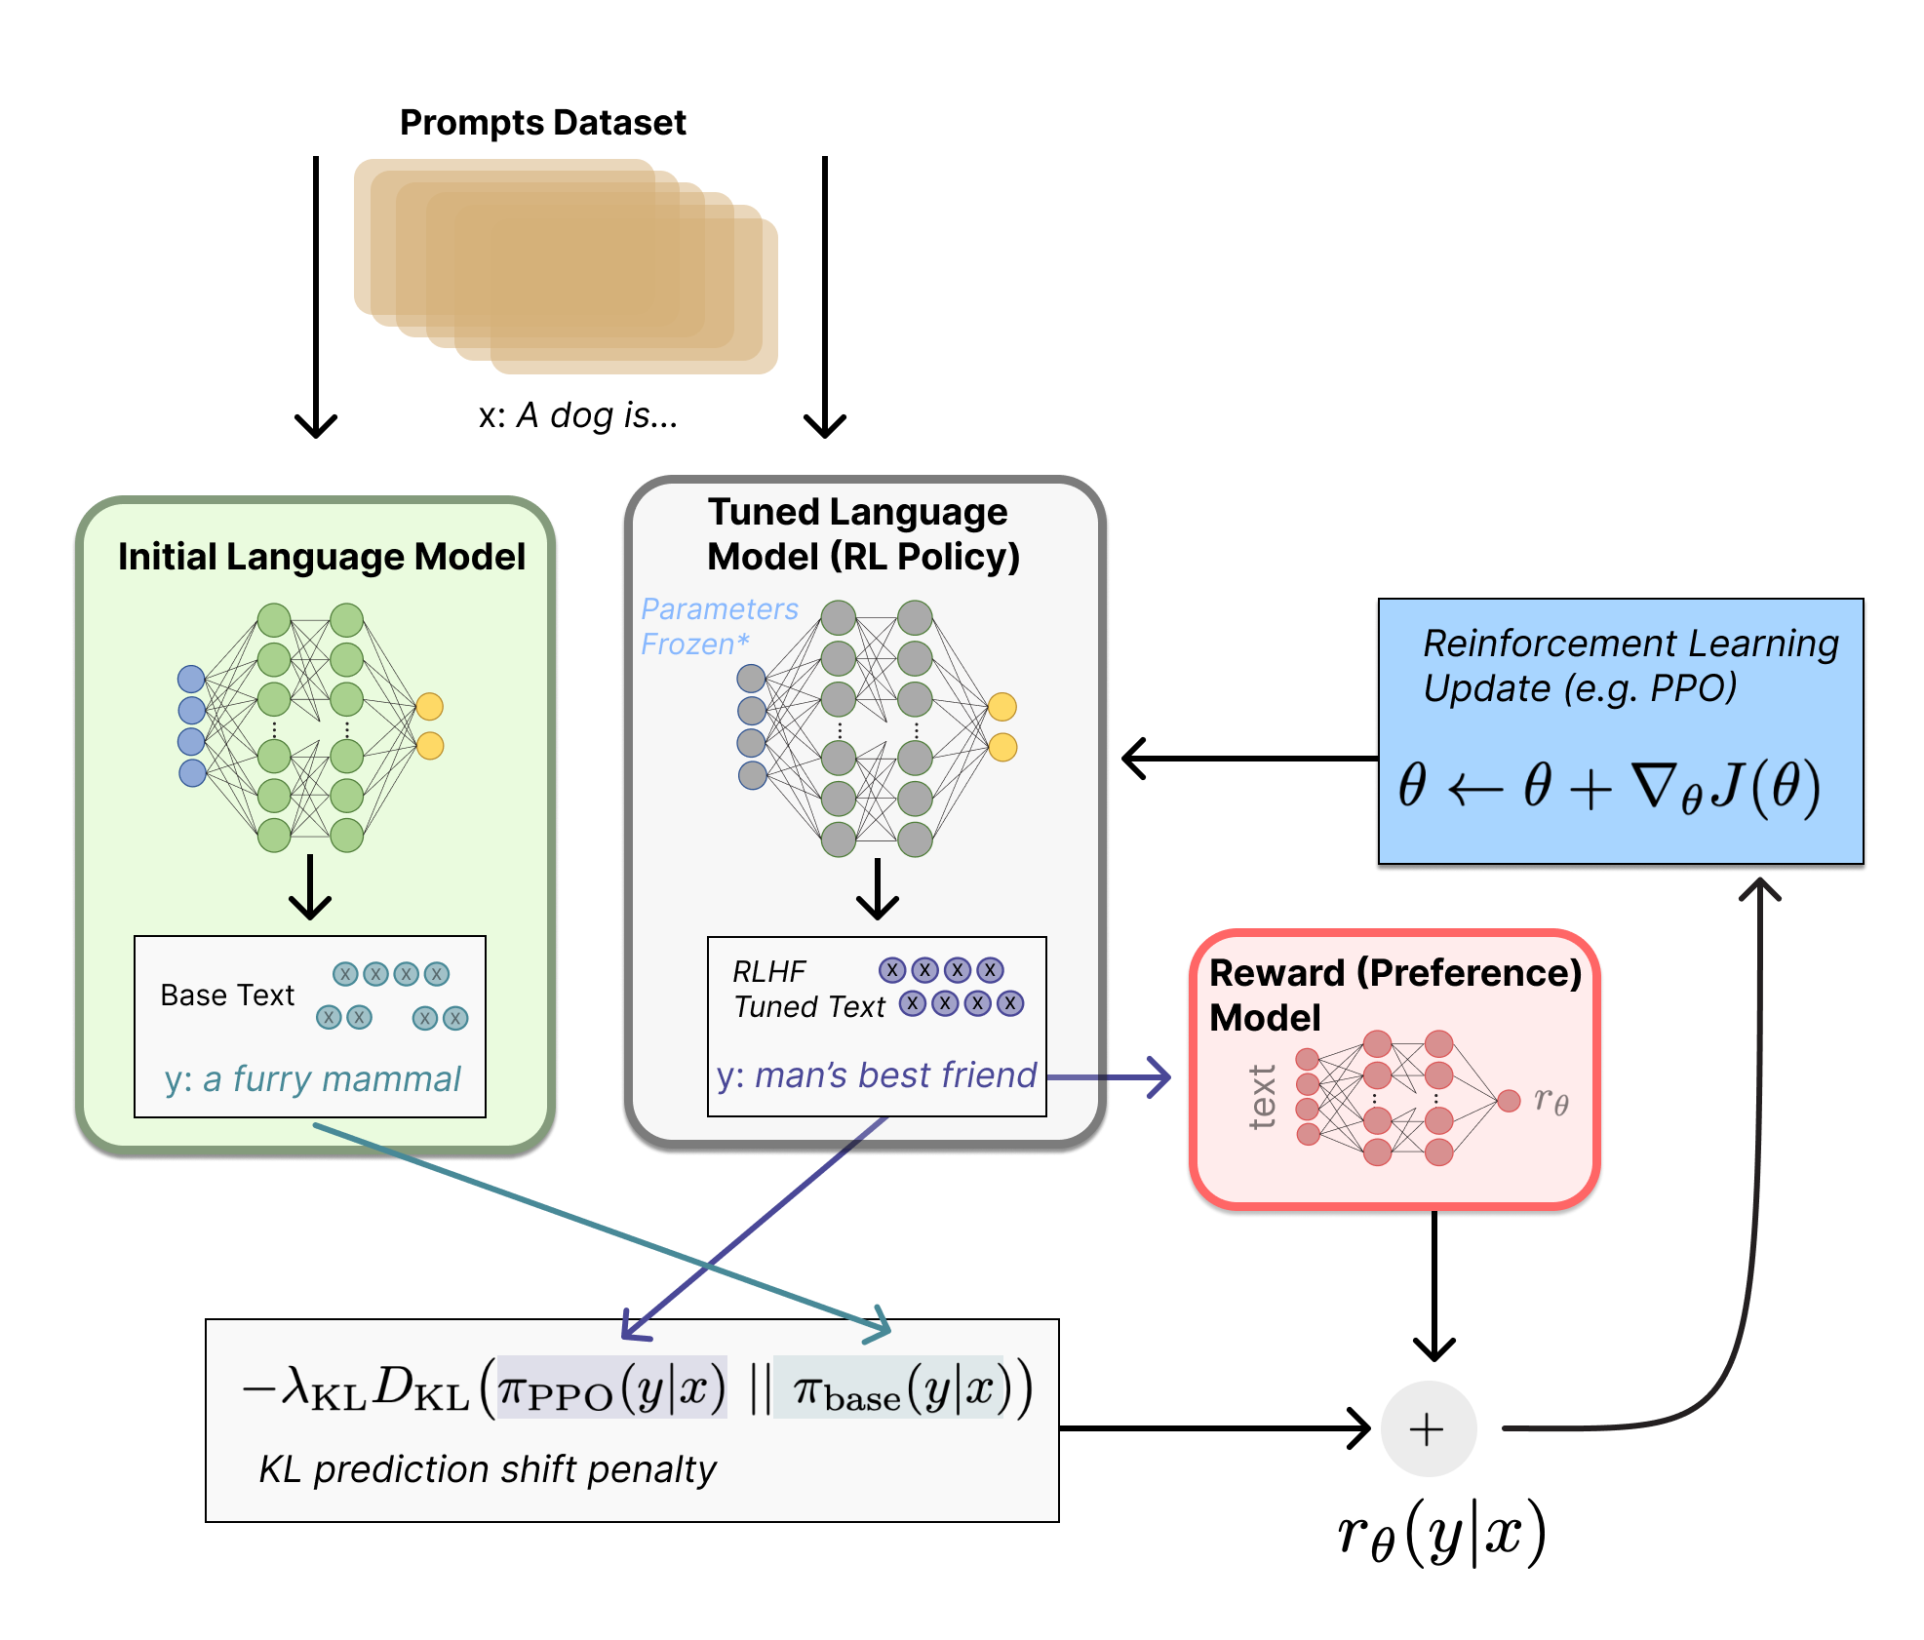
They’re then fine-tuned to match our preferences
Step 1: Train an auxiliary preference model (via human feedback) to assign scores to LLM-generated text that are consistent with our preferences
Step 2: Fine-tune the initial LLM (via reinforcement learning) to achieve better scores, implying better alignment with our preferences
Illustrating Reinforcement Learning from Human Feedback (RLHF)
https://huggingface.co/blog/rlhf
Notes:
Now, what about the systems we’re seeing today?
Does the paradigm I’ve described still fit?
“next-token predictor”
“stochastic parrot”
Generation via repeated prediction
Make the point about truth

Slide 34
Case study: maternal health SMS

Slide 35

Case Study: Triaging incoming SMS messages
https://www.praekelt.org
How can we use an LLM to solve this problem?
Notes:
What model?
How will you find it?
How will you use it?
Supervised approach
What if you wanted to do this without task-specific training?

Slide 36
Case Study: Finding instances of mistreatment
https://www.praekelt.org
How can we use an LLM to solve this problem?
Notes:
What model?
How will you find it?
How will you use it?
Supervised approach
What if you wanted to do this without task-specific training?
How to find relevant messages?
Consider: retrieval leaderboard

Slide 37
Notes on the “context window”
We are often limited by the “context window” of a given model, defined as the maximum number of tokens it can process in a single forward pass
Sometimes are documents are too long to fit
There are models with extremely long context windows, but they often have difficulty retaining information in the middle of a given document
Active area of research

Slide 38
Moving to the EHR
A foundation model for EHR data

Slide 39
Models for structured EHR data: the “language” of the EHR
A story about the progression of diabetes…
(“E11.65”, “E11.42”, “I10”, “N18.3”)
E11.65 — Type 2 diabetes mellitus with hyperglycemia
E11.42 — Type 2 diabetes mellitus with diabetic polyneuropathy
I10 — Essential (primary) hypertension
N18.3 — Chronic kidney disease, stage 3

Slide 40









Transformers for Electronic Health Records
Output
representations
$$x_{4}$$
$$x_{5}$$
$$x_{6}$$
$$x_{7}$$
$$x_{8}$$
$$x_{1}$$
$$x_{2}$$
$$x_{3}$$
$$x_{9}$$
Transformer Encoder
(token embeddings + positional encodings -> (encoder layer) x N)
Input tokens
E11.65 E11.42 I10 N18.3
Li, Y., Rao, S., Solares, J.R.A. et al. BEHRT: Transformer for Electronic Health Records. Sci Rep 10, 7155 (2020). https://doi.org/10.1038/s41598-020-62922-y

Slide 41
Transformers for Electronic Health Records
Unique consideration 1: we have position, age, and time
Output
representations
$$x_{4}$$
$$x_{5}$$
$$x_{6}$$
$$x_{7}$$
$$x_{8}$$
$$x_{1}$$
$$x_{2}$$
$$x_{3}$$
$$x_{9}$$
Transformer Encoder
(token embeddings + positional encodings -> (encoder layer) x N)
Input tokens
E11.65 E11.42 I10 N18.3
Li, Y., Rao, S., Solares, J.R.A. et al. BEHRT: Transformer for Electronic Health Records. Sci Rep 10, 7155 (2020). https://doi.org/10.1038/s41598-020-62922-y

Slide 42
Transformers for Electronic Health Records
Unique consideration 2: some tokens have associated values (e.g., labs, vitals)
Output
representations
$$x_{4}$$
$$x_{5}$$
$$x_{6}$$
$$x_{7}$$
$$x_{8}$$
$$x_{1}$$
$$x_{2}$$
$$x_{3}$$
$$x_{9}$$
Transformer Encoder
(token embeddings + positional encodings -> (encoder layer) x N)
Input tokens
E11.65 E11.42 I10 N18.3
Li, Y., Rao, S., Solares, J.R.A. et al. BEHRT: Transformer for Electronic Health Records. Sci Rep 10, 7155 (2020). https://doi.org/10.1038/s41598-020-62922-y

Slide 43
Transformers for Electronic Health Records
Unique consideration 2: some tokens have associated values (e.g., labs, vitals)
One approach to this is shown below
Output
representations
$$x_{4}$$
$$x_{5}$$
$$x_{6}$$
$$x_{7}$$
$$x_{8}$$
$$x_{1}$$
$$x_{2}$$
$$x_{3}$$
$$x_{9}$$
Transformer Encoder
(token embeddings + positional encodings -> (encoder layer) x N)
Input tokens
E11.65 E11.42 I10 N18.3
LAB ID
token
result
quartile
token

Slide 44
Predict diagnosis risk from structured EHRs
Suppose we wish to predict which children are most likely to be diagnosed with asthma based on EHRs from early life
How would we do this without a transformer-based foundation model?
How would we do this with a transformer-based foundation model?
What are the advantages of the latter approach?

Slide 45
Some current directions
(optional content)

Slide 46
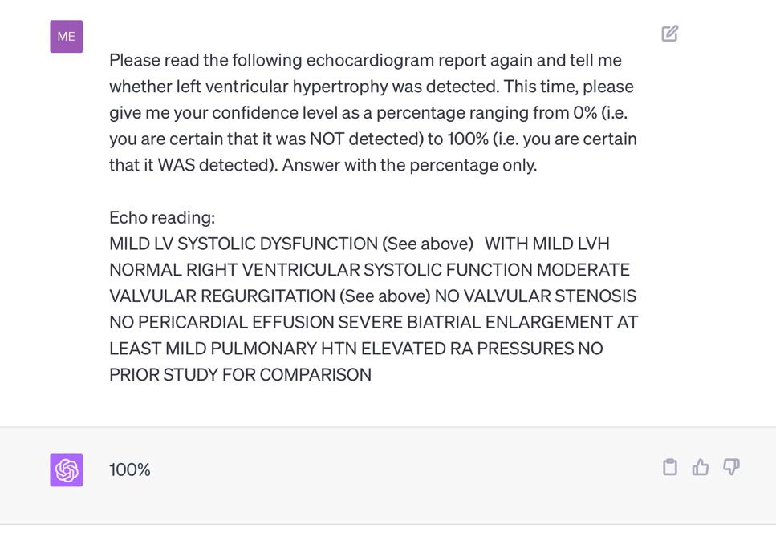
Recall: are all tasks special cases of text generation?
Notes:
Question: *should we* be using generative models for all NLP tasks?
Advantages?
zero-shot
convenient
Disadvantages?
- expensive

Slide 47
Generative LLMs enable “zero-shot” prediction: i.e. prediction without task-specific training
Notes:
Question: *should we* be using generative models for all NLP tasks?
Advantages?
zero-shot
convenient
Disadvantages?
- expensive

Slide 48
Do we still need predictive AI?
and task-specific models?

Slide 49
Often predictive and generative models are complementary.
Maternal health response system:
Speech to text (predictive)
Translation (predictive)
Identification of key concepts and topics (predictive)
Triage (predictive)
Generation of template and/or complete responses in specific cases (generative)
It is much easier to evaluate the performance of predictive models, and in turn to know when and how much to trust them.

Slide 50
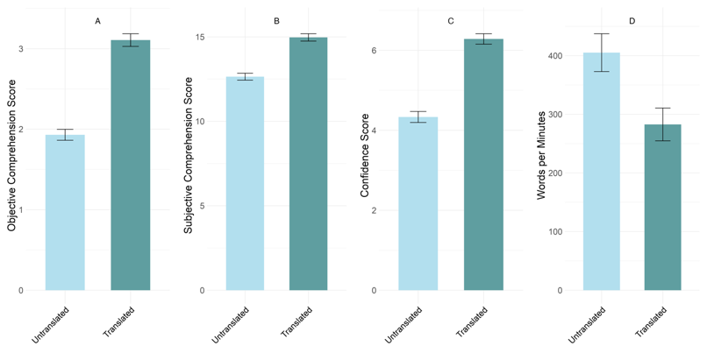


In some cases, however, generative models have superseded predictive models.
“Translation” of discharge notes into plain language using GPT4 substantially improves patients’ ability to comprehend them.
Anivarya Kumar
Isabella Wang
Notes:
Do we treat this as a translation (i.e., sequence to sequence) problem? Or a text generation problem?

Slide 51


Extracting specific info from documents: predictive or generative?
Data needed to determine scheduling needs
ICD-10
Stage
Age
Date of Dx
Hormone Receptors and molecular biomarkers
History of Treatment (med, surg, rad)
Undiagnosed patients only: Review of symptoms
While a predictive approach might be more trustworthy in principle, generative models can perform many tasks “zero-shot”, i.e. without task-specific training.
DIHI ‘24, led by Emily Norboge

Slide 52
Current directions: RAG vs long context
Suppose we wish to answer questions or extract information from a large collection of documents (e.g., all clinical notes for a given patient)
How do we use an LLM to do this?
Option 1: very long context window
Option 2: retrieval augmented generation (RAG)
Currently, RAG is commonly used because it is effective and scalable, and it (partly) addresses LLM pitfalls, including hallucinations.

Slide 53
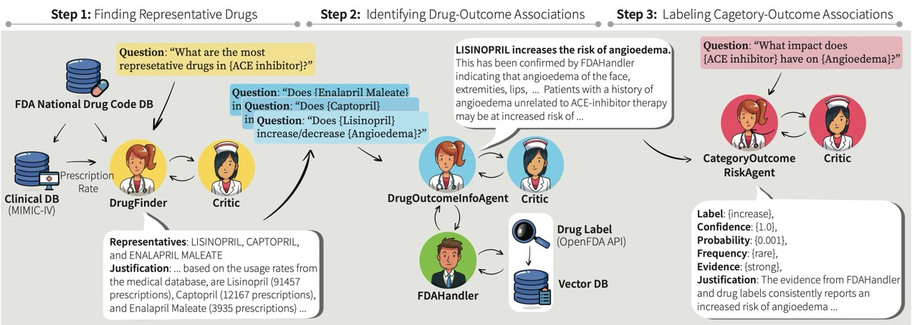
Current directions: agentic AI
Multi-LLM-agent systems including:
An orchestrator agent
Task-specific agents (e.g. DocChat, SQLchat
Critic agents
Choi, Palumbo, et al.; submitted to Machine Learning for Healthcare

Slide 54

Current directions: evaluation of generative models
Open questions include:
Can we trust models to evaluate other models?
How can models learn when to defer to human experts?
How can we identify LLM biases? (more on this in PIONEER sessions)
Notes:
Ask the group – how would you evaluate a generative model?
What approaches have you seen?

