Slide 1
Intro to Natural Language Processing for Clinical Text
Matthew Engelhard

Slide 2
Lecture Outline
Part 1: why work with clinical text?
Structured (tabular) versus unstructured (notes, etc) EHR data
What’s in notes and other unstructured data, and why is it important?
Part 2: how do we work with unstructured data?
Extracting clinical text
Converting to a format we can use
Simple models for text
Notes:
we'll begin by defining unstructured data, contrasting them with structured data, and seeing a few examples
then, digging deeper into examples of unstructured data -- clinical notes, images, and so on -- we'll start to see why learning from these data is so important. For those of you who aren't clinicians, I hope this will start to make these data a little more concrete and intuitive
Hopefully by this point I'll have convinced you that including these data in predictive models is a good idea, and so we'll start thinking about how we do that
First, we'll look at models that use JUST unstructured data -- models that make predictions just from notes, or just from images
And then, finally, we'll see how we can combine unstructured data with structured data in our predictive models

Slide 3
Part 1: why
…do we care about clinical text and other unstructured data?

Slide 4
Structured Data
Definition: data organized into specific, queryable fields as part of an overarching model, with each field having a defined purpose.
typically stored in tabular (i.e. table, spreadsheet) format
numeric variables, categorical variables and/or short free text
Examples: demographics, diagnoses, procedures, labs, meds, vitals
Notes:
and to define UNstructured data, we first need to define structured data
Structured data is...
these data are usually stored in a table, maybe as part of an overarching data model, or in a spreadsheet, say as a csv file
they're comprised of columns of distinct variables, which are usually going to be numeric or categorical, and you might have some text fields here and there
if somebody said they're we're going to hand you a dataset from their clinical study, this is what you'd expect to get
and in the EHR, this is all the stuff you'd pull out of a system like DEDUCE here at duke -- a table of demographics, a table of diagnoses, and so on

Slide 5
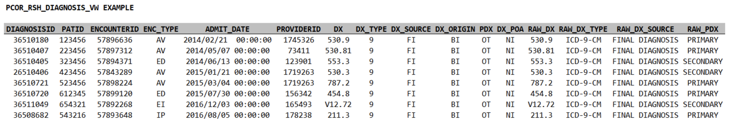
Example from Duke’s Clinical Research Datamart…
COLUMN | DEFINITION
DIAGNOSISID: | An arbitrary identifier for each record. Not currently useful for linkage across tables.
ENCOUNTERID: | The ENCOUNTERID (encounter ID) is an arbitrary identifier for a specific encounter that can be used to link information across tables in the model.
PATID: | The PATID (patient identifier) is an arbitrary, person-level identifier used to link information across tables within the data model. There is a table within the CRDM that allows an investigator with an appropriate IRB protocol to link PATID to MRN.
ENC_TYPE: | Encounter type indicates the setting in which the encounter took place (the same data are provided in the encounter table: AV=Ambulatory Visit, ED=Emergency Department, EI=Emergency Department Admit to Inpatient Hospital Stay, IP=Inpatient Hospital Stay, OS=Observation Stay, NI=No information, UN=Unknown, OT=Other
ADMIT_DATE: | The date on which the encounter began (also included in the encounter table).
PROVIDERID: | Unique identifier for a provider ? can be used to link an encounter to the provider table.
DX: | The diagnosis code; uses either ICD-9 or ICD-10
DX_TYPE: | 09=ICD-9-CM, 10=ICD-10-CM, 11=ICD-11-CM, SM=SNOMED CT, NI=No information, UN=Unknown, OT=Other
DX_SOURCE: | The approximate period within the encounter when the diagnosis was made for the patient; diagnoses are always ?Final Diagnosis (FI)?, from the billing codes.
DX_ORIGIN: | The source of the diagnosis information. ?Billing (BI)? is always the source in this data model. In 2021 OD, other diagnosis types where added that are admission and encounter_diagnosis. Billing diagnosis are still the main diagnosis to use for research projects.
Notes:
Here's an example from Duke's clinical research datamart
we have rows of identifiers, some of which can be used to link this table to other tables, including the patient id
this is a table of diagnoses, so the key column is the column of diagnosis codes
and then we have additional columns of supporting details, including the date and time, and so on
importantly, associated with this table we have a key, or dictionary, which explains what we're seeing in each of the columns

Slide 6
Unstructured Data
Definition: data that is NOT structured data
in other words, everything else
typically stored in a modality-specific format
Examples:
clinical notes (also available through CRDM)
imaging (e.g. radiology, ophthalmology, ultrasound, pathology)
physiologic time series (e.g. electrophysiologic studies, digital health)
Notes:
now, we needed to start with structured data, because the precise definition of unstructured data is:::
data that is NOT structured data
in other words -- everything else (it's a catch-all term)
these are your clinical notes -- of course, there are many different types
your images, which could be from radiological studies, but they could also be from pathology, or opthalmology, and many more
your electrophysiologic studies -- electrocardiograms, electroencephalograms, electromyelograms, electrowhateverograms
it includes digital health data -- we're seeing more and more efforts to incorporate this stuff in the EHR
it might even include audio data
and the list is always growing
NOT organized into specific, queryable fields as part of an overarching model
and they do NOT fit neatly into a csv file -- instead, they tend to be stored in specific, specialized formats
for images you've got your pngs and jpegs, but you've also got your DICOM files, for example
there's a huge variety here -- far too big to cover in a single lecture
and so we're going to be talking about some general principles and focusing mostly on the most common modalities, which are images and text

Slide 7
What information is in notes
…and why is it important?

Slide 8
A patient presents with shortness of breath…
Presents to urgent care and is transferred to the ED
Evaluated in the ED
History of present illness
Review of medical history (including meds and allergies) + social and family hx
Physical exam and review of systems
Lab results: BMP and CBC
Imaging & other studies: CT and EKG
Admitted to the hospital
Notes:
Let’s run through a really simplified case to think about what data, both structured and unstructured, will be generated
Suppose we have a patient that goes to urgent care – they’re transferred to the emergency department because the providers at urgent care suspect a PE, or pulmonary embolism
This is a blood that forms usually in the veins in your leg, then dislodges and travels through the right heart and into the lungs, where it can go no further, so it gets stuck, blocking blood flow, damaging tissue, and so on – not good
So they transfer this person to the emergency department, where a bunch of things happen, not necessarily in the particular order I’m showing here
1, a provider is going to document the patient’s story, including all the details believed to be relevant to the current situation
This is going to include the patient’s broader medical history – other medical conditions, their medications, any allergies
As well as their social history and family history – what conditions do family members have
The provider will do a physical examination at some point, again with emphasis on the current situation, and they’ll do a review of systems – this is a head to toe review of patient covering all the different organ systems
They’re also going to get some lab results – in this case, they’ll get a basic metabolic panel, which is a very common, standard set of labs that summarizes your fluid and electrolyte status, kidney function, and blood sugar levels
And they also get a complete blood count, which gives information about the cells in your blood – both white cells and red cells
They’ll also get a CT scan of the lungs, which along with the labs will help them determine whether it’s really a pulmonary embolism versus something else, pinpoint the location, see the extent of the damage, and so on
And this is a pretty serious issue, so this patient needs to be hospitalized – the emergency department is going to go ahead and admit them to the hospital

Slide 9
What will we find in the structured data?
Encounter details (ED admission)
Labs (BMP, CBC)
Vital signs
Procedure codes (CT)
Diagnosis codes (PE)
…what won’t we find?
Notes:
Now, what parts of this fairly complicated story -- and again, this is the super simple, quick and dirty version coming from a non-clinician – which parts are going to make it into the structured data?
Well, we’ll see who the patient is -- their age, sex, race
We’ll see that they came to the emergency department, and that they were admitted from the ED
We’ll see diagnosis codes, so we SHOULD end up seeing codes related to pulmonary embolism, supposing that ends up being the issue
And we’ll see procedure codes – we’ll see that they got a CT, for example
We’ll even see the details of those labs – the exact electrolyte values, their white cell count, and so on
So, that’s a lot of information. But it is really a comprehensive summary of the encounter?
Let’s thing about what we WON’T see.

Slide 10
The H&P
written by a UNC student and publicly available:
https://www.med.unc.edu/medclerk/education/grading/history-and-physical-examination-h-p-examples/
FHIR systems SHALL support, at minimum, these eight “Common Clinical Notes”:
Consultation Note (11488-4)
Discharge Summary (18842-5)
History & Physical Note (34117-2)
Procedures Note (28570-0)
Progress Note (11506-3)
Imaging Narrative (18748-4)
Laboratory Report Narrative (11502-2)
Pathology Report Narrative (11526-1)
Notes:
To do that, let’s start by looking at patient’s story, as documented by a provider
This example I’m showing you is publicly available on the internet, in case anybody is concerned
In fact, this is a note written by a UNC medical student as an example of how to write a history and physical, which is a detailed note covering all the elements I mentioned a moment ago
It’s also one of the note types required as part of the FHIR standard.
Now, if you read through this note, what you’ll find is that it’s very information dense.
There’s a ton of detailed information here, and all of it is potentially very important
We get his pain level and a description of the nature of the pain
We get subjective elements of his experience – a ”rattling” in his chest
We see that he had pneumonia about two months ago – this context may be very important to understand
Some of this makes it into structured fields, but more of it doesn’t

Slide 11
The H&P
written by a UNC student and publicly available:
https://www.med.unc.edu/medclerk/education/grading/history-and-physical-examination-h-p-examples/
FHIR systems SHALL support, at minimum, these eight “Common Clinical Notes”:
Consultation Note (11488-4)
Discharge Summary (18842-5)
History & Physical Note (34117-2)
Procedures Note (28570-0)
Progress Note (11506-3)
Imaging Narrative (18748-4)
Laboratory Report Narrative (11502-2)
Pathology Report Narrative (11526-1)
Notes:
Continuing on, we see all those different elements I mentioned
His past medical history, medications, review of systems

Slide 12
The H&P
written by a UNC student and publicly available:
https://www.med.unc.edu/medclerk/education/grading/history-and-physical-examination-h-p-examples/
FHIR systems SHALL support, at minimum, these eight “Common Clinical Notes”:
Consultation Note (11488-4)
Discharge Summary (18842-5)
History & Physical Note (34117-2)
Procedures Note (28570-0)
Progress Note (11506-3)
Imaging Narrative (18748-4)
Laboratory Report Narrative (11502-2)
Pathology Report Narrative (11526-1)
Notes:
And finally, we get to the assessment and plan --
This is the providers putting all the pieces together, summarizing the situation, and plotting next steps
The structured data will tell us a little bit about what they ended up doing, but it won’t really tell us why.
Here we get quite a bit of insight into the details of their thought process at the time.
This is not something you’ll find in a csv file

Slide 13
Notes are a rich source of info
Notes:
Now you might think – well, this is interesting, and maybe it was very important at the time, but is it really important for the kinds of things that I want to do with the data.
And of course it depends on what you’re doing, exactly, but in general the answer it YES – it matters more than you might think
Here’s the key finding of a recent JAMIA paper focused on identifying cardiovascular diseases and procedures from EHR data
Each of these concepts was identified by chart review by clinical expert annotators
And then they train models to identify those concepts based on
(a) structured data – this is “EHR-S”
And (b) clinical notes – this is “EHR-U”
Their findings tell a pretty consistent and compelling story
Both approaches do pretty well in terms of precision – also known as positive predictive value – in other words, both models are usually right when they tell you they’ve identified one of these concepts
However, the recall – aka the sensitivity – is FAR better for the unstructured models
Very often, the structured data models miss it
And if you look through the details, they do a good job building these models
The issue is not the models themselves – it’s that the structured data very often doesn’t contain the relevant information. It’s only found in the notes.

Slide 14
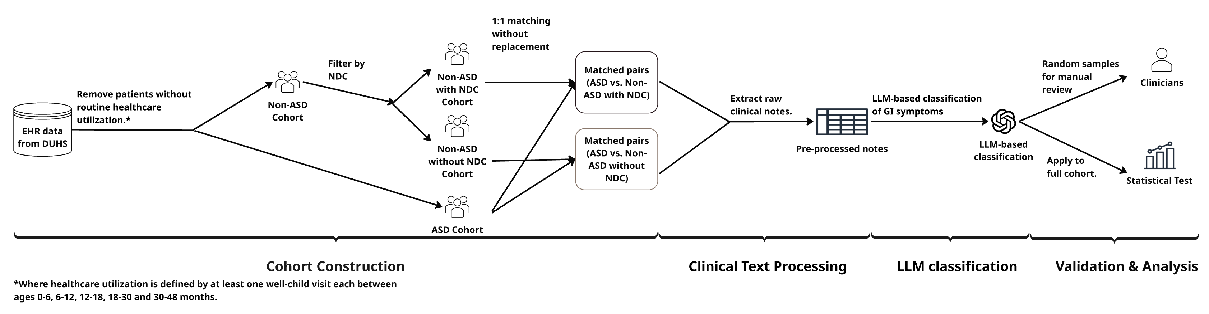
Hot off the presses: identification of early GI symptoms via structured vs notes
Courtesy of Jiaxin (Cindy) Gao and Roshni Varma

Slide 15
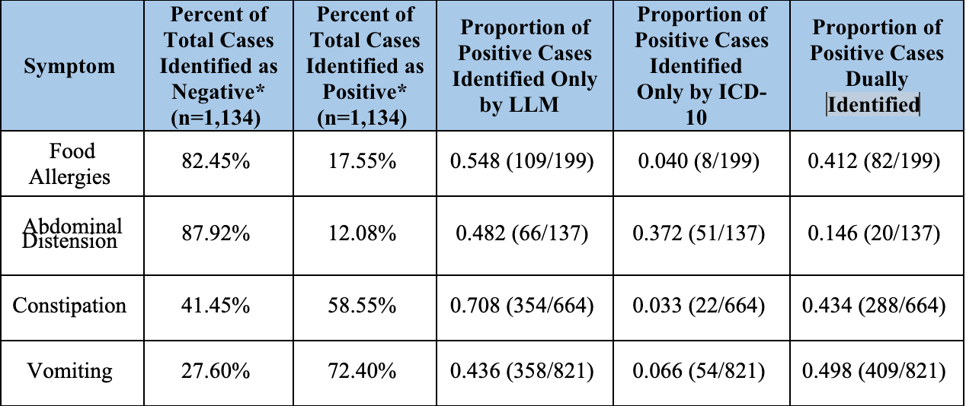
Hot off the presses: identification of early GI symptoms via structured vs notes
Courtesy of Jiaxin (Cindy) Gao and Roshni Varma

Slide 16
A patient presents with shortness of breath…
Presents to urgent care and is transferred to the ED
Evaluated in the ED
History of present illness
Review of medical history (including meds and allergies) + social and family hx
Physical exam and review of systems
Lab results: BMP and CBC
Imaging & other studies: CT and EKG
Admitted to the hospital
Notes:
OK, so hopefully I’ve convinced you that the notes matter
What about images?
Going back to our case, we know this patient also had a CT scan

Slide 17
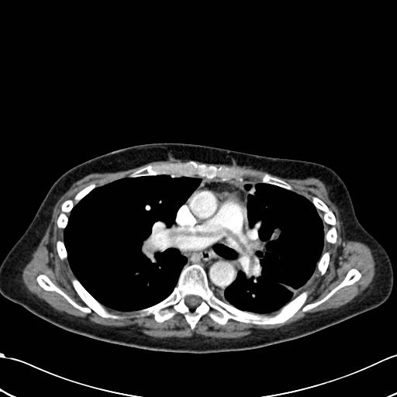
CT / Imaging
The scans / images themselves
Interpretation by radiologist (note)
Large non-occlusive pulmonary embolus draped over the bifurcation of the main pulmonary artery; a saddle pulmonary embolus.
https://radiopaedia.org/cases/pulmonary-embolism-saddle-1?lang=us
Notes:
Here’s a CT slice – this is coming from a really useful site called radiopedia – that shows a large blood clot sitting over the first branching of the main pulmonary artery
Reading a CT is a little beyond the current scope, but here we’re looking at a slice of a patient who’s lying down, with their feet coming out toward you, if you could see them
And the dark areas on either side of the center are lung tissue
So again, think about all the information that’s contained in this image
Without being a radiologist, it’s a little bit hard to even think it through
But it shouldn’t be too hard to convince yourself that there’s a ton information here about the physical characteristics of the blood clot, the surrounding vessels and tissue, and this patient’s anatomy
1000 words wouldn’t be nearly enough to describe it all
And little to none of this information makes it into structured fields
The structured data tells us that the CT scan happened, and what was done as a result – that’s about it.
Now, on top of the scan itself, there will be a note with the radiologist’s description of the image and their interpretation
So, if we use that note, we get part of the way there – we get information about this scan, as interpreted by the radiologist, that is not found in structured fields
Even so, the original scan of course contains more information than the radiologist’s note – at the end of the day, both are very valuable

Slide 18
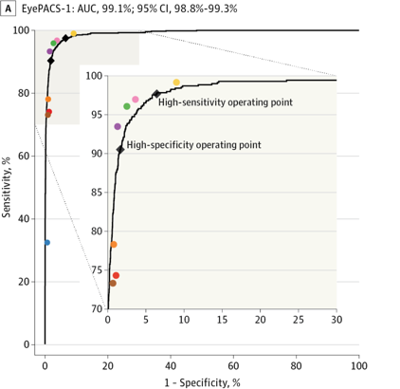
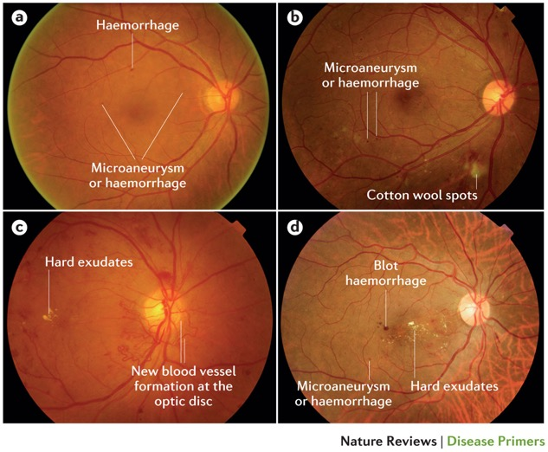
Retinopathy prediction from fundus images
colored dots are expert performance
Wong, T. Y. et al. (2016) Diabetic retinopathy
Nat. Rev. Dis. Primers doi:10.1038/nrdp.2016.12
Gulshan V, Peng L, Coram M, et al. Development and Validation of a Deep Learning Algorithm for Detection of Diabetic Retinopathy in Retinal Fundus Photographs. JAMA. 2016;316(22):2402–2410. doi:10.1001/jama.2016.17216
Notes:
But as before, we don’t really need to speculate about the value of information in images, or our ability to extract this information
Over the last few years, we’ve seen quite a few results showing that deep neural networks, if given a sufficiently large dataset to learn from -- are capable of analyzing medical images as well as – or in some cases, better than – trained specialists
Here we see the performance of a model that takes a fundoscopic image – that is, an image of the back of the eye – and predicts whether the patient has referrable diabetic retinopathy.
In this case, we see that the sensitivity and specificity of the model are on par with retina specialists
And similar findings have been observed in dermatology – a deep neural network was able to identify malignant skin lesions as well as trained dermatologists – as well as in pathology, radiology, etc
These results hold only for very specific scenarios and again, they also require large amounts of training data
Nevertheless, it’s very clear that there’s information in these images that you wouldn’t get from going over a patient’s previous medical history and other information previously captured in structured fields

Slide 19
A patient presents with shortness of breath…
Presents to urgent care and is transferred to the ED
Evaluated in the ED
History of present illness
Review of medical history (including meds and allergies) + social and family hx
Physical exam and review of systems
Lab results: BMP and CBC
Imaging & other studies: CT and EKG
Admitted to the hospital
Notes:
Now, going back to our snapshot once more, we do see that this patient had an EKG – an electrocardiogram

Slide 20
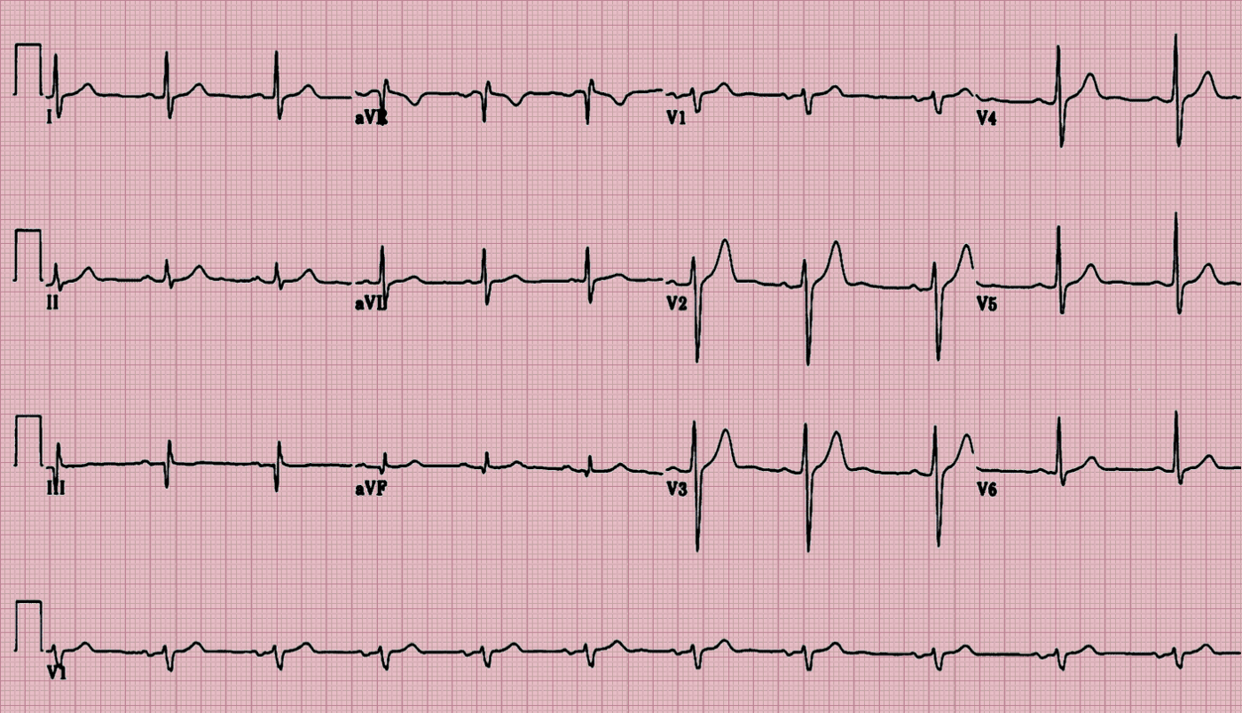
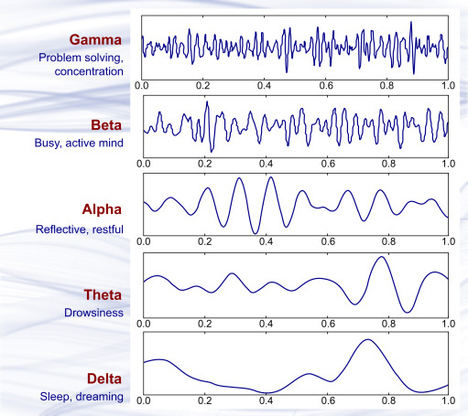
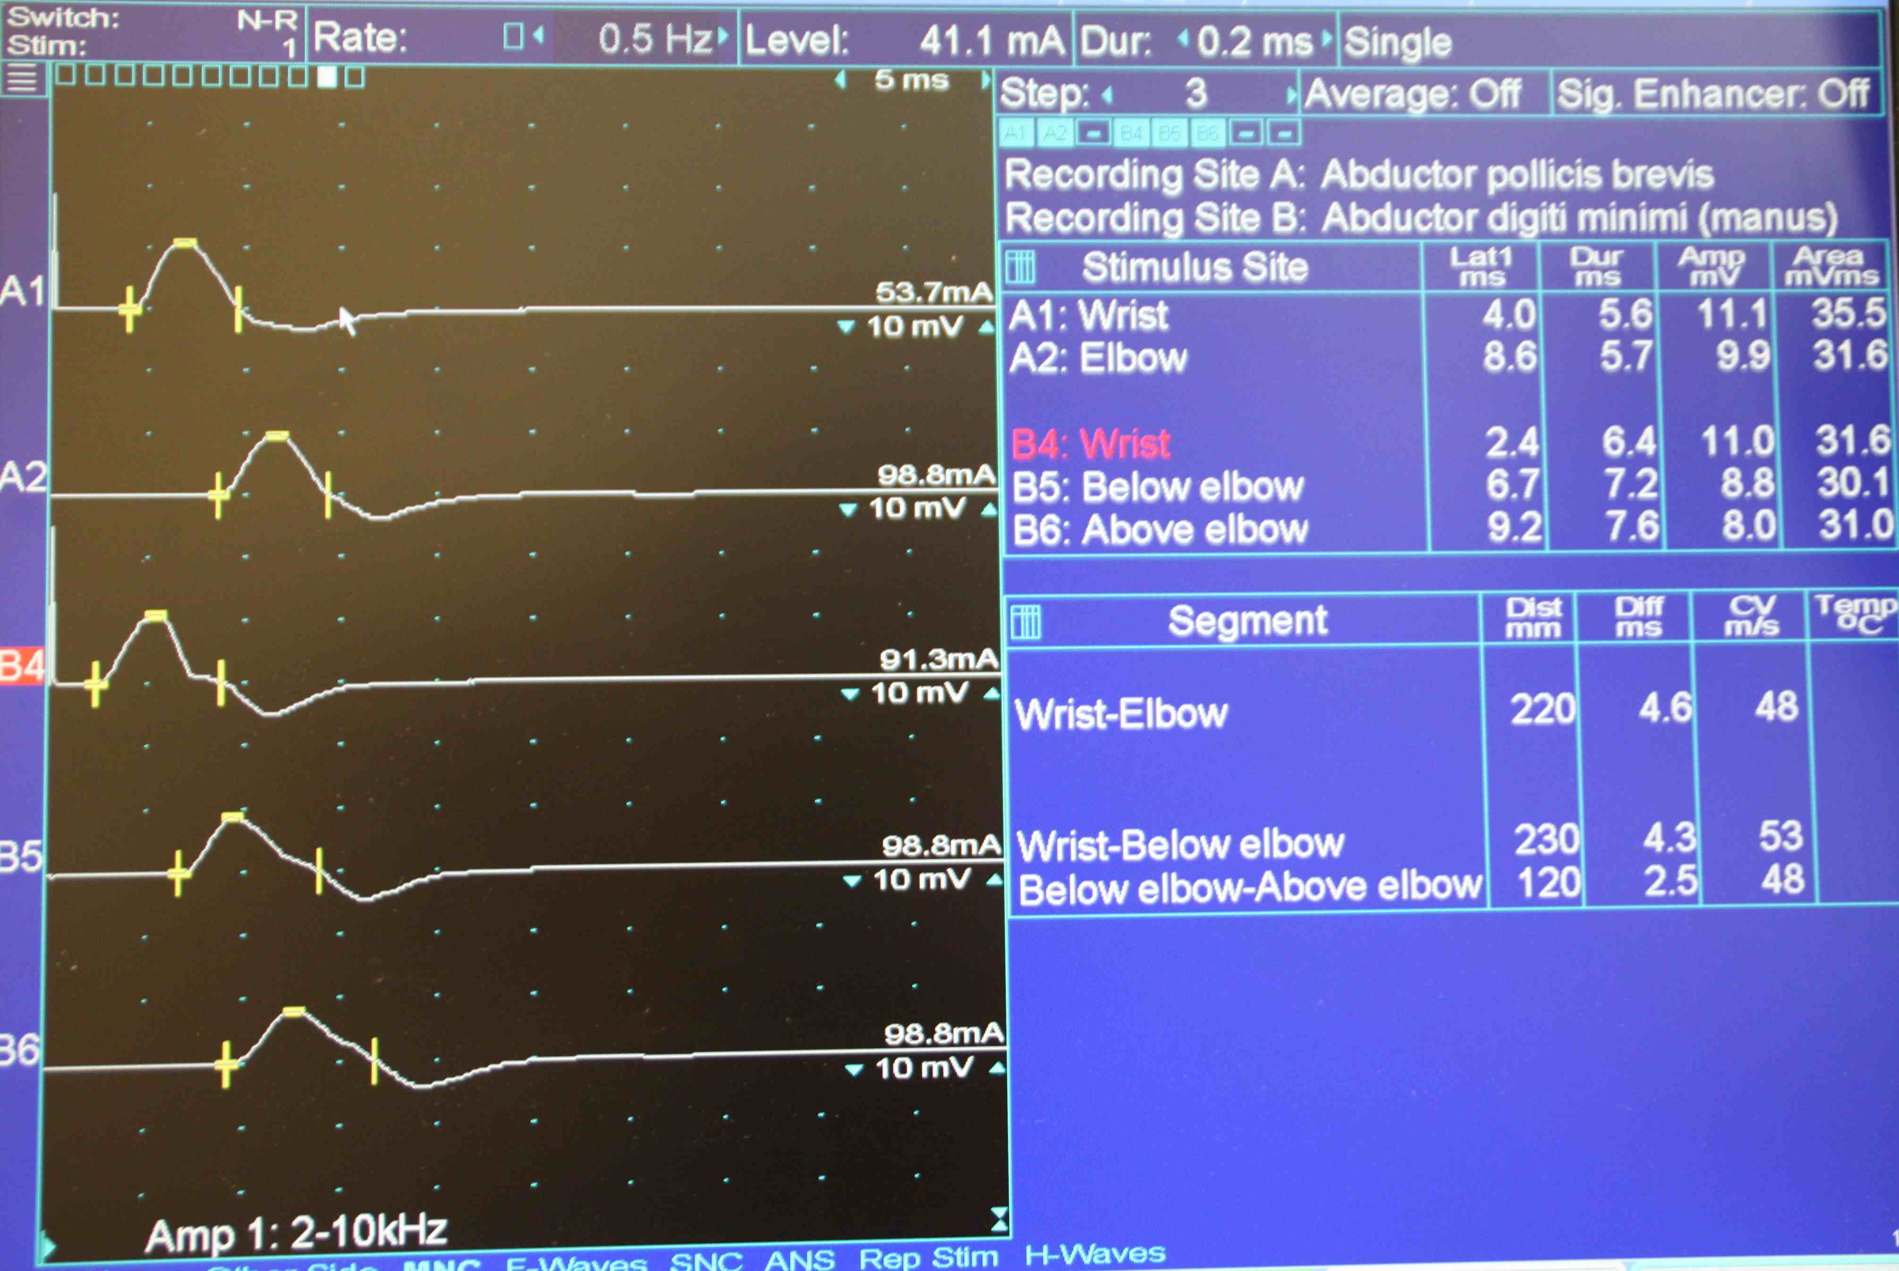
Electrophysiology
EKG (i.e. ECG)
EEG
EMG
Notes:
We’re going to focus less on electrophysiologic studies today, but suffice to say that an analogous argument holds for these data as well
Each of these studies generates a multi-dimensional physiologic time series that contains much more information than the resulting report
And in each case, the value of these data across a range of prediction tasks has been demonstrated in the biomedical literature. In fact, models for these data are fairly similar to the models that are used for image processing
I’m focusing even less on digital heatlh data in this lecture – that is, data captured by wearable devices and pertaining to the wearer’s physiology
But the same arguments hold for digital heatlh data, too, and we anticipate seeing these data integrated in EHR systems in the near future

Slide 21
Why use unstructured data?
Reason 1: it contains information not found in structured fields
clinial/domain knowledge helps gauge whether/when this info will be useful
example: use radiological images when predicting COPD prognosis
Reason 2: it may be available or useful outside of the EHR setting
example: predict malignancy from images of skin lesions
Reason 3: it is unaffected (or less affected) by provider decision-making
example: predict need for surgery from imaging of small bowel obstruction
Notes:
Before moving on to HOW we can use unstructured data, let’s take a last, quick, 10000 ft view of why this is a good idea
The first reason, and the one I’ve emphasized most here, is that these data contain information that’s not found in structured fields, yet is useful for a wide variety of analyses and prediction tasks
Now, the importance of that data compared to the structured data depends on the task, and knowing whether and when different data elements are likely to be important really depends on clinical knowledge
As a rule of thumb, it’s good to assume that these data MIGHT be important
So, when both structured and unstructured data are available, it often make sense to first build a simple model that uses structured data only
then see whether you get an improvement from adding an unstructured data modality that you hypothesize may be relevant. We’ll take a look at how to do that in just a moment.
But there are a couple other reasons we might use unstructured data
Reason 2 is that although we might be accessing the data through an EHR system initially, it might be possible to obtain similar data outside of an HER setting as well
If we find we can predict malignancy from images of skin lesions available in the HER, for example, we might ultimately aim to adapt and deploy the resulting model in a smartphone app
Finally, a third reason is that in some cases, we want to use unstructured, raw data exactly BECAUSE it has not been interpreted by a provider
Most structured data elements are affected by provider decision-making – if the provider things the patient has a PE, they’ll order different labs than if they think the patient had a heart attack
In most cases, this is helpful -- we want to take advantage of this information
But in other cases – prediction of referable diabetic retinopathy, going back to our earlier example – our goal is just the opposite – we want to see whether an algorithm can identify the condition WITHOUT the retina specialist’s interpretation
If that’s the case, we need to avoid structured elements that reflect provider decisions – and instead work only from that fundoscopic image

Slide 22
Part 1: how
…do we work with clinical text?

Slide 23
In contrast to structured data…
Pro: Less manual data wrangling (important caveats apply…)
Con: Typically larger in size and more difficult to store / load / manage
Con: Modality-specific knowledge and steps are required to incorporate these data in predictive models
Notes:
Let’s set the stage with some pros and cons
Structured data, as you know, often require a lot of data wrangling
We have to deal with missing values, which differ from column to column
There might be outliers – these might be incorrectly entered values that we need to identify and remove
There might be formatting issues with our columns, and we might need to make sure the data type in each column is specified and interpreted correctly
Dealing with these things takes time, and these issues don’t really apply to unstructured data
Instead, we have a whole different set of headaches to deal with
One is that unstructured data tend to take up a lot of space.
On top requiring more storage, this means they’re slower to copy and move around
They’re slower to load
And, critically, usually your whole dataset won’t fit in memory at once
This means you have to be more thoughtful about how and when you load the data when training your models
Machine learning libraries have tools to help with this, but still, it can be a challenge that you’re much less likely to encounter for most structured datasets
The second big challenge is that you really need to have an understanding of the specific modality you’re working with
How it’s stored – different file formats, which is beyond the current scope
And which models are appropriate for a given modality – why they’re appropriate – and how they work.

Slide 24
Roadmap: NLP for clinical text
Today: why use clinical text
Today: on prediction versus generation
Today: foundations of NLP and count-based models
Next time: word embeddings and medical concept embeddings
After that: current architectures

Slide 25
On prediction vs generation
Using current LLMs

Slide 26
Previously: predictive models for tabular data
y, associated value or label
x, data/features for a subject or patient
End goal: predict y from x
Notes:
Let’s take a moment to review what we discussed last time
Opportunity to answer questions, which we didn’t have before
We talked about the basics of a predictive model.
It takes a set of data, or features, x, and applies a mathematical function or logic to make a prediction about an associated value, y
The thing that takes x and returns the prediction about y – that’s the model, the ”machine” in machine learning.

Slide 27
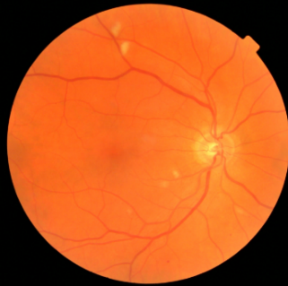
Previously: predictive models for image data
y, referrable diabetic retinopathy
x, retinal image
End goal: predict y from x
Notes:
It’s just another predictive model.
But, we need a much more complex model to due to the complex, spatial structure of these data
Extract a hierarchy of increasingly complex features

Slide 28
Now: predictive models for text data (NLP)
y, abnormality present
x, radiology report
End goal: predict y from x
Notes:
Today, we’re going to consider a new kind of predictive model, one in which the input to the model is a text document, and the output is a label associated with that document
For example, the input might be a radiology report, and the output might be a binary label indicating whether an abnormal finding was noted in the report
But as we know, all our predictive models – logistic regression, MLP, CNN – they all work with numbers
So, right from the start we’re faced with a difficult problem – how can we convert a document into a feature vector that encodes its contents?
If we can do that, we can then apply any of the classification models we’ve previously discussed
So, that’s the problem we’ll be solving today.

Slide 29
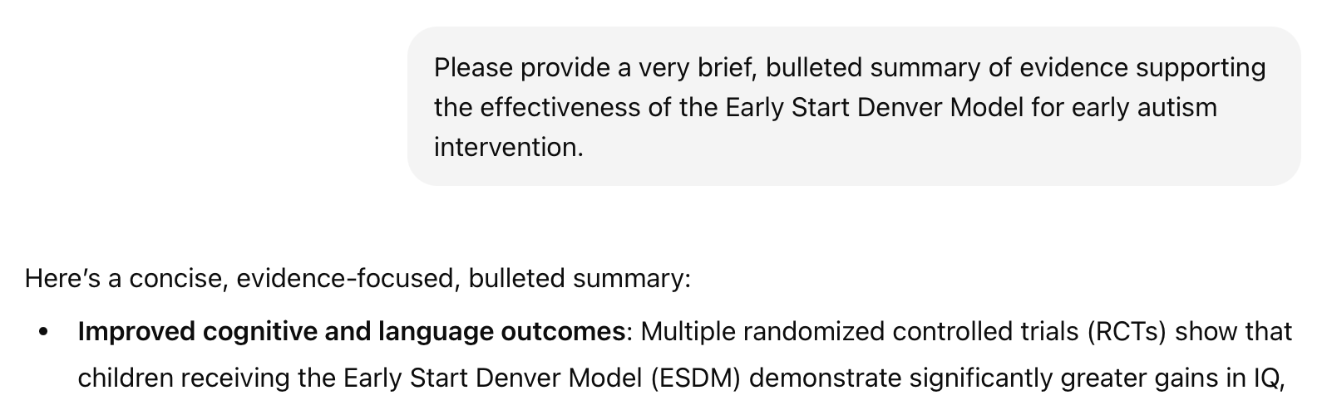

Is this generative or predictive?
y, next word
x, conversation history
“next-token prediction”
Notes:
Now, what about the systems we’re seeing today?
Does the paradigm I’ve described still fit?
“next-token predictor”
“stochastic parrot”
Generation via repeated prediction
Make the point about truth

Slide 30
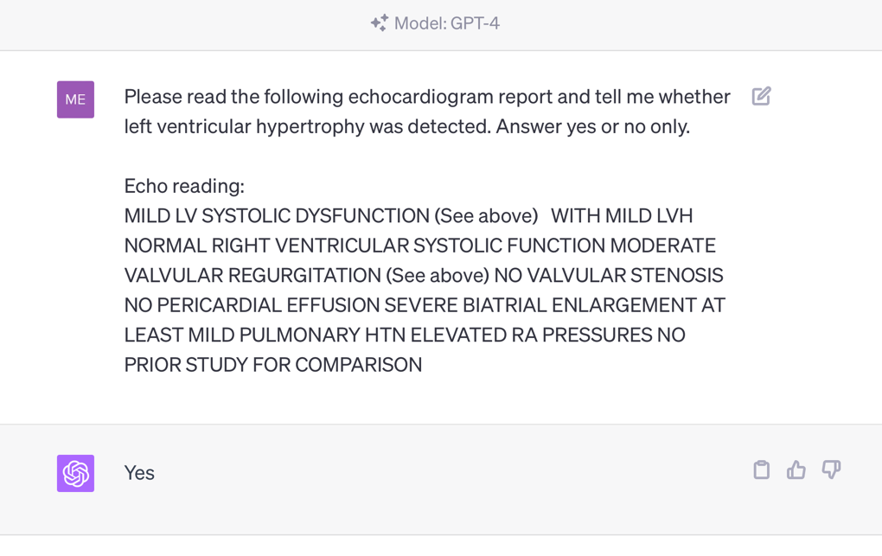
Are all tasks special cases of text generation?
Notes:
Question: *should we* be using generative models for all NLP tasks?
Advantages?
zero-shot
convenient
Disadvantages?
- expensive

Slide 31
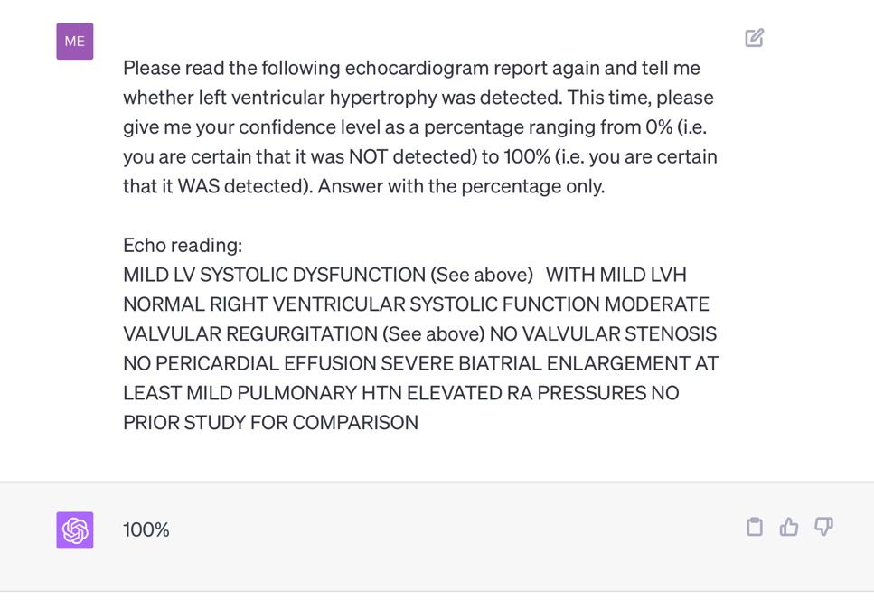
Are all tasks special cases of text generation?
Notes:
Question: *should we* be using generative models for all NLP tasks?
Advantages?
zero-shot
convenient
Disadvantages?
- expensive

Slide 32
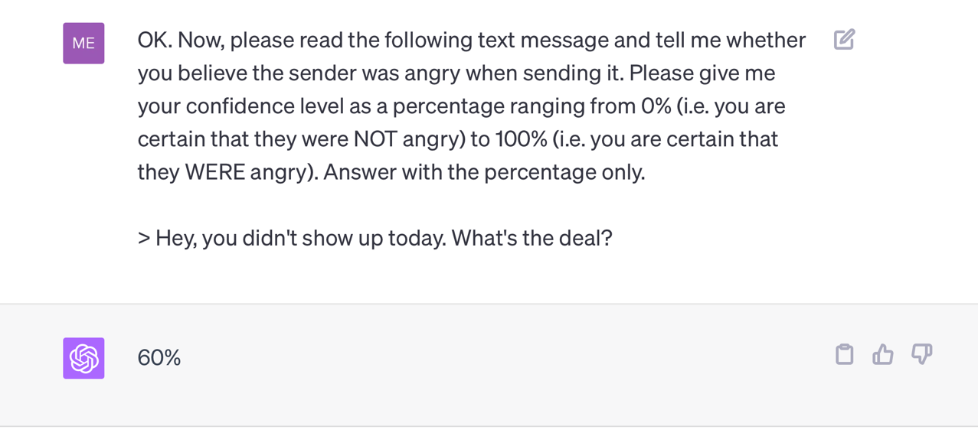
Are all tasks special cases of text generation?
Notes:
Question: *should we* be using generative models for all NLP tasks?
Advantages?
zero-shot
convenient
Disadvantages?
- expensive

Slide 33
A look ahead: LLMs are initially trained to predict the next word
y, next word
x, conversation history
“next-token prediction”
Notes:
Now, what about the systems we’re seeing today?
Does the paradigm I’ve described still fit?
“next-token predictor”
“stochastic parrot”
Generation via repeated prediction
Make the point about truth

Slide 34
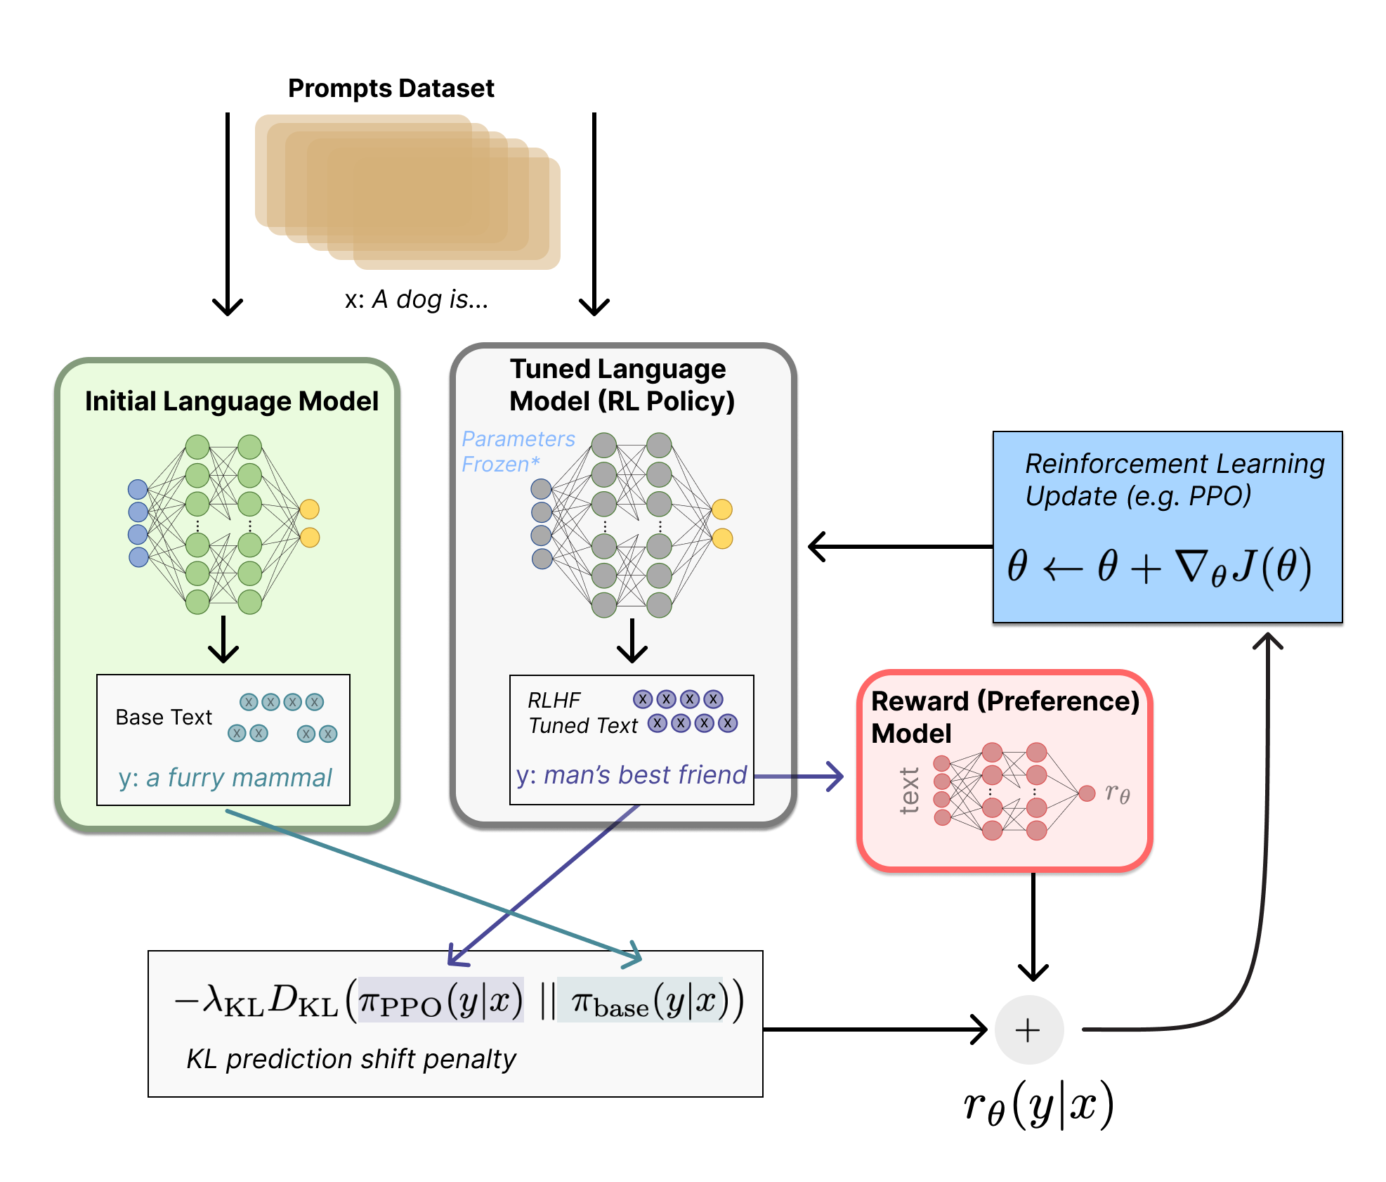
They’re then fine-tuned to match our preferences
Step 1: Train an auxiliary preference model (via human feedback) to assign scores to LLM-generated text that are consistent with our preferences
Step 2: Fine-tune the initial LLM (via reinforcement learning) to achieve better scores, implying better alignment with our preferences
Illustrating Reinforcement Learning from Human Feedback (RLHF)
https://huggingface.co/blog/rlhf
Notes:
Now, what about the systems we’re seeing today?
Does the paradigm I’ve described still fit?
“next-token predictor”
“stochastic parrot”
Generation via repeated prediction
Make the point about truth

Slide 35
Foundations of NLP
A count-based model for maternal health triage
Notes:
Stimulate discussion here

Slide 36

Case Study: SMS Triage for Global Maternal Health
Maternal Health HelpDesk:
2 million women connected to NDoH staff via SMS
https://www.praekelt.org
Binary Classification: Urgent Message? (Yes/No)

Slide 37
A Simple Predictive Model: ICU Mortality
???
WBC Count
Respiratory Rate
Creatinine
Mean BP
Hematocrit
Age
Temperature
Pulse Rate
Survival
End goal: predict odds of hospital mortality
Notes:
What goes in these boxes?

Slide 38
Training Set (Historical Data)
x₁
y₁
Find an equation that predicts $y$ based on $x$ across the training set
x₂
y₂
x₃
y₃
x₄
y₄
…
…
x_{N-1}
y_{N-1}
x_{N}
y_{N}
Notes:
How do we do that?
Gather a bunch of historical data
Want to find an equation that predicts y well based on x across that historical data
So we take all this data, we use it to find the parameters that are most consistent with the patterns of x and y that are present

Slide 39
Making Predictions for New $x$
x₁
y₁
x₂
y₂
Find an equation that predicts $y$ based on $x$ across the training set
<- Learn to predict new $y$
x₃
y₃
x₄
y₄
…
…
x_{N-1}
y_{N-1}
x_{N}
y_{N}
x_{N+1}
y_{N+1}
Notes:
Having done that, we have a trained model.
Now, when we see a NEW value of x, we simply plug it into our “learned” equation, and it tells us what we expect y to be. This is prediction.

Slide 40
Case Study: SMS Triage for Global Maternal Health
https://www.praekelt.org
Can we use a standard predictive model
setup to solve this problem?

Slide 41
This time, our training data is text
x₁
What helps with morning sickness?
How many months should I breastfeed?
I passed out and Mom said I was shaking
Where is the nearest clinic?
I am having heavy bleeding, what should I do?
What foods should I eat while pregnant?
My heart is racing and I can’t catch my breath
y₁
x₂
y₂
x₃
y₃
$yi$: Urgent or
Not Urgent?
<- Learn to predict new $y$
x₄
y₄
…
…
x_{N-1}
y_{N-1}
x_{N}
y_{N}
x_{N+1}
y_{N+1}
Notes:
Having done that, we have a trained model. Our parameters are learned – we hold them fixed.
Now, when we see a NEW value of x, we simply plug it into our “learned” equation, and it tells us what we expect y to be. This is prediction.

Slide 42
We need numbers, not words
Can we convert our text to a vector or sequence of numbers?
If yes, we can use logistic regression (or any other predictive model)!

Slide 43
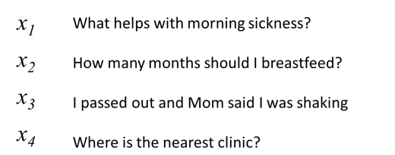
First try: count words in each SMS Step 1: Define a vocabulary of words
shaking
what
clinic
how
helps
was
nearest
many
with
said
months
the
morning
mom
should
sickness
and
I
is
how
out
breastfeed
passed
where
list of all words
(in no particular order)

Slide 44
Step 2: count how many times each vocabulary word appears in a given SMS
shaking
what
clinic
how
helps
was
nearest
many
with
said
months
the
morning
mom
should
sickness
and
I
is
how
out
breastfeed
passed
where
What helps with morning sickness?
x₁
0 | 1 | 0 | 0 | 1 | 0 | 0 | 0 | 1 | 0 | 0 | 0 | 1 | 0 | 0 | 1 | 0 | 0 | 0 | 0 | 0 | 0 | 0 | 0

Slide 45
Step 2: count how many times each vocabulary word appears in a given SMS
shaking
what
clinic
how
helps
was
nearest
many
with
said
months
the
morning
mom
should
sickness
and
I
is
how
out
breastfeed
passed
where
I passed out and Mom said I was shaking
x₃
1 | 0 | 0 | 0 | 0 | 1 | 0 | 0 | 0 | 1 | 0 | 0 | 0 | 1 | 0 | 0 | 0 | 2 | 0 | 0 | 1 | 0 | 1 | 0

Slide 46
Note that word order does not matter!
shaking
what
clinic
how
helps
was
nearest
many
with
said
months
the
morning
mom
should
sickness
and
I
is
how
out
breastfeed
passed
where
clinic is where nearest the
x₄
0 | 0 | 1 | 0 | 0 | 0 | 1 | 0 | 0 | 0 | 0 | 1 | 0 | 0 | 0 | 0 | 0 | 0 | 1 | 0 | 0 | 0 | 0 | 1

Slide 47

A “bag of words”
clinic
nearest
where
the
is

Slide 48
A “bag of medical codes”
E55.9
(you did this in coding assignment 1)
F84.5
Z79.01
E11.9
N39.0

Slide 49
Now we can use logistic regression.
$$URGENCY LOG ODDS=β0+β1x1+β2x2+…$$
LOG ODDS
𝜎
y
shaking
clinic
morning
mom
sickness
breastfeed
passed
where
$$β1 β8$$
y, associated label:
(0 = not urgent, 1 = urgent)
x₁ | x₂ | x₃ | x₄ | x₅ | x₆ | x₇ | x₈

Slide 50
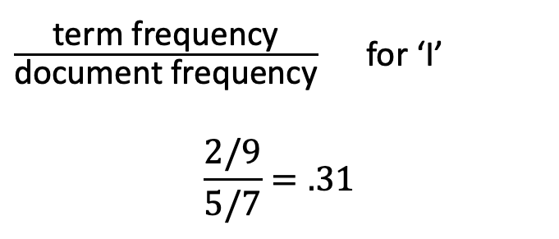
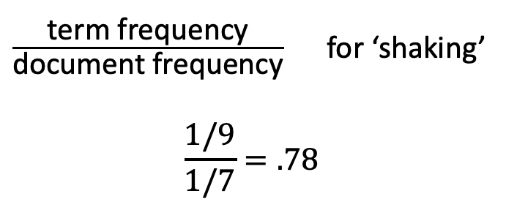
Variation on counts: term frequency-inverse document frequency (tf-idf)
What helps with morning sickness?
How many months should I breastfeed?
I passed out and Mom said I was shaking
Where is the nearest clinic?
I am having heavy bleeding, what should I do?
What foods should I eat while pregnant?
My heart is racing and I can’t catch my breath
$\frac{\text{term} \text{frequency}}{\text{document} \text{frequency}}$ for ‘shaking’
$$\frac{1/9}{1/7}=.78$$
$\frac{\text{term} \text{frequency}}{\text{document} \text{frequency}}$ for ‘I’
$$\frac{2/9}{5/7}=.31$$

Slide 51
Count-based feature extraction is still useful!
Entirely data-driven
Vocabulary of words we care about is derived from the training data
We then represent text as counts of each vocabulary word
We can also count 2- and 3-word phrases; this helps with negation and context
Knowledge-driven extraction of key words or concepts
Rather than creating a vocabulary from the data, we can identify words we (or content experts) believe are important for a given task
Concept extraction systems (e.g. cTakes) will identify many alternative phrasings for the same clinical concept (e.g. diagnosis) and group them together as a single feature

Slide 52
Discuss: pros and cons of the bag of words approach
This is important because:
Understanding the limitations of this approach is important before we consider how current approaches overcome them
Simple, bag of words models are still appropriate in some cases, and they are highly interpretable

Slide 53
Strengths and Weaknesses
(+) Count-based approaches are simple and work surprisingly well in practice
(+) Often the best approach with small datasets
(-) Does not capture word order or interpret words in context
(-) Does not group synonyms together or understand semantic relationships between words

Slide 54
Next time: word and concept embeddings

