Slide 1
Word and Concept Embeddings
Matthew Engelhard
Notes:
Last time, we talked about what word embeddings are and why they’re useful,
and then we took a look at VSWEM, a very simple word embedding based model.
Now that we have word embeddings, we can convert text to a sequence of vectors,
making NLP very similar to other sequence and time-series prediction tasks. We’ll explore that in a later lecture.
In this lecture, we’ll dig deeper into the question of what word embeddings are
by exploring how they’re learned; and of course, these two things are very closely related.

Slide 2
Logistics
Review session on April 13
In-class final on April 15
Coding assignment 3 will be posted ASAP (likely this evening) and is due on May 2

Slide 3

Last time: “bag of words” models
(+) Count-based approaches are simple and work surprisingly well in practice
(+) Often the best approach with small datasets
(-) Word representations are highly sparse and therefore inefficient
(-) Does not capture word order or interpret words in context
(-) Does not group synonyms together or understand semantic relationships between words
clinic
nearest
where
the
is

Slide 4
Today
Motivating word embeddings
How we learn word embeddings
What we can do now that we have word embeddings
Embedding-based models
Word/concept retrieval
Medical concept embeddings

Slide 5
Motivating word embeddings
Key problem: quantifying semantic relationships between words
Notes:
Old but important

Slide 6
Word embedding: a numeric representation of a word that encodes its meaning
miserable
upset
joyful
melancholy
happy
content
euphoric
sad
unhappy
satisfied
merry
ecstatic
sorrowful
depressed
down
gleeful
<- sadder
happier ->
Numeric value indicating whether the word is happy or sad

Slide 7
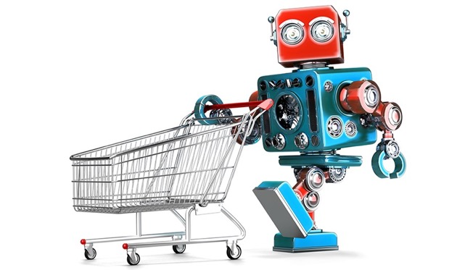
Grocery List
Training a robot to buy groceries
granulated sugar
vanilla extract
dark brown sugar
carrots
table salt
eggs
Example from Anand Chowdhury, MMCi 2019
Notes:
The robot doesn’t know all this stuff – too many grocery items!

Slide 8
Identify items by their attributes (including previously unseen items)
Dimension | 1 | 10
State | Liquid | Solid
Sweetness | Bland | Sweet
Color | Light | Dark
Size | Small | Large
Carrotness | Not really | Platonic essence of carrot

Slide 9
Why does this help us?
The model can make sense of words it hasn’t seen before (weren’t used in training)
Similar words (e.g. synonyms) will have similar attributes, and therefore will have similar effect on model predictions
(more complicated) Now we can convert text to a sequence of vectors; and we were already very good at making predictions from sequences of vectors

Slide 10
How do we learn word embeddings?
Key idea: words are defined by the contexts in which they appear

Slide 11
How do we learn these attributes?
KEY IDEA: words are defined by the contexts in which they appear
A man strolls down the street
Consider substituting one word for another.
Claim: if two words are equally likely to appear all possible contexts, then the two words mean the same thing.
A woman strolls down the street
A child strolls down the street
A crocodile strolls down the street
A banana strolls down the street
A concept strolls down the street

Slide 12
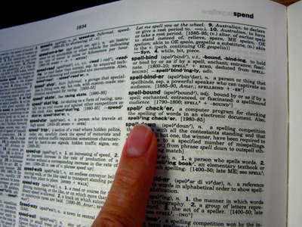
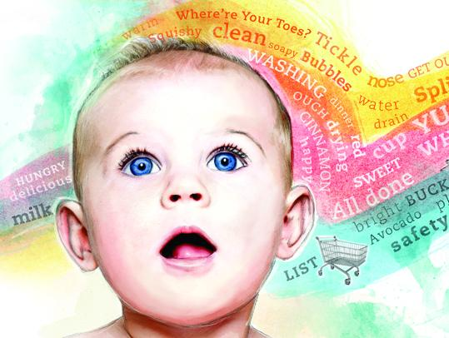
How do we learn these attributes?
KEY IDEA: words are defined by the context in which they appear
-> if words are always exchangeable, they must have very similar meaning
https://www.parenting.com/activities/baby/teach-baby-to-talk/
learn word meaning like an adult:
explicit definitions
learn word meaning like an child:
implicit definitions from context
Notes:
Like a (my) child: have the TV teach them!

Slide 13
Step 1: define co-occurrence or context
We define a context word as one that appears inside a fixed-length window around the input word in our training corpus.
(e.g. Wikipedia)
A man strolls down the street.
input context
{input word, context word}
{strolls, man}
{strolls, woman}
{swims, crocodile}
{swims, fish}
{flies, bird}
{flies, plane}
Notes:
Again, our goal is to take an input word – in this example, ‘strolls’ – and predict the probability that each word in our vocabulary will appear in its context.
What is our training set?
We can crawl through a huge text corpus – it could be Wikipedia, Twitter, randomly collected internet sites, and so on – and sample pairs of words that appear near one another.
We find that strolls appears near man, so {strolls, man} becomes an input word, context word pair
Similarly, we find that ‘flies’ appears near ‘bird’, so {flies, bird} becomes an input word, context word pair
Note that {bird, flies} is also a valid input word, context word pair: if bird appears in the context of flies, then flies also appears in the context of bird – the relationship is symmetric.
We might use a ‘context window’ of length 5, as shown in the slide, so that the input words and context words can be separated by one intervening word at most
Now we’ll create a model that predicts input words from context words

Slide 14
Step 2: find vector representations sufficient to predict the likely context (i.e. what other words are likely/unlikely to be nearby)
p(man)
p(woman)
elements of the vector corresponding to “strolls”
predict/
reconstruct
p(child)
probabilities for all words in our vocabulary
p(banana)
p(crocodile)
v(strolls)
p(concept)
Notes:
So, how do we set up the learning problem? Informally, we’re defining words based on context.
But to make that idea precise, let’s create a predictive model that encapsulates that intuition.
What we’d like to have is, for each word, a vector that allows us to predict which other words are likely to be nearby, and which words are not
In the example on the slide, we’d like to have a vector for the word ‘strolls’ that allows us to predict which words are likely to be found in its immediate context. The predicted probability of ‘woman’ should be fairly high, and the predicted probability of ‘concept’ should be very low
We’ll need predictions for each word in our vocabulary – again, this is the complete list of words we’re interested in, and for which we’d like to have word vectors. For each of those words, our model will predict the probability that that word will appear in the context of the word ‘strolls’, in this case
With this goal in mind, let’s consider how to set up our prediction task

Slide 15
Step 2: find vector representations sufficient to predict the likely context (i.e. what other words are likely/unlikely to be nearby)
p(man)
p(woman)
largest
elements of the vector corresponding to “strolls”
predict/
reconstruct
p(child)
probabilities for all words in our vocabulary
p(banana)
p(crocodile)
small but non-zero
v(strolls)
p(concept)
close to 0
Notes:
So, how do we set up the learning problem? Informally, we’re defining words based on context.
But to make that idea precise, let’s create a predictive model that encapsulates that intuition.
What we’d like to have is, for each word, a vector that allows us to predict which other words are likely to be nearby, and which words are not
In the example on the slide, we’d like to have a vector for the word ‘strolls’ that allows us to predict which words are likely to be found in its immediate context. The predicted probability of ‘woman’ should be fairly high, and the predicted probability of ‘concept’ should be very low
We’ll need predictions for each word in our vocabulary – again, this is the complete list of words we’re interested in, and for which we’d like to have word vectors. For each of those words, our model will predict the probability that that word will appear in the context of the word ‘strolls’, in this case
With this goal in mind, let’s consider how to set up our prediction task

Slide 16
Step 2: find vector representations sufficient to predict the likely context (i.e. what other words are likely/unlikely to be nearby)
p(man)
large but smaller than before
p(woman)
elements of the vector corresponding to “swims”
predict/
reconstruct
p(child)
probabilities for all words in our vocabulary
p(banana)
p(crocodile)
larger than before
v(swims)
p(concept)
close to 0
Notes:
So, how do we set up the learning problem? Informally, we’re defining words based on context.
But to make that idea precise, let’s create a predictive model that encapsulates that intuition.
What we’d like to have is, for each word, a vector that allows us to predict which other words are likely to be nearby, and which words are not
In the example on the slide, we’d like to have a vector for the word ‘strolls’ that allows us to predict which words are likely to be found in its immediate context. The predicted probability of ‘woman’ should be fairly high, and the predicted probability of ‘concept’ should be very low
We’ll need predictions for each word in our vocabulary – again, this is the complete list of words we’re interested in, and for which we’d like to have word vectors. For each of those words, our model will predict the probability that that word will appear in the context of the word ‘strolls’, in this case
With this goal in mind, let’s consider how to set up our prediction task

Slide 17
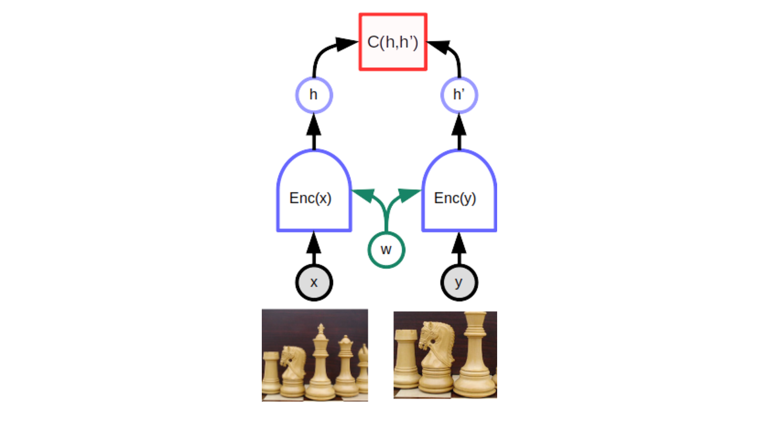
Recall: self-supervised learning
contrastive / noise contrastive
We are predicting context words from input words (skip-gram)
Later we will consider a noise contrastive version of this
masked token / patch / sequence prediction

Slide 18




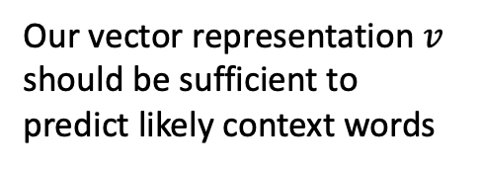
The skip-gram model
softmax
p(man)
p(woman)
p(child)
Our vector representation $v$ should be sufficient to predict likely context words
p(banana)
$$U$$
p(crocodile)
$$v$$
p(concept)
$$Uv$$
$$softmax(Uv)$$
Notes:
And then, instead of our more general notation, we’ll annotate the image to indicate that on the left, we have the vector for the word strolls, in the middle, we have all the log-odds scores for all our vocabulary words, and on the right, we have all the probabilities for all our vocabulary words

Slide 19
The skip-gram model
How do we learn these vectors?
First we’ll consider from first principles how we might predict context words based on input words
softmax
p(man)
p(woman)
p(child)
p(banana)
$$U$$
p(crocodile)
$$v$$
p(concept)
$$Uv$$
$$softmax(Uv)$$
Notes:
And then, instead of our more general notation, we’ll annotate the image to indicate that on the left, we have the vector for the word strolls, in the middle, we have all the log-odds scores for all our vocabulary words, and on the right, we have all the probabilities for all our vocabulary words

Slide 20
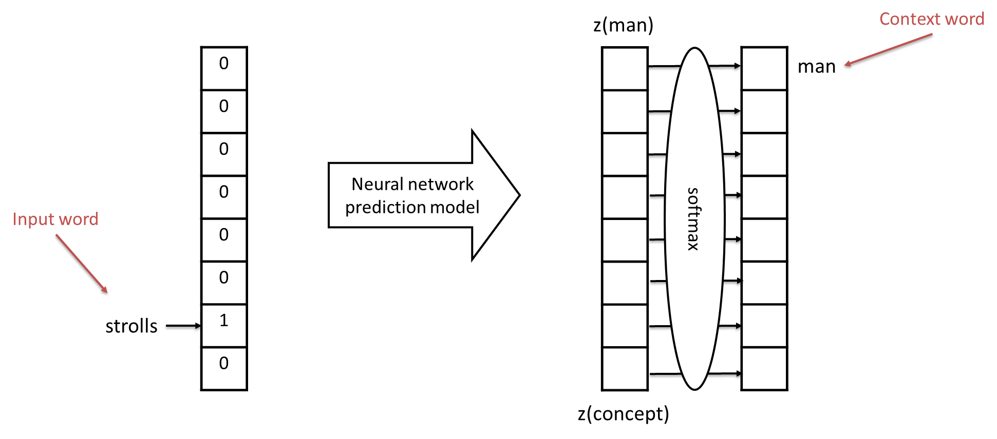
The skip-gram model
Input words and context words are one-hot encoded
(similar to bag of words representation)
Notes:
We’ll represent our input word the same way we represented sentences in our bag of words lecture, namely by taking a vector of all zeros that’s the length of our vocabulary, then placing a 1 in the position that corresponds to that word. In this case, if ‘strolls’ is the one thousandth word in our vocabulary, we’d put a 1 in position one thousand.
Note that during training, our labels – in this case, the correct context word – are created in the exact same way.
Now we have the bare bones of a model that predicts the likely context word based on the input word – what remains is to choose how we connect the two.

Slide 21
The skip-gram model
Training Data:
HUGE number of pairs of the following form:
{input word, context word}
e.g. from Wikipedia
Examples:
{strolls, man}
{strolls, woman}
{swims, crocodile}
{swims, fish}
{flies, bird}
{flies, plane}
Notes:
Once we’ve chosen how to connect them, we can use that training set we described before – the huge number of pairs, likely billions, of input words and context words.

Slide 22
The skip-gram model
Training Data:
HUGE number of pairs of the following form:
{input word, context word}
e.g. from Wikipedia
Examples:
{strolls, man}
{strolls, woman}
{swims, crocodile}
{swims, fish}
{flies, bird}
{flies, plane}
These vectors are huge!
They’re the size of our vocabulary
Notes:
But remember, the input and output vectors for this problem are huge – they’re the size of our vocabulary, which will be many thousands of words.

Slide 23
The skip-gram model
First idea:
Directly connect our input to the log-odds layer
These vectors are huge!
They’re the size of our vocabulary
Notes:
What’s the simplest possible way to connect the input to the output?
Well, we could simply connect them directly, as in logistic regression
This seems simple, but will it work?

Slide 24
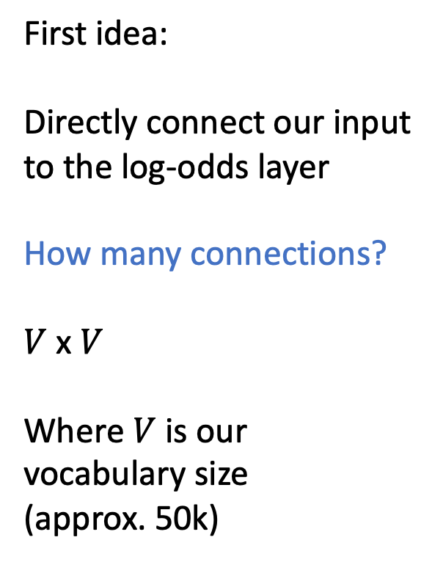
The skip-gram model
First idea:
Directly connect our input to the log-odds layer
How many connections?
$V$ x $V$
Where $V$ is our vocabulary size
(approx. 50k)
These vectors are huge!
They’re the size of our vocabulary
Notes:
The problem is that our vocabulary is too large!
Let’s suppose we have 50,000 words in our vocabulary, which is about right – it’s estimated that the average native English speaker knows about 25,000 words
we need to connect all 50,000 input words to all 50,000 output words, so the number of parameters is 50,000 squared, whcih is 2.5 billion!
A model with 2.5 billion parameters actually might be achievable in 2021, but it wasn’t when word vectors were first created
And furthermore, it doesn’t really give us what we’re looking for, which is a compact, numeric vector that represents ‘strolls’

Slide 25
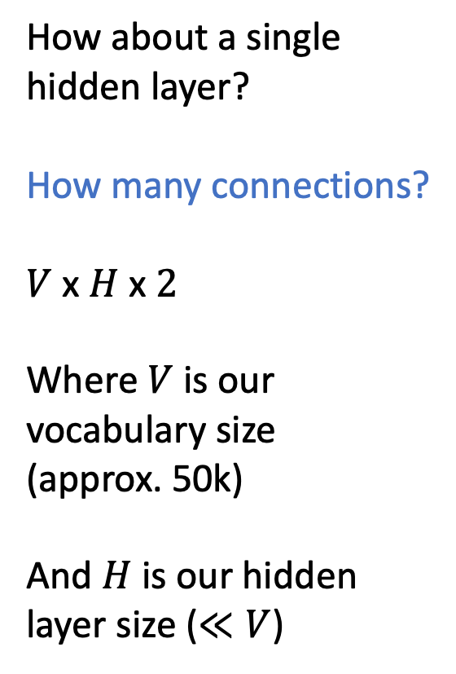
The skip-gram model
How about a single hidden layer?
How many connections?
$V$ x $H$ x $2$
Where $V$ is our vocabulary size
(approx. 50k)
And $H$ is our hidden layer size ($≪V$)
These vectors are huge!
They’re the size of our vocabulary
Notes:
So, what’s the next simplest thing we might consider?
Well, we could have a single hidden layer of size H, where H is much smaller than 50k – maybe something like 100.
How many parameters would be in such a model? Well, there would be V x H connections in the first layer – we’re connecting each vocabulary word to each of our hidden units – and there would be H x V connections in the second layer – we’re connecting each hidden unit to the log-odds corresponding to each context word.
For a vocabulary of size 50k and hidden layer of size 100, this gives us 10 million parameters, which is still big, but much less than 2.5 billion.

Slide 26
The skip-gram model
z(man)
0
0
0
0
0
0
1
0
softmax
1
0
0
0
0
0
0
0
man
strolls
z(concept)
Notes:
So, let’s try it – here’s the architecture we have in mind, with 10 million parameters

Slide 27
Use mini-batches of training examples; minimize cross-entropy loss
z(man)
0
0
1
0
0
0
0
0
softmax
0
0
0
0
0
1
0
0
swims
crocodile
z(concept)
Notes:
We’ll train it using all those training examples we collected from Wikipedia – those {input word, context word} pairs – to minimize the cross-entropy loss between the true context word and the predicted probabilities.

Slide 28




Weight Matrices $E$ and $U$ (input embeddings E; target embeddings U)
0
0
1
0
0
0
0
0
softmax
0
0
0
0
0
1
0
0
swims
crocodile
$$E$$
$$U$$
$$v=Ex$$
$$softmax(Uv)$$
Notes:
There are two matrices of parameters in this model – we’ll call the first matrix W, and the second B
Note that sometimes E and U might be tied, i.e. U=E^T

Slide 29

Weight Matrices $E$ and $U$ (input embeddings E; target embeddings U)
0
0
1
0
0
0
0
0
softmax
0
0
0
0
0
1
0
0
swims
crocodile
$$E$$
$$U$$
$$v=Ex$$
$$softmax(Uv)$$
*consider tying $E$ and $U$ such that $U=E^{T}$
Notes:
There are two matrices of parameters in this model – we’ll call the first matrix W, and the second B
Note that sometimes E and U might be tied, i.e. U=E^T

Slide 30


This is the vector we need; the embedding of swims
z(man)
0
0
1
0
0
0
0
0
softmax
p(man)
p(woman)
swims
p(child)
p(banana)
it’s compact
It allows us to predict context words for a given input word
p(crocodile)
$$E$$
$$U$$
p(concept)
v(swims) ??
z(concept)
Notes:
And now, if we step back, we see that the right side of this model looks like the logistic regression model we initially wanted…
The matrix W maps our input word to a small number of features, or attributes – and these features are used in turn to predict which context words are likely vs unlikely.
These features, or attributes – these are exactly what we were looking for – they’re attributes associated with the input word that allow us to predict its context. This is our word vector.

Slide 31
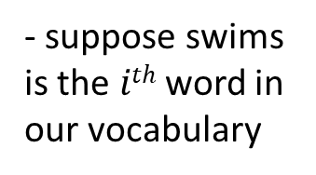
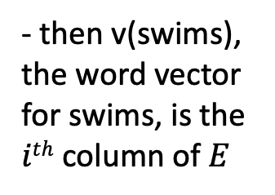


$E$ is a look-up table of word embeddings
$$x$$
0
0
1
0
0
0
0
0
$$Ex=E^{i}$$
softmax
p(man)
p(woman)
swims
p(child)
- suppose swims is the $ith$ word in our vocabulary
p(banana)
p(crocodile)
$$E$$
$$U$$
- then v(swims), the word vector for swims, is the $ith$ column of $E$
v(swims)
p(concept)
Notes:
Now if we think about W, finding this vector gets even a little bit easier.
Because when we multiply by our one-hot representation of the input word – again, this is a vector with zeros everywhere, except there’ s a 1 in position corresponding to our vocabulary word -- we’ll call that position I
When we do that multiplication, it’s simply selecting the ith column of our parameter matrix W

Slide 32


$E$ is a look-up table of word embeddings
$V$, the size of the vocabulary
$d$, the size of our embeddings
Notes:
So, zooming in on W – it’s a matrix with H rows and V columns, where V is the size of our vocabulary. And the vector we get when our input is our ith vocabulary word is simply the ith column of this matrix

Slide 33

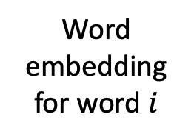
$E$ is a look-up table of word embeddings
$V$, the size of the vocabulary
$$i$$
Word embedding for word $i$
$d$, the size of our embeddings
Notes:
Which is shown here.
This ith column – this is the word vector corresponding to word i in our vocabulary.

Slide 34
We now have a distributed representation of word meaning based on context
z(man)
0
0
1
0
0
0
0
0
softmax
p(man)
p(woman)
swims
p(child)
p(banana)
p(crocodile)
$$E$$
$$U$$
v(swims)
p(concept)
z(concept)
Notes:
So, that’s it! Now we have a compact set of attributes for each vocabulary word that suffices to predict the other words that are likely to be nearby!
If the vectors are similar, the predicted context words will be similar!
If the vectors are different, the predicted context words will be different!
And the degree of difference in two word vectors depends on the degree of difference in the average context for those two words
We can think of these vectors of a ‘dense representation’ of the likely context, meaning that it’s a small number of numeric values that allows us to predict all those context words
This is what is meant by saying that we’re defining words in terms of the context in which they appear.

Slide 35
Variation 1: Continuous bag of words (CBOW)
Continuous Bag of Words (Mikolov et al., 2013)
Goal: Given surrounding context words, predict the center word
Architecture:
context words → look up embeddings → average → predict center word
Example: “A man [?] down the street” → predict “strolls”
v(center) ≈ average( v(A), v(man), v(down), v(the), v(street) )
Properties: Faster to train than skip-gram; works well for frequent words

Slide 36
Variation 2: negative sampling
Skip-gram with Negative Sampling (Mikolov et al., 2013)
Goal: Given a center word, predict which context words are real vs. noise
Training:
For each real pair (target, context), sample k “noise” words at random
Binary classification: is this a real pair or a noise pair?
Prediction: p(real) = σ( v_{target} · v_{context} )
Key advantage: Only need k+1 outputs per example (not full V-word softmax)
Works better than CBOW for rare words and larger datasets

Slide 37
Variation 3: factor the co-occurrence matrix
Step 1: Build a co-occurrence matrix M
M is V x V, where M[i,j] = count of times word i appears near word j in the corpus
Step 2: Factor using truncated SVD
M ≈ U_{d} Σ_{d} V_{d}^{T}
Keep only the top d singular values (d << V)
Step 3: Extract word vectors
Word vector for word i = row i of U_{d} (or U_{d}Σ_{d})
A compact d-dimensional representation that captures co-occurrence structure

Slide 38
Important detail: embeddings have norm 1
Constraint: ‖v‖ ≤ 1 (often normalized so ‖v‖ = 1)
Why constrain the norm?
Without constraint, embeddings can grow arbitrarily large during training
Large norms dominate similarity calculations regardless of direction
We want similarity to reflect meaning (direction), not magnitude
Key benefit:
With unit norm, cosine similarity = dot product
cos(a, b) = a · b / (‖a‖ · ‖b‖) = a · b (when ‖a‖ = ‖b‖ = 1)
All embeddings lie on the surface of a unit sphere in d-dimensional space

Slide 39
What can we do with word embeddings…
…to learn to extract increasingly complex aspects of meaning

Slide 40
Useful feature 1: retrieval
We wish to use embeddings to find words that have similar meaning to a given word
Step 1: obtain the embedding for a word of interest
Step 2: calculate cosine similarity with all other words in the vocabulary
Consider: why can’t we do retrieval with our one-hot representations?

Slide 41
Useful feature 2: applying existing models
Look up words individually to obtain their vectors
Construct a sequence of vectors
This is a sentence
x_{i}

Slide 42
What happens when we embed all words in a sentence?
Look up words individually to obtain their vectors
Construct a sequence of vectors
This is a sentence
Now we have a grid of numbers
Similar in many ways to an image
x_{i}

Slide 43
What happens when we embed all words in a sentence?
Look up words individually to obtain their vectors
Construct a sequence of vectors
This is a sentence
How do we aggregate over the sequence length?
Mean pooling
Max pooling
Learned pooling (i.e. linear attention)
(we will return to this next time)
x_{i}

Slide 44
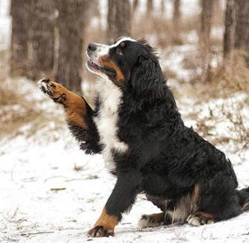
Now we can use deep learning to build our hierarchy of features.
low-level motifs
high-level motifs
dog
edges
shapes
textures
eyes
ears
paws
label
pixels
End goal: predict dog from pixels

Slide 45
Now we can use deep learning to build our hierarchy of semantic features.
low-level motifs
high-level motifs
PE
words
short phrases
concepts
topics
label
grid of semantic attributes
End goal: predict pulmonary embolism from text
Notes:
Much like in deep learning, low-level semantic features are often shared across domains/tasks, but higher level features are more task specific. So again, we can reuse models trained in different domains.

Slide 46
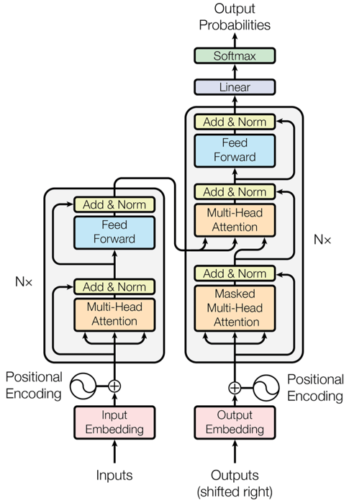
Next time: Transformer architecture
In current LLMs, embeddings are learned end to end with the rest of the model
However, the embedding concept remains central
We may view this architecture as progressively refining our embeddings based on context
Vaswani, Ashish, et al. "Attention is all you need." Advances in neural information processing systems 30 (2017).

Slide 47


Recipe for ChatGPT / modern LLMs
Word embeddings!
Backprop
Massive compute
RLHF
Transformer
Internet & Digitization

Slide 48
Important Takeaways:
We are learning a vector representation for each word based on the contexts in which it appears
training data: large number of pairs of nearby words from a large corpus
These vectors give us much more flexibility when modeling: makes text sequences like other sequences
Notes:
So, in summary:

Slide 49
Medical concept embeddings

Slide 50
Recall: our first step was to define the self-supervision task
We define a context word as one that appears inside a fixed-length window around the input word in our training corpus.
(e.g. Wikipedia)
A man strolls down the street.
input context
{input word, context word}
{strolls, man}
{strolls, woman}
{swims, crocodile}
{swims, fish}
{flies, bird}
{flies, plane}
Notes:
Again, our goal is to take an input word – in this example, ‘strolls’ – and predict the probability that each word in our vocabulary will appear in its context.
What is our training set?
We can crawl through a huge text corpus – it could be Wikipedia, Twitter, randomly collected internet sites, and so on – and sample pairs of words that appear near one another.
We find that strolls appears near man, so {strolls, man} becomes an input word, context word pair
Similarly, we find that ‘flies’ appears near ‘bird’, so {flies, bird} becomes an input word, context word pair
Note that {bird, flies} is also a valid input word, context word pair: if bird appears in the context of flies, then flies also appears in the context of bird – the relationship is symmetric.
We might use a ‘context window’ of length 5, as shown in the slide, so that the input words and context words can be separated by one intervening word at most
Now we’ll create a model that predicts input words from context words

Slide 51
Mini activity: how should we define the self-supervision task for medical codes?
If we know how to define {input code, context code} pairs, we can use any of the approaches we’ve described
Skip gram
CBOW
Negative sampling
Matrix factorization
How should we define these pairs?

