Slide 1
Attention and the Transformer architecture
Matt Engelhard

Slide 2
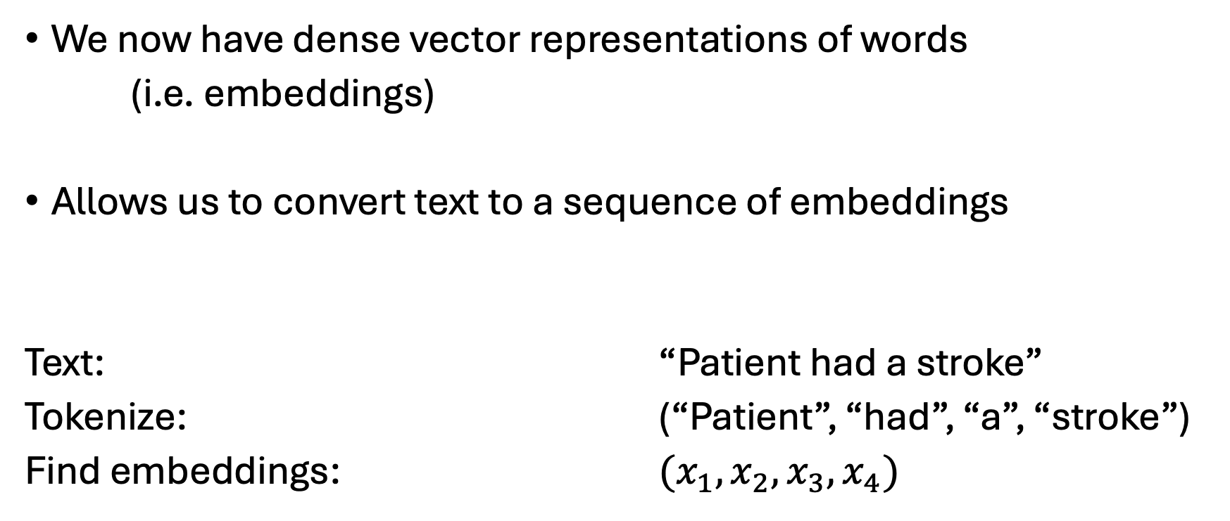
Recall: word embeddings
We now have dense vector representations of words
(i.e. embeddings)
Allows us to convert text to a sequence of embeddings
Text: “Patient had a stroke”
Tokenize: (“Patient”, “had”, “a”, “stroke”)
Find embeddings: $(x_{1}, x_{2}, x_{3}, x_{4})$
Notes:
Note that this can be done by converting to one-hot and then multiplying by embedding matrix
(V x d) embedding matrix E

Slide 3
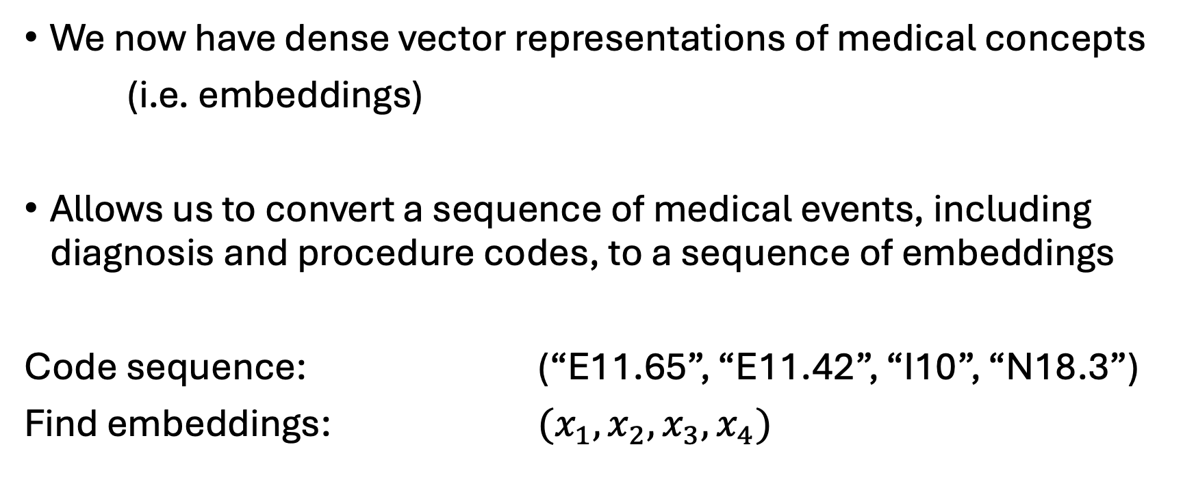
Recall: medical concept embeddings
We now have dense vector representations of medical concepts
(i.e. embeddings)
Allows us to convert a sequence of medical events, including diagnosis and procedure codes, to a sequence of embeddings
Code sequence: (“E11.65”, “E11.42”, “I10”, “N18.3”)
Find embeddings: $(x_{1}, x_{2}, x_{3}, x_{4})$
Notes:
Explain that this is a plausible sequence reflecting a clinical progression over time
E11.65 — Type 2 diabetes mellitus with hyperglycemia
E11.42 — Type 2 diabetes mellitus with diabetic polyneuropathy
I10 — Essential (primary) hypertension
N18.3 — Chronic kidney disease, stage 3

Slide 4
Motivating the Transformer
Discuss strengths and weaknesses of existing (prior to Transformer) alternatives for sequence-based prediction tasks

Slide 5
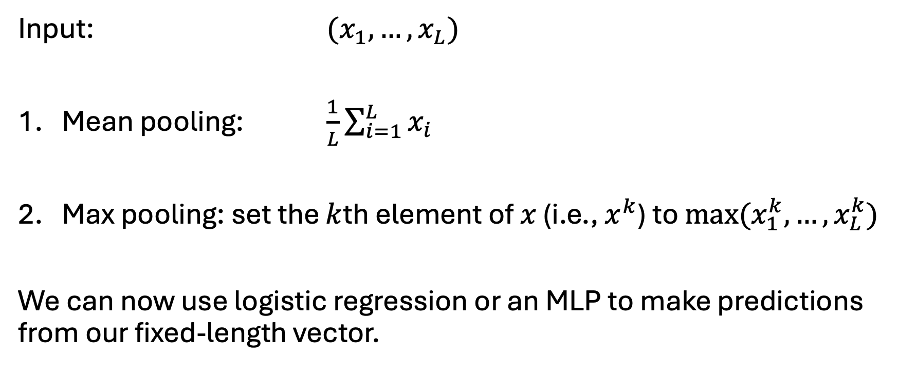
Making predictions from sequences Option 1: pooling
Input: $(x_{1}, …, x_{L})$
Mean pooling: $\frac{1}{L}\sum_{i=1}^{L}{x_{i}}$
Max pooling: set the $k$th element of $x$ (i.e., $x^{k}$) to $max⁡(x_{1}^{k}, …, x_{L}^{k})$
We can now use logistic regression or an MLP to make predictions from our fixed-length vector.

Slide 6





Making predictions from sequences Option 2: ConvNet
(d x L) sequence
K filters of
size (d x M)
Output has depth K
$$x_{1}$$
$$x_{2}$$
$$x_{3}$$
$$x_{4}$$
$$x_{5}$$
Notes:
These were the dominant NLP architecture after word embeddings were developed
Note: really, d should be depth

Slide 7
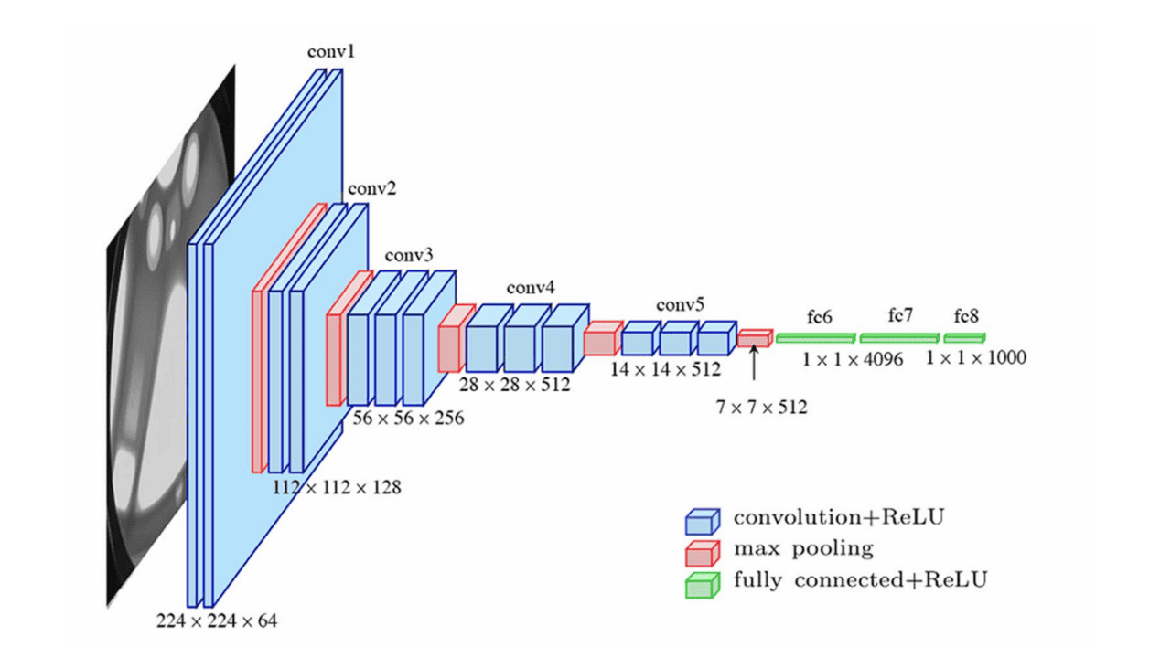
Weakness of ConvNets for language?
Important notes:
3 key types of layers
Progressive decrease in spatial resolution
Progressive increase in number of features
Not good at capturing long-range dependencies!
Image from: https://viso.ai/deep-learning/vgg-very-deep-convolutional-networks/

Slide 8













Making predictions from sequences Option 3: RNN
Sequence of Word
Embeddings (sentence)
$$h_{n−1}$$
Word-level
prediction
Neural
Network
$$h_{n}$$
$$w_{n−1}$$
Softmax
$$y_{n}$$
$$h_{n}$$
Neural
Network
$$h_{n+1}$$
$$w_{n}$$
Softmax
$$y_{n+1}$$
$$h_{n+1}$$
Neural
Network
$$w_{n+1}$$
Softmax
$$y_{n+2}$$
Also not good at learning long-range dependencies!
$$h_{n+2}$$
Notes:
We saw how this architecture could be used to predict the next word in the sequence, for example
Here, the goal is to classify each word in the sequence is classified as being PHI – one of several types – or not
in a way that’s not just informed by the embedding for that individual word, but by surrounding context

Slide 9
Attention is all you need (Vaswani et al., 2017)
“Recurrent neural networks … have been firmly established as state of the art approaches in sequence modeling and transduction problems such as language modeling and machine translation.”
“[Their] inherently sequential nature precludes parallelization within training examples, which becomes critical at longer sequence lengths, as memory constraints limit batching across examples.”
“Attention mechanisms … [allow] modeling of dependencies without regard to their distance in the input or output sequences.”
“In this work we propose the Transformer, a model architecture eschewing recurrence and instead relying entirely on an attention mechanism to draw global dependencies between input and output.”

Slide 10
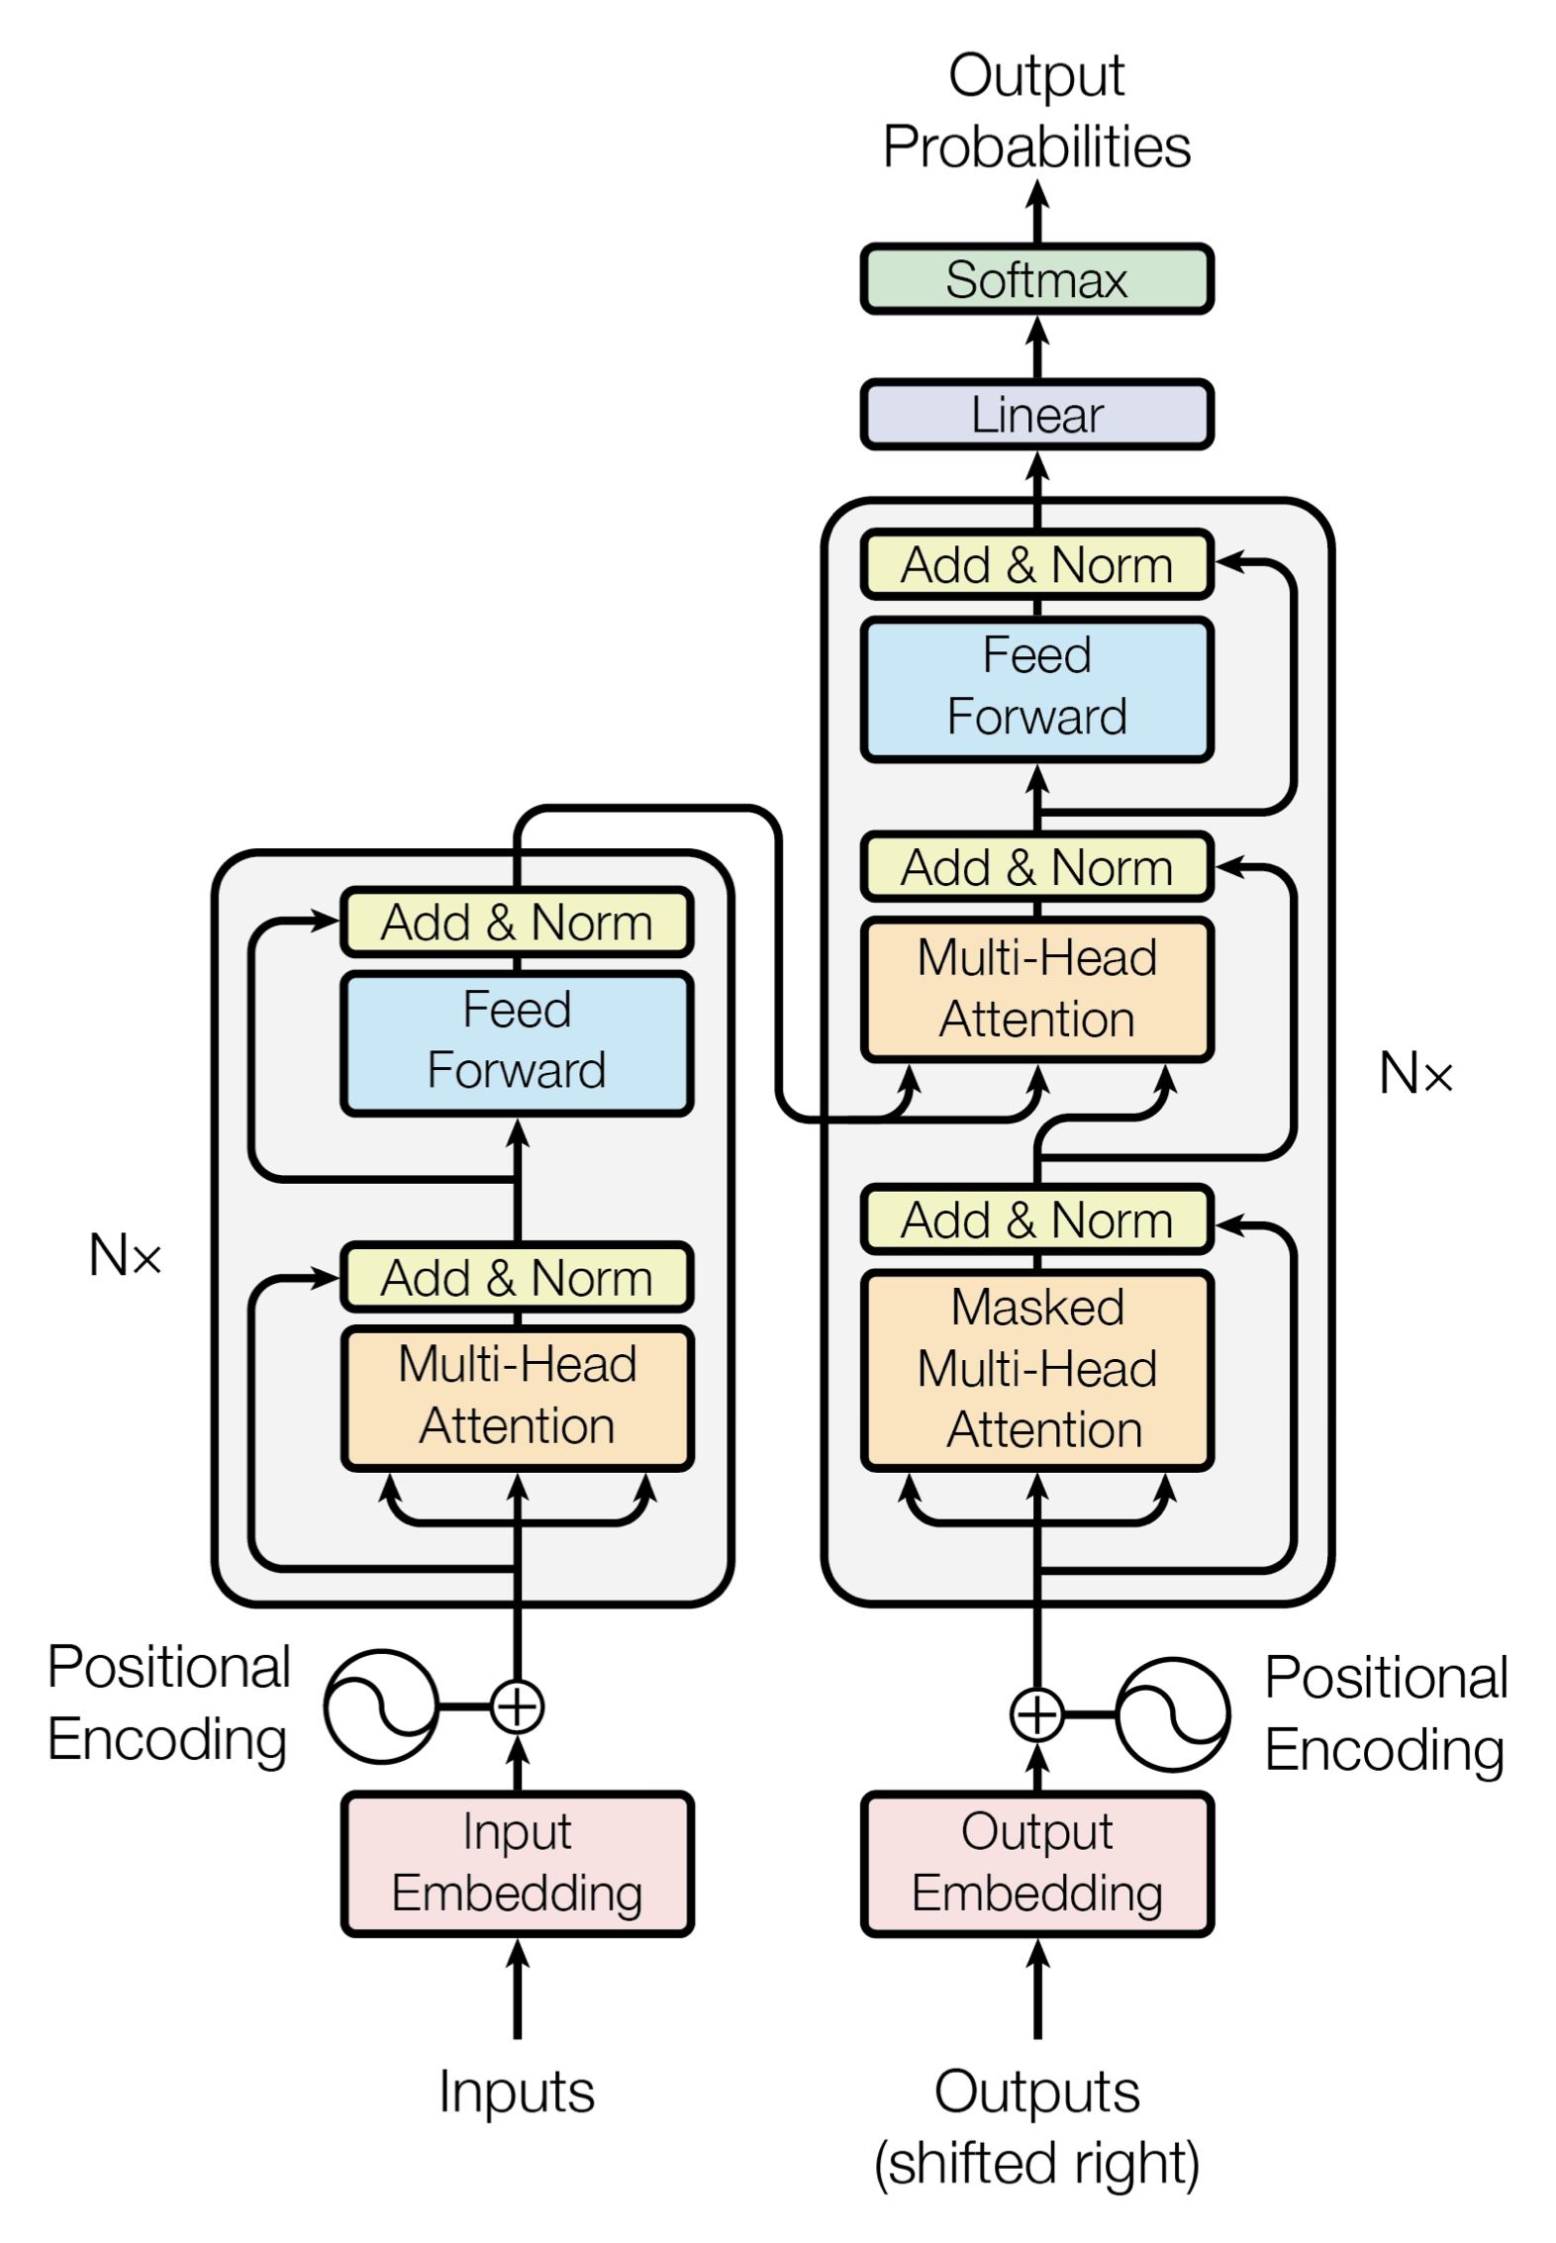
The Transformer
A neural network architecture based on the attention mechanism and thus able to capture long-range dependencies
This is an active area of study with many variations
We will focus on underlying principles more than specific architectures

Slide 11
Attention mechanisms

Slide 12
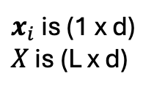
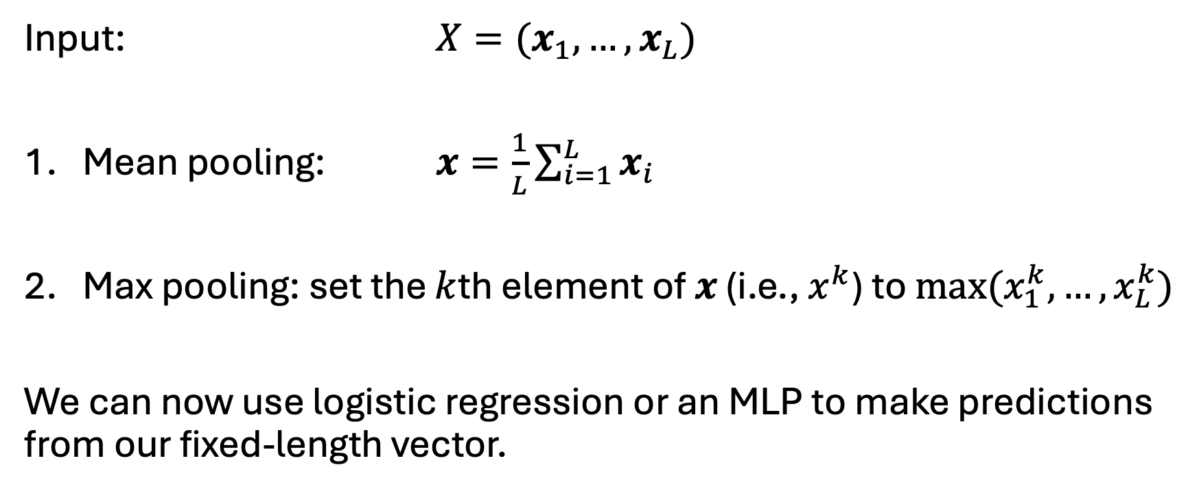
Simple linear attention
Input: $X=(x_{1}, …, x_{L})$
Mean pooling: $x=\frac{1}{L}\sum_{i=1}^{L}{x_{i}}$
Max pooling: set the $k$th element of $x$ (i.e., $x^{k}$) to $max⁡(x_{1}^{k}, …, x_{L}^{k})$
We can now use logistic regression or an MLP to make predictions from our fixed-length vector.
$x_{i}$ is (1 x d)
$X$ is (L x d)

Slide 13
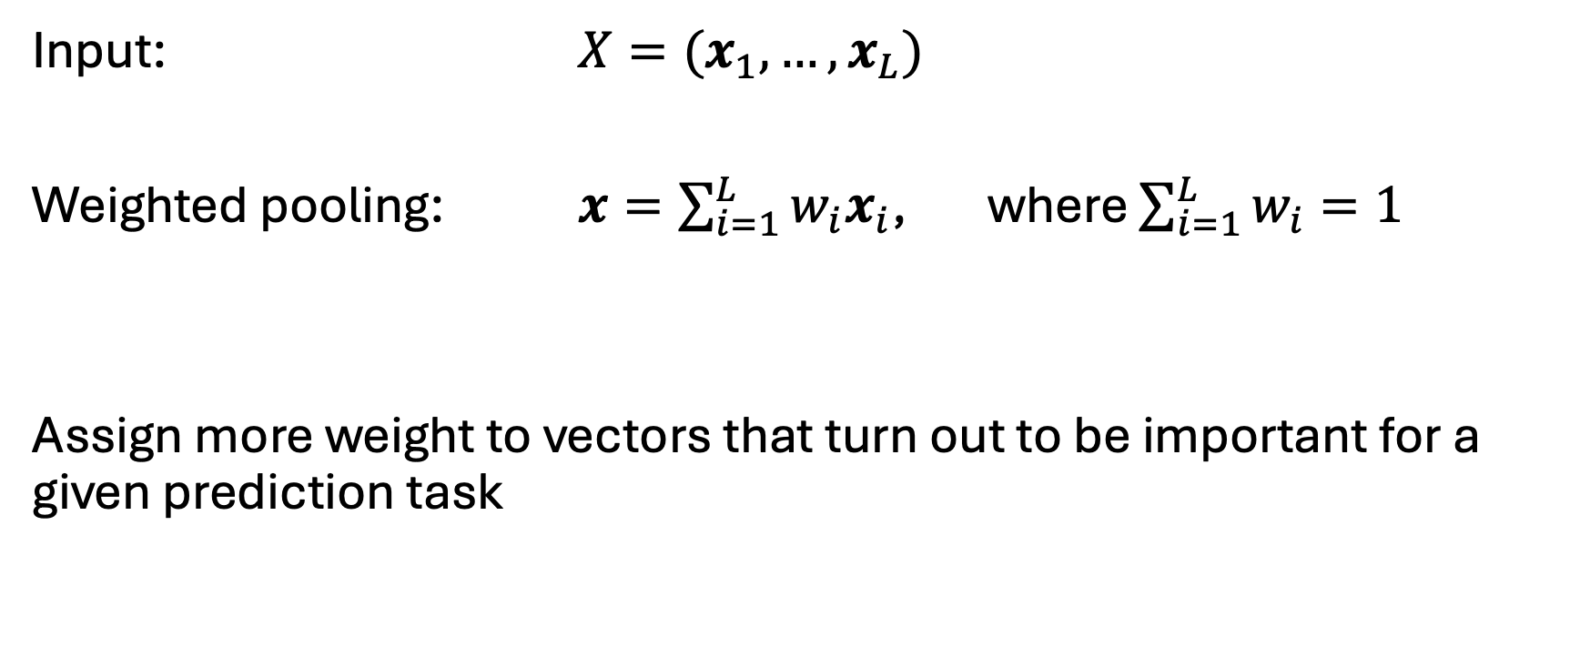
Is there a way to learn how to pool?
Input: $X=(x_{1}, …, x_{L})$
Weighted pooling: $x=\sum_{i=1}^{L}{w_{i}x_{i}}$, where $\sum_{i=1}^{L}{w_{i}}=1$
Assign more weight to vectors that turn out to be important for a given prediction task

Slide 14
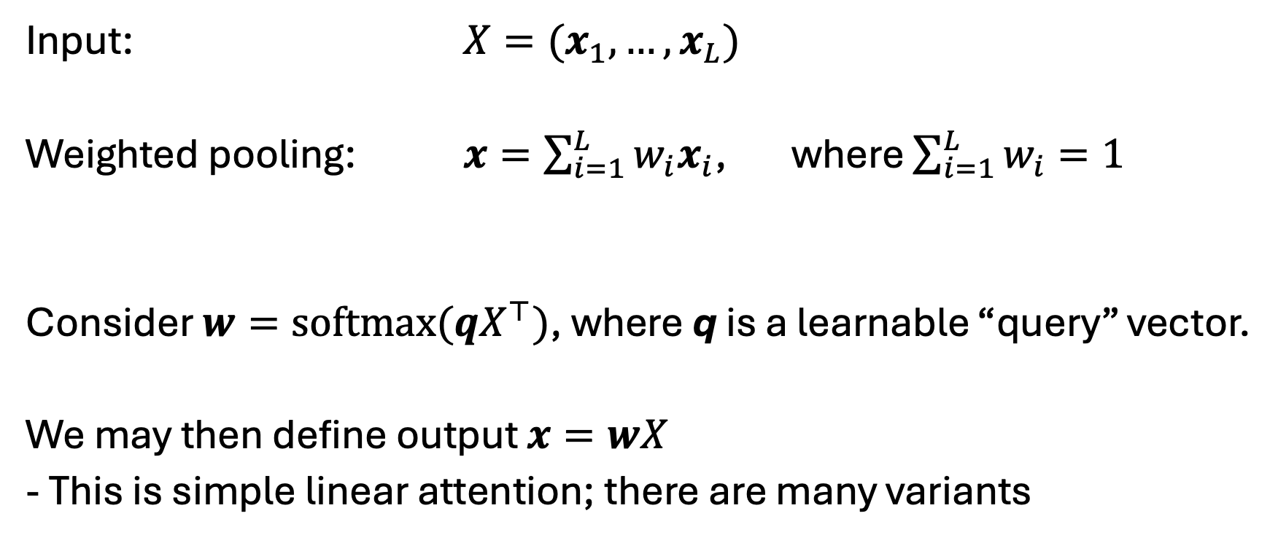
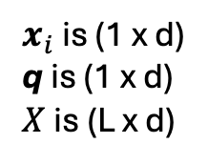
Is there a way to learn how to pool?
Input: $X=(x_{1}, …, x_{L})$
Weighted pooling: $x=\sum_{i=1}^{L}{w_{i}x_{i}}$, where $\sum_{i=1}^{L}{w_{i}}=1$
Consider $w=softmax(qX^{⊤})$, where q is a learnable “query” vector.
We may then define output $x=wX$
- This is simple linear attention; there are many variants
$x_{i}$ is (1 x d)
q is (1 x d)
$X$ is (L x d)
Notes:
X is (L x d)
q is (1 x d)
x is (1 x d)

Slide 15
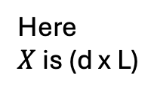
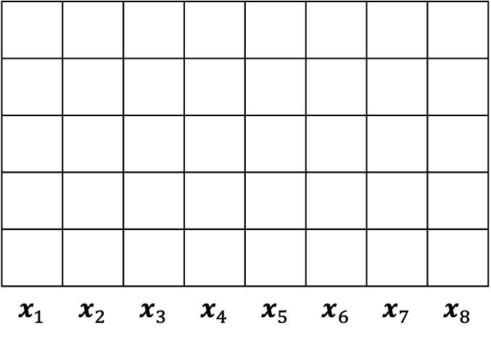
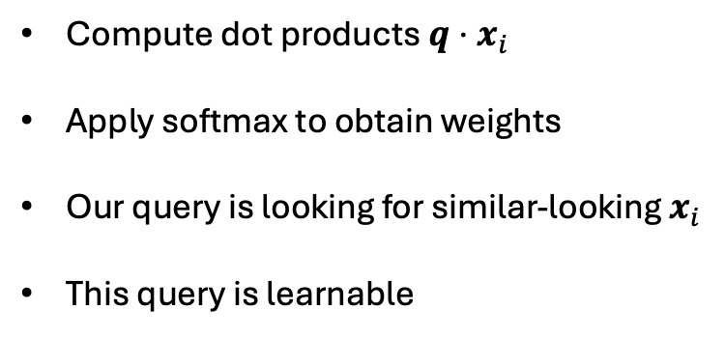

Illustration of simple linear attention (note that conventions vary on the ordering of dimensions)
$$q$$
$$x_{1}$$ | $$x_{2}$$ | $$x_{3}$$ | $$x_{4}$$ | $$x_{5}$$ | $$x_{6}$$ | $$x_{7}$$ | $$x_{8}$$
Compute dot products $q⋅x_{i}$
Apply softmax to obtain weights
Our query is looking for similar-looking $x_{i}$
This query is learnable
Here
$X$ is (d x L)

Slide 16
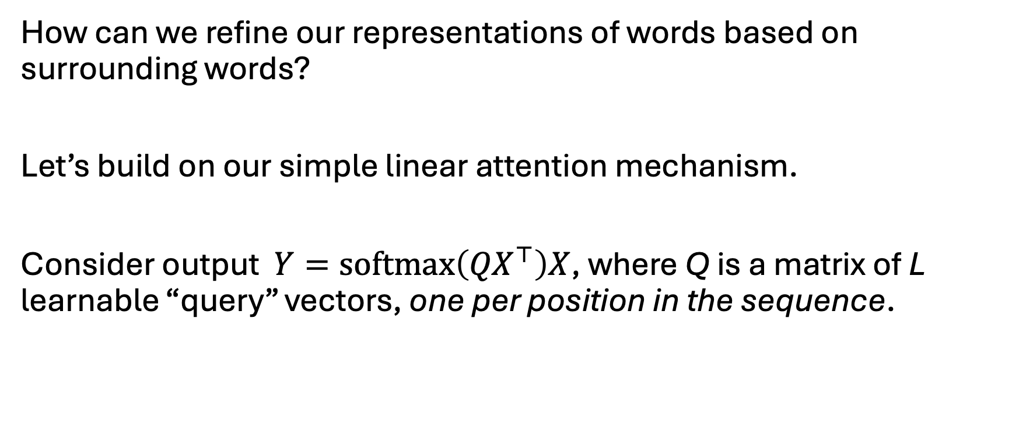

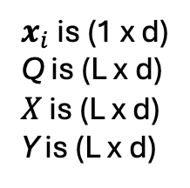
Simple self-attention
How can we refine our representations of words based on surrounding words?
Let’s build on our simple linear attention mechanism.
Consider output $Y=softmax\left({QX}^{⊤}\right)X$, where Q is a matrix of L learnable “query” vectors, one per position in the sequence.
$$Y=softmax\left({QX}^{⊤}\right)X$$
$x_{i}$ is (1 x d)
Q is (L x d)
$X$ is (L x d)
Y is (L x d)
contains a vector of attention weights for each word in the sequence

Slide 17
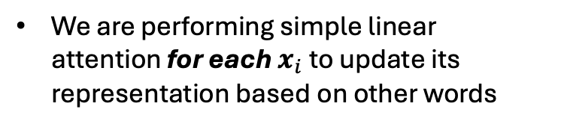

Illustration of simple self-attention (note that conventions vary on the ordering of dimensions)
$$q_{1}$$
$$x_{1}$$ | $$x_{2}$$ | $$x_{3}$$ | $$x_{4}$$ | $$x_{5}$$ | $$x_{6}$$ | $$x_{7}$$ | $$x_{8}$$
We are performing simple linear attention for each $x_{i}$ to update its representation based on other words
Here
$X$ is (d x L)

Slide 18

Illustration of simple self-attention (note that conventions vary on the ordering of dimensions)
$$q_{1}$$
$$x_{1}$$ | $$x_{2}$$ | $$x_{3}$$ | $$x_{4}$$ | $$x_{5}$$ | $$x_{6}$$ | $$x_{7}$$ | $$x_{8}$$
We are performing simple linear attention for each $x_{i}$ to update its representation based on other words
Here
$X$ is (d x L)

Slide 19

Illustration of simple self-attention (note that conventions vary on the ordering of dimensions)
$$q_{1}$$
$$x_{1}$$ | $$x_{2}$$ | $$x_{3}$$ | $$x_{4}$$ | $$x_{5}$$ | $$x_{6}$$ | $$x_{7}$$ | $$x_{8}$$
We are performing simple linear attention for each $x_{i}$ to update its representation based on other words
Here
$X$ is (d x L)

Slide 20
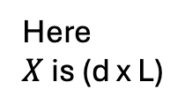
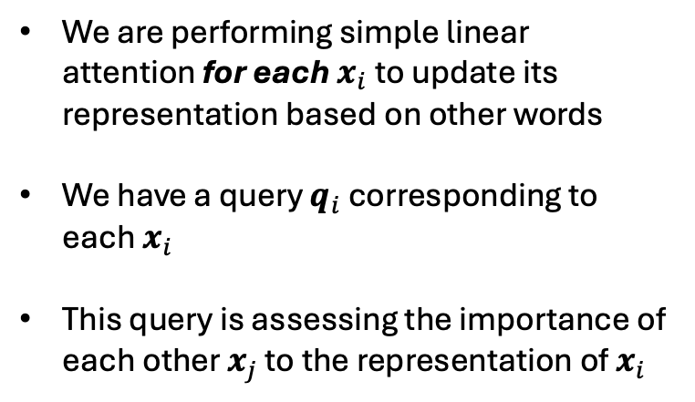

Illustration of simple self-attention (note that conventions vary on the ordering of dimensions)
$$q_{2}$$
$$x_{1}$$ | $$x_{2}$$ | $$x_{3}$$ | $$x_{4}$$ | $$x_{5}$$ | $$x_{6}$$ | $$x_{7}$$ | $$x_{8}$$
We are performing simple linear attention for each $x_{i}$ to update its representation based on other words
We have a query $q_{i}$ corresponding to each $x_{i}$
This query is assessing the importance of each other $x_{j}$ to the representation of $x_{i}$
Here
$X$ is (d x L)

Slide 21

Illustration of simple self-attention (note that conventions vary on the ordering of dimensions)
$$q_{2}$$
$$x_{1}$$ | $$x_{2}$$ | $$x_{3}$$ | $$x_{4}$$ | $$x_{5}$$ | $$x_{6}$$ | $$x_{7}$$ | $$x_{8}$$
We are performing simple linear attention for each $x_{i}$ to update its representation based on other words
We have a query $q_{i}$ corresponding to each $x_{i}$
This query is assessing the importance of each other $x_{j}$ to the representation of $x_{i}$
Here
$X$ is (d x L)

Slide 22

Illustration of simple self-attention (note that conventions vary on the ordering of dimensions)
$$q_{2}$$
$$x_{1}$$ | $$x_{2}$$ | $$x_{3}$$ | $$x_{4}$$ | $$x_{5}$$ | $$x_{6}$$ | $$x_{7}$$ | $$x_{8}$$
We are performing simple linear attention for each $x_{i}$ to update its representation based on other words
We have a query $q_{i}$ corresponding to each $x_{i}$
This query is assessing the importance of each other $x_{j}$ to the representation of $x_{i}$
Here
$X$ is (d x L)

Slide 23
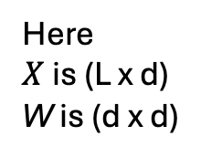
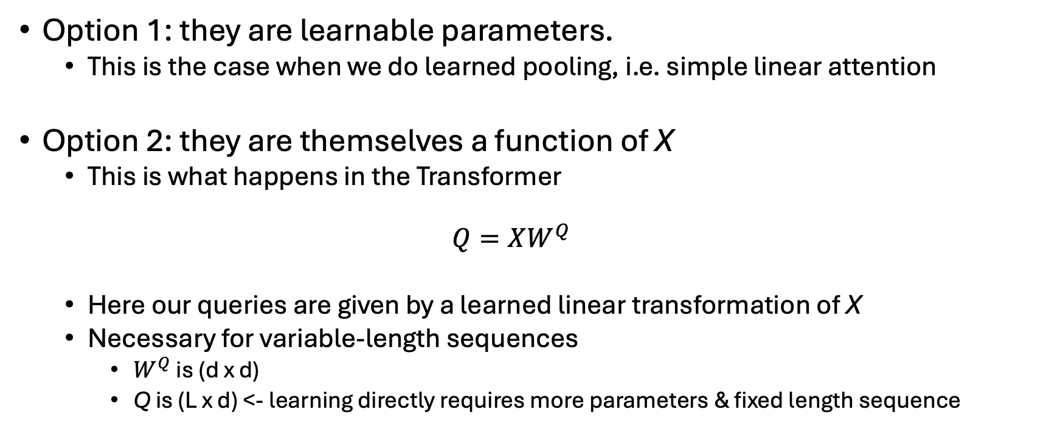
Where do these queries come from?
Option 1: they are learnable parameters.
This is the case when we do learned pooling, i.e. simple linear attention
Option 2: they are themselves a function of X
This is what happens in the Transformer
$$Q=XW^{Q}$$
Here our queries are given by a learned linear transformation of X
Necessary for variable-length sequences
$W^{Q}$ is (d x d)
Q is (L x d) <- learning directly requires more parameters & fixed length sequence
Here
$X$ is (L x d)
W is (d x d)

Slide 24
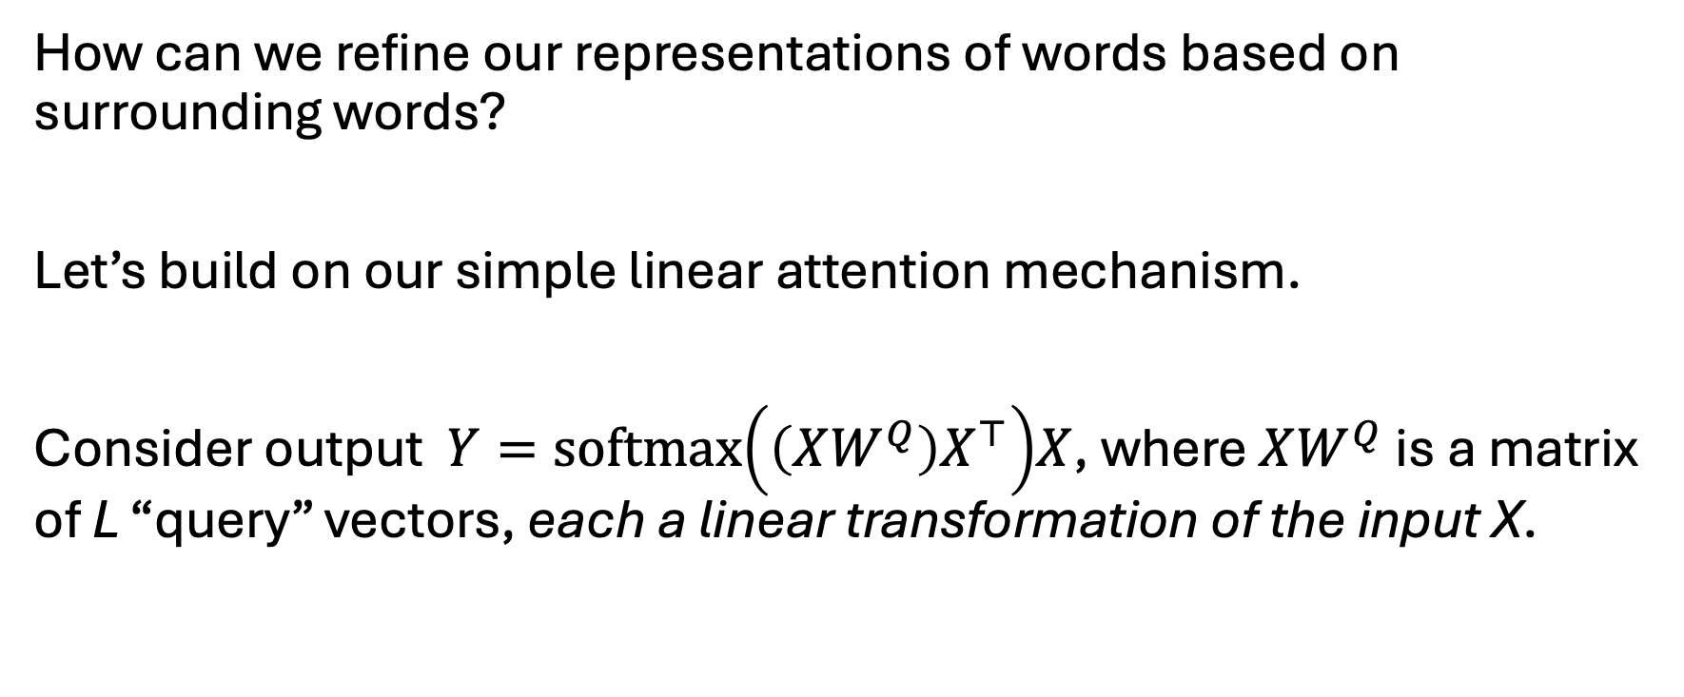
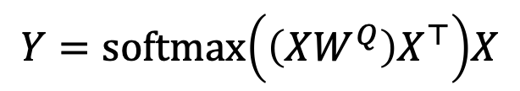
Simple self-attention
How can we refine our representations of words based on surrounding words?
Let’s build on our simple linear attention mechanism.
Consider output $Y=softmax\left({\left(XW^{Q}\right)X}^{⊤}\right)X$, where $XW^{Q}$ is a matrix of L “query” vectors, each a linear transformation of the input X.
$$Y=softmax\left({\left(XW^{Q}\right)X}^{⊤}\right)X$$
$x_{i}$ is (1 x d)
Q is (L x d)
$X$ is (L x d)
Y is (L x d)
contains a vector of attention weights for each word in the sequence

Slide 25
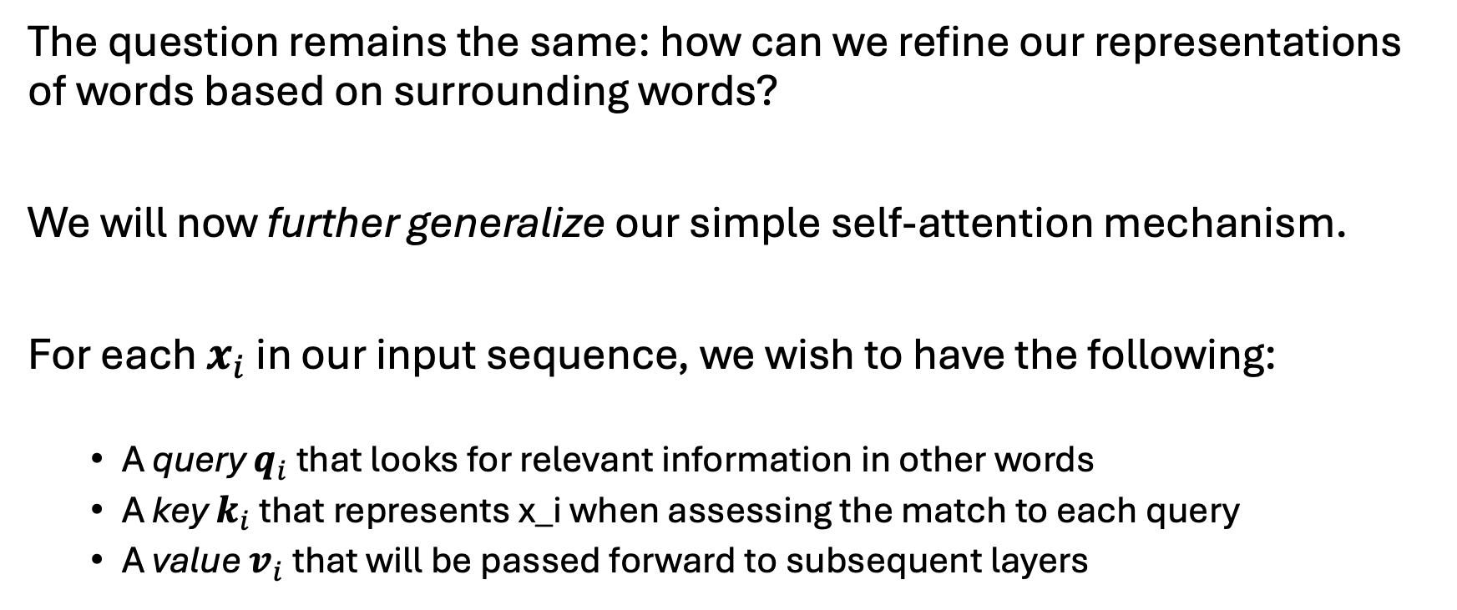
Self-attention (in contrast to simple self-attention)
The question remains the same: how can we refine our representations of words based on surrounding words?
We will now further generalize our simple self-attention mechanism.
For each $x_{i}$ in our input sequence, we wish to have the following:
A query $q_{i}$ that looks for relevant information in other words
A key $k_{i}$ that represents x_i when assessing the match to each query
A value $v_{i}$ that will be passed forward to subsequent layers

Slide 26
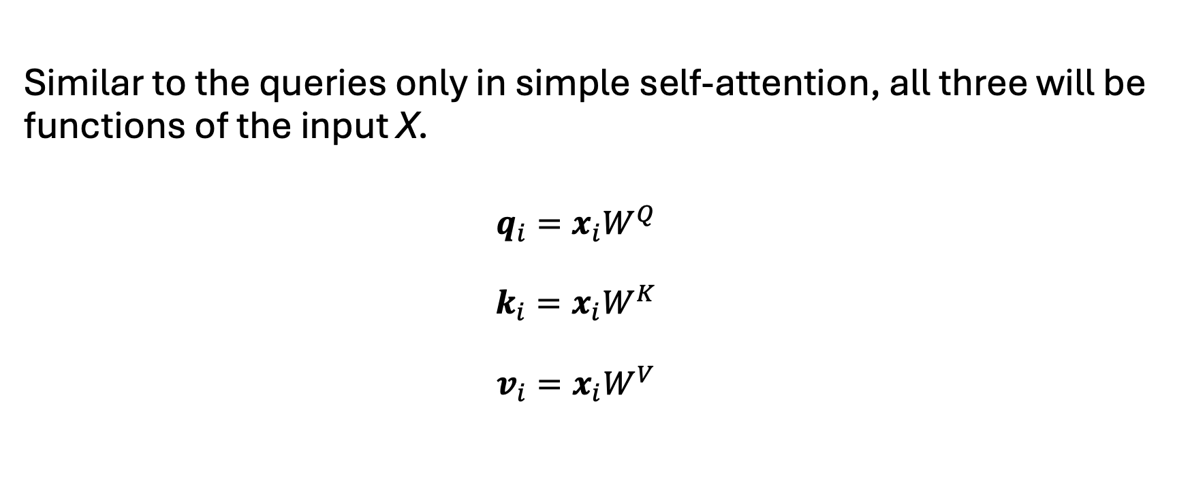
Where do the queries, keys, and values come from?
Similar to the queries only in simple self-attention, all three will be functions of the input X.
$$q_{i}=x_{i}W^{Q}$$
$$k_{i}=x_{i}W^{K}$$
$$v_{i}=x_{i}W^{V}$$
Here
$X$ is (L x d)
W is (d x d)

Slide 27
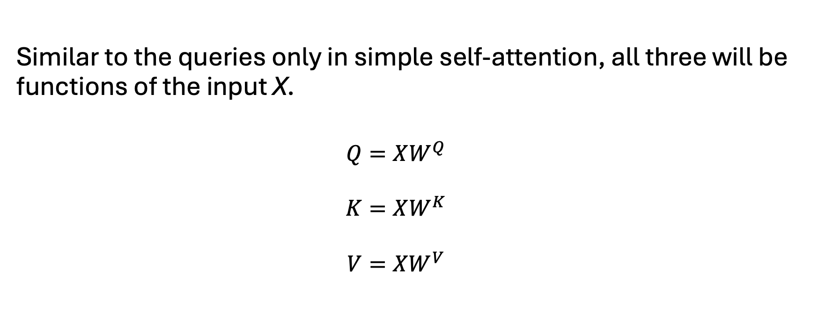
Where do the queries, keys, and values come from?
Similar to the queries only in simple self-attention, all three will be functions of the input X.
$$Q=XW^{Q}$$
$$K=XW^{K}$$
$$V=XW^{V}$$
Here
$X$ is (L x d)
W is (d x d)

Slide 28
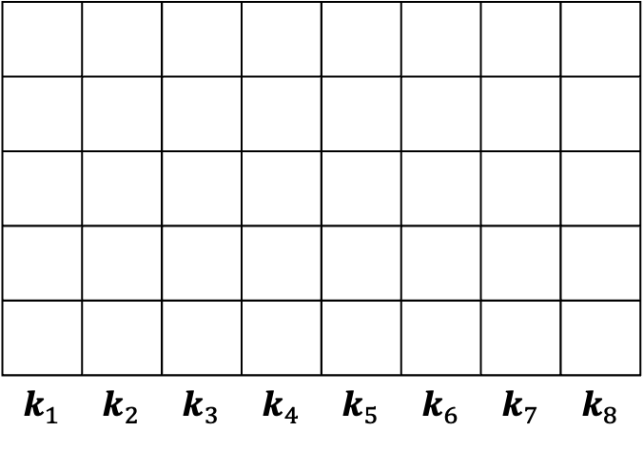
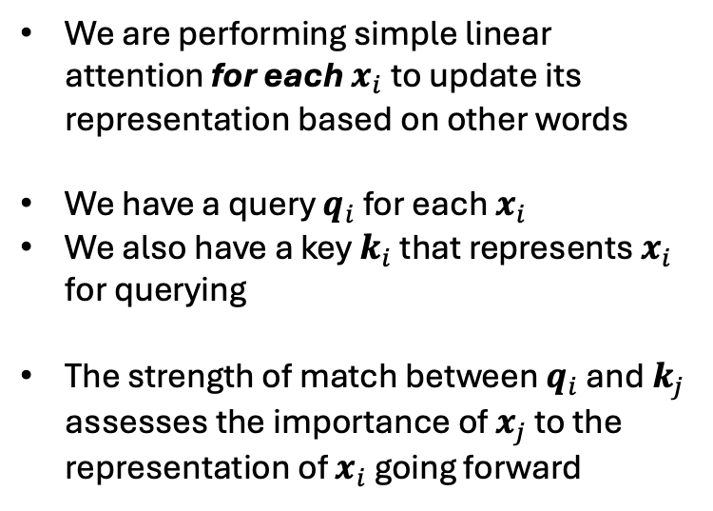
Illustration of self-attention (note that conventions vary on the ordering of dimensions)
$$q_{2}$$
$$k_{1}$$ | $$k_{2}$$ | $$k_{3}$$ | $$k_{4}$$ | $$k_{5}$$ | $$k_{6}$$ | $$k_{7}$$ | $$k_{8}$$
We are performing simple linear attention for each $x_{i}$ to update its representation based on other words
We have a query $q_{i}$ for each $x_{i}$
We also have a key $k_{i}$ that represents $x_{i}$ for querying
The strength of match between $q_{i}$ and $k_{j}$ assesses the importance of $x_{j}$ to the representation of $x_{i}$ going forward
Here
$X$ is (d x L)

Slide 29

Illustration of self-attention (note that conventions vary on the ordering of dimensions)
$$q_{2}$$
$$k_{1}$$ | $$k_{2}$$ | $$k_{3}$$ | $$k_{4}$$ | $$k_{5}$$ | $$k_{6}$$ | $$k_{7}$$ | $$k_{8}$$
We are performing simple linear attention for each $x_{i}$ to update its representation based on other words
We have a query $q_{i}$ for each $x_{i}$
We also have a key $k_{i}$ that represents $x_{i}$ for querying
The strength of match between $q_{i}$ and $k_{j}$ assesses the importance of $x_{j}$ to the representation of $x_{i}$ going forward
Here
$X$ is (d x L)

Slide 30

Illustration of self-attention (note that conventions vary on the ordering of dimensions)
$$q_{2}$$
$$k_{1}$$ | $$k_{2}$$ | $$k_{3}$$ | $$k_{4}$$ | $$k_{5}$$ | $$k_{6}$$ | $$k_{7}$$ | $$k_{8}$$
We are performing simple linear attention for each $x_{i}$ to update its representation based on other words
We have a query $q_{i}$ for each $x_{i}$
We also have a key $k_{i}$ that represents $x_{i}$ for querying
The strength of match between $q_{i}$ and $k_{j}$ assesses the importance of $x_{j}$ to the representation of $x_{i}$ going forward
Here
$X$ is (d x L)

Slide 31
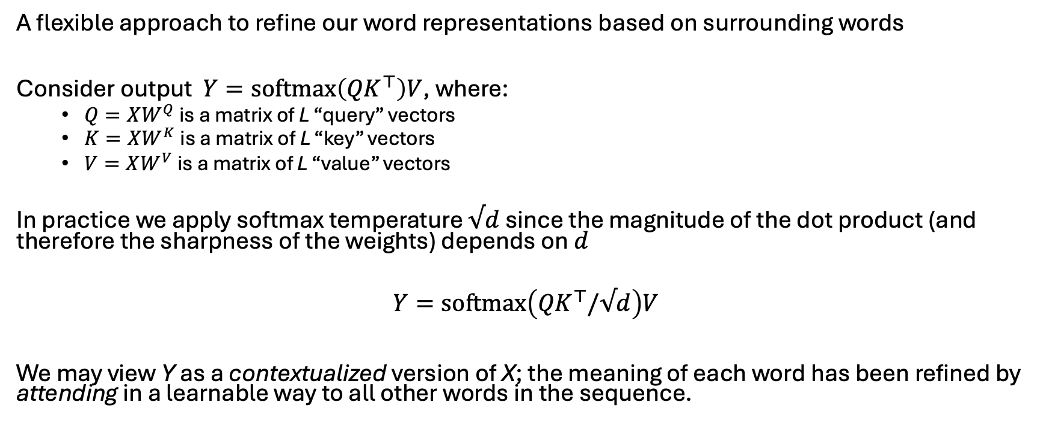
Self-attention (in contrast to simple self-attention)
A flexible approach to refine our word representations based on surrounding words
Consider output $Y=softmax\left({QK}^{⊤}\right)V$, where:
$Q=XW^{Q}$ is a matrix of L “query” vectors
$K=XW^{K}$ is a matrix of L “key” vectors
$V=XW^{V}$ is a matrix of L “value” vectors
In practice we apply softmax temperature $√d$ since the magnitude of the dot product (and therefore the sharpness of the weights) depends on $d$
$$Y=softmax\left({QK}^{⊤}/√d\right)V$$
We may view Y as a contextualized version of X; the meaning of each word has been refined by attending in a learnable way to all other words in the sequence.

Slide 32
The Transformer architecture

Slide 33
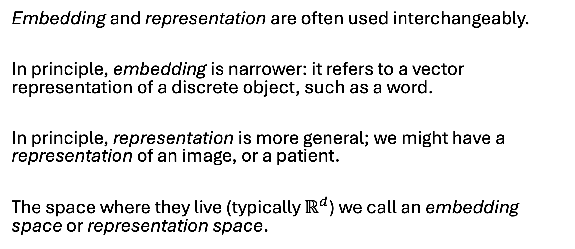
A note on terminology
Embedding and representation are often used interchangeably.
In principle, embedding is narrower: it refers to a vector representation of a discrete object, such as a word.
In principle, representation is more general; we might have a representation of an image, or a patient.
The space where they live (typically $ℝ^{d}$) we call an embedding space or representation space.

Slide 34
Transformer overview
Today we will focus on the encoder and the operations that comprise it
Key components:
input embeddings
multi-head attention
add & norm
feed forward layer
positional encodings

Slide 35
Transformer overview
DECODER
Today we will focus on the encoder and the operations that comprise it
Types of Transformers:
Encoder-only architectures (e.g. BERT)
Decoder-only architectures (e.g. GPT-x)
Encoder-decoder architectures, as shown here
ENCODER

Slide 36
Transformer overview
DECODER
Encoder only
Tasks:
Sequence- or token-level prediction or tagging
No generation needed
Advantages:
Simplicity
easier fine-tuning
Examples:
BERT
BEHRT (a BERT-like model for EHR)
ENCODER

Slide 37
Transformer overview
DECODER
Decoder only
Tasks:
Text generation
Advantages:
Simple training objective (next token prediction)
Scales well
Examples:
GPT-x
LLaMA
ENCODER

Slide 38
Transformer overview
DECODER
Encoder-decoder
Tasks:
Well-defined input sequence to output sequence
Translation
Summarization
Advantages:
Distinguish interpretation from generation
Best when input and output sequences are meaningfully distinct
Examples:
Original Transformer (shown here)
Many variants for specific tasks
ENCODER

Slide 39
Encoder components
Input embeddings and positional encodings
Input embeddings: map text to a sequence of dense vector representations
Positional encodings: add information about relative position within the sequence (we will return to this)
Transformer encoder stack (N=6 in Vaswani; N=24 in BERT-large; N=96 in GPT-3)
Multi-head attention: refine representations of words (i.e. the meaning of each token) based on other words
[information exchange across words]
Add & norm: residual connections (add) avoid vanishing gradients in earlier layers; normalizing improves numeric stability
Feed forward: nonlinear refinement of representations
[information exchange across embedding/representation dimensions]

Slide 40
Input embeddings & positional encodings
Input embeddings:
Maps input words / tokens to dense vector embeddings
Principles are those previously discussed
Typically learned end to end with the rest of the architecture
Modern architectures use sub-word embeddings
Positional encodings: we will return to this shortly.

Slide 41
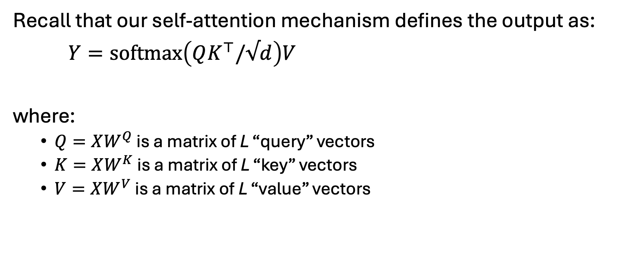
Multi-head attention
Recall that our self-attention mechanism defines the output as:
$Y=softmax\left(QK^{⊤}/√d\right)V$
where:
$Q=XW^{Q}$ is a matrix of L “query” vectors
$K=XW^{K}$ is a matrix of L “key” vectors
$V=XW^{V}$ is a matrix of L “value” vectors

Slide 42
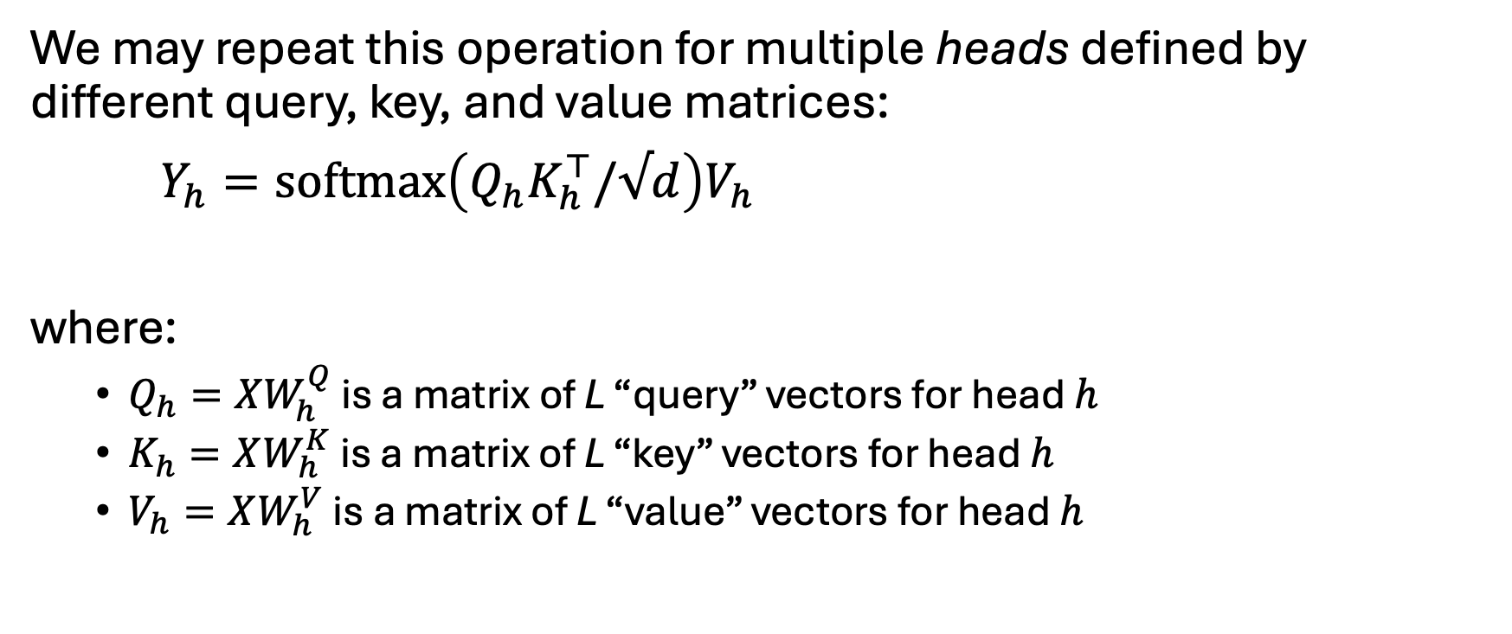
Multi-head attention
We may repeat this operation for multiple heads defined by different query, key, and value matrices:
$Y_{h}=softmax\left(Q_{h}K_{h}^{⊤}/√d\right)V_{h}$
where:
$Q_{h}=XW_{h}^{Q}$ is a matrix of L “query” vectors for head $h$
$K_{h}=XW_{h}^{K}$ is a matrix of L “key” vectors for head $h$
$V_{h}=XW_{h}^{V}$ is a matrix of L “value” vectors for head $h$

Slide 43
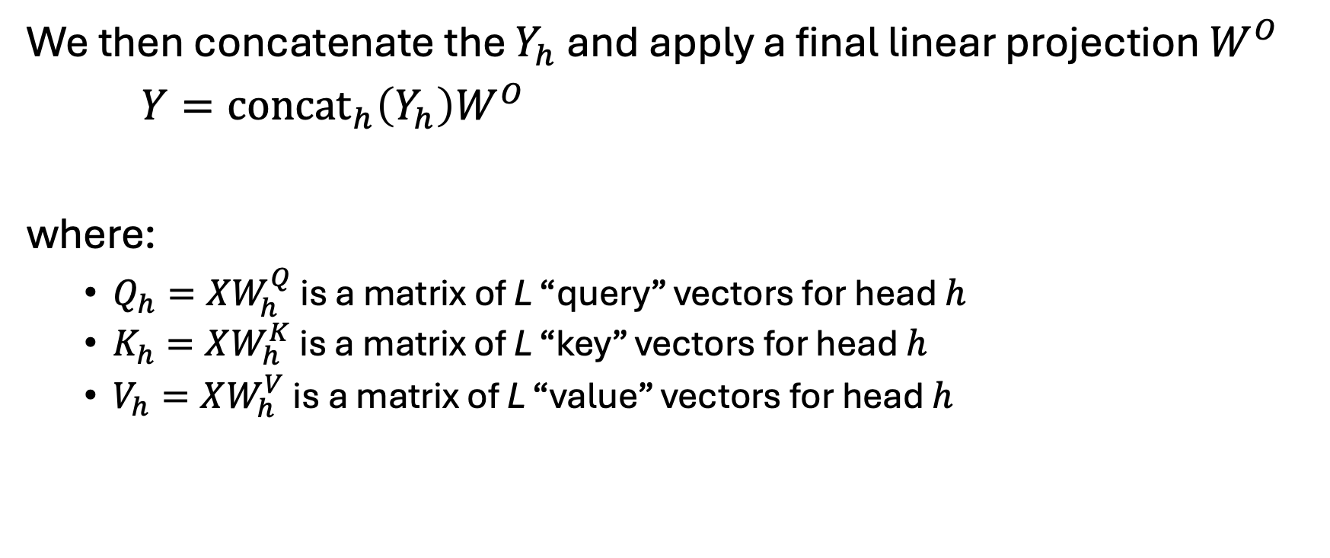
Multi-head attention
We then concatenate the $Y_{h}$ and apply a final linear projection $W^{O}$
$Y={concat}_{h}\left(Y_{h}\right)W^{O}$
where:
$Q_{h}=XW_{h}^{Q}$ is a matrix of L “query” vectors for head $h$
$K_{h}=XW_{h}^{K}$ is a matrix of L “key” vectors for head $h$
$V_{h}=XW_{h}^{V}$ is a matrix of L “value” vectors for head $h$

Slide 44
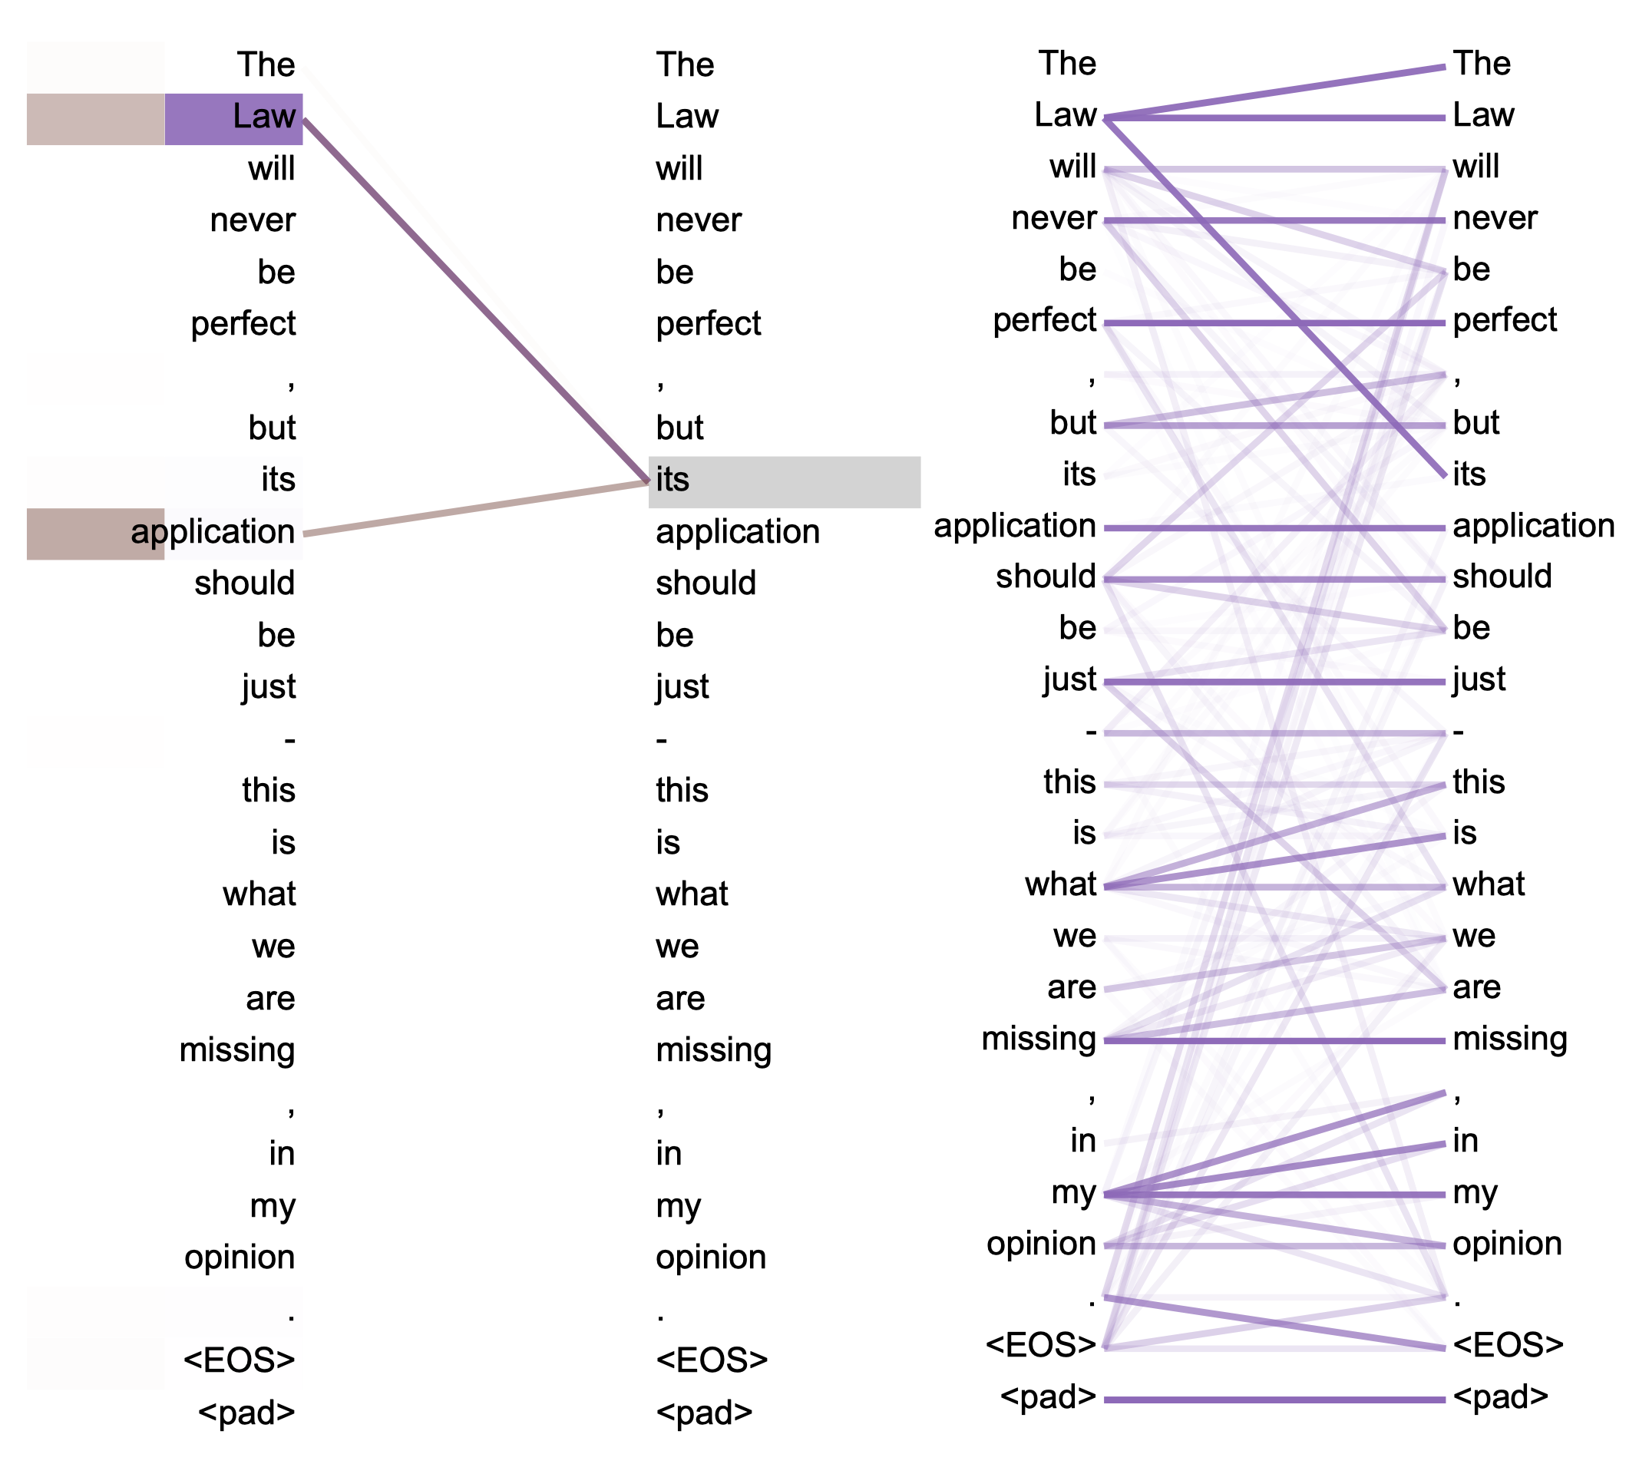
Examples from Vaswani et al
Figure 4: Two attention heads, also in layer 5 of 6, apparently involved in anaphora resolution.
Top: Full attentions for head 5.
Bottom: Isolated attentions from just the word ‘its’ for attention heads 5 and 6. Note that the attentions are very sharp for this word.

Slide 45
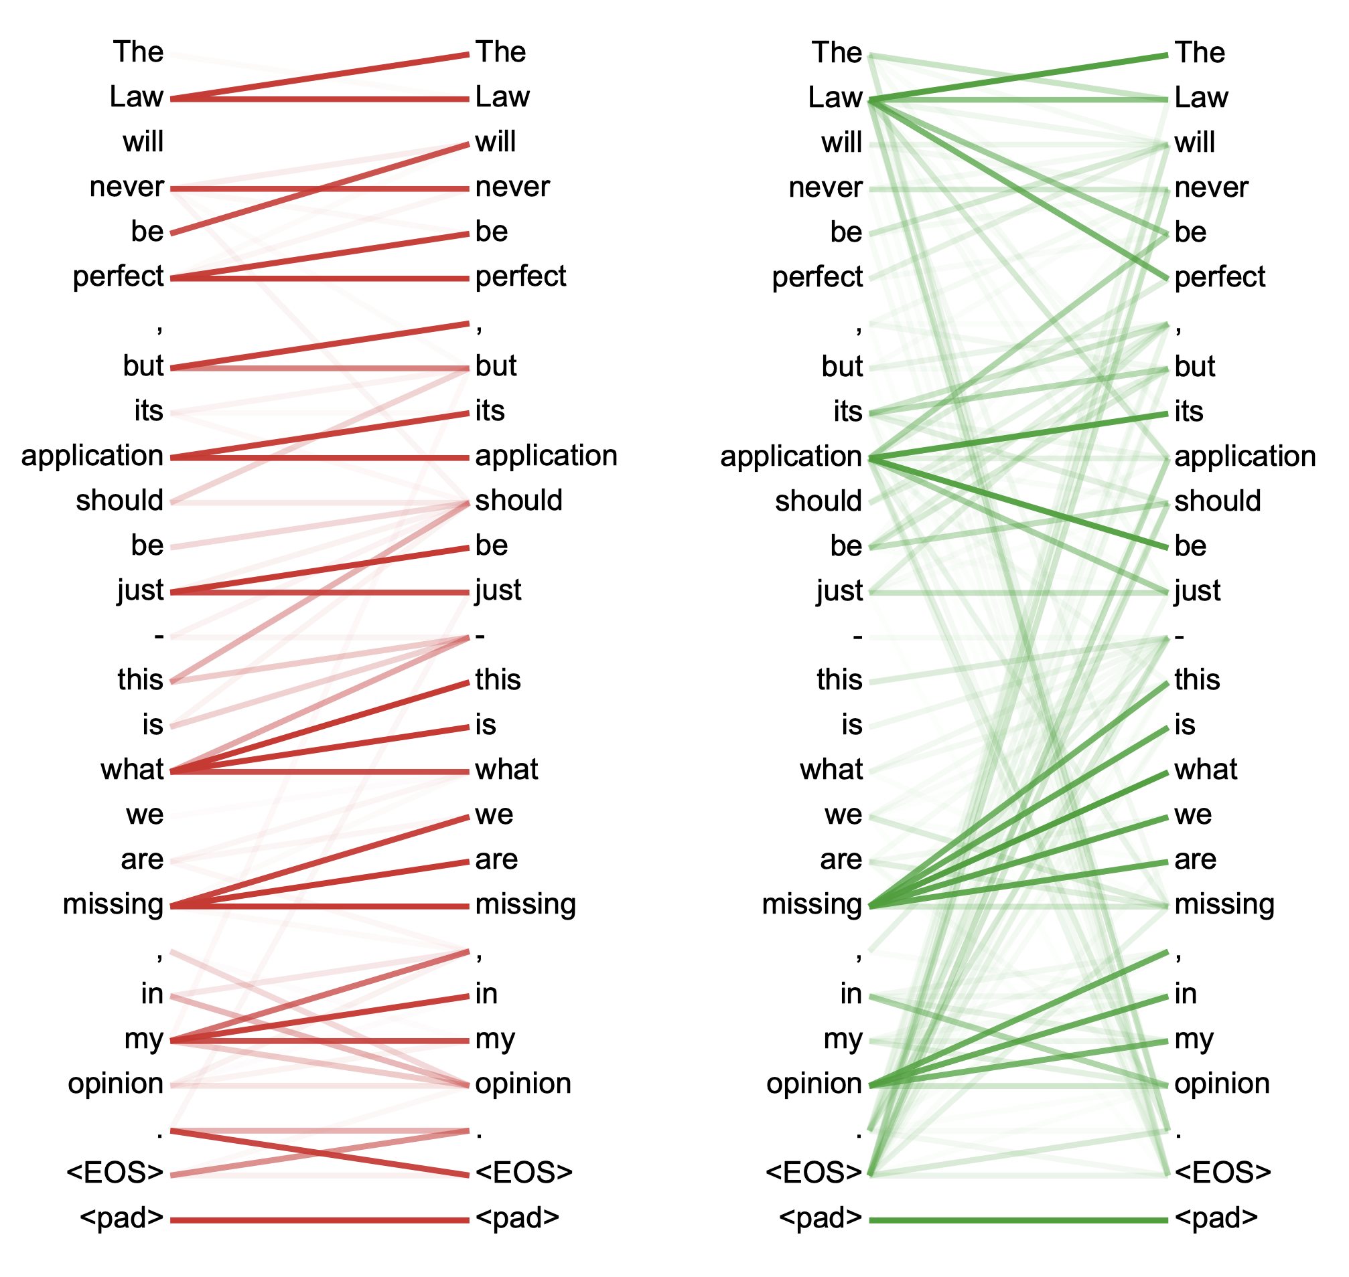
Examples from Vaswani et al
Figure 5: Many of the attention heads exhibit behaviour that seems related to the structure of the sentence. We give two such examples above, from two different heads from the encoder self-attention at layer 5 of 6. The heads clearly learned to perform different tasks.

Slide 46
Feed-forward layer
This is a layer-specific MLP applied in parallel to all the word / token representations
With the exception of the softmax, which is used to weight various representations – not apply a nonlinear transformation to them – this is the only source of nonlinearity in the model
Multi-head attention allows information exchange across words / tokens
In contrast, the feed-forward layers allow us to refine our representations in a way that allows interactions across embedding/representation dimensions
Notes:
Efficient
Increased model capacity

Slide 47
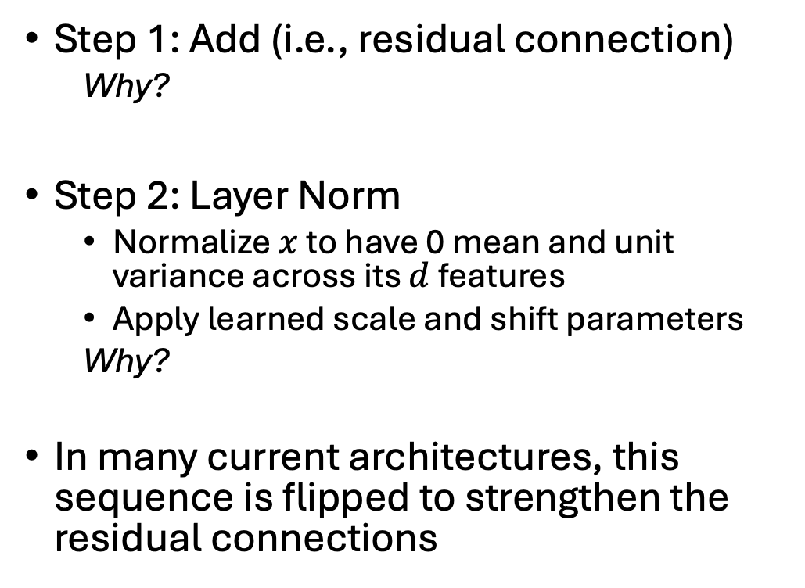
Add & norm
Step 1: Add (i.e., residual connection)
Why?
Step 2: Layer Norm
Normalize $x$ to have 0 mean and unit variance across its $d$ features
Apply learned scale and shift parameters
Why?
In many current architectures, this sequence is flipped to strengthen the residual connections
Notes:
Efficient
Increased model capacity

Slide 48
Revisiting the full encoder
Input embeddings and positional encodings
Input embeddings: map text to a sequence of dense vector representations
Positional encodings: add information about relative position within the sequence (we will return to this)
Transformer encoder stack (N=6 in Vaswani; N=24 in BERT-large; N=96 in GPT-3)
Multi-head attention: refine representations of words (i.e. the meaning of each token) based on other words
[information exchange across words]
Add & norm: residual connections (add) avoid vanishing gradients in earlier layers; normalizing improves numeric stability
Feed forward: nonlinear refinement of representations
[information exchange across embedding/representation dimensions]
Notes:
What haven’t we covered? Positional encodings.
Again emphasize that we are progressively refining our representations

Slide 49
Why do we need positional encodings?
Nothing like this needed for a CNN, RNN, etc…

Slide 50
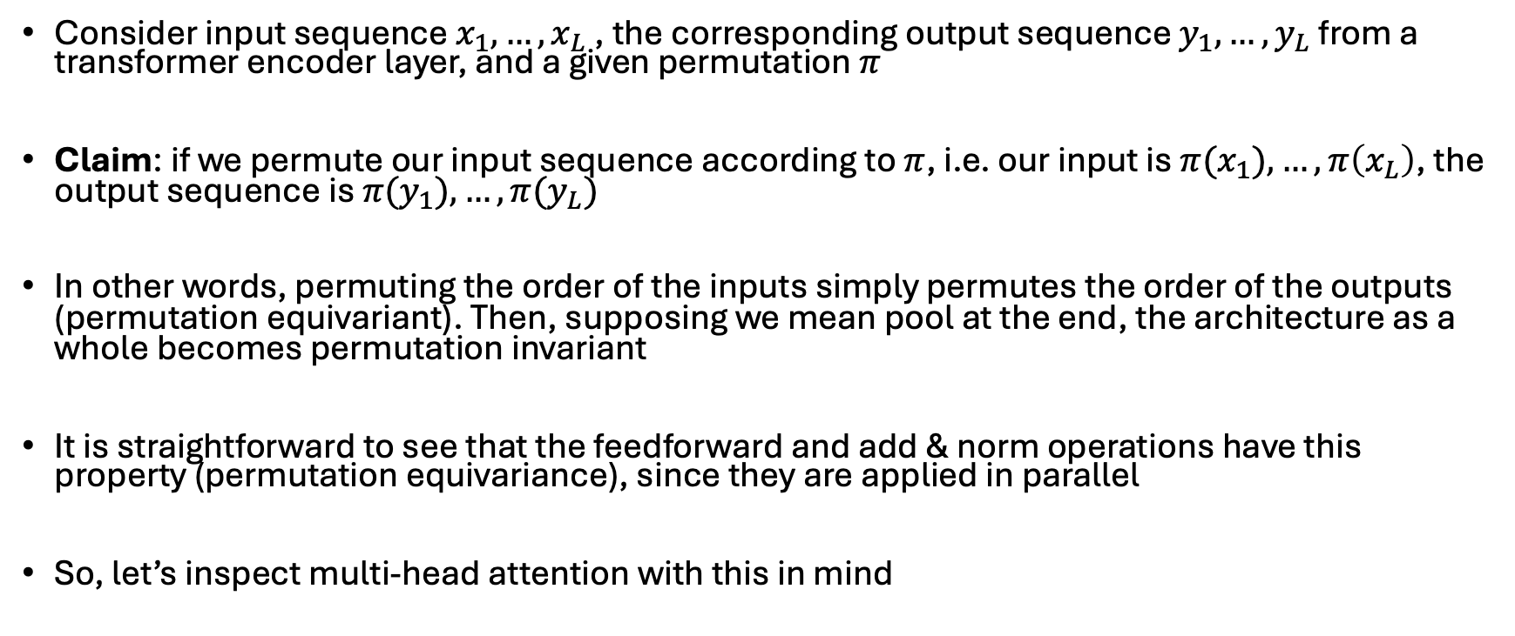
The transformer is permutation equivariant
Consider input sequence $x_{1}, …, x_{L}$, the corresponding output sequence $y_{1}, …, y_{L}$ from a transformer encoder layer, and a given permutation $π$
Claim: if we permute our input sequence according to $π$, i.e. our input is $π(x_{1}), …, π\left(x_{L}\right)$, the output sequence is $π(y_{1}), …, π(y_{L})$
In other words, permuting the order of the inputs simply permutes the order of the outputs (permutation equivariant). Then, supposing we mean pool at the end, the architecture as a whole becomes permutation invariant
It is straightforward to see that the feedforward and add & norm operations have this property (permutation equivariance), since they are applied in parallel
So, let’s inspect multi-head attention with this in mind

Slide 51
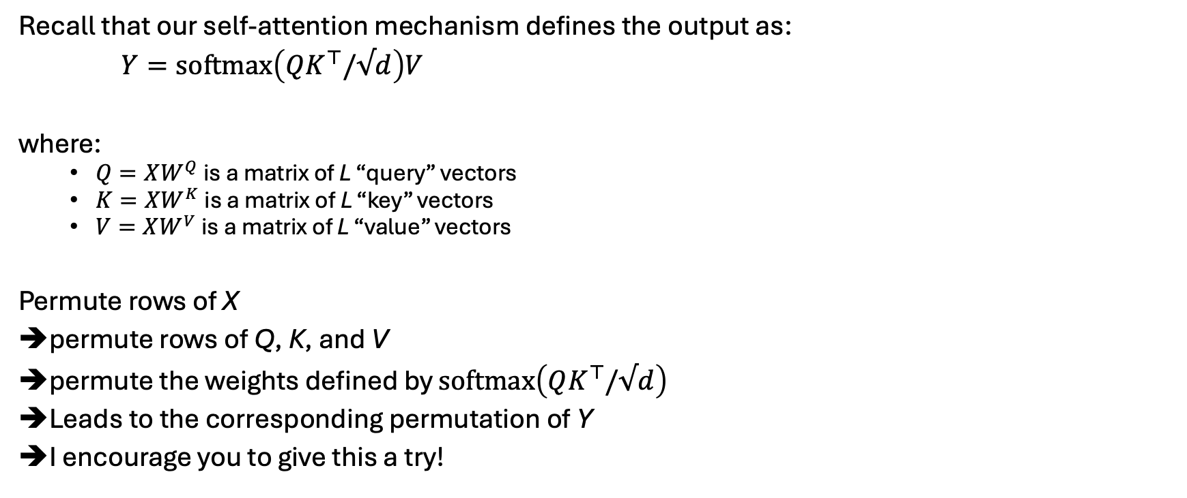
Multi-head attention is perm equivariant
Recall that our self-attention mechanism defines the output as:
$Y=softmax\left(QK^{⊤}/√d\right)V$
where:
$Q=XW^{Q}$ is a matrix of L “query” vectors
$K=XW^{K}$ is a matrix of L “key” vectors
$V=XW^{V}$ is a matrix of L “value” vectors
Permute rows of X
permute rows of Q, K, and V
permute the weights defined by $softmax\left(QK^{⊤}/√d\right)$
Leads to the corresponding permutation of Y
I encourage you to give this a try!

Slide 52
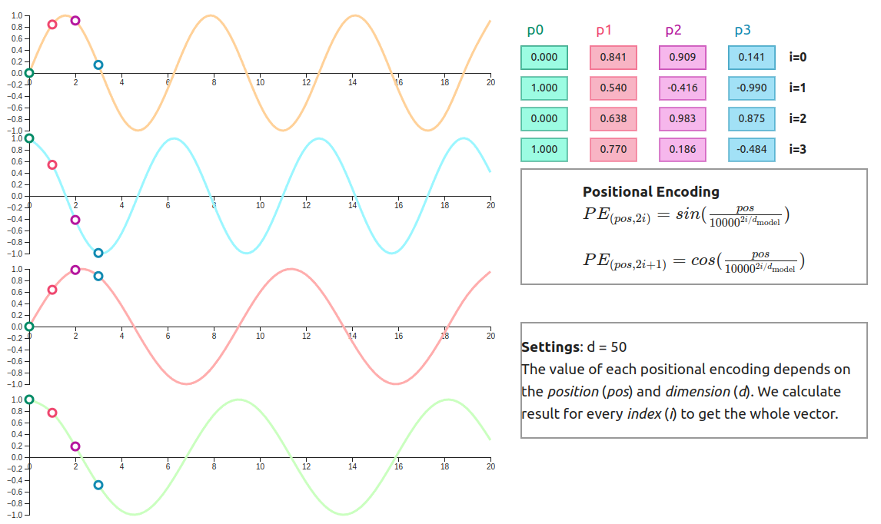
Adding positional encodings breaks this invariance & accounts for word ordering
Many variants on this idea
We will discuss a few next time

Slide 53
Making predictions
At the end of the day, our encoder stack gives us a sequence of L contextualized representations, where L is the length of the input sequence
To make predictions, we can then:
Pool across L
Use the representation corresponding to the starter ([CLS]) token
Aggregate in some other way

Slide 54
Next time
How to we train this architecture?
What variants are common in practice?
How can we use this to model structured EHR data?
Other practical considerations

