Slide 1
Practical Predictive AI Evaluation
Matt Engelhard
Duke B&B

Slide 2
Overview
We’ll discuss important considerations relevant to evaluating AI tools and making sense of their predictions in clinical/healthcare practice:
How might we use AI-based predictions, and what performance metrics are relevant to each use case?
Discrimination metrics
Calibration metrics
What information about the model do we need to know to use it responsibly?

Slide 3
Predictive AI
Use cases and associated performance metrics
Notes:
Stimulate discussion here

Slide 4
New Stage IV Risk Prediction Model
Some of your colleagues have implemented a new prediction model that aims to prevent or delay kidney failure by predicting 2-year risk of progression to stage IV CKD.
This model is based on electronic health record data, including diagnosis and procedure codes, medications, labs, and vitals; as well as social determinants of health.
You think the model sounds promising and start thinking about ways you might use it in practice.
Notes:
You want to understand how well it performs. What do you need to know?

Slide 5
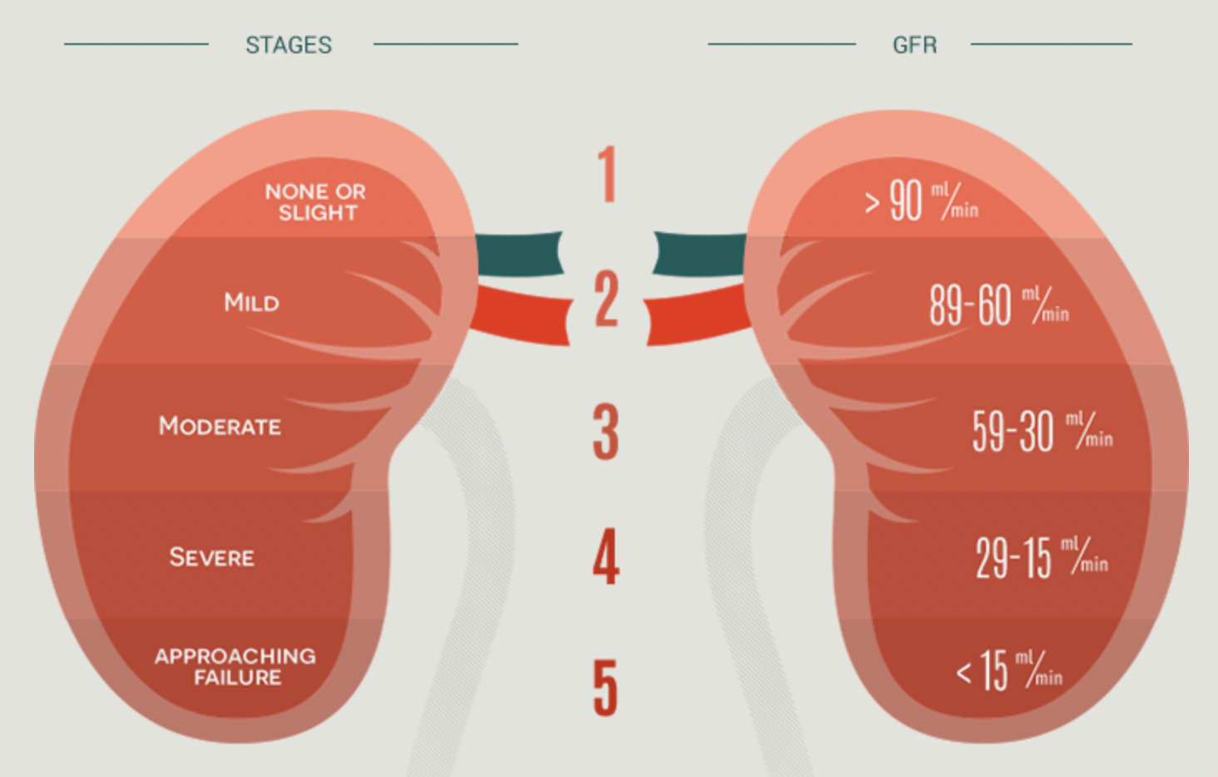
Prediction: Probability of a Binary Outcome
11%
Probability of Stage IV CKD within two years
Report Back:
How might you use this number in clinical practice (be specific)?
What performance metrics are relevant to this way of using the prediction?
Notes:
What does this number mean?
Is this number high? Is it low?
Helpful to know how this compares to other patients…
- overall
- among patients meeting specific clinical criteria
- among patients in a particular demographic
You might… use the number to decide whether to take a certain action
You might… use the number to provide context around disease, or to set expectations

Slide 6
Discrimination vs Calibration
Did not progress
Progressed to stage IV
True Risk
Perfect calibration
Predicted Risk
Predicted Risk
Can we identify individuals who will progress?
Are our predicted probabilities accurate?
Notes:
What are some specific performance measures you’ve heard of?
Are those measures of discrimination, or calibration?
When or why might discrimination be important?
When or why might calibration be important?
Connect this back to the proposed uses from the report back.
(go through each proposed use and ask them whether discrimination versus calibration is more important)

Slide 7
Assessing model discrimination
Sensitivity, specificity, PPV, NPV (threshold-based)
AUC, AUPRC (threshold-agnostic)

Slide 8
Suppose our features are highly informative. What might our model’s predictions look like?

Slide 9
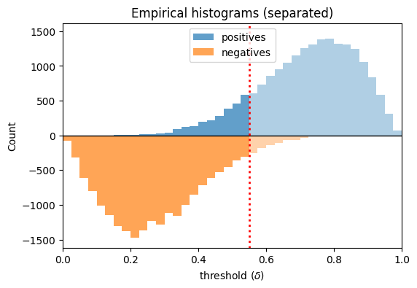
Suppose our features are highly informative. What might our model’s predictions look like?

Slide 10
Suppose our features are highly informative. What might our model’s predictions look like?
Predict
Negative
Predict
positive

Slide 11
Suppose our features are highly informative. What might our model’s predictions look like?
False
negatives
True
positives
True
Negatives
False
positives

Slide 12
Suppose our features are highly informative. What might our model’s predictions look like?
False
negatives
True
positives
Review threshold-specific metrics:
TPR (sensitivity, recall)
FPR (1 – specificity)
Precision (PPV)
NPV
Consider the clinical utility of each!!
True
Negatives
False
positives

Slide 13
Consider: how does each metric change as we vary the threshold?
Review threshold-specific metrics:
TPR (sensitivity, recall)
FPR (1 – specificity)
Precision (PPV)
NPV
Consider the clinical utility of each!!

Slide 14
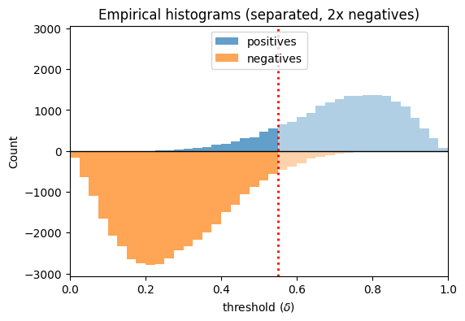
Consider: how does each metric change as we vary class balance?
Review threshold-specific metrics:
TPR (sensitivity, recall)
FPR (1 – specificity)
Precision (PPV)
NPV
Consider the clinical utility of each!!

Slide 15
Consider: how does each metric change as we vary the threshold?

Slide 16
Receiver Operating Characteristic Curve
Illustrates the tradeoff between the TPR (sensitivity) and FPR (1– specificity) as we vary the threshold.
Allows clinicians to consider this tradeoff and select appropriate operating points
The area under this curve (AUC) provides a single number summarizing this tradeoff.
In most cases this is the most important metric (why??)
Notes:
Why don’t people like the AUC?

Slide 17
So, what’s a good AUC value? (i.e., good performance)?
We’ll start to answer this question by taking a look at bad performance.
Notes:
At this point you might be wondering – so, what’s a *good* AUC value?
But we’re going to defer that question for a moment. Let’s start by thinking about what *bad* model performance would look like.

Slide 18
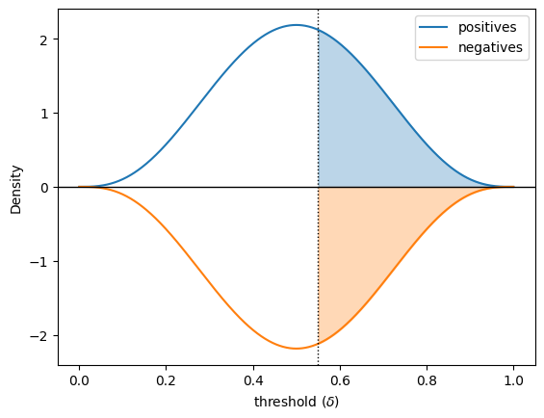
Suppose our features contain no information about the outcome. What might predictions look like?
Similar distributions between positive and negative cases.
The predicted value tells you nothing about which one it’s more likely to be.

Slide 19
Suppose our features contain no information about the outcome. What might predictions look like?
What is the:
TPR (sensitivity)?
FPR (1 – specificity)?
PPV?

Slide 20
Our “no information” predictive model
TPR and FPR always match (why?)
the distributions of positive and negative cases match
the corresponding CDFs match

Slide 21
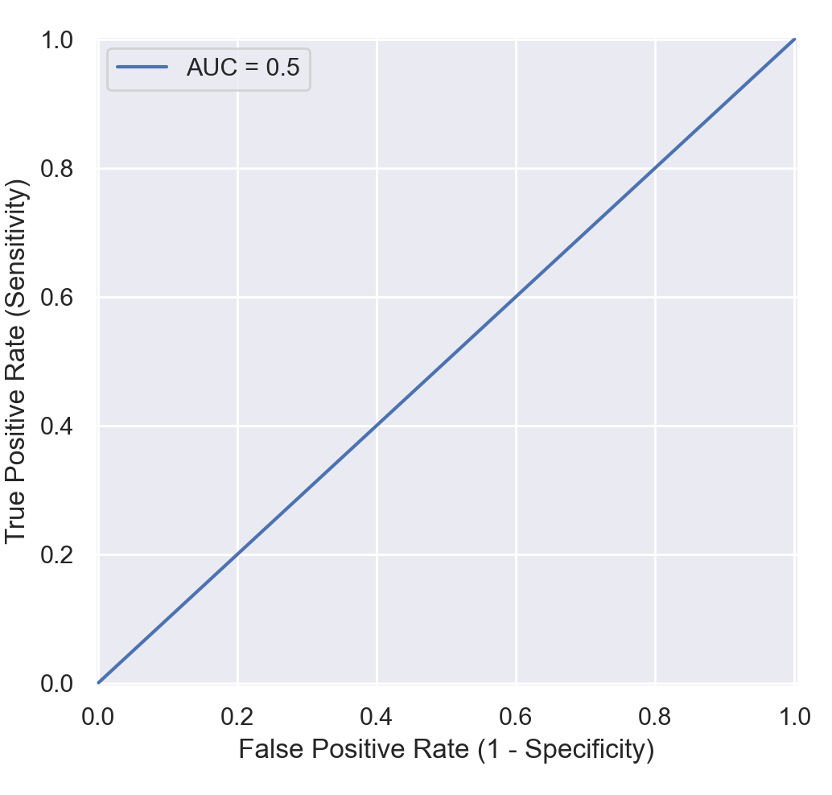
Our “no information” model
AUC is 0.5
Do we ever see AUC < 0.5?
If so, what can we infer about the distributions of our predictions for positive and negative samples?
Notes:
Again, we arrive at our no information curve, where we can vary the threshold from 0 to 1 and always get both sensitivity and false positive rate equal to 1 minus the threshold.
And again, the area under this curve is 0.5.
So, now we’ve seen what BAD performance looks like – namely, a diagonal line running from bottom left to top right on the ROC curve, and a corresponding AUC of 0.5.

Slide 22
So, what’s a good AUC value? (i.e., good performance)?
It depends.
Are predictions better than random?
Are predictions than the previous best performing model?
Are predictions better than expert performance?
Does performance exceed our (informed) expectations?
Is the model clinically useful?
Different expectations for risk prediction vs classification

Slide 23
What can we say about prediction performance when distributions match?
When distributions of predictions match between pos/neg:
predictions provide no information about the outcome
i.e. random guessing
When distributions of features (observed or latent) match between pos/neg:
features contain no information about the outcome
Note that adversarial methods operate on this principle:
Train a discriminator that predicts pos/neg (or real/fake)
Train a generator whose goal is to increase the discriminator’s loss (many variations on this)
Result? Distribution matching
Notes:
Describe variations on this idea
GAN
ADDA

Slide 24
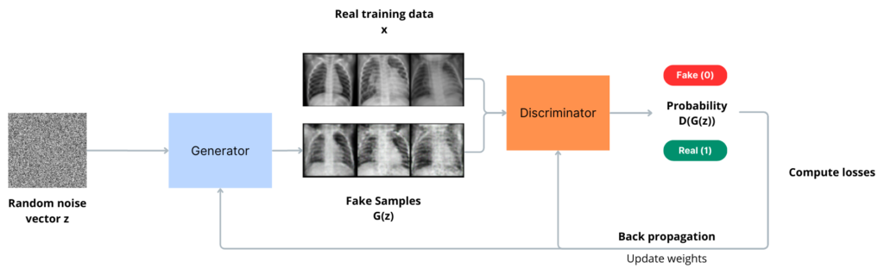
Brief overview of generative adversarial networks (GANs)
Taken from: https://blog.ovhcloud.com/understanding-image-generation-beginner-guide-generative-adversarial-networks-gan/
Notes:
- Generated samples match observed data distribution

Slide 25
We’ve quantified performance across all thresholds, but how do we use the model?
Sometimes the predicted probability really is what we care about.
Example: probability of heart attack
If so, we need to make sure our model is calibrated
More often, we need to pick a threshold so we can decide whether to:
Alert a provider
Get a biopsy
Refer the patient
etc
What threshold should we pick? What’s the right tradeoff?
Notes:
Now as we’ve discussed, we like to be agnostic to the particular decision threshold when quantifying model performance.
However, to actually use predictive models in decision-making, we typically need to pick a specific threshold
Our choice reflects the relative cost we place on false positives versus false negatives – in other words, how much we’re worried about missing cancer versus performing unnecessary testing or interventions.
And of course, this will depend on the scenario. Let’s run through a few hypotheticals.

Slide 26
Healthcare Scenarios Which performance metric is most important?
A computer vision model that detects carcinoma
Notes:
Suppose you were specifying a decision threshold for a computer vision model that detects carcinoma.
Would you be more worried about missing cancer, and therefore pick a high sensitivity threshold, or would you be more worried about unnecessary tests or intervention, and therefore pick a high specificity threshold?
There’s no right answer here – in reality, you’d need to understand the clinical scenario in much more detail to make this call.

Slide 27
Operating Point: high sensitivity
Notes:
Supposing you were more worried about missing cancer, you might pick a high sensitivity operating point like the one shown here.

Slide 28
The Precision-Recall Curve (i.e., PPV-Sensitivity Curve)
Some argue it has greater clinical relevance than the ROC curve
The no information classifier always achieves PPV equal to the base rate, or prevalence (why?)
PPV as well as the area under this curve (average precision) must be interpreted relative to prevalence
Notes:
As an important complement to the ROC curve, therefore, we often also want to plot a precision-recall curve – in other words, a sensitivity versus PPV curve.
The principles are very similar to the ROC curve. If we place our threshold near 1, we catch very few cases, therefore our sensitivity is near 0; however, our PPV is high.
On the other hand, if we place our threshold near 0, we’re predicting that every case is positive, therefore our positive predictive value – in other words, the rate at which we observe positive cases among our predicted positive cases -- is equal to the prevalence.

Slide 29
Operating Point: high sensitivity
Notes:
Here we can see our high sensitivity operating point on the precision-recall curve.

Slide 30
Healthcare Scenarios
A computer vision model that detects carcinoma
An algorithm that detects atrial fibrillation in Apple Watch users
Notes:
Now suppose you were specifying a decision threshold for an algorithm that detects atrial fibrillation in Apple Watch users.
Apple is understandably very concerned about raising too many false alarms given the large number of individuals that wear an Apple watch, therefore they are likely to pick a high specificity threshold…

Slide 31
Operating Point: high specificity
Notes:
Here’s our high specificitiy operating point on the precision-recall curve.

Slide 32
Healthcare Scenarios
A computer vision model that detects carcinoma
An algorithm that detects atrial fibrillation in Apple Watch users
An EHR-based model that monitors autism risk
Notes:
In my research, I consider EHR-based predictive models that monitor autism risk from a young age.
We are trying to identify as many children as possible as early as possible, but at the same time, there’s already a long waiting list to see a specialist, and if we create too many false alarms, we’re going to overburden the system and end up delaying diagnosis for *everyone*.
Therefore we may end up choosing a “balanced” operating point that prioritizes specificity and sensitivity about equally.

Slide 33
Operating Point: balanced
Notes:
And finally, here’s our balanced operating point. Please take a moment to think carefully about these curves and the relationships between them.

Slide 34
Healthcare Scenarios
A computer vision model that detects carcinoma
An algorithm that detects atrial fibrillation in Apple Watch users
An EHR-based model that monitors autism risk
Sometimes specificity and sensitivity are difficult to interpret, particularly for rare conditions or events.
The most clinically relevant measure is often the positive predictive value (or negative predictive value).
Notes:
Now, particularly for rare events, it often makes most sense to focus on positive or negative predictive value rather than sensitivity or specificity.
The PPV and NPV are often more directly relevant to decision-making, because they tell us what we can expect in terms of the true outcome after seeing a positive or negative result, respectively.
And we also know that for rare events, PPV can be low even when specificity is relatively high, because there are many more negative cases than positives.

Slide 35
Multi-class problems

Slide 36
Multi-class problems: “Confusion Matrix”
Predicted Label
Correct Prediction
True Label
Incorrect Prediction
Notes:
Now, in everything we’ve discussed so far, we’re thinking about binary problems – we’re distinguishing positive cases from negative cases
But in this course, we’ll also be considering multi-class problems, in which we’re predicting which of several labels corresponds to our patient, or case
For example, we might predict that a skin lesion is cancerous or benign – this is binary – but alternatively, we might predict what kind of lesion it is – a carcinoma, actinic keratosis, melanoma, and so on
In these problems, instead of a 2 by 2 ”confusion matrix” of TPs, FPs, TNs, and FNs, we instead have an N x N matrix, where N is the number of classes. We can think of this as a cross-tabulation between the true labels and predicted labels. In the top left corner, we have a count of cases for which the true label was the first label –and the predicted label was also the first label. Along the same lines, the box in the 2nd row, 3rd column tells us how many cases there were where the true label was the second label, but our model predicted the third label.
One metric we can calculate directly from this matrix is the accuracy – this is simply the number of correct predictions over the number of total predictions – in other words, the sum of the blue boxes divided by the sum of all boxes
However, it’s not obvious how all the metrics we’ve discussed previously, which are quite useful, can be applied here.

Slide 37
Multi-class problems: Binary for Label 1
Predicted Label
TruePos
<---- False Negatives ---->
False Pos
Correct Prediction
True Label
True Negatives
Incorrect Prediction
<---- False Positives ---->
Notes:
One approach – really the only approach that is common – is to instead go back to binary prediction for each of the labels of interest.
We can consider only the first label, for example. Each patient, or case, is labeled either with that label, or with some other label; and similarly, the model either predicts that label, or it predicts some other label.
If the true label is the first label, and the model also predicts the first label, that’s a true positive; whereas if the model predicts a different label, that’s a false negative.
And if the true label isn’t the first label, and the model predicts the first label, that’s a false positive; whereas if the model predicts a different label, that’s a true negative.
We can then look at all our earlier metrics – sensitivity, specificity, etc – with respect to the binary prediction task defined by the first label.

Slide 38
Multi-class problems: Binary for Label 2
Predicted Label
True Negatives
TruePos
<---- -------- False Negatives ---->
Correct Prediction
True Label
<---- True Negatives --------- ---->
<---- False Positives --------- ---->
Incorrect Prediction
True Negatives
Notes:
And, in exactly the same way, we can define all these metrics with respect to any of the other labels.
Sometimes, we might even consider the average of these metrics across all these binary tasks – a mean precision, for example, not to be confused with the average precision, which is an approximation to the area under the precision-recall curve.

Slide 39
Prediction for Ms. Z
After deciding to use the model, you see an 82 year-old woman with a new diagnosis of diastolic heart failure after a recent hospitalization. She had an echo and a cath showing left ventricular hypertrophy and grade 2 diastolic dysfunction with a preserved ejection fraction. She has a history of diabetes and retinopathy and neuropathy.
The model predicts that she is 25% likely (95th percentile) to progress to stage IV CKD within the next 2 years. This prediction is consistent with your clinical impression, so you consider whether to refer her to Nephrology.
Should you refer her? Why or why not?
Notes:
Notes for Joel – flesh out (a) clinical picture, and (b) what is the relevant patient population
Costs/benefits to different stakeholders
- patient
- hospital
- payor

Slide 40
What level of risk justifies referral?
Ms. Z’s case leads you to wonder whether referral would be appropriate in more borderline cases.
To make the process more streamlined and consistent, you decide you’d like to refer patients whose risk is above a particular threshold.
How do you decide on this threshold?
Should it be the same for everyone?
What does your decision say about cost/benefit?
Notes:
To answer this you must weigh cost vs benefit
(have to put them on the same scale; difficult/impossible to do)
(however, your decision reflects your preferences…)
- costs associated with referral
To the hospital
To the patient
- in general, could be costs associated with intervention and/or unnecessary care
Side effects
- benefits of referral
If risk is 10%, expected cost/benefit is ??

Slide 41
Assessing calibration

Slide 42
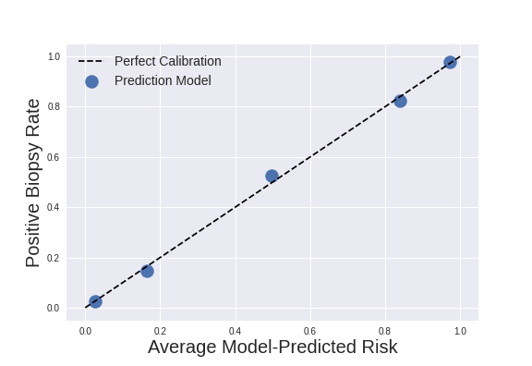
Assess Calibration Graphically

Slide 43
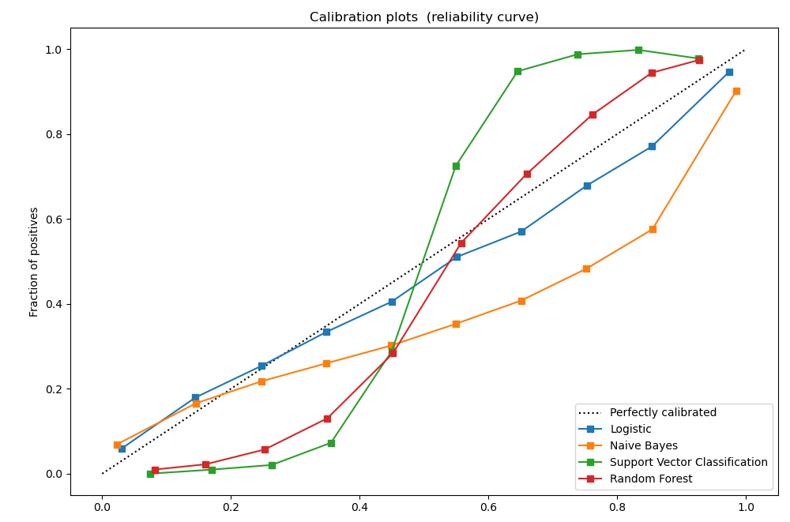
Assess Calibration Graphically
Model-Predicted Risk
From: https://scikit-learn.org/stable/modules/calibration.html
Notes:
Just to give you a sense of what a more typical calibration plot might look like, here’s an example from the scikit-learn documentation
Model whose predicted probabilities are too large (i.e. model-predicted risk > empirical risk): under the line
Model whose predicted probabilities are too small (i.e. model-predicted risk < empirical risk): over the line
Model that is ”overconfident”, meaning its predictions are too extreme (don’t have this)
Model that is “underconfident”, meaning its predictions are not extreme enough (GREEN)

Slide 44
Investigating model predictions
Looking inside the black box
Notes:
Stimulate discussion here

Slide 45
Prediction for Mr. X
You’ve been using your stage IV prediction model for several months now and have found its predictions to be helpful and in line with your clinical judgment.
You see a 32 year-old male patient with new significant hypertension (165/91). You check your model and see it predicts low stage IV CKD risk (<2%). However, on physical exam there is puffiness around his eyes and 1+ edema to his mid-shin. On urinalysis you find significant proteinuria (3+).
The model has been reliable thus far, and you wish to reconcile the findings you’re seeing with its predictions.
Report Back: What can you do to investigate?
Notes:
(young patient with some weird findings)
The setup here would be for possible membranous glomerulonephritis.

Slide 46
Key Questions
What information is available to the model?
Predictor groups
Timing of collection
Lab ID or lab values?
What population was used to train the model?
Relevant inclusion / exclusion criteria
Representation of specific demographics
What do you know that the model doesn’t (or vice versa)?
Notes:
And what might it know that you don’t?
Common to have too much confidence in the model!

Slide 47
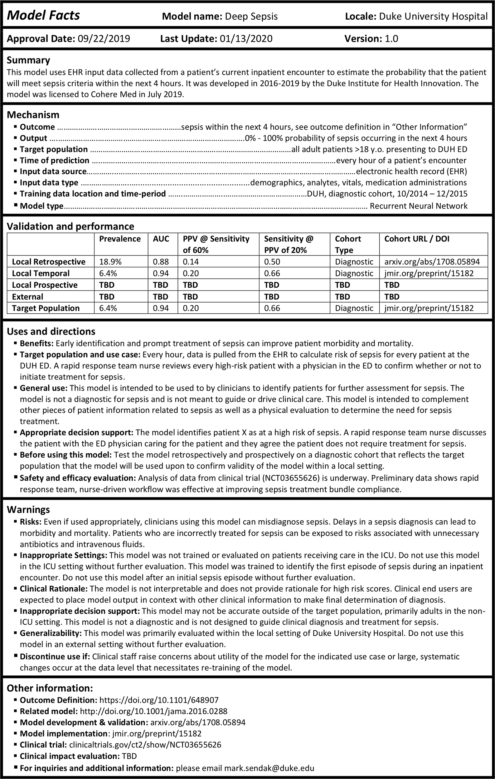
Report Back: What else should you know to use the model?
Sendak, M.P., Gao, M., Brajer, N. et al. Presenting machine learning model information to clinical end users with model facts labels. npj Digit. Med. 3, 41 (2020). https://doi.org/10.1038/s41746-020-0253-3
Notes:
What is this?
“a systematic effort to ensure that front-line clinicians know how, when, how not, and when not to incorporate model output into clinical decisions”
Things to highlight here:
SETTING:
- target and training populations: both DUHS; don’t use elsewhere
- *presenting to ED*; NOT appropriate for ICU patients
- not appropriate beyond first episode of sepsis
TIMING:
- hourly EHR data pulls
- time of prediction
- input data source and type
APPLICATION:
- not diagnostic
- identify patients for further assessment
Performance summary

