Slide 1
From Bags of Words to Large Language Models
Matthew Engelhard

Slide 2
Problem 1: make predictions from text
y, abnormality present
x, radiology report
End goal: predict y from x
Notes:
Today, we’re going to consider a new kind of predictive model, one in which the input to the model is a text document, and the output is a label associated with that document
For example, the input might be a radiology report, and the output might be a binary label indicating whether an abnormal finding was noted in the report
But as we know, all our predictive models – logistic regression, MLP, CNN – they all work with numbers
So, right from the start we’re faced with a difficult problem – how can we convert a document into a feature vector that encodes its contents?
If we can do that, we can then apply any of the classification models we’ve previously discussed
So, that’s the problem we’ll be solving today.

Slide 3



Problem 2: generate text
z, random noise
$x$, realistic clinical note
End goal: create structure from randomness
Notes:
our focus: prediction machines
What are they? functions, algorithms
more specifically: neural network prediction machines
The goal? Predict as well as we can. Approach is secondary.

Slide 4
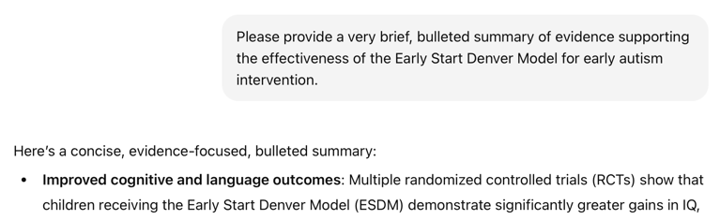

Is this generative or predictive?
y, next word
x, conversation history
“next-token prediction”
Notes:
Now, what about the systems we’re seeing today?
Does the paradigm I’ve described still fit?
“next-token predictor”
“stochastic parrot”
Generation via repeated prediction
Make the point about truth

Slide 5
The central problem of natural language processing:
How do we convert text to numbers our models can work with?

Slide 6
Text to numbers, v1: word counts
A count-based model for maternal health triage
Notes:
Stimulate discussion here

Slide 7
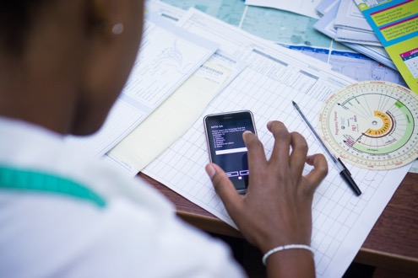
Case Study: SMS Triage for Global Maternal Health
Maternal Health HelpDesk:
2 million women connected to NDoH staff via SMS
https://www.praekelt.org
Binary Classification: Urgent Message? (Yes/No)

Slide 8
A Simple Predictive Model: ICU Mortality
???
WBC Count
Respiratory Rate
Creatinine
Mean BP
Hematocrit
Age
Temperature
Pulse Rate
Survival
End goal: predict odds of hospital mortality
Notes:
What goes in these boxes?

Slide 9
Training Set (Historical Data)
x₁
y₁
Find an equation that predicts $y$ based on $x$ across the training set
x₂
y₂
x₃
y₃
x₄
y₄
…
…
x_{N-1}
y_{N-1}
x_{N}
y_{N}
Notes:
How do we do that?
Gather a bunch of historical data
Want to find an equation that predicts y well based on x across that historical data
So we take all this data, we use it to find the parameters that are most consistent with the patterns of x and y that are present

Slide 10
Making Predictions for New $x$
x₁
y₁
x₂
y₂
Find an equation that predicts $y$ based on $x$ across the training set
<- Learn to predict new $y$
x₃
y₃
x₄
y₄
…
…
x_{N-1}
y_{N-1}
x_{N}
y_{N}
x_{N+1}
y_{N+1}
Notes:
Having done that, we have a trained model.
Now, when we see a NEW value of x, we simply plug it into our “learned” equation, and it tells us what we expect y to be. This is prediction.

Slide 11
Case Study: SMS Triage for Global Maternal Health
https://www.praekelt.org
Can we use a standard predictive model
setup to solve this problem?

Slide 12
This time, our training data is text
x₁
What helps with morning sickness?
How many months should I breastfeed?
I passed out and Mom said I was shaking
Where is the nearest clinic?
I am having heavy bleeding, what should I do?
What foods should I eat while pregnant?
My heart is racing and I can’t catch my breath
y₁
x₂
y₂
x₃
y₃
$yi$: Urgent or
Not Urgent?
<- Learn to predict new $y$
x₄
y₄
…
…
x_{N-1}
y_{N-1}
x_{N}
y_{N}
x_{N+1}
y_{N+1}
Notes:
Having done that, we have a trained model. Our parameters are learned – we hold them fixed.
Now, when we see a NEW value of x, we simply plug it into our “learned” equation, and it tells us what we expect y to be. This is prediction.

Slide 13
We need numbers, not words
Can we convert our text to a vector or sequence of numbers?
If yes, we can use logistic regression (or any other predictive model)!

Slide 14
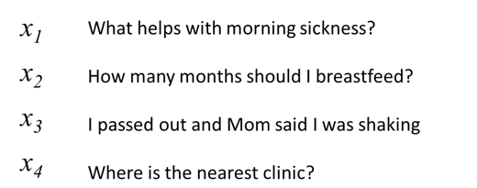
First try: count words in each SMS Step 1: Define a vocabulary of words
shaking
what
clinic
how
helps
was
nearest
many
with
said
months
the
morning
mom
should
sickness
and
I
is
how
out
breastfeed
passed
where
list of all words
(in no particular order)

Slide 15
Step 2: count how many times each vocabulary word appears in a given SMS
shaking
what
clinic
how
helps
was
nearest
many
with
said
months
the
morning
mom
should
sickness
and
I
is
how
out
breastfeed
passed
where
What helps with morning sickness?
x₁
0 | 1 | 0 | 0 | 1 | 0 | 0 | 0 | 1 | 0 | 0 | 0 | 1 | 0 | 0 | 1 | 0 | 0 | 0 | 0 | 0 | 0 | 0 | 0

Slide 16
Step 2: count how many times each vocabulary word appears in a given SMS
shaking
what
clinic
how
helps
was
nearest
many
with
said
months
the
morning
mom
should
sickness
and
I
is
how
out
breastfeed
passed
where
I passed out and Mom said I was shaking
x₃
1 | 0 | 0 | 0 | 0 | 1 | 0 | 0 | 0 | 1 | 0 | 0 | 0 | 1 | 0 | 0 | 0 | 2 | 0 | 0 | 1 | 0 | 1 | 0

Slide 17
Note that word order does not matter!
shaking
what
clinic
how
helps
was
nearest
many
with
said
months
the
morning
mom
should
sickness
and
I
is
how
out
breastfeed
passed
where
clinic is where nearest the
x₄
0 | 0 | 1 | 0 | 0 | 0 | 1 | 0 | 0 | 0 | 0 | 1 | 0 | 0 | 0 | 0 | 0 | 0 | 1 | 0 | 0 | 0 | 0 | 1

Slide 18

A “bag of words”
clinic
nearest
where
the
is

Slide 19
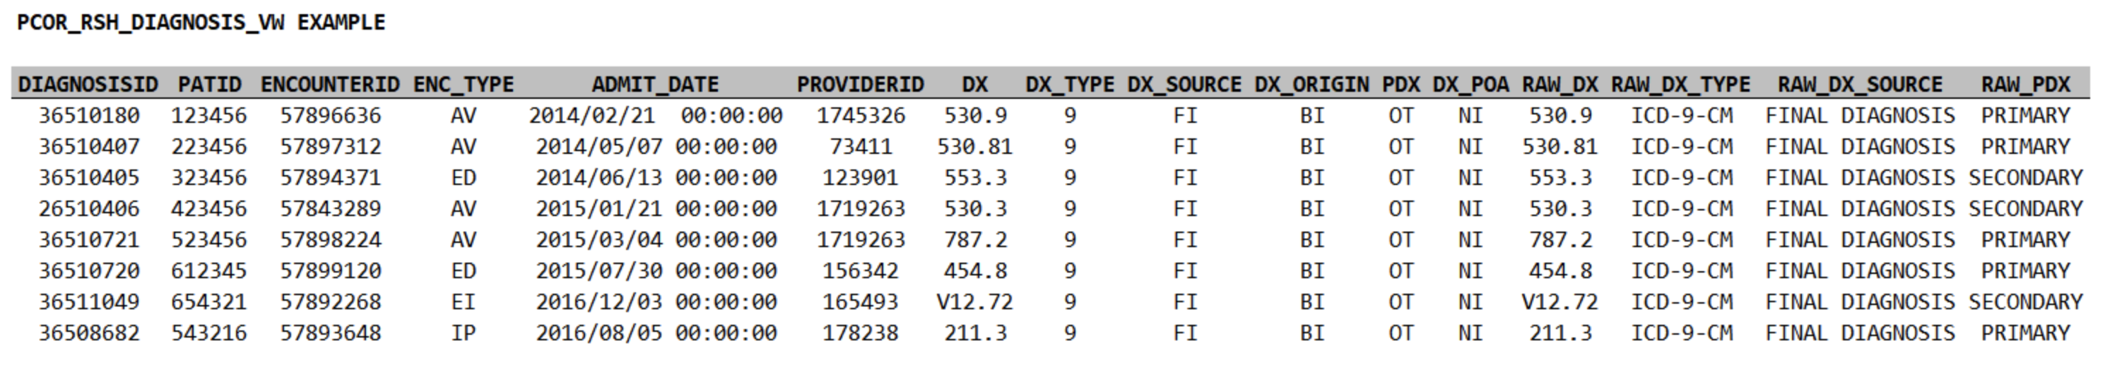
A “bag of medical codes”
E55.9
(you did this in coding assignment 1)
F84.5
Z79.01
E11.9
N39.0

Slide 20
Discuss: what are the limitations of treating text as a bag of words?

Slide 21
Text to numbers, v2: word embeddings
Key problem: quantifying semantic relationships between words
Notes:
Old but important

Slide 22
Word embedding: a numeric representation of a word that encodes its meaning
miserable
upset
joyful
melancholy
happy
content
euphoric
sad
unhappy
satisfied
merry
ecstatic
sorrowful
depressed
down
gleeful
<- sadder
happier ->
Numeric value indicating whether the word is happy or sad

Slide 23
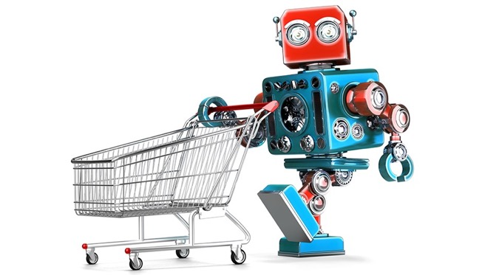
Grocery List
Training a robot to buy groceries
granulated sugar
vanilla extract
dark brown sugar
carrots
table salt
eggs
Example from Anand Chowdhury, MMCi 2019
Notes:
The robot doesn’t know all this stuff – too many grocery items!

Slide 24
Identify items by their attributes (including previously unseen items)
Dimension | 1 | 10
State | Liquid | Solid
Sweetness | Bland | Sweet
Color | Light | Dark
Size | Small | Large
Carrotness | Not really | Platonic essence of carrot

Slide 25
Why does this help us?
The model can make sense of words it hasn’t seen before (weren’t used in training)
Similar words (e.g. synonyms) will have similar attributes, and therefore will have similar effect on model predictions
(more complicated) Now we can convert text to a sequence of vectors; and we were already very good at making predictions from sequences of vectors

Slide 26
How do we learn word embeddings?
Key idea: words are defined by the contexts in which they appear

Slide 27
How do we learn these attributes?
KEY IDEA: words are defined by the contexts in which they appear
A man strolls down the street
Consider substituting one word for another.
Claim: if two words are equally likely to appear all possible contexts, then the two words mean the same thing.
A woman strolls down the street
A child strolls down the street
A crocodile strolls down the street
A banana strolls down the street
A concept strolls down the street

Slide 28
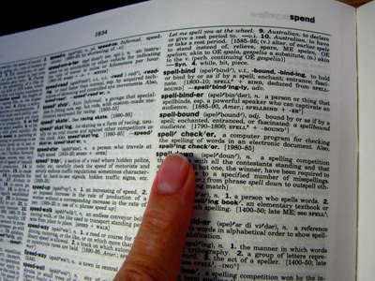
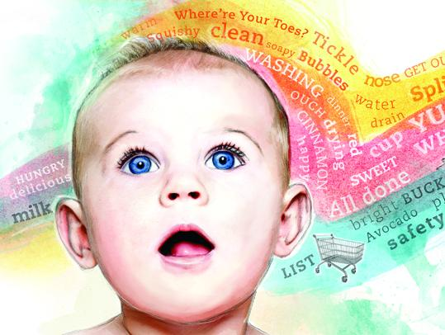
How do we learn these attributes?
KEY IDEA: words are defined by the context in which they appear
-> if words are always exchangeable, they must have very similar meaning
https://www.parenting.com/activities/baby/teach-baby-to-talk/
learn word meaning like an adult:
explicit definitions
learn word meaning like an child:
implicit definitions from context
Notes:
Like a (my) child: have the TV teach them!

Slide 29
Step 1: define co-occurrence or context
We define a context word as one that appears inside a fixed-length window around the input word in our training corpus.
(e.g. Wikipedia)
A man strolls down the street.
input context
{input word, context word}
{strolls, man}
{strolls, woman}
{swims, crocodile}
{swims, fish}
{flies, bird}
{flies, plane}
Notes:
Again, our goal is to take an input word – in this example, ‘strolls’ – and predict the probability that each word in our vocabulary will appear in its context.
What is our training set?
We can crawl through a huge text corpus – it could be Wikipedia, Twitter, randomly collected internet sites, and so on – and sample pairs of words that appear near one another.
We find that strolls appears near man, so {strolls, man} becomes an input word, context word pair
Similarly, we find that ‘flies’ appears near ‘bird’, so {flies, bird} becomes an input word, context word pair
Note that {bird, flies} is also a valid input word, context word pair: if bird appears in the context of flies, then flies also appears in the context of bird – the relationship is symmetric.
We might use a ‘context window’ of length 5, as shown in the slide, so that the input words and context words can be separated by one intervening word at most
Now we’ll create a model that predicts input words from context words

Slide 30
Step 2: find vector representations sufficient to predict the likely context (i.e. what other words are likely/unlikely to be nearby)
p(man)
p(woman)
elements of the vector corresponding to “strolls”
predict/
reconstruct
p(child)
probabilities for all words in our vocabulary
p(banana)
p(crocodile)
v(strolls)
p(concept)
Notes:
So, how do we set up the learning problem? Informally, we’re defining words based on context.
But to make that idea precise, let’s create a predictive model that encapsulates that intuition.
What we’d like to have is, for each word, a vector that allows us to predict which other words are likely to be nearby, and which words are not
In the example on the slide, we’d like to have a vector for the word ‘strolls’ that allows us to predict which words are likely to be found in its immediate context. The predicted probability of ‘woman’ should be fairly high, and the predicted probability of ‘concept’ should be very low
We’ll need predictions for each word in our vocabulary – again, this is the complete list of words we’re interested in, and for which we’d like to have word vectors. For each of those words, our model will predict the probability that that word will appear in the context of the word ‘strolls’, in this case
With this goal in mind, let’s consider how to set up our prediction task

Slide 31
Step 2: find vector representations sufficient to predict the likely context (i.e. what other words are likely/unlikely to be nearby)
p(man)
p(woman)
largest
elements of the vector corresponding to “strolls”
predict/
reconstruct
p(child)
probabilities for all words in our vocabulary
p(banana)
p(crocodile)
small but non-zero
v(strolls)
p(concept)
close to 0
Notes:
So, how do we set up the learning problem? Informally, we’re defining words based on context.
But to make that idea precise, let’s create a predictive model that encapsulates that intuition.
What we’d like to have is, for each word, a vector that allows us to predict which other words are likely to be nearby, and which words are not
In the example on the slide, we’d like to have a vector for the word ‘strolls’ that allows us to predict which words are likely to be found in its immediate context. The predicted probability of ‘woman’ should be fairly high, and the predicted probability of ‘concept’ should be very low
We’ll need predictions for each word in our vocabulary – again, this is the complete list of words we’re interested in, and for which we’d like to have word vectors. For each of those words, our model will predict the probability that that word will appear in the context of the word ‘strolls’, in this case
With this goal in mind, let’s consider how to set up our prediction task

Slide 32
Step 2: find vector representations sufficient to predict the likely context (i.e. what other words are likely/unlikely to be nearby)
p(man)
large but smaller than before
p(woman)
elements of the vector corresponding to “swims”
predict/
reconstruct
p(child)
probabilities for all words in our vocabulary
p(banana)
p(crocodile)
larger than before
v(swims)
p(concept)
close to 0
Notes:
So, how do we set up the learning problem? Informally, we’re defining words based on context.
But to make that idea precise, let’s create a predictive model that encapsulates that intuition.
What we’d like to have is, for each word, a vector that allows us to predict which other words are likely to be nearby, and which words are not
In the example on the slide, we’d like to have a vector for the word ‘strolls’ that allows us to predict which words are likely to be found in its immediate context. The predicted probability of ‘woman’ should be fairly high, and the predicted probability of ‘concept’ should be very low
We’ll need predictions for each word in our vocabulary – again, this is the complete list of words we’re interested in, and for which we’d like to have word vectors. For each of those words, our model will predict the probability that that word will appear in the context of the word ‘strolls’, in this case
With this goal in mind, let’s consider how to set up our prediction task

Slide 33
Word embeddings make it easy…
We can treat text like all the other data types!

Slide 34
What happens when we embed all words in a sentence?
Look up words individually to obtain their vectors
Construct a sequence of vectors
This is a sentence
x_{i}

Slide 35
What happens when we embed all words in a sentence?
Look up words individually to obtain their vectors
Construct a sequence of vectors
This is a sentence
Now we have a grid of numbers
Similar in many ways to an image
x_{i}

Slide 36
Now we can use deep learning…
…to learn to extract increasingly complex aspects of meaning

Slide 37
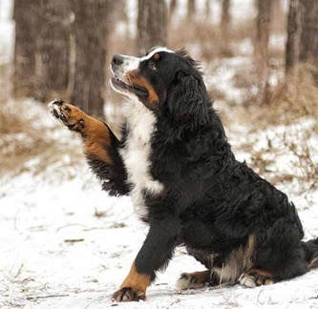
Now we can use deep learning to build our hierarchy of features.
low-level motifs
high-level motifs
dog
edges
shapes
textures
eyes
ears
paws
label
pixels
End goal: predict dog from pixels

Slide 38
Now we can use deep learning to build our hierarchy of semantic features.
low-level motifs
high-level motifs
PE
words
short phrases
concepts
topics
label
grid of semantic attributes
End goal: predict pulmonary embolism from text
Notes:
Much like in deep learning, low-level semantic features are often shared across domains/tasks, but higher level features are more task specific. So again, we can reuse models trained in different domains.

Slide 39
Back to next-token prediction

Slide 40
Now we can generate text!
y, next word
x, conversation history
“next-token prediction”
Notes:
Now, what about the systems we’re seeing today?
Does the paradigm I’ve described still fit?
“next-token predictor”
“stochastic parrot”
Generation via repeated prediction
Make the point about truth

Slide 41











(A look under the hood) TPH = “token prediction head”
the smallest person can change the course of the future [END]
TPH
TPH
TPH
TPH
TPH
TPH
TPH
TPH
TPH
TPH
TPH
Output
representations
$$x_{4}$$
$$x_{5}$$
$$x_{6}$$
$$x_{7}$$
$$x_{8}$$
$$x_{9}$$
$$x_{1}$$
$$x_{2}$$
$$x_{3}$$
$$x_{10}$$
$$x_{11}$$
Transformer Decoder
(token embeddings + positional encodings -> (decoder layer) x N)
Input tokens
Even the smallest person can change the course of the future
Notes:
Show input, block for encoder stack, prediction head
Note weight tying

Slide 42
Is this generative or predictive?
y, next word
x, conversation history
“next-token prediction”
Notes:
Now, what about the systems we’re seeing today?
Does the paradigm I’ve described still fit?
“next-token predictor”
“stochastic parrot”
Generation via repeated prediction
Make the point about truth

Slide 43
All of this also works in the EHR!
A foundation model for EHR data

Slide 44
Models for structured EHR data: the “language” of the EHR
A story about the progression of diabetes…
(“E11.65”, “E11.42”, “I10”, “N18.3”)
E11.65 — Type 2 diabetes mellitus with hyperglycemia
E11.42 — Type 2 diabetes mellitus with diabetic polyneuropathy
I10 — Essential (primary) hypertension
N18.3 — Chronic kidney disease, stage 3

Slide 45
Should you believe your LLM?
On hallucination and bias

Slide 46
First, learn to predict the next word on the internet
y, next word
x, conversation history
“next-token prediction”
Notes:
Now, what about the systems we’re seeing today?
Does the paradigm I’ve described still fit?
“next-token predictor”
“stochastic parrot”
Generation via repeated prediction
Make the point about truth

Slide 47
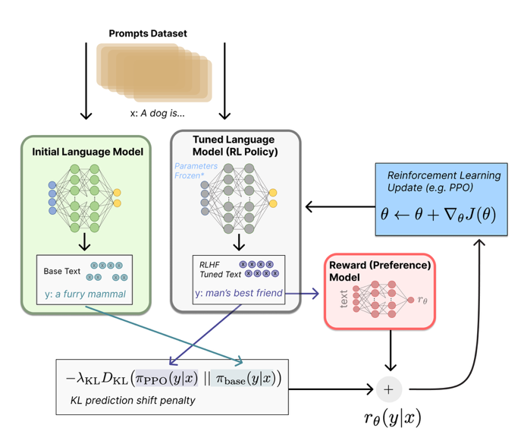
Then, learn to satisfy human preferences.
Step 1: Train an auxiliary preference model (via human feedback) to assign scores to LLM-generated text that are consistent with our preferences
Step 2: Fine-tune the initial LLM (via reinforcement learning) to achieve better scores, implying better alignment with our preferences
Illustrating Reinforcement Learning from Human Feedback (RLHF)
https://huggingface.co/blog/rlhf
Notes:
Now, what about the systems we’re seeing today?
Does the paradigm I’ve described still fit?
“next-token predictor”
“stochastic parrot”
Generation via repeated prediction
Make the point about truth

Slide 48
Discuss: Does this paradigm guarantee truth? What does it optimize for? How can it lead to bias?

Slide 49
Should you believe your RAG-enabled LLM?

Slide 50
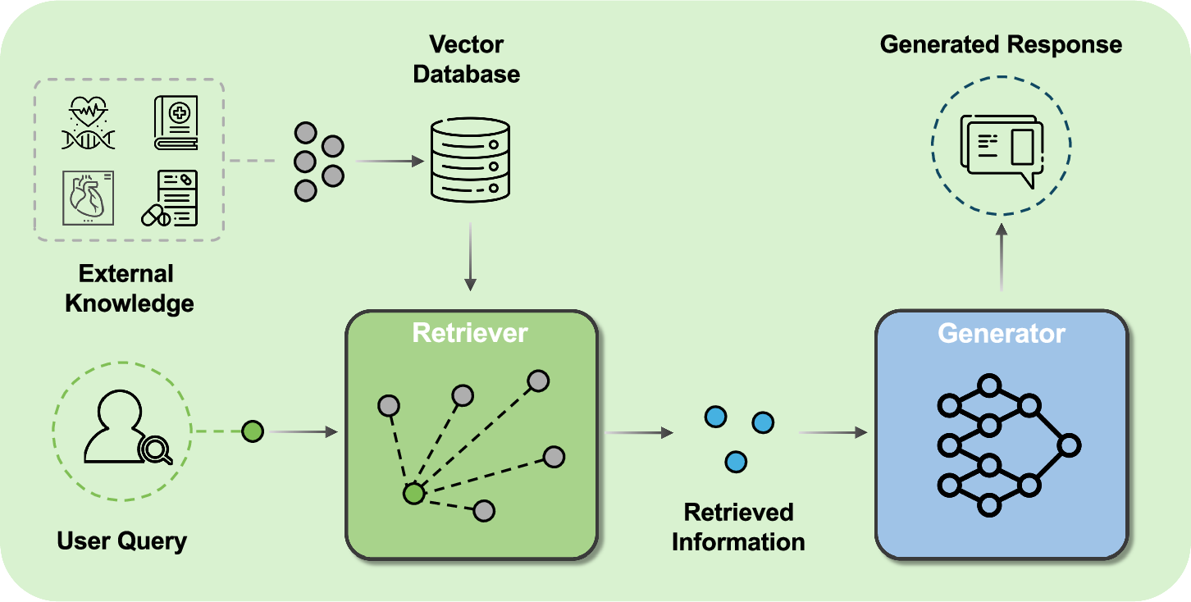
RAG augments LLMs with external knowledge
Yang, R., Ning, Y., Keppo, E. et al. Retrieval-augmented generation for generative artificial intelligence in health care. npj Health Syst. 2, 2 (2025).

Slide 51
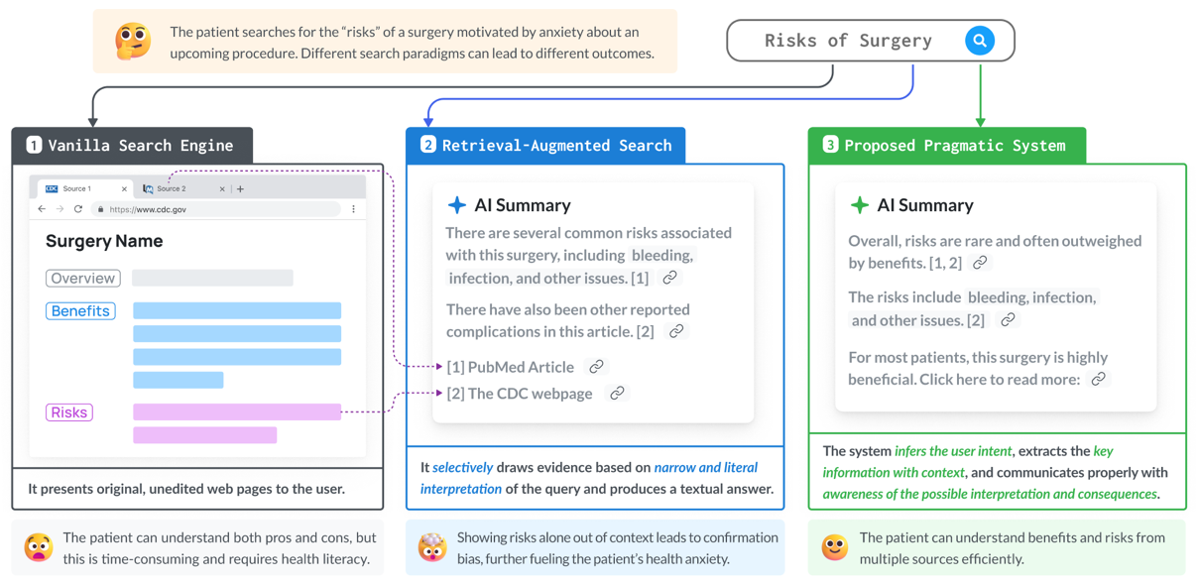
RAG is biased toward supporting the query
Position: Retrieval-augmented systems can be dangerous medical communicators. Lionel Wong, Ayman Ali, Raymond Xiong, Shannon Shen, Yoon Kim, Monica Agrawal. ICML, 2025.

Slide 52
Discuss: Experiences with RAG systems (e.g. OpenEvidence, many others) Have you identified biases?

