Slide 1
Introduction to Generative AI
Matt Engelhard
Duke Biostatistics & Bioinformatics

Slide 2
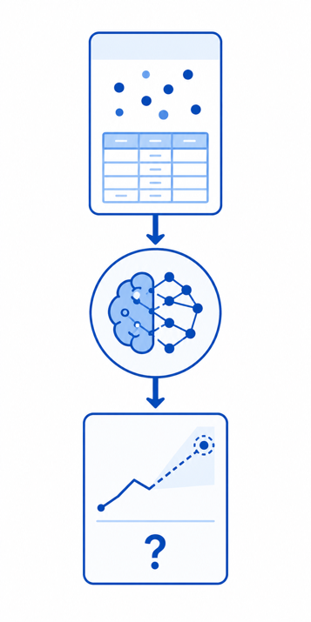
Predictive AI versus Generative AI (GenAI)
Predictive AI
Tasks
Regression
Classification
Risk prediction
Types of data
Tabular
Images
Text
Biomedical signals
Multimodal

Slide 3
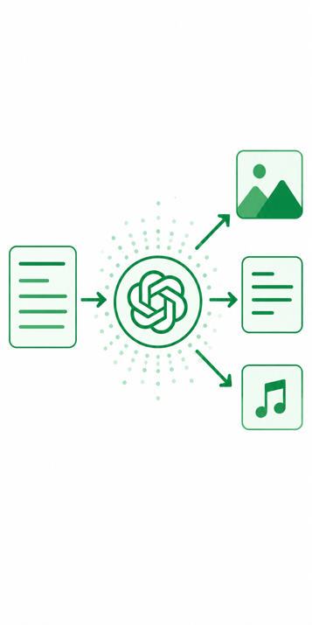
Predictive AI versus Generative AI (GenAI)
Predictive AI
Tasks
Regression
Classification
Risk prediction
Types of data
Tabular
Images
Text
Biomedical signals
Multimodal
Generative AI
Tasks
“Data generation”
Less well-defined
Can perform pred tasks
Types of data
Tabular
Images
Text
Biomedical signals
Multimodal

Slide 4
The Predictive AI Paradigm
y, associated value or label
x, data/features for a subject or patient
End goal: predict y from x
Notes:
our focus: prediction machines
What are they? functions, algorithms
more specifically: neural network prediction machines
The goal? Predict as well as we can. Approach is secondary.

Slide 5
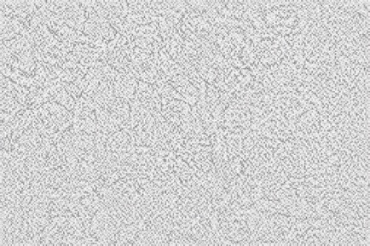
The Generative AI Paradigm
x, data/features for a synthetic subject or patient
z, random noise
End goal: create structure from randomness
Notes:
our focus: prediction machines
What are they? functions, algorithms
more specifically: neural network prediction machines
The goal? Predict as well as we can. Approach is secondary.

Slide 6
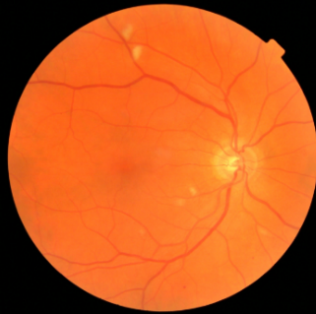
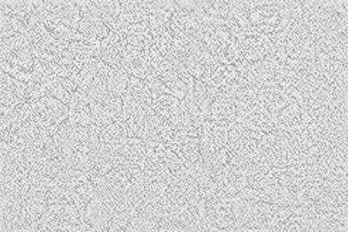
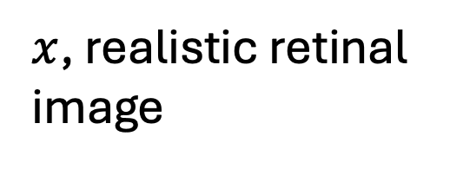
Image generation via GAN or diffusion
z, random noise
$x$, realistic retinal image
End goal: create structure from randomness
Notes:
our focus: prediction machines
What are they? functions, algorithms
more specifically: neural network prediction machines
The goal? Predict as well as we can. Approach is secondary.

Slide 7
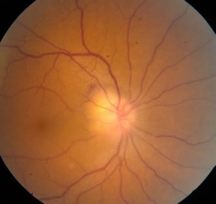

Generative Adversarial Network (GAN)
Discriminator
(CNN-based predictive model)
IMAGE GENERATOR
(CNN-based generative model)
$$P(real | x)$$
real retinal image
Notes:
our focus: prediction machines
What are they? functions, algorithms
more specifically: neural network prediction machines
The goal? Predict as well as we can. Approach is secondary.

Slide 8
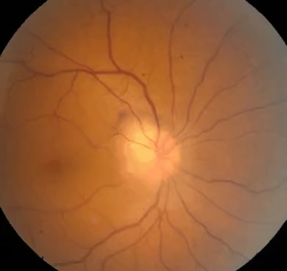
Generation via Diffusion
The model learns to predict what noise was added
During generation, it progressively de-noises
For images, the diffusion process is typically performed on latent image representations

Slide 9
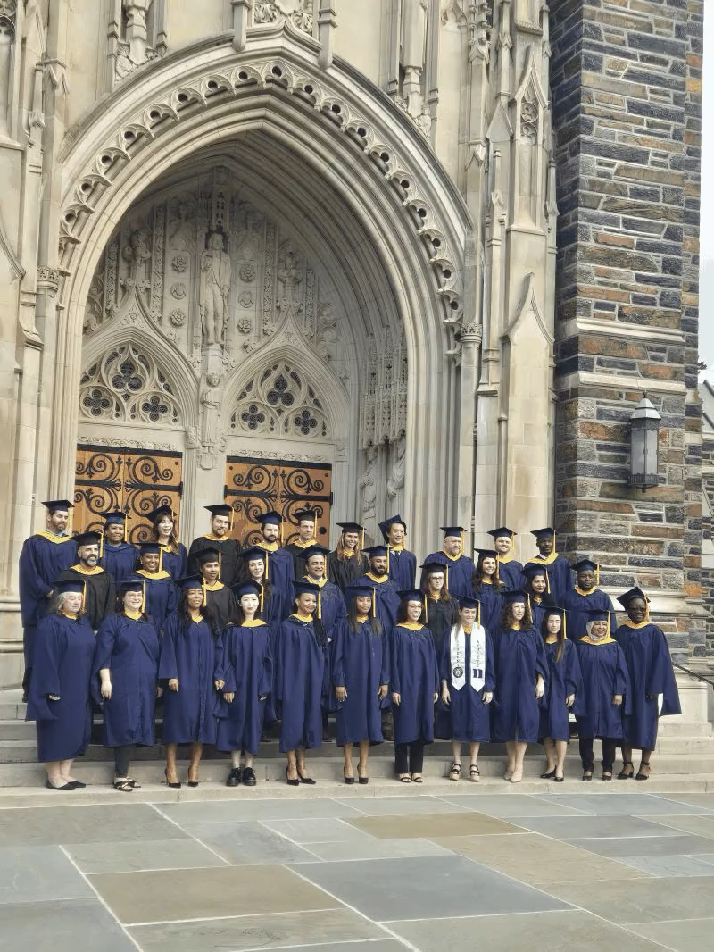
Generation via Diffusion
The model learns to predict what noise was added
During generation, it progressively de-noises
For images, the diffusion process is typically performed on latent image representations

Slide 10

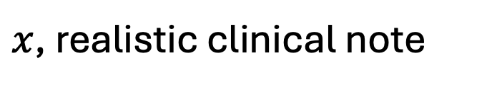
How can we generate text from randomness?
z, random noise
$x$, realistic clinical note
End goal: create structure from randomness
Notes:
our focus: prediction machines
What are they? functions, algorithms
more specifically: neural network prediction machines
The goal? Predict as well as we can. Approach is secondary.

Slide 11
How can we generate text from a prompt?
write a note reporting on an autism assessment
z, text prompt
$x$, realistic clinical note
End goal: create structure
consistent with the user prompt
Notes:
our focus: prediction machines
What are they? functions, algorithms
more specifically: neural network prediction machines
The goal? Predict as well as we can. Approach is secondary.

