Slide 1
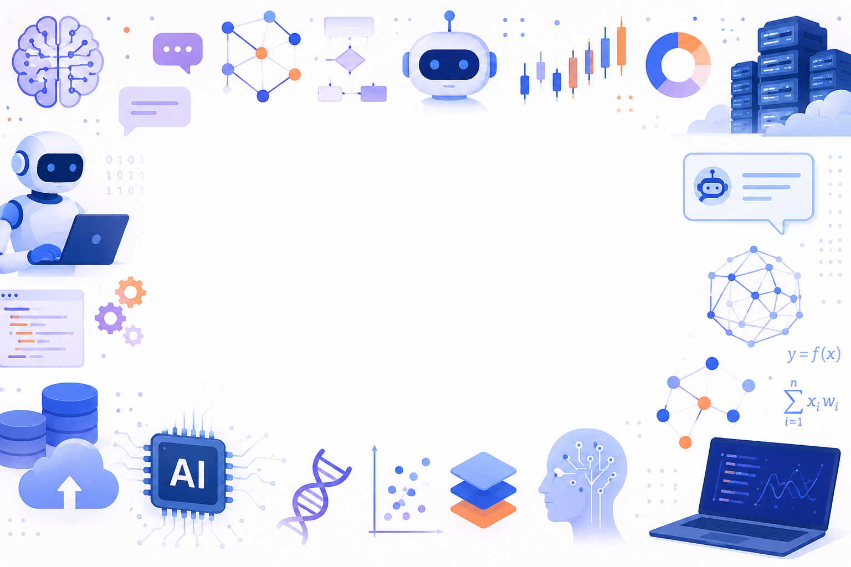
Introduction to Artificial Intelligence
Matt Engelhard
Duke Biostatistics & Bioinformatics

Slide 2
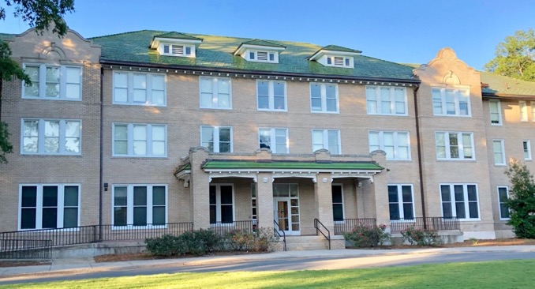
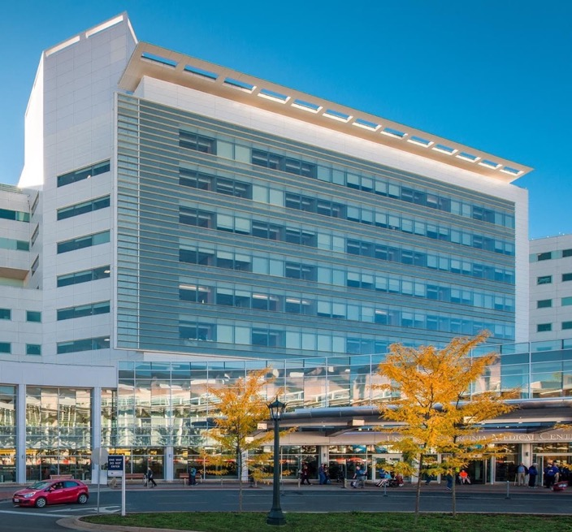
About Matt
MD/PhD at UVA
Duke Undergraduate
Duke B&B Faculty Since 2021
Notes:
My background
Duke undergrad
NSA
UVA
Back to Duke
Goal: get quants and providers to talk

Slide 3

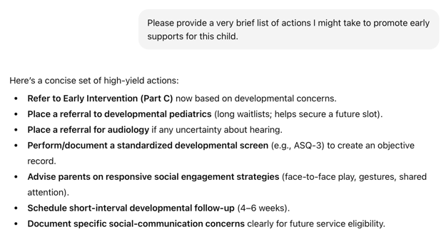



AI for enhanced neurodevelopmental support
Problem:
Inconsistent recognition and referral
Solution:
AI-based recommendations supporting personalized early actions
Predictive AI
Likelihood of autism and ADHD diagnosis
Contextual info including risk of loss to follow-up
GenAI
Relevant info is scattered across the EHR
“Clinicians wanted a breakdown of specific EHR data that informed autism likelihood predictions, along with an explanation of how the AI-based system worked. Clinicians also wanted actionable guidance on next steps following a positive screen”
Emovon, Driggers-Jones, Engelhard, Maslow, Dawson, Goldstein, and Franz. Understanding End-user Contexts and Identifying Design Preferences of an AI-based Clinical Decision Support Tool for Early Autism Detection. Submitted to JAMIA Open.
Providers need tailored guidance supporting early action and intervention
Vector Database
evidence-based best practices around early intervention
Structured
EHR
histories
Clinical
notes
Primary care provider
Notes:
I’m Matt Engelhard in B&B
Research in my group together with collaborators in B&B and Psychiatry
Illustrates how we can use AI to improve health and well-being
The first: AI for improved early action around autism +
Earlier supportive services -> better long-term outcomes
But first-line providers aren’t autism specialists
And information relevant to decision-making is scattered
across time (back to birth encounter)
and specialists
In our focus groups (led by Lauren Franz and others), providers are telling us that they don’t want another passive dashboard telling them about risk
they want timely, actionable guidance
A system that recommends concrete actions that are
Consistent with evidence-based best practices
Tailored to the individual patient
So that’s exactly what we’re building
We’ve gotten very good at predicting which patients are at highest likelihood of diagnosis
Our models pinpoint specific portions of clinical notes that are relevant and highlight them to providers
This system will take the burden off primary care providers

Slide 4
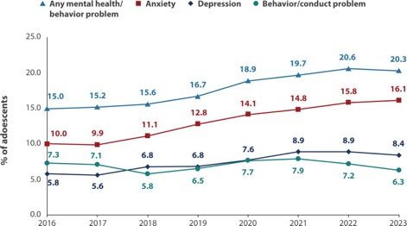
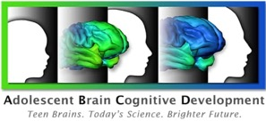


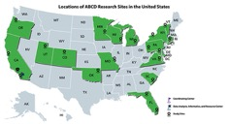

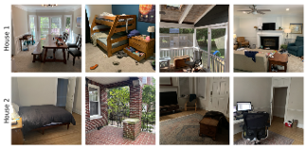
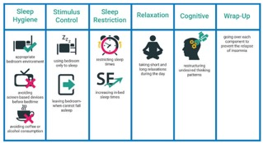
AI to improve rural adolescent mental health
Problem:
Mental health crisis in rural youth
Solution:
Mechanistic AI model that identifies high-risk youth
and suggests possible intervention target(s)
distribution
shift(s)
[use distributionally robust AI]
Increasing mental health diagnoses among children ages 12-17
Develop initial AI model in ABCD Study population
Validate in geographically
distributed rural populations
Profound shortage of mental health providers in rural areas
Add-on
studies under
development
CBT-I
components
Incorporate information about home environments via AI-based digital envirotyping
Urban:
13 per 100k
Rural:
3.5 per 100k
Clinical trial of model-guided intervention

Slide 5

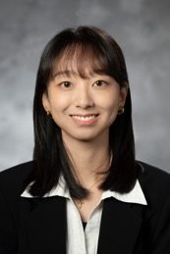


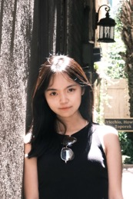





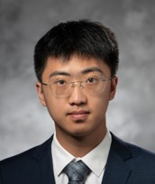


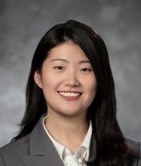
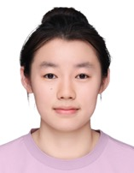


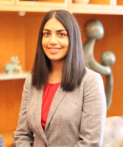
Engelhard Lab: patient-centered, AI-based CDS
Current
PhD
students
Qin
Weng
Liwen
Sun
Fengnan
Li
Yuqi
Li
Pengxi
Liu
Yuankang
Zhao
Current
MS/MB &
medical
students

Slide 6
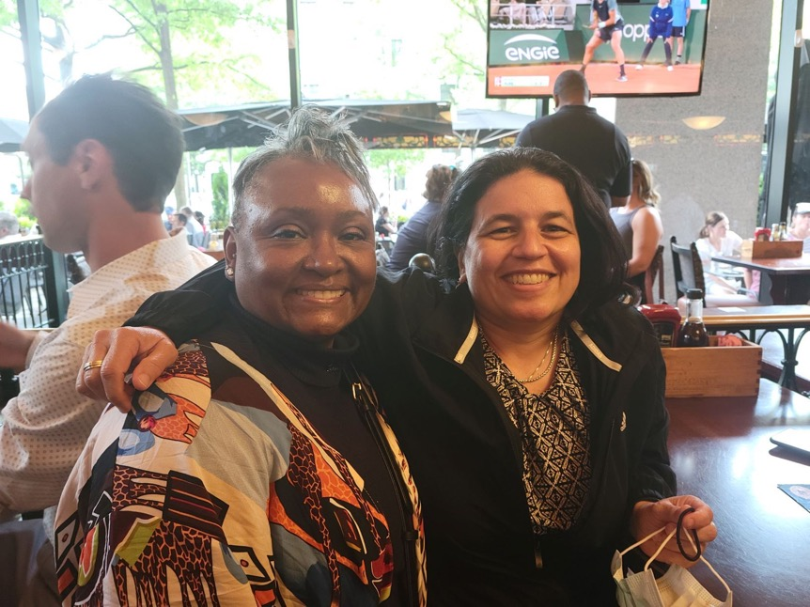
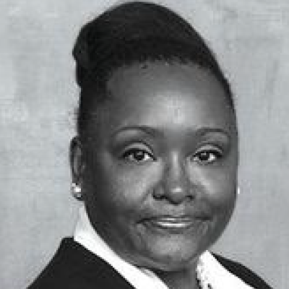
About Andrea
MMCi Class of 2021
MMCi Health Summit in DC, 2021

Slide 7
About You!
Your name
Your most recent position/training
(one line)
Are you skeptical or hopeful on impact of AI?
(1 = skeptical to 10 = hopeful)
Why?
(very briefly, e.g. it will make us dumber, or it will cure all disease)

Slide 8
What is AI?

Slide 9

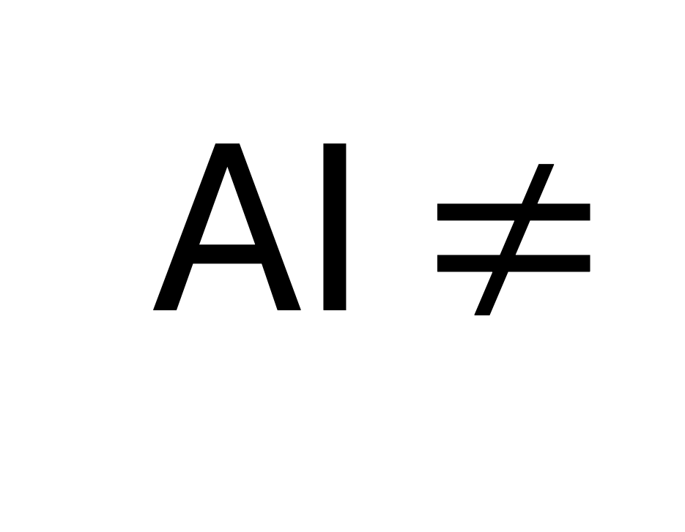
AI $≠$

Slide 10
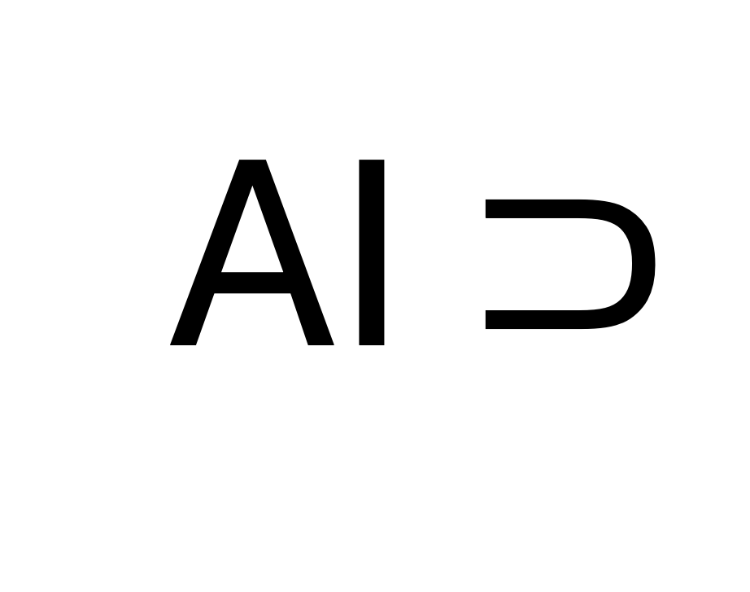
AI $⊃$

Slide 11
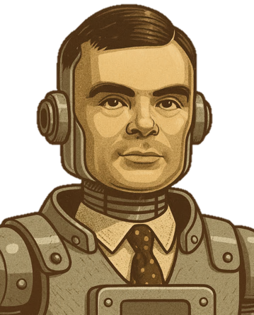
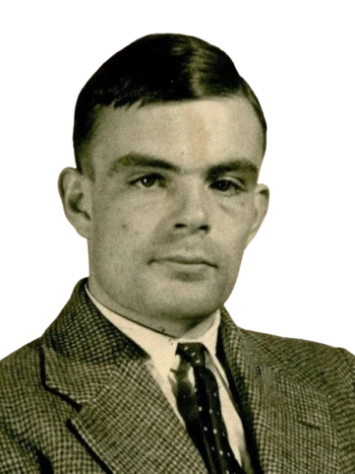
What is AI?
A scientific field concerned with developing intelligent machines.
What is intelligence?
learn from experience
solve problems
make decisions
Turing or TuringBot?
Notes:
AI: building intelligent machines. Not a new field: dates back certainly to the 50s; arguably earlier
So the question of “what is AI” becomes a question of “what is intelligence?, which is hard to define
Systems that reason from experience or data to solve a problem or goal
Turing himself, one of the fathers of AI, gave us the Turing test (has it been passed?
• ⁃ But a system that can reason about images in the same way a radiologist might — certainly this is also “intelligent”

Slide 12
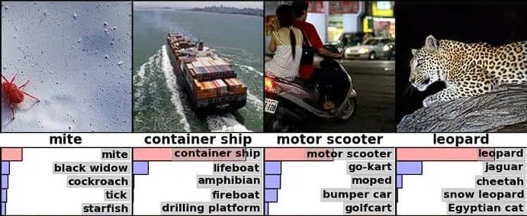
“AI” through the (recent) years
2018: AI = computer vision

Slide 13
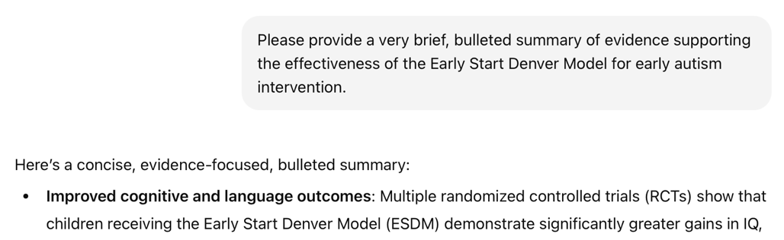

“AI” through the (recent) years
2024: AI = LLMs/chatbots

Slide 14
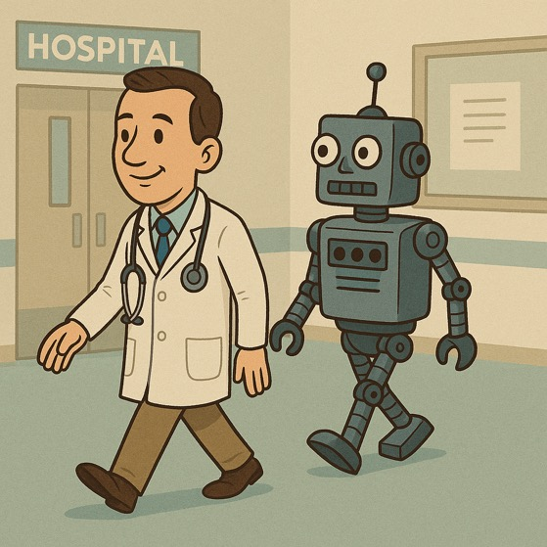

“AI” through the (recent) years
2029: AI = agents and RL

Slide 15
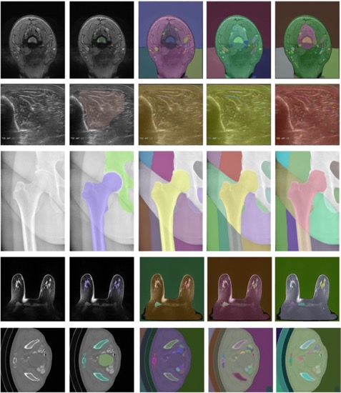
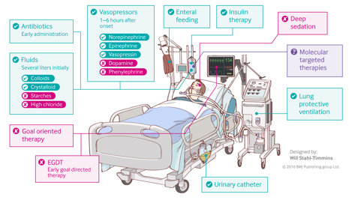
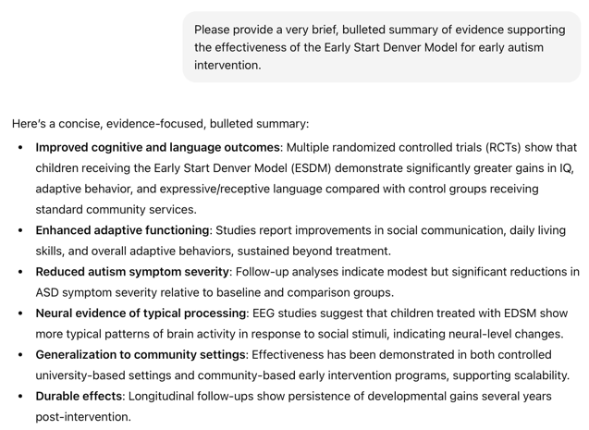
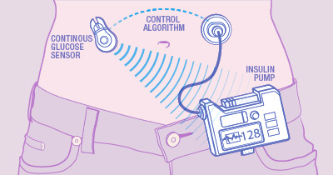
Branches of AI with high clinical impact
Computer vision
Natural language processing
Reinforcement learning
RL-based sepsis management
Mazurowski, Maciej A., et al. "Segment anything model for medical image analysis: an experimental study." Medical Image Analysis 89 (2023): 102918.
closed-loop BG control
Notes:
Three distinct branches with high clinical impact (describe)
Established impact, emerging impact, near future impact
In this course, we will focus on...
We will focus on predictive AI, which (a) is important in and of itself; and (b) will position you to understand genAI

Slide 16
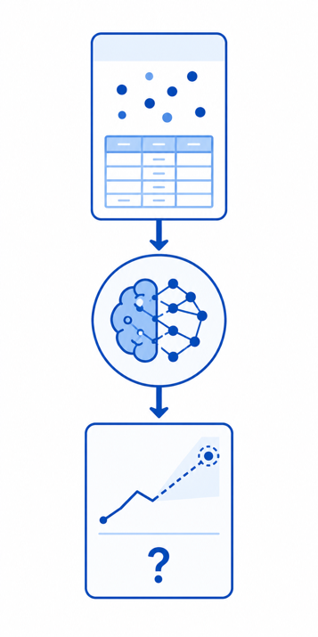
Predictive AI versus Generative AI (GenAI)
Predictive AI
Tasks
Regression
Classification
Risk prediction
Types of data
Tabular
Images
Text
Biomedical signals
Multimodal

Slide 17
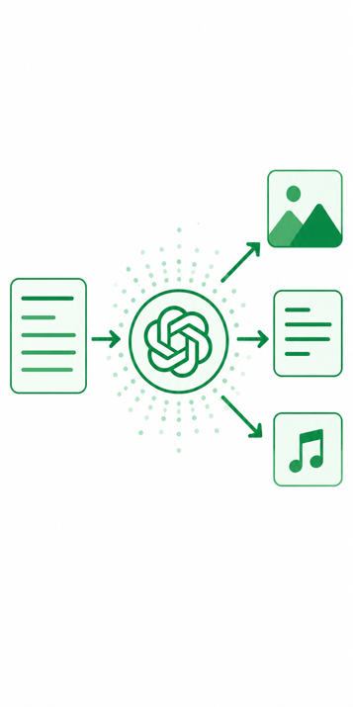
Predictive AI versus Generative AI (GenAI)
Predictive AI
Tasks
Regression
Classification
Risk prediction
Types of data
Tabular
Images
Text
Biomedical signals
Multimodal
Generative AI
Tasks
“Data generation”
Less well-defined
Can perform pred tasks
Types of data
Tabular
Images
Text
Biomedical signals
Multimodal

Slide 18
Overview of Predictive AI

Slide 19
The machine in machine learning
y, associated value or label
x, data/features for a subject or patient
End goal: predict y from x
Notes:
our focus: prediction machines
What are they? functions, algorithms
more specifically: neural network prediction machines
The goal? Predict as well as we can. Approach is secondary.

Slide 20
Simple models often work well for clinical data!
Age
WBC Count
Resp Rate
Creatinine
Mean BP
Hematocrit
Pulse Rate
Temperature
Survival
y, associated value or label
x, data/features for a subject or patient
End goal: predict odds of hospital mortality
(APACHE III)
Notes:
Tabular clinical data
Logistic regression is often enough
Our first module will focus primarily on data like this

Slide 21
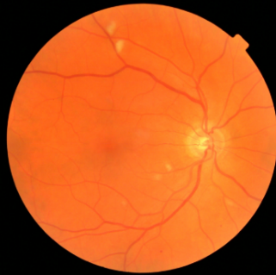
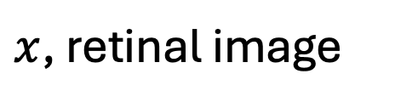
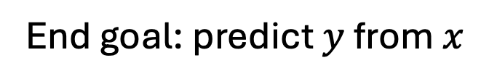
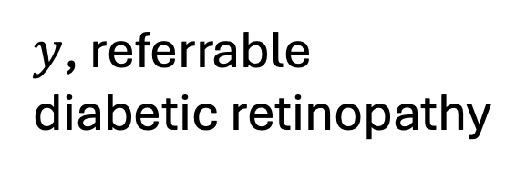
Computer vision: prediction via convolutional neural network
$y$, referrable diabetic retinopathy
$x$, retinal image
End goal: predict $y$ from $x$
Notes:
Image data and other “complex” data
Logistic regression is not enough. Why?
Second module

Slide 22

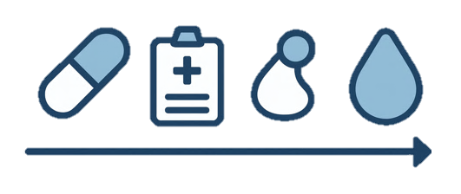
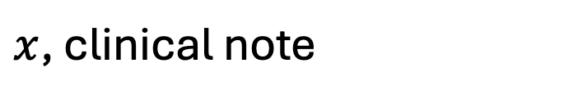
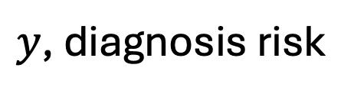
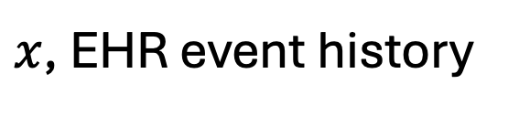
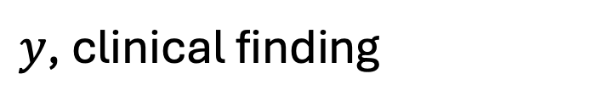
NLP and clinical sequences: prediction via stacked attention networks
$y$, clinical finding
$x$, clinical note
$y$, diagnosis risk
$x$, EHR event history
Notes:
text data
Challenge: how to convert text to numbers?
Module 3
Similarities between sequences of words vs clinical events

Slide 23
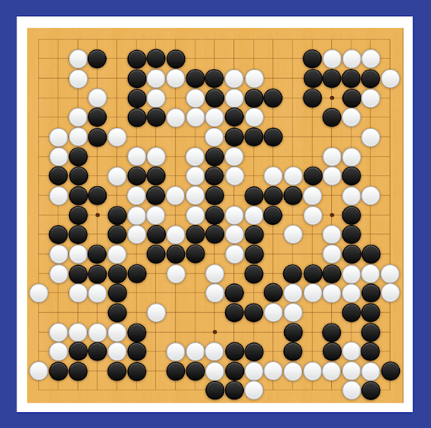
Reinforcement Learning: state to action predictions via dense NN
y, next move
x, Go board state
End goal: predict y from x
Notes:
We will not be covering RL
But importantly, this too is a prediction machine
And what you learn here is foundational for understanding RL for clinical decision-making

Slide 24
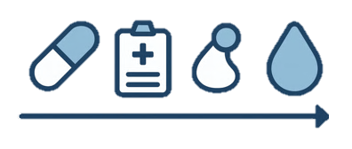
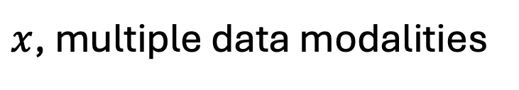
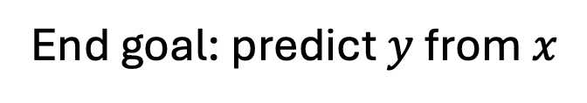
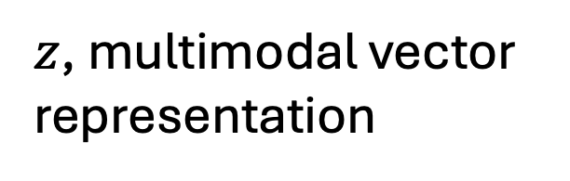
Prediction from multimodal data: modality-specific encoders + multimodal fusion
$y$, referrable diabetic retinopathy
$z$, multimodal vector representation
$x$, multiple data modalities
End goal: predict $y$ from $x$
Notes:
Module 4
Combine information from multiple modalities

Slide 25
As the complexity of the underlying data increases, so too does the probable value added by machine learning
image analysis
(radiology, pathology)
fusion of multiple modalities
Simple models based on clinical variables remain highly relevant
*Use the simplest model that gets the job done*
McKinney et al.
natural language processing (clinical notes)
Craik et al.
clinical and digital health time series
Christodoulou et al.
value added by machine learning
structured EHR or registry data
S. Huang et al.
curated clinical datasets
K. Huang et al.
Khera et al.
Engelhard MM, Navar AM, Pencina MJ. Incremental benefits of machine learning—when do we need a better mousetrap?. JAMA cardiology. 2021 Jun 1;6(6):621-3.
data complexity

Slide 26
Overview of Generative AI

Slide 27

Generating tabular data
x, data/features for a synthetic subject or patient
z, random noise
End goal: create structure from randomness
Notes:
our focus: prediction machines
What are they? functions, algorithms
more specifically: neural network prediction machines
The goal? Predict as well as we can. Approach is secondary.

Slide 28

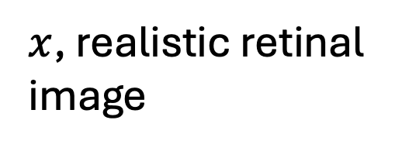
Image generation via GAN or diffusion
z, random noise
$x$, realistic retinal image
End goal: create structure from randomness
Notes:
our focus: prediction machines
What are they? functions, algorithms
more specifically: neural network prediction machines
The goal? Predict as well as we can. Approach is secondary.

Slide 29
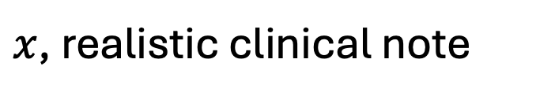
Text gen via Transformer decoder or diffusion
z, random noise
$x$, realistic clinical note
End goal: create structure from randomness
Notes:
our focus: prediction machines
What are they? functions, algorithms
more specifically: neural network prediction machines
The goal? Predict as well as we can. Approach is secondary.

Slide 30
Prompt-based generation of tabular data
generate vital signs consistent with sepsis
z, text prompt
x, data/features for a synthetic subject or patient
End goal: create structure
consistent with the user prompt
Notes:
our focus: prediction machines
What are they? functions, algorithms
more specifically: neural network prediction machines
The goal? Predict as well as we can. Approach is secondary.

Slide 31
Prompt-based image generation
create a fundoscopic image with exudates present
z, text prompt
End goal: create structure
consistent with the user prompt
$x$, realistic retinal image
Notes:
our focus: prediction machines
What are they? functions, algorithms
more specifically: neural network prediction machines
The goal? Predict as well as we can. Approach is secondary.

Slide 32
Prompt-based text generation
write a note reporting on an autism assessment
z, text prompt
$x$, realistic clinical note
End goal: create structure
consistent with the user prompt
Notes:
our focus: prediction machines
What are they? functions, algorithms
more specifically: neural network prediction machines
The goal? Predict as well as we can. Approach is secondary.

Slide 33
The prompt can be an image
$x$, realistic clinical note
z, image prompt
End goal: create structure
consistent with the user prompt
Notes:
our focus: prediction machines
What are they? functions, algorithms
more specifically: neural network prediction machines
The goal? Predict as well as we can. Approach is secondary.

Slide 34
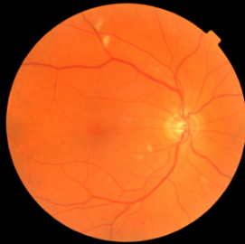

The prompt can be complex…
Generate vital signs consistent with this image and note
x, data/features for a synthetic subject or patient
z, multimodal prompt
End goal: create structure
consistent with the user prompt
Notes:
our focus: prediction machines
What are they? functions, algorithms
more specifically: neural network prediction machines
The goal? Predict as well as we can. Approach is secondary.

Slide 35
What we will cover in this class
A roadmap by course weekend

Slide 36
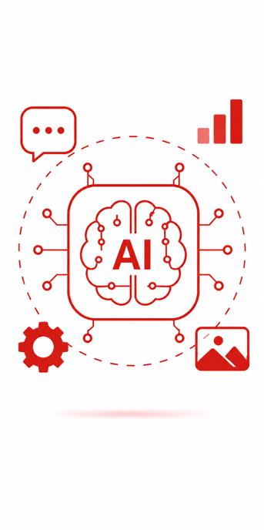
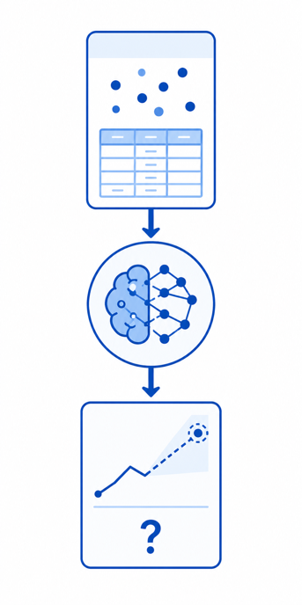
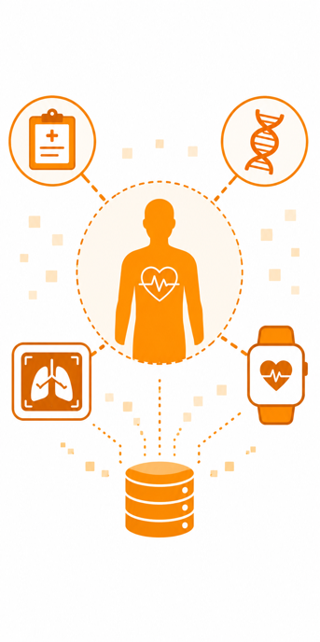


Content by course weekend
1: AI Overview
2: Predictive AI
3: Complex data
4: Generative AI
5: Emerging AI

Slide 37
Content by course weekend
1: AI Overview
2: Predictive AI
+ how to evaluate
3: Complex data
+ how learning works
4: Generative AI
+ mitigating bias
5: Emerging AI
+ explaining AI

Slide 38
Activity 1
Predictive, Generative, or Both?

Slide 39
Activity 1: predictive, generative, or both?
Instructions: propose a predictive, generative, or hybrid system for one of the following tasks/problems, or one of your own:
Improving management/handling of patient portal messages
Managing and titrating hypertension medications
Identifying social determinants of health from EHR data
Improving cancer screening
Drafting a discharge summary following a complex admission
Deliverables:
In a few sentences, describe your proposed system at a high level
Briefly explain why you believe generative, predictive, or hybrid is best
Learning Objective: consider tradeoffs and synergies between predictive and generative AI

Slide 40
Predictive, Generative, or Both?
Choosing the right tool or combination of tools

Slide 41
Pros and cons of predictive and generative AI
Predictive AI
Pros
Pro 1
Cons
Con 1
Generative AI
Pros
Pro 1
Cons
Con 1

Slide 42




















Often predictive and generative models are complementary.
Real Healthy (n=57)
Real Diseased (n=27).
Synthetic Healthy.
Synthetic Diseased.
Microbial keratitis (MK) detection:
Learn to generate synthetic data (generative)
Train an MK detection model (predictive)
(Daniel Wang et al., IOVS 2024;65:ARVO Abstract 2362)
Notes:
Daniel Wang
Anthony Kuo
Duke eye center!
An exception to the rule on synthetic data

Slide 43

Often predictive and generative models are complementary.
Maternal health response system:
Speech to text (predictive)
Translation (predictive)
Identification of key concepts and topics (predictive)
Triage (predictive)
Generation of template and/or complete responses in specific cases (generative)
It is much easier to evaluate the performance of predictive models, and in turn to know when and how much to trust them.

Slide 44



In some cases, however, generative models have superseded predictive models.
“Translation” of discharge notes into plain language using GPT4 substantially improves patients’ ability to comprehend them.
Anivarya Kumar
Isabella Wang
Notes:
Do we treat this as a translation (i.e., sequence to sequence) problem? Or a text generation problem?

Slide 45


Extracting specific info from documents: predictive or generative?
Data needed to determine scheduling needs
ICD-10
Stage
Age
Date of Dx
Hormone Receptors and molecular biomarkers
History of Treatment (med, surg, rad)
Undiagnosed patients only: Review of symptoms
While a predictive approach might be more trustworthy in principle, generative models can perform many tasks “zero-shot”, i.e. without task-specific training.
DIHI ‘24, led by Emily Norboge

Slide 46
Pros and cons of predictive and generative AI
Predictive AI
Pros
Pro 1
Cons
Con 1
Generative AI
Pros
Pro 1
Cons
Con 1

Slide 47
A blurry line
Between predictive and generative AI

Slide 48


Is this generative or predictive?
y, next word
x, conversation history
“next-token prediction”
Notes:
Now, what about the systems we’re seeing today?
Does the paradigm I’ve described still fit?
“next-token predictor”
“stochastic parrot”
Generation via repeated prediction
Make the point about truth

Slide 49

Are all tasks special cases of text generation?
Notes:
Question: *should we* be using generative models for all NLP tasks?
Advantages?
zero-shot
convenient
Disadvantages?
- expensive

Slide 50

Are all tasks special cases of text generation?
Notes:
Question: *should we* be using generative models for all NLP tasks?
Advantages?
zero-shot
convenient
Disadvantages?
- expensive

Slide 51

Are all tasks special cases of text generation?
Notes:
Question: *should we* be using generative models for all NLP tasks?
Advantages?
zero-shot
convenient
Disadvantages?
- expensive

Slide 52
Activity 2 (time permitting)
Anatomy of logistic regression

Slide 53
Course Logistics
In class: lectures, group activities, and discussion
Group assignments
Final project
AI/LLM policy

Slide 54
What you will need
Willingness to learn and engage
Patience!
A ChatGPT or Claude subscription…

