Slide 1
AI Interpretation and Bias
Matthew Engelhard

Slide 2
Investigating model predictions
Looking inside the black box
Notes:
Stimulate discussion here

Slide 3
When expert and model disagree…
You’ve been using a new AI model that predicts 2-year risk of progression to stage IV chronic kidney disease. Up to now, you’ve found its predictions to be helpful as well as consistent with your clinical judgement. This model is based on electronic health record data, including diagnosis and procedure codes, medications, labs, and vitals; as well as social determinants of health.
You see a 32 year-old male patient with new significant hypertension (165/91). You check your model and see it predicts low stage IV CKD risk (<2%). However, on physical exam there is puffiness around his eyes and 1+ edema to his mid-shin, and on urinalysis you find significant proteinuria (3+). These findings concern you, and you believe the patient’s true risk is much higher than the model is saying.
Report Back: What can you do to investigate the discrepancy between the model’s prediction and your clinical judgement?
Notes:
(young patient with some weird findings)
The setup here would be for possible membranous glomerulonephritis.

Slide 4
Key Questions
What information is available to the model?
Predictor groups
Timing of collection
Lab ID or lab values?
What population was used to train the model?
Relevant inclusion / exclusion criteria
Representation of specific demographics
What do you know that the model doesn’t (or vice versa)?
Notes:
And what might it know that you don’t?
Common to have too much confidence in the model!

Slide 5
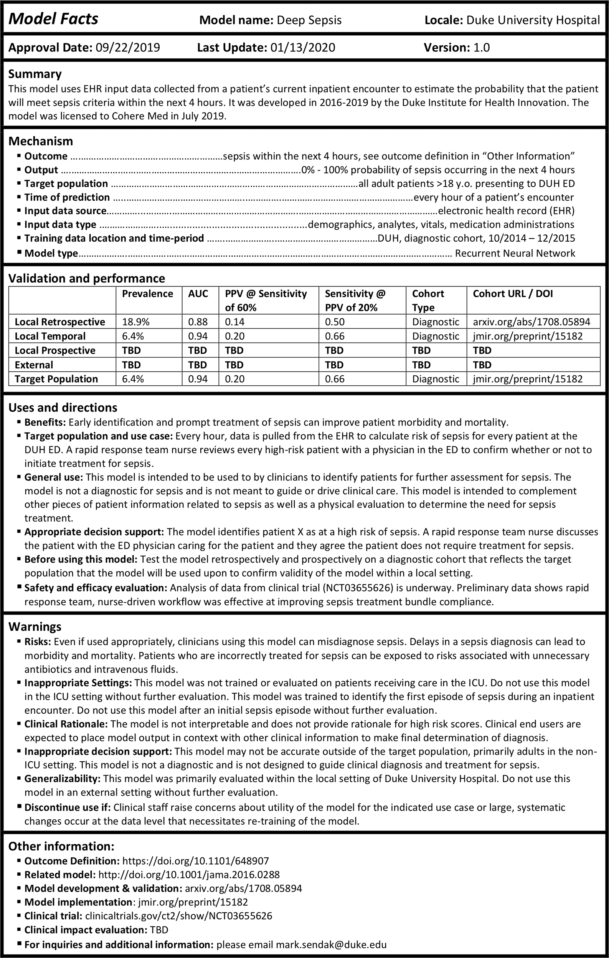
Report Back: What else should you know to use the model?
Sendak, M.P., Gao, M., Brajer, N. et al. Presenting machine learning model information to clinical end users with model facts labels. npj Digit. Med. 3, 41 (2020). https://doi.org/10.1038/s41746-020-0253-3
Notes:
What is this?
“a systematic effort to ensure that front-line clinicians know how, when, how not, and when not to incorporate model output into clinical decisions”
Things to highlight here:
SETTING:
- target and training populations: both DUHS; don’t use elsewhere
- *presenting to ED*; NOT appropriate for ICU patients
- not appropriate beyond first episode of sepsis
TIMING:
- hourly EHR data pulls
- time of prediction
- input data source and type
APPLICATION:
- not diagnostic
- identify patients for further assessment
Performance summary

Slide 6
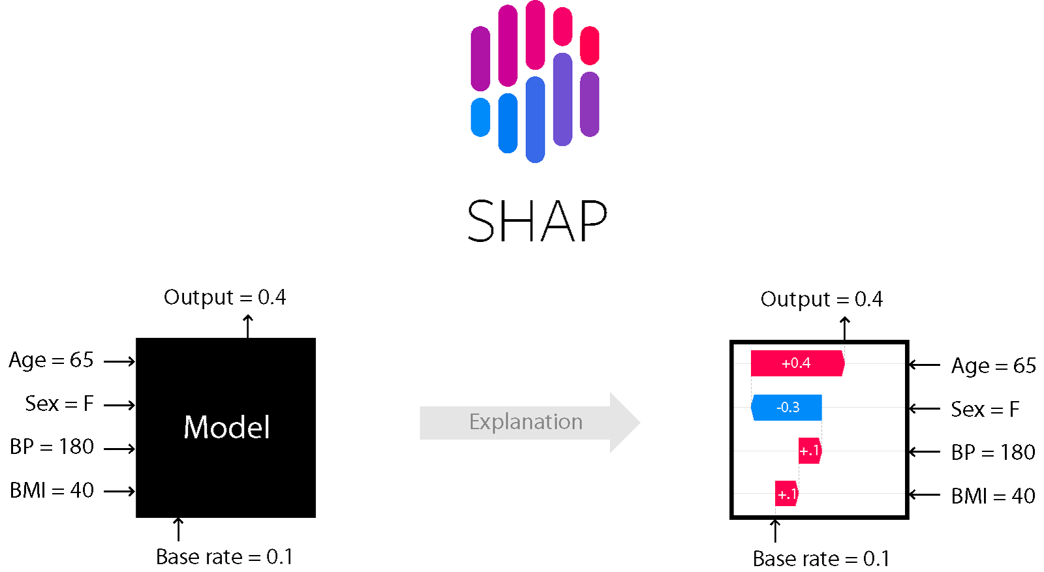
Understanding Model Predictions
What variables are available to the model, and when were they collected?
What variables are influencing the model’s prediction?
What findings are influencing your impression?
Notes:
Note that this was covered in first-year lectures
Any differences between what you’re seeing, and what it’s seeing?
Is the model aware of findings that are influencing you?

Slide 7
Algorithmic Bias
What is it, where does it come from, and what can be done?
Notes:
Stimulate discussion here

Slide 8
Growing concerns about algorithmic bias
You’ve been using the model for a year now, and you’ve noticed something potentially concerning.
The model seems to preferentially refer White patients over Black patients. Specifically, you notice that Black patients are referred only if their clinical presentation is more severe compared to White patients who are referred. You are not sure why this is happening.
Report Back: What are some possible sources of this bias, and what could you do to investigate?
Notes:
Look at data used to train
- outcome rates
- representation

Slide 9
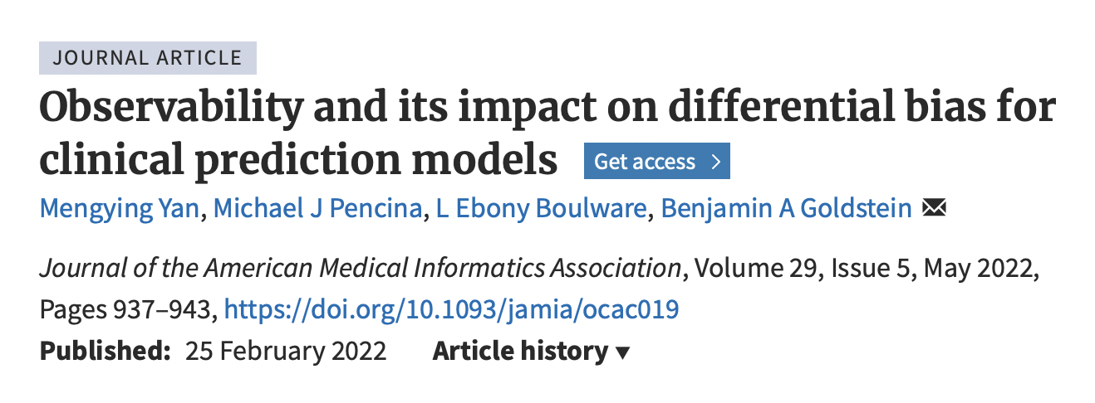
Sources of Algorithmic Bias
Many possible sources, but in most cases, it’s:
Biased outcomes in training data
Poor representation of demographics
Notes:
Unpack biased outcomes
Note that sometimes the outcomes *are not recorded*
Very difficult to correct this

Slide 10
What does it mean for a model to be fair?
Consider whether predictions are fair between two groups A and B.
One possible solution is fairness through unawareness, also called blindness, wherein the model is not given information about group status.
Report back:
- What could go wrong if the model is aware of group status?
- What could go wrong if the model is unaware of group status?
Then, propose an alternative approach to achieve or evaluate fairness.
Notes:
You want to correct this problem and make the model fair.
But what does that mean?
Intuitive idea – don’t let the model use sensitive attribute when making predictions
Divide up groups: some argue it’s good to be aware, others that it’s bad

Slide 11
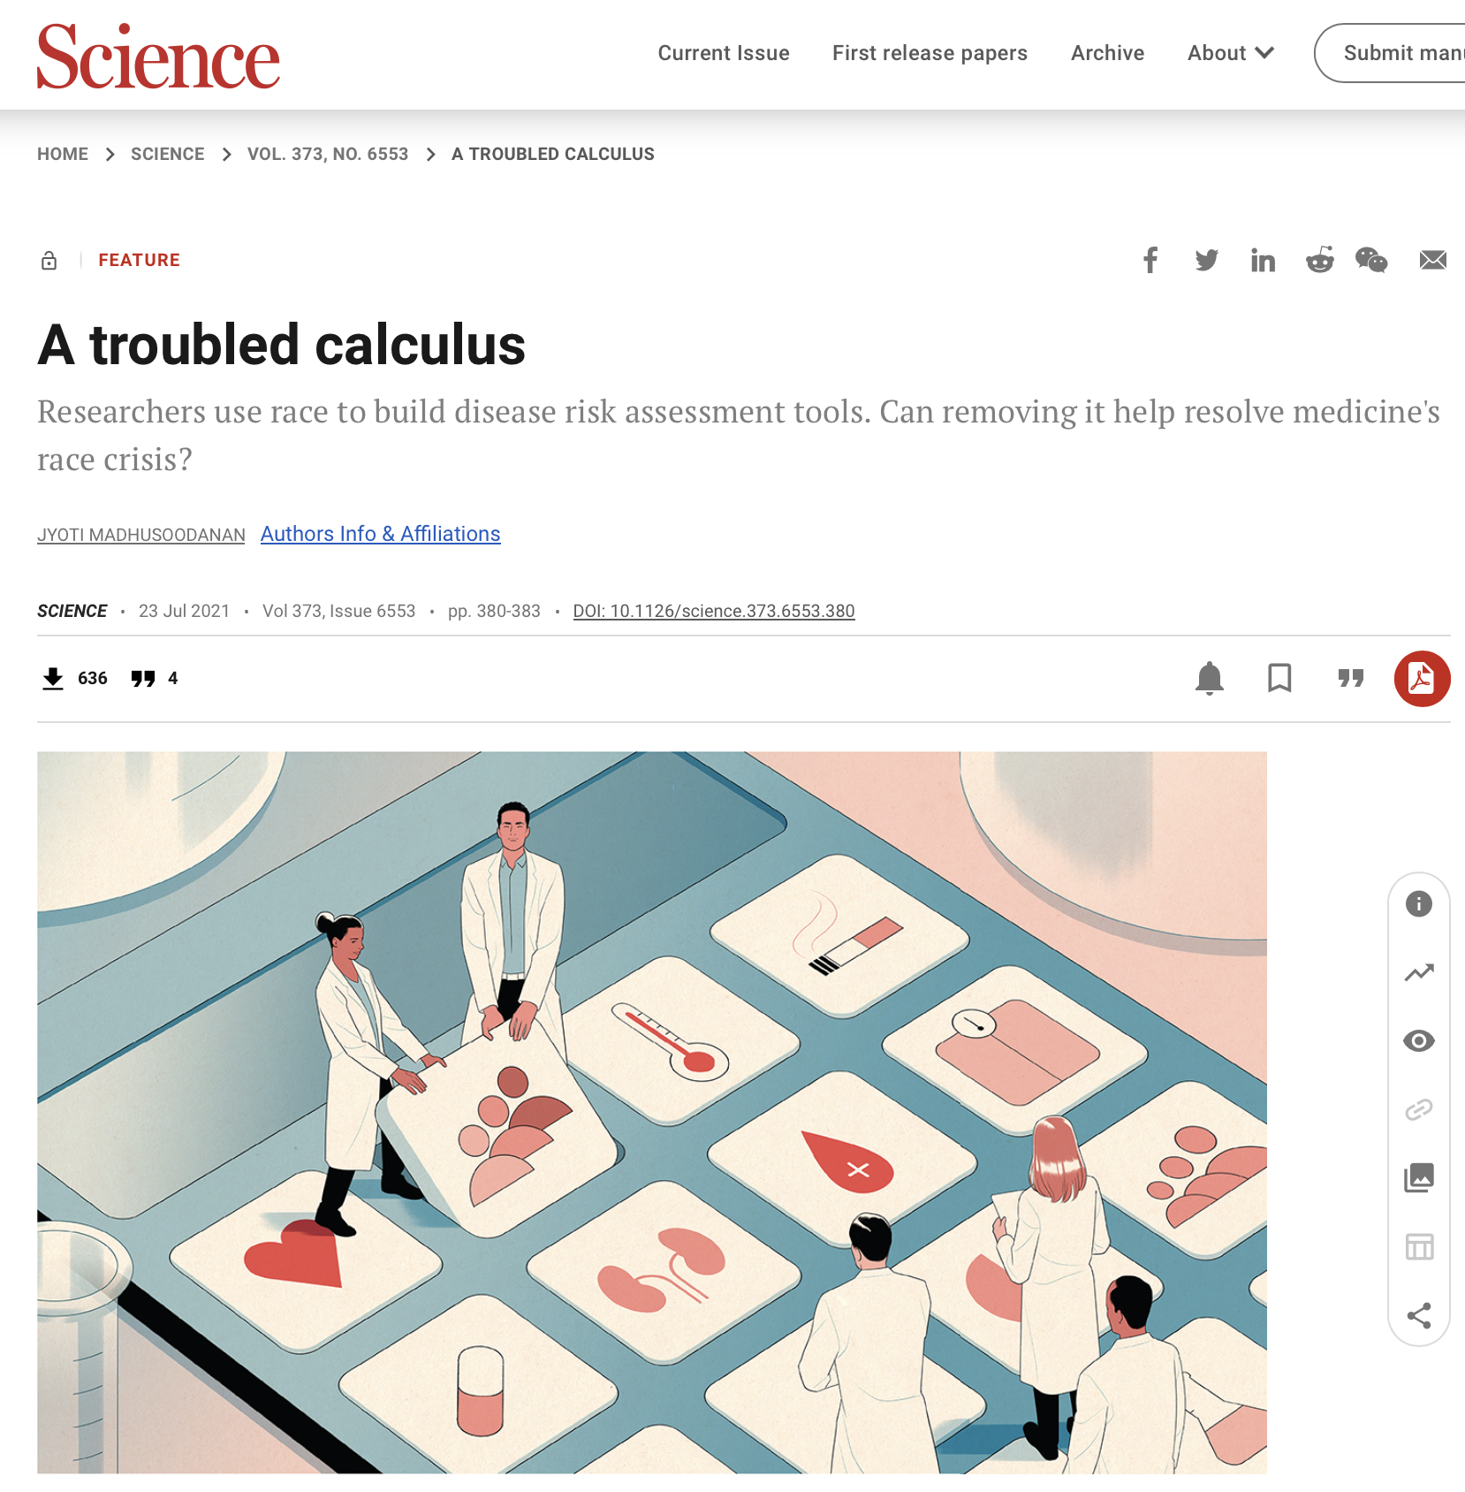
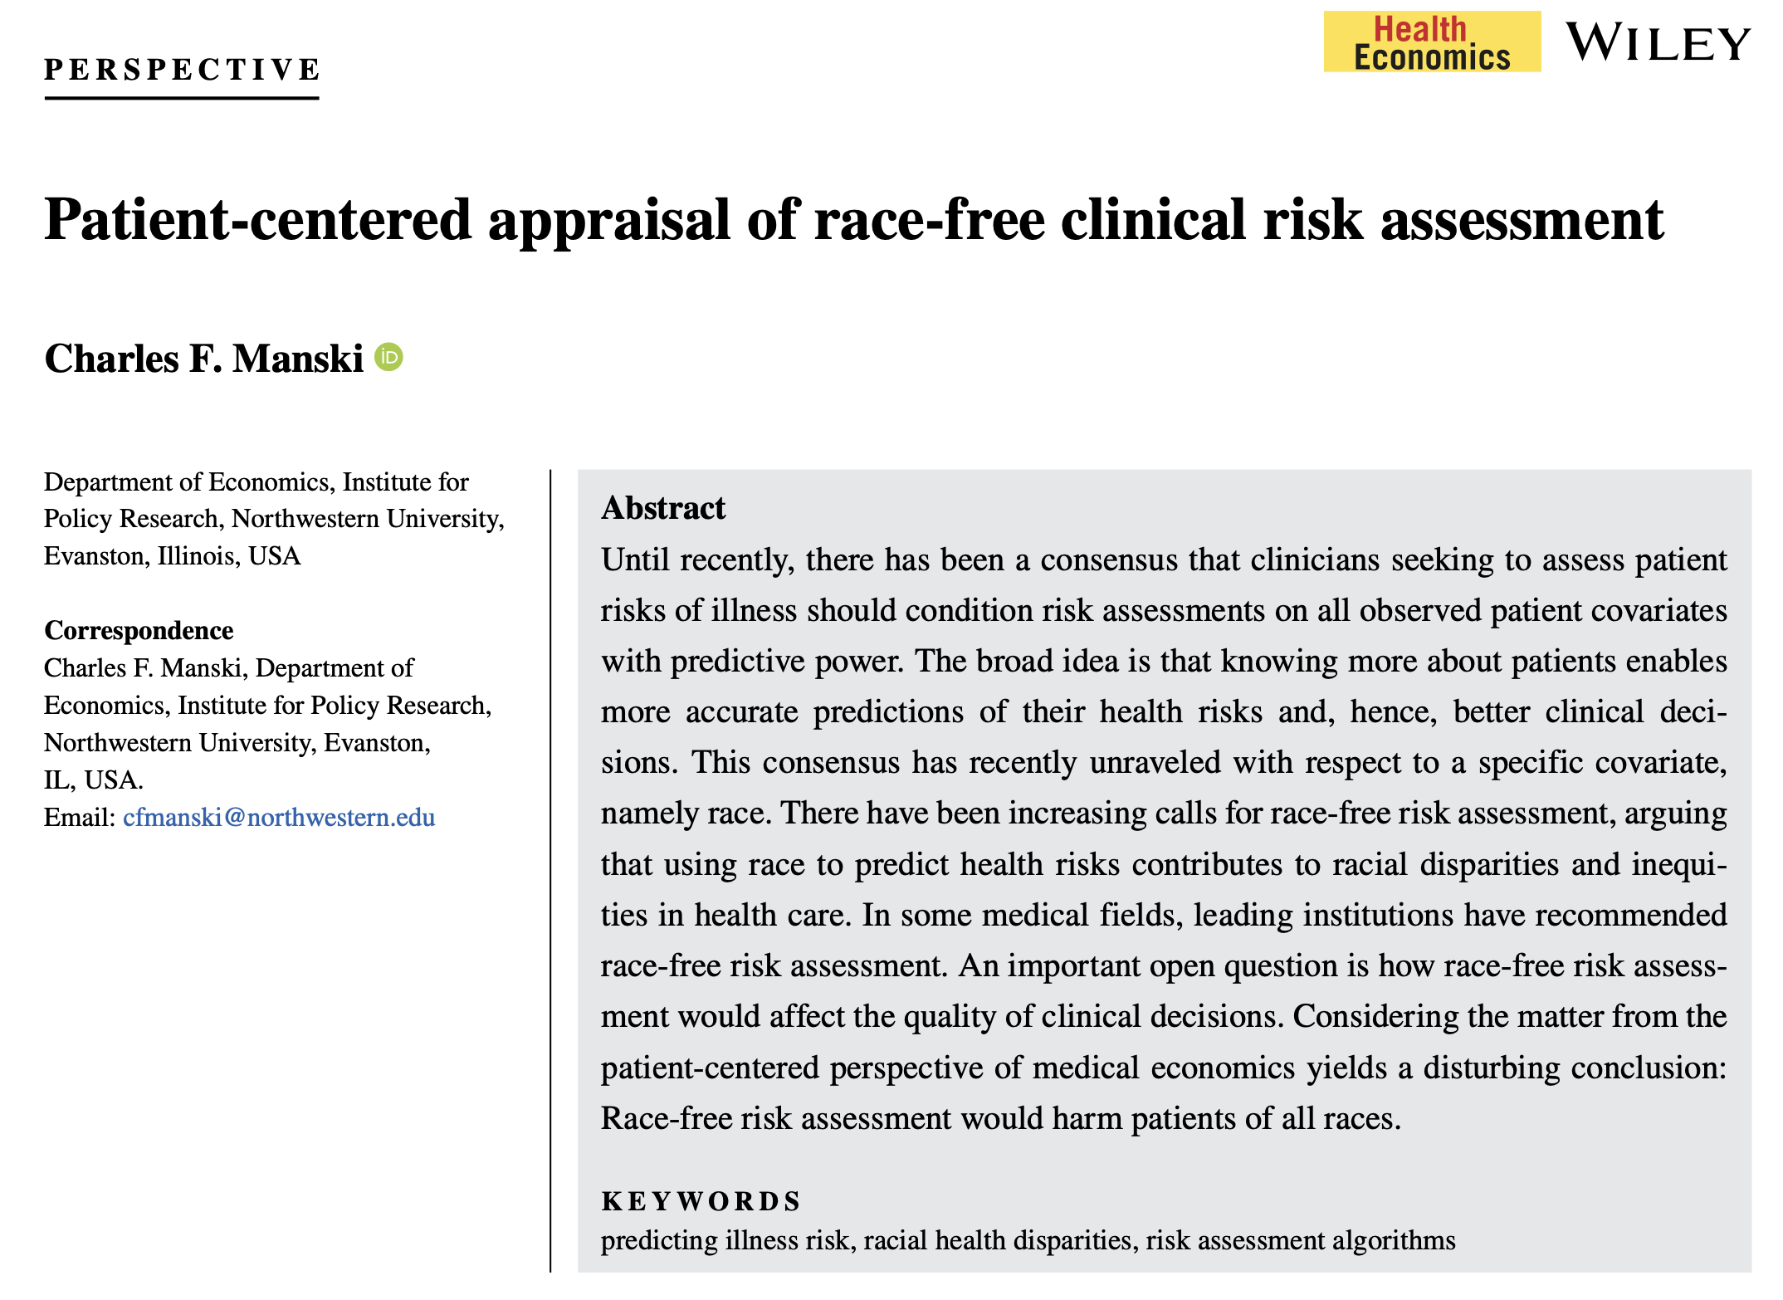
Notes:
Kidney function estimation – clear example where inclusion did harm
Critical to be aware of the potential for harm
But there’s been a trend toward excluding
Almost becoming a precedent within the clinical literature
There’s a danger in this as well
Beware an easy solution to a complex problem

Slide 12
Blindness can be ineffective or even harmful.
In some cases it is effective.
In other cases it isn’t enough to fix the problem.
In still other cases, it can make the problem worse.
Black-Black White-White Black-White White-Black
Engelhard et al. Exploring trade-offs in equitable stroke risk prediction with parity-constrained and race-free models. Artificial Intelligence in Medicine, 2025.

Slide 13
Possible definitions of algorithmic fairness
Consider whether predictions are fair between two groups A and B.
Blindness: The model cannot see group status
Independence: Model predictions are independent of group status
Separation: Model performance is similar in all groups
Individual fairness: The model makes similar predictions for similar individuals regardless of group status
Except under special (& not realistic) circumstances, (1) – (4) are mutually exclusive.
Notes:
We’ve already considered option 1
What about option 2?
- should predictions be independent of group status
- this would imply, for example, that model predicted risk on average is the same in both groups
- same distributions
- why or why not?
What about option 3?
- what does this mean?
Challenges include differential observability

Slide 14
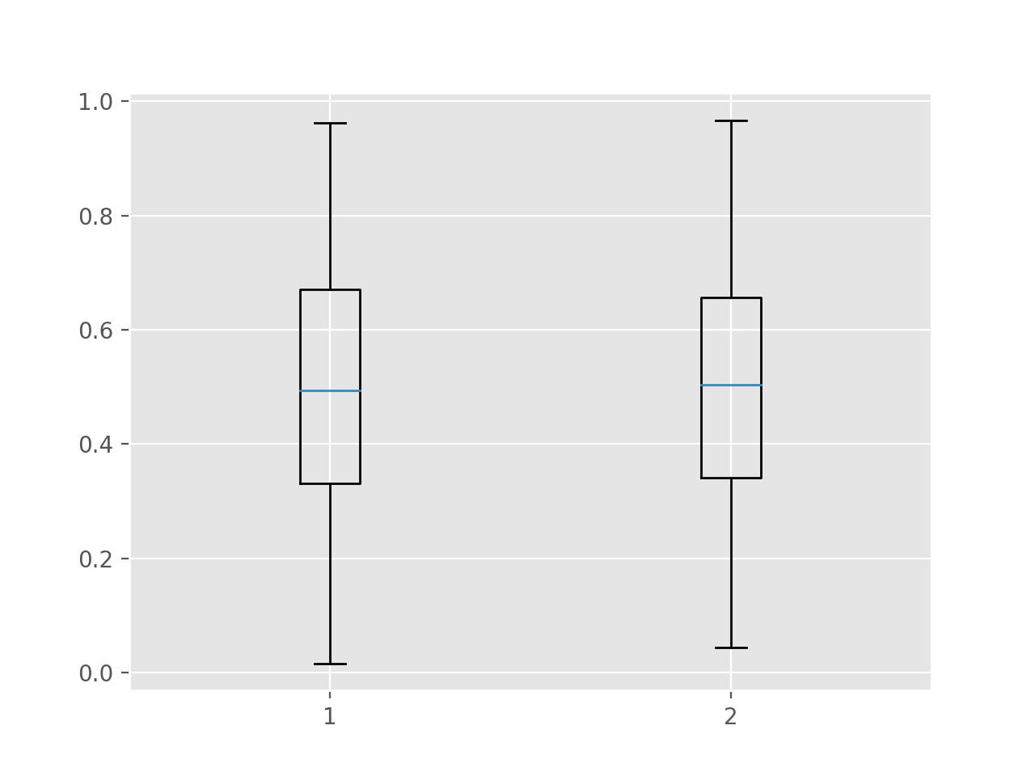
Zooming in on Independence
Model predictions are independent of group status.
This implies that the distribution of model predictions is the same in each group.
Is this fair?
Black White
Notes:
Think about what it would imply.
If we set a threshold, it would imply that White and Black patients would receive intervention at equal rates.
Is this fair?

Slide 15
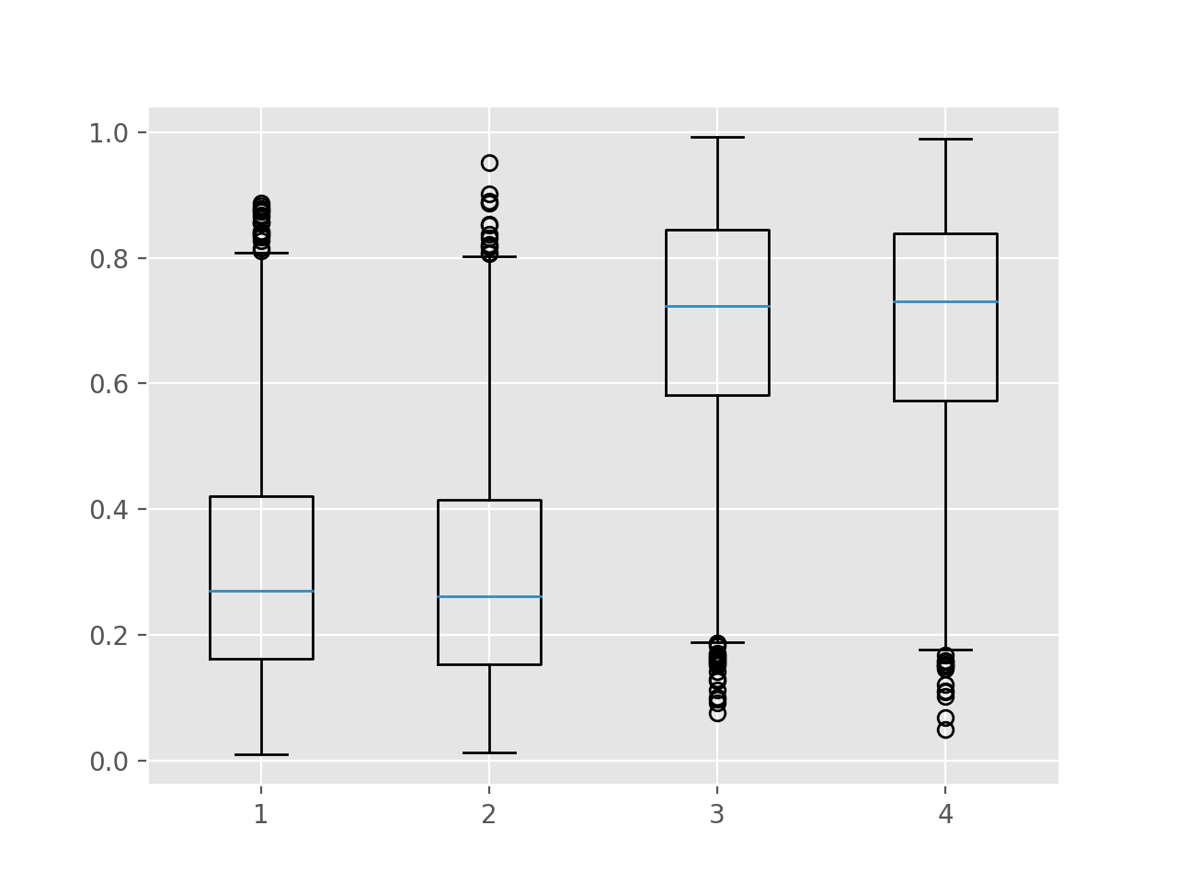
Zooming in on Separation
Model predictions are independent of group status after conditioning on the outcome.
This implies when considering individuals with the same outcome, the distribution of model predictions is the same in each group.
Is this fair?
Black White
Black White
Did not Progress
Progressed to Stage IV
Notes:
Probably the most promising in my view.
Important to note, firstly, that if outcome rates are the same in each group, then this is the same as independence.
But of course, they’re usually not.
And if they’re not, well that means that different groups will receive intervention at different rates.
The biggest problem with this:
- highly dependent on the outcomes being correct!
- difficult standard in most clinical applications
- biased outcomes, differential observability, and so on.

Slide 16
Possible definitions of algorithmic fairness
Consider whether predictions are fair between two groups A and B.
Blindness: The model cannot see group status
Independence: Model predictions are independent of group status
Separation: Model performance is similar in all groups
Individual fairness: The model makes similar predictions for similar individuals regardless of group status
Except under special (& not realistic) circumstances, (1) – (4) are mutually exclusive.
Notes:
We’ve already considered options 1-3
What about individual fairness?
This one’s just hard to implement…
- what does it mean to be similar?
- there are always factors we haven’t measured.

Slide 17
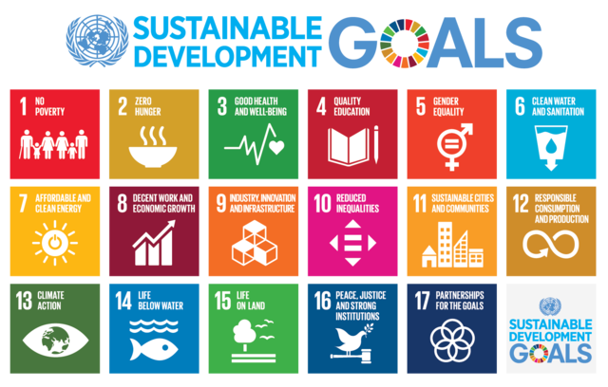
Algorithmic Bias: A Wicked Problem?
No definitive formulation
Problem is ongoing
Difficult to define or test success
Possible solutions have effects that may not be reversable
Can be considered to be a symptom of another problem
Many explanations for the problem
No right or wrong answers
Rittell and Webber, 1973
Notes:
Some of the most important problems of our time, and this is no exception!
It’s clear that there is a problem, but less clear what would constitute solving it
- Difficult to define success
‘Wickedness isn’t a degree of difficulty . . . A wicked problem has innumerable causes, is tough to describe, and doesn’t have a right answer . . .
Environmental degradation, terrorism, and poverty—these are classic examples of wicked problems’. (Camillus, 2008, p. 1).

Slide 18
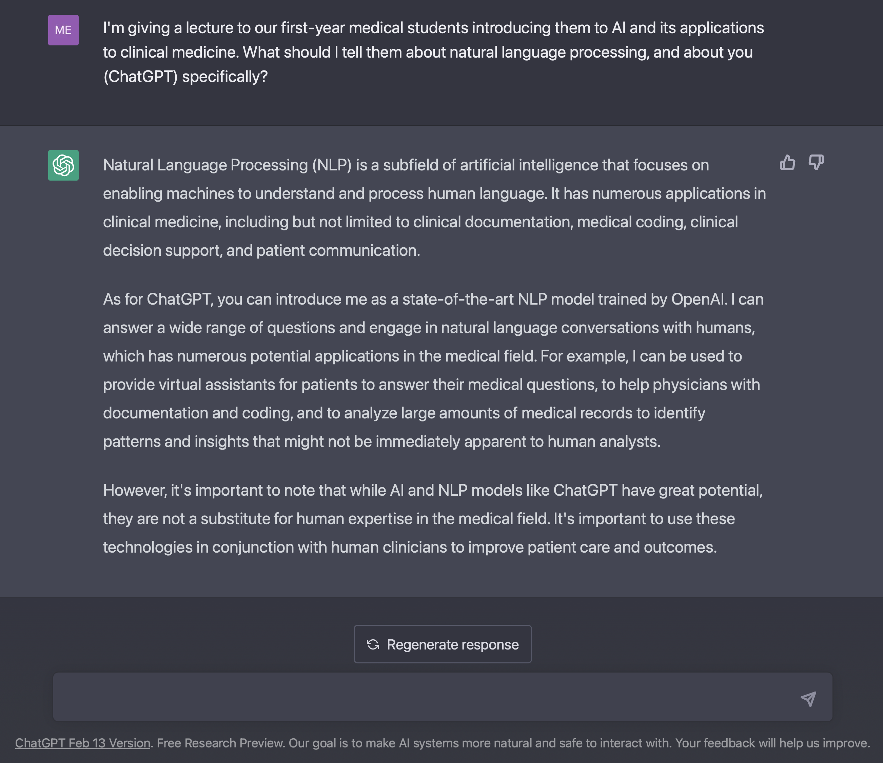
How do we
- evaluate
- understand
- debias
generative AI?
Will genAI help address biases, or exacerbate them?
Notes:
2nd pillar: natural language processing
What can NLP do?
Well, many of you have likely already explored it yourself
Now, I would never use chatGPT to write a lecture for this group – you’re too important
But I did use it to help me design my lecture for the first-year medical students
And here’s what it told me…
And if I had asked it for more specific, detailed suggestions, it would have provided them
As ChatGPT notes, it’s not a substitute for human expertise
But the system is in fact quite humble, and similar models (e.g. Google’s MedPalm2) show quite impressive performance on questions from the US Medical Licensing Exam

Slide 19
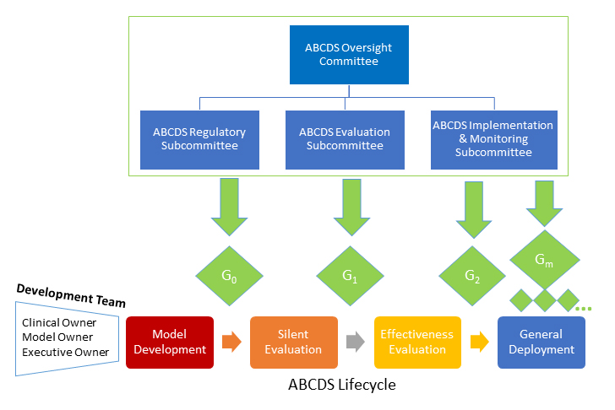

Toward Trustworthy CDS Development

