Slide 1
Arquitectura del Computador II
Sistemas Distribuidos

Slide 2
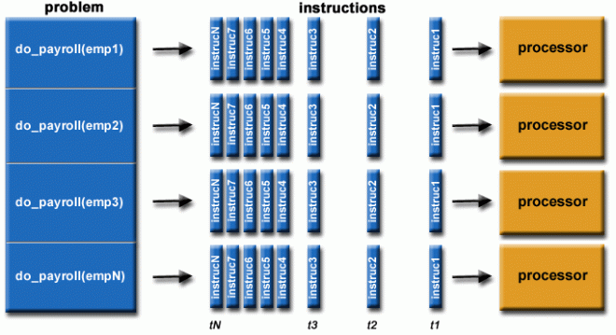
Parallel Computing

Slide 3
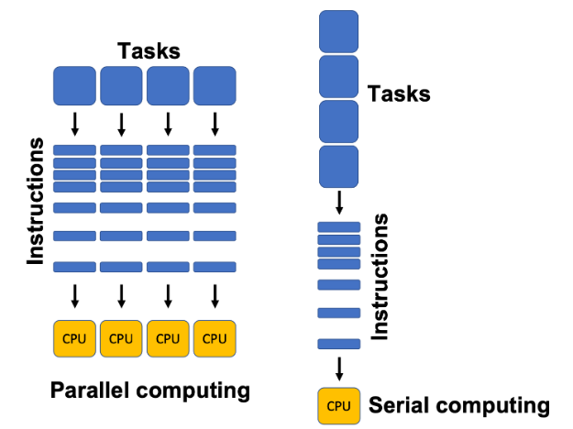

Slide 4
What Is Parallel Computing?
Parallel computing is the process of performing computational tasks across multiple processors at once to improve computing speed and efficiency. It divides tasks into sub-tasks and executes them simultaneously through different processors.
Bit-level parallelism: Uses larger “words,” which is a fixed-sized piece of data handled as a unit by the instruction set or the hardware of the processor, to reduce the number of instructions the processor needs to perform an operation.
Instruction-level parallelism: Employs a stream of instructions to allow processors to execute more than one instruction per clock cycle (the oscillation between high and low states within a digital circuit).
Task-level parallelism: Runs computer code across multiple processors to run multiple tasks at the same time on the same data.

Slide 5
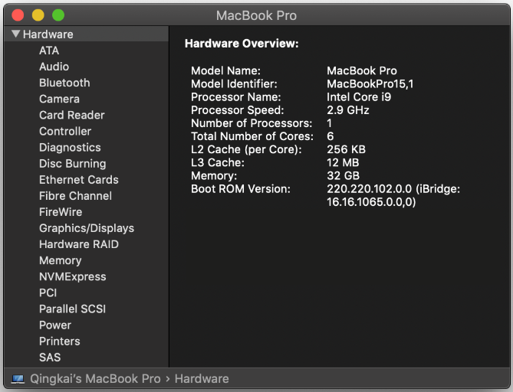

Slide 6
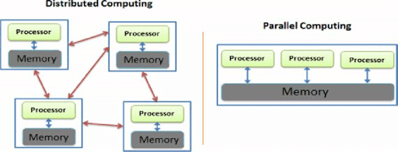
Distributed Computing

Slide 7
What Is Distributed Computing?
Distributed computing is the process of connecting multiple computers via a local network or wide area network so that they can act together as a single ultra-powerful computer capable of performing computations that no single computer within the network would be able to perform on its own.
Distributed computers offer two key advantages:
Easy scalability: Just add more computers to expand the system.
Redundancy: Since many different machines are providing the same service, that service can keep running even if one (or more) of the computers goes down.

Slide 8
When to Use Parallel Computing: Examples
This computing method is ideal for anything involving complex simulations or modeling. Common applications for it include seismic surveying, computational astrophysics, climate modeling, financial risk management, agricultural estimates, video color correction, medical imaging, drug discovery, and computational fluid dynamics.
When to Use Distributed Computing: Examples
Distributed computing is best for building and deploying powerful applications running across many different users and geographies. Anyone performing a Google search is already using distributed computing. Distributed system architectures have shaped much of what we would call “modern business,” including cloud-based computing, edge computing, and software as a service (SaaS).

Slide 9
Diferencias enter ambas?
Hardware requerido?
Escalabilidad?
Uso de Memoria?
Sincronización?
Uso?
Notes:
Difference #1: Number of Computers Required
Parallel computing typically requires one computer with multiple processors. Distributed computing, on the other hand, involves several autonomous (and often geographically separate and/or distant) computer systems working on divided tasks.
Difference #2: Scalability
Parallel computing systems are less scalable than distributed computing systems because the memory of a single computer can only handle so many processors at once. A distributed computing system can always scale with additional computers.
Difference #3: Memory
In parallel computing, all processors share the same memory and the processors communicate with each other with the help of this shared memory. Distributed computing systems, on the other hand, have their own memory and processors.
Difference #4: Synchronization
In parallel computing, all processors share a single master clock for synchronization, while distributed computing systems use synchronization algorithms.
Difference #5: Usage
Parallel computing is used to increase computer performance and for scientific computing, while distributed computing is used to share resources and improve scalability.

Slide 10
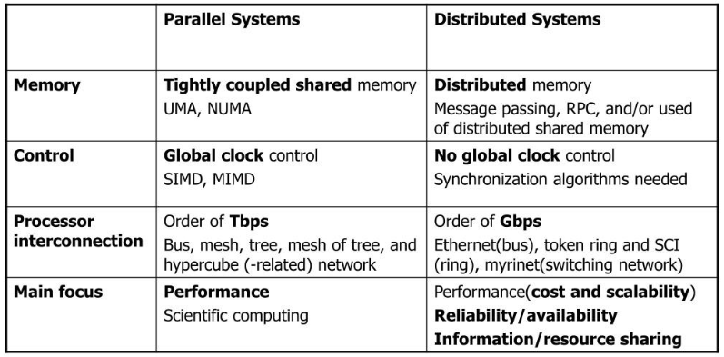
Notes:
UMA – Uniform Memory Access – NUMA: non uniform memory access

Slide 11
Que usa su raspberry?
Raspberry Pi 4 usa Broadcom BCM2711 SoC a 1.5 GHz (algunos modelos a 1.8 GHz) 64-bit quad-core ARM Cortex-A72 processor, con 1 MB sh L2 cache
Notes:
Difference #1: Number of Computers Required
Parallel computing typically requires one computer with multiple processors. Distributed computing, on the other hand, involves several autonomous (and often geographically separate and/or distant) computer systems working on divided tasks.
Difference #2: Scalability
Parallel computing systems are less scalable than distributed computing systems because the memory of a single computer can only handle so many processors at once. A distributed computing system can always scale with additional computers.
Difference #3: Memory
In parallel computing, all processors share the same memory and the processors communicate with each other with the help of this shared memory. Distributed computing systems, on the other hand, have their own memory and processors.
Difference #4: Synchronization
In parallel computing, all processors share a single master clock for synchronization, while distributed computing systems use synchronization algorithms.
Difference #5: Usage
Parallel computing is used to increase computer performance and for scientific computing, while distributed computing is used to share resources and improve scalability.

Slide 12
THANKS!
Any questions?
☺

