Slide 1
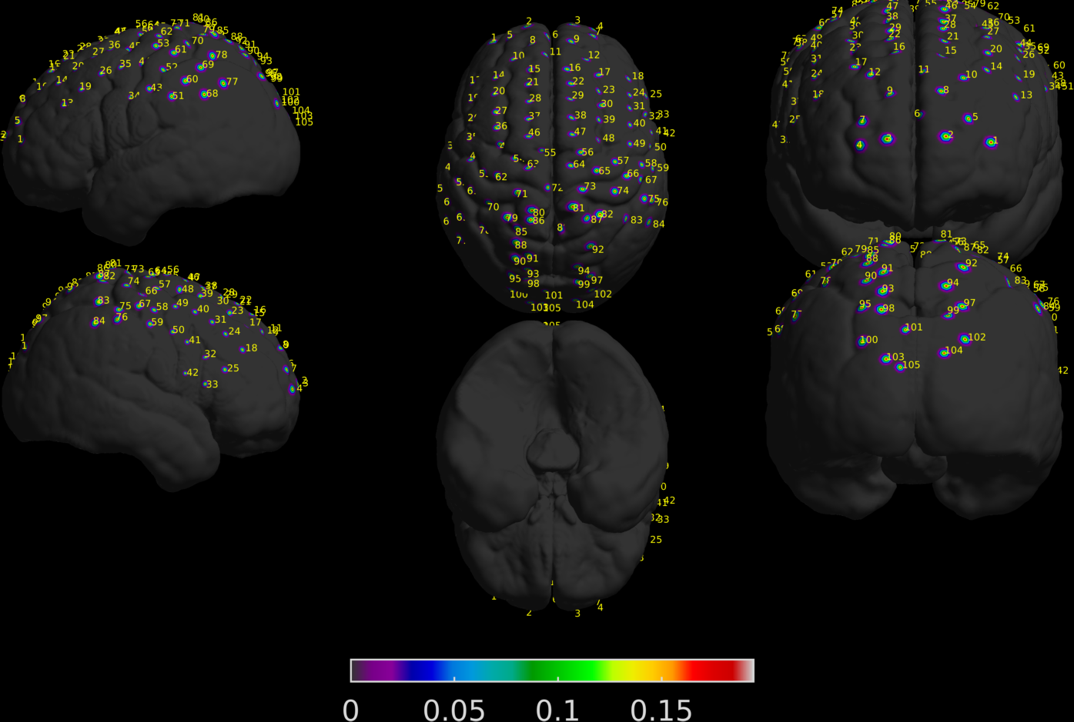
Progress on Haskin’s FNIRS data
Seok was able to project the coordinates on MNI brain
105 channels
Subject 1

Slide 2
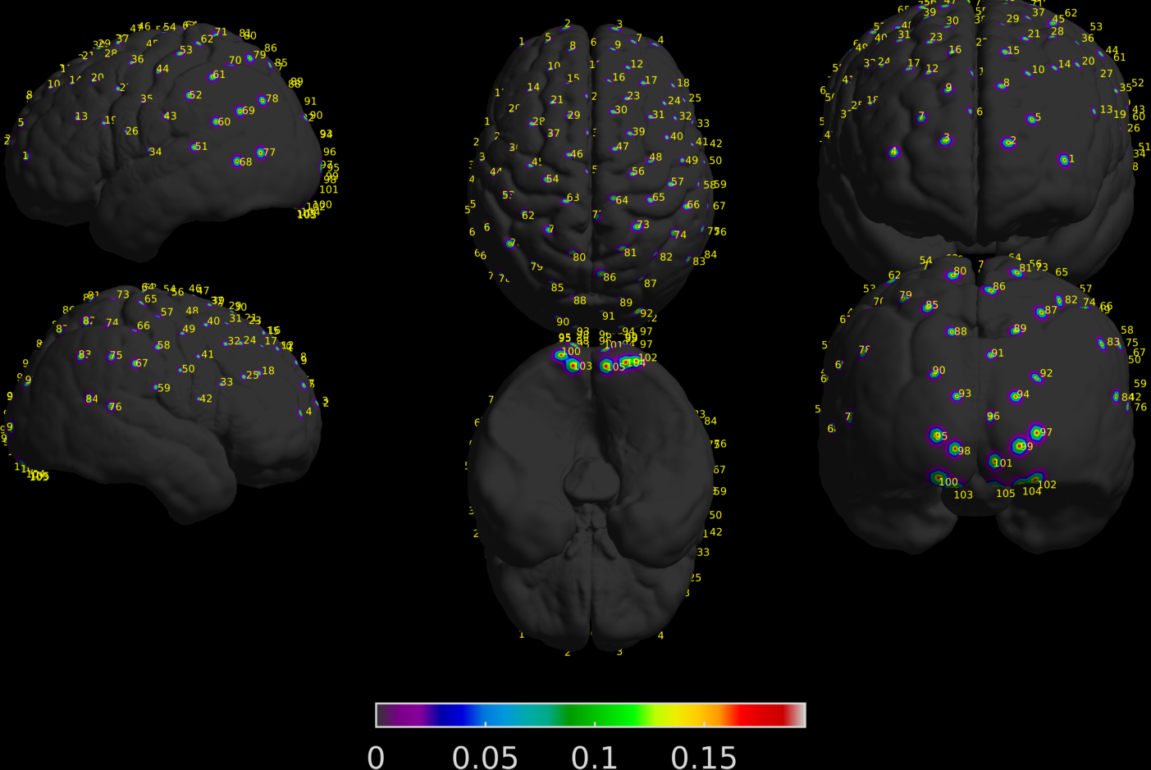
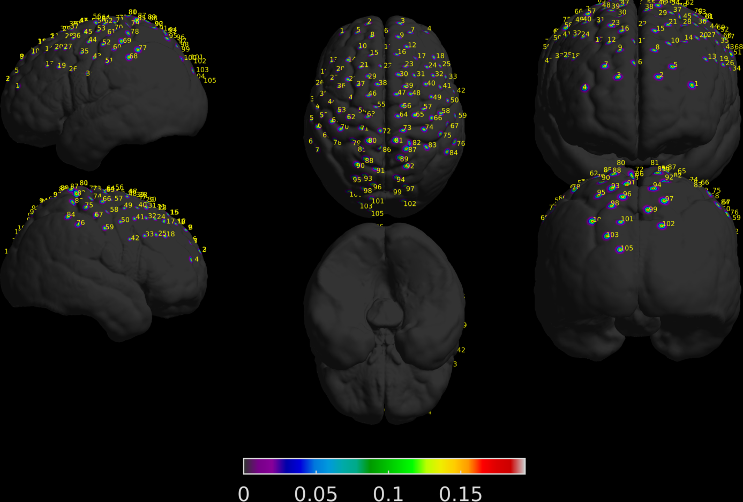
Progress on Haskin’s FNIRS data
Seok was able to project the coordinates on MNI brain
105 channels
Subject 28
Subject 29

Slide 3
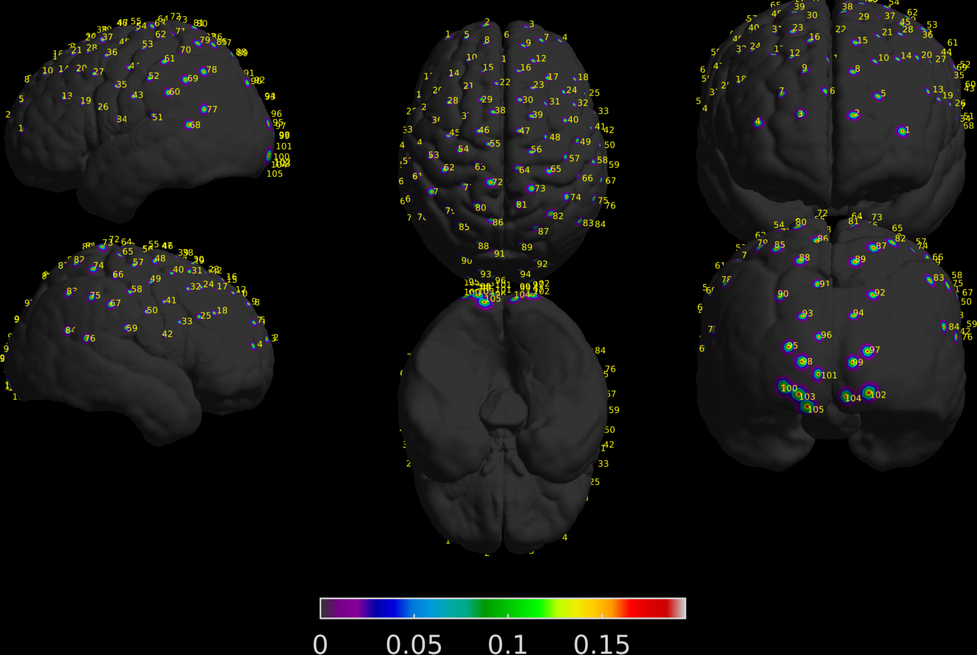
Progress on Haskin’s FNIRS data
Seok was able to project the coordinates on MNI brain
135 channels
Looks like there is only 105 channels
Subject 9

Slide 4
Connectivity Matrix
Clean data
NOT clean data

Slide 5
Connectivity Matrix
Show timeseries of data

Slide 6
Reliability paper – replicate figure 1

Slide 7
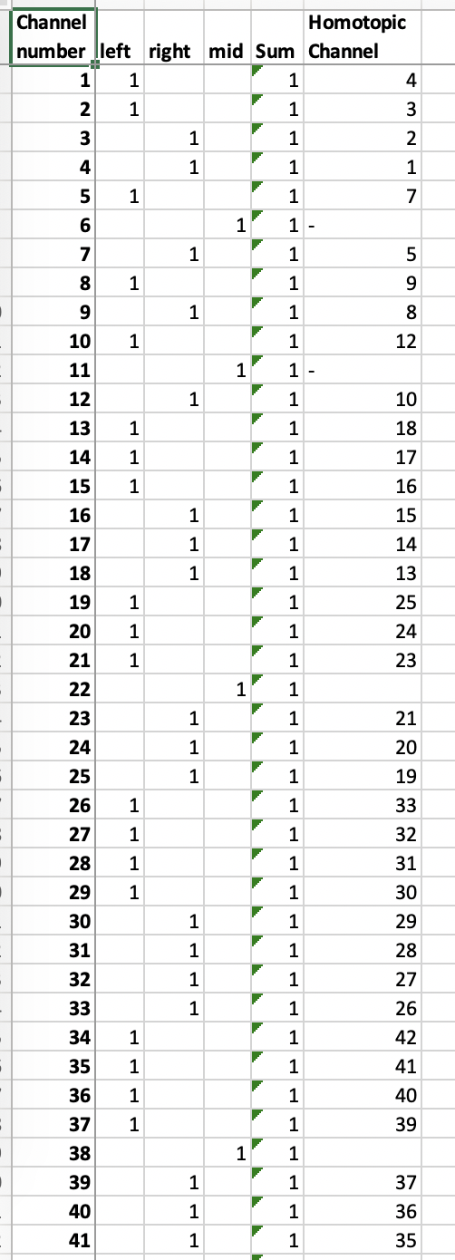
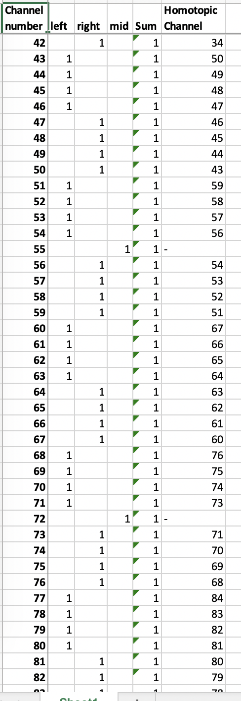
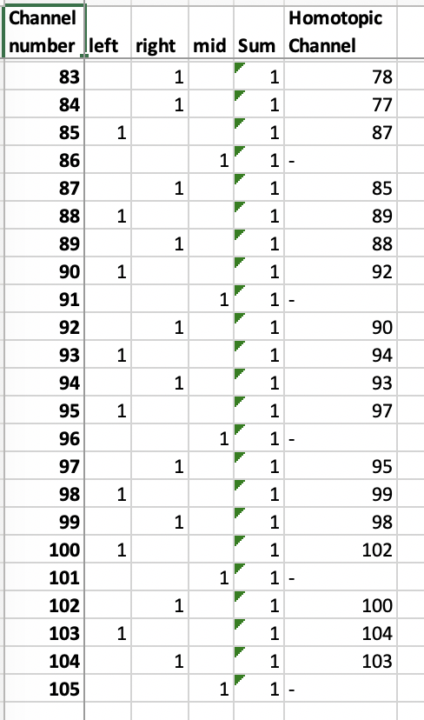
Homotopic
Clean Data

Slide 8
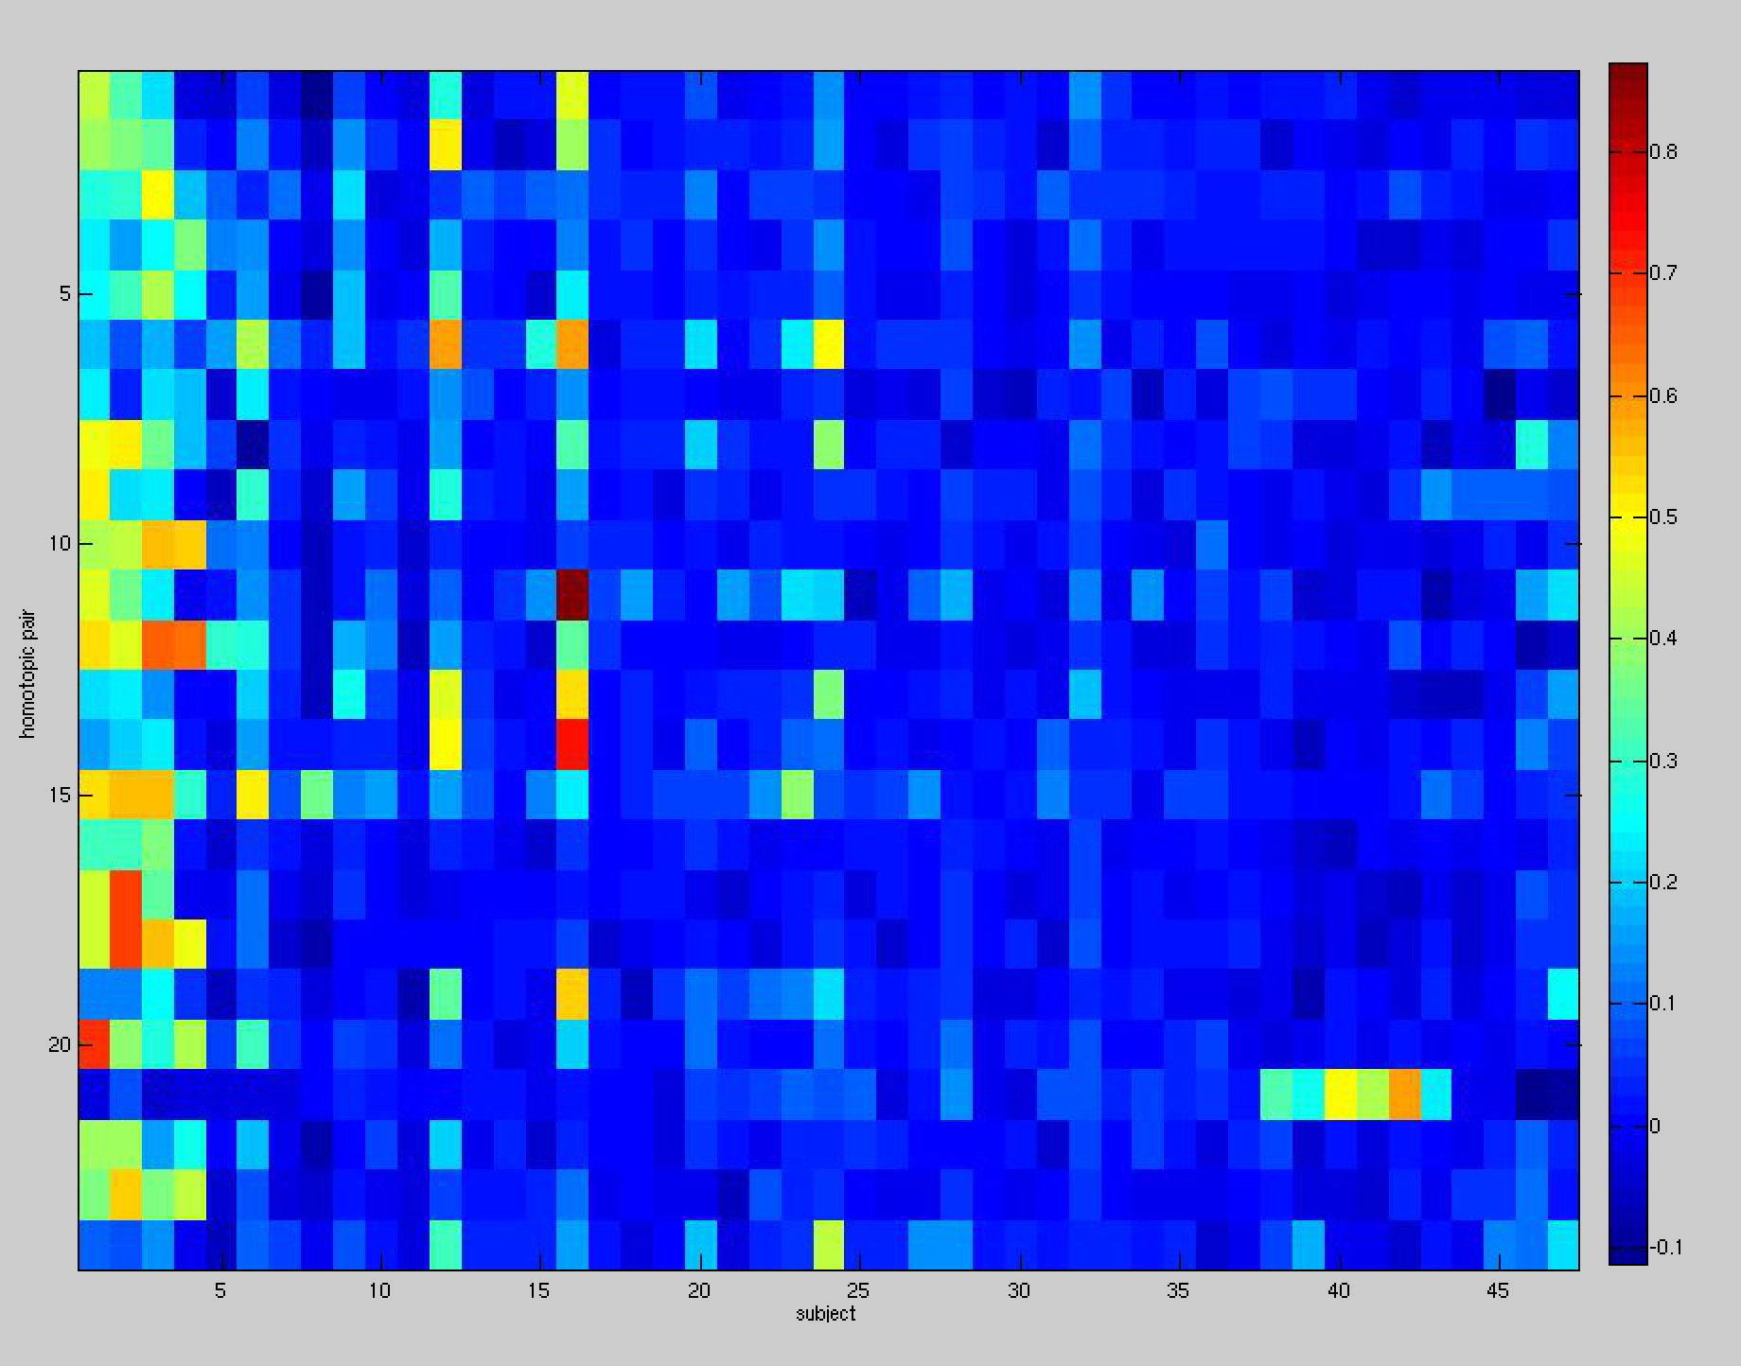
Homotopic
Clean Data
oxy
Homotopic Pair
Subject

