Slide 1
Asymmetry of Doubly Robust Estimators
Jaskaran Singh, Joon Sup Park

Slide 2
Executive Summary
Asymmetry of PS and PO model in double robust estimators
Various sample size and dimensions
Different types of DR estimators
Sensitivity Analysis

Slide 3
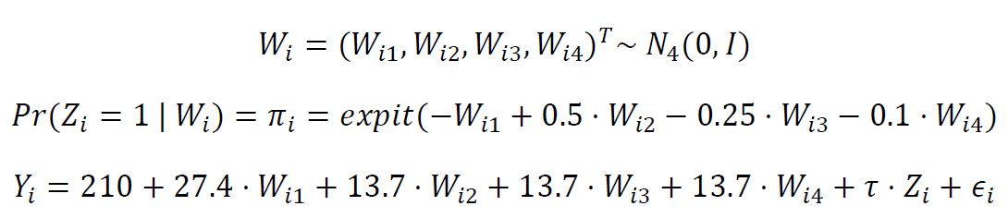
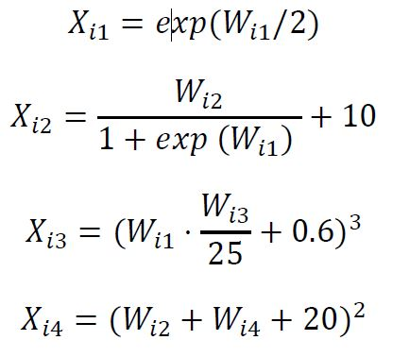
Model Setup

Slide 4
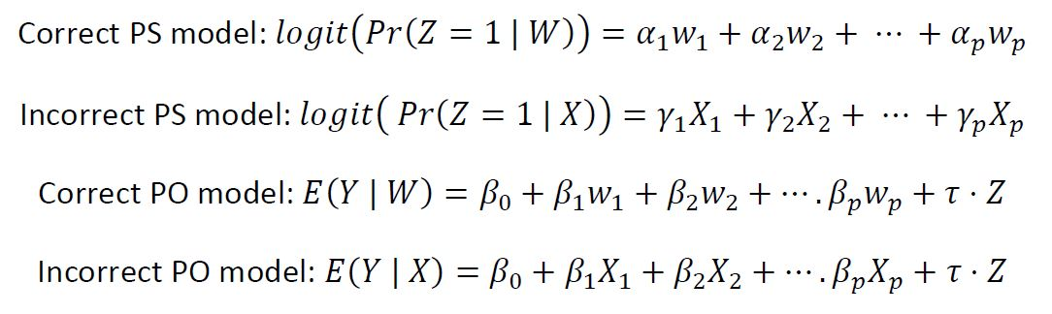
Types of PS and PO model considered

Slide 5
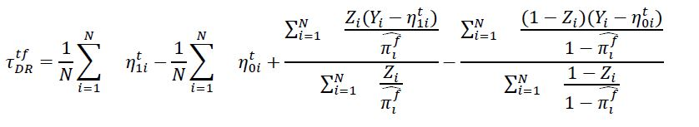
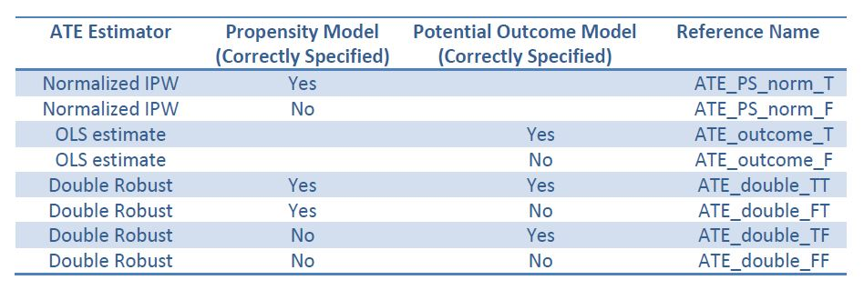
DR estimators

Slide 6
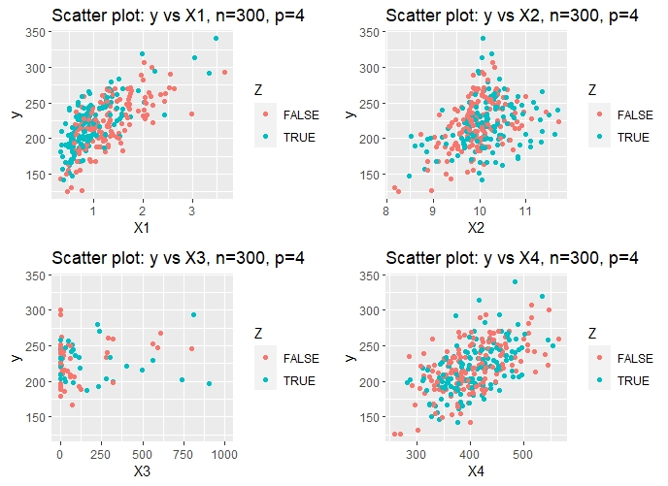
Distribution of simulated input data

Slide 7
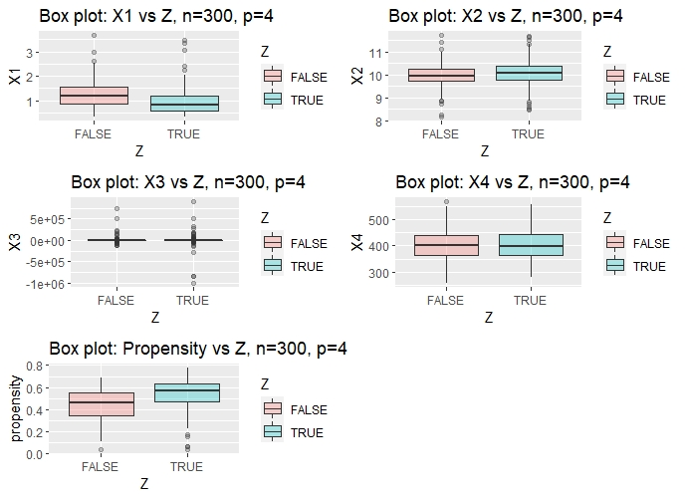
Distribution of simulated input data

Slide 8
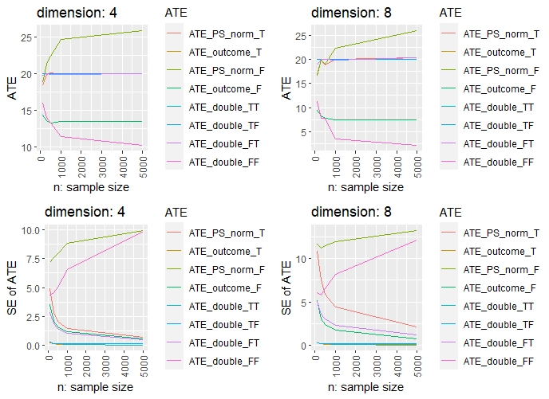
Performance of DR estimators

Slide 9
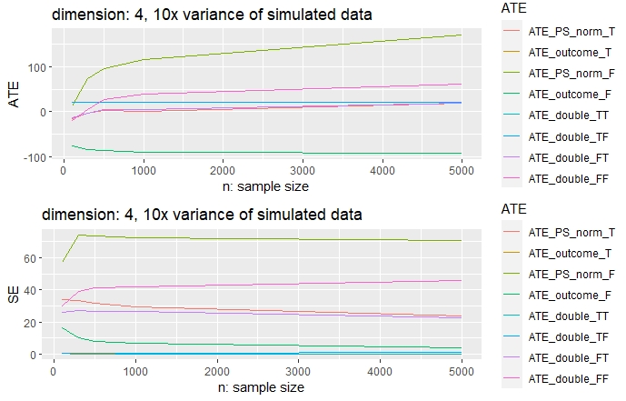
Performance of DR estimators

Slide 10
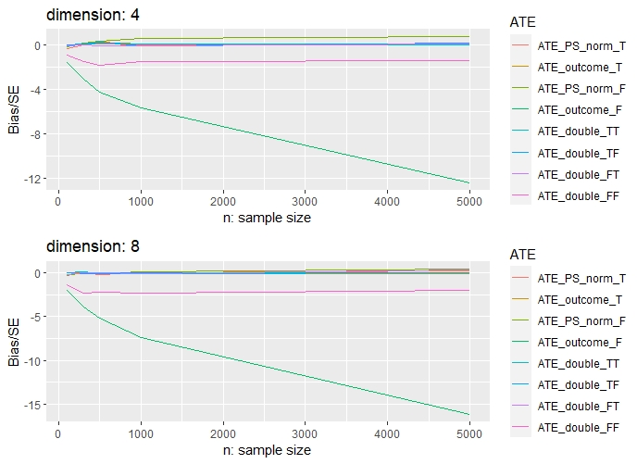
Performance of DR estimators

Slide 11
Conclusion
Asymmetric influence of Propensity and outcome model
Effect more pronounced when both are false
PS based estimator likely to be more sensitive resulting in higher variance for DR

