Slide 1
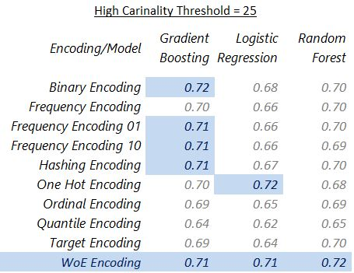
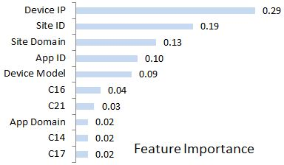
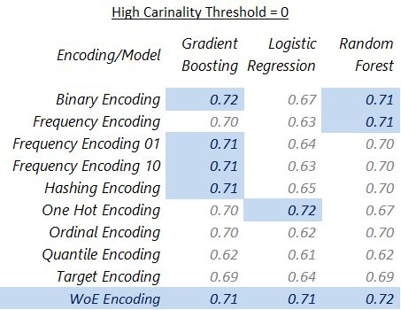
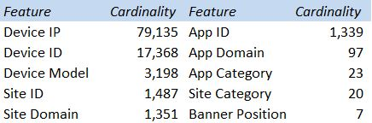



Click Through Rate (CTR) prediction for digital ads under high cardinality
Background & Motivation
Methodology
Results (Cont’d)
CTR prediction essential to bid price for ads
CTR $=\frac{\# user clicks}{\# impressions}$
Impression: every time ad is shown on internet
Digital ads data exhibits high cardinality; One Hot Encoding leads to high dimensionality, requiring increased memory and computation
Determine optimal encoding for high cardinal categorical variables
Examine effect of 8 encoding techniques on 3 classification models
Features
Encoding
Classification
Test Set auc-roc
5 fold CV
Due to imbalanced data, observation weights inversely proportion to target frequency
2 sets of experiment; Encoding for all features and only high cardinal features (cardinality>25)
Inference via optimal encoding & classification
Research Goals
Which encoding techniques are optimal for categorical variables?
Should optimal encoding be used only for high cardinal features, leaving low cardinal features to one hot encoding?
Which features are most useful in predicting CTR for digital ads?
Encoding Techniques
One Hot: expand into dummy columns of {0,1}
Ordinal: replace levels by ordinal number
Binary: split binary representation of ordinal
Frequency: group less frequent levels
Target: replace level by mean/cond. probability
Hash: Level into integer using hashing function
Quantile (50%): replace level by target median
Weight of Evidence (WoE): replace level by conditional log(odds)
Dataset Familiarity
CTR data for 10 days provided by Avazu, online advertising company, on Kaggle
All features categorical, representing attributes for users, ads and context
Imbalanced dataset, 17% of ads clicked
Eight features anonymized by Avazu, for privacy
120k records randomly sampled from 40 million records, due to computational challenge
Conclusion
Results
WoE encoding is optimal for low and high cardinal variables
Domain and identifier for website/app, user device IP/model are most useful to predict CTR
Optimal encoding should be model/data agnostic; extend research to new models/data
Future work includes optimal encoding for each feature and deep learning based encodings

