Slide 1
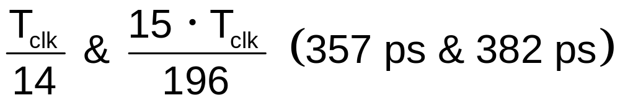
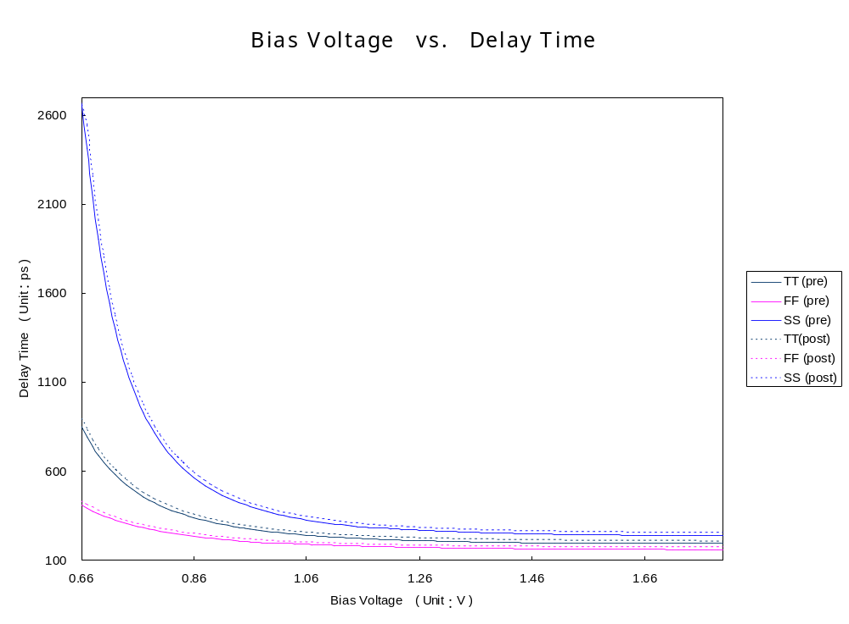
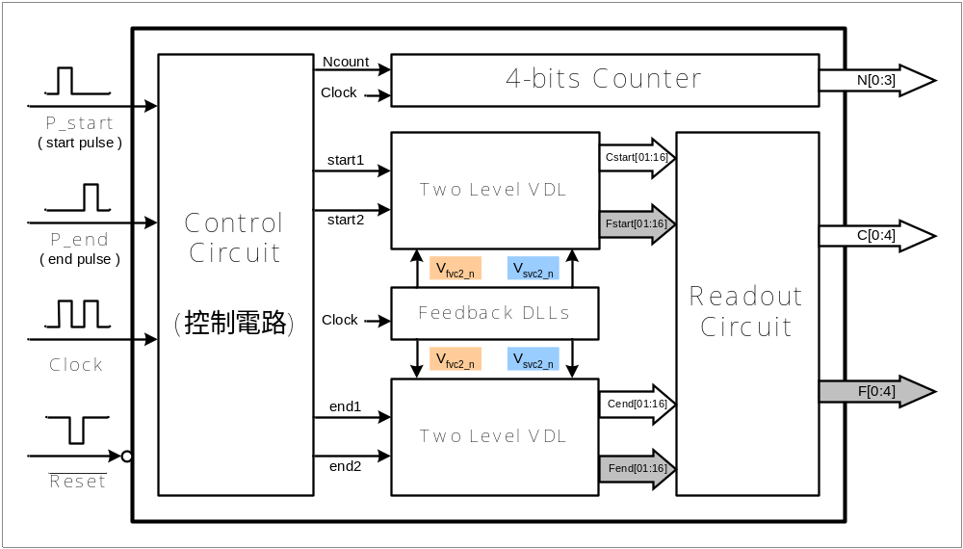
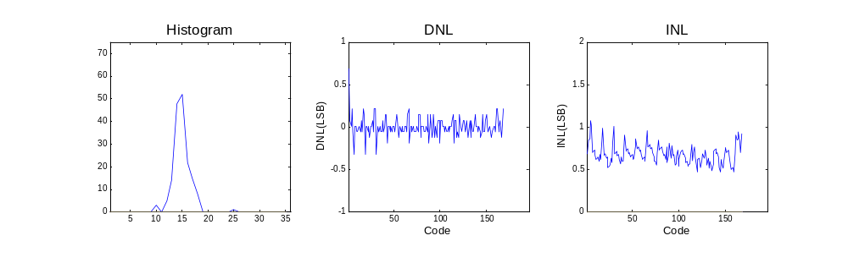
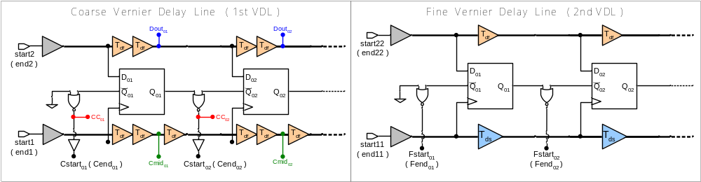
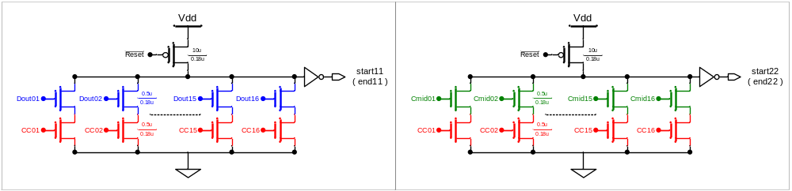
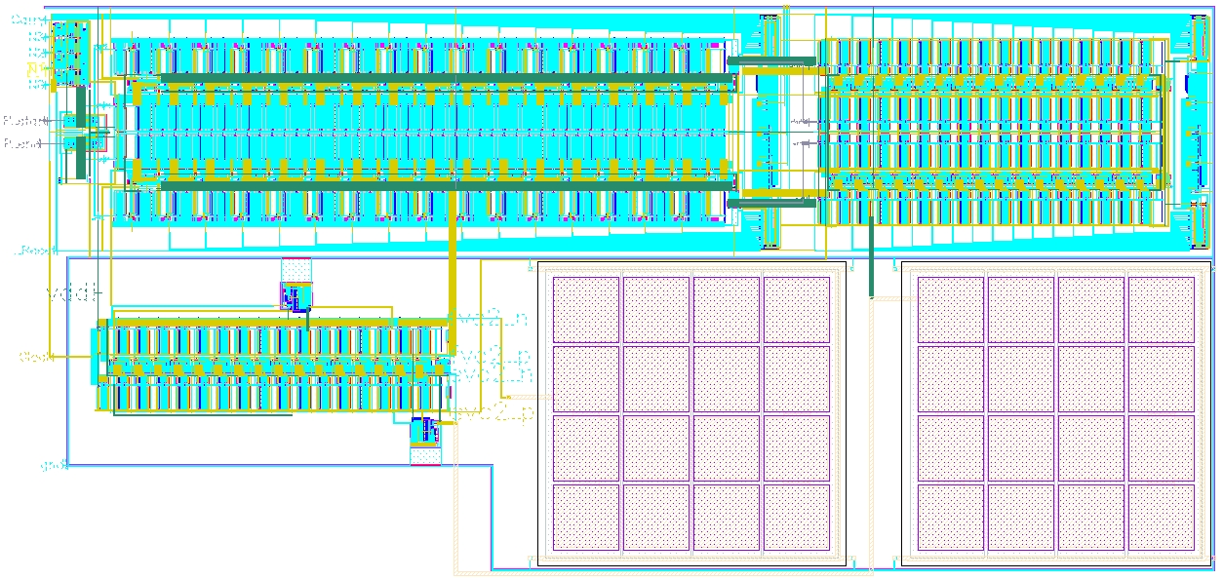
A Time-to-Digital Converter with Two Level Vernier Delay Line
學生：李谷桓 學號：G913117 指導教授：周懷樸教授
國立清華大學 工程與系統科學研究所碩士班
Purpose
Simulation Results
To Design a high resolution Time-to-Digital Converter (TDC) which can improve the problem of long conversion time in single level Vernier Delay Line (VDL) and reduce the elements.
．Two kinds of delay time are used in the circuit
．Delay elements are controlled by DLL to get above delay times.
Block Diagram
◆ Full Circuit - Linearity simulations
．Control Circuit ：Convert pulse signals to step signals.
．4bits Counter ：Count the time of integral period part.
．Two Level VDL ：Resolve the time of non-integral period.
．Feedback DLLs ：Provide bias voltage for delay elements.
．Readout Circuit ：Convert thermal code to binary code and subtract the results.
◆ Full Circuit - Characteristics
Two Level VDL
Fabrication Process | TSMC CMOS 0.18um 1P6M
Resolution | 29.6 ps
Input Range | 0 ~ 75 ns
Conversion Time | < 5 Tclk ( < 16 Tclk for single level VDL )
DNL (LSB) | -0.33 ~ +0.69
INL (LSB) | +0.47 ~ +1.08
Clock Frequency | 200 MHz
Supply Voltage | 1.8 V
Core Size | 445um．215um
．NOR gates can detect the first low to high stage.
．Use the results of DFF as the switches to transfer proper signals to the Fine VDL.
Full Layout
Conclusion
Comparing to single level VDL, two level VDL can effectively reduce the conversion time.
◆ The capacitances in DLL can be smaller for faster feedback and more precise bias voltage.
◆ The non-linearities come from
．Pulse appears near the clock rising edge ( < 220 ps )
．DLL static error
．DFF setup time

