Slide 1
NoC Communication Strategies using Time-to-Digital Conversion
Crescenzo D'Alessandro, Nikolaos Minas, Keith Heron, David Kinniment, Alex Yakovlev
Microelectronics Systems Design Group
School of EECE
Newcastle University, UK

Slide 2
Outline
Introduction: Phase encoding
Motivation
Time-to-Digital conversion
Two-/Multiple-wire Time Encoding
Calibration Issues
Results
  FPGA Results
  On-Chip simulation Results
Conclusions

Slide 3
Phase Encoding
Dual-Rail
Main idea: encode data on the phase relationship between two identical out-of-phase signals
Resistant to transient faults
Similarity with dual-rail dual-spacer protocol
t_0 before t_1
t_1 before t_0
ref
t_1
t_0
sp0
sp1
sp0
sp1
sp0
data
0
0
1
0

Slide 4
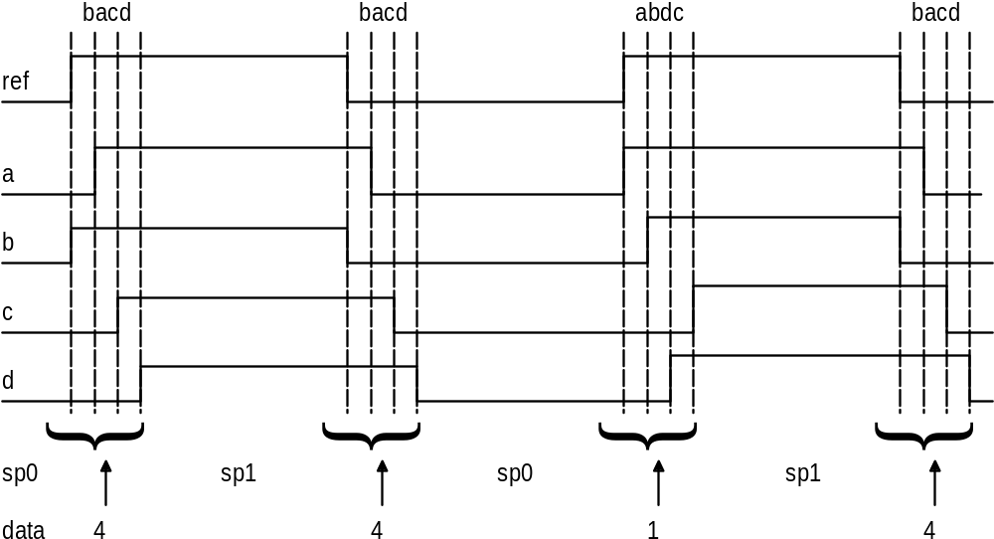
Multiple Rail
No group of wires has the same delay
All wires toggle when an item of data is sent
Fixed symbol time nδ

Slide 5
Motivation
Some research is focusing on the use of serial links for on-chip communication to ease the problems of PVT variations
Phase-Encoding for on-chip communication is one example
Fundamental limitation of a serial link is the limited bitrate achievable
  Even decreasing the width of the pulses and the time between them you cannot achieve the same bitrate of a parallel bus
However serial links offer advantages such as lower induced cross-talk
The idea behind this work is to improve the bitrate of a serial link by measuring the time between events and investigate the trade-offs involved

Slide 6
TDC
Time-to-Digital conversion is a research topic on its own
Different levels of complexity
Arguably the simplest type is a tapped delay line
In this case a “start” signal is delayed a number of times
A “stop” signal is compared to each version of the “start” signal, to monitor at which point the “stop” overtakes the “start”
Normally temperature-encoded

Slide 7
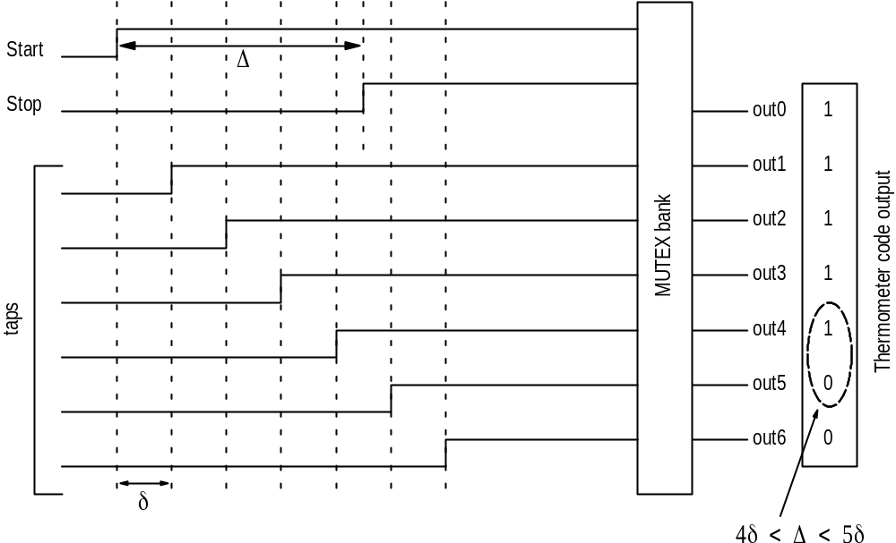
TDC
Example of waveform for tapped delay line TDC
Resolution = ± δ

Slide 8
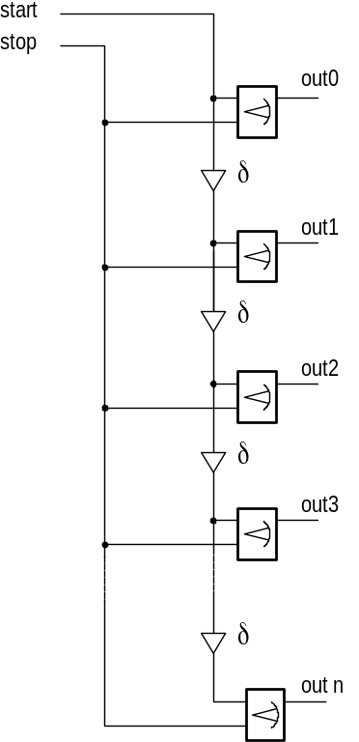
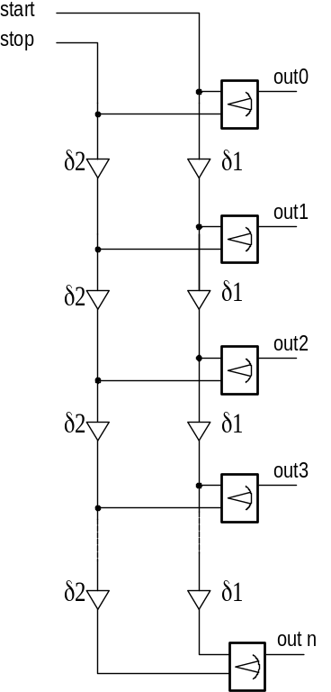
TDC – Implementation
Left: simple tapped delay line
The resolution depends on the value of δ
Right: improved delay line – Vernier delay line
The resolution becomes |δ₂-δ₁|
Better solution: resolution less than a single delay element

Slide 9
2-wires Time Encoding
Different ways to encode data using 2-wires and measuring the time separation between them
Repeated single spacing: a number of slots available for the events to occur in
The slots have equal time separation between each other
Can only be used if one of the events occur at the first slot
Multiple spacing: similar idea, but the time between the slots changes

Slide 10
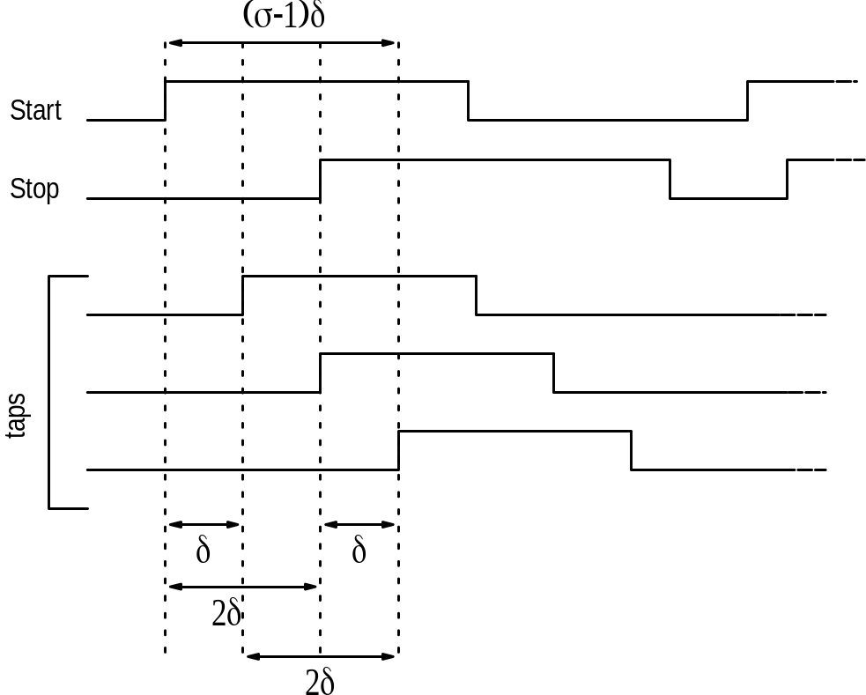
2-wires Time Encoding
Example of single spacing
σ is the number of available slots
δ is the time separation between slots
Note that different combinations of slots lead to same time separations (2δ in the figure)
Number of bits:
  log₂σ if only positive times used (start before stop)
  Log₂(2σ-1) if positive/negative times used

Slide 11
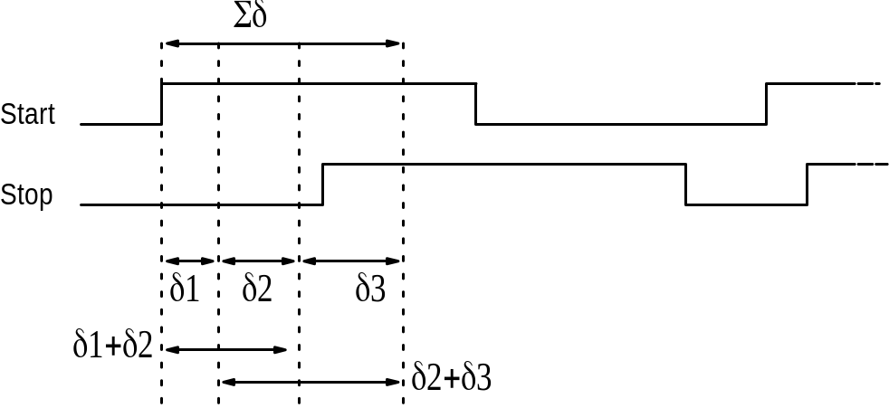
2-wires Time Encoding
Example of multiple spacing
Different δ values
Slot distance does not set on its own the time distance
Bit/symbol = log₂(σ²-σ+1)
Complex sender/receiver

Slide 12
Multiple-wires T. Enc.
Two ways to implement it
Either straight multiple-wire
  Any wire can be a reference for the others
  Uniform/multiple slots
Or pair-wise multiple-wire
  Bank of 2-wire links
Straight multiple-wire implementation can be done
  Using one wire as a clock
  Any wire can be the reference for any other – problems deciding who is the reference
  Multiple references – coincident events

Slide 13
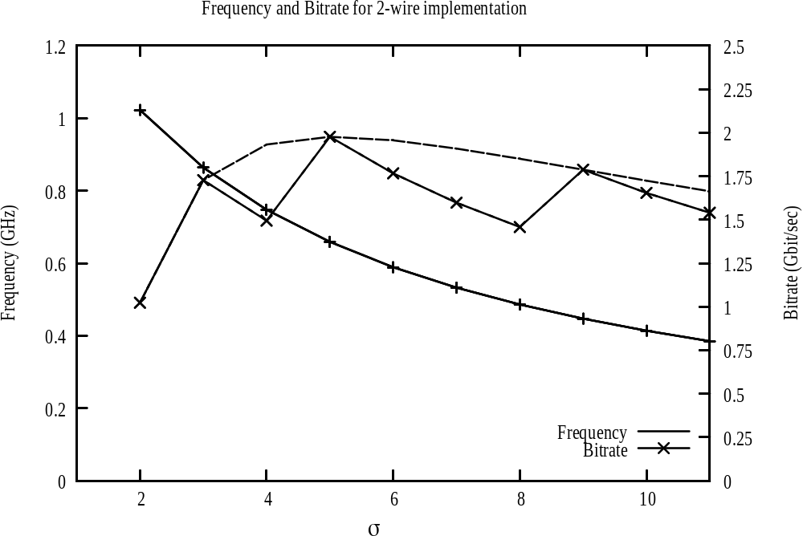
Bitrate - 2 wires
Figure shows the bitrate achievable using 2 wires
Optimum at 5 σ – 5 time slots
Refers to uniform slots
Notice however that one slot is “lost”, so effectively optimum is when 2 bits/symbol are sent
Details in the paper

Slide 14
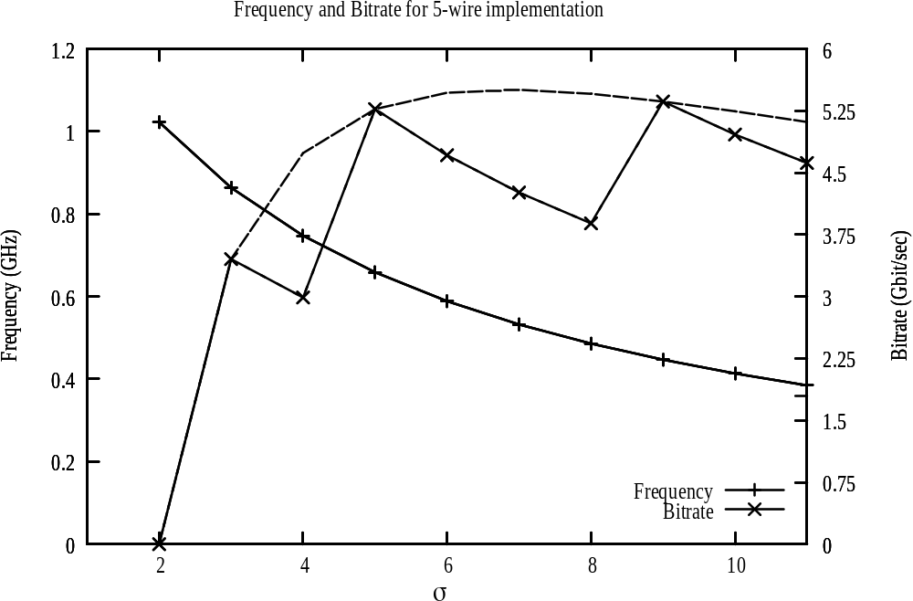
Bitrate – 5 wires
In this case 5 wires were used
This graph assumes that one wire is a fixed reference for the TDCs
Optimum again at 5 time slots

Slide 15
Delay Corruption
Mismatch in process variations cause a systematic delay offset to appear between the two lines, which could cause errors in decoding
Voltage/Temperature variations instead introduce transient delay/phase error
Additionally, cross-talk causes both transient delay/phase error and symbol-dependent delay corruption
As the wires are always “allies” in terms of cross-talk (for small time separations), the longer the wire, the more corrupted the phase relationship between the wires
What is then the optimal length of wire which “guarantees” that the delay relationship is maintained?

Slide 16
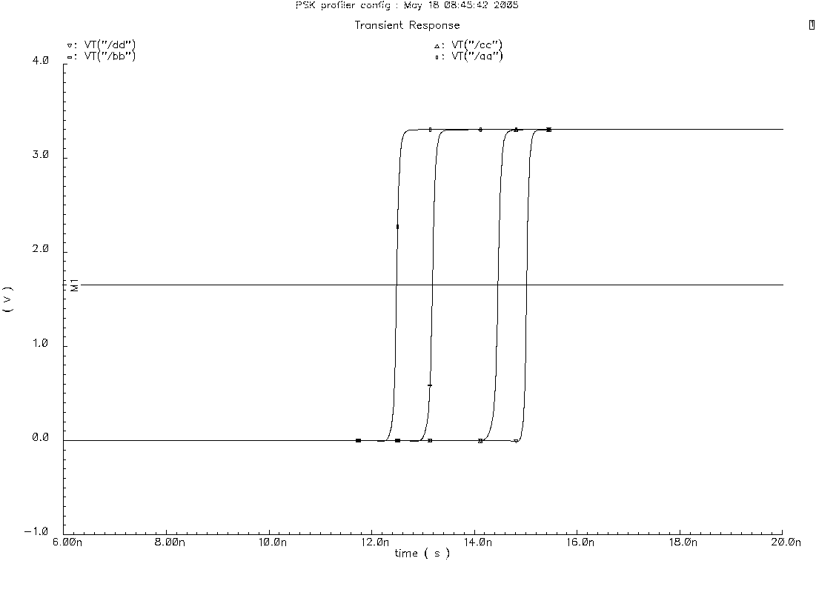
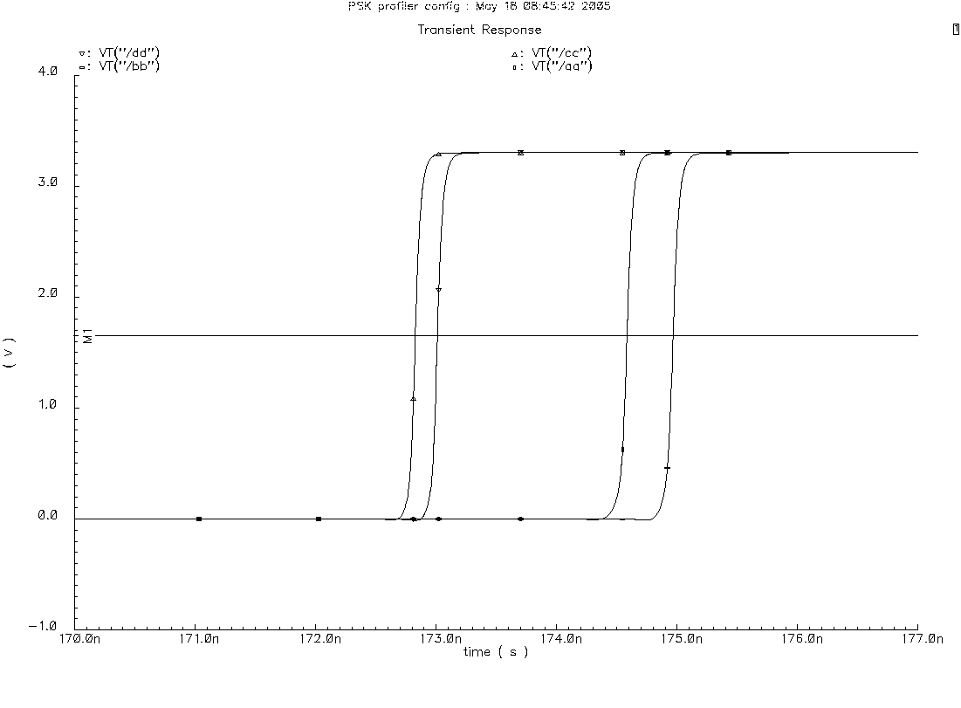
Delay Corruption
Example of delay corruption
No change in sequence - change in absolute value of delay
Identical (ideally) transistors and wires

Slide 17
Calibration Issues
To avoid the effects of PVT variations, calibration may be used
The system could “align” the two wires at the various slots
Then the receiver would be able to counter the effects of variability
However, this is very impractical
  Large area overhead
  Large time overhead (calibration time)
Different schemes are being investigated, but area of calibration units and calibration downtime are major concerns
The effect of delay corruption is to be investigated in more details – use of error correction/detection techniques
Gray codes offer some help

Slide 18
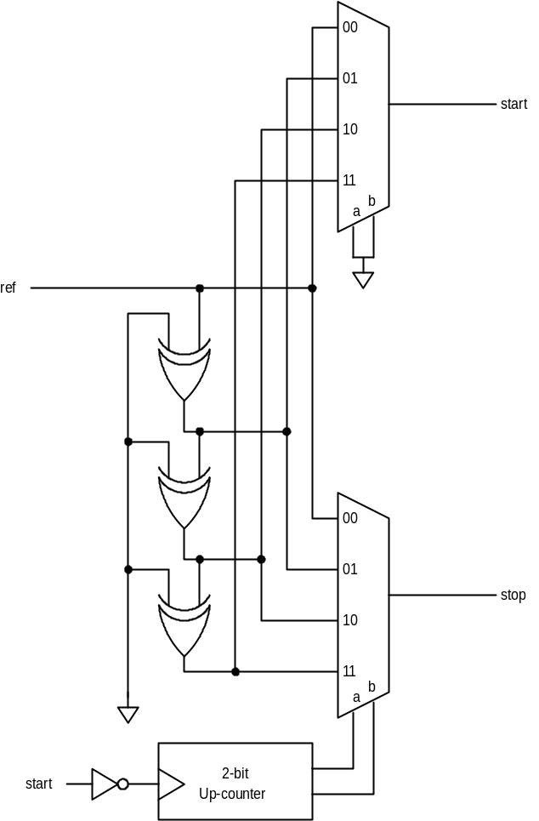
FPGA Implementation
2-bit/symbol implementation
The counter provides a sequence of symbols
The “start” signal is a clock
The “reference” signal is a delayed version of the same clock
Each input to the multiplexers is a delayed version of the “reference” signal
Note: the top multiplexer is present for delay-matching

Slide 19
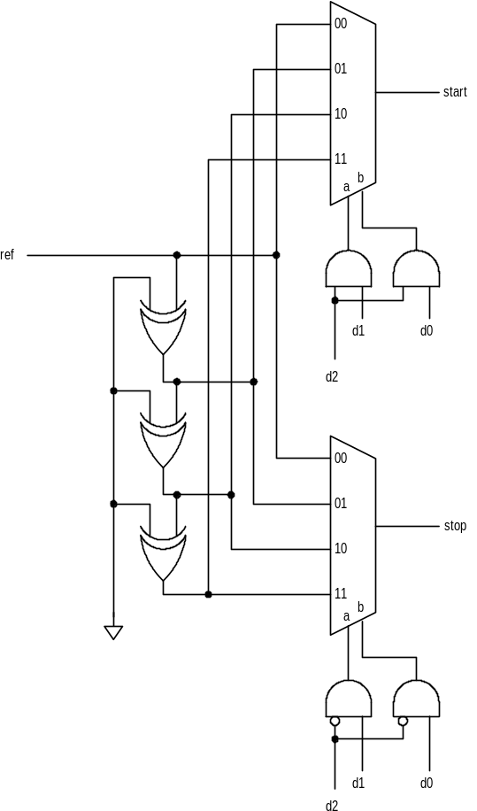
FPGA Implementation
Simple extension for 3-bit symbols
The selection of the multiplexers input is done through a simple encoding logic
Uniform slots

Slide 20
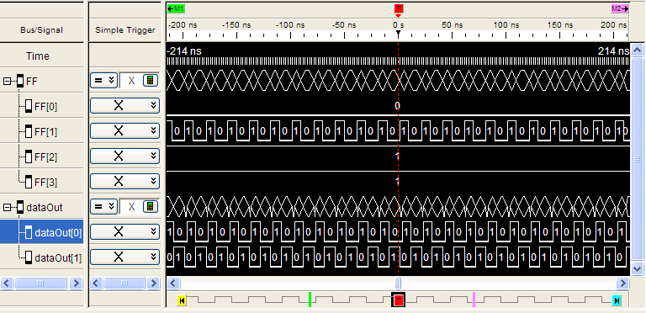
FPGA Results
Two same-frequency clocks were used and the time separation changed
Figure shows metastability if the sender delay was mismatched to the rec’s

Slide 21
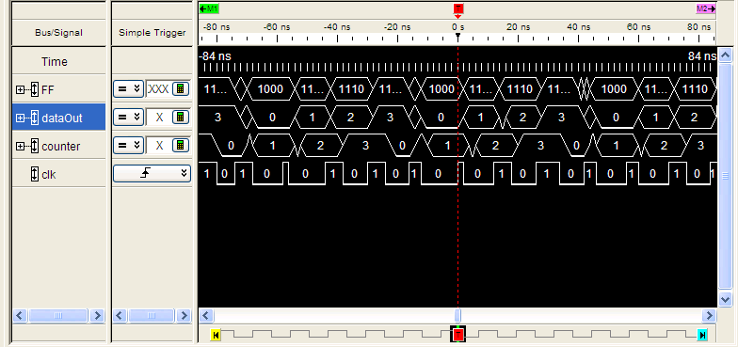
FPGA Results
70 MHz external clock
Internal sender/receiver

Slide 22
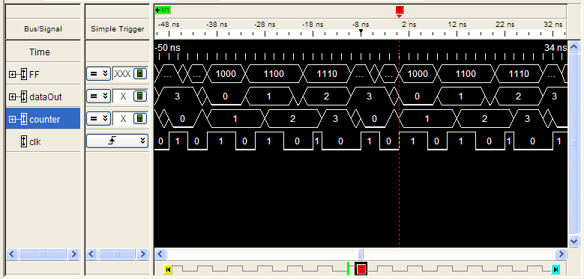
FPGA Results
Internal clock reference = 100 MHz

Slide 23
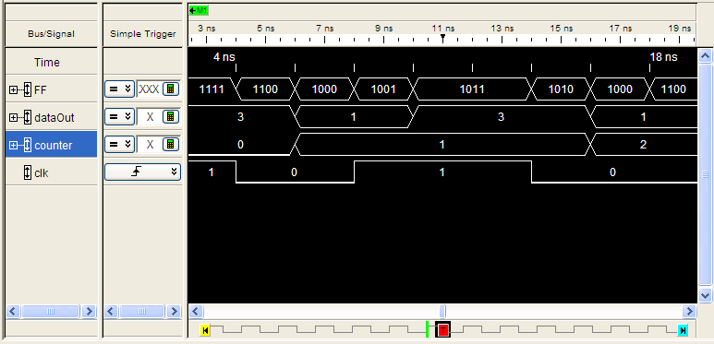
FPGA Results
Observed result of occasional metastability – note “dataOut”
Internal clock reference = 100 MHz

Slide 24
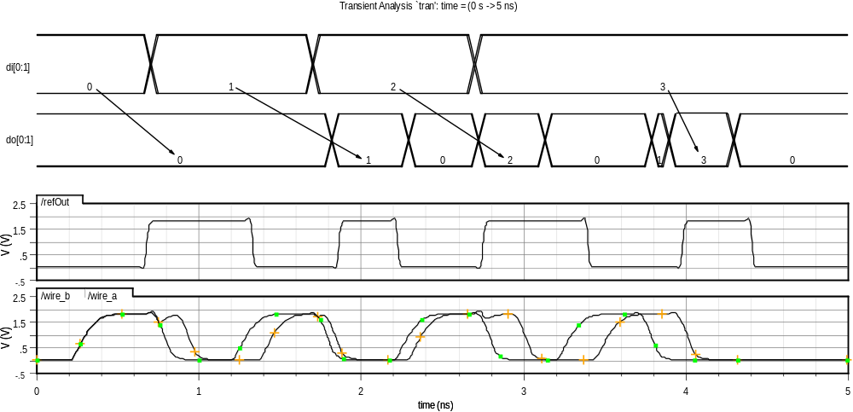
On-chip Simulations
On-chip simulation results (pre-layout, 0.18μm)
Clock reference = 1 GHz, resulting in 2 Gb/s using 2 wires

Slide 25
Conclusions
A radical approach to on-chip communication has been proposed
The results show promising developments in terms of high-speed communication between blocks, and can be used for NoC design
A proof-of-concept FPGA design has been implemented and tested and an on-chip system has been simulated
The strong points of this concept: Reduction the number of wires required for a given bit-rate
If reliability is a fundamental issue and area overhead is less important, the TDC design can employ higher-resolution TDCs. This is the main focus of future work
Future research: off-chip applications, more thorough analysis of metastability in the TDCs, different encoding (pre-sender) to improve reliability
Silicon results for validation of the on-chip design required in the short term

Slide 26
Contact details
Crescenzo S. D’Alessandro
Microelectronics Systems Design Group
School of Electrical, Electronics and Computer Engineering
Merz Court
Newcastle University, UK
Crescenzo.D’Alessandro@ncl.ac.uk
http://async.org.uk

