Slide 1
Laboratory: “Customized Embedded Processor Design”
Semester SS2020
Hussam Amrouch, Lars Bauer, Sajjad Hussain
(Lehrstuhl Prof. Dr. J. Henkel)
CES - Chair for Embedded Systems
KIT - Karlsruhe Institute of Technology, Germany

Slide 2
ASIPs: efficiency vs. flexibility
“Hardware solution”
ASIC:
- Non-programmable,
- highly specialized
The best performance
The highest development cost
Only reasonable for high volume products
ASIP
(extensible
processor)
- instruction extension/definition
“efficiency”: MIPS/$, MHz/mW, MIPS/area, …
- parameterization
inclusion/non-inclusion of
functionality/devices
General purpose
processor
“Software
solution”
Flexibility, 1/time-to-market, …
src: Henkel “Design and Architectures for Embedded Systems (ESII)”

Slide 3
ASIPs: efficiency vs. flexibility
“Hardware solution”
ASIC:
- Non-programmable,
- highly specialized
ASIP
(extensible
processor)
- instruction extension/definition
“efficiency”: MIPS/$, MHz/mW, MIPS/area, …
- parameterization
Extremely flexible
Bad performance
inclusion/non-inclusion of
functionality/devices
General purpose
processor
“Software
solution”
Flexibility, 1/time-to-market, …
src: Henkel “Design and Architectures for Embedded Systems (ESII)”

Slide 4
ASIPs: efficiency vs. flexibility
“Hardware solution”
ASIC:
- Non-programmable,
- highly specialized
ASIP
(extensible
processor)
- instruction extension/definition
“efficiency”: MIPS/$, MHz/mW, MIPS/area, …
- parameterization
inclusion/non-inclusion of
functionality/devices
Optimized for an application
Still flexible, but achieves a better performance
“Software
solution”
General purpose
processor
Flexibility, 1/time-to-market, …
src: Henkel “Design and Architectures for Embedded Systems (ESII)”

Slide 5
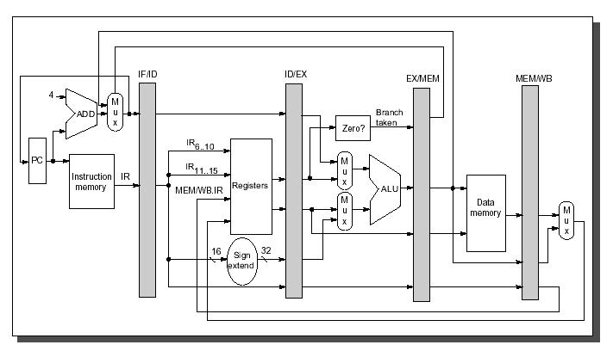
Pipeline Processor
src: Muhammad Shaaban “The DLX Architecture”, lecture on ‘Computer Architecture’

Slide 6
Pipelining

Slide 7
Pipeline Processor Used
Parameters | Architecture
Basic architecture | RISC
Memory architecture | Harvard
Instruction length | 32
Data length | 32
Addressing | Byte address
The number of general-purpose registers | 32
The number of pipeline stages | 4
The number of delayed branch slot | 0
Floating-point unit | N/A
Forwarding | full forwarding
Alignment | 1-byte, 2-byte and 4-byte
Endian-ness | Big Endian
Interrupts | Reset, Internal, External
Brownie STD 32 is a RISC-type pipeline processor architecture. The Brownie architecture is designed for an easy and fast pipeline processor. It is a Load-/Store-architecture,

Slide 8
Goal of ASIP Lab
Creating new CPUs with new instructions and implementing these new instructions in Hardware and Software with evaluation and testing
The main goals are:
creating new ASIPs for special applications
benchmark those ASIPs to find out their benefits and drawbacks
and finally to interpret the benchmark results

Slide 9
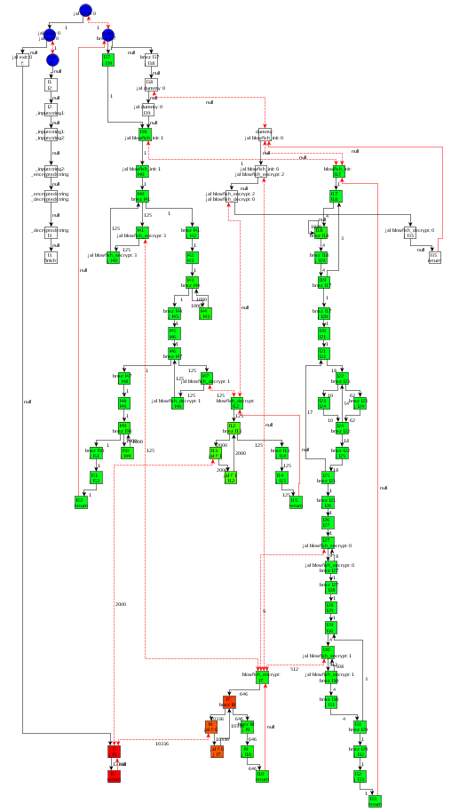
Profiling on Control-Flow Graph
Each node is a Base Block:
The instructions in a Base Block are always executed together
No jumps in a Base Block, except the end
No jump targets in a Base Block, except the beginning
Blowfish with 1 KB input data: Encrypt and Decrypt

Slide 10
Constraints for Designing Custom Instructions
Number of Input-/Output-Values to Custom Instruction
Limited by register file, e.g. 4 read and 2 write ports
‘Forbidden Nodes’, e.g. Load/Store
Convex Graph
Limited Frequency, Area, Power, and/or Energy Budget
An ASIP that consumes more power may consume less energy, if the application terminates much earlier
load

Slide 11
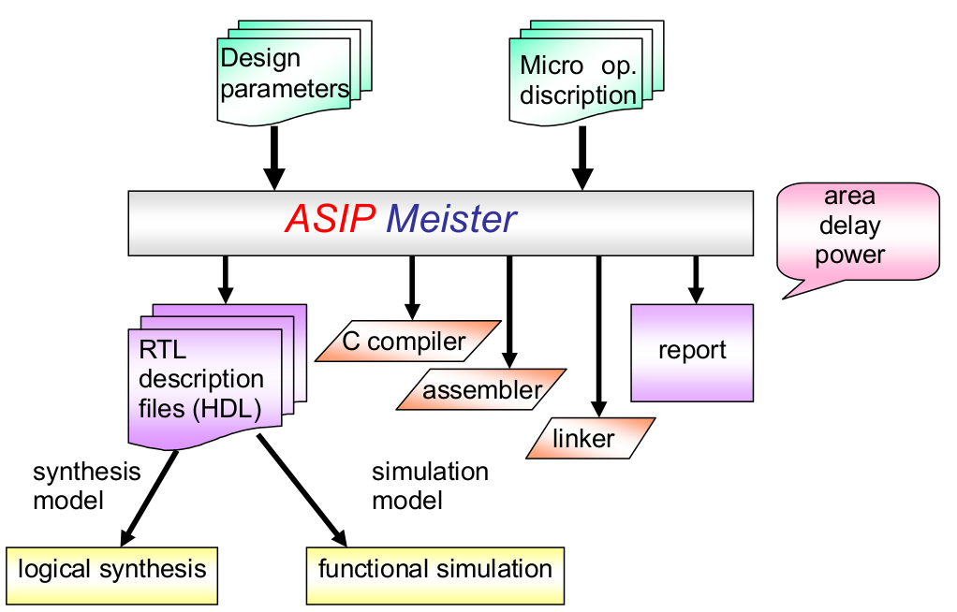
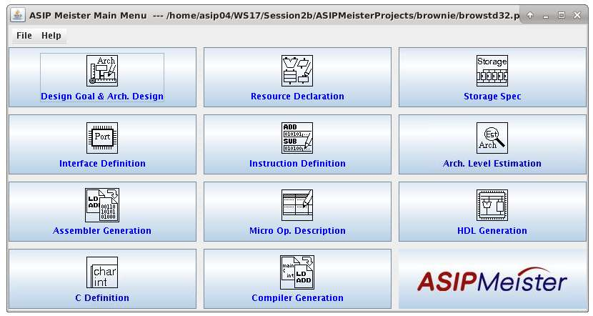
Tasks in ASIP Lab
Programming in assembly language
Implementing new instructions with ASIP Meister (+Simulation, +Hardware)
Evaluating the results from the new CPU
designing new instructions for large applications with testing
Creating different CPU versions
Fig.1 ASIPmeister Software
Fig. 2 ASIP Meister Input and Output

Slide 12
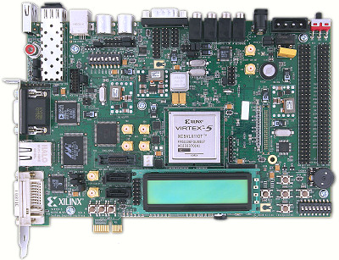
Lab Environments
dlxsim: Instruction Set Simulator adapted for Brownie Processor
ASIPMeister: To create new processor
Extended GCC compiler: compiler out of an processor architecture description in ASIPMeister.
ModelSim: simulator for VHDL-Code
Xilinx ISE: Synthesis of VHDL-Code
XPower: To estimate power consumption
Virtex-5 FPGA Evaluation Board

Slide 13
Important Directories
/home/asip00/Sessions/SessionX: The lab exercise for each session. For instance; the “Laboratory Script” is placed at Sessions/Session0.
Before each session is started, the corresponding material will be copied to its folder.
/home/asip00/Documents/: The relevant tutorials and manuals for the Lab.
/home/asip00/epp:
AM_tools: ASIPmeister tools to generate custom compiler
ASIPMeisterProjects: a template project
dlxsimbr_Laboratory: DLXIM simulator to be used
mkimg: Lab Makefile and Scripts
StdLib: standard library for I/O

Slide 14
Important Documents
Following is used as reference material. In each session, only the relevant chapters are asked to read. No need to go through all these.
Laboratory Script
ASIPMeister Users’ Manual (AM_usersmanual_en.pdf)
ASIPMeister Tutorial (AM_tutorial_en.pdf)
Brownie STD 32 Reference Manual (BrownieSTD32_Spec_en.pdf)
Brownie STD 32 Package ReadMe.txt (README_en.txt)
Using the GNU Compiler Collection (Compiler.pdf)
The GCC Assembler (GCC Assemble.pdf)
The GNU linker (linker.pdf)

Slide 15
Important Note
Lab computers, software and hardware can be accessed remotely.
Generally, the sessions need to be executed on one of the following Lab PCs:
i80labpc01, i80labpc02, … i80labpc10
ASIPmeister is ALWAYS executed from i80pc57. This PC can be SSH-ed from any of above PCs i.e. i80labpcXX or from your laptop.
FPGA JTAG driver is setup on i80labpc10, and FPGA board can be accessed via this PC only.
For remote/ONLINE access use ssh –X username@i80labpc10.ira.uka.de

Slide 16
Important Note
Due to prevailing condition the lab will be conducted ONLINE
Meetings: Though Zoom (Will decide today)
Lab PCs: Accessed through SSH (Using MobaXterm, X2Go, Putty etc.)
User accounts will be sent to you via email

Slide 17
How to access?
Accessing PC:
Login to i80labpcXX using user@i80labpcXX.ira.uka.uk via MobaXterm.
ssh –X user@i80pc57 and perform all exercises here.
In case you need to implement your application to FPGA, you need to login to i80labpc10, i.e., ssh –X user@ i80labpc10
Accessing Helping Material
/home/asip00/Documents
/home/asip00/Sessions
/home/asip00/epp
Creating recommended directory structure
Create new project directory for each new project
Create new application directory for each new application
To create new project use TEMPLATE_PROJECT.

Slide 18
Recommended Reading
For the first session, read the following:
ASIPmeister User Manual
Laboratory Script’s Chapter 1
Laboratory Script’s Chapter 3 (dlxsim; without 3.2.2, 3.2.3 & 3.3.2)

Slide 19
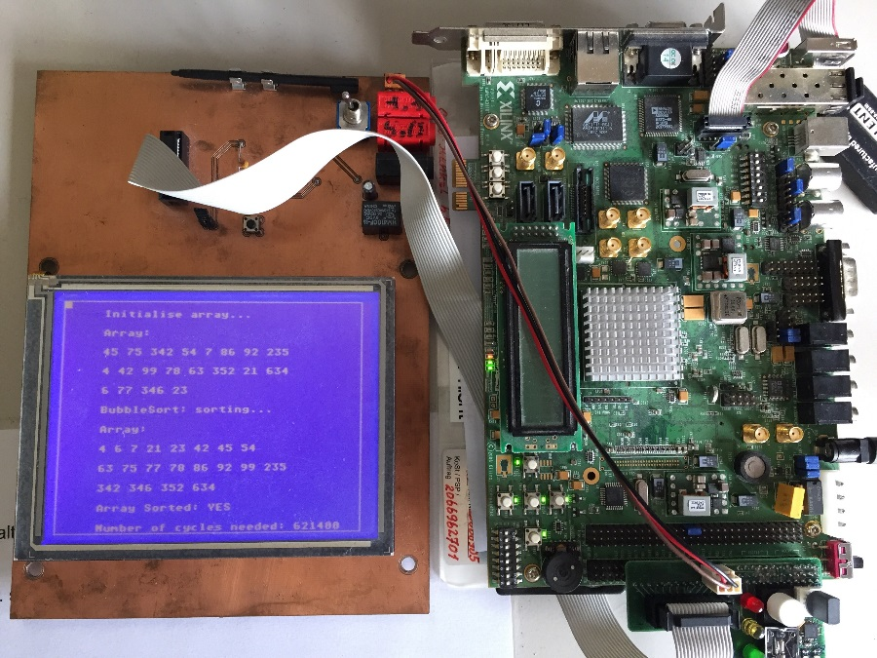
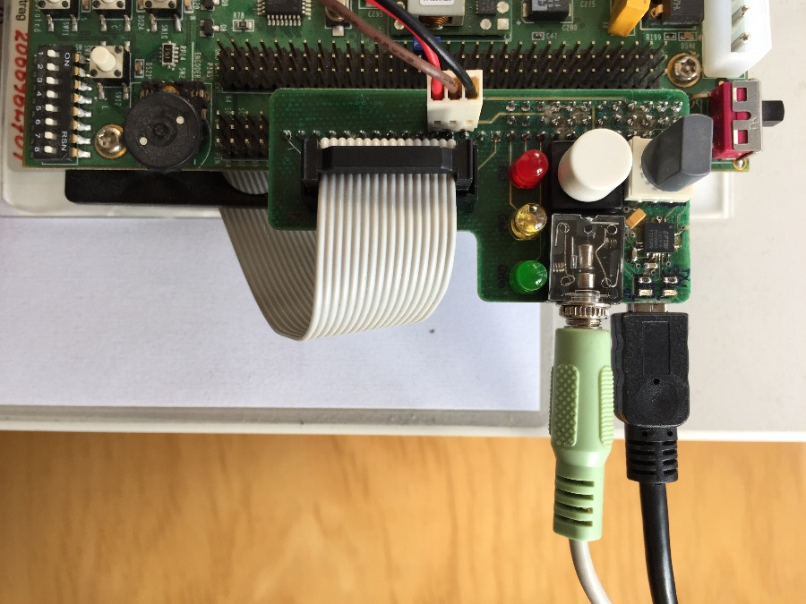
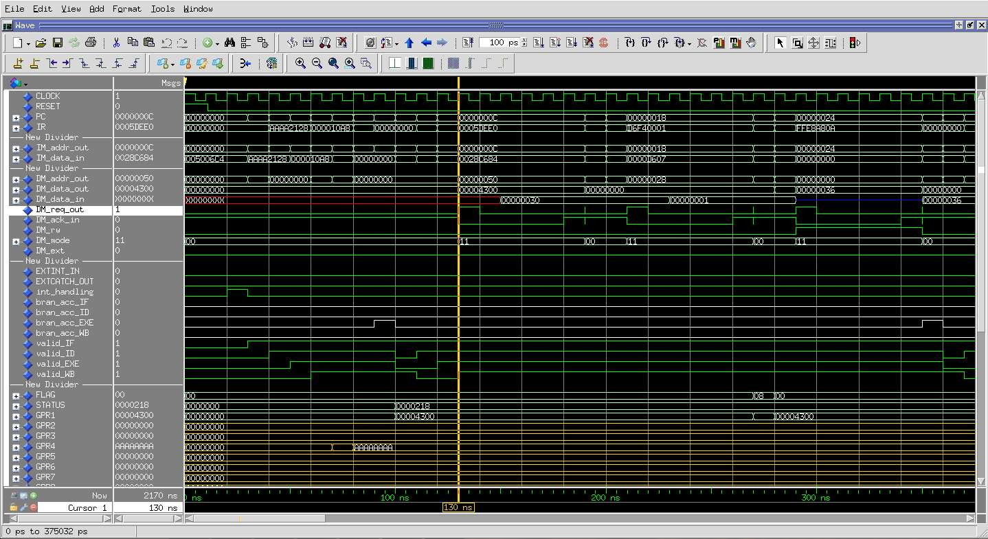
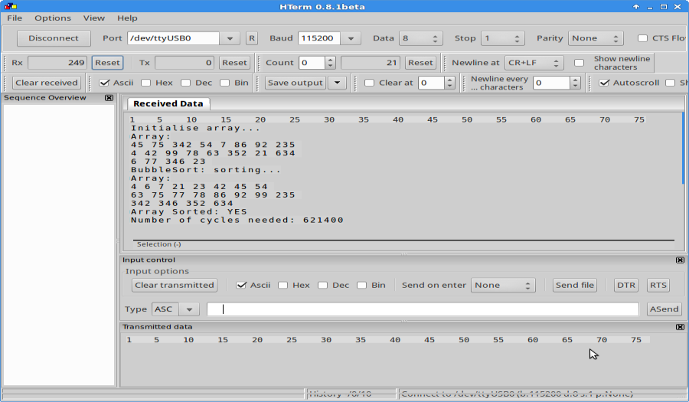
Bubble Sort Example
ASIP Lab Hardware Virtex-5 Setup
Peripheral Board Connections
CPU Signals (ModelSim Simulation)
Output to UART hterm

Slide 20
Supervisors and the regular meeting
Dr. Hussam Amrouch
Dr. Lars Bauer
Sajjad Hussain
Regular Meeting: what about Monday 14:00 ?
Questions??

