Slide 1
Lab: Designing Embedded Application-Specific Processors
Majd Eddin Mansour Paul Georg Wagner
Supervisors: Sajjad Hussain
Dr. Hussam Amrouch

Slide 2
Outline
Introduction To The Project
ADPCM Decoder Algorithm
Simulating and Implementing Steps
Preparing a Benchmark
Performance Optimized CPUs
Area Optimized CPUs
Conclusion

Slide 3
ADPCM Algorithm (pseudo code)
static int indexTable[16] = {
-1, -1, -1, -1, 2, 4, 6, 8,
-1, -1, -1, -1, 2, 4, 6, 8,
};
static int stepsizeTable[89] = {
7, 8, 9, 10, 11, 12, 13, 14, 16, 17,
19, 21, 23, 25, 28, 31, 34, 37, 41, 45,
50, 55, 60, 66, 73, 80, 88, 97, 107, 118,
130, 143, 157, 173, 190, 209, 230, 253, 279, 307,
337, 371, 408, 449, 494, 544, 598, 658, 724, 796,
876, 963, 1060, 1166, 1282, 1411, 1552, 1707, 1878, 2066,
2272, 2499, 2749, 3024, 3327, 3660, 4026, 4428, 4871, 5358,
5894, 6484, 7132, 7845, 8630, 9493, 10442, 11487, 12635, 13899,
15289, 16818, 18500, 20350, 22385, 24623, 27086, 29794, 32767
};

Slide 4
ADPCM Algorithm (pseudo code)
int adpcm_decoder(unsigned char* indata, int len) {
for ( ; len > 0 ; len-- ) {
} }
/* Step 4 - difference and new predicted value */
vpdiff = step >> 3;
if ( delta & 4 ) vpdiff += step;
if ( delta & 2 ) vpdiff += step>>1;
if ( delta & 1 ) vpdiff += step>>2;
if ( sign )
valpred -= vpdiff;
else
valpred += vpdiff;
/* Step 2 - Find new index value (for later) */
step = stepsizeTable[index];
index += indexTable[delta];
if ( index < 0 ) index = 0;
if ( index > 88 ) index = 88;
/* Step 3 - Separate sign and magnitude */
sign = delta & 8;
delta = delta & 7;
/* Step 1 - get the delta value */
if ( bufferstep ) {
delta = inputbuffer & 0xf;
} else {
inputbuffer = *indata++;
delta = (inputbuffer >> 4) & 0xf;
}
bufferstep = !bufferstep;
/* Step 5 - clamp output value */
if ( valpred > 32767 )
valpred = 32767;
else if ( valpred < -32768 )
valpred = -32768;

Slide 5
Simulating ADPCM
Application compiled with gcc and executed
Converted to assembly:
To understand the instructions used for the decoder
Easier to replace group of instructions with new instructions
Very helpful in area optimizing to find out the unneeded components
Simulated with dlxsim and ModelSim
Using the unmodified CPU
The output correctness is verified by comparing results

Slide 6
Implementing ADPCM
CPU with App loaded to the FPGA and simulated
Bitrate in dlx_Toplevel.vhd set to 96 kHz audio
A bitstream is generated using Xilinx ISE for dlx_basis CPU
The bitstream is initialized with the application and uploaded
As a result we could hear the decoded output by the FPGA
Very slow playback at 25, 50, 75 MHz
Yet slow playback at 100 MHz (deep sound)
Sound is encoded with 192 kHz instead of 96 kHz
We resampled the provided audio data by decoding the sound and re-encoding it with 96 kHz

Slide 7
Preparing a Benchmark
The output and the function calling are removed from adpcm.c
The provided adpcmDataStereo_MINI.h is linked
Converted to Assembly
Simulated with ModelSim to record the count of cycles
(CLK_HALF_PERIOD = 10ns // 50 MHz)
Area and timing reports are generated the using Xilinx ISE
Synthesized VHDL files + benchmark framework are loaded
Power benchmark with Xilinx ISE
After creating VCD files using ModelSim

Slide 8


Benchmark Results (Basis CPU)
Cycles | 388.814
Critical path [ns] | 6,316
$\frac{1}{6,316}≈158 Mhz$ (Maximum)
$$\frac{388.814}{1300} ≈300 \frac{cycle}{sample}$$

Slide 9
Benchmark Results (Basis CPU)
Execution Time [ms] | 7,78 | 2,46 | 13,41

Slide 10
PERFORMANCE optimization

Slide 11

Performance Optimization
Goal: Minimizing the execution time
Reduce number of cycles
Optimize existing code
Create suitable hardware components/instructions
Enhance data parallelism
Convert project to assembly to allow finer control
Main point of optimization: for-loop

Slide 12
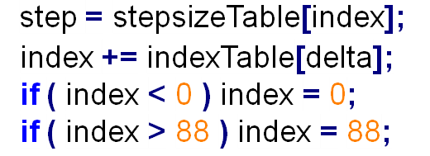
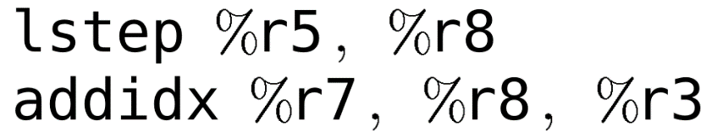
Performance Optimization 1
Outsourcing index and step calculation to hardware
New VHDL component
Saves two address calculations/memory accesses
Saves two if-statements
Notes:
- Arrays defined in VHDL
- No need for a clamp instruction, just add clamping to the actually important component

Slide 13
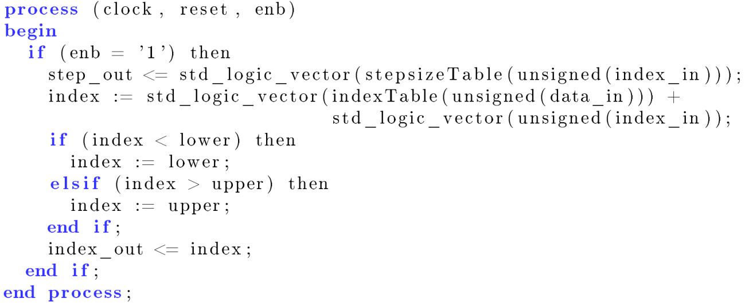
Performance Optimization 1
VHDL implementation of lstep and addidx instruction
Input: sample, old index
Output: step, new index
Notes:
- Arrays defined in VHDL
- No need for a clamp instruction, just add clamping to the actually important component
13

Slide 14
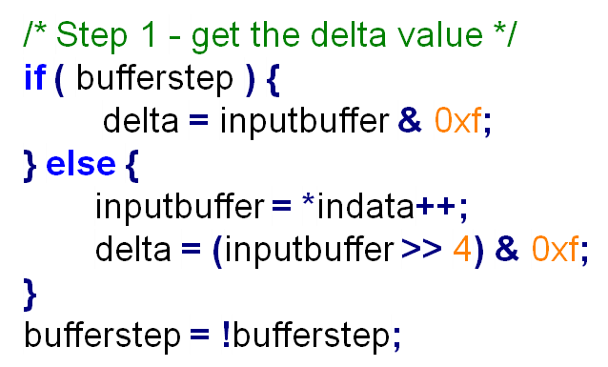
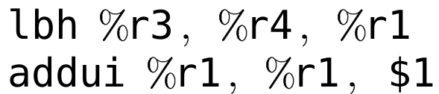
Performance Optimization 1
Loading two samples at once
Load one byte
Store two samples in two registers
No new VHDL component required
Also process two samples in one loop iteration
Notes:
Enables us to process two samples in one loop iteration
=> Data parallelism
14

Slide 15
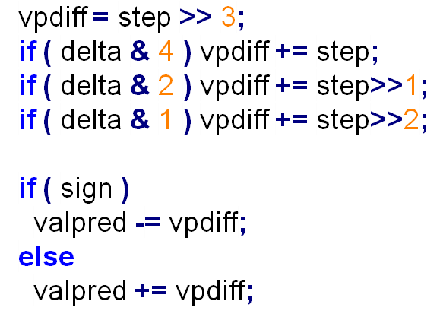
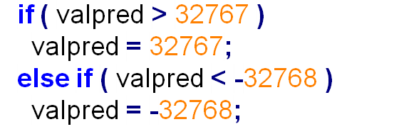
Performance Optimization 1
Outsource PCM decoding to hardware
Input: Sample (r3), Step (r5), Previously decoded sample (r10)
Output: Decoded sample (r9)
Notes:
15

Slide 16
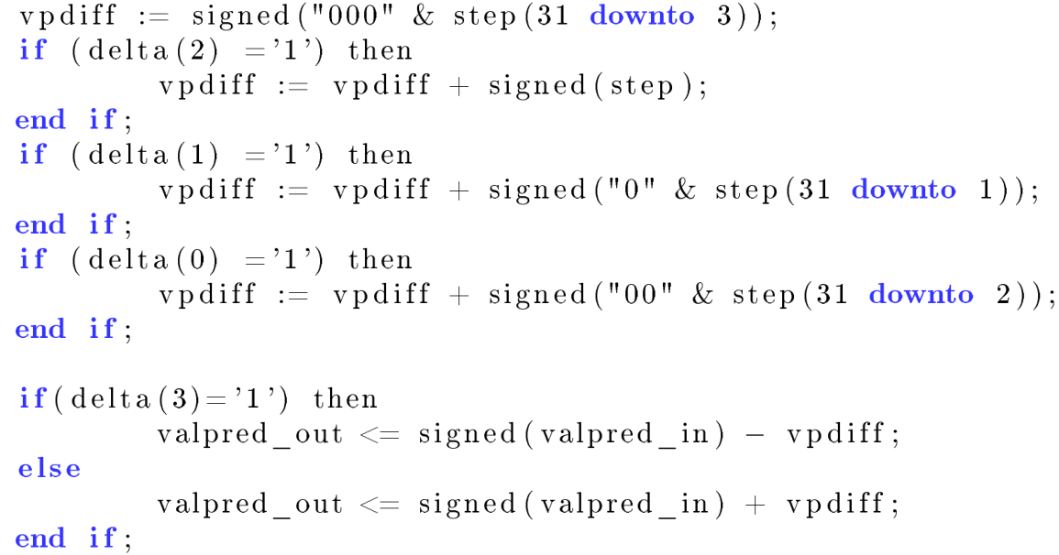
Performance Optimization 1
VHDL implementation of pcmdec instruction
Notes:
- Clamping omitted
16

Slide 17
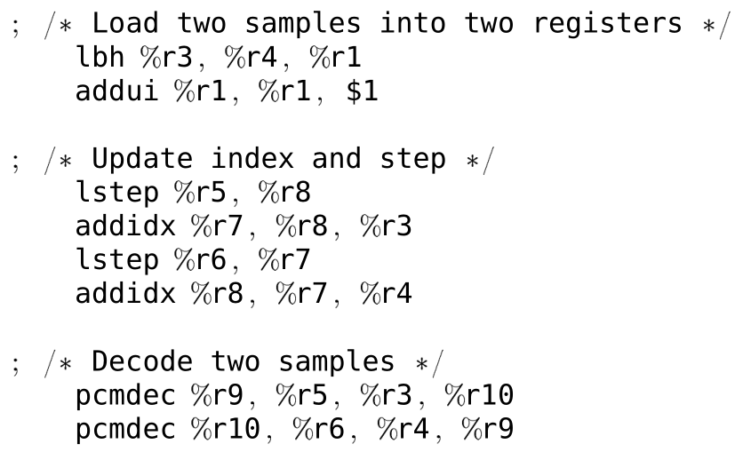
Performance Optimization 1
Optimized code inside the for-loop
Notes:
- Registers r8 and r10 are preserved over the iterations (they hold old index and old decoded sample)
17

Slide 18
Performance Optimization 1: Results – Execution Time
# Cycles basis | 388.814
# Cycles opt1 | 36.462
Speedup | 10,7
Notes:
Speedup of 10,7
This is paid for by higher area requirements (about 50% more)
And of course higher power requirements

Slide 19
Performance Optimization 1: Results – Power & Energy

Slide 20

Performance Optimization 1: Results – Area
basis:
opt1:
Notes:
Area requirement increased by about 50%

Slide 21
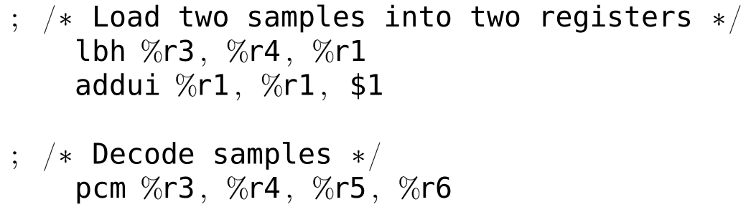
Performance Optimization 2
Reducing number of components to just one
Step calculation and decoding of two samples is done in a single component
Advantages
Reduced number of instructions
Code inside the for-loop becomes very simple
Notes:
- New pcm instruction
- Inputs: Two input samples (r3 and r4), step (r5) and previously decoded sample (r6)
- Outputs: Two output samples (r3 and r4), new step (r5) and secondly decoded sample (r6)
21

Slide 22
Performance Optimization 2: Results – Execution Time
# Cycles basis | 388.814
# Cycles opt2 | 18.258
Speedup | 21,3
Notes:
Speedup doubles (mostly due to the decreased number of instructions)
Interestingly: Critical path gets shorter => Probably because we do not use multiple components in a single cycle anymore
Area decreases only marginally

Slide 23
Performance Optimization 2: Results – Power & Energy
Notes:
Dynamic power increased only marginally
Nevertheless energy requirement decreased significantly, because of lower execution time

Slide 24
Performance Optimization 2: Results – Area
basis:
opt2:
Notes:
Marginally less area than before

Slide 25
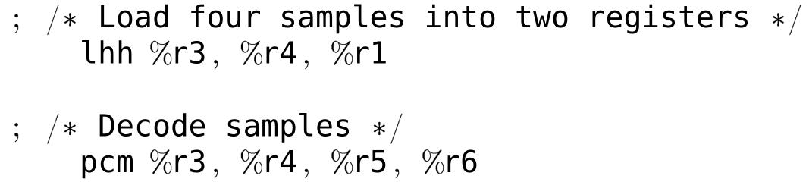
Performance Optimization 3
Increase the number of samples decoded in one step
Currently: two output registers holding two decoded samples
In each register two 16-bit output samples can be stored
Goal: decode four samples with one instruction
New load instruction loads four input samples
Also increases address register
Notes:
- New pcm instruction
- Inputs: Two input samples (r3 and r4), step (r5) and previously decoded sample (r6)
- Outputs: Two output samples (r3 and r4), new step (r5) and secondly decoded sample (r6)
25

Slide 26
Performance Optimization 3: Results – Execution Time
# Cycles basis | 388.814
# Cycles opt3 | 6.554
Speedup | 59,3

Slide 27
Performance Optimization 3: Results – Power & Energy

Slide 28
Performance Optimization 3: Results – Area
basis:
opt3:
Notes:
Another increase by about 25% compared to the previous version.

Slide 29
Performance Optimization: Problems
Constrained number of operand registers
With 32 bit long instruction words, 6 bit opcode and 5 bit register addresses, only 5 register operands are supported
Used operand registers for input and output simultaneously
Unproblematic due to pipeline structure
Standard register file only supports a maximum of 4 read and 4 write ports
Data parallelism requires storing of multiple samples in one register
Theoretical limit: 7 output samples written in one instruction
The third optimized CPU supports a maximum of 4 output samples
Notes:
29

Slide 30
Performance Optimization 3: Overall Speedup

Slide 31
Area optimization

Slide 32
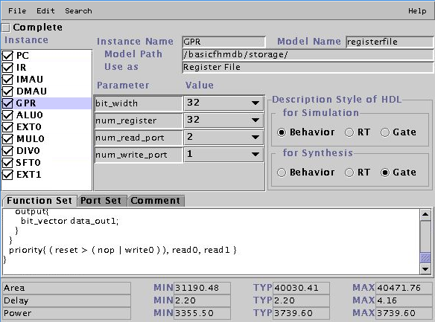
Area Optimization
Goal: Reducing the needed slices and LUTs
Method: Using as few components as possible
By simply removing as many hardware resources as possible from the CPU description

Slide 33
Area Optimization 1
The MUL0 and DIV0 resources are removed from the CPU
Along with the instructions that use these resources
The size of the register file is reduced from 32 to only 16 registers.
Registers are addressed using only 4 bits instead of 5 bits.
The micro operations which use the register address is modified
In those macros we simply removed the most significant bit before calling GPR.read() or GPR.write() with a register address
The dedicated link register, and hence the jal, jalr, and jr instructions are removed

Slide 34
Area Optimization 1: Results - Slices, LUTs
(5%)
(2,4%)
(6%)
(3%)

Slide 35
Area Optimization 2
Yet more registers are removed from the register file
Registers are generalized and reused as much as possible
For example, in each iteration the base address of the input sample array has to be reloaded
The code is re-implemented in order to use only seven registers
This increases the number of required instruction cycles, and hence the execution time

Slide 36
Area Optimization 2: Results - Slices, LUTs
(5%)
(2,4%)
(1,7%)
(6%)
(3%)
(2,5%)

Slide 37
Area Optimization: Results – Power & Energy
Execution Time [ms] | 7,78 | 4,05 | 4,79

Slide 38
Area Optimization: Problems
As we used the registers (from r0 to r7), r0 could not be used as a general purpose register.
Could be hardware coded
After re-implementing the code for the second optmization, it was not feasable to debug with dlxsim
Dlxsim shows correct results, but ModelSim does not

Slide 39
Conclusion
Optimizing performance can be applied on costs of either power and energy or area
In our project the performance optimization caused a small loss of area
Optimizing area can be applied on costs of performance, power or energy

Slide 40
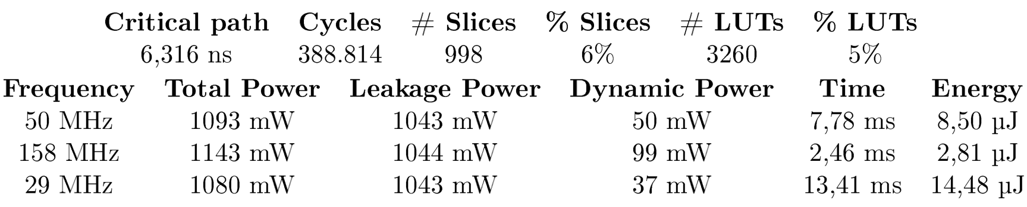
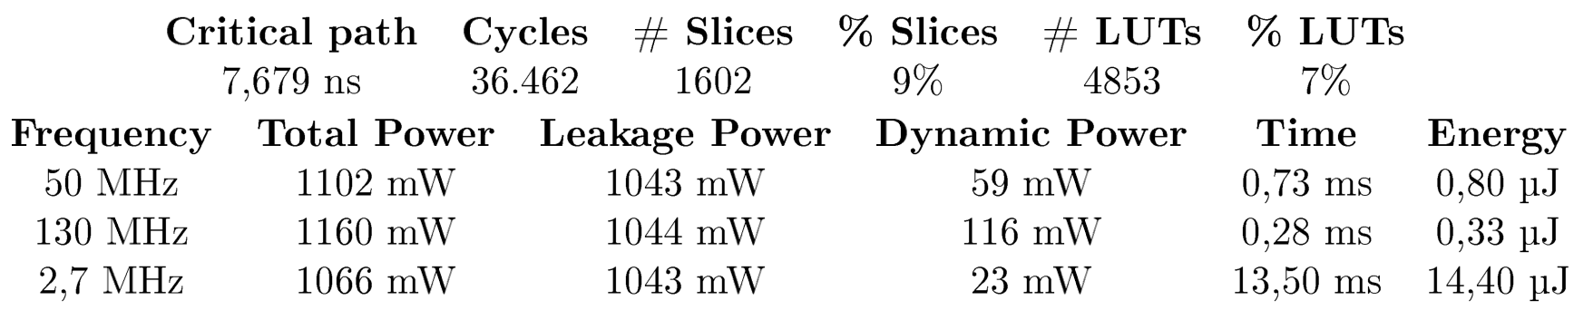
Appendix: Benchmark Results
Basis CPU
Performance Optimized Version 1

Slide 41
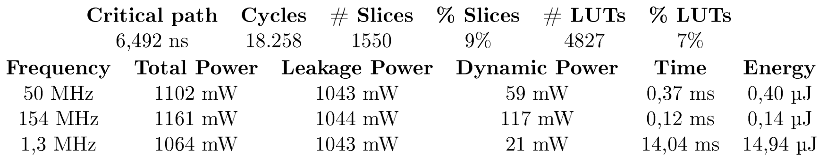
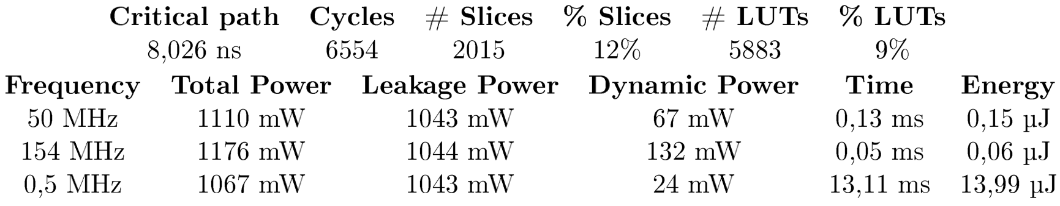
Appendix: Benchmark Results
Performance Optimized Version 2
Performance Optimized Version 3

Slide 42
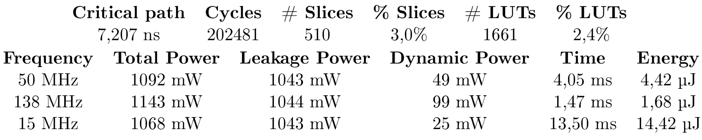
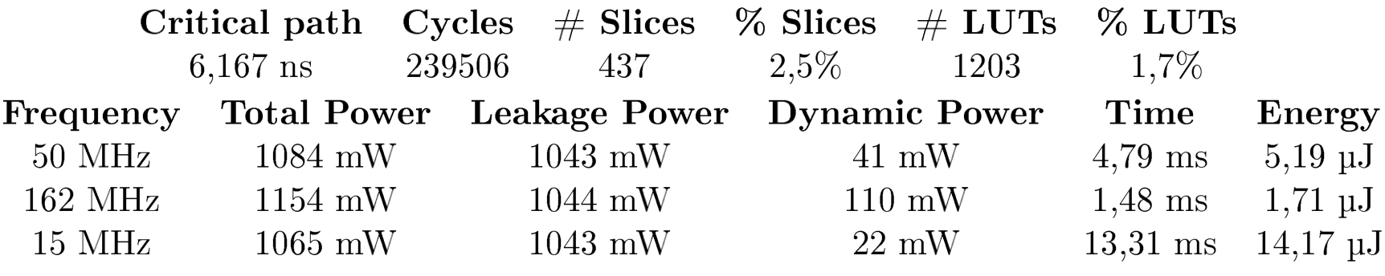
Appendix: Benchmark Results
Area Optimized Version 1
Area Optimized Version 2

