Slide 1
ADPCM ASIPs
Nitzsche, Pachideh - Group 02

Slide 2
Analysis of the Basis CPU
Nitzsche, Pachideh – Group 02

Slide 3
Analysis of the Basis CPU
Measurement as per chapter 6.4
  ASIPMeister HDL files with benchmark framework
  Standard ISE configuration
Area Report
  998 Slices
  3260 Slice LUTs
Timing Report
  Critical path of 6.316ns
  Max. frequency of 158.328MHz
Nitzsche, Pachideh – Group 02
Notes:
The outline is just an and has to be adjusted example (see https://sdqweb.ipd.kit.edu/wiki/Vortragshinweise) and copied to each slide manually. The current chapter should be in bold font. The distance of the words can be adjusted automatically by PowerPoint: select all words and arrows and then select “Anordnen -> Ausrichten -> Horizontal verteilen” (PowerPoint2007).
Prof. Dr. Max Mustermann |
Name of Faculty
<Nummer>

Slide 4
Area - Optimized Processor
16 Register GPR
Reduced Instruction Set and Hardware Resources
Custom ADPCM Application
Nitzsche, Pachideh – Group 02

Slide 5
Area: General Approach
Exploring ASIPMeister’s functionalities
  (Design priority from “Performance” to “Area”)
  Using the built-in estimation system to decide on the meaningfulness of design changes, e.g.
    GPR read ports from 2 to 1: saves 5000 gates
    Replacing all jumps with rel. jumps: 500 gates
    Reducing ISA to 16bit: 10000+ gates
    GPR registers from 32 to 16: 17000 gates
Nitzsche, Pachideh – Group 02
Notes:
The outline is just an and has to be adjusted example (see https://sdqweb.ipd.kit.edu/wiki/Vortragshinweise) and copied to each slide manually. The current chapter should be in bold font. The distance of the words can be adjusted automatically by PowerPoint: select all words and arrows and then select “Anordnen -> Ausrichten -> Horizontal verteilen” (PowerPoint2007).
Prof. Dr. Max Mustermann |
Name of Faculty
<Nummer>

Slide 6
Area: General Approach
Xilinx ISE configuration
  Design Strategy “Area Reduction with Physical Synthesis” applied
    Automatically configures design modes and effort levels throughout all stages of synthesis
Nitzsche, Pachideh – Group 02
Notes:
The outline is just an and has to be adjusted example (see https://sdqweb.ipd.kit.edu/wiki/Vortragshinweise) and copied to each slide manually. The current chapter should be in bold font. The distance of the words can be adjusted automatically by PowerPoint: select all words and arrows and then select “Anordnen -> Ausrichten -> Horizontal verteilen” (PowerPoint2007).
Prof. Dr. Max Mustermann |
Name of Faculty
<Nummer>

Slide 7
Area: Stripping the CPU
The GPR’s register set was reduced from 32 to 16 registers (32bit)
  Custom register file specification
  Changes to all instruction types
  Adjustments to some Micro Op. Descriptions
Removal of all instructions, that weren’t used by the -O3 compiled application
  29 instructions removed
  MUL and DIV resources removed
Nitzsche, Pachideh – Group 02
Notes:
The outline is just an and has to be adjusted example (see https://sdqweb.ipd.kit.edu/wiki/Vortragshinweise) and copied to each slide manually. The current chapter should be in bold font. The distance of the words can be adjusted automatically by PowerPoint: select all words and arrows and then select “Anordnen -> Ausrichten -> Horizontal verteilen” (PowerPoint2007).
Prof. Dr. Max Mustermann |
Name of Faculty
<Nummer>

Slide 8
Area: Generating the application
Manual overhaul of the assembly code was infeasible
→compiler needed
Changes while working with the CoSy makescripts:
  Startup script support for new special registers
  Debugging files that are generated on i80pc06
Final touches to the generated code
  Removal of NOPs
  Fixed compiler bug: zero-register wasn’t used for initializations
Nitzsche, Pachideh – Group 02
Notes:
The outline is just an and has to be adjusted example (see https://sdqweb.ipd.kit.edu/wiki/Vortragshinweise) and copied to each slide manually. The current chapter should be in bold font. The distance of the words can be adjusted automatically by PowerPoint: select all words and arrows and then select “Anordnen -> Ausrichten -> Horizontal verteilen” (PowerPoint2007).
Prof. Dr. Max Mustermann |
Name of Faculty
<Nummer>

Slide 9
Speed - Optimized Processor
Custom Instructions
Custom Instructions
Custom Instructions
(and some code optimizations)
Nitzsche, Pachideh – Group 02

Slide 10
Speed: Choosing custom instructions
Finding bottlesnecks
Rate capabilities of hardware
Add some required hardware
Implement custom instructions
→Goal: One instruction per ADPCM step
Nitzsche, Pachideh – Group 02
Notes:
The outline is just an and has to be adjusted example (see https://sdqweb.ipd.kit.edu/wiki/Vortragshinweise) and copied to each slide manually. The current chapter should be in bold font. The distance of the words can be adjusted automatically by PowerPoint: select all words and arrows and then select “Anordnen -> Ausrichten -> Horizontal verteilen” (PowerPoint2007).
Prof. Dr. Max Mustermann |
Name of Faculty
<Nummer>

Slide 11
Speed: Finding bottlenecks
Estimated required cycles per ADPCM step
  e.g. Step 1 needed about 200 cycles
Large amount of cycles for if/else commands
  Partly due to strange compiler decisions
Nitzsche, Pachideh – Group 02
Notes:
The outline is just an and has to be adjusted example (see https://sdqweb.ipd.kit.edu/wiki/Vortragshinweise) and copied to each slide manually. The current chapter should be in bold font. The distance of the words can be adjusted automatically by PowerPoint: select all words and arrows and then select “Anordnen -> Ausrichten -> Horizontal verteilen” (PowerPoint2007).
Prof. Dr. Max Mustermann |
Name of Faculty
<Nummer>

Slide 12
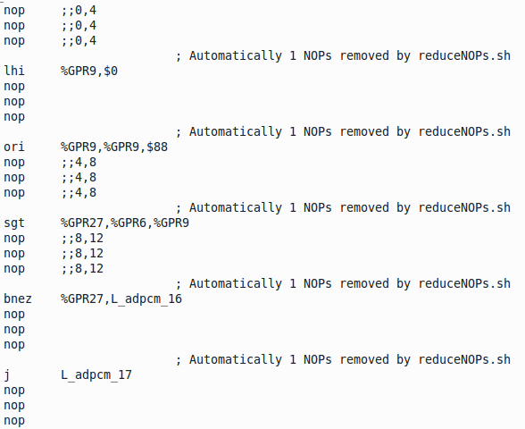
Speed: Is the CoSy Compiler crazy?
if ( index > 88 )
Nitzsche, Pachideh – Group 02
Notes:
The outline is just an and has to be adjusted example (see https://sdqweb.ipd.kit.edu/wiki/Vortragshinweise) and copied to each slide manually. The current chapter should be in bold font. The distance of the words can be adjusted automatically by PowerPoint: select all words and arrows and then select “Anordnen -> Ausrichten -> Horizontal verteilen” (PowerPoint2007).
Prof. Dr. Max Mustermann |
Name of Faculty
<Nummer>

Slide 13
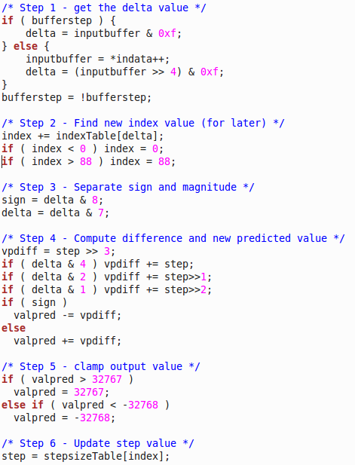
Speed: Possible Custom Instructions
delta(inputbuffer, indata, bufferstep)
clamp(index, 0, 88)
vpd(vpdiff, delta, step)
vpd(vpdiff, delta, step)
sgn(sign, valpred, vpdiff)
clamp(index, 1, 32767)
Nitzsche, Pachideh – Group 02
Notes:
The outline is just an and has to be adjusted example (see https://sdqweb.ipd.kit.edu/wiki/Vortragshinweise) and copied to each slide manually. The current chapter should be in bold font. The distance of the words can be adjusted automatically by PowerPoint: select all words and arrows and then select “Anordnen -> Ausrichten -> Horizontal verteilen” (PowerPoint2007).
Prof. Dr. Max Mustermann |
Name of Faculty
<Nummer>

Slide 14
Speed: The clamp-Instruction
clamp(index, 0, 88)
clamp(index, 1, 32767)
Nitzsche, Pachideh – Group 02
Notes:
The outline is just an and has to be adjusted example (see https://sdqweb.ipd.kit.edu/wiki/Vortragshinweise) and copied to each slide manually. The current chapter should be in bold font. The distance of the words can be adjusted automatically by PowerPoint: select all words and arrows and then select “Anordnen -> Ausrichten -> Horizontal verteilen” (PowerPoint2007).
Prof. Dr. Max Mustermann |
Name of Faculty
<Nummer>

Slide 15
Benchmark Results
Nitzsche, Pachideh – Group 02

Slide 16
Benchmark Results Part 2
CPU | @50MHh |  |  | @max. |  |  | @min.
 | time [ms] | power [mW] | Energy [uJ] | time [ms] | power [mW] | Energy [uJ] | time [ms] | power [mW] | Energy [uJ]
basis | 8.74 | 52 | 454.5 | 2.77 | 127 | 351.8 | 5.16 | 76 | 392.2
area | 5.84 | 55 | 321.2 | 2.05 | 134 | 274.4 | 6.34 | 51 | 323.3
speed | 1.52 | 103 | 156.6 | 0.63 | 220 | 138.6 | 6.09 | 41 | 249.7
Nitzsche, Pachideh – Group 02
Notes:
The outline is just an and has to be adjusted example (see https://sdqweb.ipd.kit.edu/wiki/Vortragshinweise) and copied to each slide manually. The current chapter should be in bold font. The distance of the words can be adjusted automatically by PowerPoint: select all words and arrows and then select “Anordnen -> Ausrichten -> Horizontal verteilen” (PowerPoint2007).
Prof. Dr. Max Mustermann |
Name of Faculty
<Nummer>

Slide 17
Benchmark Results Part 1
CPU | area [LUTs] | cr. path [ns] | max. freq. [MHz] | cycles | min. freq. [MHz]
basis | 3260 | 6.316 | 158.328 | 436k | 84.5
area | 1259 | 7.02 | 142.45 | 291k | 46
speed | 4756 | 8.307 | 120.38 | 76k | 12.5
Nitzsche, Pachideh – Group 02
Notes:
The outline is just an and has to be adjusted example (see https://sdqweb.ipd.kit.edu/wiki/Vortragshinweise) and copied to each slide manually. The current chapter should be in bold font. The distance of the words can be adjusted automatically by PowerPoint: select all words and arrows and then select “Anordnen -> Ausrichten -> Horizontal verteilen” (PowerPoint2007).
Prof. Dr. Max Mustermann |
Name of Faculty
<Nummer>

Slide 18
Benchmark Results Part 2
CPU | @50MHh |  |  | @max. |  |  | @min.
 | time [ms] | power [mW] | Energy [uJ] | time [ms] | power [mW] | Energy [uJ] | time [ms] | power [mW] | Energy [uJ]
basis | 8.74 | 52 | 454.5 | 2.77 | 127 | 351.8 | 5.16 | 76 | 392.2
area | 5.84 | 55 | 321.2 | 2.05 | 134 | 274.4 | 6.34 | 51 | 323.3
speed | 1.52 | 103 | 156.6 | 0.63 | 220 | 138.6 | 6.09 | 41 | 249.7
Nitzsche, Pachideh – Group 02
Notes:
The outline is just an and has to be adjusted example (see https://sdqweb.ipd.kit.edu/wiki/Vortragshinweise) and copied to each slide manually. The current chapter should be in bold font. The distance of the words can be adjusted automatically by PowerPoint: select all words and arrows and then select “Anordnen -> Ausrichten -> Horizontal verteilen” (PowerPoint2007).
Prof. Dr. Max Mustermann |
Name of Faculty
<Nummer>

Slide 19
Is it over yet?
Thanks for your attention!

