Slide 1
Design and Implementation of an IoT-based Control Device for an off-the-shelf Coffee Machine
Karim Ben Ammar

Slide 2
Outline
Motivation
<number>/24

Slide 3
Outline
Motivation
Design/Implementation
2/24

Slide 4
Outline
Motivation
Design/Implementation
Challenges
2/24

Slide 5
Outline
Motivation
Design/Implementation
Challenges
Conclusion
2/24

Slide 6
Motivation
Limit usage to authorized users
3/24

Slide 7
Motivation
Limit usage to authorized users
Prevent money loss due to miscounting the tally sheets or users forgetting to write down their transaction, etc
3/24

Slide 8
Motivation
Limit usage to authorized users
Prevent money loss due to miscounting the tally sheets or users forgetting to write down their transaction, etc
The coffee machine may present an unusual behaviour
3/24

Slide 9
Motivation
Limit usage to authorized users
Prevent money loss due to miscounting the tally sheets or users forgetting to write down their transaction, etc
The coffee machine may present an unusual behaviour
Solution: Automated Control System
3/24

Slide 10
Motivation
Limit usage to authorized users
Prevent money loss due to miscounting the tally sheets or users forgetting to write down their transaction, etc
The coffee machine may present an unusual behaviour
Solution: Automated Control System
  Allow access only to authorized users
3/24

Slide 11
Motivation
Limit usage to authorized users
Prevent money loss due to miscounting the tally sheets or users forgetting to write down their transaction, etc
The coffee machine may present an unusual behaviour
Solution: Automated Control System
  Allow access only to authorized users
  Automatically detect the user's choice and charge him accordingly
3/24

Slide 12
Motivation
Limit usage to authorized users
Prevent money loss due to miscounting the tally sheets or users forgetting to write down their transaction, etc
The coffee machine may present an unusual behaviour
Solution: Automated Control System
  Allow access only to authorized users
  Automatically detect the user's choice and charge him accordingly
  Keep track of the coffee machine's behaviour
3/24

Slide 13
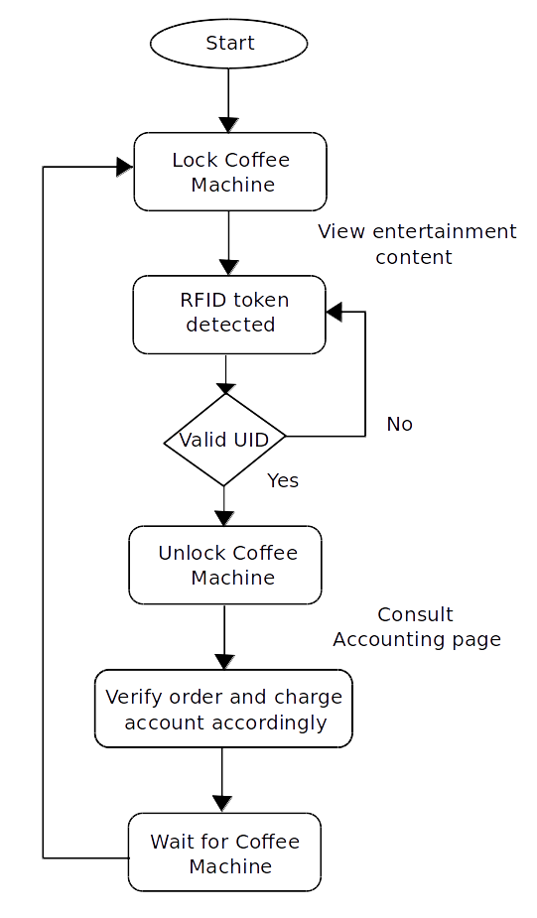
Motivation : Workflow
4/24

Slide 14

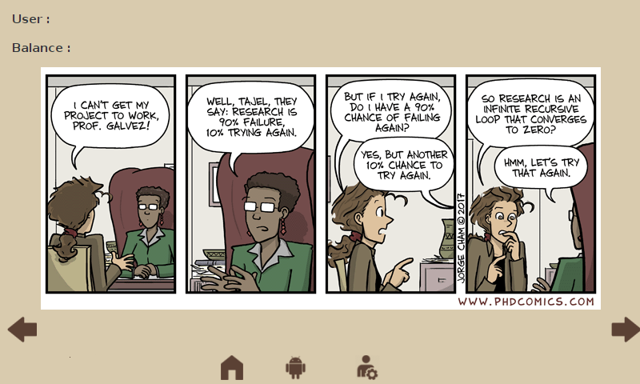
Motivation : Workflow
4/24

Slide 15
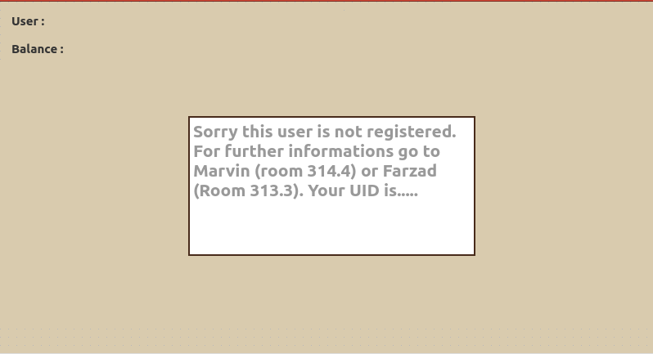
Motivation : Workflow
4/24

Slide 16
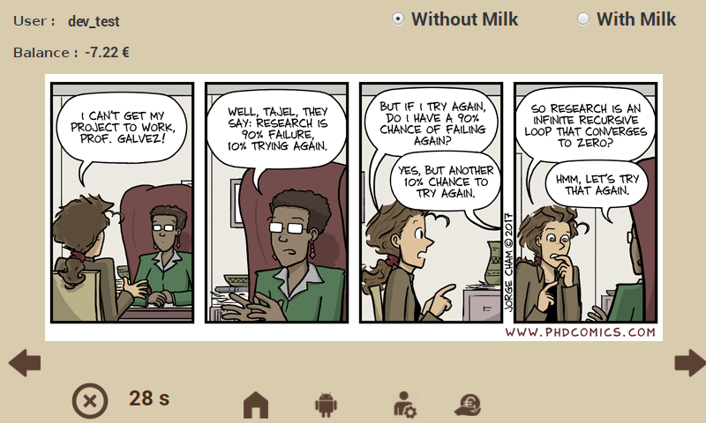
Motivation : Workflow
4/24

Slide 17
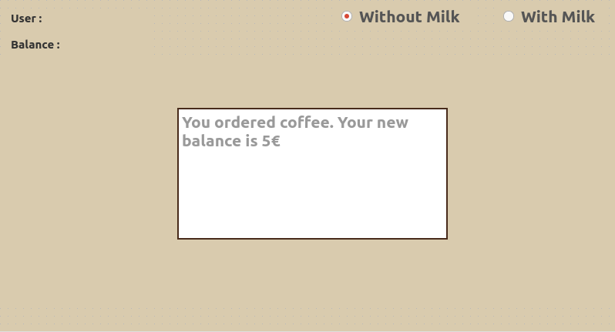
Motivation : Workflow
4/24

Slide 18
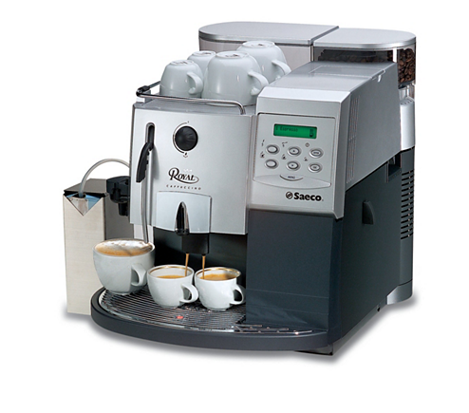
Design/Implementation
The system should :
  Lock the coffee machine until a valid RFID token is provided
5/24

Slide 19
Design/Implementation
The system should :
  Lock the coffee machine until a valid RFID token is provided
  Smartphone based authentification
5/24

Slide 20
Design/Implementation
The system should :
  Lock the coffee machine until a valid RFID token is provided
  Smartphone based authentification
  Automatically detect the state of the coffee machine
5/24

Slide 21
Design/Implementation
The system should :
  Lock the coffee machine until a valid RFID token is provided
  Smartphone based authentification
  Automatically detect the state of the coffee machine
  Charge the user independently of the server's state
5/24

Slide 22
Design/Implementation
The system should :
  Lock the coffee machine until a valid RFID token is provided
  Smartphone based authentification
  Automatically detect the state of the coffee machine
  Charge the user independently of the server's state
  Continuously monitor the coffee machine's behaviour and log it for future analysis
5/24

Slide 23
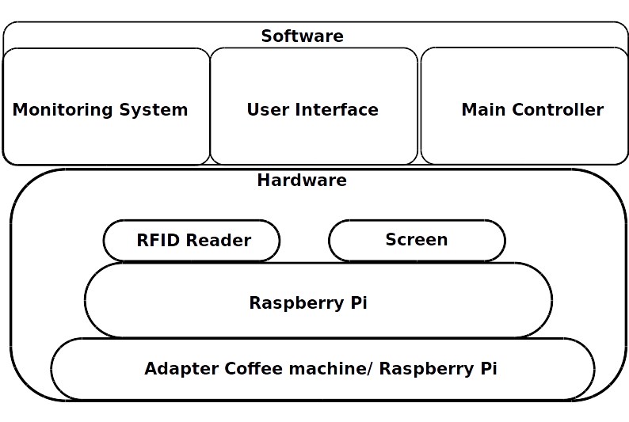
Design/ Implementation
6/24

Slide 24
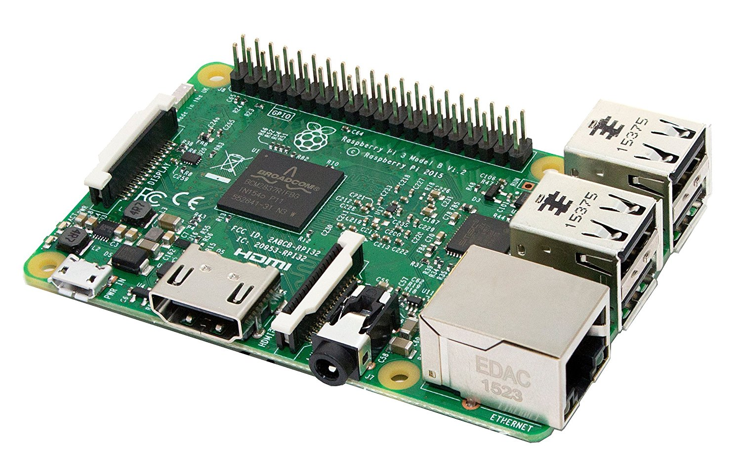
Hardware
Raspberry Pi
7/24

Slide 25
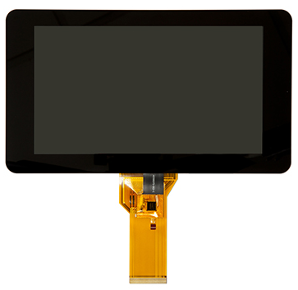
Hardware
Raspberry Pi
Official 7'' touch screen
7/24

Slide 26
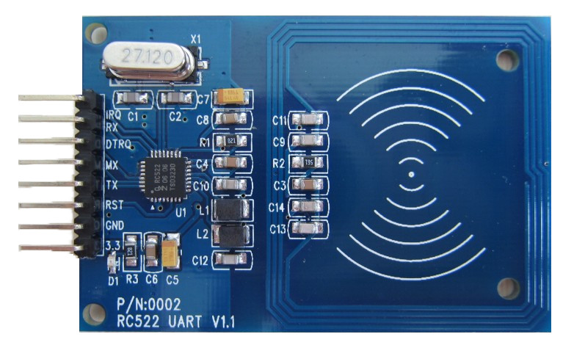
Hardware
Raspberry Pi
Official 7'' touch screen
Joy-IT RFID Module
7/24

Slide 27
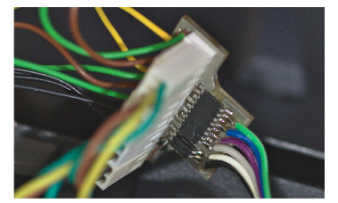
Hardware
Raspberry Pi
Official 7'' touch screen
Joy-IT RFID Module
Custom PCB
7/24

Slide 28
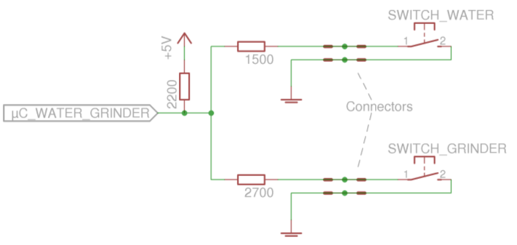
Adapter Coffee machine/ Raspberry Pi
Capture all the sensor's output
Simulate the water level sensor (Lock/Unlock mechanism)
8/24

Slide 29
Tasks of the Raspberry Pi
Continuously listen to the RFID Reader
9/24

Slide 30
Tasks of the Raspberry Pi
Continuously listen to the RFID Reader
Update the entertainement content
9/24

Slide 31
Tasks of the Raspberry Pi
Continuously listen to the RFID Reader
Update the entertainement content
Manage every transaction
9/24

Slide 32
Tasks of the Raspberry Pi
Continuously listen to the RFID Reader
Update the entertainement content
Manage every transaction
Log the behaviour of the coffee machine
9/24

Slide 33
Tasks of the Raspberry Pi
Continuously listen to the RFID Reader
Update the entertainement content
Manage every transaction
Log the behaviour of the coffee machine
Listen for incoming HTTP requests from the Android app
9/24

Slide 34
Tasks of the Raspberry Pi
Continuously listen to the RFID Reader
Update the entertainement content
Manage every transaction
Log the behaviour of the coffee machine
Listen for incoming HTTP requests from the Android app
We can divide the system in 3 main parts : User interface, Main Controller, and Monitoring system
9/24

Slide 35
Libraries
MFRC522 library : RFID reading
10/24

Slide 36
Libraries
MFRC522 library : RFID reading
Beautifulsoup library : Find the image extension before downloading the entertainement content
10/24

Slide 37
Libraries
MFRC522 library : RFID reading
Beautifulsoup library : Find the image extension before downloading the entertainement content
PyQt : User Interface
10/24

Slide 38
Libraries
MFRC522 library : RFID reading
Beautifulsoup library : Find the image extension before downloading the entertainement content
PyQt : User Interface
Transitions : Generate the Finite State Machine
10/24

Slide 39
Libraries
MFRC522 library : RFID reading
Beautifulsoup library : Find the image extension before downloading the entertainement content
PyQt : User Interface
Transitions : Generate the Finite State Machine
Tornado library : Intercepting HTTP Request
10/24

Slide 40
Software: User interface
Provide entertainment content
11/24

Slide 41
Software: User interface
Provide entertainment content
Show the accounting page of the current user
11/24

Slide 42
Software: User interface
Provide entertainment content
Show the accounting page of the current user
Display the user's informations & order
11/24

Slide 43
Software: User interface
Provide entertainment content
Show the accounting page of the current user
Display the user's informations & order
Milk choice & save it
11/24

Slide 44
Software: User interface
Provide entertainment content
Show the accounting page of the current user
Display the user's informations & order
Milk choice & save it
11/24

Slide 45
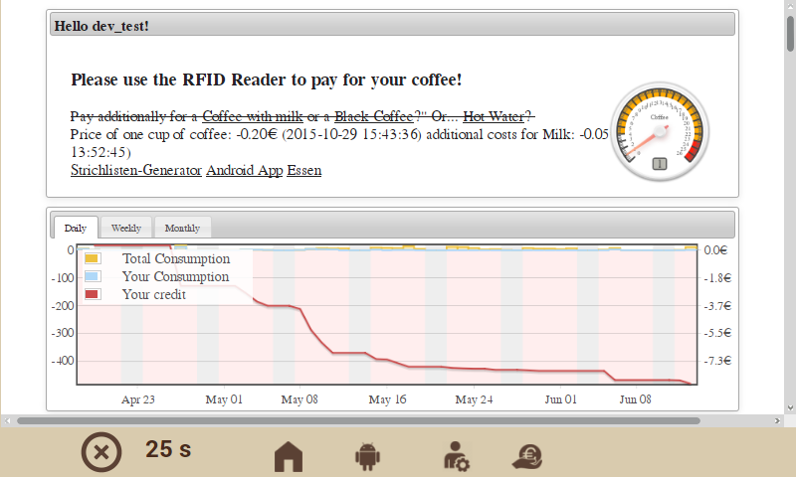
Software: User interface
12/24

Slide 46
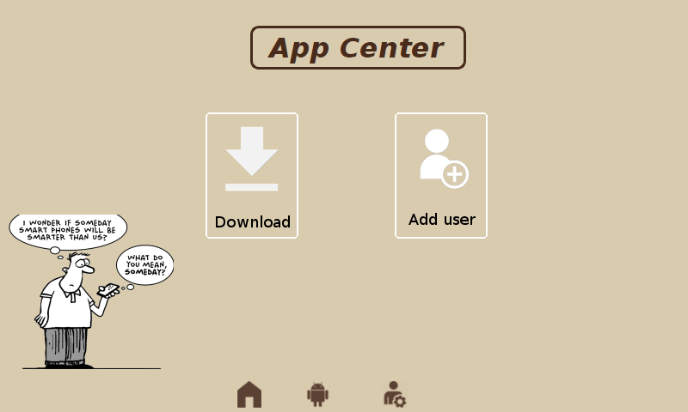
Software: User interface
12/24

Slide 47
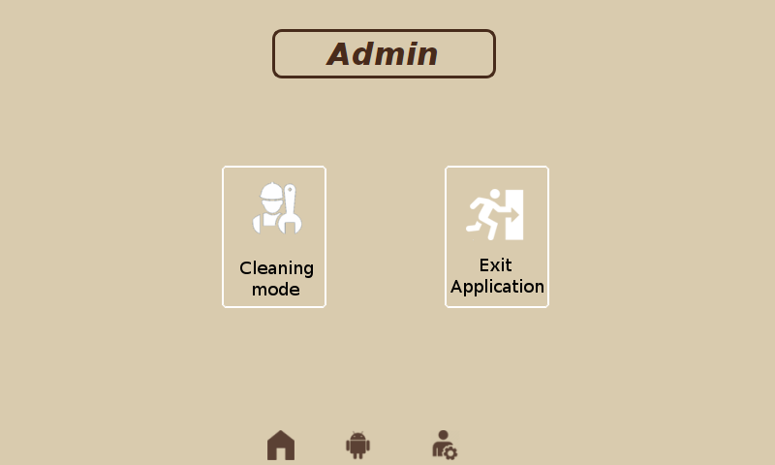
Software: User interface
12/24

Slide 48
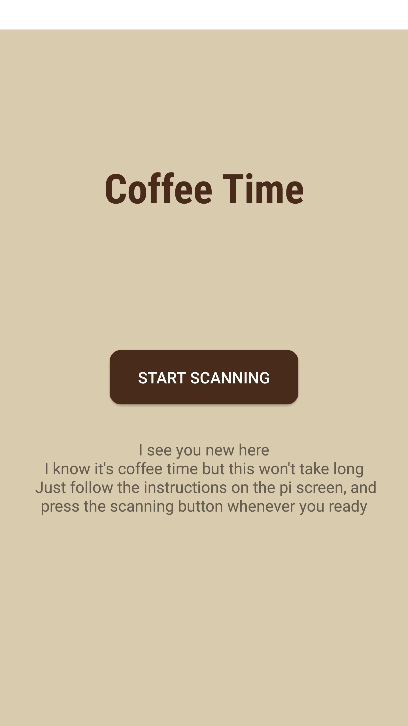
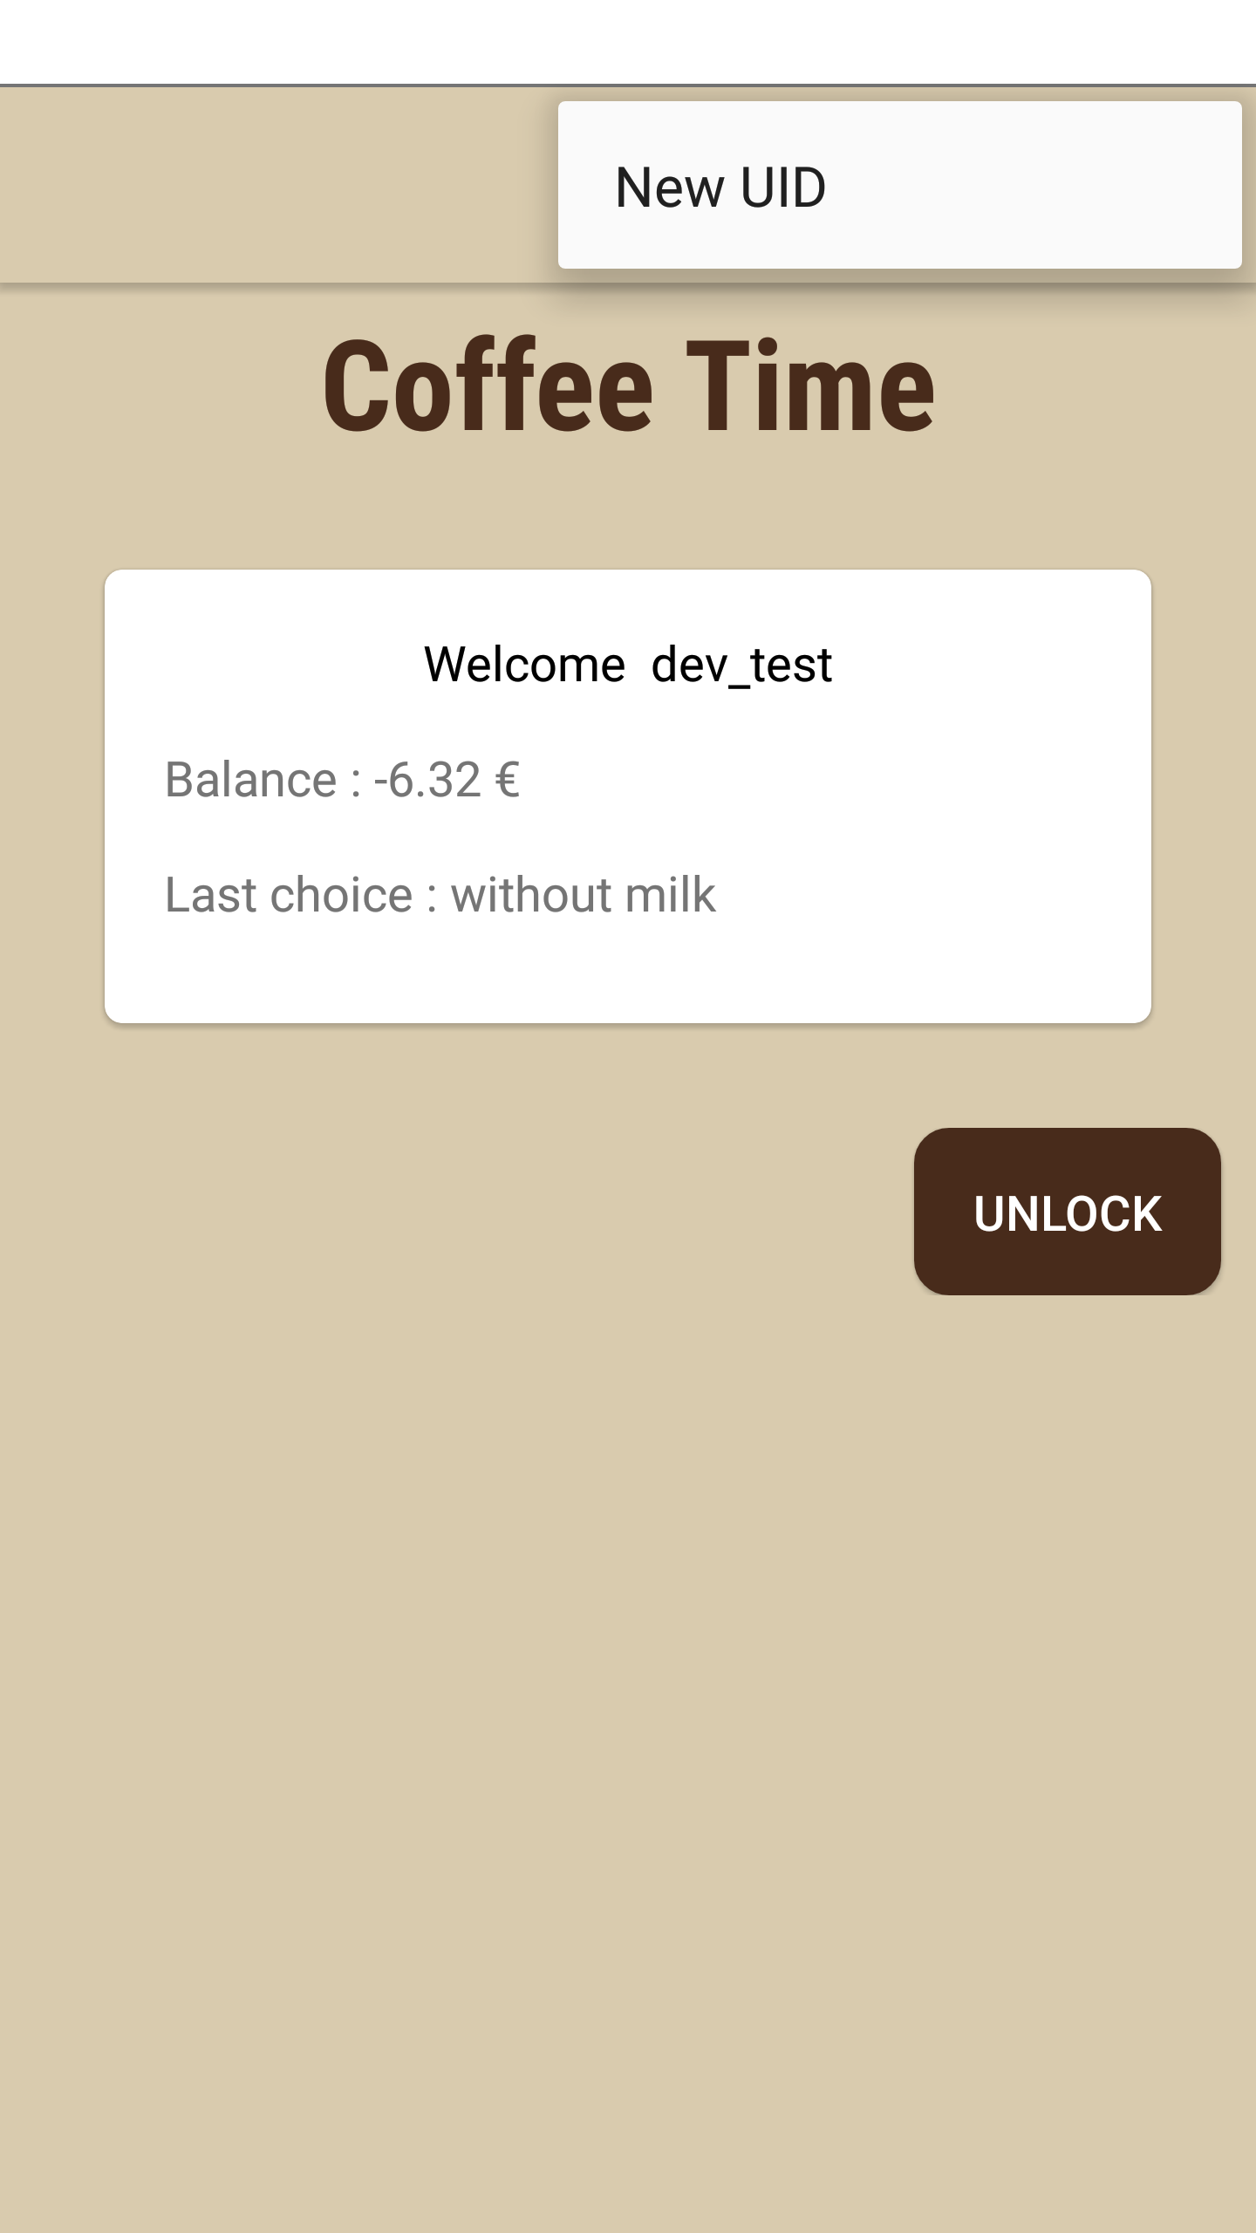
Software: User interface
Use a smartphone as an identification mechanism
Manage between the 2 identification processes
13/24

Slide 49
Software: Main controller
Lock/Unlock the coffee machine + Buzzer
14/24

Slide 50
Software: Main controller
Lock/Unlock the coffee machine + Buzzer
RFID reading
14/24

Slide 51
Software: Main controller
Lock/Unlock the coffee machine + Buzzer
RFID reading
No water notification
14/24

Slide 52
Software: Main controller
Lock/Unlock the coffee machine + Buzzer
RFID reading
No water notification
Daily check up :
14/24

Slide 53
Software: Main controller
Lock/Unlock the coffee machine + Buzzer
RFID reading
No water notification
Daily check up :
  Download the daily entertainment content
14/24

Slide 54
Software: Main controller
Lock/Unlock the coffee machine + Buzzer
RFID reading
No water notification
Daily check up :
  Download the daily entertainment content
  Forward any offline transaction to the server
14/24

Slide 55
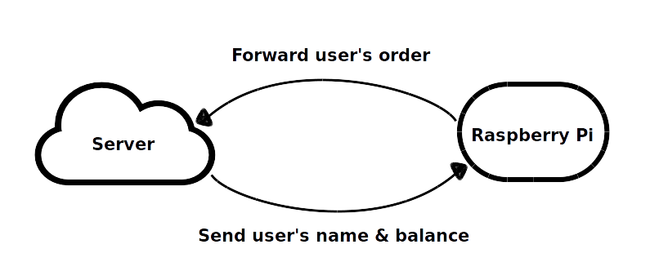
Software: Main controller
Lock/Unlock the coffee machine + Buzzer
RFID reading
No water notification
Daily check up :
  Download the daily entertainment content
  Forward any offline transaction to the server
14/24

Slide 56
Software: Monitoring System
Continuously read from the coffee machine's sensors
15/24

Slide 57
Software: Monitoring System
Continuously read from the coffee machine's sensors
Generate the machine's corresponding Finite state machine (FSM)
15/24

Slide 58
Software: Monitoring System
Continuously read from the coffee machine's sensors
Generate the machine's corresponding Finite state machine (FSM)
Configuration :
  Config file : Sensors name and pin number
15/24

Slide 59
Software: Monitoring System
Continuously read from the coffee machine's sensors
Generate the machine's corresponding Finite state machine (FSM)
Configuration :
  Config file : Sensors name and pin number
  States folder : Different sensors input for each state in a seperate file
15/24

Slide 60
Software: Monitoring System
Continuously read from the coffee machine's sensors
Generate the machine's corresponding Finite state machine (FSM)
Configuration :
  Config file : Sensors name and pin number
  States folder : Different sensors input for each state in a seperate file
  Run the program
15/24

Slide 61
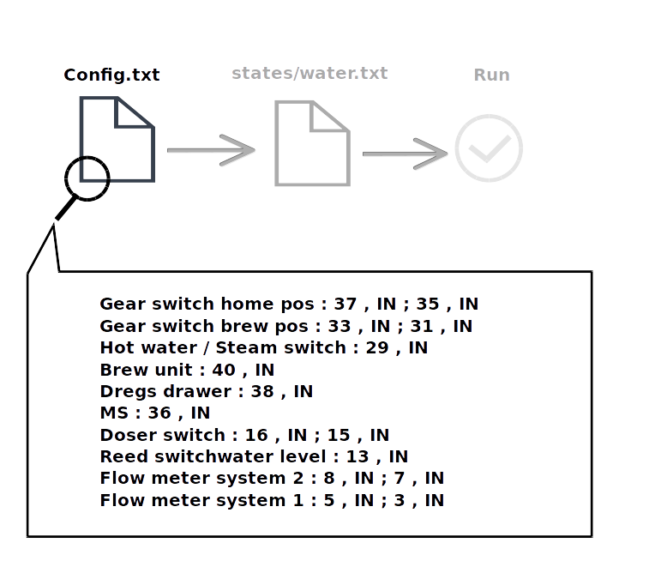
Software: FSM
16/24

Slide 62
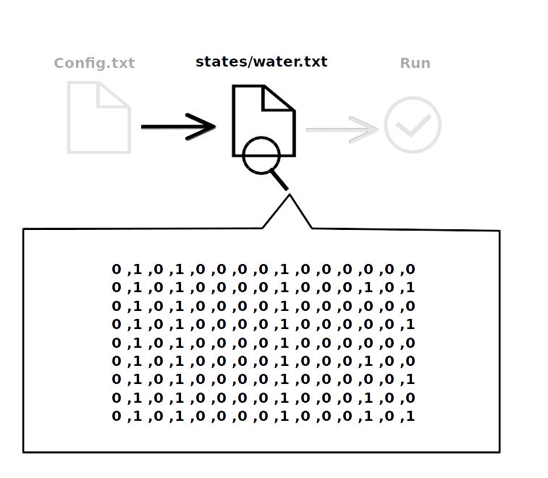
Software: FSM
17/24

Slide 63
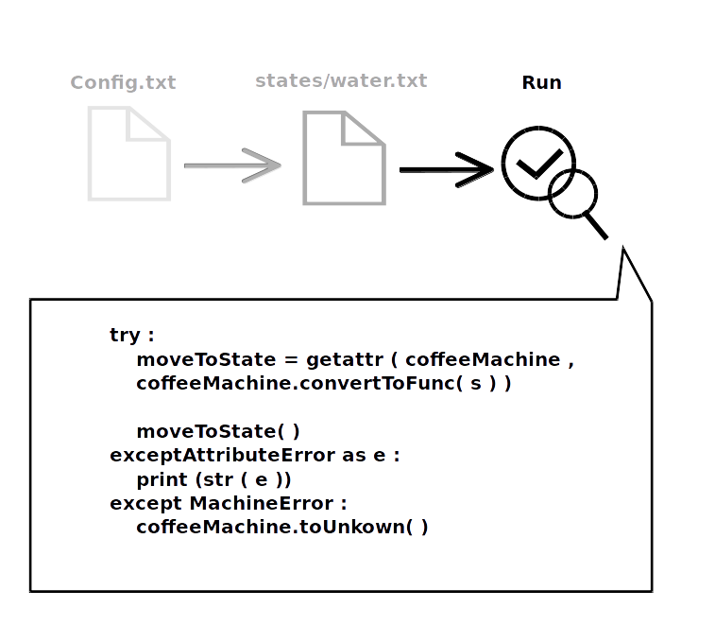
Software: FSM
18/24

Slide 64
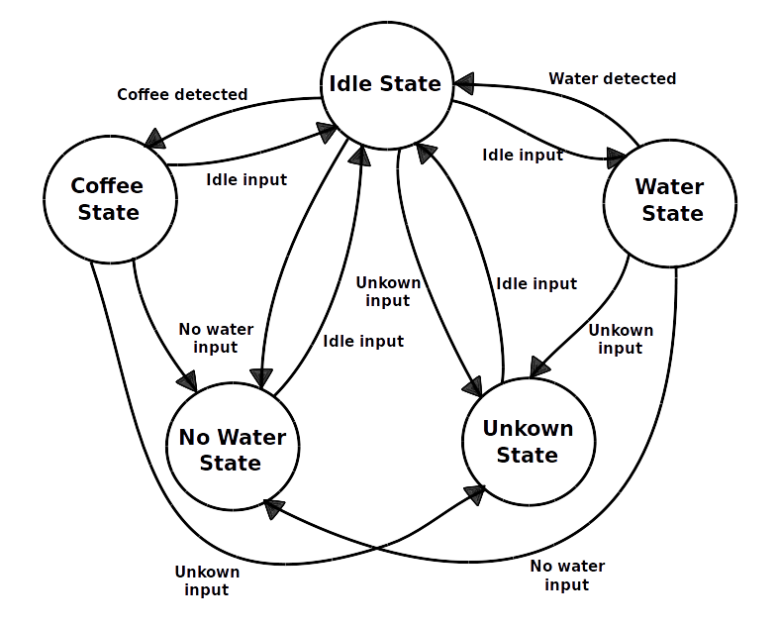
Software: FSM
19/24

Slide 65
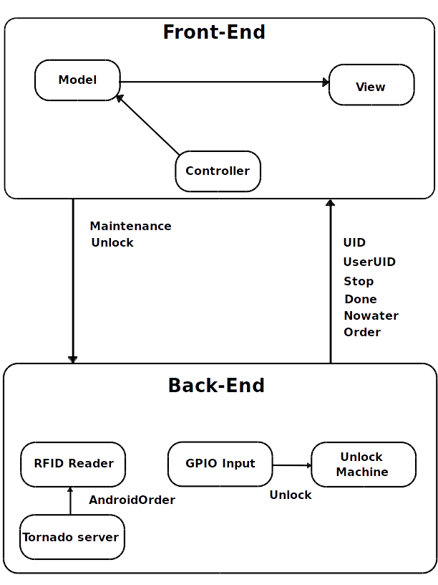
Process communication
Shared memory
20/24

Slide 66
Process communication
Shared memory
Sockets
20/24

Slide 67
Process communication
Shared memory
Sockets
Pipes
20/24

Slide 68
Process communication
Shared memory
Sockets
Pipes
Text files
20/24

Slide 69
3D Case
Printed with Formlab's Form 2
21/24

Slide 70
3D Case
Printed with Formlab's Form 2
Modeling : Blender
21/24

Slide 71
3D Case
Printed with Formlab's Form 2
Modeling : Blender
The whole case is composed from 3 separate parts
21/24

Slide 72
3D Case
Printed with Formlab's Form 2
Modeling : Blender
The whole case is composed from 3 separate parts
Printing Time for each part : 15h.30min
21/24

Slide 73
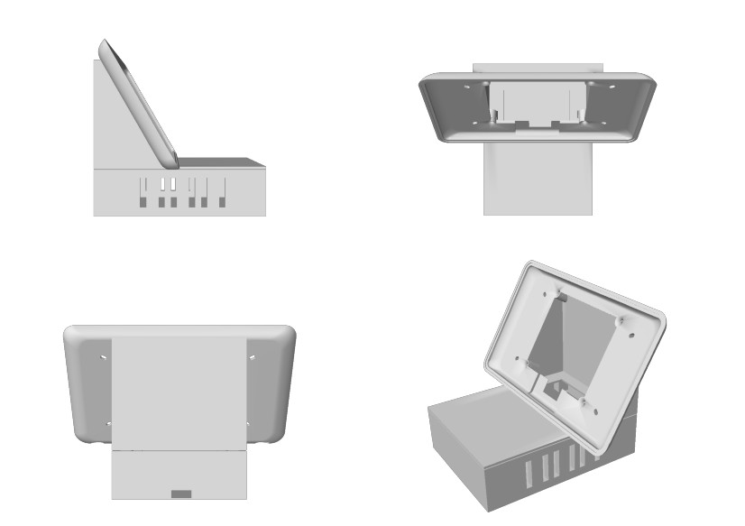
3D Case
Printed with Formlab's Form 2
Modeling : Blender
The whole case is composed from 3 separate parts
Printing Time for each part : 15h.30min
21/24

Slide 74
Challenges
No threads possible : separate processes
22/24

Slide 75
Challenges
No threads possible : separate processes
No stable input detected
22/24

Slide 76
Challenges
No threads possible : separate processes
No stable input detected
Blocking Firewall
22/24

Slide 77
Challenges
No threads possible : separate processes
No stable input detected
Blocking Firewall
Failing RFID Reader
22/24

Slide 78
Challenges
No threads possible : separate processes
No stable input detected
Blocking Firewall
Failing RFID Reader
Charging after warming up
22/24

Slide 79
Conclusion
We created an automated control system that can be easily plugged to a coffee machine
23/24

Slide 80
Conclusion
We created an automated control system that can be easily plugged to a coffee machine
RFID Tokens based authentication system
23/24

Slide 81
Conclusion
We created an automated control system that can be easily plugged to a coffee machine
RFID Tokens based authentication system
Smartphone based authentication system
23/24

Slide 82
Conclusion
We created an automated control system that can be easily plugged to a coffee machine
RFID Tokens based authentication system
Smartphone based authentication system
Offline mode
23/24

Slide 83
Conclusion
We created an automated control system that can be easily plugged to a coffee machine
RFID Tokens based authentication system
Smartphone based authentication system
Offline mode
Entertainment content
23/24

Slide 84
Conclusion
We created an automated control system that can be easily plugged to a coffee machine
RFID Tokens based authentication system
Smartphone based authentication system
Offline mode
Entertainment content
Automated order detection -> charging the user accordingly
23/24

Slide 85
Conclusion
We created an automated control system that can be easily plugged to a coffee machine
RFID Tokens based authentication system
Smartphone based authentication system
Offline mode
Entertainment content
Automated order detection -> charging the user accordingly
Monitoring the coffee machine's behaviour, logging, etc
23/24

Slide 86
Conclusion
We created an automated control system that can be easily plugged to a coffee machine
RFID Tokens based authentication system
Smartphone based authentication system
Offline mode
Entertainment content
Automated order detection -> charging the user accordingly
Monitoring the coffee machine's behaviour, logging, etc
Sound based state detection ?
23/24

Slide 87
Thank you for your
attention !
24/24

