Slide 1
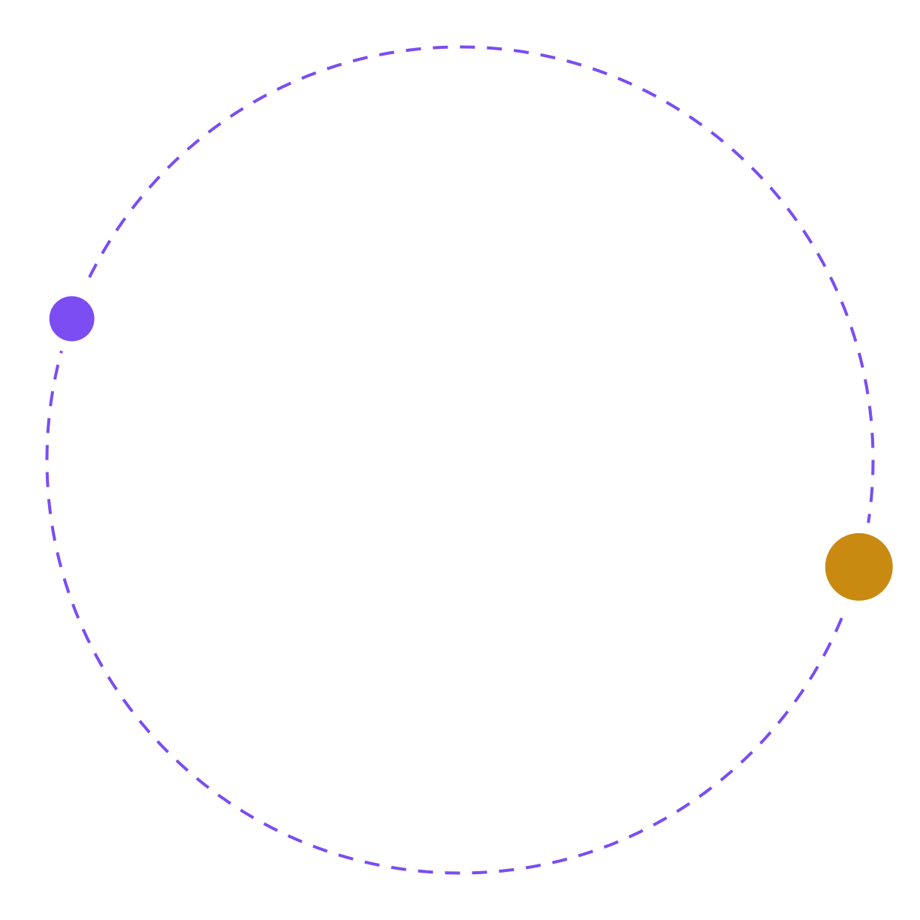
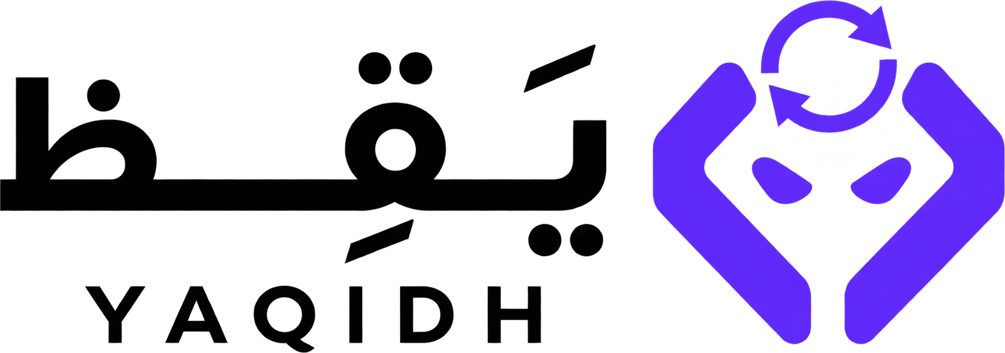
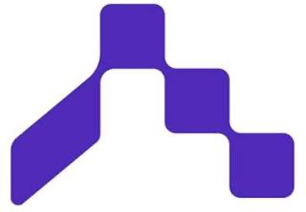
Security Readiness Check
Proactive security, faster releases.
Yaqidh checks, explains, and re-checks automatically. While final approval always remains in human hands.
Notes:
Yaqidh is a launch companion for software teams. It checks every pull request before release, explains problems in Arabic, verifies the fix, and a human approves.

Slide 2
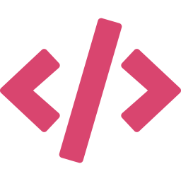
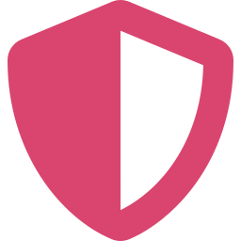
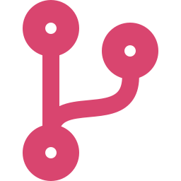
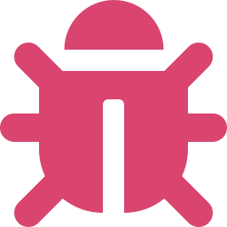
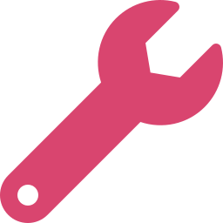
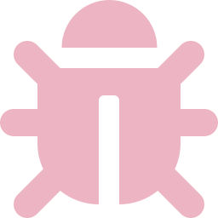
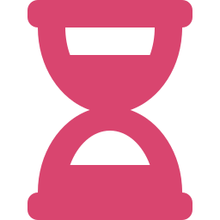

The problem
Developer
Security team
Notes:
Every review starts a new waiting cycle. A flaw takes 252 days on average to fix, up 47% in five years (Veracode 2025). 81% say security testing slows delivery (Black Duck 2025). The four-step cycle is a typical scenario, not a statistic.

Slide 3
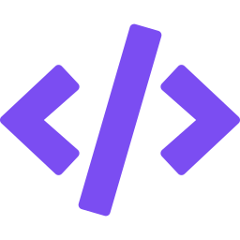
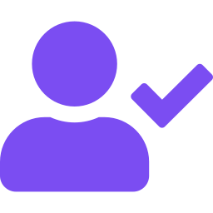
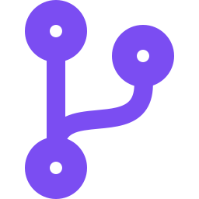
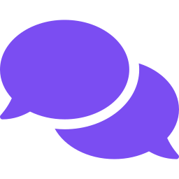
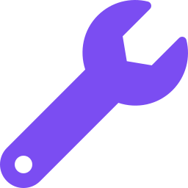

The solution
Developer
Human approver
Notes:
The developer submits a pull request. Yaqidh runs three real tools, written rules decide pass or block, and the AI only explains each issue in Arabic. After the fix, Yaqidh re-scans: the re-scan is the proof, not the developer's word. Then QA and Security approve by name, and the gate opens for that release only.

Slide 4

Why now
+47%
45%
longer to fix a flaw in 5 years
of AI-written code has security flaws
Veracode, State of Software Security 2025
Veracode 2025
81%
Saudi Arabia is investing in cybersecurity
say security testing slows delivery
Our goal: train a model inside the Kingdom
Black Duck 2025 survey
Notes:
Fix time is up 47% in five years (Veracode 2025). 45% of AI-written code has security flaws (Veracode 2025). 81% say security testing slows delivery (Black Duck 2025). Saudi Arabia is investing in cybersecurity, and our future goal is to train a model inside the Kingdom.

Slide 5
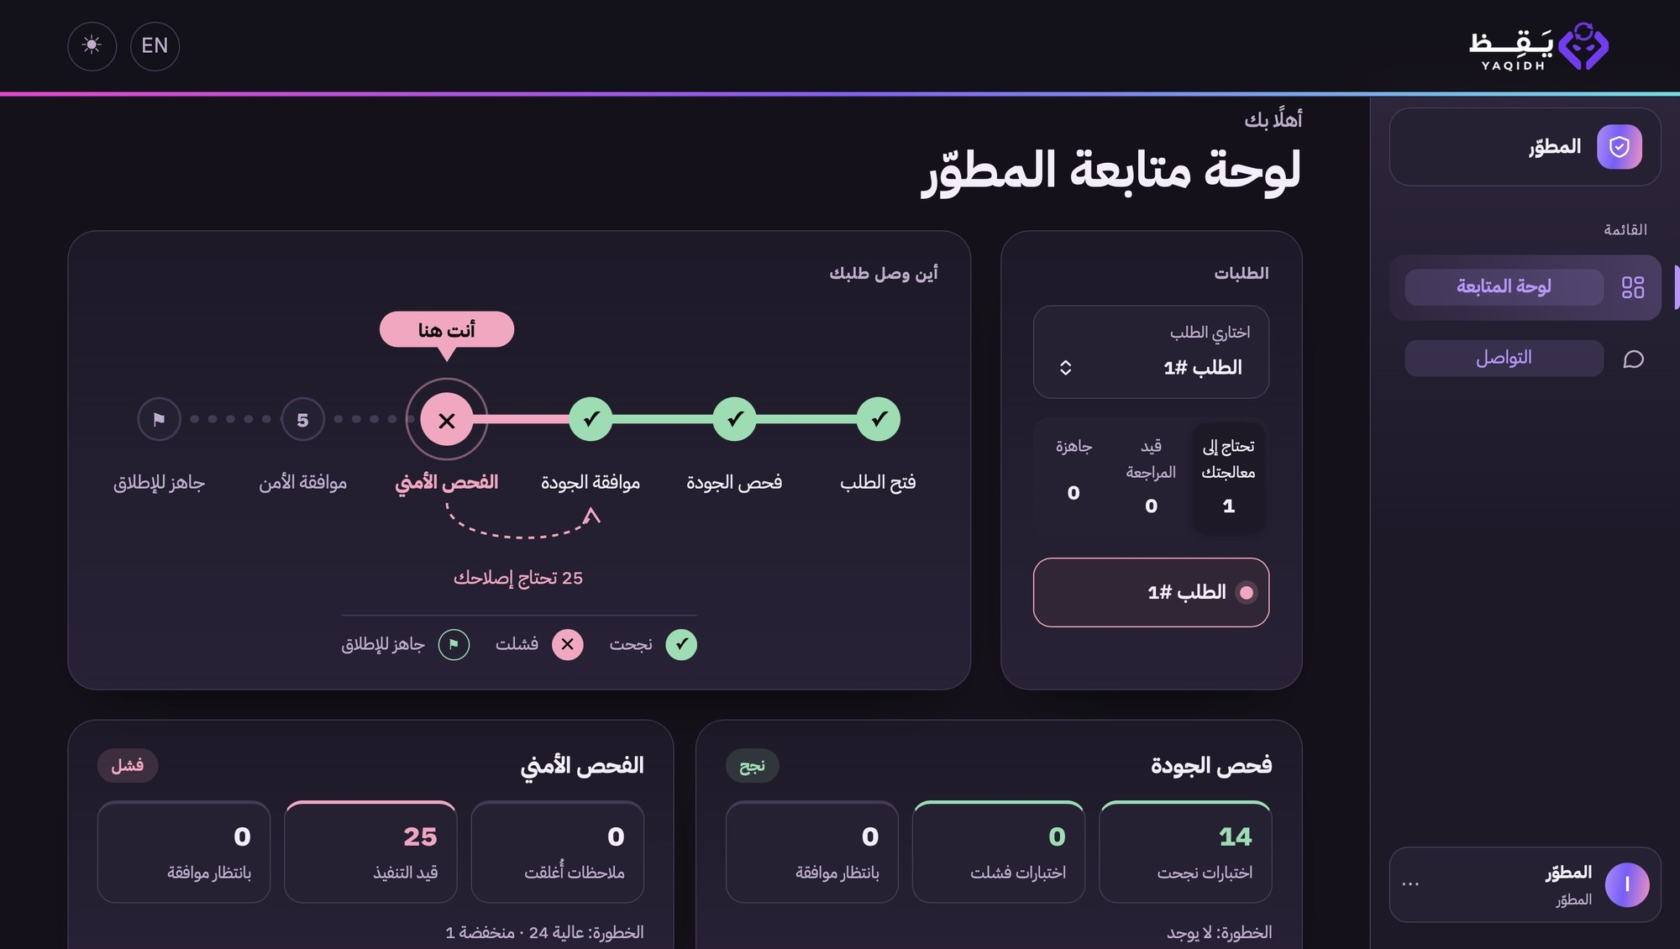
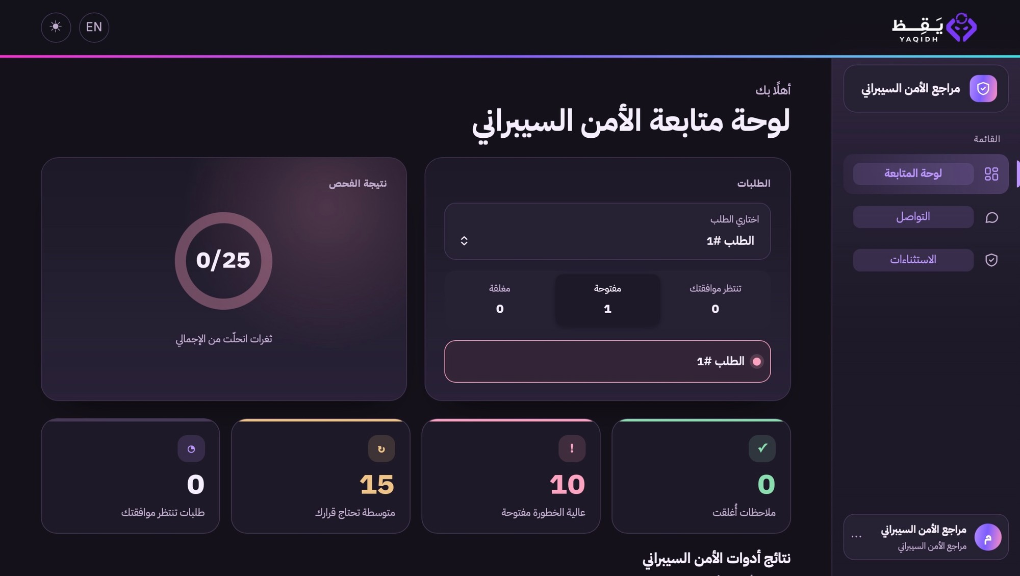
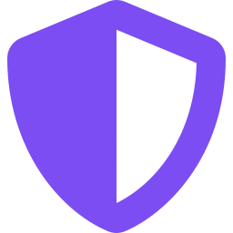
Our system
Developer
Security reviewer
Notes:
One web dashboard, a view for each role. Left: the Developer sees where the request is on the journey and what needs fixing. Right: the Security reviewer sees the scan result and the open findings. We tested the whole system on a demo app, 11 of 11 steps with real tools. Next: a live trial on a real GitHub repository, measuring time and model usage.

Slide 6
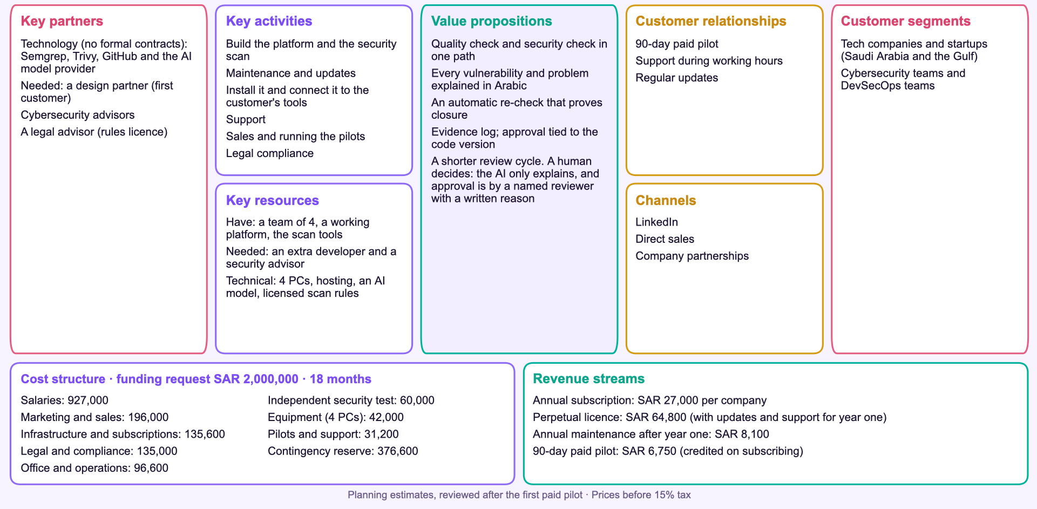
Business model

